Slide 1
Understanding Drug Abuse and Addiction
Steve Hanson
Notes:
Psychopharmacology is the study of the effects of drugs on behavior.
There are two points I hope will be repeated through out this presentation and I would like you to keep them in mind during the course of the presentation.

Slide 2
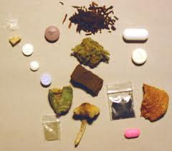
Basic Questions
Why do people do drugs?
Why can’t/ won’t some people stop?
Notes:
Here I make a reference to those people who seem to be in the news all the time about being in an out of rehab – Robert Downey Jr., Darryl Strawberry for example. We hope to be able to explain why some people have a very hard time stopping.

Slide 3
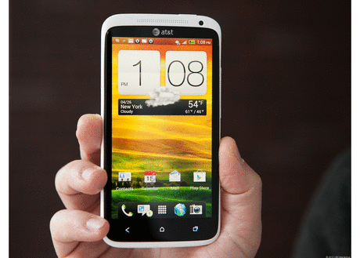
Realities
People like Drugs.
We all like things faster and easier.
Notes:
People like drugs – aspirin, medications, a cocktail at a party etc.
For faster and easier I make a comment about having a microwave oven to popcorn in versus the old fashioned jiffy pop method.
Drug users use drugs to get them to feeling states faster and easier.

Slide 4
How Drugs Work
Interact with neurochemistry
Results:
  Feel Good – Euphoria/reward
  Feel Better – reduce negative feelings
Notes:
Feel good – the high
Feel better – avoid stress anxiety and withdrawal symptoms.

Slide 5
Voluntary
Drug Use
Compulsive
Drug Use
(Addiction)

Slide 6
Addiction is a Brain Disease
Prolonged Use Changes
the brain in Fundamental
and Long Lasting Ways

Slide 7
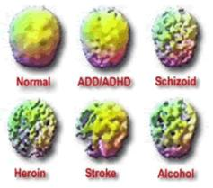
Brain Changes

Slide 8
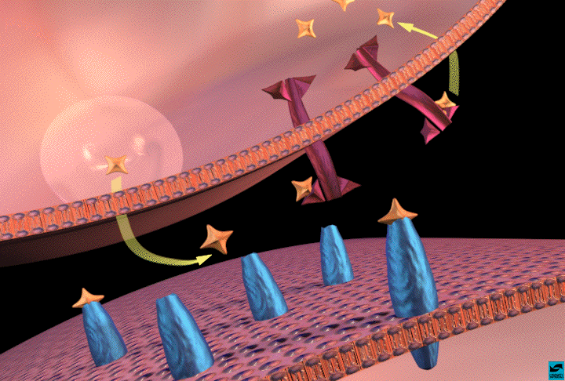
Neurotransmitter Action
Release of NT
Notes:
Neurotransmitters are how messages are sent from one cell to another. The first neuron releases a Neurotransmitter (NT) into the synapse. The NT crosses the synapse and fits into the receptor site on the second neuron and activates it. Once that happens, the receptor releases the NT and it is recycled by the first neuron by reuptake.
Drugs change this process. Prozac and Zoloft block the reuptake of Serotonin. All of the serotonin then keeps returning to the receptor sites and keeps reactivating the 2nd neuron. Cocaine works the same way, only it stops the reuptake of dopamine and norepinephrine.
Methamphetamine greatly increases the amount of NT released by the first neuron (turns your kitchen faucet into a fire hose)
Heroin resembles a NT (endorphin) and can activate the receptor site itself.

Slide 9
Neurotransmitters
Acetylcholine – Memory
Dopamine – Reward/Euphoria
Norepinephrine – Metabolic Rate
Serotonin – Mood, Sleep Regulation
Notes:
Acetylcholine - memory – Alzheimers disease not enough Acetylcholine – marijuana lowers Acetycholine results in poor memory when high
Dopamine – key to addiction – the high
Norepinephrine – this is the chemical that controls heart rate, respiration, blood pressure and the fight/flight response.
Serotonin – mood, sleep regulation, rage control

Slide 10
Natural Rewards
Food
Water
Sex
Nurturing
Notes:
These things are naturally rewarding – they feel good. Imagine what would happen if they were painful – we’d stop eating, drinking, having sex, and taking care of our kids. Our species would become extinct.

Slide 11
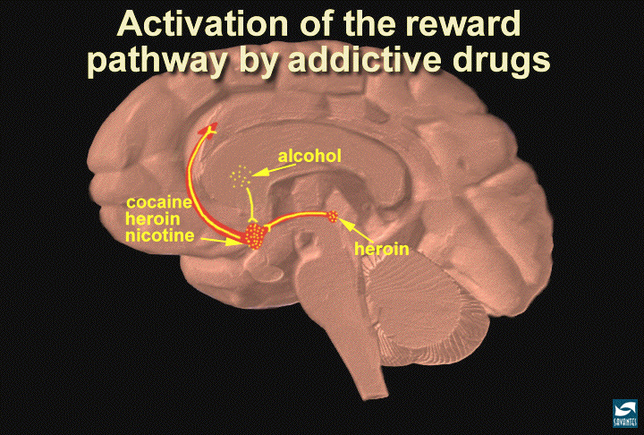
methamphetamine
marijuana
ecstasy
opium
etc.
Notes:
Receptor sites for cocaine, heroin, nicotine, amphetamines etc. are all in these areas. Stimulating these areas causes the person to want to do it again. If it feels good – do it – again and again.

Slide 12

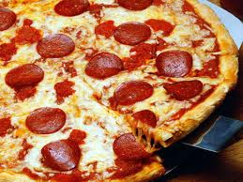
Food
FOOD
200
NAc shell
150
100
% of Basal DA Output
Empty
50
Box
Feeding
0
0
60
120
180
Time (min)
Source: Di Chiara et al.

Slide 13

Sex
SEX
200
150
DA Concentration (% Baseline)
100
15
10
Copulation Frequency
5
0
Scr
Scr
Scr
Scr
Bas
Female 1 Present
Female 2 Present
Sample
Number
1
2
3
4
5
6
7
8
9
10
11
12
13
14
15
16
17
Mounts
Intromissions
Ejaculations
Source: Fiorino and Phillips

Slide 14
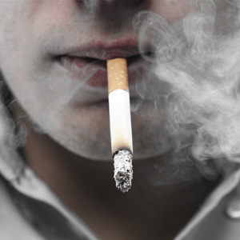
Nicotine
250
NICOTINE
200
Accumbens
Caudate
% of Basal Release
150
100
0
1
2
3 hr
0
Time After Nicotine

Slide 15
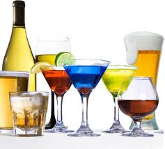
Alcohol
250
Alcohol
Accumbens
Dose (g/kg ip)
200
0.25
0.5
1
% of Basal Release
2.5
150
100
0
0
1
2
3
4hr
Time After Ethanol

Slide 16
Effects of Drugs on Dopamine Levels
COCAINE
MORPHINE
Accumbens
250
Accumbens
400
Dose (mg/kg)
200
0.5
300
DA
1.0
DOPAC
2.5
HVA
% of Basal Release
10
% of Basal Release
150
200
100
100
0
0
0
1
2
3
4
5 hr
0
1
2
3
4
5hr
Time After Cocaine
Time After Morphine
Source: Di Chiara and Imperato

Slide 17
Methamphetamine
METHAMPHETAMINE
1100
Accumbens
1000
900
800
DA
700
DOPAC
600
HVA
% of Basal Release
500
400
300
200
100
0
0
1
2
3
4
5 hr
Time After Amphetamine
Source: Di Chiara and Imperato

Slide 18
Behavior Pathways
Rewarding behaviors can become routine
“Subconscious” control of the behavior
Difficult to extinguish behaviors because people are not always aware when they are initiated.
Resistant to change
Notes:
People start doing the things “automatically” – have two cigarettes lit, drive home and can’t remember if you stopped for that stop sign.
Ask the participants to quickly cross their arms – then have them cross them the “other way” – it feels weird and you have to think about it. Drug use can become an automatic behavior – so can overeating.

Slide 19
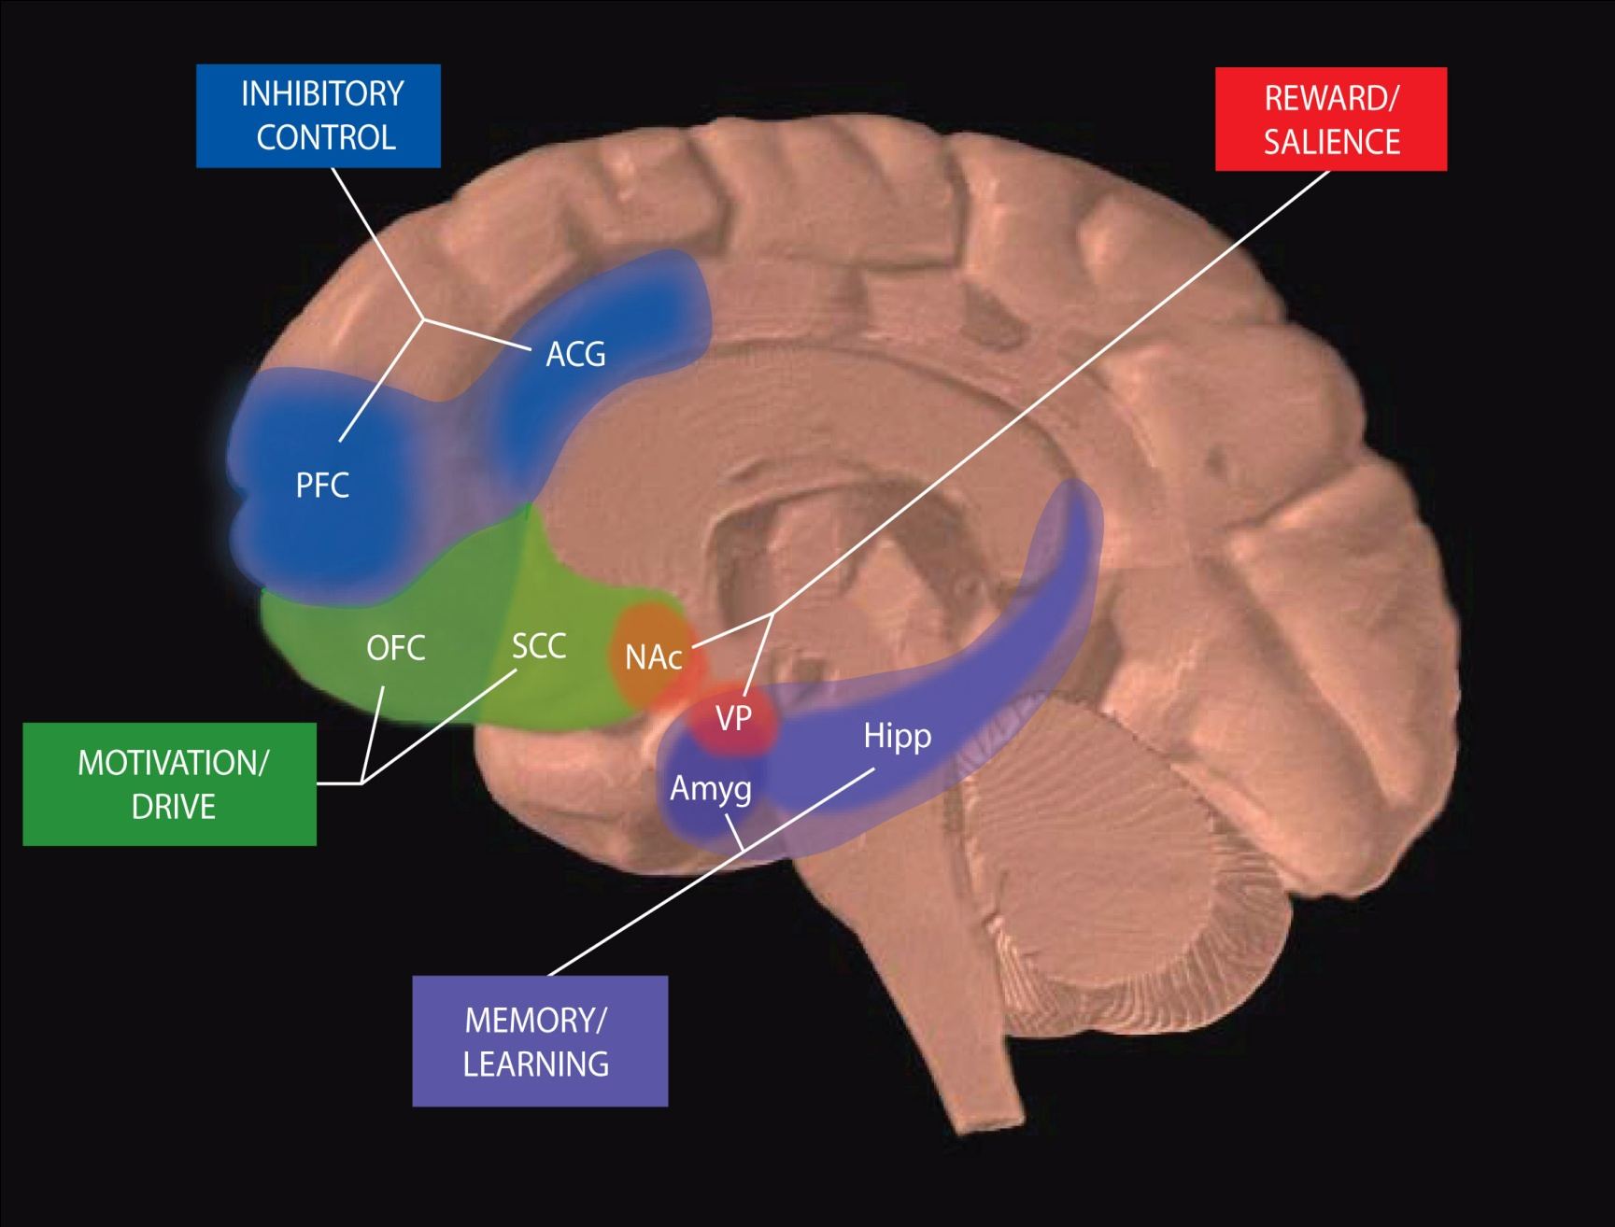
Circuits Involved In Drug Abuse and Addiction
GO
STOP
All of these must be considered
in developing strategies to
effectively treat addiction
Notes:
Brain circuits are affected by drug abuse and addiction. The areas depicted contain the circuits that underlie feelings of reward, learning and memory, motivation and drive, and inhibitory control. Each of these brain areas and the behaviors they control must be considered when developing strategies to treat drug addiction.
PFC – prefrontal cortex; ACG – anterior cingulate gyrus; OFC – orbitofrontal cortex; SCC – subcallosal cortex; NAcc – nucleus accumbens; VP – ventral pallidum; Hipp – hippocampus; Amyg – amygdala

Slide 20
Go & Stop
Craving elicits Go!!
Powerful
Activity in limbic system not frontal cortex
Feeling/reacting vs. thinking/planning
Thinking initiates Stop!!
Addicts have “bad brakes” – Stop!
Hard to stop this fast moving car.

Slide 21

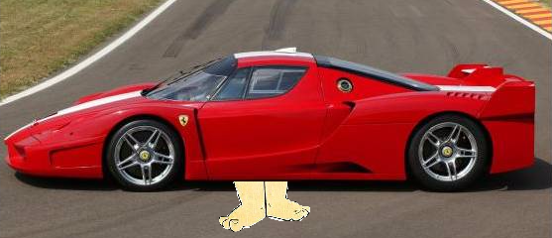
Fred Flintstone Brakes

Slide 22
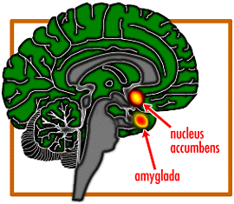
Craving
Relapse
Trigger
Memory
Impaired
Judgement
Stimulation
of Nucleus
Accumbens
& Amygdala
Focus on Drug
Anxiety Increases

Slide 23
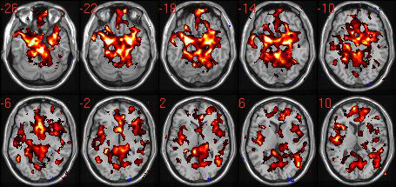

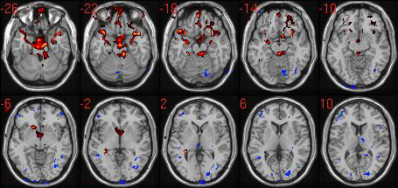

AMYGDALAR CONNECTIVITY
during brief .5 sec Cocaine Cues
Placebo
Drug 2 amyg conx (n=7)
Baclofen blunts AMYGDALAR CONNECTIVITY
Baclofen
Source: Childress, et al, unpublished
Notes:
The subjects were scanned after placebo administration and then again after 7 days of treatment with the drug Baleen. The data shows that Baleen treatment results in a substantial decrease in the extent and intensity of brain activation response to the drug cues. Again, these data have not yet been published in a peer-reviewed journal.

Slide 24
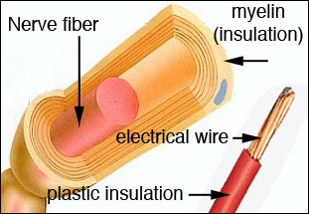
Myelination
Why it’s hard to change

Slide 25
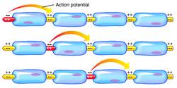
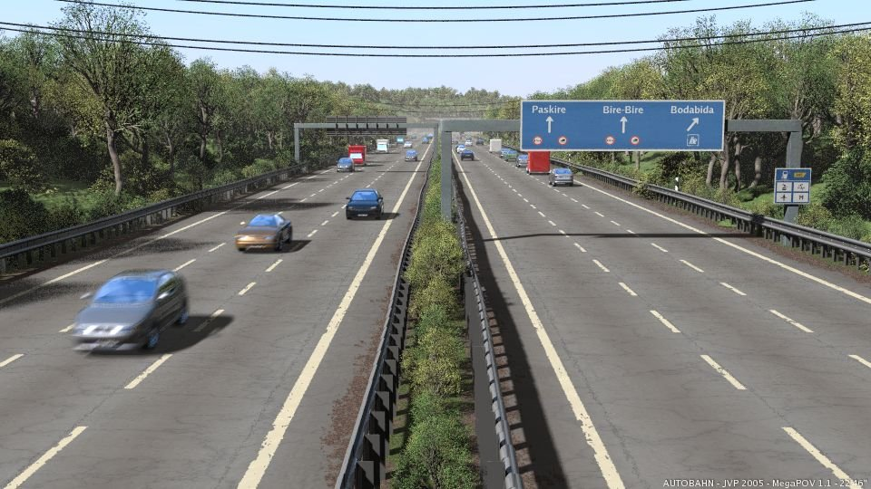
Myelination = Stronger & Faster
Like Paving a Dirt Road

Slide 26
Chemical Dependency
Chronic Disease Prone to Relapse
Requires significant behavior changes
Similar to Heart Disease, Diabetes, Asthma, Gingivitis,etc.
Similar treatment “success”
Notes:
Compliance rates are similar for these diseases. Ask if anyone knows a diabetic who doesn’t comply with what their doctor says, or heart disease patients who don’t change their diet. How many of the participants are 100% compliant with what their dentist tells them.
Now drug courts increase success because of the monitoring. Do you think you’d be more compliant if your dentist gave you a urine test every week that would tell if there were any times that you skipped flossing?

Slide 27
Relapse Happens
Poor Craving Management
The Relapse Process – Gorski
Get the train back on the tracks

Slide 28
Cocaine Effects
Blocks Reuptake of DA and NE – increases activity
Central Nervous System - Euphoria
Peripheral NS - NE Fight/Flight
  HR, BP, Temp, bronchodilation, dilates pupils

Slide 29
5 mins
Smoked - onset 5-12 seconds
30-40 mins
Snorted - onset 2 mins.
15 mins
1 hour
Notes:
Using a pen, mimic taking a hit off a crack pipe. Count 5 seconds – this is the time it takes for Dopamine to start flooding the reward system and the limbic system. It is “instant on” for the drug user.
With crack there is a higher,quicker high and a lower faster low.

Slide 30
Dose Response
Metabolic
Crisis
EFFECTS
Psychosis
Paranoia
Energized
Anxiety
Euphoria
DOSE

Slide 31
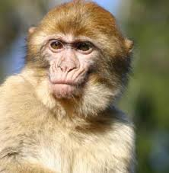
Animal Studies
Primates will ignore food and water in order to get cocaine – to the point of death by starvation/dehydration
Given unlimited access to cocaine, animals will quickly die from cocaine related deaths.
Notes:
3rd study – essentially unlimited cocaine – all dead in five days – seizure, heart attack, stroke
Cocaine only drug that monkeys will self administer til death.

Slide 32
Stopping Cocaine Use
Anhedonia - Dopamine depletion
Craving - intense craving for drug

Slide 33
Methamphetamine
DOPAMINE
DOPAMINE

Slide 34
Meth - Signs of Abuse
  mean temperment
  compulsive
  excited talk
  “Meth mouth”
  rapid weight loss
  nervous energy
  no “need” for sleep
  aggressive

Slide 35
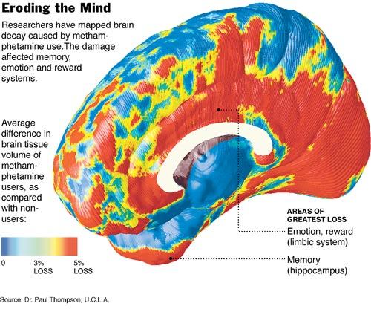
Notes:
Using methamphetamine involves massive brain damage and decay-impacting the memory, emotion and reward systems. (UCLA-Dr. Paul Thompson)
You see that the two areas of greatest loss affect Emotion and Reward (or what we derive pleasure from) and Memory. “Do any of you who work with methamphetamine users see them have trouble remembering things?”

Slide 36
Meth - Signs of Withdrawal
  long crash
  apathy
  depression
  fatigue
  anxiety
  suicidal ideation
  cravings

Slide 37
Alcohol
Most popular drug of abuse
Probably the most physically toxic of drugs
Damages almost every organ in the body
Easy access, adults use, advertising, relatively inexpensive.
THE DRUG for Youth

Slide 38
Action
Dopamine – excitement & reward
Serotonin – feel – “normal”
GABA – lowers anxiety
Endorphins – pain relief, reward, craving
Notes:
This slide shows the action of alcohol on various neurotransmitter systems.

Slide 39
Endorphins
Drink
Craving
Endorphins
Endorphins
Reward
Stop Drinking
Block Endorphins with Naltrexone
– Break Reward Cycle
Notes:
Description of the Endorphin theory of alcoholism. The theory states that some people are born with both a low level of normal endorphin activity as well as an increase in endorphin activity when alcohol is consumed. They drink – experience the reward of increased endorphins and drink more – when they stop drinking the decrease endorphins and begin craving.
When they are given naltrexone (ReVia) and then drink they do not experience the endorphin reaction. They think we’ve ruined drinking for them.

Slide 40
Endorphins
Drink
Craving
Endorphins
Endorphins
Reward
Stop Drinking
Block Endorphins with Naltrexone
– Break Reward Cycle
Notes:
Description of the Endorphin theory of alcoholism. The theory states that some people are born with both a low level of normal endorphin activity as well as an increase in endorphin activity when alcohol is consumed. They drink – experience the reward of increased endorphins and drink more – when they stop drinking the decrease endorphins and begin craving.
When they are given naltrexone (ReVia) and then drink they do not experience the endorphin reaction. They think we’ve ruined drinking for them.

Slide 41
Opiates
Natural Opiates
Derived from raw opium
Morphine
Codeine
Semi-synthetics
Modified Natural
Heroin
Vicodin
Synthetics
Fentanyl
Demerol
Methadone

Slide 42
Opiates
Heroin more potent -60-80% - <10% in ‘70’s
Younger age group – 18-24 y.o. and younger
Suburban/Rural
Users start with snorting - IV within 12 months
Withdrawal painful - not deadly
Lots of Relapse

Slide 43
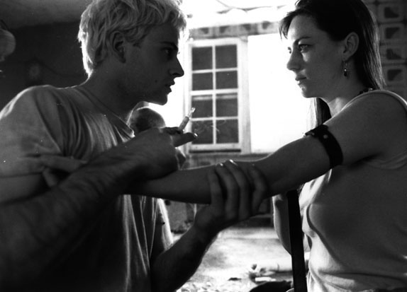

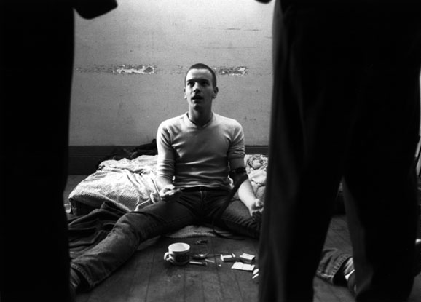
“Take the best orgasm
you’ve ever had…
Multiply it by a thousand.
And you’re still nowhere
near it.

Slide 44
Heroin
Effects
Withdrawal
Analgesia - change in pain perception
Euphoria - Intense
Sedation - “on the nod”
Respiratory Depression
Cough Suppression
Nausea/vomiting
Constipation
Pain
Depression
Alert
Rapid Breathing
Coughing
Nausea/Vomiting
Diarrhea
3-5 days

Slide 45
Addiction/Dependency
Opioids trigger reward system – euphoria – leads to continued use – addiction
Withdrawal symptoms are significant – regular use to avoid withdrawal - dependence

Slide 46
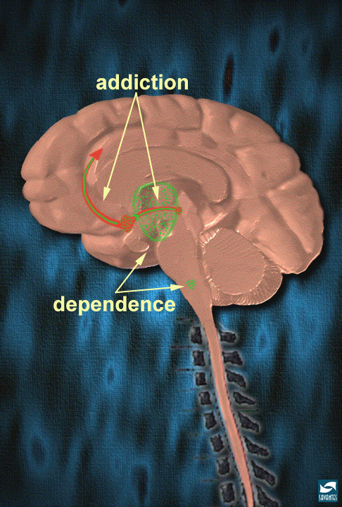
Addiction vs. Dependency

Slide 47
Heroin usage patterns
Highly addictive and dependence producing
Significant tolerance up to 35X
Increased cost
Tolerance management (Tx, jail, etc.)
Mixing with other opiates and other drugs (speedballing/cocaine)

Slide 48
Treatment
Traditional Recovery Based/NA
Naltrexone - Antagonist/Blocker
Opiate Maintenance Tx – withdrawal management
  Methadone- daily
  Buprenorphine/Suboxone
  Methadone to abstinence models

Slide 49
Prescription Opiates
OxyContin-an oral, controlled release form of the drug- Much abuse – crush the tablet – heroin-like high
Darvon
Vicodin
Dilaudid

Slide 50
Two “Types” of Rx Drug Abusers
The Drug Abuser who likes Rx drugs.
  Frequently use other drugs (cocaine, alcohol, heroin, other non-Rx drugs)
  Fits the “model” of a drug abuser.
  “addicted” to high
The Patient who becomes dependent on their medication
  Infrequent use of other substances – unless can’t get Rx.
  Don’t fit “model” of drug user – age, other behaviors.
  “dependent” on the drug

Slide 51
Why Prescription Drug Users May Believe That They Are “Different”
“I had/have real pain, I wasn’t using these to get high like those drug addicts”
“My doctor prescribed these for me. It wasn’t my idea”
“I never robbed anyone or did those things that addicts do.”
“I have to take something for this pain!”

Slide 52
What the Rx Drug User Might Have Trouble Relating To
“Hitting Bottom”
Changing People, Places & Things
Change your “Lifestyle”
You must be completely abstinent from everything else – alcohol included
Going to meetings all of the time.

Slide 53
Marijuana
Used since 2,700 BC
More potent today (5-10X) than ‘70’s
Kids starting younger
Eliminates boredom, focus concentration, lowered anxiety, euphoric, increased appetite.

Slide 54
Spice/K2 and Synthetic Cannabinoids

Slide 55
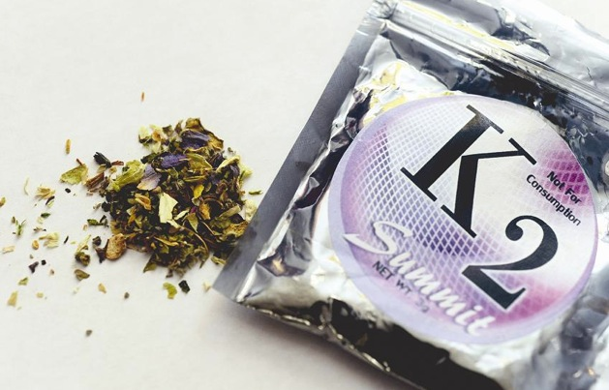
Preparation of the “incense”:
botanicals are sprayed with liquid preparations of:
  HU-210
  HU-211
  CP 47,497
  JWH-018
  JWH-073

Slide 56
Origins of Synthetic Cannabinoids
HU-210 & HU-211 - synthesized at Hebrew University, Israel in 1988. HU-210 is an anti-inflammatory; HU-211 as an anesthetic
CP 47,497 - developed by Pfizer in 1980 as an analgesic
JWH-018 & JWH-073 - synthesize by a researcher at Clemson (1995) for use in THC receptor research - John W. Huffman
more than 100 different synthetic cannabinoids have been created

Slide 57
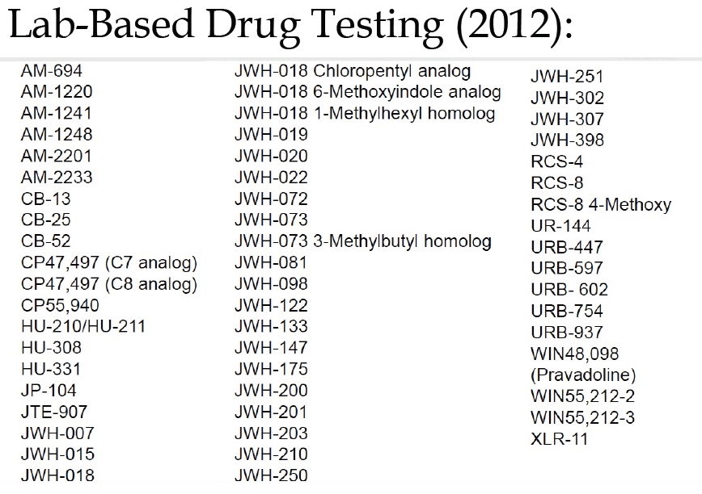

Slide 58
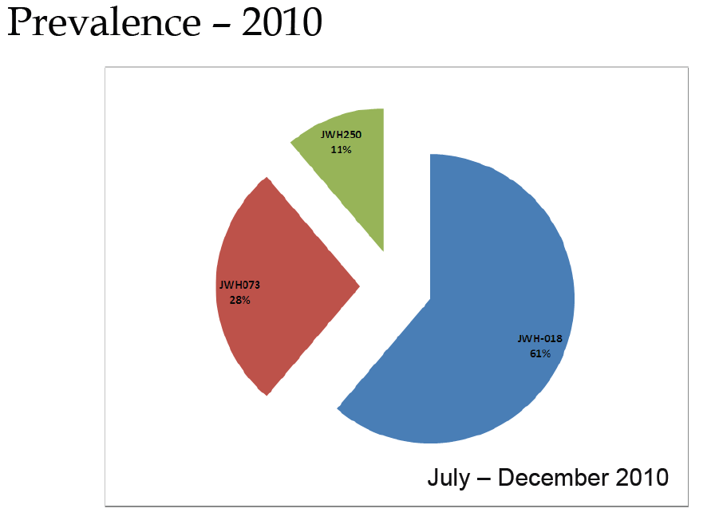

Slide 59
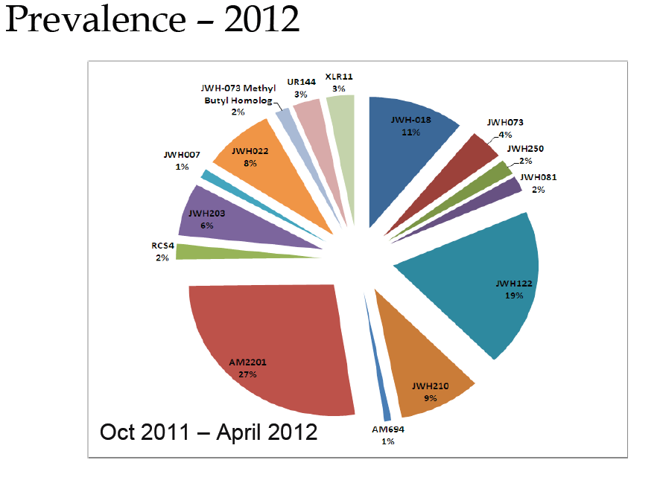

Slide 60
Some Effects of Synthetic Cannabinoids are Similar to THC
increase heart rate & blood pressure
altered state of consciousness
mild euphoria and relaxation
perceptual alterations (time distortion)
intensification of sensory experiences
pronounced cognitive effects
impaired short-term memory
reduction in motor skill acuity
increase in reaction times

Slide 61
Some Effects of Synthetic Cannabinoids are Different to THC
production inconsistencies
herbal incense blends are harsher to inhale
increased restlessness & aggressive behavior
herbal incense produces a shorter “high” (perceptual alterations & sensory effects are limited)
doesn’t mix well with alcohol (hangovers)
incense costs more than marijuana

Slide 62

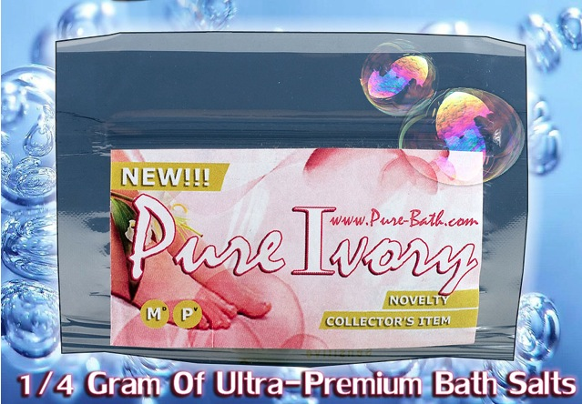
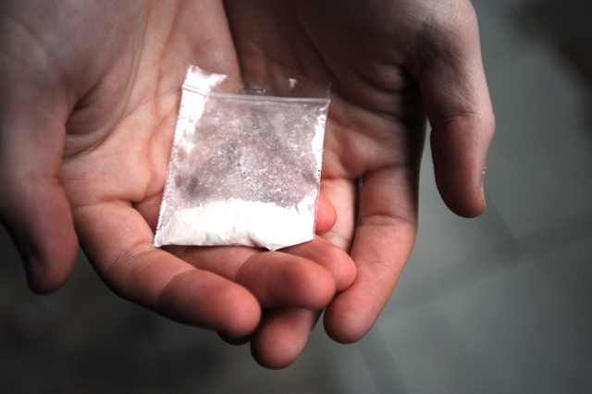
Bath Salts:
Ivory Wave
Ivory Pure
Ivory Coast
Purple Wave
Vanilla Sky

Slide 63
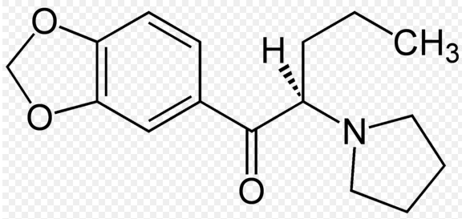
What’s in Bath Salts?:
Methylenedioxypyrovalerone (MDPV) is a psychoactive drug with stimulant properties which acts as both a norepinephrine-dopamine reuptake inhibitor (NDRI).
MDPV has four times the potency of Ritalin
MDPV - no history of FDA approved medical use
sold since 2007 as a research chemical

Slide 64
Pharmacological Effects of “Bath Salts”:
increase heart rate & blood pressure
pupil dilation
hyperactivity, arousal & over stimulation
increased energy & motivation
euphoria - agitation
dizziness
nausea
breathing difficulties
diminished perception of the requirement for food and sleep

Slide 65
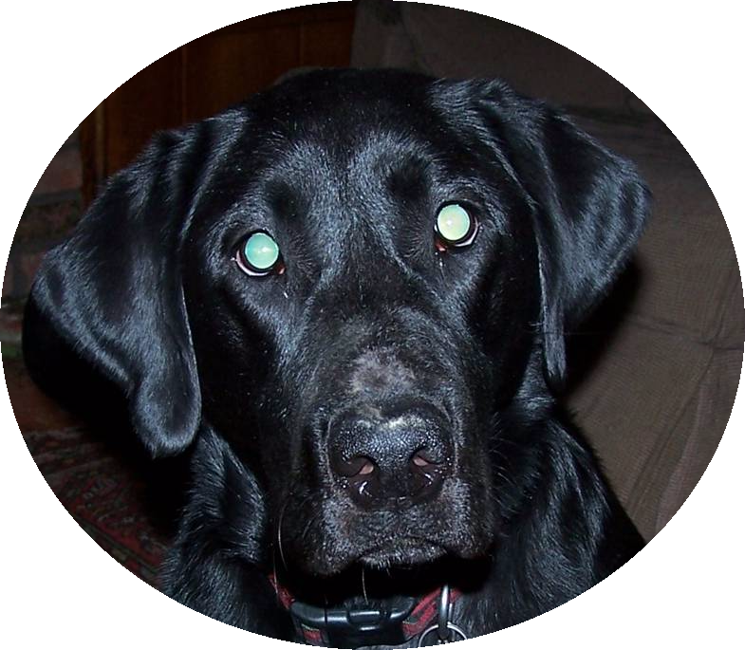
Introducing:
Boomer
The Addiction Dog

Slide 66
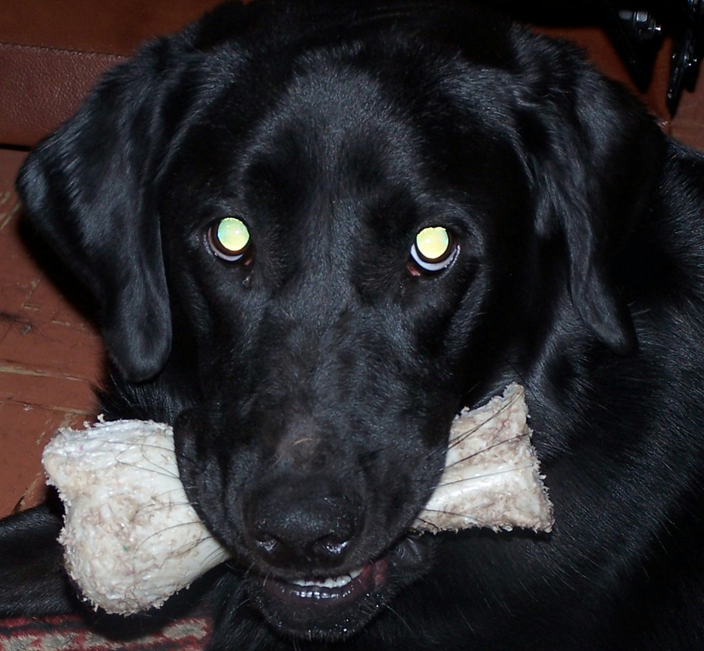
Addiction is like…
A dog with a bone
The dog does not want to let go of the bone (addiction/ denial).
It gets excited when it thinks its going to get its bone (craving)
It always wants more bones (loss of control)
Sometimes the dog takes you for a walk.

Slide 67
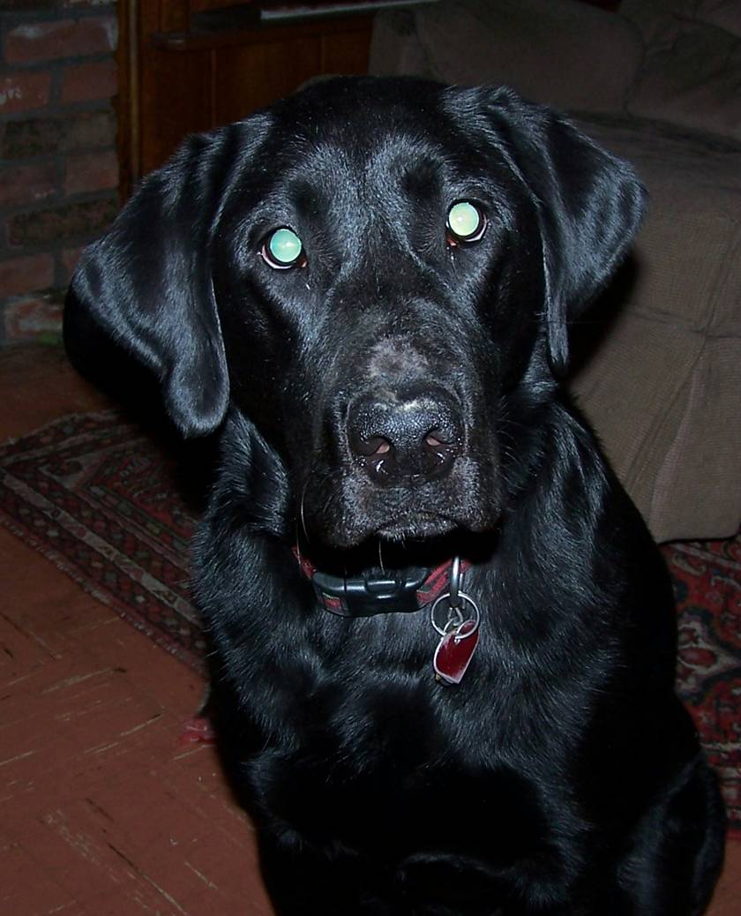
What Boomer is Thinking
What can I get
away with?
They won’t test me
for another week.
Try the second-
hand smoke
excuse.
We can talk
our way out
of this.

Slide 68
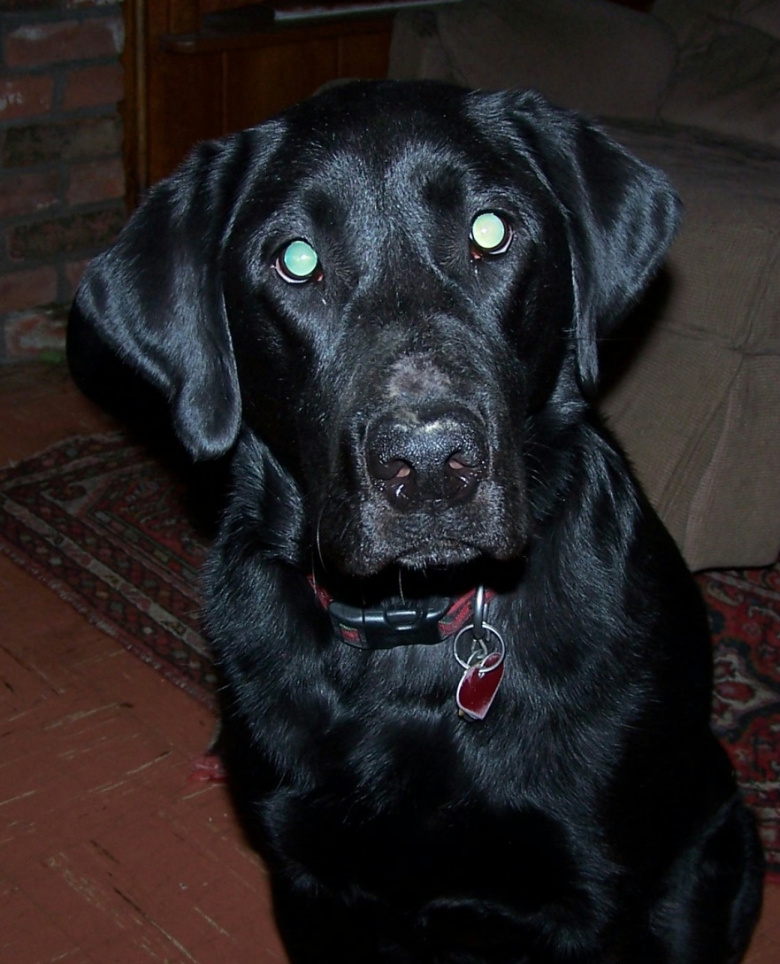
Treatment is like…
Obedience School for the Dog
You teach the dog’s owner to control the dog.
You develop a variety of tools (relapse prevention) to help the dog be obedient.
Some dogs are harder to train.

Slide 69
Early Recovery Issues
Loss of lifestyle
Loss of Coping Strategy
Withdrawal
Cognitive deficits related to early abstinence

Slide 70
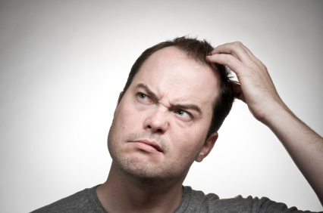
Cognitive Deficits
Memory problems - short term loss
Difficulty with abstractions
Difficulty with impulse control
Similar performance to those with brain damage - Improves.

Slide 71
The End
Thanks

