Slide 1
Update on State Initiatives
Hon. Elliott Levine
WATCP Annual Conference
March 24,2015

Slide 2
Statewide CJCC
Subcommittees:
Problem-Solving Courts Subcommittee
Evidence-Based Practices Subcommittee
Data Sharing/Benchmarks Subcommittee
Outreach and Communication Subcommittee

Slide 3
Problem-Solving Court Subcommittee
Treatment Court Standards Training – Starting Fall 2015
Drug and Hybrid Court Performance Measures Training
Monitors problem-solving court activities of partner agencies – Problem-Solving Court Coordinator, TAD program, WATCP to lend support when appropriate

Slide 4
Evidence-Based Practices Subcommittee
Statewide EBDM Phase V Recipiant
Six Counties; Chippewa, Marathon, Outagamie, La Crosse, Rock and Waukesha
Pew- MacArthur Results First Initiative – DOJ
Applying for a Justice Reinvestment Initiative
Monitor TAD program activities

Slide 5
Effective Justice Strategies Subcommittee
Subcommittee of the Wisconsin Supreme Court Planning and Policy Advisory Committee
Members of EJS with DOC have worked together to design and implement the use of COMPAS and the new pre-sentence investigation report
Members served on the WATCP workgroup to develop and revise state treatment court standards
Provides oversight for the Director of State Courts Office performance measures training
Developing Standards Training for this fall.

Slide 6
Effective Justice Strategies Subcommittee
Maintains a statewide directory of CJCCs
Participates in the Results First Initiative
Developed and maintains an inventory of programs available to counties to use as sentencing options
Collaborated with WI DOJ, DOC and NIC with the EBDM Phase V implementation.

Slide 7
Treatment Alternatives and Diversion Program
Administered by the Wisconsin Department of Justice jointly with TAD partners – Department of Health Services, Department of Corrections and Director of State Courts Office
Currently funds 34 projects totaling more than $4 million

Slide 8
Joint Legislative Council Study Committee on Problem-Soling Courts and Treatment Alternatives.
Generated a report that resulted in…
OWI Tx Court Participants easier access to occupational licenses
Allowed Tx Courts access to IID reports
State CJCC would oversees TAD
Funding for TAD evaluations
Expands the type of programs that can be funded by TAD
Changed the violent offender definition and lifts the exclusion under certain conditions
Created a TAD Family Tx Court option
Allows Home Detention for mandatory jail terms if someone is placed on probation
Asks Joint Legislative Audit Committee to audit racial disparities in Tx Courts

Slide 9
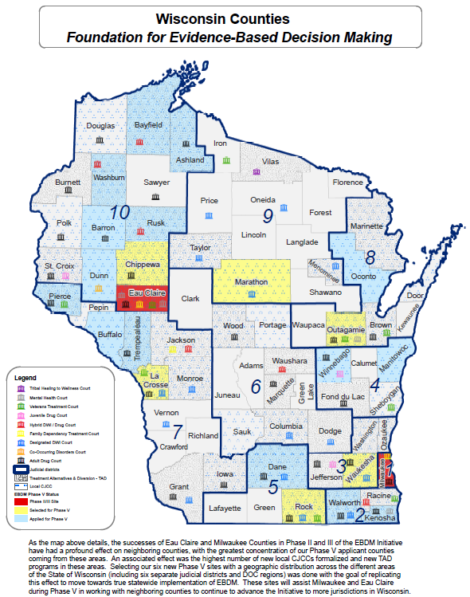

Slide 10
Integrated Data System
The Wisconsin Department of Justice is developing an integrated data system for Wisconsin’s diversion and problem-solving courts
Enable projects with multiple funding sources (federal, state, or local) to enter data into one system
Will include core elements for each participant and separate modules for diversion projects, problem-solving courts.
Additional modules with data elements unique to each problem-solving court model.

Slide 11
Integrated Data System
Merges existing databases (TAD, and eValuate) into one
Share common data elements
Eliminates need for sites to enter program information into multiple databases
Enable local sites to conduct process and outcome evaluations
Incorporates data requirements from Performance Measures project
Includes quarterly and preset automated reports for sites
Will incorporate reporting capabilities to generate BJA funding reports for sites

Slide 12
CJCC Evidence-Based Practices Subcommittee, David O’Leary, Chairperson
Matt Raymer, WI DOJ
raymermc@doj.state.wi.us
CJCC Problem-Solving Court Subcommittee, Kelly Thompson, Chairperson
Matt Raymer, WI DOJ
raymermc@doj.state.wi.us
Treatment Alternatives and Diversion
Ray Luick, WI DOJ
luickrj@doj.state.wi.us
Adult Drug and Hybrid Court Performance Measures
Kerry Connelly, Director of State Courts Office
kerry.connelly@wicourts.gov
Integrated Data System
Matt Raymer, WI DOJ
raymermc@doj.state.wi.us
Pew-MacArthur Results First Initiative
Matt Raymer, WI DOJ
raymermc@doj.state.wi.us
NIC Evidence-Based Decision Making Initiative
Matt Raymer, WI DOJ
raymermc@doj.state.wi.us
Legislative Council Joint Study Committee on Problem-Solving Courts, Alternatives and Diversion
http://legis.wisconsin.gov/lc/

