Slide 1
Honorable Mary E Triggiano
Rebecca Foley, JD/MSW
March 24, 2015

Slide 2
A Whole New Approach
“Along the way, she enrolled in the Family Drug Treatment Court program.
“They told me: If you do what you need to do, we will put your daughter back with you,” Theresa says. So she did.
What helped, what helped beyond measure, she says, is the way the entire system focused on getting her better and on getting her daughter home.
“I didn’t feel pressure from them, she says. “I felt support.”
- Theresa Trigg, 1st FDTC graduate

Slide 3
The Drug Treatment Court Movement
2014-25th Anniversary of the first Drug Treatment Courts (ADTC)
The first Family Drug Treatment Court (FDTC) started in Reno, Nevada in 1995
Currently, there are 334 Family Drug Treatment Courts in the U.S.
Milwaukee County Family Drug Treatment Court is the first FDTC in the State of Wisconsin

Slide 4
The FDTC Mission
Through collaboration, and with accountability and enhanced assess to treatment services, the Family Drug Treatment Court improves the safety, well-being and permanence of children, supports the recovery of their parents from alcohol and drug dependence, and enhances the functioning of the family.

Slide 5
The Story of Milwaukee County Family Drug Treatment Court
Q: What does it take to start a FDTC?
A: Collaboration, a lot of hard work, and more collaboration
Our process:
Planning started in 2010 led by Judge Karen Christenson
Brought together Wisconsin Department of Children and Families/Bureau of Milwaukee Child Welfare, District Attorney’s Office, Office of the Public Defender, private bar, Guardians Ad Litem, and Milwaukee County Behavioral Health Division
18 months’ planning: program design, interagency agreements, federal grant (OJJDP)
Started operation October 1, 2011

Slide 6
How does FDTC work?
Prospective participants are identified by:
Bureau of Milwaukee Child Welfare
District Attorney’s Office
Parents’ Attorneys
Others
Participants invited to apply to FDTC
PARTICIPATION IS COMPLETELY VOLUNTARY
FDTC Team reviews applications
Participants officially enrolled/commit to 4 Phase Program
FDTC Team, including Judge, reviews each participant’s progress every week.
Participants meet as a group in open court with FDTC Judge Triggiano who speaks to each person individually
Frequent, random, observed drug tests conducted to monitor compliance with results reported weekly to FDTC

Slide 7
Opiate use, primarily heroin, is the leading type of addiction.
Addictive substance | Primary drug of choice | Any use of drug
Any opiates | 54.9% | 67.4%
Cocaine/crack | 19.6% | 44.6%
Alcohol | 18.5% | 34.8%
Marijuana | 6.5% | 29.3%

Slide 8
Quick Connection to Substance Abuse Treatment and Services
“You may be free of me now, but I could always put you in restriction. All it takes is “one more time” and I’ll have you on that mission! I’ll pretend to be your friend even though I’m faker than fiction! You need to always be aware of this because I am YOUR ADDICTION!!!
--- Rebekkah Webb, FDTC Participant
Most participants are served through Milwaukee County’s WIser Choice program. Others have private insurance.
Treatment services
Recovery support services align with comprehensive, trauma-informed services:
Peer support
Mental health services
Education/employment
Housing assistance
The FDTC Team coordinates treatment, recovery and child welfare services to achieve agreed-upon goals.

Slide 9
4 Phases of FDTC
Phase 1: Support the choice to become a drug-free parent and start living drug-free. | Phase 2: Challenge the parent to confront the reasons for addiction.
Phase 3: Support the transition of parent’s behavior into self-sufficiency for the family. | Phase 4: Improve the capacity to safely parent children with or without ongoing supervision by BMCW.

Slide 10
Best Practices
FDTC Best Practices | Milwaukee County FDTC
Focus on services to child and parents | √
Decrease time to treatment entry | √
Frequent counseling sessions | √
Longer time in treatment | √
Relationship with judge | √
Frequent random and observed urine drug testing | √
Treatment representative attends staffings | √
Judge attend staffings | √
Results of program evaluation lead to drug court modifications | √
Program caseload is less than 125 | √
S.M. Carey, J. Mackin, Judge D. Burleson, K. Walker, “Family Drug Treatment Court Costs and Best Practices: What do we know so far?” NPC Research, NADCP Annual Conference 2013

Slide 11
National Outcomes
FDTC approach is a winning one:
Improving treatment engagement and completion
Reducing length of time children spend in foster care
Increasing the rate and speed of reunification
Reducing arrests
Saving system resources

Slide 12
How do we measure results?
By measuring everything that happens:
54-item six-month reports to OJJDP
6-month follow-up on treatment outcomes
Drug testing, court attendance, and permanency progress
Comparison group
Currently creating a data evaluation committee

Slide 13
Is Treatment Working?

Slide 14
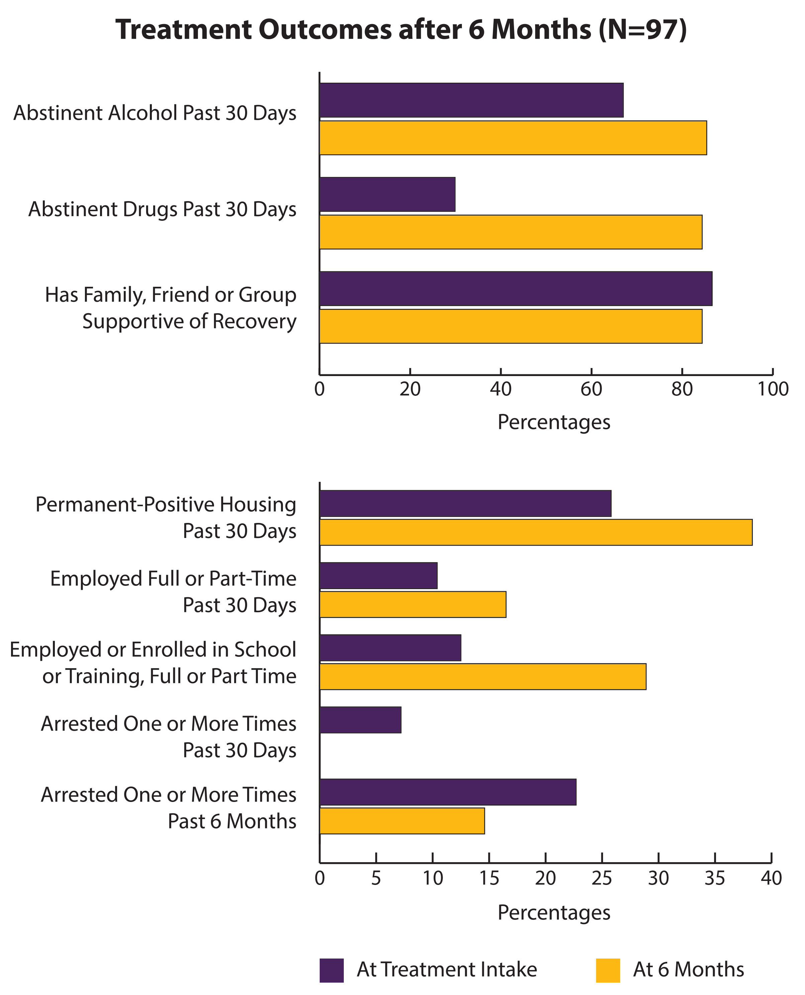

Slide 15
Is permanency being achieved?

Slide 16
12 Month Permanency Outcomes for 317 Children

Slide 17
12 Month Permanency Outcomes for 317 Children

Slide 18
Healthy Babies! There have been no drug positive births for active participants or graduates.

Slide 19
Systems Change
“In an adversarial system, trust between parties is a rare commodity. The FDTC build trust and thus confidence in the system. Trust is born out of respect and listening to everyone so that they feel heard. FDTC allows for more time for each case thus increasing the opportunity for building respect and confidence.”
---Judge Mary Triggiano, Children’s Court
“The process of seeking out professionals and advocating for themselves is not only becoming a growing phenomenon among many FDTC participants; it’s also infiltrating the non-FDTC participants. Word is getting around the court system that the professionals are approachable, accessible and genuinely interested in a favorable outcome for their families. I am sensing that the stigma associated with child welfare as being just ‘baby snatchers’ is slowly abating and families are viewing the system as a place of refuge, help, and encouragement.”
---Attorney Shelia Hill-Roberts, Milwaukee County
“Most important has been the FDTC’s ability to provide its participants significantly speedier access to services of all sorts, not only within the court’s and Bureau’s control, but also community-wide. This quick access greatly enhances trust and personal buy-in by our participants much earlier than one would see in a typical, non-FDTC CHIPS case. These are critical basic building blocks for long-term success and reduced recidivism.”
---Attorney Mary Moore, Private Bar

Slide 20
Robyn and Joslyn’s Story

