Slide 1
Childhood Trauma: Essential Information for Courts
2015 WATCP CONFERENCE
March 26th, Milwaukee, WI
Judge Mary Triggiano
Tim Grove, Chief Clinical Officer, SaintA
Notes:
Judge T
Handouts – ACE questionnaire

Slide 2
WHY TRAUMA?
Drug Court Participant: “I have finally come to realize that I’ve use opiates/heroin mainly along with other mind altering substances to merely try and obtain a fulfillment, a momentary relief from all the pain and trauma I’ve endured in 26 years.”
Psychological evaluation: “this young [woman] is truly trying to struggle her way out of a series of painful, emotionally debilitating circumstances that were not her choice.”
Victim impact statement: “He would get mad, choke me up, drug me down stairs, bite me…My daughter saw it all. We don’t sleep at night…When we hear noises, we jump…”
Presentence Investigation report: “It appears that Mr. K is suffering from PTSD from being sexually assaulted at a young age.”
Divorce: “There is domestic violence in this relationship and the child’s emotional well-being has been greatly impacted because of it. Dad is the primary aggressor sufficient to trigger the presumption against joint custody.”
Notes:
Judge T

Slide 3
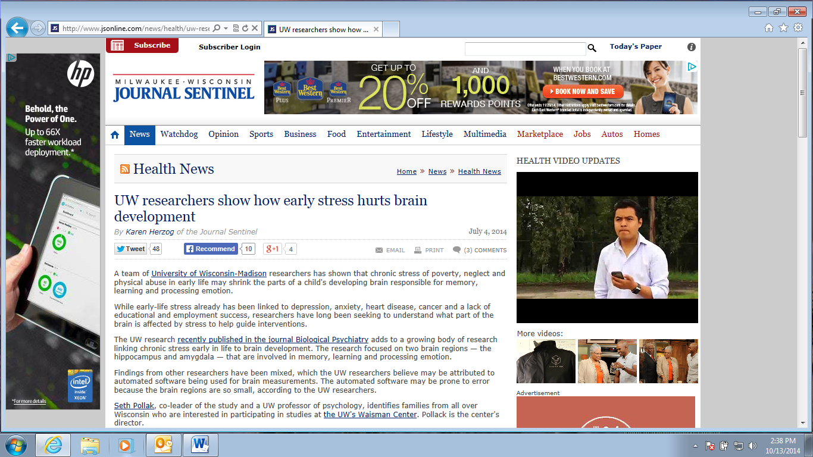
Notes:
Tim

Slide 4
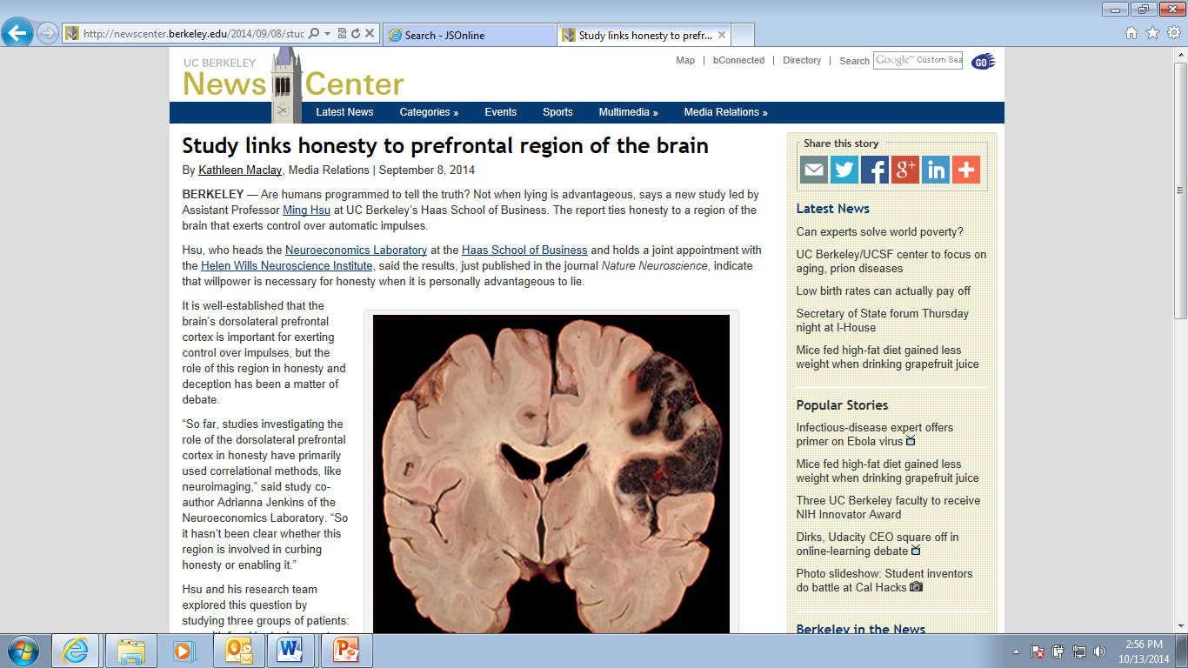
Notes:
Tim

Slide 5
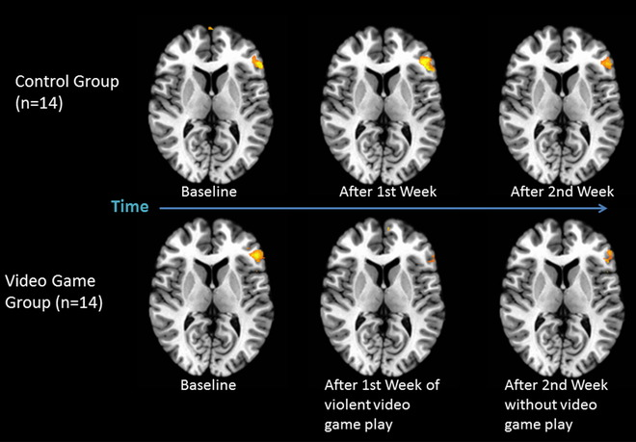
Matthews, 2011
Notes:
Tim

Slide 6
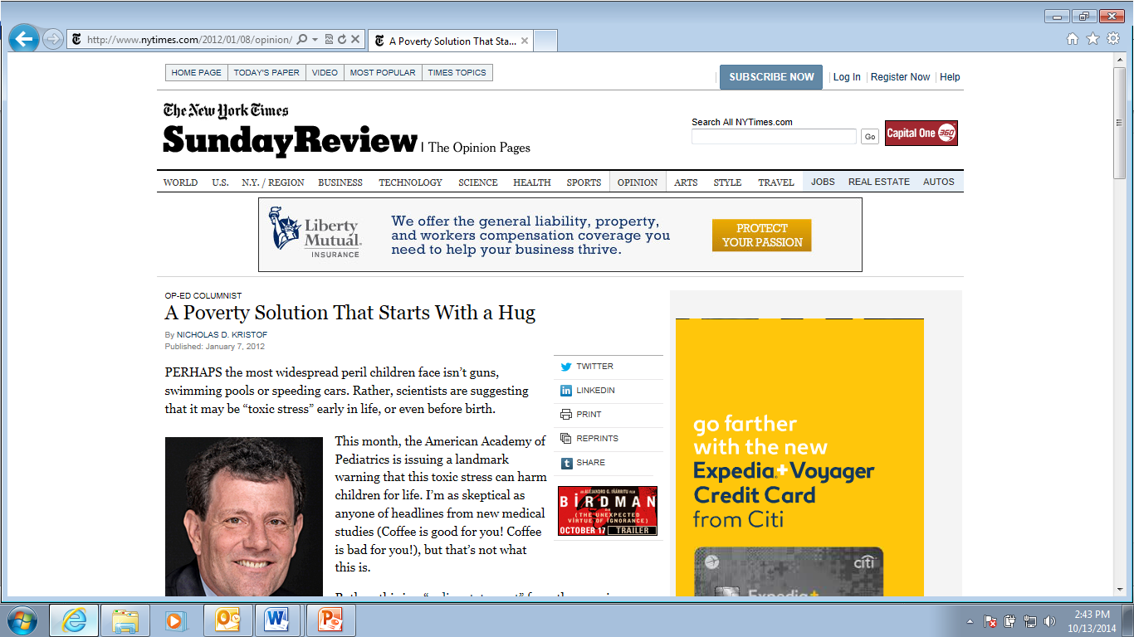
Notes:
Tim

Slide 7
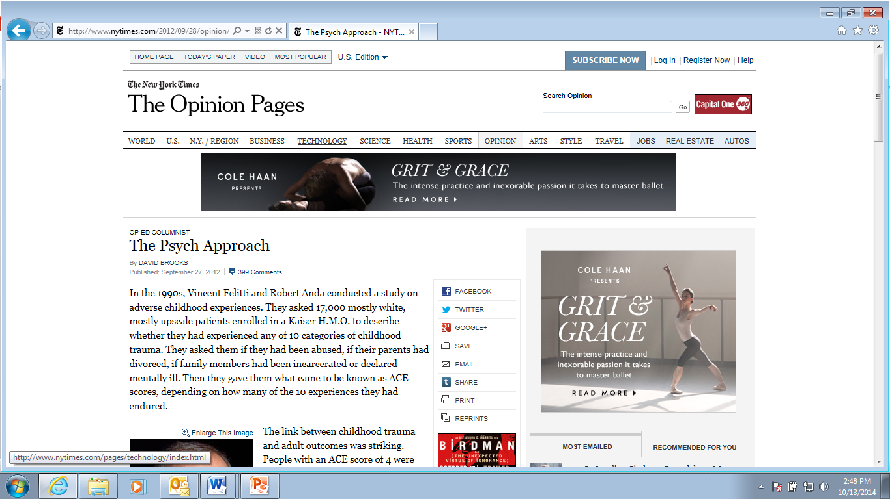
Notes:
Tim

Slide 8
David Brooks…
“When you look over the domestic policy landscape, you see all these different people in different policy silos with different budgets: in health care, education, crime, poverty, social mobility and labor force issues. But, in their disjointed ways, they are all dealing with the same problem — that across vast stretches of America, economic, social and family breakdowns are producing enormous amounts of stress and unregulated behavior, which dulls motivation, undermines self-control and distorts lives.
Maybe it’s time for people in all these different fields to get together in a room and make a concerted push against the psychological barriers to success.”

Slide 9

“Trauma is to mental health as smoking is to cancer”
-Dr Steven Sharfstein
Former President, American Psychiatric Association
Notes:
Tim

Slide 10

1964
Civil Rights act signed
The Beatles
Cassius Clay
Cost of a house – 13k
42% smokers*
*CDC, 2014
Notes:
Tim

Slide 11

2012
President Obama re-elected
Maroon 5
London Olympics
Cost of a house – 146k
18% smokers*
*CDC, 2014
Notes:
Tim

Slide 12

42% to 18% = 8,000,000 Lives*
*JAMA, 2014
Notes:
Tim

Slide 13
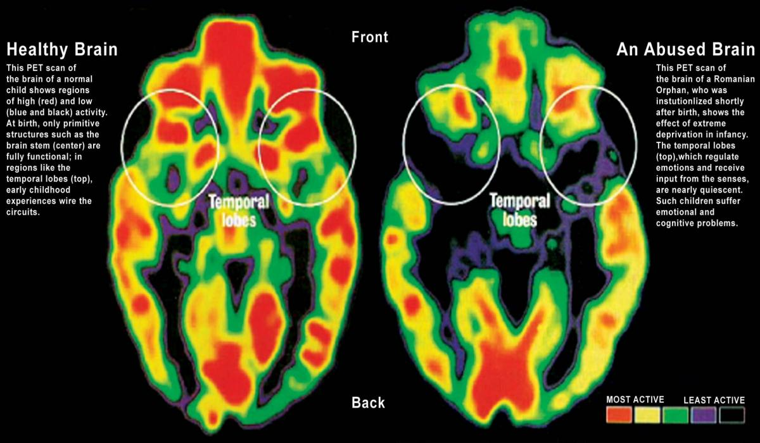
The Next Big Thing..
Notes:
Tim

Slide 14

ORIGINAL ACE STUDY
Conducted in 1995 through 1998 and was led by Dr. Vincent Felitti at Kaiser Permanente San Diego and Dr. Robert Anda at Centers for Disease Control and Prevention (CDC).
More than 17,000 participants:
75% white; 36% college educated; and 39% college graduates.
The ACE Study was originally designed to identify factors that predispose individuals to adopt risky behaviors or develop conditions that put them at risk for health problems.
CDC, 1995-1997
Notes:
Judge T
Anyone hear of the ACE study?
When we discuss trauma, we always discuss its prevalence and in doing so, we focus a lot of attention on the ACE study.
The largest study of its kind ever done to examine the health and social effects of adverse child hood experiences over the lifespan.
Dr. Anda from CDC and Dr. Feletti Kaiser Permanente’s Health Clinic in Calif. analyzed the relationships between multiple categories of Adverse Childhood Experiences and later health and behavioral outcomes.
Over 17,000 Kaiser patients were asked to do two things:
complete a confidential survey about childhood maltreatment and family situations that might cause toxic stress for a child – ACES.
Report their current behaviors as well as physical and mental health status.

Slide 15

WHAT IS AN ACE?
An ACE is exposure to any of the following before
the age of 18:
1. Recurrent physical abuse
2. Recurrent emotional abuse
3. Sexual abuse
4. Physical neglect
5. Emotional neglect
6. An alcohol or other drug abuser in the household
7. An incarcerated family member
8. A household member who was chronically depressed, mentally ill, institutionalized or suicidal
9. Violence between adults in the home
10. Parental separation or divorce
CDC, 1995-1997
Notes:
Judge T
What they meant by adverse childhood experiences was medical and social problems of national importance -- abuse & neglect, alcoholic or drug addicted caregiver, incarcerated family member, mentally ill or suicidal person in the home, DV in the home, and loss of a parent to death, abandonment or divorce.
The ACE score calculator is a simple tool with yes/no questions about these key areas. The ACE score is a measure of cumulative exposure to these experiences before the age of 18. Exposure to any single ACE condition is counted as one point; points are tallied and totaled. Possible ACE scores range from “0” –no adverse experiences; to 10—many adverse experiences.
ACE score focuses only on the # of ACE categories experienced. It does not capture the frequency or severity of any given ACE in a person’s life.
WHAT THEY FOUND WAS THAT WHEN BAD THINGS HAPPEN TO YOU, THEY CAN CONTINUE TO HAPPEN TO YOU.

Slide 16
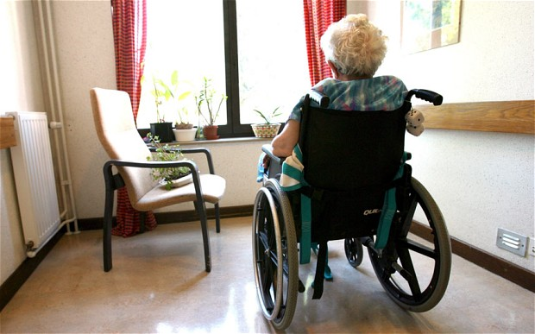

ORIGINAL ACE STUDY –GENERAL FINDINGS
ACEs:
–are common
–have long-term, damaging consequences
–can happen in any family
–have a cumulative effect—the higher the score, the higher the likelihood of health risk behaviors and poor health outcomes
–are a leading determinant of public health spending
CDC, 1995-1997
Notes:
Judge T
The results surprised Feletti and Anda -
Common, destructive and have an effect that often lasts for a life-time.
the frequency of ACES was much higher than expected. In this well-educated, middle class and employed demographic – only 36% reported NO ACE’s -- Over 12% had reported four or more ACES.
ACEs are strong predictors of later health risks and disease
As the # of ACE’s increased the likelihood of depression, cancer, diabetes, STDs, alcoholism, drug use, smoking, chronic bronchitis and emphysema, suicides, and homelessness significantly increased.
This combination makes ACEs the leading determinant of the health and social well-being of our nation
This is the big, scary truth about trauma, there is no such thing as “getting over it.”

Slide 17
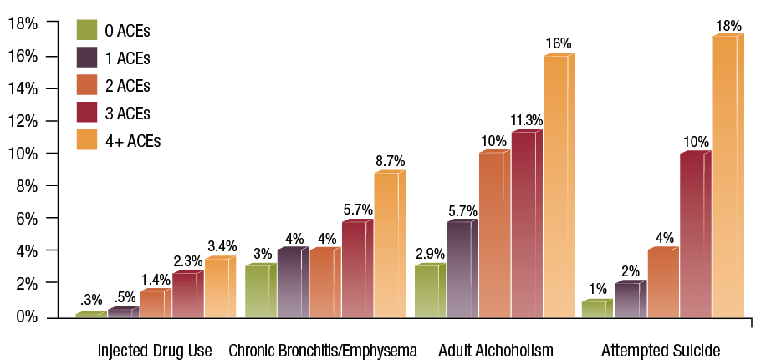
ORIGINAL ACE FINDINGS
WI CTF, 2012-2014
Notes:
Judge T
This is how the numbers begin to unfold. This graph shows the prevalence of selected outcomes increasing as ACE scores increase.
For instance, the relationship between ACE’s and IV drug use is powerful and follows a perfect dose-response curve. So a male child with and ACE score of 6 has a 4,600% increase in the likelihood of later becoming an IV drug user when compared to a male child with an ACE score of 0.
Attempted Suicide - an individual with an ACE score of 4 or more was 460% more likely to be suffering from depression than someone with an Ace score of 0. - they also found that there was a 1220% increase in attempted suicide bet these two groups. At the highest ACE scores the prevalence of suicide increases 3,000 to 5,100%.
Feletti and Anda found that many other measures of adult health have a strong graded relationship to what happened in childhood: next slide

Slide 18
Adverse Childhood Experiences (ACE) Study
Household dysfunction Kaiser* WI** ILS Cohort*** Legal
Substance abuse 27% 27% 62% 25%
Parental separation/divorce 23% 21% 62% 25%
Mental illness 19% 16% 42% 25%
Violence between adults 13% 16% 31% 8%
Incarcerated household member 5% 6% 50% 4%
Abuse
Psychological /Emotional 11% 29% 54% 27%
Physical 28% 17% 42% 22%
Sexual 21% 11% 27% 14%
Neglect
Emotional 15% 54% 19%
Physical 10% 42% 6%
* Center for Disease Control and Prevention 1995-97
** http://wichildrenstrustfund.org/files/WisconsinACEs.pdf
***SaintA © 2014 All Rights Reserved
Notes:
The Adverse Childhood Experiences (ACE) Study 1995-1997
Study conducted by the Center for Disease Control - Examines the health and social effects of ACEs throughout the lifespan among 17,421 members of the Kaiser Health Plan in San Diego County
More than 60% in Kaiser study (San Diego) one or more Aces; Study replicated in 19+ states
Wisconsin Data
2010 Wisconsin Behavioral Risk Factor Survey (BRFS), more than 4,000 randomly selected Wisconsin adults were asked about adverse experiences, or ACEs, they may have had prior to age 18. (BRFSS The Behavioral Risk Factor Surveillance System is a state based system of telephone surveys that collects information on health risk behaviors, prevalence)
4,000 people 56% at least one; 14% four or more
What were the demographics of the population studied: (74% college of some sort, 44% graduated)
What would our community’s ACES score be?

Slide 20
ACE Study – A Comparison*
Notes:
Judge T

Slide 21
ACE Attributable Problems
Alcoholism and alcohol abuse
Chronic obstructive pulmonary disease (COPD)
Depression
Fetal death
Health-related quality of life
Illicit drug use
Ischemic heart disease (IHD)
Liver disease
Risk for intimate partner violence
Multiple sexual partners
Sexually transmitted diseases (STDs)
Smoking
Suicide attempts
Unintended pregnancies
Early initiation of smoking
Early initiation of sexual activity
Adolescent pregnancy
CDC, 1995-1997
Notes:
Judge T

Slide 22
ACE Score and Drug Abuse
Ever had a
drug problem
Ever addicted
to drugs
Ever injected
drugs
Impact
Dr. Robert Anda – CDC
Notes:
Judge T

Slide 23
Notes:
Now we be can begin to anticipate why ACEs are related to certain behaviors and social conditions. Here we see the risk of becoming an alcoholic increases six-fold from an ACE Score of zero to a score of 6.
And ACEs affect relationships---people with higher ACE Scores are more likely to marry an alcoholic. Think for a minute about these indicate how ACEs tend to be transmitted from one generation to the next.

Slide 24
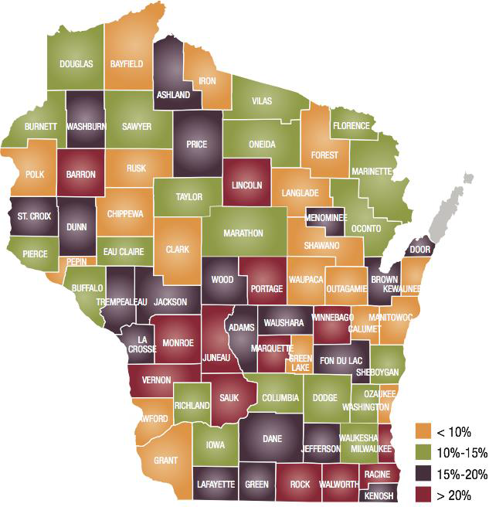
ACES IN WISCONSIN
WI CTF, 2012-2014
Notes:
Judge T
Prevalence by county of those with 4 or more ACE’s from the 2011/12 survey responses.
Yellow – fewer than 10% of adult residents have 4 or more ACEs (19 Counties)
Green – 10 – 15% (20)
Purple – 15-20% (20)
Red – more than 20% have 4 or more ACE’s (13)

Slide 25

“ACEs may be the single leading determinant of the health and well being of our country”
-Dr Rob Anda
Notes:
Judge T

Slide 26
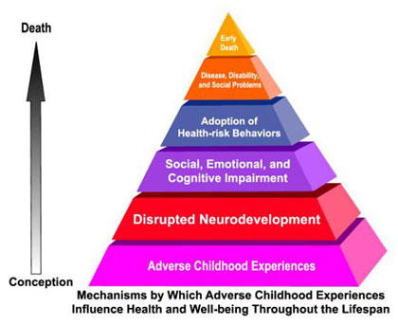
How Does This Happen?
CDC 1995-1997
Notes:
Tim
Toxic Stress Video

Slide 27
Environmental Input
Core relationship
Cortex
slower
Vestibular
Hippocampus
Propriocentric
Touch
Sensory Thalamus
Amygdala
Taste
Very Fast
Smell
Sound
Sight
Response
LeDoux 1996

Slide 28

Evident in Heart Rate?
12 yr old Boy
HR BP Resp
82 99/60 20
78 102/73 27
103 98/56 24
65 102/83 12
90 118/64 20
68 92/69 24
SaintA 2014
Notes:
Tim

Slide 29
Other Indicators
Memory Issues – especially with recall
Re-experiencing (flashbacks, nightmares, intrusions)
Anxiety related symptoms (sleep, concentration, attention)
Somatic complaints (constipation)
World View
Notes:
Tim

Slide 30


Link to Adult Functioning
Notes:
Tim

Slide 31

All rights reserved © 2006-2014 Bruce D. Perry and The ChildTrauma Academy
Notes:
Tim

Slide 32
Notes:
Tim
Preventing ACEs and their intergenerational transmission is the greatest opportunity for improving the well-being of human populations. In fact, the ACE Study team and ACE Interface believe this is the greatest opportunity of our time… perhaps of all time.
This slide shows the percentage of various health and social problems that epidemiologists estimate are caused by ACEs. The calculation that is commonly used to do this in public health studies is called Population Attributable Risk; this is displayed as a percentage as an “oil spill” on this slide. The percentage of a problem coated by the oil spill represents the percentage of each problem that is potentially preventable by preventing ACEs.
The percentages are quite large. In fact the high percentages on this chart are rarely seen in public health studies.
The cumulative effects of ACES reflect a powerful opportunity for prevention – no matter if you are working to prevent heart disease or cancer, end homelessness or hopelessness, or improve business profitability – as we align a portion of our work around a common goal of preventing the accumulation of ACEs and moderating their effects, we will reduce all of these problems, and many others, all at once!

Slide 33
What Wisconsin is Doing
2015 Conference on Child Welfare and the Courts: Moving Toward a Trauma-Informed Wisconsin, 9/30-10/2.
Fostering Futures
ACE Project – CTF
Trauma Informed Care
  DCF
  DHS
    Office of Children’s Mental Health
  CCIP
  DOC
  Police Depts. (Milwaukee)
  Providers
Wisconsin Alliance for Infant Mental Health
NCJFCJ – trauma audits
Notes:
Judge T

Slide 35
ALIGNING WHAT WE KNOW WITH WHAT WE DO
Trauma-Awareness:
  Many courts have come to recognize that acknowledging and understanding the impact of trauma on court participants may lead to more successful interactions and outcomes
  Courts that do not practice trauma-informed decision making may inadvertently increase the level of trauma that families experience
  Every interaction is an opportunity
Notes:
Judge T
It is important for judges to be aware of and sensitive to the experience of litigants moving through system. Given the prevalence of trauma, a judge should take a universal cautions approach. That does not mean that you have to be both judge and treatment provider. It’s about making incremental changes in how you approach those who appear in front of you.
Rather, trauma awareness is an opportunity to make small adjustments that improve outcomes while minimizing avoidable challenges and conflict during hearings.

Slide 36
Tools/Resources
NCTSN BENCH CARD for the Trauma-Informed Judge. The National Child Traumatic Stress Network and the National Council on Juvenile & Family Court Judge. (http://www.courts.ca.gov/documents/JudgeBenchCards_final.pdf)
HEALING INVISIBLE WOUNDS: Why Investing in Trauma-Informed Care for Children Makes Sense , July 2010. Justice Policy Institute. (http://www.justicepolicy.org/images/upload/10-07_REP_HealingInvisibleWounds_JJ-PS.pdf)
SAMSHA’s National Center on Trauma-Informed Care & SAMSHA’s National GAINS Center for Behavioral Health and Justice: Essential Components of Trauma-Informed Judicial Practice (Draft), 2013.
Ten Things Every Juvenile Court Judge Should Know About Trauma and Delinquency, www.ncjfcj.org.
Notes:
Judge T

Slide 37
Additional Resources
ACEs in Wisconsin
  http://wichildrenstrustfund.org/
ACEs Connection
  http://acesconnection.com/
ACE Study web page
  http://www.acestudy.org/
Center for Disease Control
  http://www.cdc.gov/ace/
Center on the Developing Child at Harvard University
  http://developingchild.harvard.edu
Child Emotion Lab at University of Wisconsin-Madison
  http://www.waisman.wisc.edu/childemotion/seth.html
Child Trauma Academy
  http://www.childtrauma.org
Notes:
Judge T

Slide 38
Credits
V Matthews et al, Indiana University, 2011
Centers for Disease Control and Prevention, 2014
Centers for Disease Control and Prevention, The ACE Study, 1995-1997
Holford et al, Journal of the American Medical Association, 311, 164-171 (2014)
O’Connor, C., Finkbiner, C., & Watson, L. (2012). Adverse Childhood Experiences in Wisconsin: Findings from the 2010 Behavioral Risk Factor Survey. Madison, WI: Wisconsin Children’s Trust Fund and Child Abuse Prevention Fund of Children’s Hospital & Health System
Bruce D Perry, Child Trauma Academy, 2006-2014
Rob Anda & Laura Porter, Ace Interface, 2014
Notes:
Judge T

Slide 39
Questions?
Mary Triggiano
414-278-4519
Mary.Triggiano@
wicourts.gov
Tim Grove
414-465-5775
tgrove@SaintA.org

