Slide 1
A Certified Peer Specialist is a person who has not only lived the experience of mental illness and/or substance use disorder but also has had formal training in the peer specialist model of mental health and/or substance use disorder supports. They use their unique set of recovery experiences in combination with solid skills training to support peers who are living with mental illness and/or substance use disorders.
Certified Peer Specialists in Drug Treatment Courts
http://www.wicps.org
“When I needed someone to walk beside me, peer support was there.” —Steve

Slide 2
Sustainability - Certified Peer Specialists through CCS
Available in all 50 states and Medicaid reimbursable in 35, peer support is considered a best practice by the Substance Abuse and Mental Health Services Administration (SAMHSA). Established in the public mental health system and moving into the private sector, the research shows that peers improve outcomes.
Peer support services have been shown to:
Reduce symptoms and hospitalizations
Increase social support and participation in the community
Decrease lengths of hospital stays and costs of services
Improve well-being, self-esteem, and social functioning
Encourage more thorough and longer-lasting recoveries
Regardless of the setting or role, we know that peer supporters
actively involved in a person’s recovery can make all the difference.
https://www.mhanational.org/peer-services

Slide 3
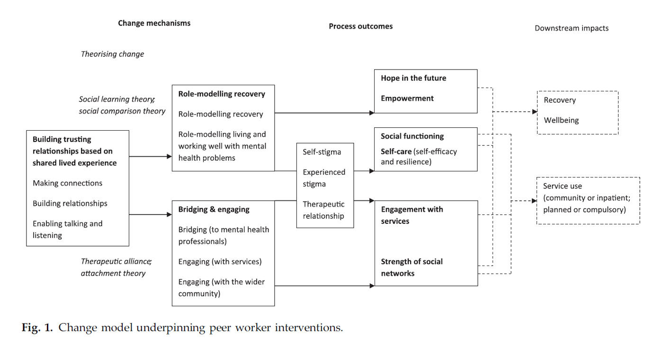
http://peersforprogress.org

Slide 4
Who better to walk alongside another than someone who has been on the journey-
“She was there for me, hands down,
no matter the time of day or night, she was there.”
-C.M.

Slide 5
Many Pathways to Recovery
Certified Peer Specialists walk alongside,
exploring opportunities and trying on new ways of living
“Peer support helped me see that I was not hopeless.
It gave me my voice back and bolstered my self-worth.” —Michelle

Slide 6
“Peer support helped me see that I was not hopeless.
It gave me my voice back and bolstered my self-worth.” —Michelle

