Slide 1
Treatment Court Coordinator Core Competencies
©NADCP
The following presentation may not be copied in whole or in part without the written permission of the author of the National Association of Drug Court Professionals. Written permission will generally be given upon request.

Slide 2
Disclosure
This project was supported by Grant No. 2016-DC-BX-K007 awarded by the Bureau of Justice Assistance. The Bureau of Justice Assistance is a component of the Department of Justice’s Office of Justice Programs, which also includes the Bureau of Justice Statistics, the National Institute of Justice, the Office of Juvenile Justice and Delinquency Prevention, the Office for Victims of Crime, and the SMART Office.
Points of views or opinions in this document are those of the author and do not necessarily represent the official position or policies of the U.S. Department of Justice.

Slide 3
Your Role
What does a Treatment Court Coordinator do?
What are the expectations of your position?
What skills are needed to do this job?
What skills do you need to develop to meet the expectations as a coordinator?
Notes:
Show by raising your hands if you have asked or been asked these questions.

Slide 4
Your Role
Notes:
Think about the coordinator role as being the repair man. The Judge is the person operating the machine and the coordinator is ensuring the machine operates correctly. If there is a problem with cog #4 (aka treatment) then the coordinator works to fix cog #4 to make sure everything is working well.

Slide 5
Core Competencies
Case flow management
Resource allocation, acquisition, budget and finance
Visioning and strategic planning
Building relationships
Program documentation
Notes:
each competency is integral in the performance of your duties, though you may not carry out all components of each competency, your expertise in these competencies is necessary in order to implement, advocate, modify and sustain your program. We will discuss each of these competencies individually.

Slide 6
Real Expectations
Change agent
Problem solver
Miracle worker
Referee
Mind reader
Glue stick

Slide 7
Understanding Client’s Needs
Notes:
It is important for the Coordinator to know the entire process from referral to graduation of the program. This section will be broken down between things to know for screening and while in the program.
The coordinator must be able to understand and convey this process to the team, stake holders, referral sources, etc.

Slide 8
You know my name, not my story. You’ve heard what I’ve done, not what I’ve been through.
Notes:
Read the slide and have the audience think about who we are being served. Too often in the criminal justice system our participants are being told not to share their story because it might cause them more trouble. For example, what is the first thing a defense attorney tells a client during normal criminal proceedings? They tell them to not speak because they might get themselves into more trouble or it might influence a plea deal. It is the same when our clients do not complete a task. We assume it is them being oppositional when in reality they might not have the skill or we have not taken the time to understand the barriers.

Slide 9
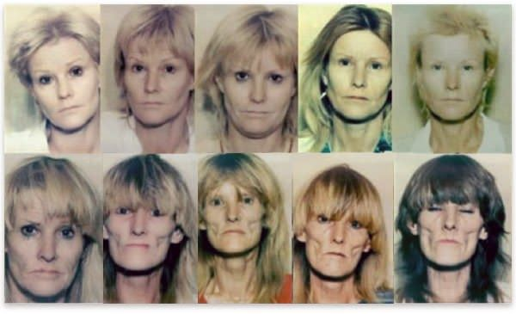
Our Clients
Notes:
We all have seen this picture of the progression of methamphetamine use over 10 years from a series of mug shots of this woman. It is easy to say she is our target population but why? What is her story and why did she progress so far in her struggle with methamphetamines?

Slide 10
Our Clients
History
Failure
Mistrust
Jail is easy
Adversarial role with courts
Notes:
It is important to remember that trust is not immediately earned with new clients, especially when their history with law enforcement, the courts, and probation probably was not positive. When we first screen our clients, they want to change but do not always believe they can change. Plus, they are constantly getting negative reinforcements to not do the program from their peers - telling them that they will be doing extra jail time, be sanctioned every week, and end up not better. So how do we combat this?

Slide 11
Meet Client Where They are At
Understand where the client is coming from
Housing
Criminal history
Treatment history
Peers/relationships
Employment history
Accomplishments/success
Notes:
This is where having a good pre-screening tool comes in handy. The first interaction with the Treatment Court Team needs to be positive and supportive. No matter what screening instrument being used, the screener needs to be non-judgmental and there to gather information to get a clear picture of who the potential client is. Since we are targeting High Risk/High Needs clients, this will not be their first interaction with the courts and probation. We need to come with the understanding that there is no reason for them to trust us as we ask personal questions about their life. So do not get offended or mirror them if they have an attitude. Chances are, they want change but have been lied to or screwed over by the system before. Remember we are the professional, and the tone of the program begins with the initial screening for the program.
One side note: the pre-screen interview should be used purely for determination of being accepted into the therapeutic program. We want the client to be honest about their current usage, living environment, lifestyle. If we use the information gathered for premise to file new probation violations or law violations – all trust will be lost and word will get around the community of this practice and volunteers for the program will dry up. Be sure to refer to your jurisdiction policy and procedures on this matter.

Slide 12
Assessment Tools_______
Legal Screening
Risk/Needs assessment – validated
Static and dynamic factors
Validated for your population
Clinical Screening
Chemical dependency evaluation– validated
SAMHSA? / ASAM?
Notes:
Part of the screening is determining the Assessment Tools used to determine if a client is high risk/high needs. Screening a client should be a team approach. It includes the prosecutor looking at the criminal history along with any mediating factors that might place the client at-risk to the community or the program. Probation/Coordinator/Case Manager should perform a risk/needs assessment to determine risk level – Just assuming that someone is High Risk/High Needs based off past experience or their criminal history is a poor way to determine eligibility. Remember…we do not want to place someone that is lower risk into a high risk group…This will only increase the risk level of the lower risk client.
We also want to have a validated clinical screening tool to determine level of treatment needed. This needs to be a validated tool – not a hodge podge of screening questions taken from different assessments. There is a reason why assessment tools are validated – because they have been proven to work.
The north star is that these two screenings are done prior to staffing the new referrals. You want to have all the information before approving the client for the program.

Slide 13
Assessment Tools_______
SHARE!!!
Notes:
All team members need to have to opportunity to share information about the client. Probation or the prosecutor might not know if the client is under investigation by law enforcement or if they might be an informant. Every team member should feel comfortable to share the information gathered.

Slide 14
Timing Matters_______
Responsivity
Needs
Criminogenic
Needs
Maintenance
Needs
Early
Middle
Late
Notes:
It is also important to meet identify the needs clients have at each stage. For example, a client entering the program will need stability along with treatment so the most important needs might be housing along with the correct dosage of treatment. You will not want to have them start a MRT class or begin working on their GED if they do not have the tools to stay sober.

Slide 15
Wrap Around Services
HOUSING
EMPLOYMENT
EDUCATION
SUPPORTS
RELATIONSHIPS
INSURANCE
TRANSPORATION
LIFE SKILLS
Notes:
It is important to look at the big picture and see the whole client. This includes looking at the client’s housing issues, relationships, employment, education, support network, and life skills. Understand how the client is meeting or not meeting these needs. Get their perspective of the situation. It is easier to get buy in from the client if they have ownership. Trying to force something on someone that feels like there is no issue only leads to conflict and frustration for both the therapeutic court team and the client.

Slide 16
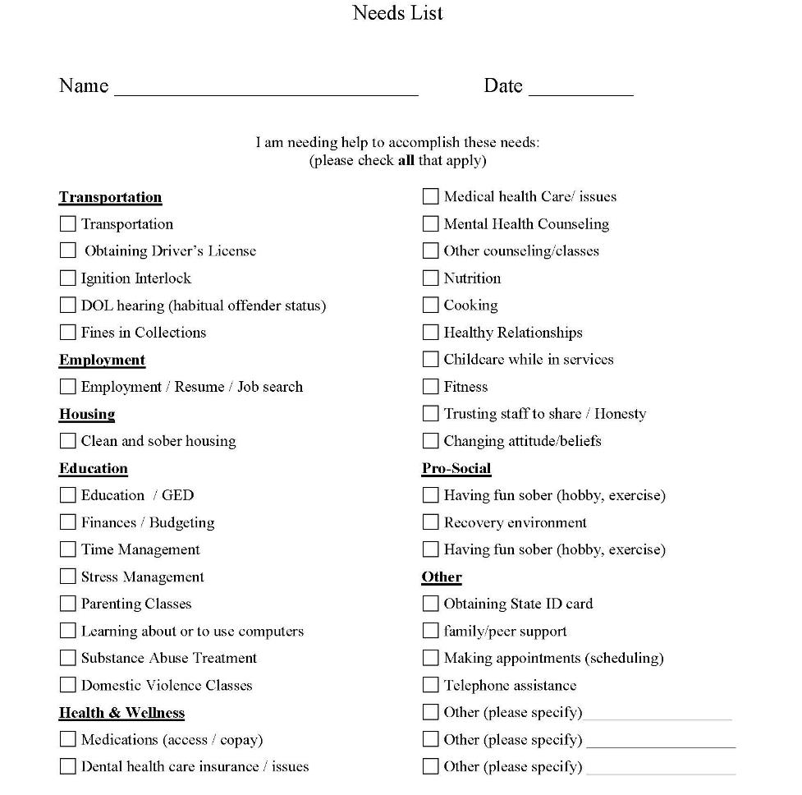
Needs List
Give Ownership to Client
Notes:
One simple activity that the client can complete is a “Needs Assessment”. This is not a validated tool, but it gives the client control at identifying which areas in their life they are successful and in which areas of their life they need assistance. This is an example of a “Needs Assessment” the client fills out at their intake with their probation officer. It gives a platform to discuss how the client is meeting those needs. The cool thing about the “Needs Assessment” is that it can be used throughout the program. It is a great contrast to see what the needs are at the beginning, middle, and end of the program.

Slide 17
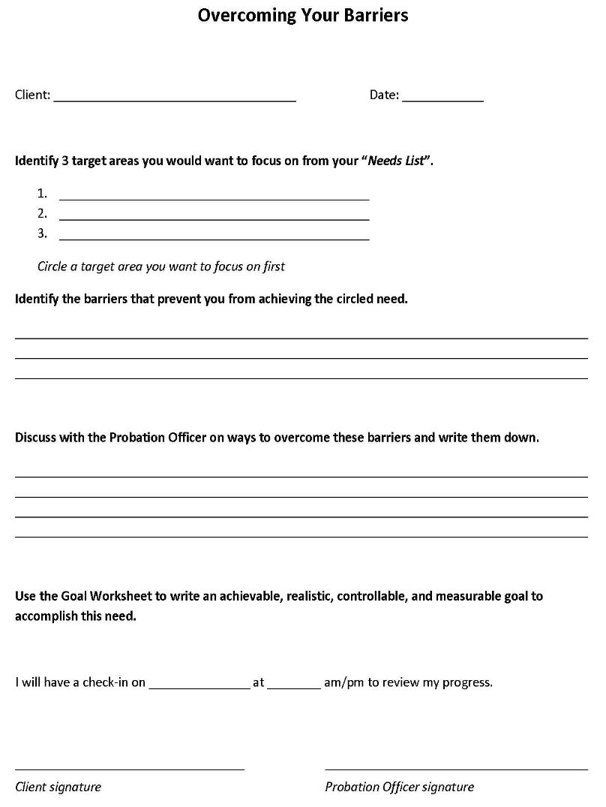
Barriers Worksheet
Housing
Transportation
Trusting Staff
K
I
S
S
eep
Do not have a sober place to stay
Bad rental history
No current job
t
Look into living at an Oxford House
Apply for housing assistance
Go to local Unemployment office to get help
with resume
imple
illy
Notes:
This is where it all starts coming together and plans are being made. First and foremost remember the KISS method {click Animation} … Keep {click animation} It {click animation} Simple {click animation} Silly {click animation}. This is not rocket science so don’t make it complicated. Remember we need to meet our clients at their level.
So John identified three areas he wants to focus on from the Needs List (Assessment). This is a good time to reference Glasser’s 5 Basic Needs and remind John the goal is to improve his quality of life and this exercise is meeting his freedom and power needs. {click animation} So John writes down Housing, Transportation, and Trusting Staff. John then circled Housing as his target barrier. {click animation}
Now that a target barrier is identified, the probation officer can guide John through the rest of the worksheet. Remember the goal is to keep it simple. {click animation} John identifies that he doesn’t have a place to stay, terrible rental history, and no job. These are big barriers that would prevent anyone from getting housing. It is good to let John know many clients in the program have struggled finding clean and sober housing in the beginning, but making a plan is what helped them be successful.
{click animation} The next section is the foundation for how John will find safe and sober housing. It will also be the objectives for our goal setting. This is where the probation officer’s expertise in community resources is necessary. If you are unfamiliar with your community resources, check with your local Department of Human Services ask the treatment case manager on the team about services. Most communities have fliers or brochures for services. If not, start building your own list and build a working relationship with these agencies to learn about their services and how they can benefit your clients. Remember we are in the business to change lives and if our clients could find the help they need on their own, they would need our programs.
Before setting a time to review progress and sign the worksheet, start the goal’s worksheet.

Slide 18
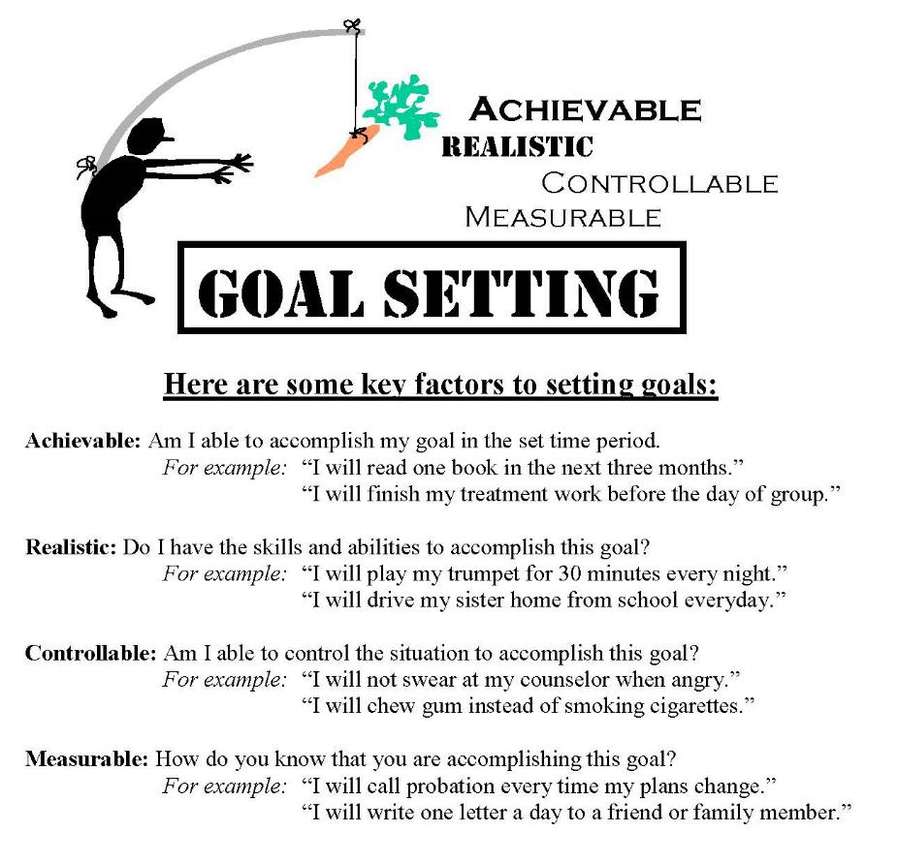
Setting Goals
Notes:
Ok…I know you are thinking another worksheet? But what we are doing with our clients is reinforcing a plan to change negative behaviors through repetition. This also reinforces the plan with the client to where they have ownership and will have better follow through.
Quick Overview on Goal Setting. Goals need to be achievable, realistic, controllable, and measurable. We want to set up our clients for success! Some simple questions to ask when setting goals are:
{click animation} Am I able to accomplish my goal in the set time period?
{click animation} Do I have the skills and abilities to accomplish this goal?
{click animation} Am I able to control the situation to accomplish this goal?
{click animation} and How do you know that you are accomplishing this goal?
If the answer is yes for each of the goal objectives, then the client is setting achievable, realistic, controllable, and measurable goals.

Slide 19
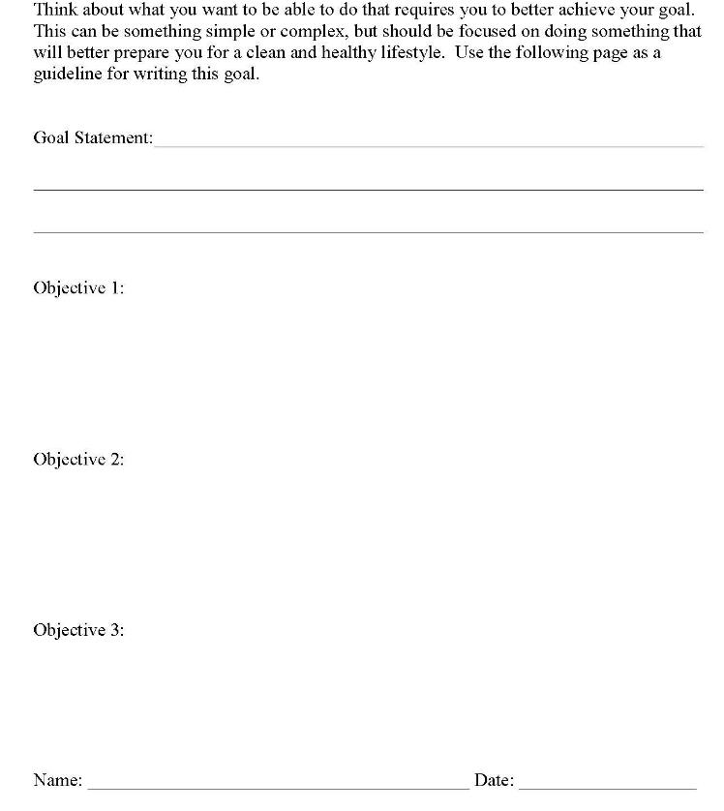
Setting Goals
Use the Overcoming Your Barriers Worksheet as your guide and fill out the Goal Statement
I will successfully find
clean and sober housing by:
Visiting 2 Oxford Houses to get my questions answered by my next court date
Go to the Housing Authority to apply for housing assistance by my next court date
Be sure to have the Client Sign the Goal Statement
Go to the work source office and get help with my resume to apply for work by my next PO report date
Share with the Team
John Doe
Notes:
The Goal Statement will be whatever the identified barrier is and in this case John identified housing as his barrier. {click animation} John’s goal statement is “I will successfully find clean and sober housing by:” It is important to write positive goals that are specific. Remember good goal setting is writing goals that are achievable, realistic, controllable, and measurable. This is done in the Objectives. {click animation}
John plans to visit 2 oxford houses to get his questions answered by the next court date. This objective passes the test because John has the ability to do this, he has the resources to call the Oxford Houses to interview them, and he has a specific date to complete it by. To take it a step further, the probation officer could have John write out his questions prior leaving the appointment. {click animation}
John also plans to go to the Housing Authority to apply for assistance. This objective passes the test because he has the ability to do it. Let’s say John has transportation issues and no bus lines run near the housing authority. If we had this objective with no plan for transportation, then we would be setting John up for failure. When reviewing the goals and objectives, if there is an issue to where it is not achievable or realistic, then the PO needs to help the client problem-solve the situation or choose a different objective. {click animation}
Objective 3 is also in John’s control by going to the work source office to get help with his resume. {click animation}
Last, but the most important is to get the client to sign the goals. This is important because it is showing ownership and commitment to complete them. So when he comes back to court or to the next PO report day and does not complete something, the ownership is on him.
So talking about not completing something. Chances are, not everything will be completed. I am always reminded of the movie “What About Bob” with Bill Murray and Richard Dreyfuss. Richard Dreyfuss is a renowned psychotherapist that writes a book titled “Baby Steps” and Bill Murray is the compulsive, needy client. Compulsive and needy sounds like a lot of our clients. Anyways, Bill Murray follows Richard Dreyfuss and his family on their family trip. Bill Murray overcomes many of his fears and anxieties by literally taking baby steps which drives Richard Dreyfuss insane. Just like our clients, they too need to take baby steps. But what happens is that as probation officers or court team members, we get frustrated and driven crazy about their inability to accomplish things. If you are getting to this point, remember change is not easy, but focusing on the successes and problem-solving the misses is key. Giving up on someone is easy and probably what our clients have experienced their whole life. This is why it is essential that if the client is unsuccessful, it is the prime time to go back to the drawing board and find out if one of the goals/objectives really wasn’t achievable, realistic, controllable, or measurable.

Slide 20
Case Management Flow
From arrest/referral point to graduation and beyond
Traditional process vs. treatment court process
Development of MIS to manage data
Continuous review: eye on efficiency and effectiveness

Slide 21
Resource Allocation, Acquisition,
Budget & Finance

Slide 22
Resource Allocation, Acquisition, Budget & Finance
Grant writing
Budget management
Purchasing
Contracting services; MOU & monitoring
Finding $$$ to keep the program functioning
Notes:
Funding – grant, legislative or local allocation, program fees, offender service dollars, staffing pattern restructure

Slide 23
Visioning & Strategic Planning

Slide 24
Visioning & Strategic Planning
Caseload projections
What are our budget needs now, next year, etc…
Recommend a future strategy, plan and/or goal
Plan for future staff turnover
Learning from others, applying it locally
Wish list
Notes:
Capacity and realistic/manageable caseload ratio
Changes/modifications that need to be made, special populations/needs to be implemented or acquired, where are we succeeding or failing and why?
List Serv / statewide info sharing – relative to your population

Slide 25
Building Relationships

Slide 26
Building Relationships
Team facilitator
Coordinating treatment provider network
Community resource knowledge-base
Interagency contact
Community outreach
Public relations and the media

Slide 27
Program Documentation

Slide 28
Program Documentation
Grant administration – progress reports
Policy & Procedure manuals
Client handbooks
Contracts / release of information
Court forms
Interagency memorandum of understanding
Program evaluation…DATA!!!
Notes:
Grants: progress and outcome measures GPRA, GAIN, Goals/Objectives – what are you reporting?
Evals: Process and Outcomes: Are we effective? Who is succeeding, who is failing, identify gaps in service provisions or needs for certain populations

Slide 29
What Skills Do I Need to Develop?
Assess your strengths
Assess what skills you need to develop
Inquire about training and education opportunities
Don’t wait for someone to guide you
Make sure that your job is do-able!!!
Notes:
Numbers person (data) or soft skills (outreach/relationships). Assess how you can balance/manage the skills in need of development – partner with another who possesses same.

Slide 30
In Conclusion…
If you are doing your job well, few will likely notice…
…until you go on vacation!!!

