Slide 1
Drug Testing 101 with CBD/THC
WATCP Coordinator Conference - October 4, 2019
Bridget Lorenz Lemberg Lab Director / Toxicologist

Slide 2
Forensic Fluids
Specializing in Oral Fluid drug testing since 2005
Extensive Drug List – Over 150 compounds
LC/MS/MS technology to confidently quantitate levels as low as 0.1 ng/mL
18 to 24 hour turn around time
Located in Michigan
We test over 2,000 samples per day

Slide 3
Drug Testing Options
Oral Fluid and Blood and Breath
Actual levels (immediate use, up to four days) *
Urine
Measures metabolites/past use (several hours after use, up to four/five days) *
Meconium
Chronic drug consumption in the last trimester of pregnancy *
Hair
Indication of chronic use only, 1.5 inches of hair = 90 days *
* Peer reviewed papers available

Slide 4
Window of Detection

Slide 5
Oral Fluid Testing
Non-invasive, easily obtained, fast collection time, no facilities needed or specialized personnel, preserves dignity
Drug concentrations in saliva are proportional to drug concentrations in plasma/blood
If observed correctly, eliminates cheating

Slide 6
Laboratory Testing
Screening Assays and LC/MS/MS Testing

Slide 7
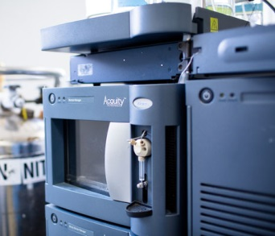
Technology
Screening
Confirmation

Slide 8
Screening
Examples:
OPIATES (Heroin/6MAM, Morphine, Codeine)
FENTANYL (Fentanyl, Norfentanyl only)
AMPHETAMINE (Adderall, Vyvanse, MDA/Adam, Phentermine/Adipex)
METHAMPHETAMINE (MDMA/Ecstasy, Methcathinone)
COCAINE (Cocaine, Benzoylecgonine, Ecgonine methyl ester, Cocaethylene)

Slide 9
Screening/False Positives
Why Is a “Screen” a Screen?
PCP – Dextromethorphan
Opiates – Hydrocodone, Oxycodone, Oxymorphone, Hydromorphone (not measured in an Opiate Screen)
Naproxen, NSAIDs – THC
Benzodiazepines – Alprazolam (normally only one detected)
Barbiturates – Phenobarbital not always measured

Slide 10
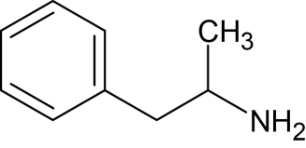
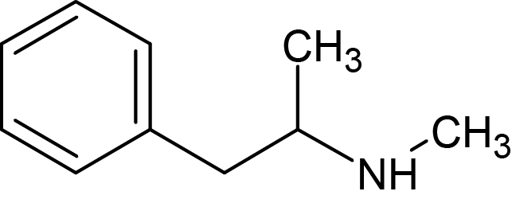
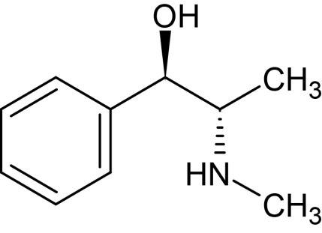
Screening/False Positives
(±)-Amphetamine
(±)-Methamphetamine
Ephedrine

Slide 11
Confirmation
What does LCMSMS mean?
Liquid Chromatography, Tandem Mass Spectrometry
It identifies drugs by their “fingerprint”
Each drug has a unique structure

Slide 12
LC/MS/MS
Liquid Chromatography/Tandem Mass Spectrometry (LC/MS/MS)
LC/MS/MS or “Confirmation testing” is analytically precise and extremely accurate, by measuring the specific molecular mass, and the concentration (amount) of any drug(s), in a sample. The testing identifies not only the parent drug but also its metabolites. Thus providing data on the exact drug and amount of drug found.

Slide 13
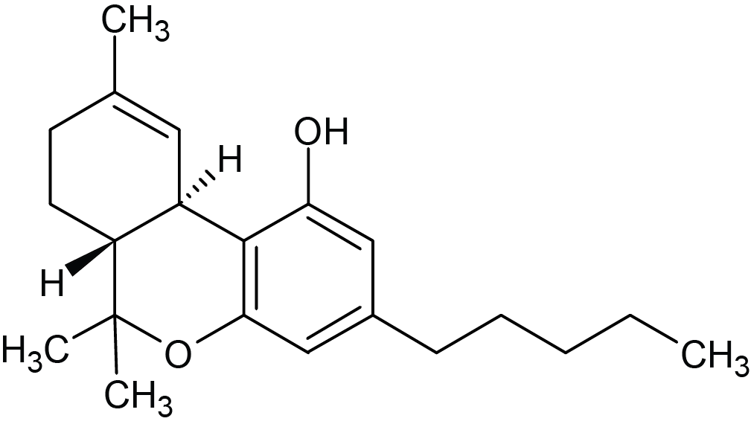
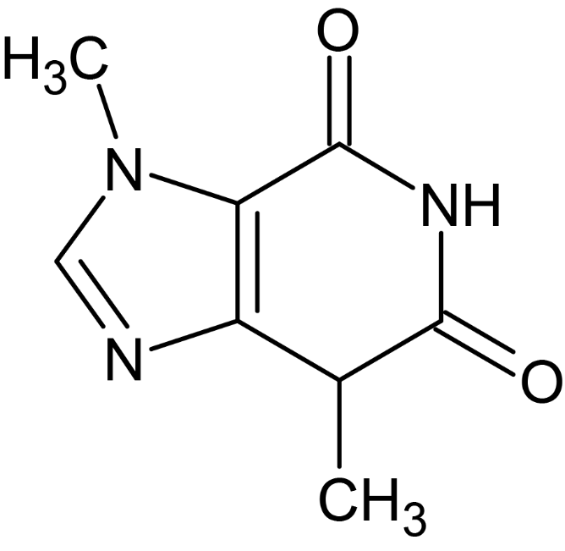
LC/MS/MS
Marijuana
Chocolate

Slide 14
Drug List

Slide 15
Drug List
Opiates
6-Acetylmorphine (Heroin)
Codeine (Tylenol 3)
Hydrocodone (Vicodin, Lortab, Lorcet, Hycodan, Norco, Xodol, Vicoprofen)
Hydromorphone (Dilaudid)
Morphine (Kadian, Oramorph, Avinza, MSIR, MS Contin, MSI, MSER)
Oxycodone (Percocet, Endocet)
Oxymorphone (Numorphan, Opana)
Fentanyl
Pentazocine (Talwin)
Meperidine (Demerol)
Propoxyphene (Darvon)
Dextromethorphan
Opiate Treatments
Naloxone (Narcan)
Naltrexone (Depade, Vivitrol)
Methadone (Dolophine)
Buprenorphine (Suboxone, Subose)
Synthetic Fentanyls
Sufentanil
Remifentanil
3-Methylfentanyl

Slide 16
Drug List
Synthetic Marijuana Compounds
JWH-018
JWH-073
JWH-210
JWH-250
AM-694
AM-2201
UR-144
XLR-11
FUB-PB-22
THJ-2201
AB-CHIMINACA
AB-FUBINACA
AB-PINACA
“Bath Salts”
PVP
MDPV
Methylone
Butylone
Mephedrone
Pyrovalerone
Ethylone
Methcathinone
Flephedrone
Methedrone

Slide 17
Drug List
Others
PCP & LSD
Psilocin (Mushrooms)
Methaqualone (Qualudes)
Salvinorin A
Bisacodyl (Dulcolax)
Phentermine (“Phen-Phen”)
Atropine
Scopolamine
Kratom and Krocodil
NBOMEs: 25I- NBOME, 25B, 25C, 25D, 25H
Tianeptine
U-47700

Slide 18
MH Drug List
Tricyclic Antidepressants
Amitriptyline (Elavil)
Desipramine (Norpramin)
Doxepin (Sinequan)
Imipramine (Tofranil)
Maprotiline (Ludiomil)
Nortriptyline (Aventyl, Pamelor)
Trimipramine (Surmontil)
SSRIs
Paroxetine (Paxil)
Citalopram (Celexa)
Sertraline (Zoloft)
Escitalopram (Lexapro)
Fluoxetine (Prozac)
Fluvoxamine (Luvox)
Benzodiazepines
Alprazolam (Xanax)
Bromazepam (Lexotan)
Chlordiazepoxide (Librium)
Clonazepam (Klonopin)
Diazepam (Valium)
Estrazolam (Doral)
Flunitrazepam (Rohypol “Roofies”)
Flurazepam (Dalman)
Lorazepam (Ativan)
Lormetazepam (Loramet)
Midazolam (Versed)
Nitrazepam (Mogadom)
Nordiazepam
Oxazepam (Serax)
Prazepam (Centrax)
Temazepam (Restoril)
Triazolam (Halcion)

Slide 19
MH Drug List
Therapeutic Drugs
Topiramate (Topomax)
Divalproex sodium/Valproic acid (Depakote)
Gabapentin (Neurontin)
Carbamazepine (Tegretol)
Bupropion (Wellbutrin)
Venlafaxine (Effexor)
Mirtazapine (Remeron)
Trazodone (Desyrel)
Buspirone (Buspar)
Propranolol (Inderal)
Benzytopine mesylate (Cogentin)
Duloxetine (Cymbalta)
Zolpidem (Ambien)
Lamotrigine (Lamictal)
Tramadol (Ultracet, Ultram)
Carisoprodol (Soma) Meprobamate
Methylphenidate (Ritalin, Concerta)
Clonidine
Strattera
Antipsychotics
Risperidone (Risperdal)
Quetiapine fumarate (Seroquel)
Aripiprazole (Abilify)
Olanzapine (Zyprexa)
Haloperidol (Haldol)
Thiothixene (Navane)
Fluphenazine (Prolixin)
Ziprasidone (Geodon)

Slide 20
Cannabinoids
Delta 9 Tetrahydrocannabinol (THC)
Cannabidiol (CBD)
Epidiolex® (FDA approved June 2018)
Cannabidivarin (CBDV)
Cannabinol (CBN)
Cannabichromene (CBC)
Cannabigerol (CBG)

Slide 21
Cannabinoids
Evidence for use in treatments
Treatment of chronic pain
Antiemetic for chemotherapy induced nausea
Improve multiple sclerosis spasticity
Children: Lennox-Gastaut Syndrome and Dravet Syndrome (Epidiolex®)
Improving sleep disturbances associated with sleep apnea

Slide 22
THC v CBD

Slide 23
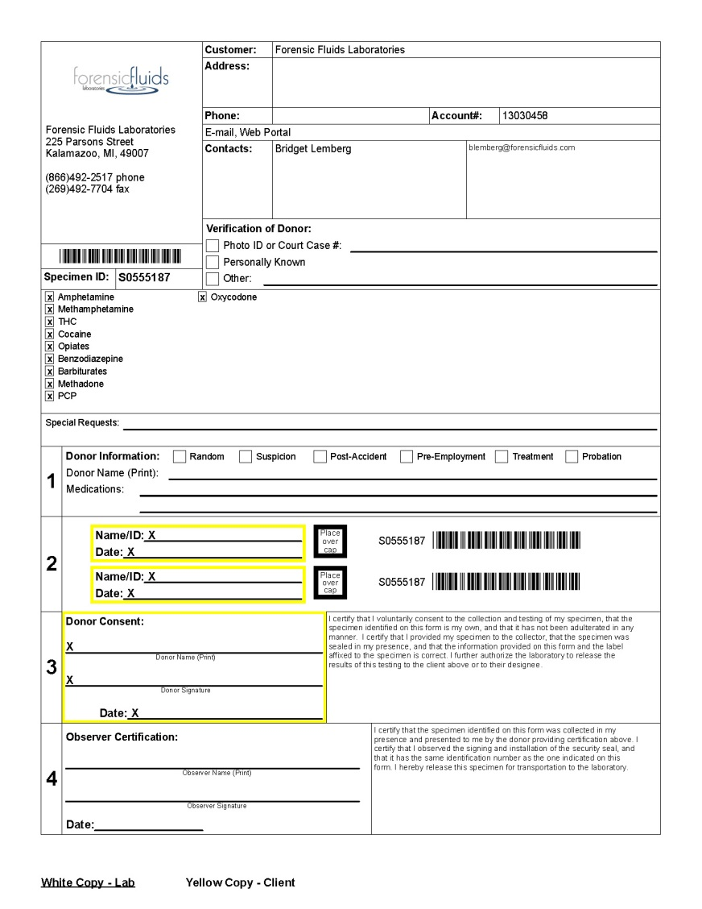
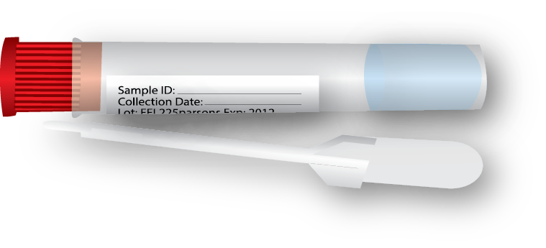
Sample Collection | Chain of Custody

Slide 24
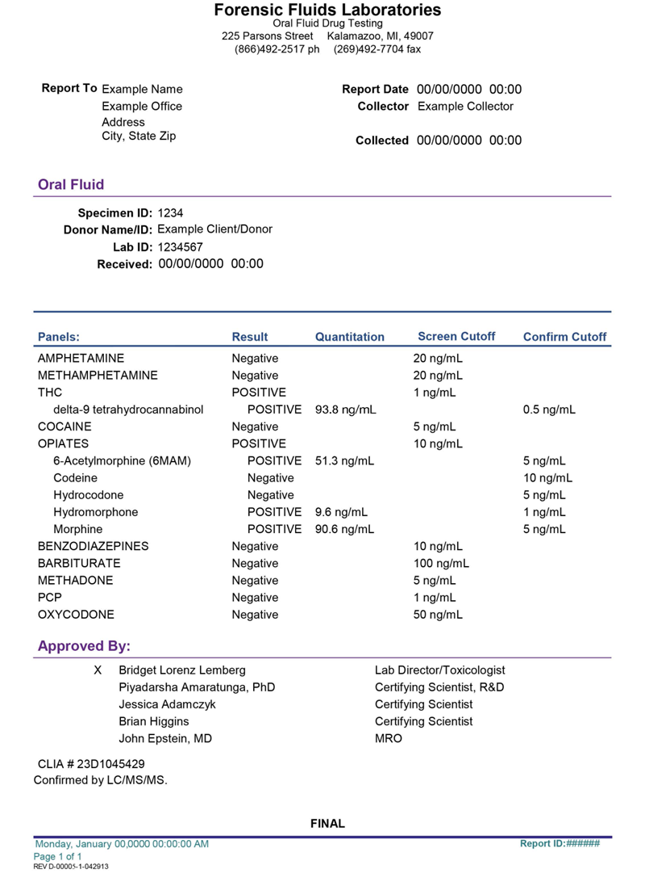
Lab Report

Slide 25
Questions?
Email blemberg@forensicfluids.com for more information

