Slide 1
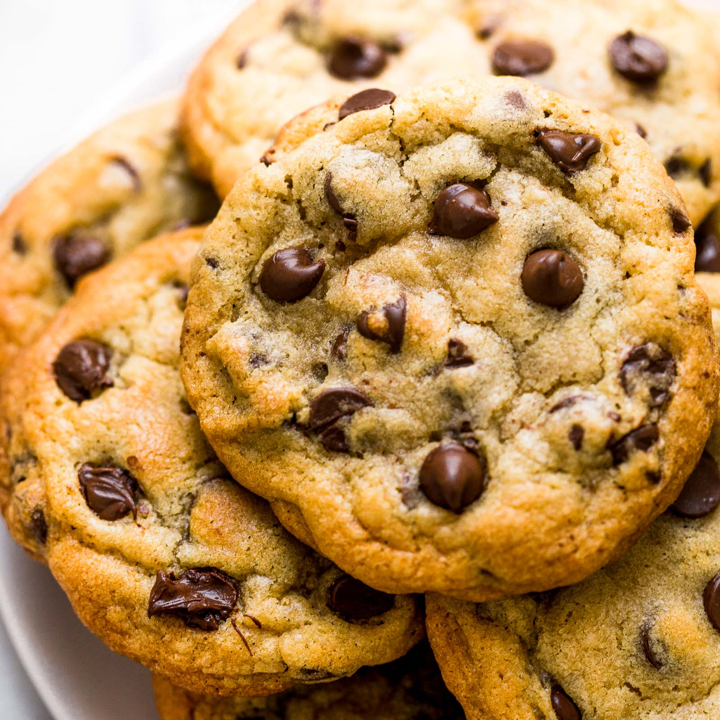
The Best Recipe
SD Problem-Solving Court Unit
Noreen Plumage – Director
Cody Westergren - Analyst

Slide 2
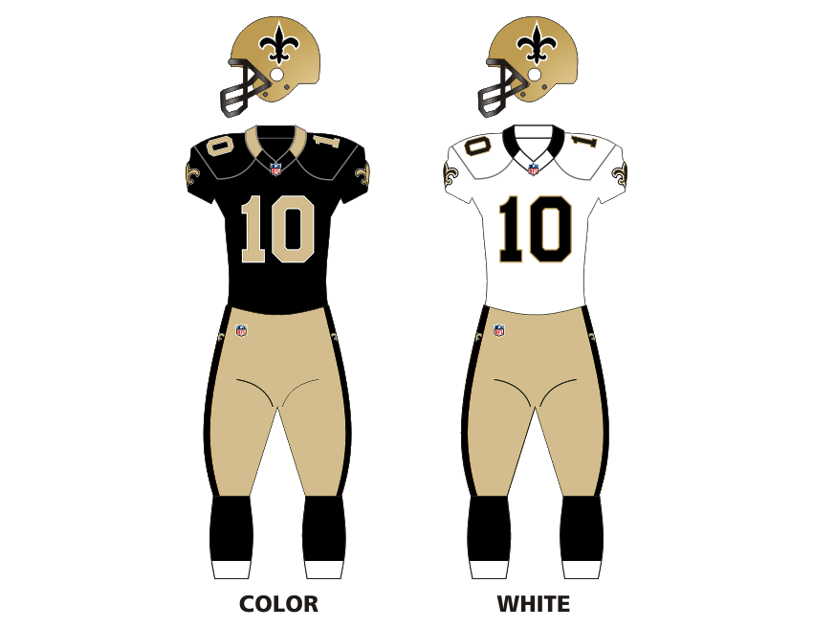
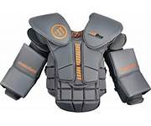
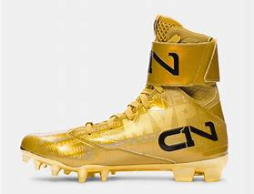
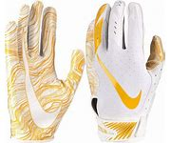
Helmet
Football
Face Guard
Chest Protection
Team Jersey
Player Number
Cleats
Mouth Guard
Pants
Thigh Pad
Gloves
Knee Pad
Sock

Slide 3
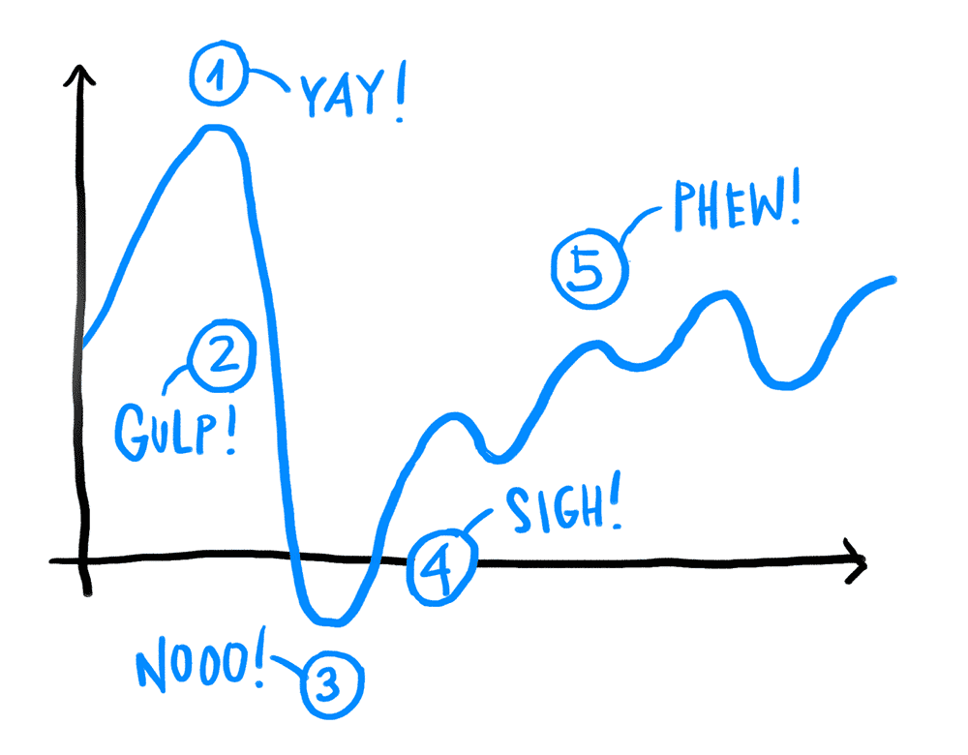
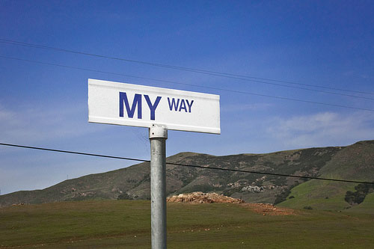
Barriers to success
PILE OF BINDERS
The LeArNiNg CuRve
I did it “MY WAY”

Slide 4
Notes:
THE PILE OF BINDERS PROBLEM
A great strength of Drug Courts is the amount of research and support materials that exist, the dozens of binders full of information and the practices of individual courts and state programs throughout the country. It is also a weakness.
Even the current Best Practices Standards Volumes, which represent the clearest, simplest compilation and distillation of the best practices, are somewhat dense and not particularly user friendly in that their recommendations must be extracted in order to be applied.
While it is certainly true that for 26 years Drug Courts have managed to work within the Ten Key Components and the binders they had and create strong programs that closely adhered to the Drug Court model, the existing tools are not optimal for efficient education and implementation. It is not necessarily simple or easy for team members to readily access, understand, apply and prioritize actions using the available tools. It’s hard. And that is a barrier to education and adherence to the model.

Slide 5
Learning Curve
Notes:
THE LEARNING CURVE PROBLEM
Drug Courts are alternative sentencing programs that represent a significant departure from the standard philosophies and practices of the criminal justice system. The learning curve for Drug Courts is steep and significant. Drug Court Teams spend roughly 2 hours a week on Drug Courts and receive approximately 30 hours of formal training before they begin performing their roles. This is not a lot of time to go from initial exposure to very new information to effective integration and application, especially when you consider that much of the training runs counter to almost all their other training and experience.
In order to be compliant with the Drug Court Model, team members must understand the significance of adherence and the consequences of failing to adhere to that model. (It is interesting to note that at the national level the importance of fidelity to the Drug Court model is so fundamental as to be seen as almost a given. While adherence to the model is viewed as extraordinarily significant, it is addressed as such within the programs and literature but is not necessarily singled out for special broadcast or emphasis. It is possible that while team members have heard about the importance of adherence to the Drug Court model frequently and in a variety of ways, that messaging may not have resulted in actual clarity about it’s importance.)

Slide 7
Best Practices Come First
Best Practices are your “Recipe Foundation”

Slide 8
IF YOUR DRUG COURT ISN’T WORKING
YOU ARE NOT DOING DRUG COURT

Slide 9
SUCCESS
Notes:
Court success is tied directly to fidelity to the Drug Court model. At this stage in the development of the South Dakota Drug Court Program it is logical to turn focus and resources to helping courts overcome the barriers to understanding the significance of and faithfully working to implement the Drug Court model. This FIDELITY FIRST strategy would prioritize adherence to the Best Practice Standards as the main focus and goal of the South Dakota State Drug Court Program, beginning with an emphasis on education and providing targeted training and tools to support implementation efforts.
If the dedicated team members and strong leaders currently building Drug Courts are clear and committed to the importance of the Drug Court model they can spend their time and energy leveraging the existing tools and research to build strong Drug Courts capable of producing strong results. They do not have to waste time and resources considering and experimenting with modified versions of Drug Courts that are untested or that have already been tested and proven to be ineffective or even harmful. (Certainly it is useful for courts to innovate and find new strategies for forwarding Drug Court goals but experimentation can and should be informed by past work and research so experimentation isn’t needlessly repetitious.)
Building a Drug Court is a large commitment and challenge. Even under the best circumstances, with the best and most dedicated people, building a Drug Court can be confusing and frustrating. It is a disservice to team members, courts, communities and Drug Court supporters to invest so significantly in anything but the Drug Court model. The proposed Fidelity First strategy makes it a priority that all team members are educated and trained to understand the importance of following the model and then works to provide support to help them implement that model efficiently within their own court.

Slide 10
No One “ACES”
Drug Court

Slide 11
Green – 100%
Red – 79% and Below
Yellow - 99%-80

Slide 12
TELL THE TRUTH

Slide 13
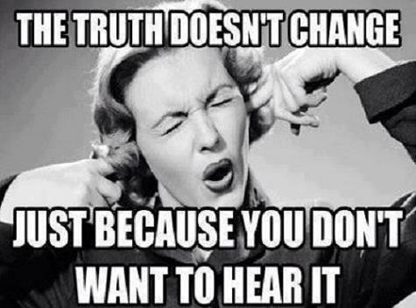

Slide 14
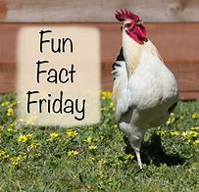
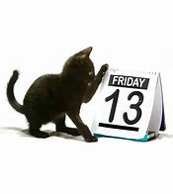
FRIDAY IS FRIDAY

Slide 15
NO MATTER THE SHADE
RED IS RED

Slide 16
= RED

Slide 17
Green – 100%
Red – 79% and Below
Yellow - 99%-80

Slide 20
Best Recipe Fidelity to the DRug Court Model
Noreen.plumage@ujs.state.sd.us
Cody.Westergren@ujs.state.sd.us

