Slide 1

What to do when everything catches up with you??
WATCP COORDINATORS CONFERENCE 2019
Hope Road
Tamra Oman, CPS, SAC
myhoperoad@gmail.com

Slide 2

WELCOME!! GLAD YOU ARE HERE!!
YOU ARE NOT HERE TO JUST FILL A SPACE OR TO BE A
BACKGROUND CHARACTER IN SOMEONE ELSES MOVIE.
NOTHING WOULD BE THE SAME IF YOU DID NOT EXIST.
EVERY PLACE YOU HAVE EVER BEEN AND EVERY PERSON
YOU HAVE SPOKEN TO WOULD BE DIFFERENT WITHOUT YOU.
WE ARE ALL CONNECTED AND WE ARE ALL AFFECTED
BY THE ACTIONS, DECISIONS, AND EXISTENCE OF THOSE AROUND US.
NEVER FORGET THIS-YOU MATTER!!!
WHAT’S YOUR PASSION?

Slide 3
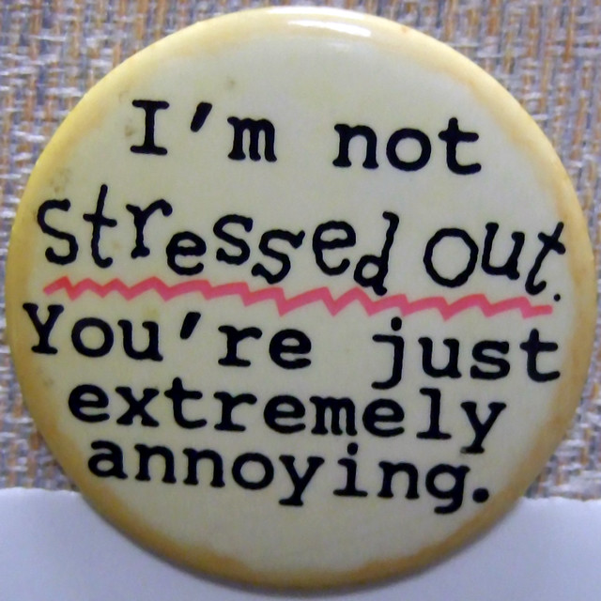

WELL HELLO !!!!

Slide 4

Monday, Tuesday, Wednesday…?

Slide 5
“DEAD HORSE WISDOM”
What kinda’ horse are you riding??

Slide 6
Wisdom says that when you discover you are riding a dead horse; the best strategy is to dismount. How we often say….
Change riders Harness several dead horses together for increased speed. Declare that “No horse is too dead to beat.” Provide additional funding to increase the horse’s performance. Declare the horse is “better, faster, and cheaper” dead. Study alternative uses for dead horses. | Say things like “This is the way we always have ridden this horse.” Appoint a committee to study the horse. Arrange to visit other sites to see how they ride dead horses. Create a training session to increase our riding ability. Promote the dead horse to a supervisory position.

Slide 7
What’s Really Going On?:
What is your favorite part of what you do?
What is most challenging or difficult part of what you do?
What makes you feel supported in your work?
What doesn’t?
Finally, what would you like it to be like?
Notes:
Have you thought about these questions at all? Take a look at the initial reflective questionnaire

Slide 8
Have you figured out…
what’s in it for you??
Notes:
Something we rarely ask ourselves

Slide 9
Where Do We Begin??
With Ourselves!
Be the change you want to see in the world- Mahatma Gandhi
Notes:
Pass out Dead Horse Wisdom- we certainly aren’t asked this on our interviews or during our annual evaluation, etc…

Slide 10
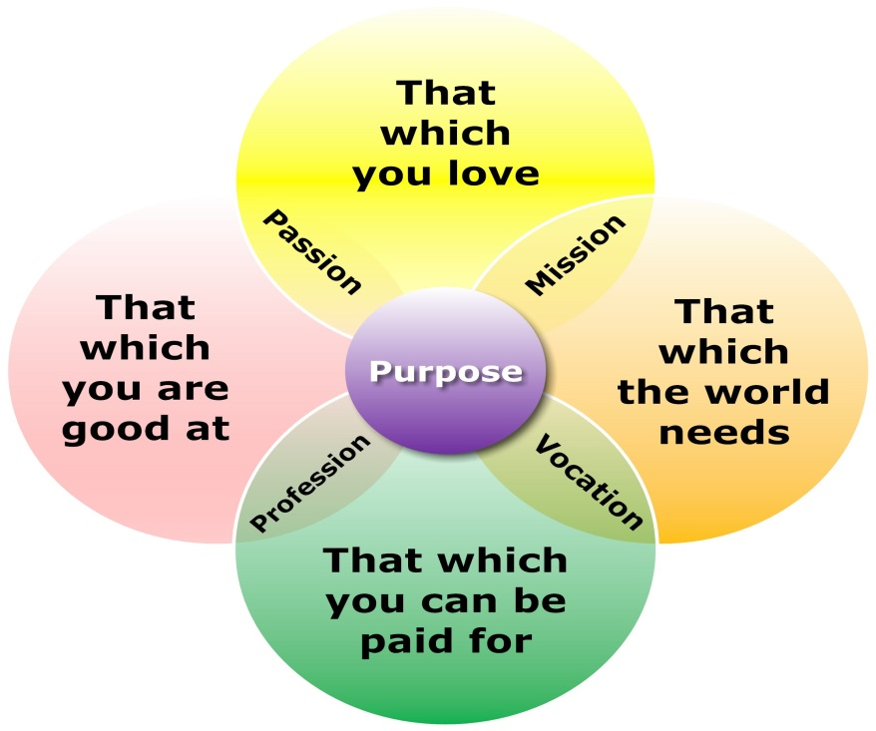
WHAT DO WE ALL WANT???
WE were born with a deep desire to love and be loved
To Fit
To FEEL LIKE WE MATTER
To find our “purpose” or what truly “moves” us
To have peace
To be happy

Slide 11
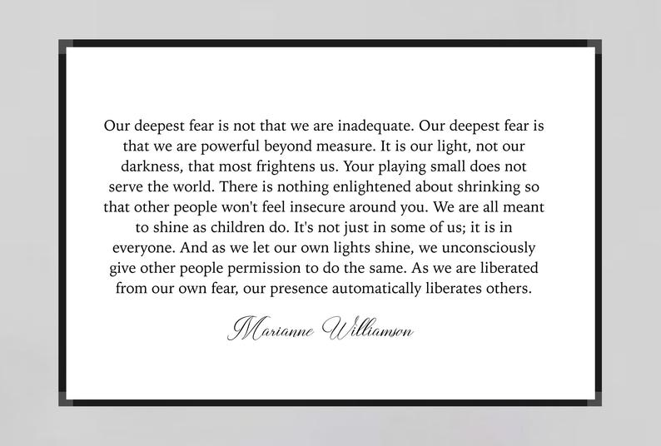


Slide 12
THE REALITY- BY THE NUMBERS
Folks who work in corrections have the highest rates of alcoholism, addiction, domestic violence, divorce, and suicide. If we make it through that we are at risk for dying 20 years earlier than those who don’t work in corrections.
Corrections officers suffer from post-traumatic stress disorder at more than double the rate of military veterans in the US, according to Caterina Spinaris, the leading professional in corrections-specific clinical research and founder of Desert Waters Correctional Outreach, a nonprofit based in Colorado.
.

Slide 13
PREVALANCE
In 2011, Spinaris did an anonymous survey of corrections officers, testing them for indications of PTSD: repeated flashbacks of traumatic incidents, hyper-vigilance, insomnia, suicidal thoughts and alienation, among others. She found that 34% of corrections officers suffer from PTSD. This compares to 14% of military veterans.
The suicide rate among corrections officers is twice as high as that of both police officers and the general public, according to a New Jersey police taskforce. An earlier national study found that corrections officers’ suicide risk was 39% higher than all other professions combined.

Slide 14
Prevalence Child Welfare Workers
50% traumatic stress symptoms in severe range (Conrad& Kellar-Guenther, 2006)
34% met the PTSD diagnostic criteria, due to secondary traumatic stress (Bride 2007)
37 % reported clinical levels of emotional distress associated with secondary traumatic stress (Cornille and Meyers,1999)
50% suffered from ‘high’ to ‘very high’ levels of compassion fatigue
(Conrad & Kellar-Guenther, 2006)

Slide 15
Prevalence
Therapists, Sexual Assault:
70% experienced vicarious trauma (Lobel, 1997)
Social Workers, Domestic Violence and Sexual Assault:
65 % had at least one symptom of secondary traumatic stress (Bride, 2007)
Hospice Nurses:
79% moderate to high rates of compassion fatigue;
83% didn't have a debriefing support after a patient's death (Abendroth & Flannery, 2006)
Immigration Judges:
Higher burnout levels than hospital physicians and prison wardens (Curtis, 2010)

Slide 16
Who’s got it?? Signs and Symptoms
Physical & psychological signs- Hyperarousal symptoms (e.g., nightmares, difficulty concentrating, being easily startled, sleep difficulties) Feeling numb Feeling unable to tolerate strong emotions Increased sensitivity to violence Cynicism Generalized despair and hopelessness, and loss of idealism Anger Disgust Fear | Manifestations & relationship signs Difficulty setting boundaries and separating work from personal life Feeling like you never have time or energy for yourself. Feeling disconnected from loved ones, Increased conflict in relationships General social withdrawal Decreased interest in activities that used to bring pleasure, enjoyment, or relaxation Irritable, intolerant, agitated, impatient, needy, and/or moody Increased dependencies or addictions involving nicotine, alcohol, food, sex, shopping , internet, and/or other substances Sexual difficulties Impulsivity
Notes:
Give examples- Easter dinner conversation….our interesting perspectives on people, actions, the ball park, how we see the world because of our work

Slide 17
What’s it look like in your work
Make decisions without adequate reflection;
Make mistakes that cost time or money, and may even put people at risk;
Take on too much work, or assignments that the team or agency is ill-prepared to complete (or complete well);
Not fulfill commitments;
Take excessive unplanned time off;
Blame others instead of seeking understanding and productive collaboration;
Devalue and/or ridicule beneficiaries, staff, managers, or donors; and
Infect colleagues with their own cynicism, depression, and/or lack of motivation.
Notes:
Give examples…what kinda’ conversations take place around you? Don’t get things done and look at others and tell yourself, well at least I did this…This program, blah, blah, blah

Slide 18
What’s it look like at home?
With your family and friends
parental over-protectiveness
loss of compassion and hope
Checked out
Don’t want to hear much from others
Can’t relate like you used to
Different “worlds”
withdrawal
overusing alcohol or drugs
lack of sleep
diminished sexuality
Notes:
Give examples- Language with family, when you go shopping, etc…

Slide 19
What’s Really Going On?:
What is your favorite part of what you do?
What is most challenging or difficult part of what you do?
What makes you feel supported in your work?
What doesn’t?
Finally, what would you like it to be like?
Notes:
Have you thought about these questions at all? Take a look at the initial reflective questionnaire

Slide 20
WHY IS ANY OF THIS IMPORTANT?
In order to create a recovery culture, or a culture most people say they want to work in- we must first be aware of ourselves:
what we want (what’s in it for me?),
what we bring to the table (our gifts, talents, passions, etc..),
and what gets in the way of our success (ideas, beliefs, or attitudes)?
Notes:
Parallel world- what we hope for or ask of for our clients- what we want from this? What our beliefs are regarding change and possibilities? CLUELESS OR BIGGIE

Slide 21
THE DREAM
ARE YOU HAPPY?
ARE YOU LIVING THE LIFE YOU WANT FOR YOURSELF?
(Family, friends, community, career?)
ARE YOU WHERE YOU WANT TO BE IN LIFE?

Slide 22

Let’s take a look at time & commitment

Slide 23
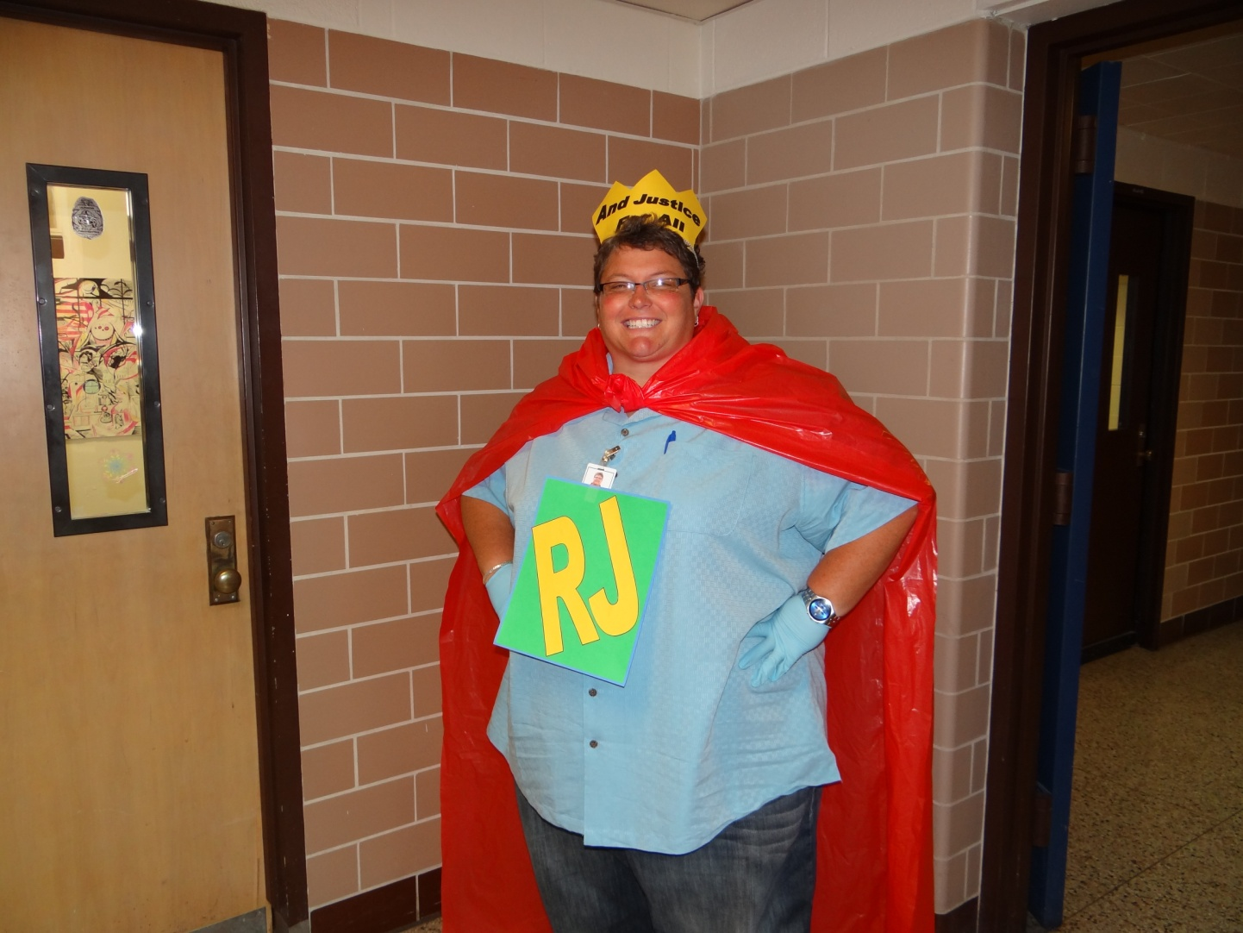
HOPE! That’s what’s in it for me

Slide 24
So now what??
THERE IS HOPE- if you think you “got it” there are things you can do to “treat it”-
You can develop a plan of action for wellness
You can renew or refresh or refuel your purpose
You can also invest in prevention

Slide 25
Where to begin The ABC's
A-Awareness
Check in with yourself regularly
How are you feeling (physically and emotionally)?
Can you figure out at least some of the reasons why you might be feeling this way?

Slide 26
B- Balance
Balancing your personal needs with the demands of your work; and
Balancing really demanding work with less challenging work
Try to Take a break daily, make sure you eat, take a walk
Make sure you take vacations or get away, go on a retreat, find a hobby

Slide 27
C- connection
Connections with other people
Other communities
People with similar interests
People and things that are important to you
“Strong relationships afford the best protection in traumatic and stressful environments… Above all factors, we seem to be dependent on the strength and nature of our relationships with one another, with the earth on which we live, and with the God who created us.“
(Fawcett, 2003, p.7)

Slide 28
OK- TIME TO TALK AND SHARE RESOURCES
WHAT HAS WORKED FOR YOU IN THE PAST? (Share with one another what you do to take care of your self, what makes you happy, what recharges you?)
What do you want to incorporate back into, or for the first time in your life?
What’s your commitment to the renewal or adding something new after our time together? (write it down and share it!)

Slide 29

We're in this together

Slide 30


Slide 31


THANK YOU FOR ALL YOU DO! THANK YOU FOR BEING YOU!!!
We think it is vital to be a part of sharing HOPE wherever we can- It might be the ONE THING that reminds people THEY MATTER!
HOPE ROAD
LEAVE A REVIEW
TAMRA OMAN
myhoperoad@gmail.com

