Slide 1
Comprehensive Community Services (CCS)
Danielle Graham-Heine, MS
Langeston Hughes
October 3, 2019

Slide 2
CCS
It is a recovery-focused integrated behavioral health program.
It provides psychosocial rehabilitation services.
It offers home- and community-based services.
Notes:
Psychosocial Rehabilitation Services that assist an individual to address ones needs
Services are home and community based

Slide 3
Psychosocial Rehabilitation: Medicaid Definition
Psychosocial rehabilitation services are services and supportive activities that assist members with mental health and/or substance abuse conditions to achieve their highest possible level of independent functioning, stability, and independence and to facilitate recovery.

Slide 4
Recovery:
Wis. Admin. Code §
DHS 36.03(23)
The process of a person's growth and improvement, despite a history of mental or substance use disorder in attitudes, values, feelings, goals, skills, and behavior and is measured by a decrease in dysfunctional symptoms and an increase in maintaining the person's highest level of health, wellness, stability, self-determination, and self-sufficiency.

Slide 5
Recovery: Substance Abuse and Mental Health Services Administration
A process of change through which individuals improve their health and wellness, live a self-directed life, and strive to reach their full potential. Four major dimensions support recovery:
Health
Home
Purpose
Community
Notes:
Home – Having a stable and safe place to live
Health – Overcoming or managing one’s disease(s) or symptoms and making informed, healthy choices that support overall well-being
Purpose – Conducting meaningful daily activities
Community – Having relationship and social networks that provide support, friendship, love and hope

Slide 6
Medical Necessity
Medical items and services that are "reasonable and necessary” for the diagnosis or treatment of illness or injury or to improve the functioning of the person.

Slide 7
CCS Promotes Recovery
Coordinated and comprehensive array of services
Person-centered planning and services
Person driven
Team approach (family and natural supports)
Individualized (no cookie cutter) services
Trauma-informed care approach

Slide 8
CCS Service Array
Screening and assessment
Service planning
Service facilitation
Diagnostic evaluation
Medication management
Physical health monitoring
Peer support
Skill development
Employment skill training
Psychoeducation
Wellness management
Psychotherapy
Substance use treatment

Slide 9
Eligibility for CCS
Across the lifespan
Mental health and/or substance use diagnosis
Severe emotional disturbance (SED)
Need more than outpatient counseling but less than an intensive wraparound program

Slide 10
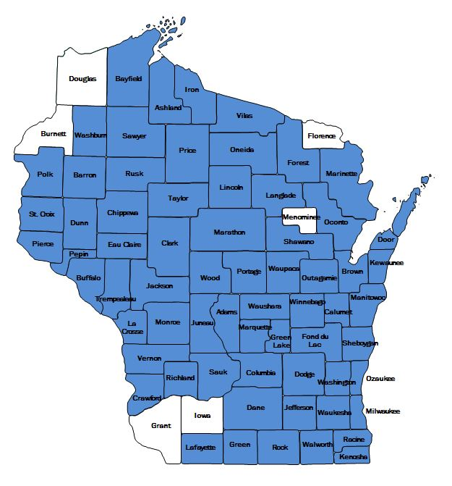
Certified CCS Counties and Tribes
Red Cliff Tribe
Lac du Flambeau Tribe
Lac Courte Oreilles Tribe

Slide 11
CCS Goals
Increase access to treatment and services
Increase programs that promote recovery
Strengthen county and tribal resources
Reduce costly inpatient services and need for crisis and emergency services

Slide 12
Contact Information
Danielle Graham-Heine, MS
CCS Coordinator
608-261-7652
danielle.grahamheine@dhs.wisconsin.gov
Langeston Hughes
CCS Coordinator
608-266-9612
langeston.hughes@dhs.wisconsin.gov

