Slide 1
Equity, Inclusion & Diversity: Importance of Data and What it Says
WATCP Coordinator Conference
Tina Freiburger, PhD and Alyssa Sheeran, MS
University of Wisconsin - Milwaukee
Notes:
Complete survey at beginning

Slide 2
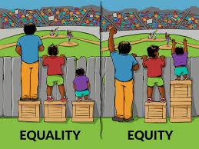
Equity
Fair treatment, access, opportunity for all
Full participation for all groups
Inclusion
Sense of belonging
Feeling of being seen, listened to, respected, valued
Being part of a community
Diversity
Numerical representation
Characteristics that make one individual or group different from one another
Notes:
Equity – improving justice & fairness within procedures/processes & distribution of resources
Diversity – what could diversity include beyond race/ethnicity? (next slide)

Slide 3
When to Consider Equity, Inclusion, and Diversity
Who gets in?
Who graduates?
Who remains successful after graduation?

Slide 4
What data do you currently collect to assess equity, inclusion, and diversity?
Notes:
Ex) race/ethnicity, gender identity, geographical location, type of substance
How do you really know you have an equity & inclusion problem if you don’t collect data or miss certain data points?
- referral data? Admittance data?

Slide 5
Importance of Data
Data helps us identify patterns
Communicate with stakeholders and the public
Identify places for improvement and enhancement
Notes:
- We think we see patterns that may not actually be there
Anecdotal evidence can resonate with us. Sometimes because it aligns with what we already believe to be true and other times it might be memorable because its something about the circumstances of the incident that makes it so. We might be strongly impacted by incidences that occur early on and then pay more attention to those that fit a similar pattern and disregard those that do not fit that pattern.
- stakeholders – obtain/support program funding; community
Helps to communicate to the community that the program exists and the particulars of the program. In addition to communicating our successes to the community and stakeholders, it also helps keep expectations reasonable. When the public hears that a program is "effective" they often have the tendency to then expect the program to work 100% of the time with 100% of the participants. That, however, is not a reality. By consistently communicating realistic expectations, we can somewhat manage these expectations.
- improvement – data allows for identifying most effective way to produce best outcomes
Things are always changing—can identify what has worked well and still works well and what worked well but no longer works so well. We have to be willing to try new things and have an objective way of assessing success

Slide 6
What data points are important to include?
Race/ethnicity
Gender
Sexual orientation
Gender identity
Age
Religion
Disability
Social economic status
Location
Transportation issues
Access to stable housing
Behavioral and physical health issues
Drug of choice
Childcare and employment responsibilities

Slide 7
When to Consider Equity, Inclusion, and Diversity
Who gets in?
Who graduates?
Who remains successful after graduation?

Slide 8
Who gets in?
Who is being screened?
Public awareness of the court
Notes:
Does everyone have access – how are you reaching to those in need? (marketing)
Who is generally making the referrals? Who are you missing?

Slide 9
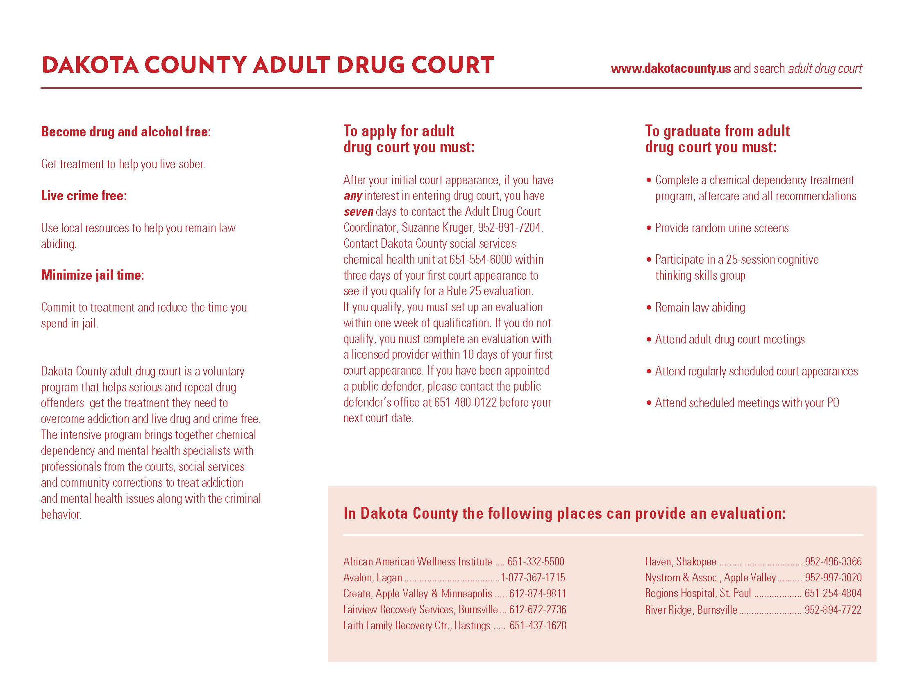

Slide 11
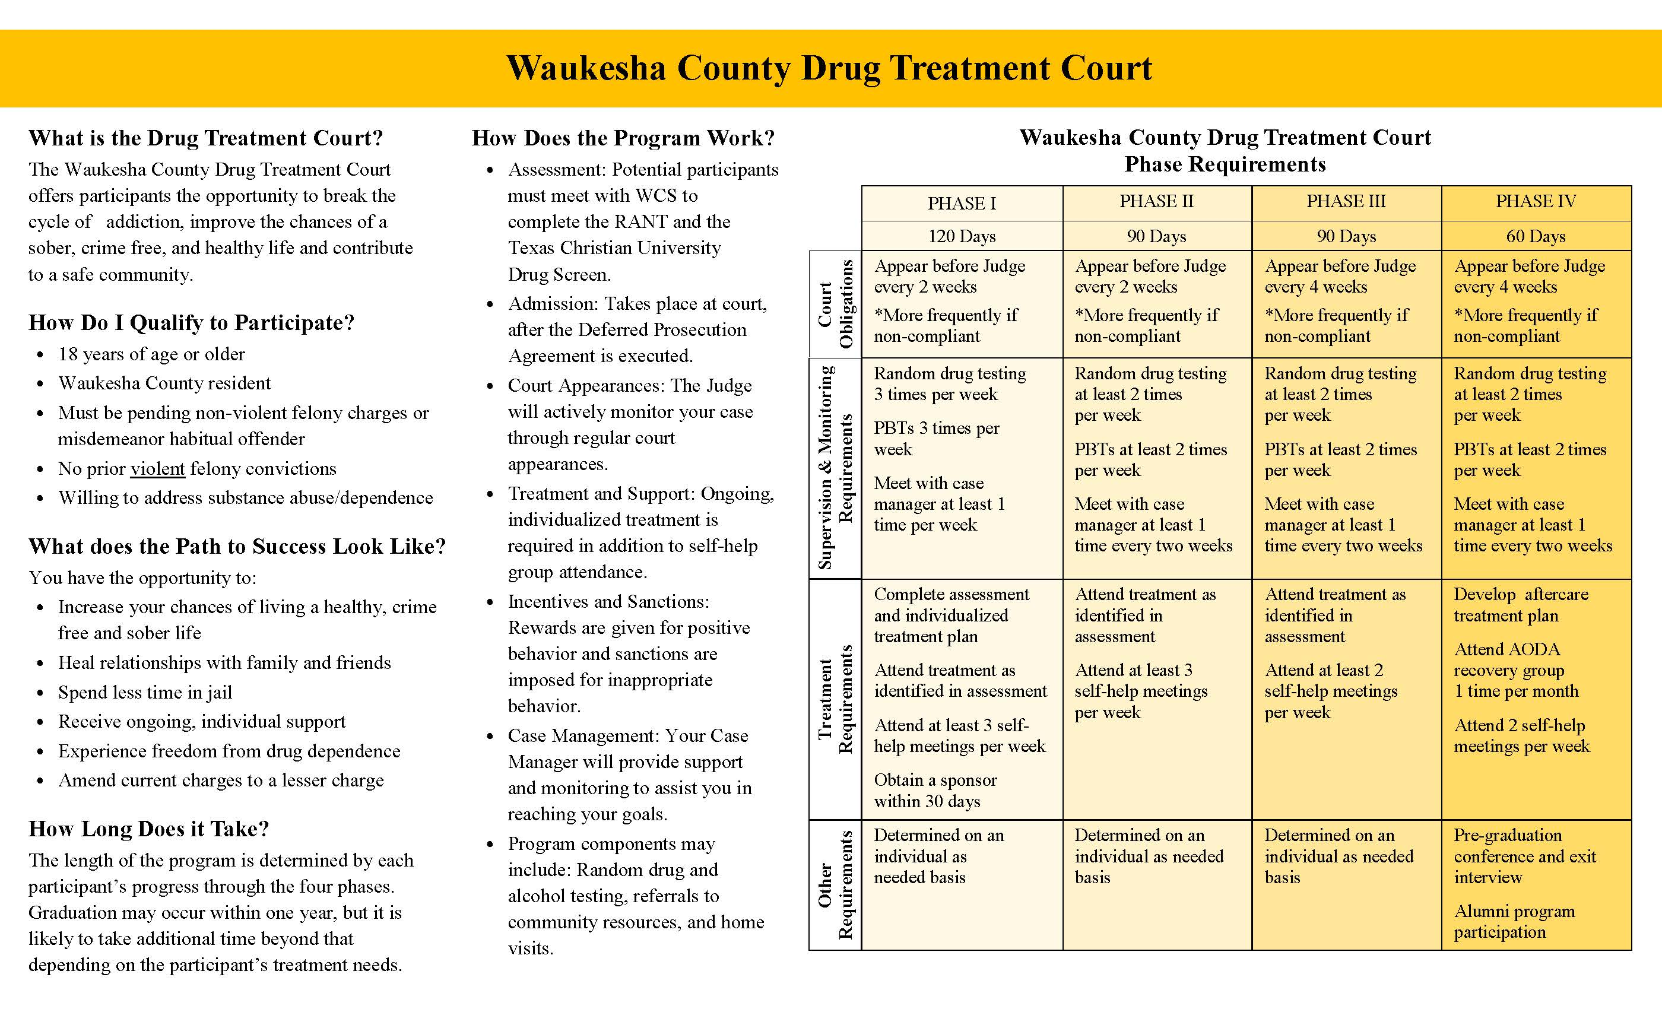

Slide 12
Who gets in?
How do we best determine need?
Often determined by comparing demographics of court participants to those in the general population

Slide 13
Census Data vs. DTC Referrals

Slide 14
Census Data vs. Arrests vs. DTC Referrals

Slide 15
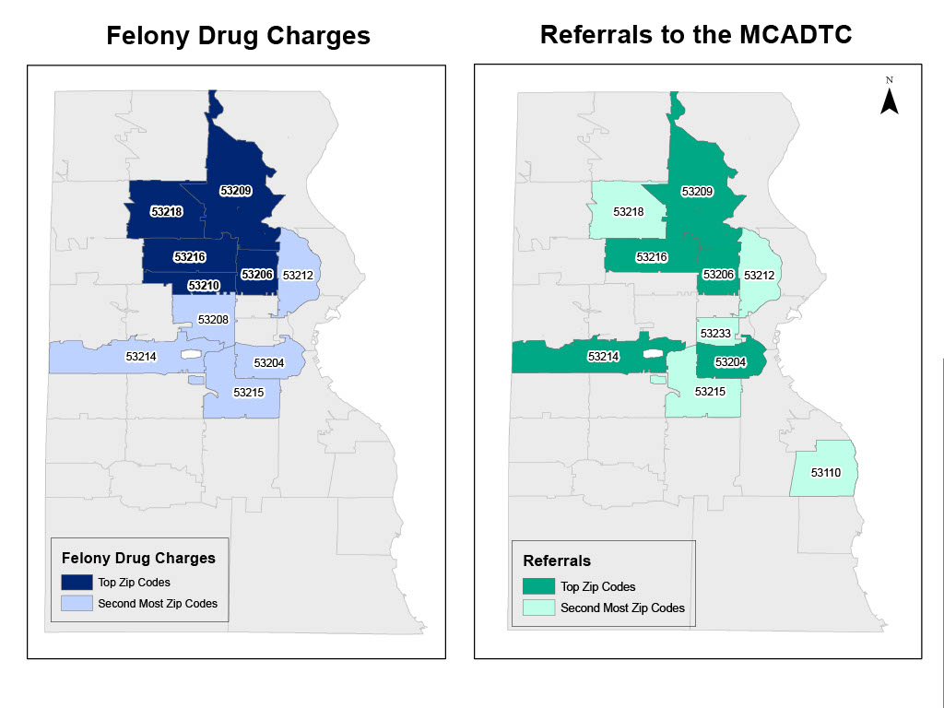
Arrests vs. Drug Court Population
Notes:
Disparities that exists among zip codes will also likely result in a racial disparity.
-- also found reason for non-admission of weapons connected too
53209 – felony drug charges (N=208); referrals (N=26); admitted (N=6; 23.1%)
-198 of 208 were Black, 2 Hispanic, 8 White
53207 – felony drug charges (N=33); referrals (N=7); admitted (N=5; 71.4%)
- 2 of 33 were Black; 7 Hispanic, 24 White

Slide 16
Notes:
After arrest/charge -- leads to referral and process begins
Let's say your court screens everyone – should you still be concerned? What else could come into play?

Slide 17
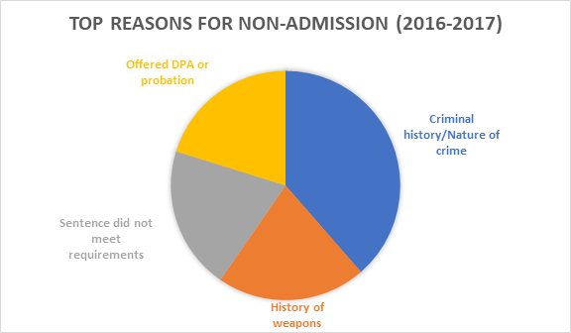
Who is excluded?
Are eligibility requirements keeping some individuals out?
Which requirements? If they are leaving people out, do they really need to be out?
Notes:
Weapons charge from years ago? Should they be excluded?
- saw this connected with previous slide on zip codes
Violent offenses
- research finds equally successful
- case-by-case basis
*Can re-examine data

Slide 18
When to Consider Equity, Inclusion, and Diversity
Who gets in?
Who graduates?
Who remains successful after graduation?
Notes:
Beyond just intake and assessment

Slide 19
Completing Court
Are their barriers that are affecting participants’ abilities to graduate?
Are there policies that impact participants' abilities to graduate?
Diversity of the team and treatment services
Drug of choice
Gender-responsive programming
Culturally competent services
Dual-diagnoses
How do we bring data into this?
Notes:
**Lacrosse example
Policies -- (MCADTC) 2016 changed amount of consecutive sobriety time required to advance phases (shortened time at beginning phases)
- changes made to be more consistent with research looking at proximal/distal goals; assumption that clients will likely struggle more at beginning of program (provides positive reinforcement at beginning to further motivate behavior change)
Diversity of team – all members of court/treatment involved in daily operations? (court, case managers, treatment providers)
- introduction of mental health provider (psychiatrist or psychologist) to help
Data --> becomes important to get participant feedback... (qualitative next slide)

Slide 20
Participant Feedback
"It was really hard to keep my job while I was in the program. If you work first shift, or even second shift, you really can’t keep up the treatment hours they want you to do and the drops that you have to do a few times a week. My boss would get really mad or annoyed that I had to leave work or come in late just to do all this stuff. It’s like you can only do third shift while your in the program and even that is really hard to do then because now you have to juggle sleeping and all your stuff for the program."
"I guess some of the programs were really repetitive and a lot of them I had heard all of the stuff before. I mean I guess sometimes its good to keep hearing that stuff but it would have been cool to maybe do something a little different. Like something out in the community that’s not going to hear the same stuff you always hear in group."
Notes:
Drug testing -- (equity) fair resources/services for all that won't inhibit their recovery
Programs – options for all participants? Gender-responsive? Appropriate for all age groups? (see a younger clientele over the years – programs geared towards that? Treatment team competent?)
- limited resources and programs (e.g., residential or transitional housing) affecting participants' ability to successfully complete program?
- all have access to MAT?

Slide 21
Factors that impact graduation
 | Referral to Admission | Significance Level | Admission to Successful Completion | Significance Level
Race
Black, non-Hispanic | 34.1% | .0222* | 46.5% | NS
White, non-Hispanic | 45.5% |  | 47.7%
Hispanic/Latino | 39.6% |  | 45.2%
Gender
Female | 45.3% | NS | 47.1% | NS
Male | 39.3% |  | 47.9%
Age
25 or under | 45.9% | NS | 22.6% | .004**
26-35 | 36.4% | NS | 51.8% | NS
35-60 | 42.9% |  | 59.5%
Failure to appear at court
Number of violations & custody sanctions
Notes:
Failure to appear in court
- Can we try to understand why participants are not appearing? (relapse and scared? Can we make them feel more comfortable to show up and be honest and, in turn, receive the help they need to succeed?)
Violations
- How can we implement other sanctions besides custody that will prove effective?

Slide 22
Other Indicators of Success, Beyond Graduation
Recovery and Support
 | Strongly Agree | Agree | Neither Agree or Disagree | Disagree | Strongly Disagree
I have family who supports my recovery. | 84% | 12% | 0% | 4% | 0%
My close friends support my recovery. | 72% | 28% | 0% | 0% | 0%
Notes:
Exit survey

Slide 23
Other Indicators of Success, Beyond Graduation
 | I do not have anyone | One person | Two People | Three People | More than Three People
How many people do you have to count on to help you when you experience cravings? | 0% | 0% | 12% | 4% | 84%
How many of those people are also in recovery? | 0% | 16% | 36% | 12% | 24%
How many people can you tell that you are about to use without feeling embarrassed? | 8% | 0% | 16% | 20% | 56%
How many people will not be disappointed if you feel like using? | 28% | 12% | 16% | 4% | 40%
How many people can you call if you are about to use? | 0% | 0% | 16% | 4% | 80%

Slide 24
Other Indicators of Success, Beyond Graduation
Housing
Employment

Slide 25
Other Indicators of Success, Beyond Graduation
"They gave me insight into my license, what I got to do to get my driver’s license back. They got access to housing and anything really, you know, transportation, wherever you’re struggling or have a problem."
"I think the program really helped me to build structure in my life and get a daily routine down."
" I think it really helped me with my mental health issues and with my relationships with my kids and family."

Slide 26
When to Consider Equity, Inclusion, and Diversity
Who gets in?
Who graduates?
Who remains successful after graduation?

Slide 27
Success after Graduation
Do certain factors contribute to continued success after graduation?
Who is not successful? Are there patterns that emerge?

Slide 28
Recidivism data
Table 1: New Charge Rates for 2016, 2017, and 2018 MCADTC Graduates
 | 6 months | 12 months
New Charge Rate | 6.3% | 11.4%
*All nine individuals were male
*Average age = 35 years
*None of these individuals received MAT during program
Notes:
Non-recidivism
- Race/ethnicity = White (60%), Black (30%), Hispanic (10%)
- Gender = Male (75.7%), Female (24.3%)
- Major drug problem = heroin (65.7%)
- MAT = 10 received (4 suboxone, 3 vivitrol, 3 methadone)
- Age = 34.25 years

Slide 29
What Other Factors Indicate “Success"?

Slide 30
Revisit your list of the data you currently collect to assess equity, inclusion, and diversity. Are there additional data points you should collect?
How could that data be collected?

Slide 31
Thank you!
Tina Freiburger, PhD
Email: freiburg@uwm.edu
Alyssa Sheeran, MS
Email: pfeiffe8@uwm.edu

Slide 32
Possible Disparities within ADTC

Slide 33
Census Data vs. Drug Court Population
Notes:
General population v. referrals*****
Populations are similar --> what problems may we still have with equity and inclusion?

Slide 34
Arrests vs. Referrals
Notes:
Public awareness of court

Slide 35
Drug Court Population vs. Arrests
Notes:
General population, arrest, referrals*******

Slide 36
What other factors indicate "success"?

