Slide 1
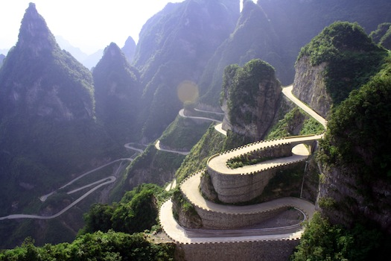
Exploring Non-traditional Pathways to Recovery
Paula Buege CPS, CPPS
Tamra Oman CPS, SAC

Slide 2
MAKE AN IMPACT

Slide 3
WELCOME
THANK YOU FOR ALL YOU DO!!!
What do you hope to get out of our time together?

Slide 4
Objectives
Identify the goal (s) of Treatment Courts
Discuss Ideas and SAMSHA’s Definition of Recovery
Explore Possibilities and Opportunities
Increase knowledge and capacity to improve outcomes for Treatment Court participants

Slide 5
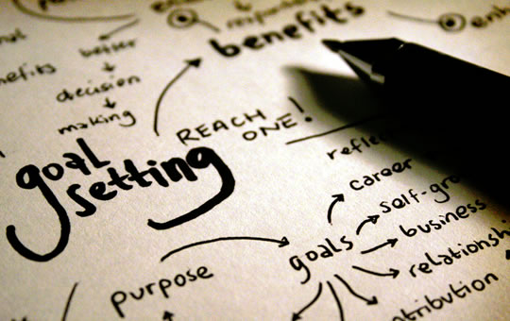
GOALS
What are the goals of treatment courts?
What are the goals of the participants?
Where might they be the same and where might they differ?
Exploring how our beliefs define potential

Slide 6
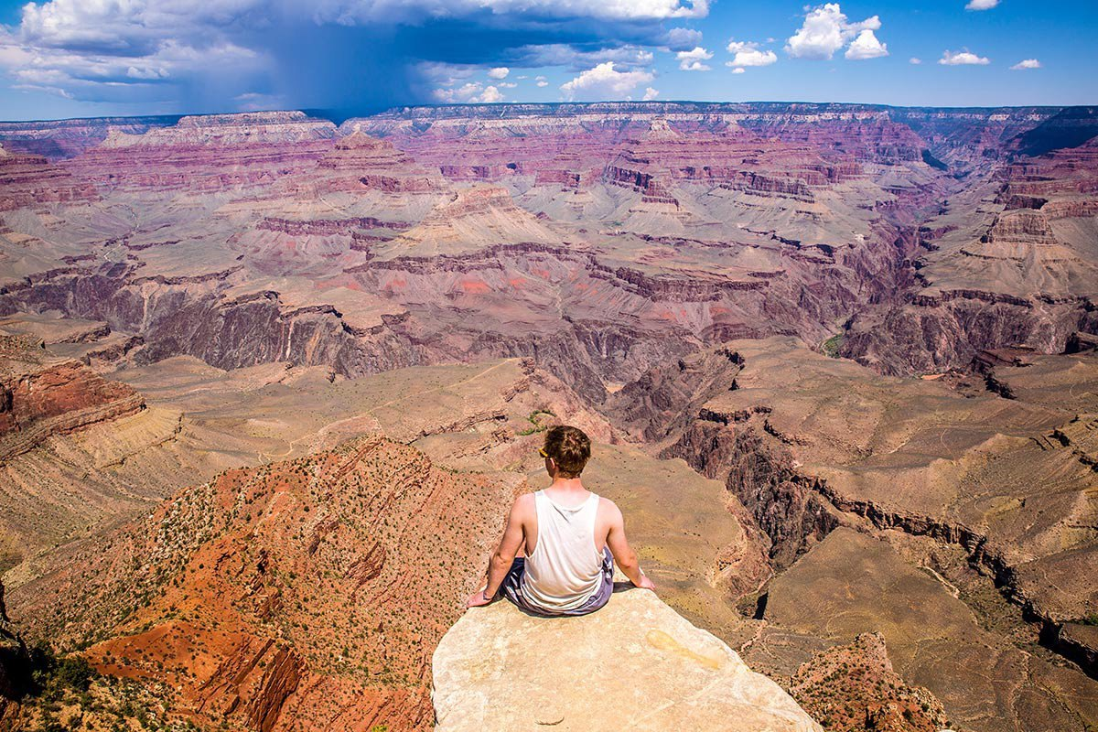
GRAND CANYON EXERCISE You are asked to cross the grand canyon, you are alone and have a broken leg and if you don’t go or get there, you lose what you love the most! GO!!
What are your fears? What is keeping you from taking the first step?
What are the options to get there?
What tools and equipment do you need?
How are you going to do it?

Slide 7
DEFINTION OF RECOVERY
How do you define recovery?
How do folks in your care define recovery?
Is there a place where you can find common ground?

Slide 8
SAMSHA’S DEFINTION OF RECOVERY
Recovery is a process of change through which people improve their health and wellness, live self-directed lives, and strive to reach their full potential. ... Health—overcoming or managing one's disease(s) or symptoms and making informed, healthy choices that support physical and emotional well-being

Slide 9
SAME GOAL, PARALLEL WORLDS DEFICITS OR STRENGTHS?
Enabling
Behaviors
Drug seeking
Unmotivated
Non-compliant
Supporting
Coping Skills
Persevering
Doing what you know
Committed to beliefs

Slide 10
THINKING OUTSIDE THE BOX
When we replace the “I” from Illness with “we” we now have WELLNESS
How do we shift from a “sickness/illness” perspective into a “wellness” perspective? Building on strengths…
Think of time when you wanted to change something- what increased your chances for success?
What or who did you need to walk with you while you made these changes?
What was most helpful to you?
No one could do it for you; what did they do with you?

Slide 11
What are the many pathways to recovery?
There are as many as there are individuals
It’s personal
There is ‘no one size fits all’
How do we explore these pathways with people we are serving?
How might we meet with them to explore the ideas for their recovery and wellness journey?

Slide 12
The traditional path has been:
Based on the medical model
This is the path to recover (abstinence- if not it’s treatment or incarceration)
If you don’t do it “this way” it’s wrong or you won’t get there
We must impose consequences to increase the likelihood of success and accountability!

Slide 13
Shifting to a recovery model:
Meeting people where they are at
Ask them what they want- support them in developing a plan to move towards that
Explore transferable skills
Use a strength-based approach, what has worked in the past, build on that

Slide 14
How’d we get here? People supported us by doing:
Honoring my experiences and right to choose
Helping me understand I am in charge of my decisions and outcomes
Asking me what happened, not what’s wrong with me
Celebrating my resilience
Reminding me of my strengths
Believing in me when I couldn’t believe in myself
Exploring with me my purpose and social responsibility to myself and others

Slide 15
How’d we get here, continued
Creating a safe space to be honest
Being transparent about expectations
Offering space to learn from the times I fell
Open to continue working with me as I make mistakes and continue learning and growing
Not giving up on me

Slide 16
What might that look like:
AA, NA, Smart Recovery, Support Groups
Religion/Spirituality
Abstinence, Harm Reduction
Counseling, Therapy, Treatment
Homeopathic/Holistic (incl CBD oil, supplements, nutrition)
Mindfulness, Meditation, Yoga, Tai Chi
Medication/MAT
School/Education
Advocacy (changing systems- purpose for the pain)
Book Clubs
Recreation/Leisure
Cooking/Baking
Gardening
Physical wellness (running, gym/working out)
Art/Music/Expressive Art/Dance
Social Capital- Involvement in Community

