Slide 1
Constitutional Issues in Drug Courts
Monica Christofferson
Associate Director, Technical Assistance

Slide 2
Notes:
The Center for Court Innovation seeks to help create a more effective and humane justice system through:

Slide 3
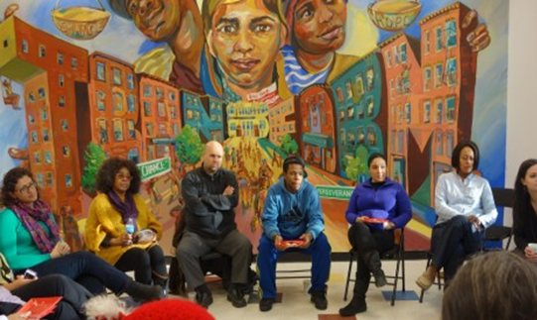
Operating Programs
Our operating projects are comprised of dozens of different court based, community based, and other programs. These programs serve thousands of New Yorkers and we learn many lessons from their work
Notes:
Our operating projects are comprised of dozens of different court based, community based, and other programs. They are community courts, youth justice programs, and, re-entry programs, all over the NYC and NJ areas. Some examples are the Midtown Community Court, which was the first community court in the country, and the Red Hook Community Justice Center. These programs serve thousands of New Yorkers and we learn many lessons from their work. Mention ability to host site visits.

Slide 4
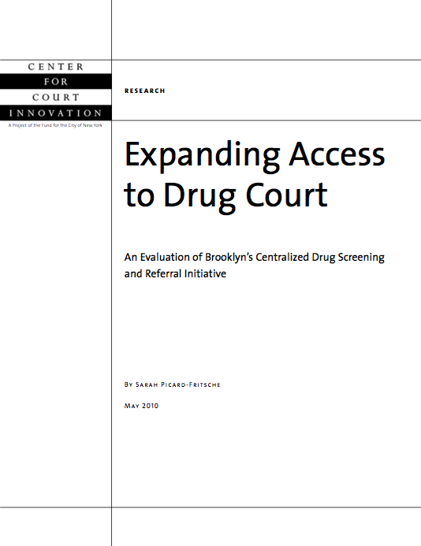
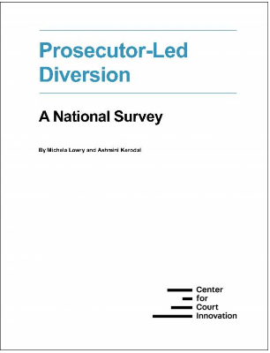
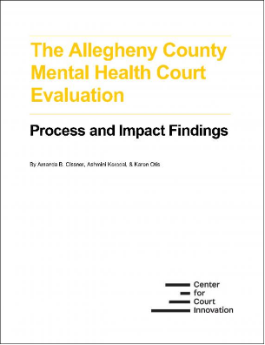
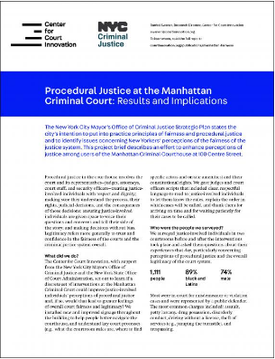
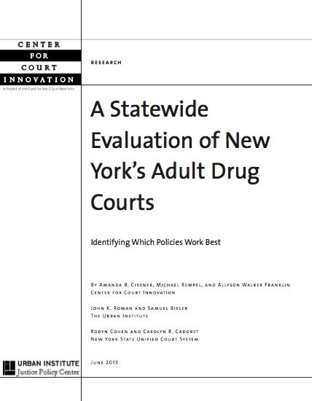
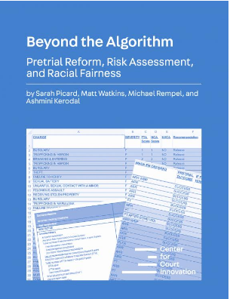
Research
The Center has a prolific research department that has conducts original research to improve the criminal justice system.
Notes:
We
conduct national field-based research on a wide variety of
subject matters as well as working closely with the state of New
York to evaluate our operating programs.

Slide 5
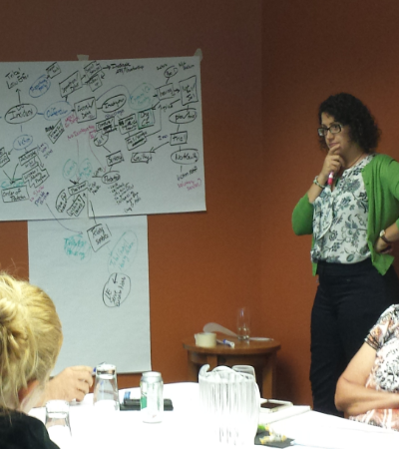
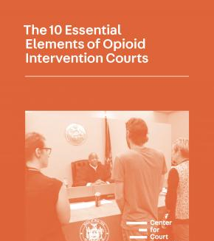
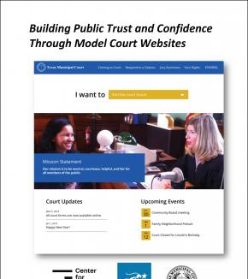
Expert Assistance
BJA’s statewide treatment court TTA provider
Implementation and enhancement of treatment courts
Provide TTA around the country for community courts, treatment courts, tribal justice, prosecutor-led diversion, and other problem-solving justice initiatives
Notes:
Recently worked with the Wisconsin Office of Court Operations to conduct a statewide strategic plan for problem-solving courts

Slide 6
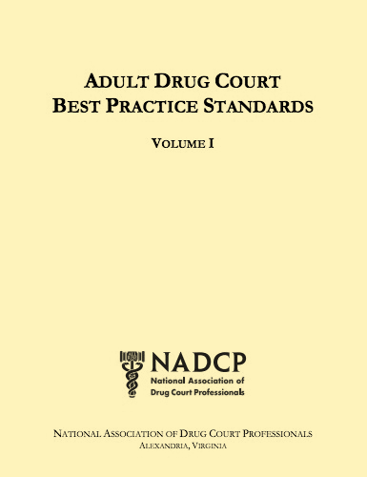
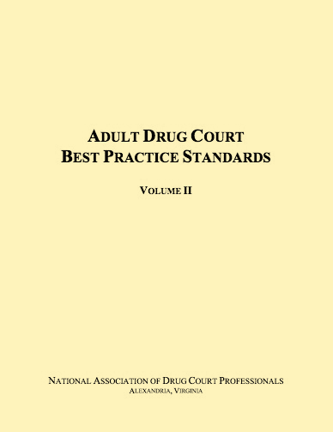
Constitutional vs. Recommended
25+ years of research
Adult Drug Court Best Practice Standards
Notes:
Example: A drug court can, arguably, refuse to allow participants to use MAT, according to case law. But, it’s a bad practice.
During this you will learn the lowest bar of ensuring constitutional protections but that should not be where the bar is for your DTC

Slide 7
1. Eligibility

Slide 8
Eligibility Considerations
Practical considerations
Current charge and criminal history
Criminogenic risk-need profile (usually HR/HN)
Availability of appropriate treatment services
Drug court’s overall capacity
Legal considerations
Equal protection
Notes:
As I just mentioned, constitutional challenges to eligibility is obviously not the only criteria you want to consider

Slide 9
Equal Protection
14th Amendment EP clause: requires states to treat similarly situated persons in like manner.
Courts use three tests:
Strict scrutiny: used when there’s a “fundamental right” or a “suspect class” at issue (race, religion, national origin, alienage)
Intermediate scrutiny: used when there is a “semi-suspect” class at issue (gender)
Rational basis: all other cases
Notes:
Equal Protection: nor deny to any person within its jurisdiction the equal protection of the laws.
Strict scrutiny: If there is a “fundamental right” (right to migrate between states, the right to vote, the right to marry, and the right to secure access to the justice system) or a “suspect class” (race, religinion, national origin, alienage) at issue scrutiny standard of review will apply. Under strict scrutiny review, the government must show that the law or practice serves a compelling state interest and is narrowly tailored to serve that interest.
Intermediate scrutiny: Used when there is a semi-suspect class (gender). Under intermediate scrutiny review, the government must show that the law or practice furthers an important state interest by means that are substantially related to that interest.
Rational Basis: Rationally related to a legitimate government interest

Slide 10
Is there a “fundamental right” to participate in drug court?
No fundamental right
Lomont v. State, 852 N.E.2d 1002 (Ind. Ct. App. 2006)
Likewise, drug offenders are not a suspect class
Therefore, courts use the “rational basis” test in EQ cases re: drug court eligibility
Notes:
A jurisdiction deciding not to fund a DTC is also not a violation since there is no fundamental right to participate in a DTC
Lomont- DUI- received a plea in which he was to participate in a drug diversion program- county didn’t have one- alleged that the lack of a diversion program violated his constitutional rights his argument was that different punishments were given to individuals who committed the same crime based simple on the availability of a diversion program in their county- was treated no different than drug offenders similarly situated in that county.

Slide 11
Equal Protection
Moreover, a jurisdiction has no obligation to open a drug court.
State v. Harner, 103 P.3d 738 (Wash. 2004) (decision not to create a drug court because of budgetary consideration was rational)
Notes:
A jurisdiction deciding not to fund a DTC is also not a violation since there is no fundamental right to participate in a DTC

Slide 12
Exception: Burdening a Suspect Class
If drug court eligibility policies/practices disproportionately burden a suspect class.
Obviously, categorical exclusions of a suspect class (e.g., based on race) are not permissible.
Issue is policies/practices that have the unintended effect of excluding a suspect class.
E.g., Policy excluding pregnant individuals disparate impact on women intermediate scrutiny
Notes:
The U.S. Supreme Court has held that discriminatory impact of a law or practice does not, by itself, make the law or practice unconstitutional. Proof of discriminatory intent is required to show a violation of the Equal Protection Clause
Village of Arlington Heights v. Metro. Hous. Dev. Corp., 429 U.S. 252 (1976) (holding that “[p]roof of racially discriminatory intent or purpose is required to show a violation of the Equal Protection Clause”); Washington v. Davis, 426 U.S. 229, 96 S. Ct. 2040 (1976)(“A rule that a statute designed to serve neutral ends is nevertheless invalid, absent compelling justification, if in practice it benefits or burdens one race more than another would be far reaching and would raise serious questions about, and perhaps invalidate, a whole range of tax, welfare, public service, regulatory, and licensing statutes that may be more burdensome to the poor and to the average black than to the more affluent white”); United States v. Armstrong, 517 U.S. 456 (1996). See also, Oyler v. Boles, 368 U.S. 448 (1962) (finding that the “conscious exercise of some selectivity in enforcement is not in itself a federal constitutional violation” but that equal protection prohibits prosecutors from deliberately basing their decision to prosecute on "an unjustifiable standard such as race, religion, or other arbitrary classification,").

Slide 13
Exception: Burdening a Suspect Class
Bottom line: look carefully to ensure that your eligibility policies/practices are not disproportionately excluding members of a suspect class
Notes:
This is an affirmative burden on the court system

Slide 14
Equal Protection and Alienage
“Alienage” refers to a person’s status as a non-citizen of the U.S.
Alienage is a suspect class strict scrutiny
Therefore, a ban on non-citizens entering drug court would be impermissible.
BUT…what about illegal aliens?
NOT a suspect class rational basis review
Notes:
Relying on US v. Carolene Producs and Graham v. Richardson that set the basis- In Bernal v. Fainter, the U.S. Supreme Court explicitly held that “a state law that discriminates on the basis of alienage can be sustained only if it can withstand strict judicial scrutiny.”

Slide 15
So can drug courts exclude illegal aliens?
Yes, if there is a legitimate government purpose for excluding
Likelihood of deportation
People v. Espinoza, 132 Cal. Rptr. 2d 670 (Cal. Ct. App. 2003) (upholding exclusion where the substantial likelihood of the defendant’s deportation would prevent him from completing the program)
Notes:
Plyler v. United States, the U.S. Supreme Court held, “[w]e reject the claim that ‘illegal aliens’ are a ‘suspect class.’ No case in which we have attempted to define a suspect class . . . has addressed the status of persons unlawfully in our country
The main focus on that decision was whether he could complete the terms of probation- aka drug treatment. Because the “primary purpose and condition of that probation-- that the defendant obtain drug treatment--cannot be effectively achieved” they affirmed the lower court decision.

Slide 16
Equal Protection and Indigence
Can a drug court exclude a person on the grounds that they cannot afford to pay fines/fees?
Indigence is not a suspect class
BUT, excluding a person from an alternative-to-incarceration program on the basis of inability to pay violates equal protection
State v. Shelton, 512 S.E.2d 568 (1998) (finding a violation of equal protection when defendant was denied home detention because he could not afford a monitor and was therefore remanded to jail).
Notes:
The U.S. Supreme Court, in Williams v. Illinois, held that “the Equal Protection Clause of the Fourteenth Amendment requires that the statutory ceiling placed on imprisonment for any substantive offense be the same for all defendants irrespective of their economic status
State v. Shelton- arrested for driving his tractor while intoxicated
If you prove the inability to pay- If you have found they have the ability to pay and have not/will not that is different
People v. Trask, Court of Appeals Third District of CA 201- cannot terminate from drug court program due to inability to pay
D was found eligible and enrolled in diversion program- the specific diversion program ordered had intake and monthly fees- D couldn’t pay and no programs could help- terminated her and sentenced her to 3 years
“Will not allow the statute to be construed to provide an additional grounds for termination of diversion-- the inability to pay fees.”

Slide 17
Equal Protection and Health Conditions
Can a drug court exclude a person on the basis of their physical or mental health condition
Health condition is not a suspect class
So, drug courts can exclude if there is a legitimate government purpose
Evans v. State, 667 S.E.2d 183 (Ga. Ct. App. 2008) (finding no equal protection violation where exclusion was based on the program’s lack of resources to handle “serious mental health issues” as well as the program’s lack of access to HIV-related resources).
Notes:
Although DTC should be serving high risk/high need there is the practical reality that there may not be the resources and supervision necessary for an individual.
Happens a lot with mental health due to limited resources

Slide 18
What about the Americans With Disabilities Act?
It is unclear whether the ADA applies.
ADA has 3 major requirements:
Physical or mental impairment (substance use disorders and emotional illness qualify)
Impairment must substantially limit a major life activity (caring for oneself, manual tasks, walking, seeing, hearing, speaking, breathing, learning, working)
Qualified individual (otherwise eligible for the government service being offered)

Slide 19
What about the Americans With Disabilities Act?
It seems like a defendant with a substance use disorder who can’t work because of their addiction would be eligible, right?
Maybe
Hard to show a substantial impairment of a major life activity. E.g., Evans v. State,667 S.E.2d 183 (Ga. Ct. App. 2008) (mental illness and HIV-positive status did not affect a major life activity)
Also, there’s some suggestion that the ADA may not apply to criminal sentencing matters. State v. Barclay, 2017 Iowa App. LEXIS 43 (Iowa Ct. App. 2017)
Notes:
ADA: State v. Barclay, ___ N.W. 2d ___ (Iowa Court of Appeals 1/11/2017) (Defendant asserts he was denied access to drug court because of his mental health disability—a violation of the Americans with Disabilities Act-ADA. The court doubted whether the ADA provides rights at sentencing and held that Barclay had not proven his mental illness hampered a major life activity. The court also noted Barclay had not properly preserved his equal protection argument.)

Slide 20
Prescription Drugs
Can a drug court exclude a person on the basis of their use of lawfully-prescribed medications (e.g., oxycodone for chronic pain)?
Use of prescription drugs is not a suspect class
So, drug courts can exclude if there is a legitimate government purpose.
People v. Webb, 2011 Cal. App. Unpub. LEXIS 1896 (2011) (upholding exclusion from drug court, in part, because of defendant’s inability to focus as a result of strong pain medications).
Notes:
If the prescription use INTERFERES with the treatment- keep that in mind as we go forward the next few slides

Slide 21
Medical Marijuana
Similar to prescription drug analysis.
People v. Beaty, 105 Cal. Rptr. 3d 76 (Cal. Ct. App. 2010) (when medical marijuana is legal, its use cannot serve as the “sole basis” for excluding defendant from drug court; however, exclusion is permitted based on related factors, such as current or past abuse of marijuana, relation between marijuana use and abuse of other substances, or interference with treatment progress could provide an adequate basis for exclusion).
Notes:
Same focus here- not the use of the drug as much as whether it interferes with the treatment goals
OK= Medicinal legal

Slide 22
Medication-Assisted Treatment
Similar to prescription drug analysis
Rational basis only
BUT…
It’s possible that a challenge based on the ADA, Rehabilitation Act, 14th Amendment, or 8th Amendment could succeed.
More importantly, it’s bad practice to deny MAT
Notes:
Some commentators have asserted that drug court participants may have a fundamental constitutional right, or a statutory right under the Americans with Disabilities Act, to receive MAT (Legal Action Center, 2009). If this assertion is correct, then drug courts would require a compelling state interest or a substantial reason to deny MAT. The court’s ruling would also need to be narrowly tailored to achieve legitimate government aims (see, e.g., People v. Hackler, 1993).
8th amendment- Excessive bail shall not be required, nor excessive fines imposed, nor cruel and unusual punishments inflicted.

Slide 23
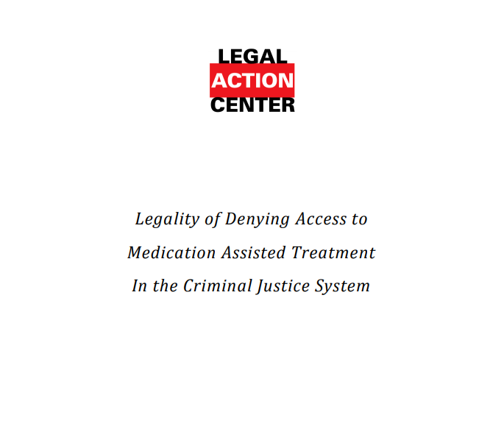
Medication-Assisted Treatment
Notes:
reference

Slide 24
2. Admission

Slide 25
Waiver of Rights
Defendants traditionally have to waive several constitutional rights when pleading guilty:
Right to trial
Right to confront witnesses
Right against self-incrimination
Right to appeal
Waiver must by knowing,
voluntary, and intelligent.
“It is essential that lawyers education themselves as to the availability, requirements, and appropriateness of drug court program… to ignore the need to learn about the drug court process is to ignore the evolution of the justice system” –Smith v. State
Notes:
Knowingly, voluntarily, and intelligently given- it is the responsibility of both the DA, Defense Counsel and the court to ensure participants understand the rights they are giving up by participating in the program
Critique of early drug courts was that they were so focused on efficiency and streamlining the process they ran the risk of violating participants due process – a lot of that focus has changed through the emphasis of communication and treatment but still an issue

Slide 26
Waiver of Rights
But there are special considerations for drug courts.
Waiver of appeal may be limited
People v. Kitchens, 46 A.D.3d 577 (N.Y. App. Div. 2007) (waiver of right to appeal does not foreclose appellate review of due process claim that sentencing court failed to hold a hearing regarding the circumstances surrounding defendant’s failure to complete drug treatment program)
Notes:
We will get to termination and sanctions later but this is important to know
Just because you waive your right to appeal does not mean there can’t be an appellate review of due process concerns surrounding a termination hearing
Waive your right to appeal your guilty plea but not your right to raise concerns based on how or why you may have been terminated from the program

Slide 27
Waiver of Rights
No waiver of right to termination hearing
State v. Laplaca, 27 A.3d 719 (N.H. 2011) (rejecting waiver of the right to a hearing because it was impossible for the defendant to have knowledge of the allegations brought against him when the facts giving rise to those allegations had yet to occur)
Notes:
Due process rights are implicated here and what exact process is due will be covered in a few slides
You don’t know ahead of time if you will want to contest the legitimacy of a drug test result or termination for circumstances which there are factual discrepancies about

Slide 28
Search Waivers
Can drug courts require participants to submit to warrantless searches? To random searches?
Yes, search waivers are a reasonable condition of probation and/or post-plea drug court.
Griffin v. Wisconsin, 483 U.S. 868 (1987) (holding search of probationer valid on the grounds that probation qualifies as a “special need” of the state and mandates a decreased expectation of privacy).
People v. Ramos, 101 P.3d 478 (Cal. 2004) (by accepting probation, defendant waives Fourth Amendment rights and has no reasonable expectation of traditional Fourth Amendment protection”)
Notes:
Pre plea or pretrial release will have different standards than this because a person has not committed a crime- something to keep in mind for diversion cases or when out on bond awaiting admittance into the program etc.

Slide 29
3. Participation

Slide 30
Mandatory Drug Testing
Can drug courts require random drug testing.
Yes, of course, or we would all be out of business!
Drug testing is permitted as a condition of probation/release as long as it is “reasonably related” to the case.
Notes:
Pretrial/Bond: reasonable and based on individualized assessment that the person may use drugs during release (individualized suspicion=prior drug convictions & self reported drug use)

Slide 31
12-Step Programs
Can drug courts mandate participation in Alcoholics Anonymous/Narcotics Anonymous?
No. Why? Because of 1st Amendment’s Establishment Clause
Kerr v. Farrey, 95 F.3d 472 (7th Cir. 1996) (holding that a prison violates the Establishment Clause by requiring attendance at Narcotics Anonymous meetings which used “God” in its treatment approach).

Slide 32
12-Step Programs
Also can’t condition other benefits on participation in AA/NA.
Griffin v. Coughlin, 673 N.E.2d 98 (N.Y. 1996) (finding a violation of the Establishment Clause where privileges such as family visitation were conditioned on prisoner’s participation in a program that incorporated Alcoholics Anonymous).
Notes:
Jackson v. Nixon, 747 F. 3d 537. (8th Cir. 2014) “parole stipulation requiring him to attend and complete a substance abuse program with religious content in order to be eligible for early parole violates the Establishment Clause of the First Amendment.”

Slide 33
What to do, then?
Offer secular alternatives
O’Connor v. California, 855 F. Supp. 303 (C.D. Cal. 1994) (finding that the Establishment Clause was not violated because the DUI probationer had several choices of programs, including self-help programs that are not premised on monotheistic deity).
In re Garcia, 24 P.3d 1091 (Wash. Ct. App. 2001) (concluding that the Department of Corrections did not coerce participation in a religious program where non-religious classes were available to defendant).
Notes:
As a practical matter you want to be sure that these alternatives are known to every participant- each participant must be aware they have the choice of programs

Slide 34
Secular Alternatives
LifeRing Recovery (www.lifering.org)
Rational Recovery (www.rational.org)
Secular Organizations for Sobriety (www.secularhumanism.org/sos)

Slide 35
Geographic Restrictions
Can a drug court prohibit a person from going to certain locations?
Yes, if the restriction is reasonably related to the participants rehabilitation needs and narrowly drawn.
Factors:
Geographic size of the area
Whether there is a compelling need to enter the area
Whether supervised entry is feasible
Notes:
People v. Rizzo, 842 N.E.2d 727, 727 (Ill. App. Ct. 2005)- factors mentioned above

Slide 36
Geographic Restrictions
Examples:
State v. Morgan, 389 So. 2d 364 (La. 1980) (prohibiting entrance into the French Quarter, noting that it is a relatively small geographic area and is known for prostitution, the defendant’s charged offense).
State v. Wright, 739 N.E.2d 1172 (Ohio Ct. App. 2000) (invalidating a probation term that prohibited entry to any place where alcohol is served or consumed; ambiguous condition; could subject him to punishment for innocent conduct such as going to the grocery store or gas station).

Slide 37
Association Restrictions
Can a drug court prohibit a person from associating with specific individuals?
Yes, if the restriction is reasonably related to the participant’s rehabilitation needs and narrowly drawn.
Must be specific.

Slide 38
Association Restrictions
Examples:
U.S. v. Soltero, 510 F. 3d 858 (9th Cir. 2007) (condition prohibiting defendant from associating with “any known member of any criminal street gang” is permissible; but condition prohibiting defendant from associating with any known member of “any disruptive group” was overbroad)
U.S. v Showalter, 933 F. 2d 573 (7th Cir. 1991) (upholding condition of probation barring defendant from association with neo-Nazis and skinheads)
U.S. v. Schiff, 876 F. 2d 272 (2d Cir. 1989) (upholding condition of special release for defendant convicted of tax evasion from associating with organizations advocating non-compliance with tax law)

Slide 39
Association Restrictions
Incidental contact with prohibited associates is not enough to revoke probation.
Arciniega v. Freeman, 404 U.S. 4 (1971) (reversing defendant’s parole revocation, which was based on his association with ex-convicts who worked at same restaurant)
U.S. v. Green, 618 F. 3d 120 (2nd Cir. 2010) (finding that condition only applied to association with gang members known to defendant)

Slide 40
Dress Restrictions
Dress restrictions are permitted as long as they are reasonably related to the offense and to the goal of preventing future criminality.
Must give the offender adequate notice of what kinds of dress permitted.
U.S. v Brown, 223 Fed. Appx. 722 (9th Cir. 2007) (restriction on clothing “which may connote affiliation or membership in” specific gangs was overly vague, failed to give adequate notice of precisely what apparel is prohibited”)

Slide 41
Employment Requirements
Can a drug court require a participant to try and get a job?
Yes.
U.S. v. Melton, 666 F.3d 513 (8th Cir. 2012) (finding that “a defendant’s failure to put forth a good faith effort to seek employment is a valid ground for revoking a supervised release”)
Garrett v. State, 680 N.E.2d 1 (Ind. Ct. App. 1997) (vacating defendant’s probation revocation because there was insufficient evidence that her failure to secure employment was due to her lack of effort)
Notes:
Effort is the crux of the argument here- if they are trying.

Slide 42
Employment Restrictions
Can a drug court prohibit a participant from getting certain types of jobs?
Yes, when the restriction is reasonably related to the defendant’s crime and the goals of probation.
Thomas v. State, 710 P.2d 1017 (Alaska Ct. App. 1985) (upholding a condition of probation that prohibited the offender from working in commercial fishing following his conviction for theft crimes that were related to his work in that industry).
Notes:
See this also in financial embezzlement cases

Slide 43
Community Service Requirements
Can a drug court require a participant to perform community service work?
Yes, generally permitted as reasonably related to the rehabilitation of the offender.
U.S. v. Restor, 679 F.2d 338 (3rd Cir. 1982) (community service may serve the rehabilitative purpose of probation by helping to reinstate offenders in society, integrate them in a working environment, and inculcate a sense of social responsibility).

Slide 44
Community Service Requirements
But, community service requirements can be excessive.
In re Ragland, 973 S.W.2d 769 (Tx Ct. App. 1998) (requiring weekly community service over the course of a year constitutes a restraint on liberty entitling probationer to pursue relief by petition for writ of habeas corpus”)
Notes:
Other ideas include- writing letters, increased meetings with supervising or treatment team

Slide 45
Staffing Meetings
Staffing meetings are typically:
Held outside regular court sessions
Informal, off the record meetings
For the team to share information about clients
To prepare for formal status hearings
NOT for making formal findings or decisions

Slide 46
Staffing Meetings
When conducted properly, normal due process rights do not apply to staffing meetings
Defendant is not entitled to be present
Defense counsel need not be present
Need not be open to the public or on the record

Slide 47
Staffing Meetings
Cases:
In re Interest of Tyler T., 781 N.W.2d 922 (Neb. 2010) (therapeutic goals of drug court make it unnecessary for every action to be a matter of record but that a hearing must be on the record “when a liberty interest is implicated”).
State v. Sykes, 339 P.3d 972 (Wash. 2014) (drug courts are different from ordinary courts; because of their unique characteristics, staffing meetings need not be open to the public).

Slide 48
Ex Parte Communications
Normally, ex parte communications are strictly forbidden.
But the ABA and many states have made an exception for problem-solving courts.

Slide 49
Ex Parte Communications
Colorado Code of Judicial Conduct: Rule 2.9
Comment 4: A judge may initiate, permit, or consider ex parte communications expressly authorized by law or by consent of the parties, including when serving on therapeutic or problem-solving courts such as many mental health courts, drug courts, and truancy courts. In this capacity, judges may assume a more interactive role with the parties, treatment providers, probation officers, social workers, and others.

Slide 50
4. Sanctions

Slide 51
Sanctions and Due Process
Some cases say that sanctions can be imposed without a formal hearing and full due process protections
State v. Rogers, 170 P.3d 881 (Idaho 2007) (holding that intermediate sanctions do not implicate the same due process concerns as termination and approving the use of informal hearings)
Commonwealth v. Nicely, 326 S.W.3d 441 (Ky. 2010) (holding that “the elements of due process normally accorded a defendant at a probation revocation hearing are not followed” for a drug court sanction because “defendants who enter drug court waive those rights while in the program)

Slide 52
Sanctions and Due Process
But others disagree
State v. Brookman, 460 Md. 291, 190 A.3d 282 (2018)
In re Miguel R., 63 P.3d 1065 (Ariz. Ct. App. 2003)
Judge William Meyer: When a participant challenges allegations of noncompliance, “the court should give the participant a hearing with notice of allegations, the right to be represented by counsel, the right to testify, the right to cross-examine witnesses, and the right to call his or her own witnesses.”
--From The Drug Court Judicial Benchbook
Notes:
Factual challenges- when the participant says he didn’t do it
When jail is a sanction you should always have the full range of due process available for your participants

Slide 53
5. Termination

Slide 54
Termination and Due Process
Due process protections are required whenever a defendant faces the possible loss of a recognized “liberty interest”
Freedom from jail is certainly a liberty interest
So due process is required for drug court termination
Notes:
This is constructed based on the post-plea model.
14th: No State shall make or enforce any law which shall abridge the privileges or immunities of citizens of the United States; nor shall any State deprive any person of life, liberty, or property, without due process of law; nor deny to any person within its jurisdiction the equal protection of the laws.
5th: nor shall be compelled in any criminal case to be a witness against himself, nor be deprived of life, liberty, or property, without due process of law; nor shall private property be taken for public use, without just compensation.

Slide 55
Termination and Due Process
What about pre-plea court models?
Liberty interest is not limited to incarceration
Meyer v. Neb., 262 U.S. 390 (1923) (noting that “liberty” is manifest not only in freedom from bodily restraint but also as the right of the individual “to enjoy those privileges long recognized…as essential to the orderly pursuit of happiness by free men.”)
Notes:
This is constructed based on the post-plea model.
Meyer v. Neb: language of Justice McReynolds in Meyer
Without doubt, [the liberty guaranteed by the due process clause] denotes not merely freedom from bodily restraint but also the right of the individual to contract, to engage in any of the common occupations of life, to acquire useful knowledge, to marry, establish a home and bring up children, to worship God according to the dictates of his own conscience, and generally, to enjoy those privileges long recognized at common law as essential to the orderly pursuit of happiness by free men.
Not sure they would have considered termination from diversion programs in 1923 when this case was decided but it is a good thought process to engage in when deciding if a liberty interest is at stake in the termination. Also, as good practice is to hold a hearing and have it on the record to protect against any claims of a violation of due process

Slide 56
Termination and Due Process
What process is due?
Mathews v. Eldridge, 424 U.S. 319 (1976) (explaining that due process is flexible and calls for “such procedural protections as the particular situation demands.”)
Not very helpful?
Notes:
Variety of treatment court models and policies and procedures make it hard for any court to determine due process standards for “treatment courts” or even adult drug courts

Slide 57
Termination and Due Process
Let’s try again…
written notice of the alleged violations
disclosure of evidence
right to appear
present witnesses and confront adverse witnesses
neutral and detached magistrate
written findings with reasons
Morrissey v. Brewer, 408 U.S. 471 (1972)
Notes:
This is a parole revocation standard, but it applies to drug court termination as well, according to numerous cases.
Post-Conviction Proceedings.—The right to counsel under the Sixth Amendment applies to “criminal prosecutions,” a restriction that limits its scope but does not exhaust all constitutional rights to representation in adversarial contexts associated with the criminal justice process. The Sixth Amendment requires counsel at the sentencing stage,⁴³³ and the Court has held that, where sentencing was deferred after conviction and the defendant was placed on probation, he must be afforded counsel at a hearing on revocation of probation and imposition of the deferred sentence.⁴³⁴ Beyond this, however, the Court has eschewed Sixth Amendment analysis, instead delimiting the right to counsel under due process and equal protection principles.⁴³⁵
⁴³³ Townsend v. Burke, 334 U.S. 736 (1948).
⁴³⁴ Mempa v. Rhay, 389 U.S. 128 (1967) (applied retroactively in McConnell v. Rhay, 393 U.S. 2 (1968)).
⁴³⁵ State criminal appeals, applications for collateral relief, and post-sentencing parole or probation determinations are examples of procedures with respect to which the Court has not invoked the Sixth Amendment. Using due process analysis, the Court has found no constitutional right to counsel in prison disciplinary proceedings. Wolff v. McDonnell, 418 U.S. 539, 560–70 (1974); Baxter v. Palmigiano, 425 U.S. 308, 314–15 (1976). See Fourteenth Amendment, “Rights of Prisoners,” infra.
What this basically means is you need to hold a termination hearing- where the participant has the right to contest the basis of their termination with defense counsel present

Slide 58
Termination and Due Process
That standard may sound familiar…
Based on parole revocation due process standard Morrissey v. Brewer, 408 U.S. 471 (1972)
Extended to probation revocation Gagnon v. Scarpelli, 411 U.S. 778, 782 (1973)
Held as the standard for termination from drug treatment court in several states State v. Shambley, 281 Neb. 317 (2011)
Also incorporated into state statute
N.J. Stat. Ann. § 2C:35-14f(1)-(6) (requires a finding on the record, considers the nature and seriousness of the violations, and gives special weight to treatment provider’s termination recommendation).
Notes:
This is a parole revocation standard, but it applies to drug court termination as well, acc
State v. Shambley, 281 Neb. 317 (2011) (Drug court program participants are entitled to the same due process protections as persons facing termination of parole or probation.)
Lawson v. State, 969 So.2d 222 (Fla. 2007) (finding that a trial court has discretion to find a defendant in willful violation of probation for being discharged from a drug court program even if the sentencing court “fails to specify the number of chances the defendant would have to complete the program or impose a time period for compliance.”).
Harris v. Commonwealth, 279 Va. 541, 546 (2010) (vacating a sentencing judgment based on a probation analogy because the judge terminated the defendant from drug court without a recorded hearing and without affording defendant the opportunity to be present or participate in the hearing).ording to numerous cases.

Slide 59
Termination and Due Process
What if the defendant waived a termination hearing as a condition of entering drug court?
Waiver not valid
State v. Laplaca, 27 A.3d 719 (N.H. 2011) (rejecting waiver of the right to a hearing because it was impossible for the defendant to have knowledge of the allegations brought against him when the facts giving rise to those allegations had yet to occur)
Notes:
This is a parole revocation standard, but it applies to drug court termination as well, according to numerous cases.
Discussed this earlier- you can’t know what the termination will be based on

Slide 60
Termination and Evidence Needed
Preponderance of the evidence standard
State v. Varnell, 155 P.3d 971 (Wash. Ct. App. 2007) (in drug court termination, “the burden is on the State to prove noncompliance with the agreement by a preponderance of the evidence”)
Hearsay evidence permitted
State v. Rogers, 170 P.3d 881 (Idaho 2007) (revocation process should be flexible enough to consider evidence including letters, affidavits, and other material that would not be admissible in an adversary criminal trial).
State v. Shambley, 795 N.W.2d 884 (Neb. 2011) (hearsay evidence is admissible, but the court may not rely solely on hearsay).
Notes:
This is a parole revocation standard, but it applies to drug court termination as well, according to numerous cases.

Slide 61
Termination and Judicial Recusal
Can the drug court judge preside over the termination/sentencing hearing?
The case law is split, but here’s the recommended approach:
Alexander v. State, 48 P. 3d 110 (Okla. Crim. App. 2002) (holding that “if an application to terminate a Drug Court participant is filed, and the defendant objects to the Drug Court team judge hearing the matter by filing a motion to recuse, the defendant’s application for recusal should be granted and the motion to remove the defendant from the Drug Court program should be assigned to another judge for resolution.”)
Notes:
This is a parole revocation standard, but it applies to drug court termination as well, according to numerous cases.

Slide 62
Basis of Termination
Basis of termination
Valid penological justification
Is there a difference between termination based on unwillingness to attend treatment v. unavailability of treatment?
Notes:
Keep in mind in our list of items needed for a termination hearing is written notice of alleged violation-
One reason is to give the participant the chance to contest whether this is a reason they can be terminated from the program
U.S. v. Gallo, 20 F.3d 7, 13 (1st Cir. 1994) (upholding probation revocation based on the violation of a condition requiring probationer to submit to psychiatric hospitalization.)
People v. Bacchi, 112 A.D.2d 940, 941(2d Dept 1985) (finding that defendant failed to satisfy special probation conditions that required psychiatric treatment without reasonable explanation.)
State v. Noonan, 2019-Ohio-2960 (Ct. App.) (The trial court abused its discretion in finding that defendant violated her community control, because her discharge from the residential drug treatment facility was due solely to her medical issues.)
U.S. v. Clarkson, 208 F.3d 218 (8th Cir. 2000) (stating that probation is properly revoked when the defendant does not comply with release terms, whether the failure is the result of willfulness, carelessness, or impaired mental capacity).

Slide 63
Basis of Termination
If a participant is terminated from Drug Court because adequate treatment was unavailable to meet his or her clinical needs, fairness dictates the participant should receive credit for the efforts in the program and should not receive an augmented sentence or disposition for the unsuccessful termination.
(Bowers, 2007; Justice Policy Institute, 2011; National Association of Criminal Defense Lawyers, 2009)
Notes:
Keep in mind in our list of items needed for a termination hearing is written notice of alleged violation-
One reason is to give the participant the chance to contest whether this is a reason they can be terminated from the program. If it is failure to attend a phsych eval that is a violation but if it is that they don’t have a psychiatrist in the area then you should consider alternatives to termination.
This comes up more for medical reasons – not violating equal protection for not taking people into the program for these reasons but terminating them for something they can’t control could have very adverse consequences- most notable probat
To do otherwise is likely to dissuade addicted offenders and their defense attorneys from choosing the Drug Court option. Defense attorneys are understandably reluctant to advise their clients to enter Drug Court when there is a serious risk their client could receive an enhanced sentence despite his or her best efforts in treatment ion violation or strictest sentence in plea deal

Slide 64
Resources
The Drug Court Judicial Benchbook
https://www.ndci.org/sites/default/files/nadcp/14146_NDCI_Benchbook_v6.pdf
NDCI’s legal resource webpage
https://www.ndci.org/resources/law/
Legal Action Center resources (www.lac.org)
Medication Assisted Treatment in Drug Courts
Confidentiality and Communication

Slide 65
Monica Christofferson
Associate Director
National Technical Assistance
Center for Court Innovation
520 8th Ave.,
New York, NY 10018
(440) 864-6259
christoffersonm@courtinnovation.org

