Slide 1
Beyond Veteran Courts: Creative Solutions to Assist Veterans in the Justice System
Sandy Deich, Gerald Sieren, Edward Zapala, & Abigail Ziebell

Slide 2
Agenda
Introductory comments
Veteran dorms (& other prison/jail efforts)
Wisconsin Dept. of Veterans Affairs (WDVA) – State resources & law enforcement efforts
Medical Legal Partnerships (& other Civil Legal assistance)
VA Support services via the Veteran Justice Programs outside of the treatment court context
VA Community Care Options
Success stories

Slide 3
1. Introductory comments
Edward Zapala, LCSW
Veterans Justice Programs (VJP) Coordinator, Madison VA Hospital

Slide 4
This Photo by Unknown Author is licensed under CC BY-NC-ND

Slide 5
Notes:
NIC, VA, and SAMHSA… to organize efforts to divert out of justice system

Slide 6
Why go beyond Vet Courts?
Veteran Courts are part of intercept 3
What about diverting Veterans before then (intercepts 1 & 2), so Vet Court not needed or
What about the rest of intercepts 3, 4, & 5?
How about those for whom Vet Courts are not appropriate?
How about those that have been terminated from a Vet Court?
May aid in identifying potential applicants for your Vet Court
Vet Court Judge may help start
Veterans deserve more then one intervention from us

Slide 7
Recognition of Barriers
Limited Resources
Funding
Time
Creation of new positions
Have Existing Infrastructure
Population need may not justify the resource allocations
Others…
Notes:
poll

Slide 8
Creative Solutions
Utilize existing Treatment Courts in your area (e.g., establish a “Veterans track”)
Veteran courts have a unique advantage in that many treatment resources already exist
Government (including Vet Centers)
Nonprofits
Other community

Slide 9
Veteran dorms (& other prison/jail efforts)
Edward Zapala, LCSW
Veterans Justice Programs (VJP) Coordinator, Madison VA Hospital

Slide 10
Madison VJP outreach--incarcerated
Regular jail outreach jail to: Dane, Dodge, Rock, & Winnebago (IL), etc. Co.; pending with others
Over 600 individuals seen as of 2019
~40% of inmates new to MAD VA
Prison outreach in WI: Columbia, Dane, Marquette, Crawford, & Grant Co.
Notes:
Out of a sample of 144 individuals, 91 hadn’t been to Mad VA in last 3 years (63%). This includes non-vets/VHA-ineligible (about 40%). Relevant for VERA funding.

Slide 11
Notes:
Units (pods) just for Vets have been around for ~ 10 years (starting in SF, CA), early evidence is they are better for staff and inmates (less behavioral issues, more comradery/access to services…), one program in Madison’s catchment

Slide 12
Notes:
None in Madison’s catchment currently

Slide 13
I feel like I brought a lot of shame to the Marine Corps. I’m just trying to make up for that and I think I can, and I’m okay spending the rest of my life to do that. Unlike other people in society or in the Corps who haven’t done something like I’ve done, they can go on with their lives. I believe it’s incumbent on me to give back the rest of my life and I’m okay with that. I’ve found my place.
Ron Self (founder of the peer-led and prison-based “Veterans Healing Veterans from the Inside Out”) who is now formerly incarcerated

Slide 14
Independent evaluation in CA of a jail Veteran’s Dorm found…
Participation associated with lower recidivism (16% vs. 27%)
Safety was facilitated in the unit (per rule violation data [1% vs. 43%] & staff perceptions)
Created a “rehabilitative-focused environment” (95% participants would recommend to others)

Slide 15
Wisconsin Dept. of Veterans Affairs (WDVA) – State resources & law enforcement efforts
Gerald Sieren
Veterans Program Supervisor, Madison WDVA

Slide 16
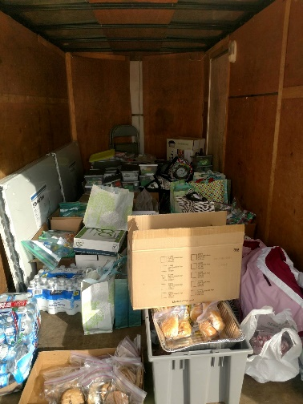
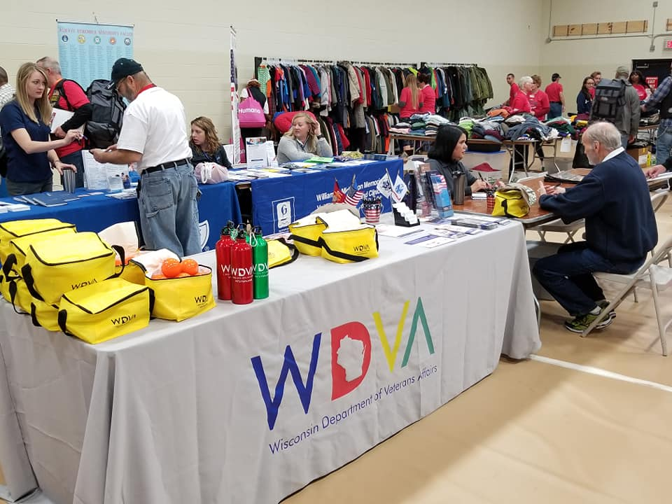
WISCONSIN DEPARTMENT OF VETERANS AFFAIRS VETERAN OUTREACH & RECOVERY PROGRAM (VORP)

Slide 17
WHAT DOES THE WISCONSIN DEPARTMENT OF VETERANS AFFAIRS DO?
There are three lanes of traffic when it comes to veterans' benefits.
1. Federal (VA)
2. State (WDVA)
3. Local (CVSO,VSO)
The federal VA provides benefits and medical care for veterans regardless of state residency.
The WDVA is a state agency and provides benefits, programs and services to veterans and their families of the state of Wisconsin.
Local entities, such as the CVSO’s, and VSO’s provide both state and federal benefits at local (County) level.

Slide 18
PROGRAM LOCATIONS

Slide 19
The mission of the Wisconsin Department of Veterans Affairs is to work on behalf of Wisconsin's veterans community — veterans, their families and their survivors — in recognition of their service and sacrifice to our state and nation.​​​

Slide 20
VETERANS OUTREACH & RECOVERY PROGRAM
MISSION: Serving those who served, where they are, to inspire change at the individual and community level. #wisvets
VISION: Veterans – care for one, care for all
VALUES:
Our work will be guided and informed by our beliefs and commitments to:
Integrity – We demonstrate professionalism through honor, respect and stewardship
Empowerment – We promote resiliency and accountability through collaboration and creativity
Empathy – We build connections by recognizing each person’s unique life story

Slide 21
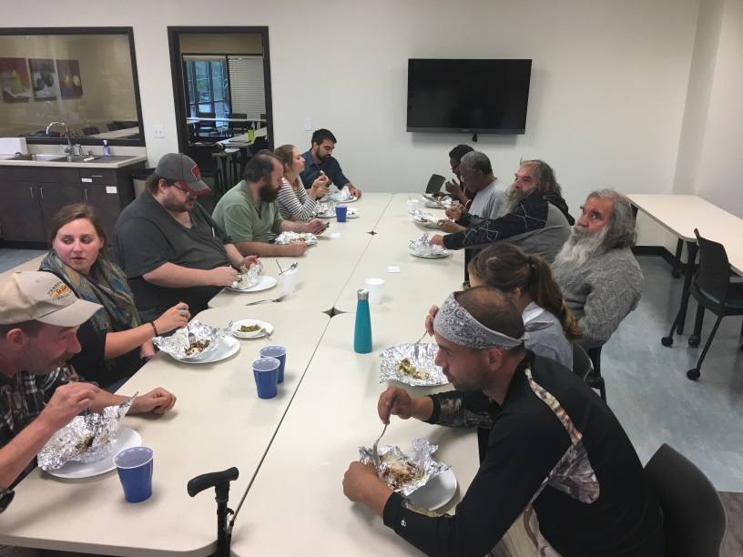
WHAT IS VORP
The Veterans Outreach & Recovery Program is a comprehensive, coordinated outreach program serving veterans who would benefit from connection with community services and who may need support in navigating those service systems with a special focus on treatment and recovery support.
Notes:
Pillars of Excellence Award Winner

Slide 22
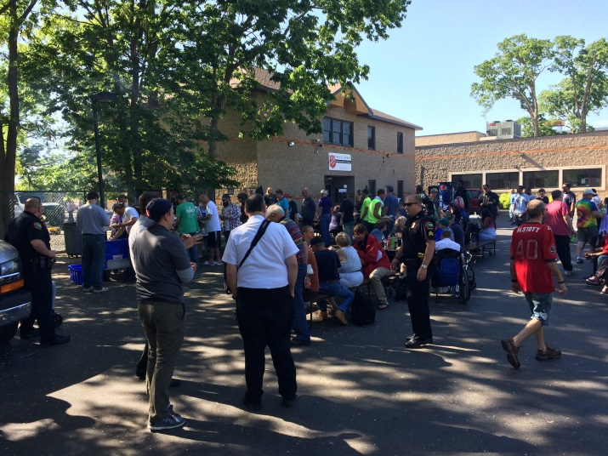
HISTORY
Grant Collaboration with DHS
2014-2017
49 Counties
Strict eligibility
State Pilot
2018-2019
72 Counties
Referral & Recovery Tracks
Permanent Funding
July 2019
Recovery Track
Notes:
During the Grant – 330 Enrollees and over 800 Contacts

Slide 23
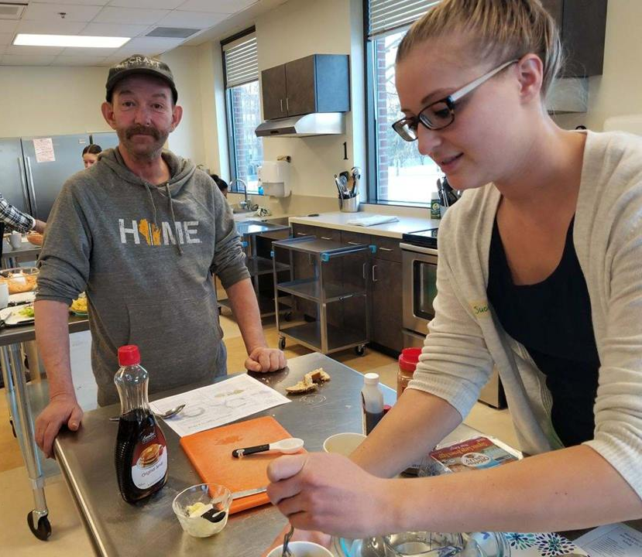
VORP TODAY
Permanent funding through the State of Wisconsin
No requirement of homelessness or diagnosis
Provide case management
Serve veterans who are in crisis
Serve 72 counties, in 11 Regions, with 11 outreach staff and 1 clinician

Slide 24
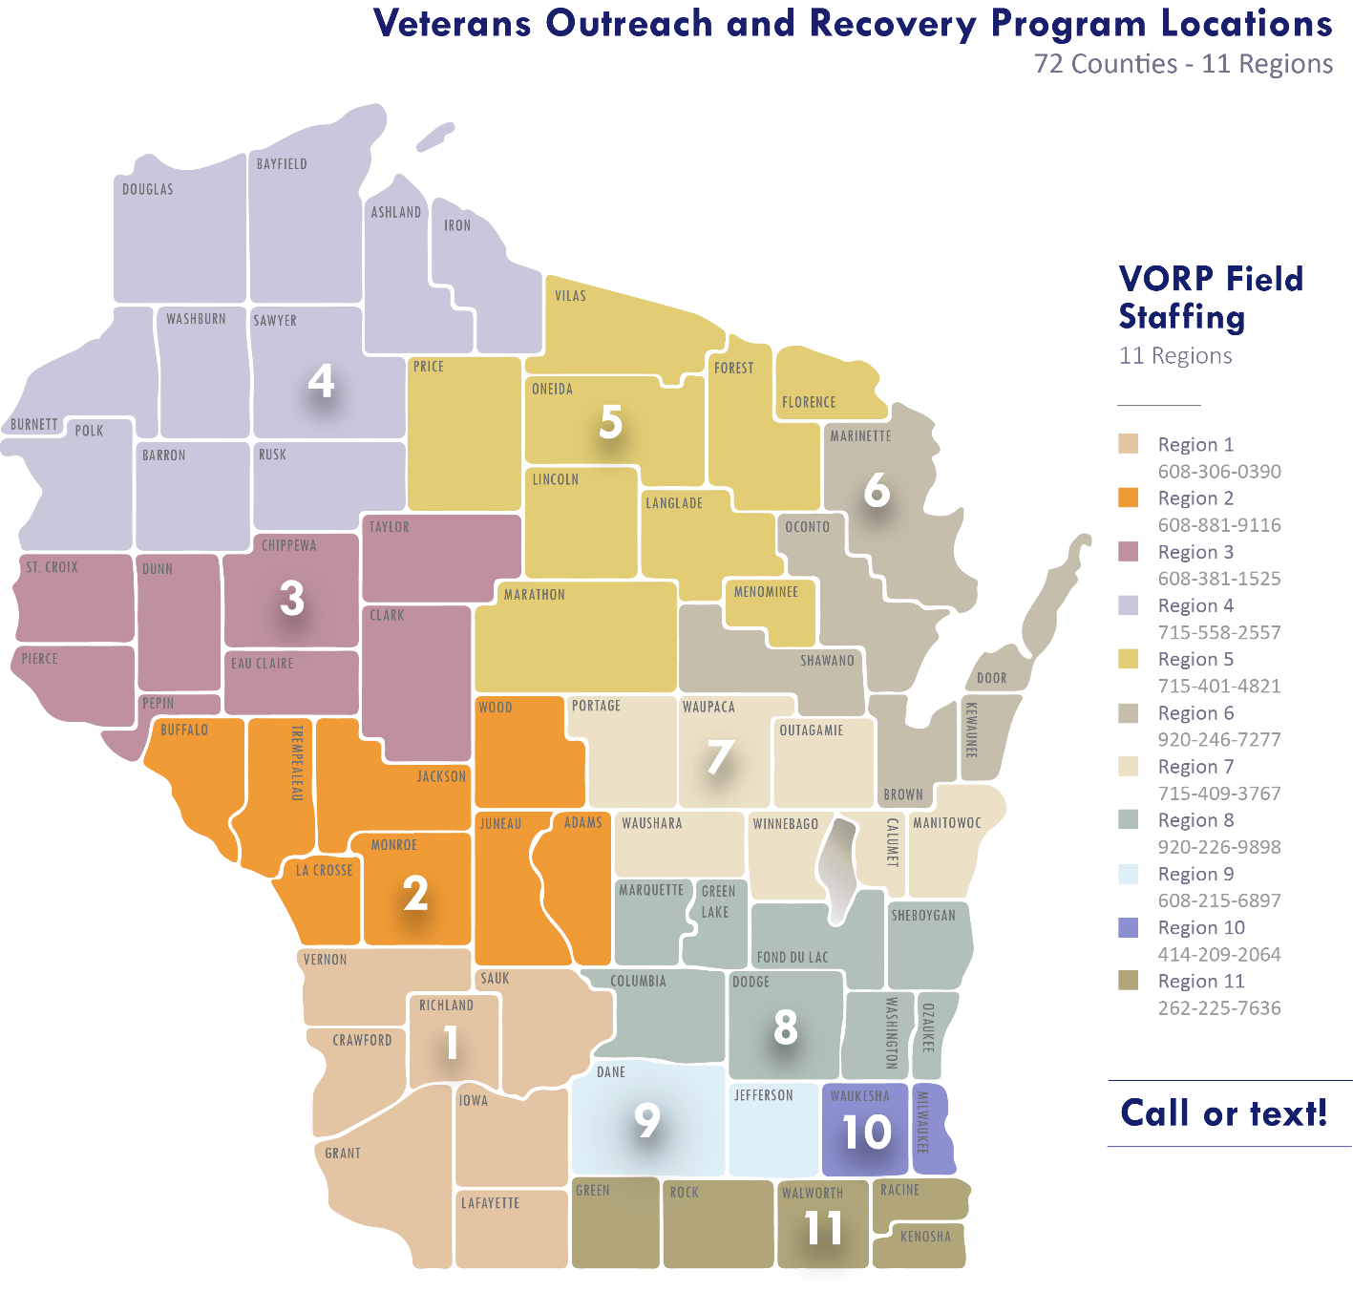
STAFF BY REGION

Slide 25
CRITERIA FOR ENROLLMENT IN VORP
Verification of the following:
Are serving in the national guard of any state or a reserve component of the U.S. armed forces
Served on active duty in the U.S. armed forces, forces incorporated as part of the U.S. armed forces, a reserve component of the U.S. armed forces, or the national guard of any state and were discharged under conditions other than dishonorable
Notes:
Service in the military does not guarantee USDVA benefits or healthcare.
VORP serves those who do not meet eligibility for other veteran programming.

Slide 26
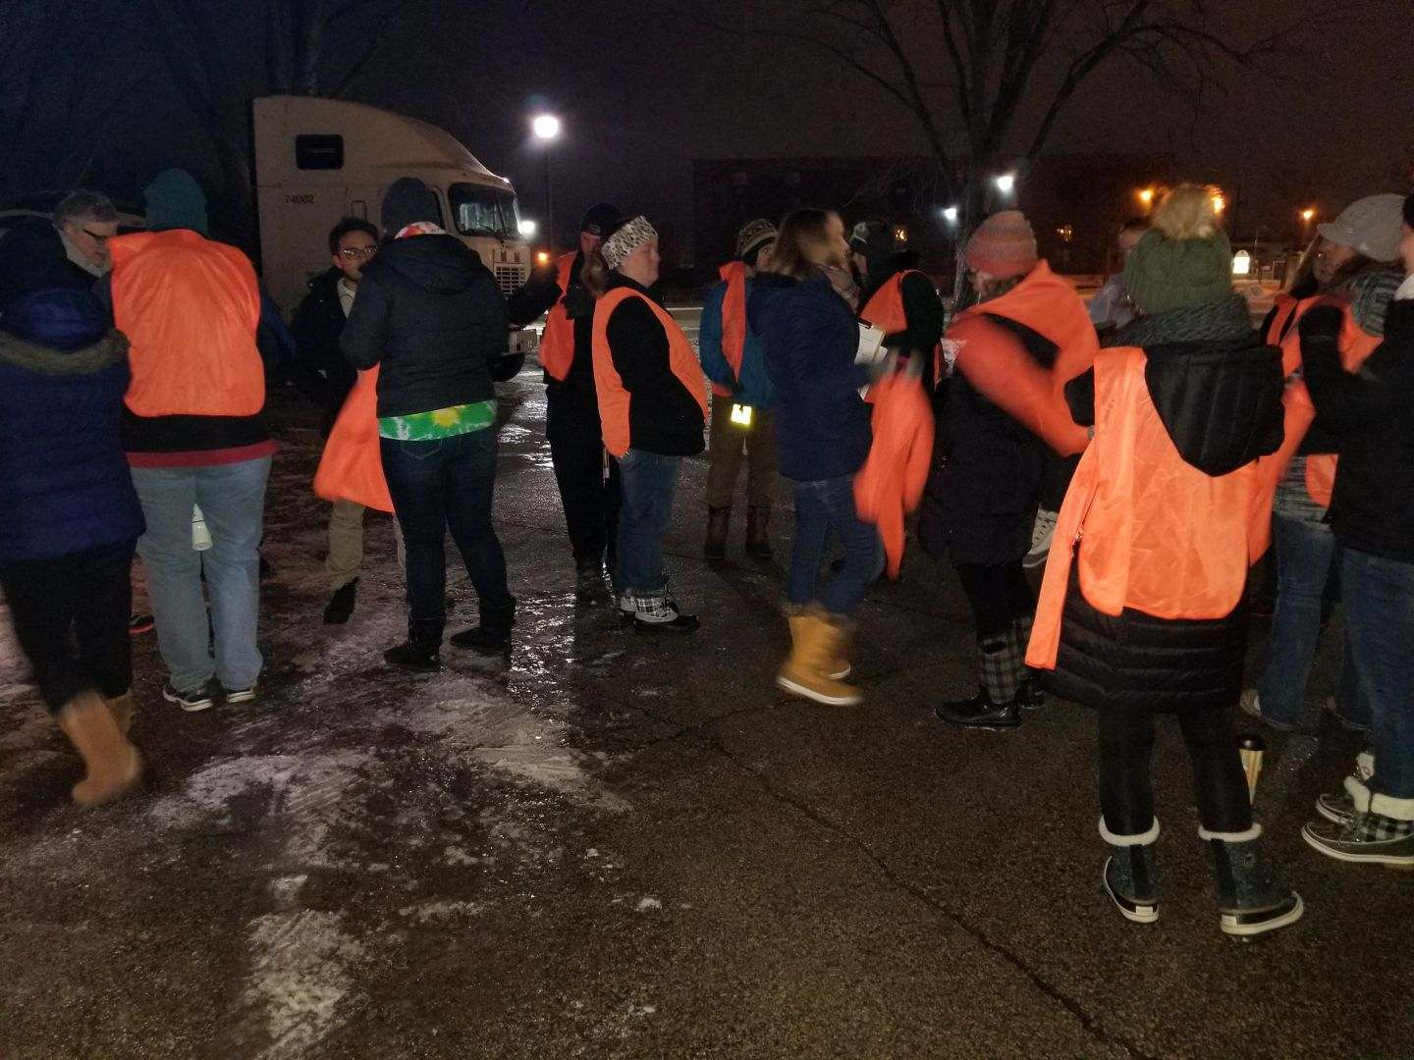
HOW WE SERVE VETERANS
Taking our programs and services to the veteran. Into the family home, on the street, in the jails, in the parks and forests, homeless shelters, and even in a disabled or roadside parked car.

Slide 27
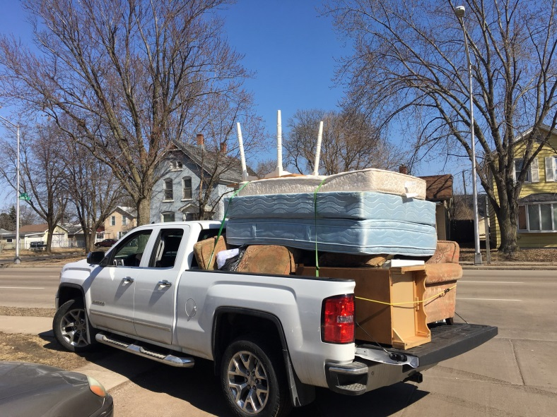
SERVICES
Home – Assistance in having a stable, safe place to live
Motivation – Assistance finding the internal motivation needed to change behavior
Recovery – Assistance with mental health and/or substance use issues
Payment of treatment for mental health and/or substance use disorders
Notes:
WDVA payment only as a last resort when USDVA, county, and other care benefits are unavailable.

Slide 28
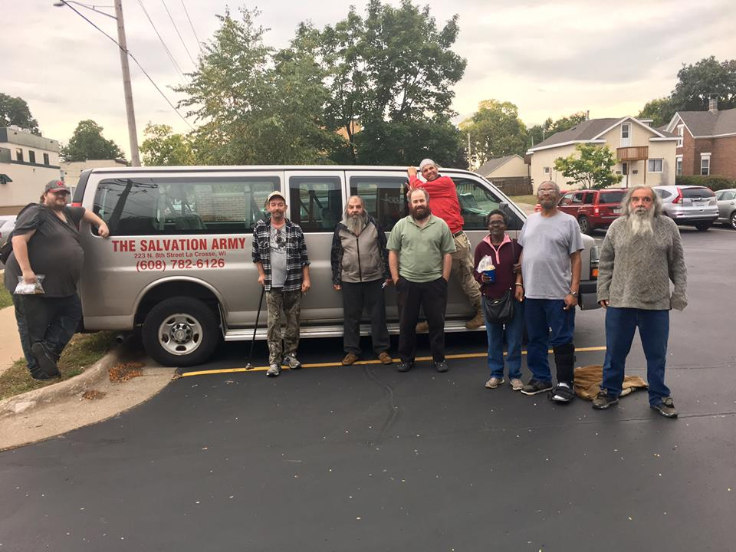
SERVICES
Health – Assistance in managing conditions and making choices that support well-being
Purpose – Assistance in conducting meaningful daily activities for the independence, income, and resources to participate in society
Community – Assistance in building relationships and social networks

Slide 29
VORP NETWORK
Work with local shelters and others to find temporary, transitional, and permanent housing
Establish a network that makes treatment options more accessible to veterans
Connection to benefits, employment, and education specialists
Educate service providers on military culture and veterans benefits
Law enforcement

Slide 30
VORP DATA
As of March 2, 2020
Contacts | 664
Referral Enrollees | 547
Recovery Enrollees | 223
Services | 3894
Referrals | 1964
Notes:
Referral Track just for Pilot, eliminated as of December 31, 2019.
Contact and Recovery Enrollees are from 1/1/18 to 3/2/20
Services and referrals are from 4/16/18 to 3/2/20

Slide 31
VORP COMMUNITY PARTNERSHIP EXAMPLES
County/Tribal Veterans Service Officers
HUD – VA Supportive Housing (HUD-VASH), Supportive Services for Veteran Families (SSVF), and other housing programs
USDVA Medical Centers, Community-Based Outpatient Clinics, and Vet Centers
Private and non-profit clinics
County behavioral health services
Heat for Heroes
American Red Cross
DVOPs
Notes:
U.S. Department of Housing and Urban Development-VA Supportive Housing (HUD-VASH)
Supportive Services for Veteran Families (SSVF),

Slide 32
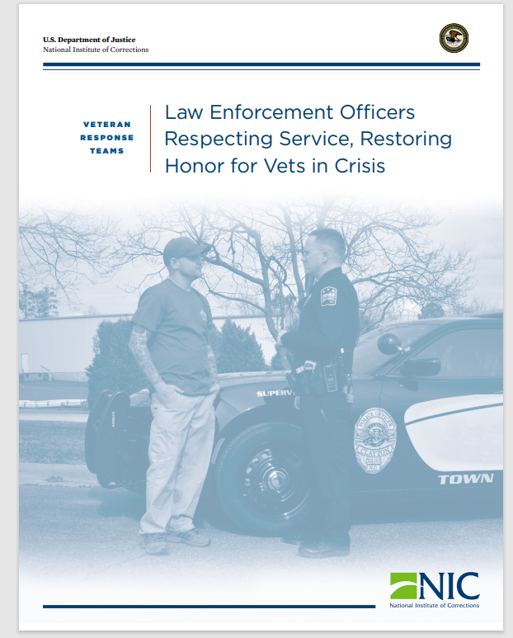

Slide 33
VA Community Care Options
Abigail Ziebell, LCSW, CSAC
Veteran Justice Program/Milwaukee VAMC

Slide 34
Partnering with Resources VA’s office of Community Care
Eligibility Criterion (Must be eligible for VA Care)
Veteran needs a service not available at VA Medical Center or clinic
Veteran lives in a US state or territory that does not have a VA facility
Veteran qualified in the ‘grandfathered’ provision of related to distance eligibility (greater than 40 miles from the facility) prior to the Mission Act being signed into law
VA cannot furnish care within certain designated Access standards
30 minute drive time for ‘general’ appointments; 60 minute drive time for specialty care
Wait time for general appt. is greater than 20 days; wait time for specialty appointment is greater than 28 days
It is in the Veteran’s Best medical Interest (example: VA provider feels the Veteran would benefit from seeing a particular specialist)

Slide 35
Partnering with Resources Office of Community Care
A Veteran has been referred into Community Care, now what?
Consults are expected to be reviewed by VA staff within 7 days of entry
First appointment (if approved) should be scheduled within 30 days
Office of community Care staff will assist the Veteran, or the referring provider, with information on which community care facilities are considered in-network
Community care providers sends the claim/bill to a Third Party administrator for payment of services
Optum

Slide 36
Civil legal assistance (such as Medical Legal Partnerships)
Edward Zapala, LCSW
Veterans Justice Programs Coordinator (Madison VA Hosp.)

Slide 37
Veteran Civil Legal Clinic
For criminal issues, there are Public Defenders or court-appointed attorneys, etc. but what about for civil legal issues?
How many of YOUR clients?
… “free walk-in legal clinic that serves low-income veterans and their families. Volunteer attorneys, along with paralegals and law students, provide brief legal advice, information and referrals on a variety of civil legal matters. Additionally, staff from the …County Veterans Service Office provides information about military benefits and other resources available to veterans….”
Sometimes hosted at VA Hospitals
State Bar, Law School, CVSO, VA Hospital…

Slide 38
Medical-Legal Partnerships video
“Lawyers as Specialists on the Health Care Team” (https://medical-legalpartnership.org/)
“lawyers are integrated into healthcare settings to help patients resolve civil legal issues that may affect their health or access to healthcare and social services.”
Nearly 300 in U.S., 15 with VA (as of 2017)
Study of 4 sites in CT & NY from 2014-2016 serving 950 Veterans found…
Most common problems: housing, VA benefits, & family/consumer issues
Of those followed for 1 yr., “significant improvements in housing, income, and mental health” were observed; didn’t require legal goals to be met

Slide 39
Medical-Legal Partnerships, cont.
Can refer to a Vet Court (if people go there in error, etc.)
May be harder to complete Vet Court if one has civil legal issues (& resulting problems)

Slide 40
Veteran Justice Program Support from VA
Abigail Ziebell, LCSW, CSAC
Veteran Justice Program/Milwaukee VAMC

Slide 41
Veteran Justice Program (VJP) Support from VA
In addition to supporting the development, and sustaining existing treatment courts – VJP also assist with:
Education and Training to local Law Enforcement, including Crisis Intervention Training
Outreach and support to local prisons and jails to assist with continuity of care needs, and discharge planning
Connecting justice involved with local resources to manage their specific issues
Helping them enroll in VA healthcare
Treatment Matching Assessments
Information on Treatment courts/accessing attorney support

Slide 42
Veteran Justice Program (VJP) Support from VA
Developing & utilizing processes (potentially including Veterans Reentry Search Service [VRSS] for identifying Veterans
Education. “Provides the Veteran with information on resources…”
Consultation and Advocacy. “… receipt of VA services and issues presented by justice-involved Veterans”.
Systems Intervention. “intended to improve VA, criminal justice, and non-VA community programs’ services to Veterans involved in criminal justice”.
Facilitating access to civil legal services

Slide 43
Creative Solutions
Deferred Prosecution or Deferred Sentencing Agreements/Diversions
While a specific treatment court may not be feasible, treatment services remain available to rehabilitate justice involved Veterans, and allow for a reduction in recidivism
Who will monitor?
Use of Risk Tools can determine if a monitor is even necessary. Low risk folks may not require a monitor, and can simply provide treatment verification letters to the court.
Moderate/High Risk individuals could benefit from DOC supervision, monitoring from systems that are used with other treatment courts/DPA’s, or even seeking routine treatment updates at established intervals

Slide 44
Success Stories

Slide 45
VORP SUCCESS STORIES
Veteran’s mother contacted WDVA to thank VORP for “saving her son’s life”, thanks to the treatment and support from VORP.“
“Just wanted you to know that you are a huge reason I'm alive today and made it to where I'm at.”
He said his friend is, “So happy, upbeat, and overall pleased. In the past, when we've talked, he sounded very depressed and despondent. Now he sounds like a different guy.”
Notes:
For instance, a coordinator developed a relationship with an OEF/OIF veteran in Green Bay who was struggling. In an unforgettable day, the ORC received an emergency call from the veteran who had just taken pills along with a liter of vodka. The veteran realized he didn’t want to die and called the now-trusted ORC. Thankfully, the veteran survived.
We then worked to get him treatment for depression and PTSD at a Domiciliary Residential Rehabilitation Treatment Program. When he completed treatment, we found him permanent housing with the assistance of HUD-VASH. The veteran recently told the coordinator who helped save his life, “Just wanted you to know that you are a huge reason I'm alive today and made it to where I'm at.”
In another case, we received a note from a friend of Vietnam veteran near Beloit who was too proud to accept help. His friend did not have a water heater and, therefore, hadn't showered or washed clothes in a long time. Our coordinator began visiting, also learning that the veteran’s toilet didn’t work. After they built a rapport, the ORC asked if we could please help him. He agreed.
Our ORC worked with Habitat for Humanity who contracted a plumber to install a new water heater, toilet, sink and faucets. The veteran was nearly in tears as these items were being installed.
We received a thank you from the friend who originally contacted us. He said his friend “is so happy, upbeat, and overall pleased. In the past, when we've talked, he sounded very depressed and despondent. Now he sounds like a different guy.”

Slide 46
YOUR success stories

Slide 47
Conclusion/Questions

Slide 48
Questions/Parting Thoughts
Contact info
Contact Info
Edward Zapala, LCSW
Veteran Justice Program/Madison VA
Telephone: (608) 280-2095
Email: Edward.Zapala@va.gov
Abigail Ziebell, LCSW, CSAC
Veteran Justice Program/Milw VA
Telephone: (414) 882-3375
Email: Abigail.Ziebell@va.gov
Sandy Diech
Benefits Specialist, Sauk Co. Veterans Service Office
Telephone: (608) 355-3260
Email: sandy.deich@saukcountywi.gov
Gerald Sieren
Veterans Program Supervisor, Madison WDVA
Telephone: (608) 733-1791
Email: Geralda.Sieren@dva.Wisconsin.gov

Slide 49
Additional information
https://www.va.gov/HOMELESS/VJO.asp (general VJO)
www.Missionact.va.gov
https://info.nicic.gov/nicrp/system/files/033091.pdf (Veterans Response Teams for law enforcement)
https://dva.wi.gov/Pages/benefitsclaims/VORP.aspx (VORP)
https://wicvso.org (CVSOs)

Slide 50
Abridged references
VHA Directive 1162.06(1)
NIC, 2018. Barracks Behind Bars
NIC, 2019. Barracks Behind Bars II
Burke, C., 2018. “Veterans Moving Forward (VMF) Final Evaluation Results”
Tsai J, et al., 2017. Medical Legal Partnerships at Veterans Affairs medical centers improved housing and psychosocial outcomes for vets, Health Affairs

