Slide 1
Understanding the Opioid Epidemic and Principles for a Solution
2022

Slide 2
Disclosures
  Presenter: Dr. John McAuliffe, Medical Director Sauk Prairie Healthcare and Family Practice Provider at Prairie Clinic, S.C.
  “I have no relevant financial relationships with the manufacturer(s) of any commercial product(s) and/or provider(s) of commercial services discussed in this CME activity.”

Slide 3
Introduction
Purpose: Share a strategy to treat opiod addiction at the community and country level
Key Principles:
  Act quickly: 1-3 Days
  Close networking between law enforcement, behavioral science, medical practioners and community; all need to be at “the table”
  Managing stress and alienation by connecting is critical !

Slide 4
Understanding the Opiod Epidemic and Principles for a Solution
Define the problem
A Solution:
  Society
  1:1 in clinic
  Individual – locus of control
Define Addiction
Neurobiology
Chronic pain
Clinical application
Conclusions
Questions

Slide 5
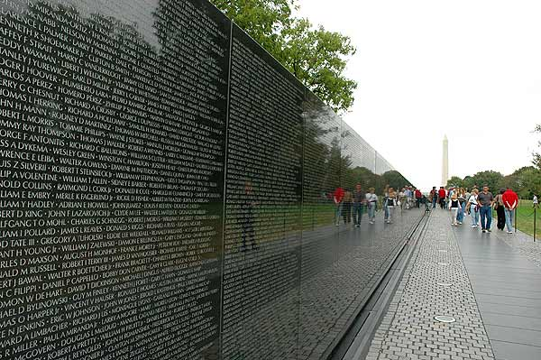
The Problem

Slide 6
The Problem
Vietnam War (1955-1975) – 58,000 killed over twenty years²
88,000 deaths each year are related to alcohol¹
47,000 deaths each year are due to overdose¹
1 death every 19 minutes
21 Million people in the U.S. have a substance abuse disorder¹
  This is comparable to the number of people with diabetes
  1.5 times the prevalence of all cancers combined¹
  Forecast: opioids could kill nearly 500,000 Americans in the next decade¹⁴
Lack of resources:
Only one in 10 people with addiction gets help³

Slide 7
The Solution
Vietnam
  Drug use was about 30% (self-reported)
  Dropped to less than the society rate of 6.8%²
  Conclusion: Environment dictates behavior
Rat Studies – 1981
  Challenged “root causes of addiction centered on the neurochemical pleasure response”
  Rats isolated in cages preferred morphine water to regular water
  Rats in community with space, food and other rats preferred water to morphine water
  Conclusion: “Addiction is not about feeling good, it is about feeling less.”⁴
Our Goal:
  Design and study a community-based model of treatment

Slide 8
Data
Total number of participants = 420
Current participants = 209 with a 62-70% retention
30 are on Naltrexone after one year

Slide 9

A Mother and Son’s Story
How did this happen?

Slide 10
Definition of Addiction¹³:
Addiction is a primary, chronic disease of brain reward, motivation, memory and related circuitry. Dysfunction in these circuits leads to characteristic biological, psychological, social and spiritual manifestations. This is reflected in an individual pathologically pursuing reward and/or relief by substance use and other behaviors.

Slide 11
Chronic Disease of the Brain¹¹
Relationship is the most therapeutic tool we have
Connection – Listen without judgement
Focus on commonality
Alzheimer's patients: deepest emotional need: to love and be loved

Slide 12
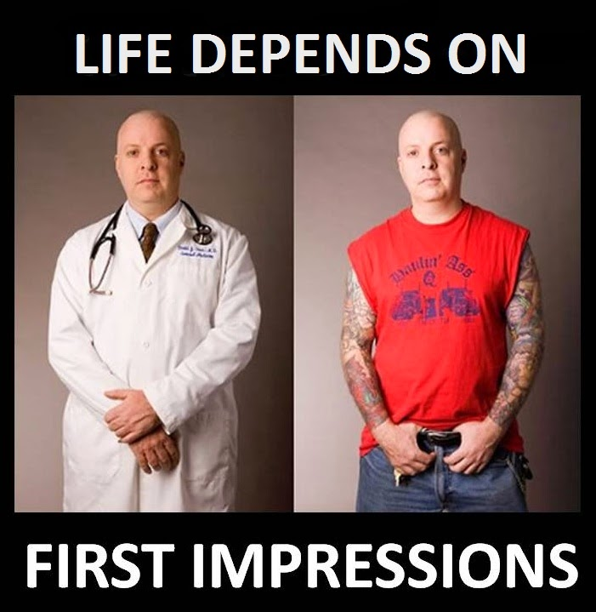
First Impressions¹²
Warmth = Trust
Competence = Power

Slide 13
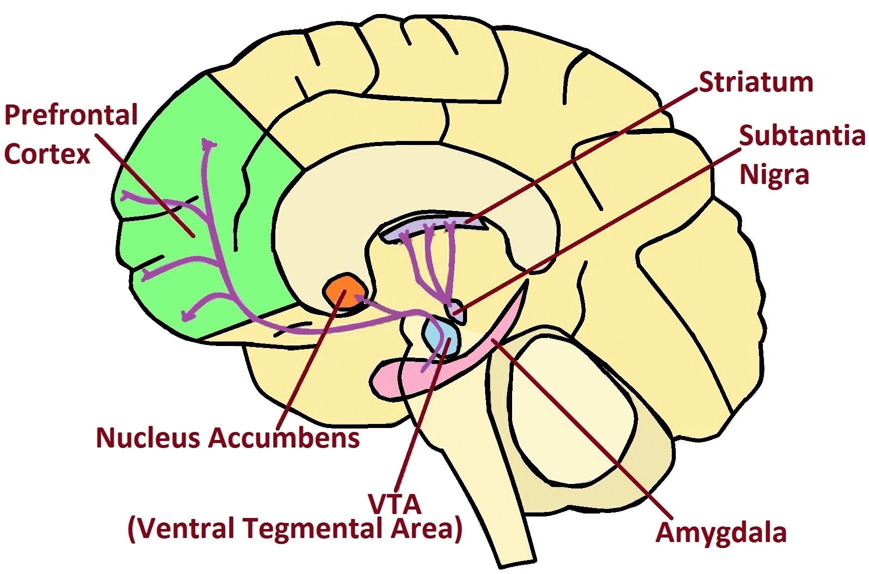
The Brain
"Dopamine pathways" by NIDA, Quasihuman - Derivative work of File:Dopamine Pathways.png. Licensed under Public Domain via Commons

Slide 14
Biochemistry Drives Behavior

Slide 15
Introduction
Purpose: Share our current understanding of what drives behavior
Key Principles: 3 Pathways
  Reward Pathway = Dopamine = Addiction
  Stress/Fear/Memory Pathway = Cortisol = Mental Illness
  Contentment Pathway = Serotonin = Mental Health

Slide 16
Baseline
Brain Circuitry^{5,10}
Habits
Adapted from Stahl’s Essential Psychopharmacology by Stephen M. Stahl

Slide 17
Introduction of the drug^{5,10}
Adapted from Stahl’s Essential Psychopharmacology by Stephen M. Stahl
and Healthy Brain, Happy Life by W. Suzuki

Slide 18
Compulsive Use
(Addiction) ^{5,10}
Breathing Analogy
Adapted from Stahl’s Essential Psychopharmacology by Stephen M. Stahl
and Healthy Brain, Happy Life by W. Suzuki

Slide 19
With Naltrexone^{5,10}
No Overdose
Adapted from Stahl’s Essential Psychopharmacology by Stephen M. Stahl
and Healthy Brain, Happy Life by W. Suzuki

Slide 20
Chronic Pain
Pain lasting longer than 3 months
Centralization of pain
  Chemical response to sensory input⁷
  Anxiety, fear, insomnia, depression aggravate
  “Neurons that fire together wire together”
  Overlap between emotional and physical pain

Slide 21
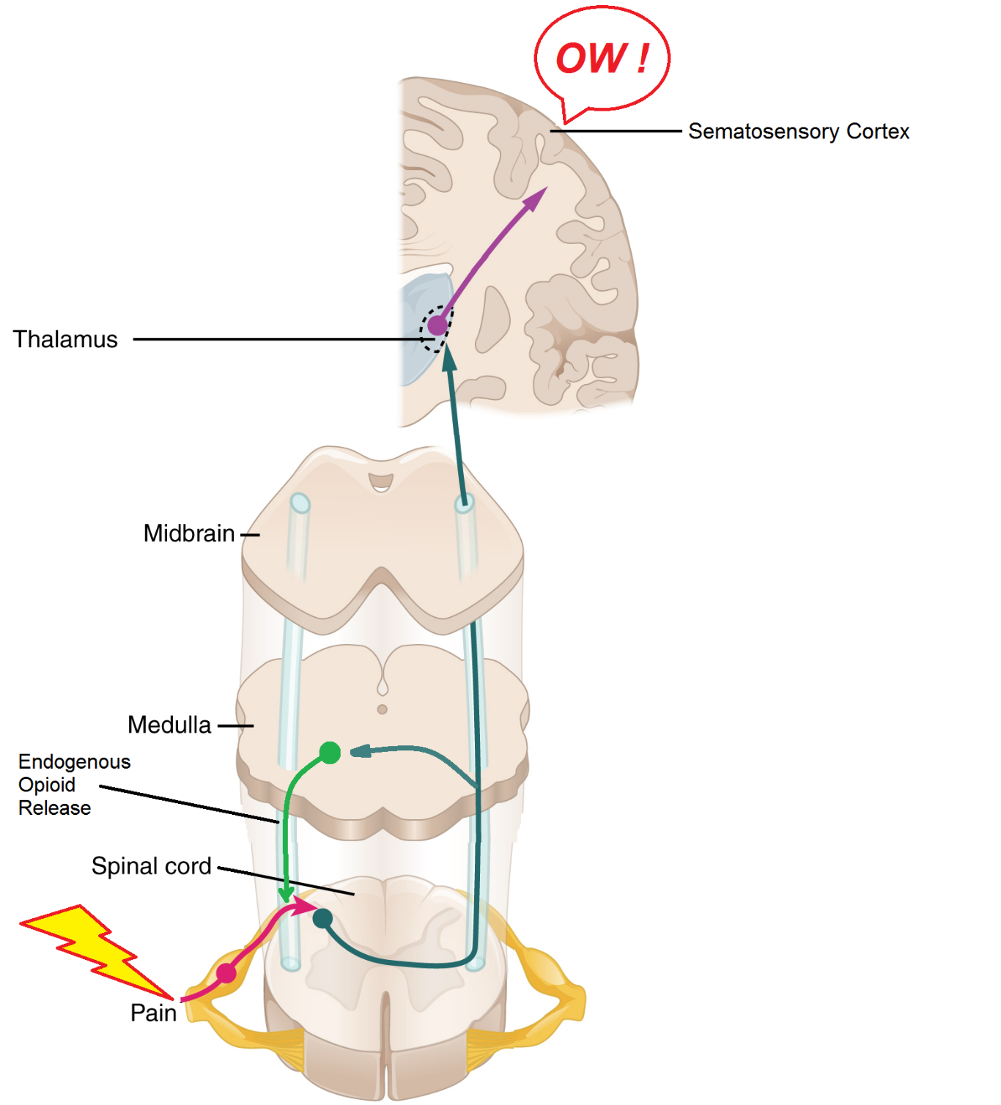
Normal Pain Pathway¹⁰
Nocioceptic Pain
Neuropathic Pain
Adapted illustration from Anatomy & Physiology, Connexions web site.
OpenStax College. Licensed under Public Domain via Commons

Slide 22
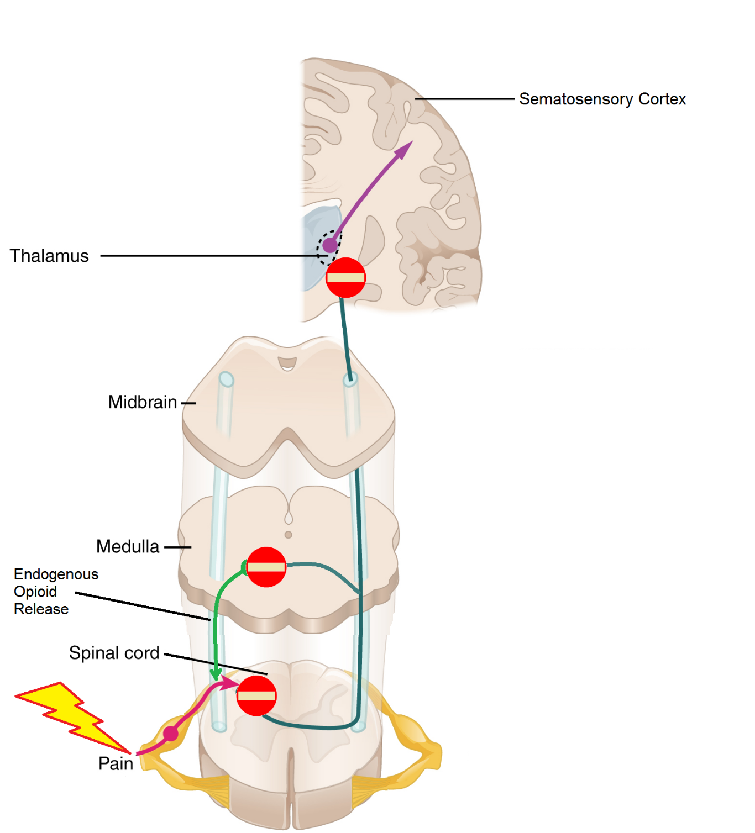
Opioids inhibit neurotransmission to reduce or prevent pain
Acute at End of Life
Need exit policy
Adapted illustration from Anatomy & Physiology, Connexions web site.
OpenStax College. Licensed under Public Domain via Commons

Slide 23
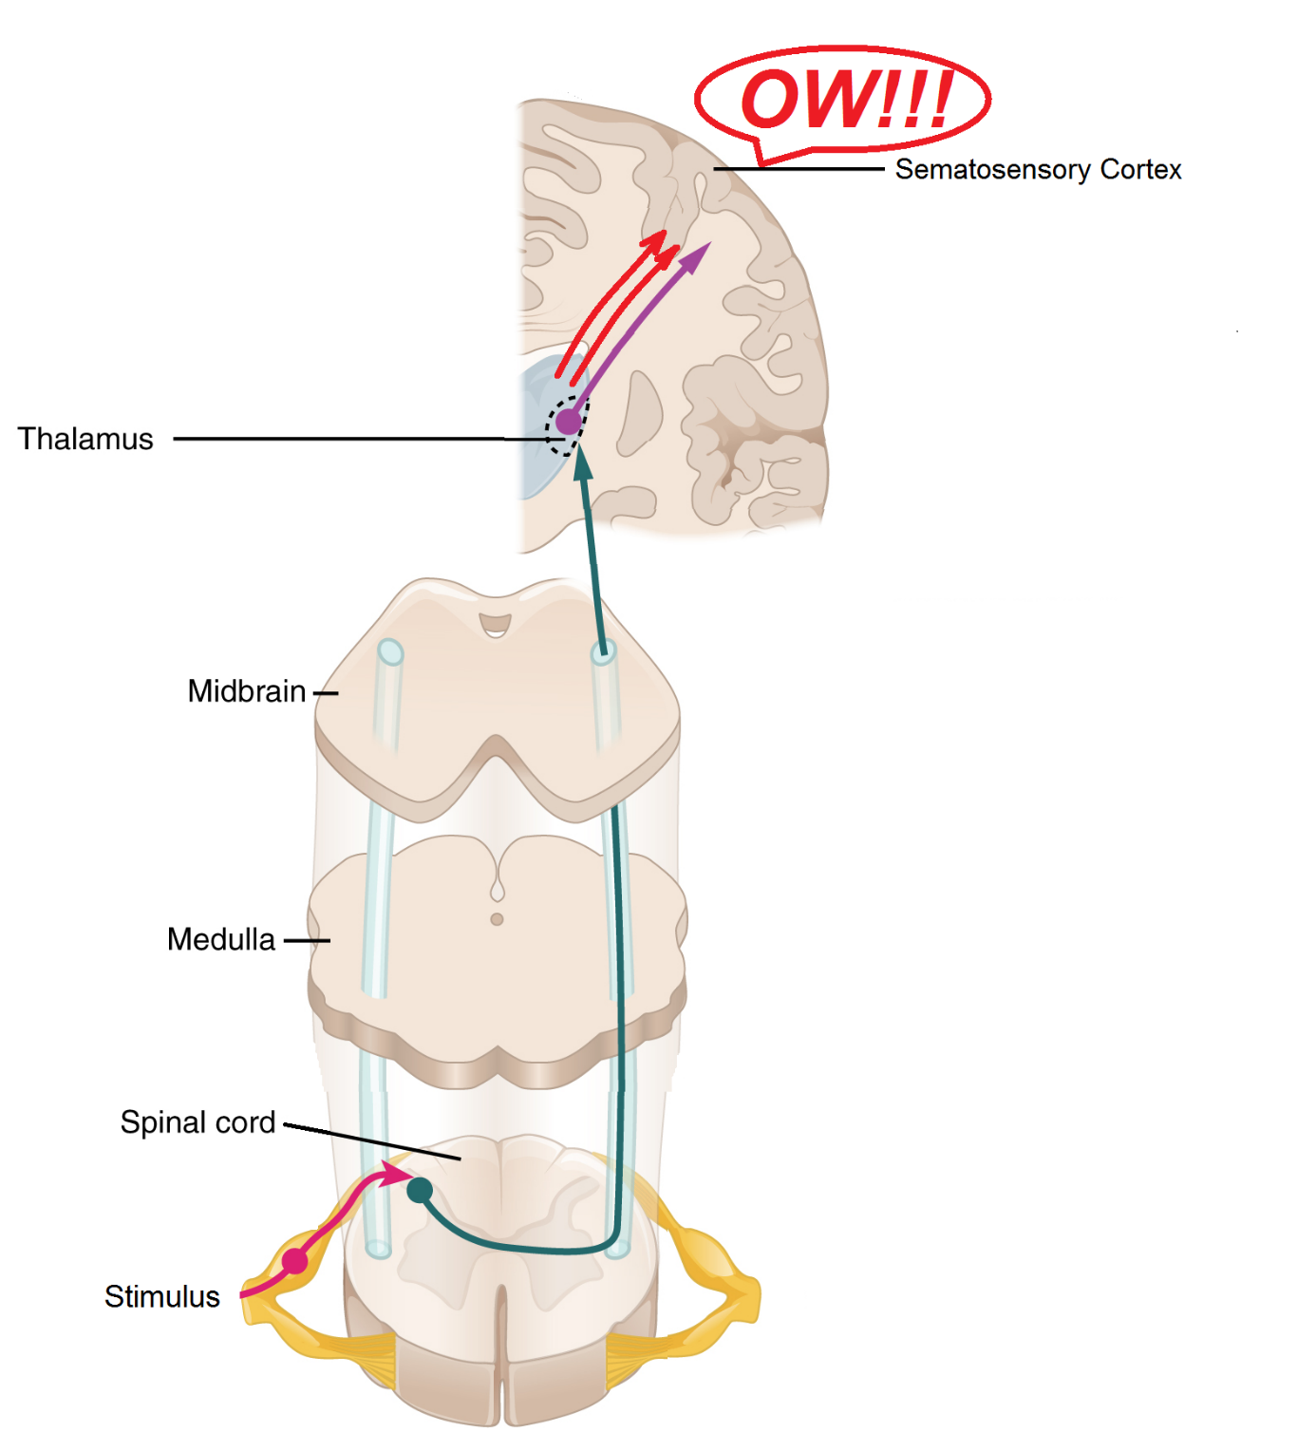
Suprasegmental Central
Sensitization and
Increased Pain¹⁰
Stress
Depression
Insomnia
Anxiety, fear, insomnia, depression, aggravation⁷
Neurons that fire together wire together
Overlap between emotional and physical pain
Adapted illustration from Anatomy & Physiology, Connexions web site.
OpenStax College. Licensed under Public Domain via Commons

Slide 24
Chemical Response to Sensory Input⁷

Slide 25
The Brain

Slide 26
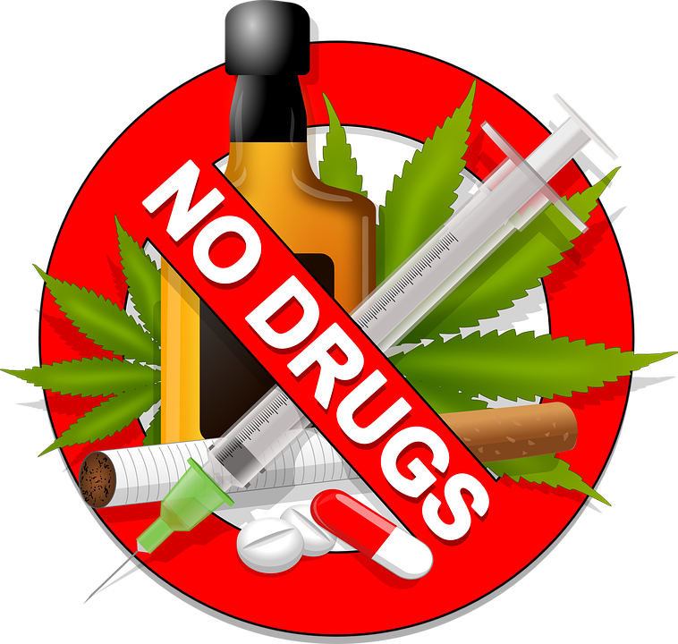
“Back in Control”
Clinical Study⁷
Treatment:
  Active Medication
  Expressive Writing
  Cognitive Behavioral Therapy (CBT)
  Massage
  Stimulus Response

Slide 27

Monthly Visits
Anxiety – GAD7
Insomnia
Depression – PHQ9
Trauma

Slide 28
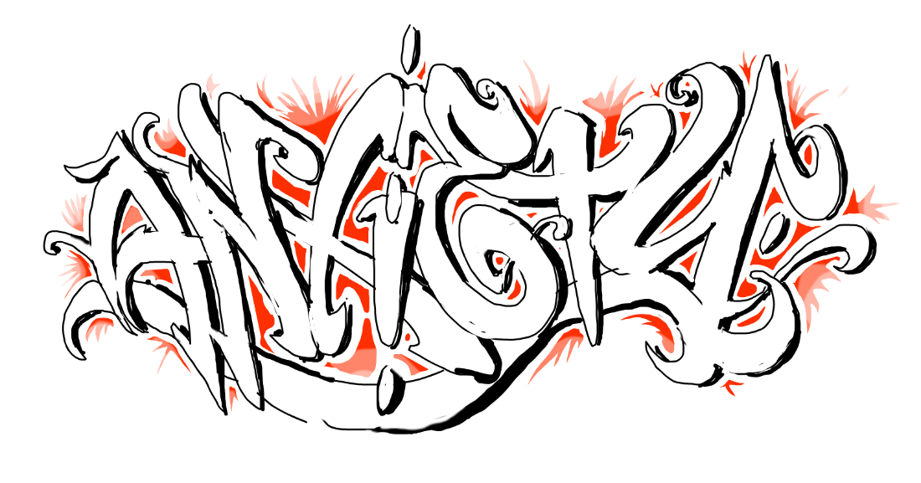
Anxiety
GAD7
Exercise
Expressive Writing
Active Meditation
Medications:
  Hydroxyzine
  Buspirone
  Trazodone
  Clonidine
  Gabapentine
  Propranolol

Slide 29

Insomnia
Sleep hygiene
Expressive Writing
Medications: Non-addicting:
  Trazodone
  Clonidine
  Quetiapine
  Hydroxyzine
  Gabapentine

Slide 30
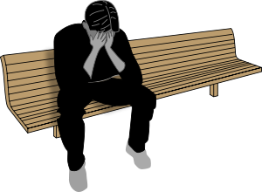
Depression
PHQ9
Other Causes:
  Grief over loss
  Nutrition deficiencies
  Sleep Apnea
Treatment⁸:
  Sleep
  Exercise
  Diet
  Tricyclic and SSRI: Citaloprom, Sertraline

Slide 31
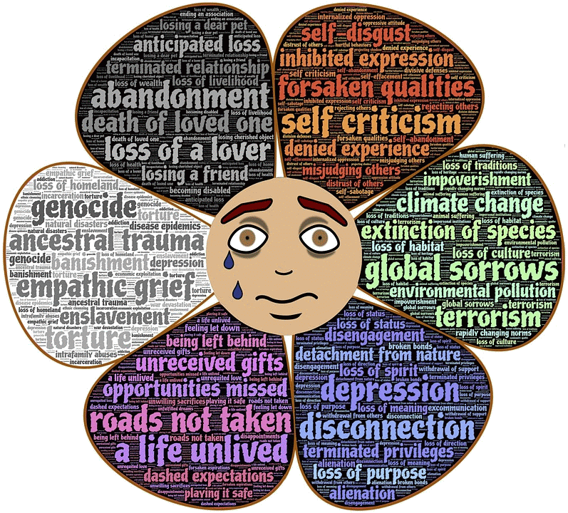
Trauma
Being able to feel safe with other people defines mental health
Foster safety, predictability and being known and seen
First step is acknowledging that a child is upset: then calm him, then explore the cause and possible solutions
Prime reason for habitual drug use in teens is they cannot stand the physical sensations that signal fear, rage and helplessness⁹
Treatments¹⁵:
  Prazosin
  Sertraline
  Venlafaxine
  CBT
  Transcranial magnetic stimulator

Slide 32
R E S T R I C T E D
AG 200.6 HEADQUARTERS 6TH INFANTRY DIVISION
07 APO 5
GENERAL ORDERS
NUMBER 118
SECTION I – AWARDS OF SILVER STAR
* * *
By direction of the President, under the provisions of the Act of Congress approved 9 July 1918 (Bull 43 WD 1918) a SILVER STAR is awarded by Commanding General, 6th Infantry Division, APO 5, to the following named officers and enlisted men:
* * * * *
Private First Class FORREST T. MCAULIFFE, 37451827, Infantry, United States Army, For gallantry in action against the enemy at Bayanan, Luzon, Phillippine Islands on 22 March 1945. During an enemy attack, the communication wire of a company defending the area was cut so that observers of supporting mortars and weapons could not call for or direct their fire. Private McAULIFFE, armed with an automatic rifle, rose in his foxhole which was on the edge of the perimeter nearest the attack. With utter disregard for his own safety and oblivious of the fire on all sides, he halted the Japanese advance until communications were restored. During the attack on enemy positions that followed, his company was caught in a barrage of Japanese 150mm mortar fire which inflicted many casualties. Private McAULIFFE worked his way through the continuous mortar fire, removing the dead and evacuating the wounded until all had been rescued to a place of safety. Home address: Mrs. Mary McAuliffe (Wife), 411 Baratoga Ave. Marshall, Minnesota.
* * * * * * * * * *
BY COMMAND OF MAJOR GENERAL HURDIS:
OFFICIAL: /t/BRUCE PALMER, JR
/s/EMORY L. FOWLER Colonel, GSO
/t/EMORY L. FOWLER Chief of Staff
Major AOD
Adjutant General
X TRUE EXACT COPY:
JAMES T. NICKELS
1st Lt., 20th Inf.
Adjutant
R E S T R I C T E D

Slide 33
Conclusion
Brain Model
Be:
  Good animal - move
  Child - play
  Saint - commitment

Slide 34
Stress – 3 Syndromes
Avoid
Relax
Sleep
Exercise
Hobbies
Service
3 Friends
Express emotions
Prayers

Slide 35
THE FOUR AGREEMENTS²⁰
Be impeccable with your word
Don’t take anything personally
Don’t make assumptions
Always do your best

Slide 36
Helpful, Hopeful, Peaceful = Acceptance, Gratitude

Slide 37
We are what we repeatedly do.
Excellence, then, is not an act, but a habit.
Will Durant

Slide 38
Sources
Murthy H. (2017) Surgeon General’s Report on Alcohol, Drugs and Health, JAMA, 317(2), p133-134
Char, J. (1972) Drug Use in Vietnam, American Journal of Psychiatry, 129(4), 123-125
Hsor, Y. (2017) Opioid Addiction: Alarming Death Rate in Primary Care, J Addict Med. Published online April 2017. Abstract
Weiss, R. (2016) Why Do People with Addictions Seek to Escape Rather Than Connect? A look at the approach to addiction treatment
Suzuki, W. (2015) Healthy Brain, Happy Life, 196
Longo, A. (2016) Neurobiologic Advanced from the Brain Disease Model of Addiction, NEJM, 374(4), 363-370
Hanscom, D. (2016) Back in Control, p 18, 132, 152
Maksimowski, M. (2017) Targeting Depression: Primary Care Tips and Tools, JFP April 2017, Vol 66 No 4, p 244-249
Kolk, B. (2015) The Body Keeps the Score, 354
Stahl, S. (2008) Stahl’s Essential Psychopharmacology, 790, 801, 952-954
Chapman, G. (2016) Keeping Love Alive As Memories Fade, p14
Cuddy, A. (2015) Presence, p71-73
American Society of Addiction Medicine (2011), ASAM News, Vol 26 No 3, p1
American Society of Addicition Medicine (2017), ASAM Weekly, 7/5/2017
Arieh Shalev, Israel Liberzon, et. al., Post-Traumatic Stress Disorder, New England Journal of Medicine, June 22, 2017, 2459-69
Richard J. Bonnie, et. al. (2017) Both Urgency and Balance Needed in Addressing Opioid Epidemic, JAMA, August 1, 2017, 318, p423
Brat GA et. al., (2018) Postsurgical Prescriptions for Opioid Naïve Patients and Association with Overdose and Misuse, BMJ 2018 Jan 17
Erin Krebs, (2018) Effect of Opioid vs. Nonopioid Medication on Pain-Related Function with Chronic Back Pain or Hip or Knee Osteoarthritis Pain, JAMA, 319(9), p872-882.
Darnall, BD, et. al., (2018) Patient-Centered Prescription Tapering in Community Outpatient with Chronic Pain, JAMA 2018, Feb 19
Don Miguel Ruiz, (1997) The Four Agreements

