Slide 1
Case Manager Attitudes & Expectations
WATCP Coordinators Conference 2022

Slide 2
Objectives
Participants will examine the evidence that case manager attitudes and expectations play a role in client outcomes.
Participants will identify attitudes and expectations that will improve client outcomes
Participants will discuss ways to encourage these traits in case management staff

Slide 3
“The relationship is necessary…to bring about behavior change.” (Spiegler & Guevremont 2003)
This is the MINIMUM necessary to generate behavior change
Absent the ATTITUDES that allow for relationship building, there CANNOT be behavior change
Attitudes toward clients and EBP can be predictive of outcomes
24% of the difference between those who are burned out vs. those who are satisfied with their job is directly attributable to attitudes toward clients

Slide 4
Attitudes and Professional Alliance
Working alliance
“has found to be related to client motivation and readiness for treatment, and … predictive of substance abuse treatment retention and outcomes.” (Redko et al. 2007)
“build self-esteem, self-confidence, regain a sense of identity different from their previous drug-using lifestyle, and consequently seek substance abuse treatment. (ibid)
Based on Hubble, Duncan, & Miller 1999

Slide 5
Attitudes and Professional Alliance
Positive Rapport
Poor Rapport
Decrease recidivism
Increase recidivism
More likely to take advice
Increase compliance
Increased violations
Increase agent/CM safety
Less likely to seek assistance
“While programs utilizing evidence-based practices can be effective in reducing recidivism (Chadwick et al., 2015), our study suggests that offender outcomes might also be significantly improved by simply enhancing the supervision process to incorporate techniques associated with the establishment of supportive rapport.”
(Gricius & Chamberlain 2017)

Slide 6
What attitudes are necessary to form a quality professional relationship with your clients?

Slide 7
Important Note
“Supportive rapport between a parolee and parole officer is based on trust, helpfulness, and professionalism; it is not based in the sociability of the relationship. When parolees perceive that they have supportive rapport with their parole officer, their likelihood of recidivating decreases. Relatedly, perceived non-supportive rapport (which captures a lack of interest and helpfulness on the parole officers’ part) on the part of the parolee tends to increase recidivism.” (Gricius & Chamberlain 2017)

Slide 8
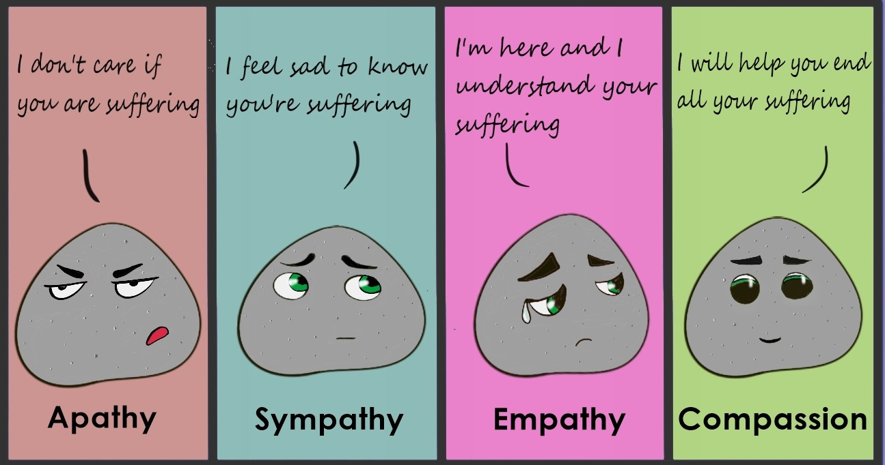
Beliefs & Attitudes that foster behavior change
I want to help you overcome your suffering
https://www.mantranam.com/comic-strip/

Slide 9
Beliefs & Attitudes that foster behavior change
What does this mean?
Strength-Based
Client strengths, abilities, and assets are emphasized during assessment and planning
Client’s retain control over goal-setting and resource/treatment choice
The relationship between client and provider is important
Client’s community seen and treated as a resource not a barrier
Case management as an active community-based process
“Clients often perceive their own selves as their biggest barrier to following through with treatment.” Redko 2007

Slide 10
Beliefs & Attitudes that foster behavior change
Case Manager as Advocate
Not just about managing conditions
“The paramount goal when dealing with substance abuse clients and diverse services with frequently contradictory requirements is the need to promote the client’s best interests.” SAMHSA 2015
“For criminal justice clients, advocacy may entail the recommendation of sanctions to encourage client compliance and motivation.” SAMHSA 2015

Slide 11
Beliefs & Attitudes that foster behavior change
Respect
Respect is given (clients may not know how to earn it) and modeled as a pro-social behavior
Understand change is difficult and respects effort
Positive feedback = Character + Behavior
Negative feedback = Behavior NOT Character

Slide 12
Beliefs & Attitudes that foster behavior change
Non-Judgment
An extension of respect
Unconditional Positive Regard
Seeing the person, no matter what
Interacting without judgement
It is about respect NOT liking nor approving
The negative is neutral
NOT painting lipstick on a pig
“If you think it's about smiling and nodding, you are doing it wrong… UPR only makes sense as a way to be with others if you think the theory behind it is right. But more than that, if you don’t buy the theory, you won’t actually be able to do it—no matter how hard you try.” (Stephen 2012)

Slide 13
Beliefs & Attitudes that foster behavior change
Client Hope Self-Efficacy ( connected to Strengths Based)
The client has capacity to solve their own problems (although may need guidance or assistance)
Working WITH vs. fixing FOR the client
Time pressure?
Process or outcome?
Consequences for failure regardless of effort?
In order to succeed, people need a sense of self-efficacy, to struggle together with resilience to meet the inevitable obstacles and inequalities of life.
Albert Bandura

Slide 14
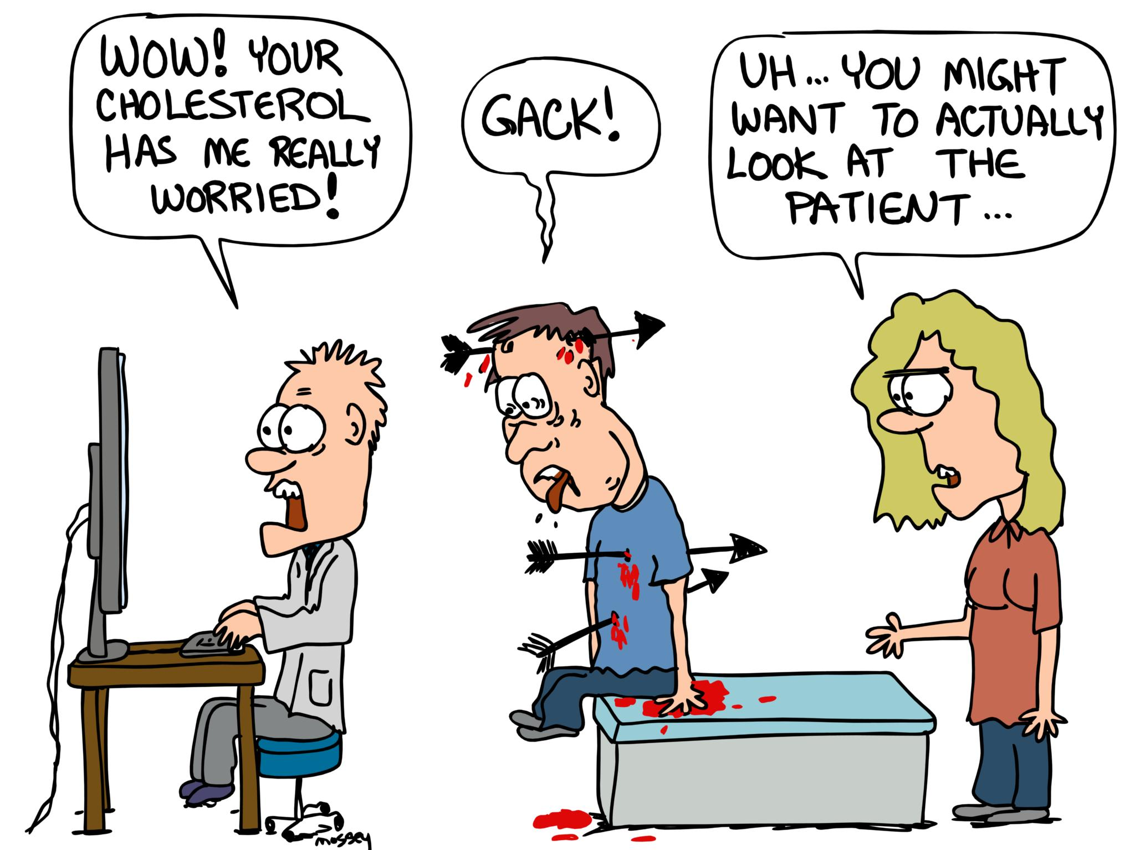
Beliefs & Attitudes that foster behavior change
Flexible
Able to change approach when there are challenges or lack of progress
Change approach but keep structure and focus on criminogenic needs
More of the same or try something different
Roll with resistance
Client Driven ( connected to Strengths Based)
Applying specific responsivity
https://dailytimes.com.pk/330512/doctors-need-to-learn-empathy/ (edited)

Slide 15
Beliefs & Attitudes that foster behavior change
Community Based ( connected to Strengths Based)
The client does not exist in a vacuum
Recovery is about re-integration with the community and the creation of new relationships and resources to foster resiliency
Pragmatic
Meet the client where they are at
Focus on tangible concrete goals that are desired by the client and achievable
Explicitly teaching skills
Responsivity Principle – Social Learning Theory/Skill Streaming

Slide 16
Cultural Sensitivity – 5 necessary elements
Valuing Diversity
Cultural Self-Assessment
Understanding the Dynamics of Cultural Interaction
Incorporating Cultural Knowledge
Adapting Practices to the Diversity Present in the Population
What we do and how we do it should match our client base not our staff base
“based on a review of 117 published and unpublished studies is that ‘attention to BOTH fidelity and adaptation is essential for successful implementation of evidence-based substance abuse prevention programs.’”
Burlew et al. 2013

Slide 17
Final Thoughts
“Although certain skills may enhance the ability to assist clients, these may only be useful in the context of a trusting and respectful relationship where the clients are shown respect and given help in identifying their personal strengths.” – Redko et al. 2007
“Outcomes are almost always lower than anticipated. There is a tendency to rely too heavily on EBP instead of focusing on building healthy, long-lasting and respectful relationships with clients.” – Taxman & Belenko 2011

Slide 18
“The relationship is necessary but not sufficient to bring about behavior change.” (Spiegler & Guevremont 2003)
What you do (expectations) is how behavior change is achieved
Attitudes open the door, expectations are how we walk through the door

Slide 19
Adaptation of EBP
Findings of Perdoni, Taxman, & Fletcher 2008
72 counties and 644 potential respondents
This was more optimistic than some other similar studies
Only 4 of 13 measures were adopted by over half of agencies
Only “use of comprehensive treatment methods that address multiple needs” was implemented in over 75% of agencies
Several measures implemented in <15% of agencies
Average of 5 of 13 competencies implemented
“This body of research overwhelmingly suggests practitioner attitudes toward EBPs can either facilitate or impede adoption and implementation of EBP” (Viglione 2018)

Slide 20
Areas of Competency
Criminal Justice Competencies
Recovery Oriented Competencies
Treatment Workforce Competencies
Ability to work with criminal justice stakeholders within a legal framework while adhering to evidence-based practice.
Ability to work with people from a strengths perspective, support people’s recovery process, support dignity of risk
Ability to work with people respectfully, navigate regulations, recognize roles of different workers, work independently, etc.
General Workforce Competencies
Ability to get to work on time, interact with other co-workers and supervisor, pick up on the cultural norms of the agency, communicate needs & respond to others’ communications, etc.
CBP & Social Learning Theory

Slide 21
Difficulties Meeting Expectations
Asking case managers to have expertise that is equivalent of master’s experience
Even in master’s programs exposure to the knowledge in our field is not present
EBP
CBP
Behavior Change
Social Learning Theory
“To date, the articulation of EBP has been primarily a “top down” process, one aimed at meeting scientific concerns rather than clinical applications, and which has paid scant attention to organizational and other barriers to implementation and sustainability” – Belenk, Wexler, & Taxman 2008

Slide 22
What Works
Administrators who report goals that embrace organizational learning and change
Defined strategy to implement and sustain EBPs
Administrators who prioritize training for staff
Additional training for supervisors who oversee implementation
Policies that integrate services with treatment providers.
Administrators that prioritize staffing needs
Existing demands
Ongoing coaching and support
Organizations that promote a positive attitude toward clients’ ability to change, treatment over punishment, and belief in EBPs
Build capacity to sustain change
Cadre of trainer and coaches
Cross-organizational teams

Slide 23
What Works: Belenko, Wexler, & Taxman 2008

Slide 24
Final Thought
“The evidence upon which we have drawn all concludes that any positive impact which correctional measures can have upon offenders [sic] will rely heavily upon the personal relationship with the various staff with whom they interact.”
Dowden & Andrews 2004

Slide 25
Contact Information
Jason Chapman
Training and Quality Control Coordinator
jchapman@justicepoint.org
Cell: 262-825-4245

Slide 26
References
***Belenko, S., Wexler, H. K., & Taxman, F. (2008). Technology transfer of evidencebased practice (EBP) in substance abuse treatment in community corrections settings. Washington, DC: National Institute of Corrections. Accessed 9/27/22 https://www.researchgate.net/profile/Harry-Wexler/publication/237706683_Technology_Transfer_of_Evidence-based_Practice_in_Substance_Abuse_Treatment_in_Community_Corrections_Settings/links/00463531f9072341ce000000/Technology-Transfer-of-Evidence-based-Practice-in-Substance-Abuse-Treatment-in-Community-Corrections-Settings.pdf
Burlew AK, Copeland VC, Ahuama-Jonas C, Calsyn DA. Does cultural adaptation have a role in substance abuse treatment? Soc Work Public Health. 2013;28(3-4):440-60. doi: 10.1080/19371918.2013.774811. PMID: 23731430; PMCID: PMC4220306. Accessed 9/27/22 https://www.ncbi.nlm.nih.gov/pmc/articles/PMC4220306/#R28
Center for Substance Abuse Treatment. Comprehensive Case Management for Substance Abuse Treatment. Treatment Improvement Protocol (TIP) Series, No. 27. HHS Publication No. (SMA) 15-4215. Rockville, MD: Center for Substance Abuse Treatment, 2000. Accessed 9/27/22 https://store.samhsa.gov/sites/default/files/d7/priv/sma15-4215.pdf
Chamberlain, A. W., Gricius, M., Wallace, D. M., Borjas, D., & Ware, V. M. (2018). Parolee–parole officer rapport: Does it impact recidivism?. International Journal of Offender Therapy and Comparative Criminology, 62(11), 3581-3602. Accessed 9/27/22 https://www.academia.edu/download/55447387/Chamberlain__Gricius__Wallace_2017.pdf
Fulton, B., Stichman, A., Travis, L., & Latessa, E. (1997). Moderating probation and parole officer attitudes to achieve desired outcomes. The Prison Journal, 77(3), 295-312. Accessed 9/27/22 https://www.academia.edu/download/41441253/Moderating_Probation_and_Parole_Officer_20160122-4434-141xcms.pdf
Fulton, Betsy & Stichman, Amy & Travis, Lawrence & Latessa, Edward. (1997). Moderating Probation and Parole Officer Attitudes to Achieve Desired Outcomes. Prison Journal - PRISON J. 77. 295-312. 10.1177/0032855597077003005. Accessed 9/27/22 https://www.researchgate.net/publication/246857294_Moderating_Probation_and_Parole_Officer_Attitudes_to_Achieve_Desired_Outcomes
Gallavan, D. B., & Newman, J. L. (2013). Predictors of burnout among correctional mental health professionals. Psychological services, 10(1), 115. Accessed 9/27/22 https://scholar.archive.org/work/5lnd33lsmrg5xff2qagzo2tsfu/access/wayback/http://construct.haifa.ac.il/~azy/Gallavan_4.pdf
Hubble, M. A., Duncan, B. L., & Miller, S. D. (1999). The heart and soul of change: What works in therapy. American Psychological Association.
Hunter, S.B., Han, B., Slaughter, M.E. et al. Associations between implementation characteristics and evidence-based practice sustainment: a study of the Adolescent Community Reinforcement Approach. Implementation Sci 10, 173 (2015). https://doi.org/10.1186/s13012-015-0364-4 Accessed 9/27/22
Idrogo, Jasmine & Yelderman, Logan & Blomquist, Martha‐Elin & Broadus, Angela. (2021). Perceived and Actual Knowledge Gain among Juvenile Drug Treatment Court Team Members: A Pre‐Post Analysis of On‐Site Training and Technical Assistance. Family Court Review. 59. 10.1111/fcre.12545. Accessed 9/27/22 https://www.researchgate.net/publication/354630140_Perceived_and_Actual_Knowledge_Gain_among_Juvenile_Drug_Treatment_Court_Team_Members_A_Pre-Post_Analysis_of_On-Site_Training_and_Technical_Assistance

Slide 27
References
Lacey Schaefer & Gemma C. Williams (2018): The Impact of Probation and Parole Officers’ Attitudes about Offenders on Professional Practices, Corrections, DOI: 10.1080/23774657.2018.1538710 Accessed 9/27/22 https://doi.org/10.1080/23774657.2018.1538710
Latessa, E.J. (PowerPoint) Evidence Based Practices: What Gets in the Way and some Ideas to Help Systems Move Forward. Accessed 9/27/22 https://slideplayer.com/slide/11975943/
Mathews, B. (2015). An examination of criminal justice curricula in Colorado: Searching for evidence-based practices. Journal of Criminal Justice Education, 26(4), 357-370. Accessed 9/27/22 https://www.researchgate.net/profile/Brandon-Mathews/publication/276839652_An_Examination_of_Criminal_Justice_Curricula_in_Colorado_Searching_for_Evidence-based_Practices/links/555a2b6408ae6943a877cad7/An-Examination-of-Criminal-Justice-Curricula-in-Colorado-Searching-for-Evidence-based-Practices.pdf
Murphy, A., Rhodes, A. G., & Taxman, F. S. (2012). Adaptability of contingency management in justice settings: survey findings on attitudes toward using rewards. Journal of substance abuse treatment, 43(2), 168–177. https://doi.org/10.1016/j.jsat.2011.11.004 Accessed 9/27/22
REDKO, C., RAPP, R. C., ELMS, C., SNYDER, M., & CARLSON, R. G. (2007). Understanding the Working Alliance Between Persons with Substance Abuse Problems and Strengths-Based Case Managers. Journal of psychoactive drugs, 39(3), 241-250. Made available by Doctor Redko upon request – thank you!
Skeem, Jennifer & Eno Louden, Jennifer & Polaschek, Devon & Camp, Jacqueline. (2008). Assessing Relationship Quality in Mandated Community Treatment: Blending Care With Control. Psychological assessment. 19. 397-410. 10.1037/1040-3590.19.4.397. Accessed 9/27/22 https://www.researchgate.net/publication/5762663_Assessing_Relationship_Quality_in_Mandated_Community_Treatment_Blending_Care_With_Control
Stephern J., Unconditional Positive Regard. (2012). Retrieved 3 October 2022, from https://www.psychologytoday.com/us/blog/what-doesnt-kill-us/201210/unconditional-positive-regard
Viglione, J. (2018). A multi-level examination of organizational context on adult probation officer attitudes toward evidence-based practice. International journal of offender therapy and comparative criminology, 62(5), 1331-1356. Accessed 9/27/22 https://globcci.org/wp-content/uploads/2021/07/Adult-Probation-Officer-Attitudes-Toward-Evidence-Based-Practice-in-the-U.S.-2018.pdf

