Slide 1
Coordinator 101
Presented by:
Heather Kierzek, statewide problem-solving coordinator
Kristin Schier, Grant county treatment court coordinator

Slide 2
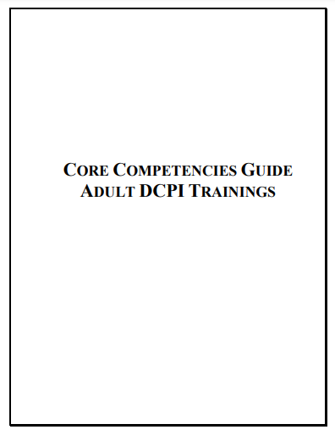
Learning targets
Understand the complicated role of a treatment court coordinator
Understand the unique responsibilities of a coordinator in Wisconsin
Notes:
Engage audience: ask years of experience, rural or urban

Slide 3
“A drug court coordinator oversees the activity of the team, conducts quality assurance of each team member, maintains client data, remains informed regarding budgetary concerns of the drug court and coordinates services from each discipline, and the local community, in a manner that is most therapeutic to the drug court participant.”
Notes:
Discuss how this could vary in counties - if you are a new coordinator discuss your specific role with your supervisor / judge / team.

Slide 4
Core competency 1
Participates fully as a Drug Court team member, committing him or herself to the program mission & goals and works as a full partner to ensure their success.
Notes:
Schedule regular meetings focused on program structure, revisits program mission, goals & objectives w/team, arranges team building activities, conducts quality assurance of all services

Slide 5
Core competency 2
As part of the drug court team, in appropriate non-court settings (i.e. staffing), the coordinator reports on previous incentives and sanctions or lack thereof.
Notes:
Assists, in selection of participants, works w/ the team to create appropriate incentives/sanctions, creates files for each participant, maintains a log of incentives/sanctions and assures consistency of incentives/sanctions

Slide 6
Core competency 3
Is knowledgeable of addiction, alcoholism and pharmacology generally and applies that knowledge to suggest responses.
Notes:
Creates open dialogue w/treatment provider to ensure appropriate treatment, gathers information to keep team members informed, conducts quality assurance to ensure appropriate treatment and actively participates in staffings.

Slide 7
Core competency 4
Is knowledgeable of gender, age and cultural issues that may impact the offender’s success.
Notes:
Arranges training opportunities to inform team members about cultural competence and conducts quality assurance to assure application of cultural competence by all team members

Slide 8
Core competency 5
Develops team resource strategy to acquire funding. Writes grant applications and manages the program’s budget. Creates opportunities to obtain funding and build linkages by supporting team in community outreach and lobbying activities.
Notes:
Obtain training on grant seeking and writing, create long-term funding plan, with team, not solely dependent upon grant funding, research potential funders and other sources of revenue for program, investigate how other programs obtained and maintained funding, practice grant writing in advance of actually submitting applications, create effective book keeping system including an inventory of drug court supplies

Slide 9
Core competency 6
Participates in the planning process to create and memorialize program eligibility standards, operating procedures and rules. Assist in the development of the client contract, confidentiality releases and entry procedures. Create MOUs and linkage agreements.
Notes:
Scheduling planning meetings, brainstorms with entire team on ideal program structure then compromises with team
members regarding structure of program during planning process meetings, Memorializes all agreed upon terms of the program structure, Gathers information needed for team members to make informed decisions

Slide 10
Core competency 7
Negotiates and monitors treatment and ancillary service contracts. Conducts site visits, reviews progress reports and assists in audits and certification monitoring. Creates and monitors standards for urine collection and compliance reporting. Ensure gender, age and culturally specific treatment services.
Notes:
Researches best practices for treatment and ancillary services, Informs treatment provider about expectations including appropriate progress reports for treatment court purposes, works with team members from treatment, community supervision and law
enforcement to create most effective urine collection and compliance reporting model
for the treatment court program then seeks input from other team members before finalizing a method, helps to promote a productive work environment where each team member can
participate, gathers information needed to keep team members informed

Slide 11
Core competency 8
Create and maintains a data collection system to monitor client compliance, identify trends and provide a basis for evaluation.
Notes:
Seeks out Management Information Systems (MIS) to collect data, works with Evaluator to create an effective method of data collection, consistently inputs data - CORE
Reviews information collected and shares with team members
Works with Evaluator to interpret statistical relevance -

Slide 12
Core competency 9
Create interagency linkages to address client’s ancillary needs in the areas of culture, age and gender needs, medical and mental health provision, educational, vocational, skills training and employment training and placement.
Notes:
Maps out providers in community, arranges meeting with providers to begin process of building a relationship, develop memoranda of understanding with providers willing too offer services to treatment court clients, monitor treatment court participant’s involvement with ancillary services

Slide 13
Core competency 10
Develop police and corrections linkages to improve supervision and agency coordination.
Notes:
Keep law enforcement informed about progress of treatment court clients and supervision
efforts, extend invitations to all drug court events, share statistical data showing positive impact of drug court on local community

Slide 14
What does all this actually look like?
Finding common goals and rolling with resistance
Facilitating difficult conversations with team members
Building and fixing relationships with community members, agencies, employers, county leaders
Finding money and resources to support your clients many and varied needs
Grant reporting, data entry/management, budgeting, program evaluation

Slide 15
What does all this actually look like?
Case flow management
Document, document, document
Training, training, training

Slide 16
CASE Flow management
Notes:
It’s important to intervene at the right time. Failing to address responsivity needs first, will not allow your participants to address any of the other needs they have. Addressing needs in this order will increase engagement in the program which will increase successful program completion and lower recidivism.

Slide 17
Wrap around services
TRANSPORTATION
Notes:
The more wrap around services your program can provide, the more successful your participants will be. Reducing barriers for your participants is one of the main priorities of a treatment court program.

Slide 18
Special requirements for Wisconsin coordinators
If you are TAD funded
CORE reporting
eGrants reporting

Slide 19
challenges
Managing multiple directives across diverse team member agencies/organizations
Having responsibility but not authority to make changes
Directing the work of team members but not having supervisory authority
Lack of resources (financial, treatment providers, judicial, etc)

Slide 20
HELP!!
Coordinator listserv
State courts website
Treatmentcourts.org

