Slide 1
Custom and Traditions
Utilized within a Healing to Wellness Court

Slide 2
History
Tribal Healing to Wellness Court team includes not only tribal judges, advocates, prosecutors, police officers, educators and substance abuse and mental health professionals, but also tribal elders and traditional healers. “The concept borrows from traditional problem-solving methods utilized since time immemorial and utilizes the unique strengths and history of each tribe.”

Slide 3
Purpose
Elevates importance of tribal identities, culture, spiritual beliefs, and practices as essential for improving well-being
Ensures cultural wisdom and traditional practices are taken into account and supported as fundamental elements of programs, policies, and activities for improving behavioral health

Slide 4
Common Beliefs
Ho-Chunk life is centered on the four seasons and the natural world.
Traditional spirituality is not a ‘religion’ so much as it is a way of life.
Native spirituality and beliefs are sacred. To use them in any way other than the way they were intended would be sacrilegious.
Learning to live in the traditional ways is not easy.

Slide 5
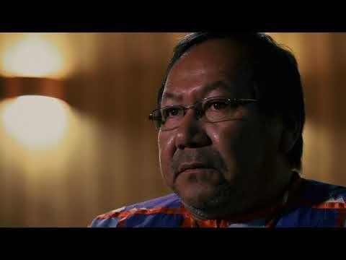
People of the Big Voice

Slide 6
Beliefs Common to Most Tribes
There is a Supreme Being, a Creator, a Great Spirit, God.
Everything the Great Spirit has created is good.
Many lesser spirits wander the earth, some control weather, some interact with humans, some inhabit the underworld.
Plants and animals, as well as humans, are part of a spirit world.
This spirit world exists side-by-side with the physical world and often intermingles with this physical world.
Before you were conceived, before you were born, you had a spirit.
When your body dies, your spirit will live on.
Take care of Grandmother Earth, and Grandmother Earth will take care of you.

Slide 7
Teaching Values
    Responsibility
    Duty
    Courage
    Leadership
    Honesty
    Respect
    Generosity
    Honor
    Love
    Harmony
    Balance
    Wisdom

Slide 8
Traditional Roles – Children
  Responsibilities
  Respect the Elders
  Seek Knowledge from Elders
  Learn to be Quiet and Listen
  Learn by Example
  Learn, through play, by practicing what they see

Slide 9
Traditional Roles – Men
Patrilineal (females respect for male relatives)
Kinship to be respected
Respect for self & others
  Protectors (Warriors) – Keep tribe safe
  Hunters – Provided for tribe
  Planners
  Conduct Ceremonies
  Made items for Rituals/Ceremonies
  Teach older children

Slide 10
Traditional Roles – Women
  Gathering
  Process food
  Cook
  Make garments
  Take care of home
  Take care of young children
  Planners
  Family ties handed down through women

Slide 11
Traditional Roles – Elders
  One thing I liked about Elders is they thought about things before they would say anything. They told me that as I get older and experience life, things will start to make sense to me.
  For example, I would ask an Elder a question. He wouldn’t respond right away. He would take his time before he answered my question. When he did answer, I thought to myself that’s not the answer I was looking for. But later when something I came up that I didn’t know how to deal with it. I would think about what my Elder told me, then what he told before made sense to me.

Slide 12
Health and the Disabled
  Traditionally being healthy and a whole person were essential to living a good life.
  Some tribes visualized health as a medicine wheel with four parts – spiritual, mental, physical, & emotional.
  In order to be healthy, all aspects of the medicine wheel had to be in balance.
  Another concept is that man is three-fold – mind, body, & spirit.
  Wellness is harmony in body, mind, & spirit.
  Wellness is often a choice.

Slide 13
Health and the Disabled (Continued
  A physical disability is irrelevant to a person’s state of wellness.
  Wellness can be accomplished in a wheelchair or without a leg. If the body is healthy, if the mind is sharp, if the individual is following their beliefs and choosing to be in harmony with their environment, then a physical disability is irrelevant to wellness.
  How to deal with a physical disability is not something I would think about. Instead, I would probably look at how to enhance my ability to fulfill my role within the community.

Slide 14
Health and the Disabled (Continued
  We are all responsible for our state of wellness; with the way we promote harmony between ourselves and the people we meet.
    It is not the events that happen to him [man] that create his harmony, but his response to those happenings. Every human chooses the responses he makes, and thus in this way, he chooses whether or not to be in harmony. Being able to stand firm in his harmony is a priceless accomplishment for the Indian, for it means the disruptions of the world cannot affect him. (Locust, 1985, p. 11)

Slide 15
Traditional Leaders
  They cared about people, not just family, but the whole tribe.
  They respected the people around them.
  They served the people. The leaders often would not eat until everyone else in the tribe had eaten.
  They were honest. They did not lie.
  They were courageous. They dared to do what needed to be done.
  They were not afraid to face reality and define problems.

Slide 16
Ho-Chunk Traditional Values and Spirituality
“Our children are taking their lives, our families are being torn apart, our culture is disappearing because of substance abuse, suicide and violence, it is time to act by committing our time, ideas and resources to stop this destruction.”

Slide 17
Summary
  This presentation summarizes some of the ideals, beliefs, and values of traditional Ho-Chunk ways.
  These are the values we need to hold on to if we wish to live a good life.
  These are the values we must build upon if we wish to grow.
  Each Tribe has similar ideals, beliefs and values.
  These are the values we must spread to our non-Indian brothers and sisters if America is going to grow as a country.

