Slide 1
Understanding Historical Trauma in Native Populations
Simone Ninham, MSW, APSW
Oneida Nation Healing to Wellness Court Coordinator

Slide 2
Objectives
What is Historical Trauma?
How does Historical Trauma present in the populations we serve?
How culture and community can help in healing

Slide 3
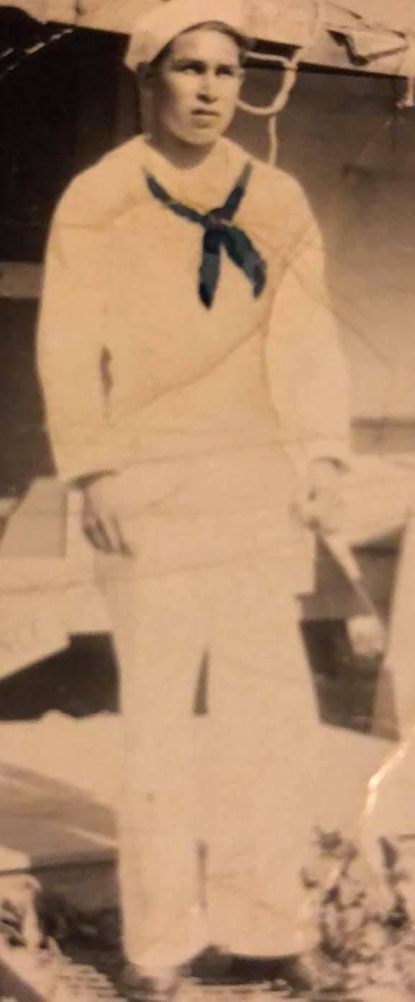
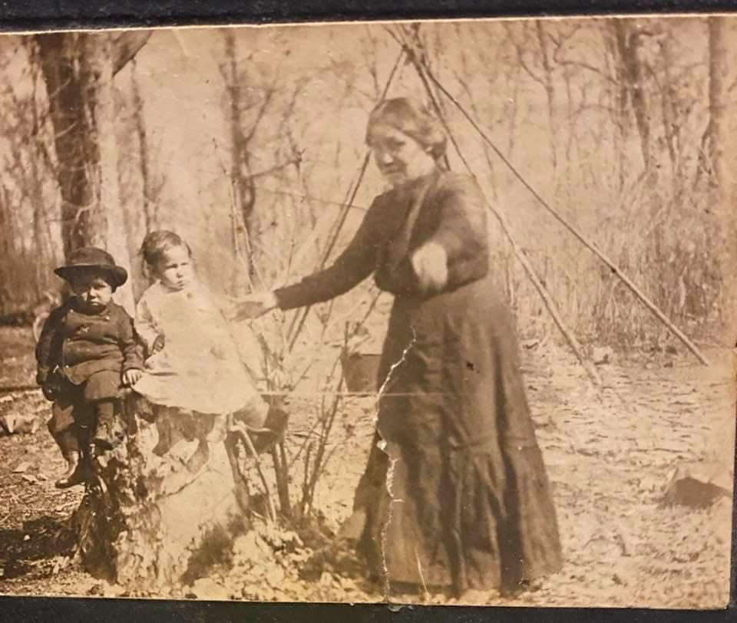
About Me

Slide 4
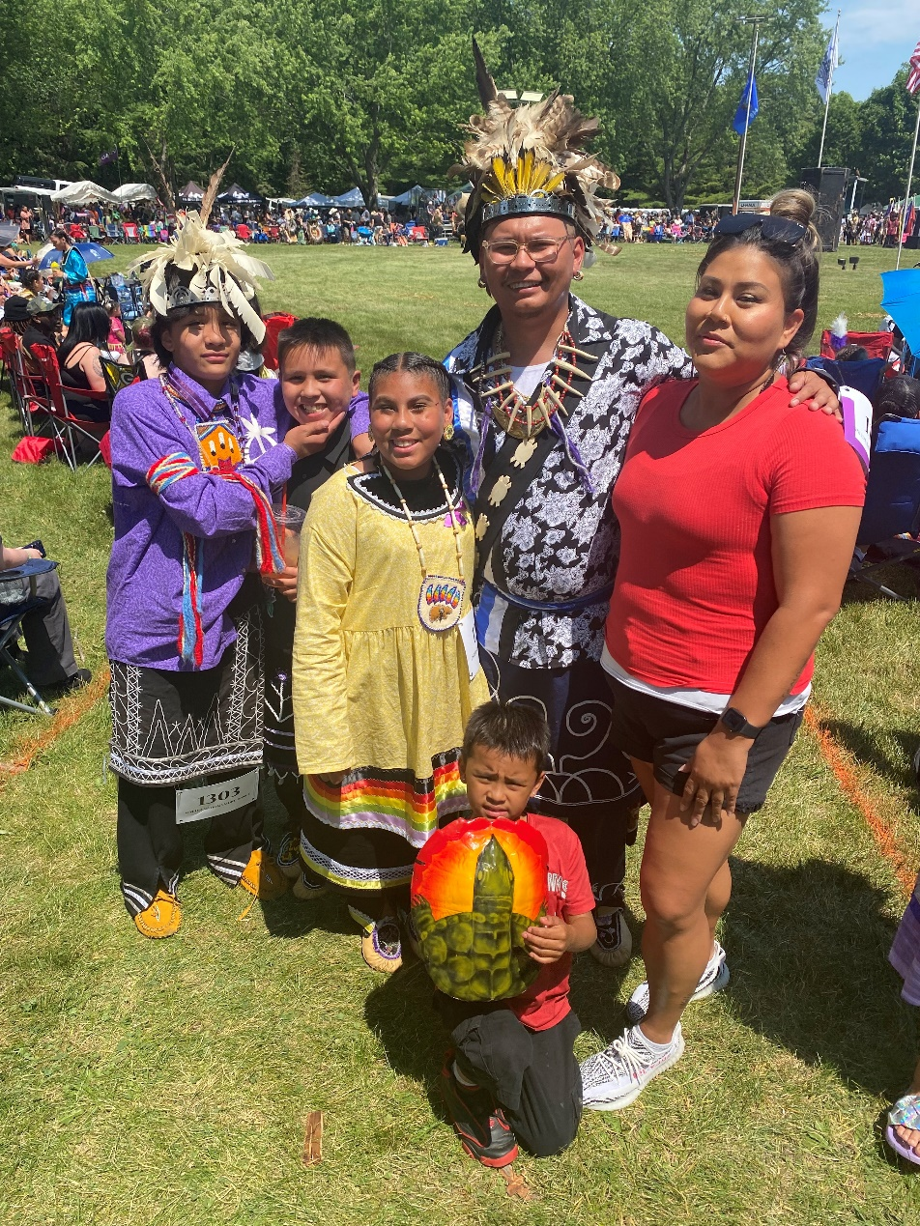

Slide 5
What is Historical Trauma?

Slide 6
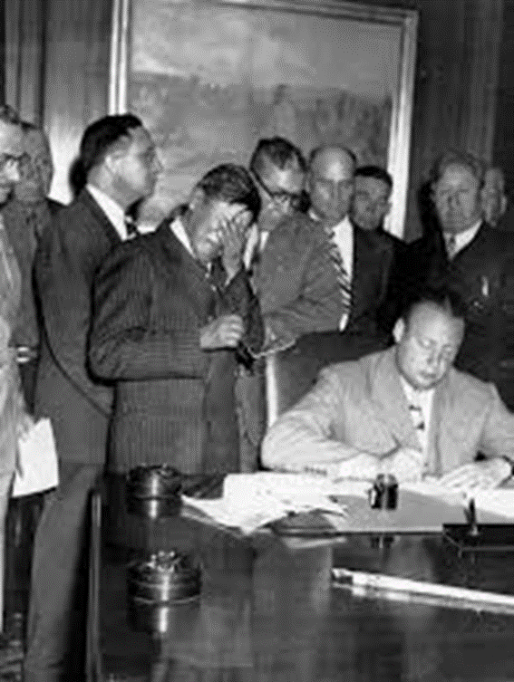
Federal Indian Policy
Contact
Removal (1830s-1850s)
Allotment and Assimilation Era (1880s-1940s)
Boarding Schools (1860s-1960s)
Termination and Relocation Era (1940s-1960s)
Self-Determination Era (1960s-now)
American Indian Religious Freedom Act (1978)

Slide 7
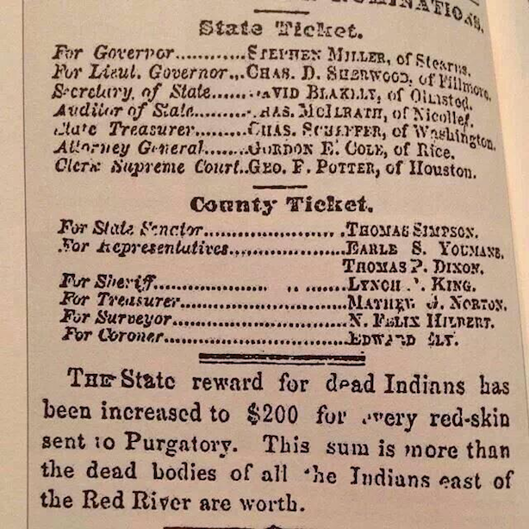
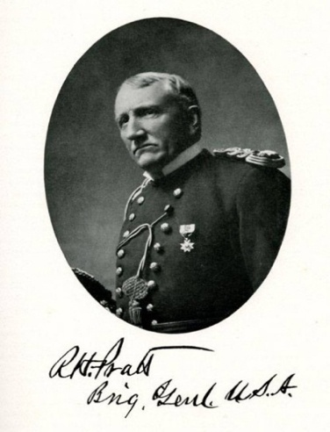
"A great general has said that the only good Indian is a dead one, and that high sanction of his destruction has been an enormous factor in promoting Indian massacres. In a sense, I agree with the sentiment, but only in this: that all the Indian there is in the race should be dead. Kill the Indian in him, and save the man." — Gen. Richard Henry Pratt

Slide 8
Historical Trauma
Developed by Maria Yellowhorse Braveheart, PhD (Hunkpapa/Oglala Lakota) in the mid-1980’s and has become critical in understanding the impact of colonization on Native populations
Historical trauma is cumulative emotional and psychological wounding over the lifespan and across generations, emanating from massive group trauma
The historical trauma response is a constellation of features in reaction to massive group trauma
This response is observed among Lakota and other Native populations, Jewish Holocaust survivors and descendants, Japanese American internment camp survivors and descendants

Slide 9
How Historical Trauma Presents in the Populations We Serve

Slide 10
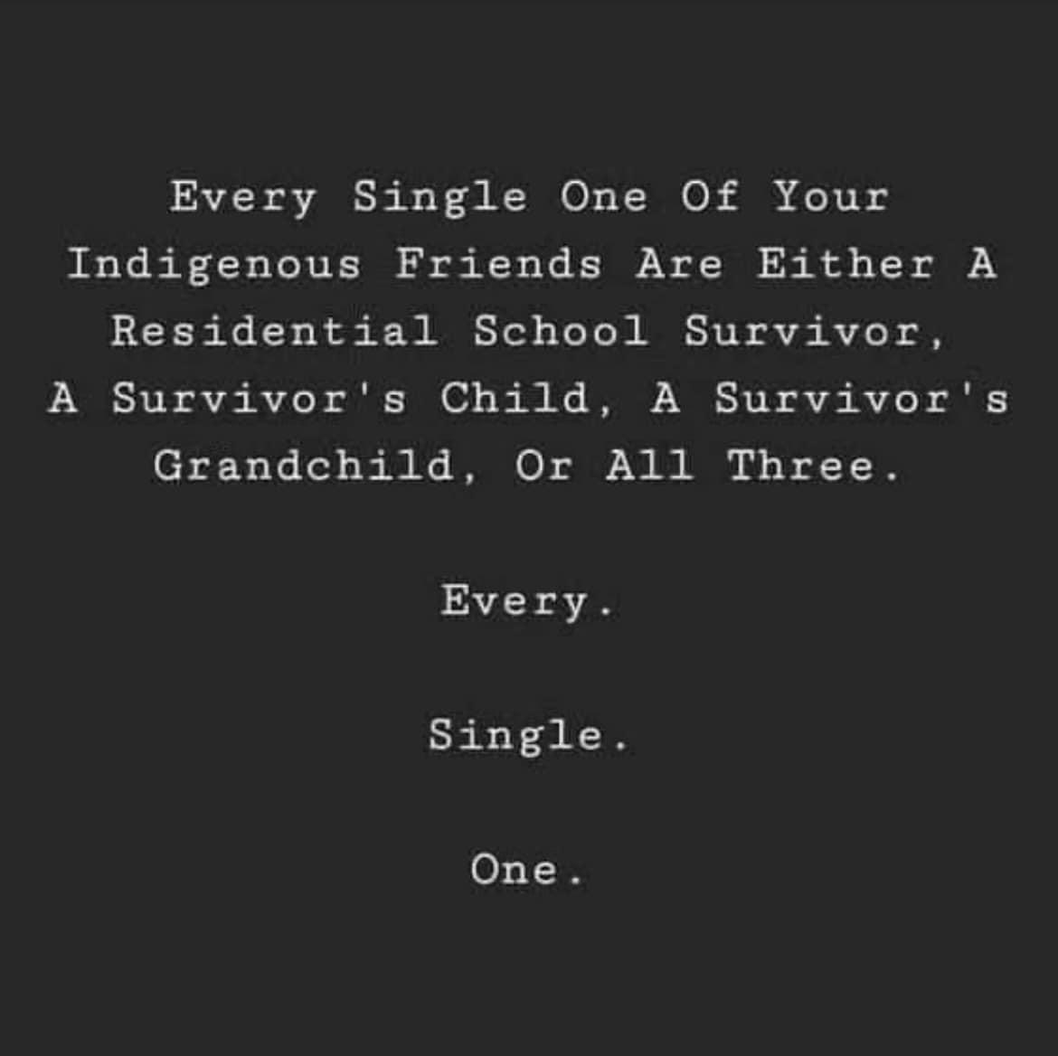

Slide 11
Can present as:
Anxiety disorders
Depression, mood disorders, and other symptoms of mental illness
Fearfulness or unwillingness to take risks
Hypervigilance
Separation anxiety
Unrealistic fears about dying or losing a loved one
Increased risk of substance abuse
Uncharacteristic behavior and acting out
Intense feelings of shame
Social avoidance and withdrawal

Slide 12
Parenting
Relationships
Substance use
High mortality rates
Lower life expectancy
Suicide
Lateral violence
Mental health
Childhood trauma

Slide 13
How Culture and Community Can Help in Healing

Slide 14
Releasing the historical trauma through healing and reclaiming traditional protective values and practices
Language revitalization
Tribal ceremonies, beliefs, and practices
Identify an elder/spiritual leader within the community who can serve as a mentor
Look at multiple layers of cultural identity
Tribal, gender, military status, etc.

Slide 15
Focus on Healing
We are survivors
We are resilient
We are committed to healing

Slide 16
Video
https://www.youtube.com/watch?v=Gs0iwY6YjSk

Slide 17
Yaw^ko! Miigwech!
sninham2@oneidanation.org

