Slide 1
Identifying Decision Points Through the Lens of the Adult Best Practice Standards
Addressing Racial and Ethnic Disparities (RED) in Treatment Courts:
Taylor DeClerck, Program Manager
Shawn Rogers, Senior Program Manager
Notes:
Taylor

Slide 2
Notes:
Taylor

Slide 3
Notes:
Taylor

Slide 4
Overview
Systemic Disparities
History
Interpersonal Disparities
Equality vs Equity
Implicit Bias/Cultural Humility
Operational Disparities
RED Decision Points
Action Planning
Notes:
Taylor
We recognize that conversations on disparities require much more than an hour and a half workshop. We hope this is the beginning of a long–term commitment on so many fronts in the criminal legal system. We’re going to walk you through the steps we’ve identified as necessary components to address disparities in treatment courts. We call it the three leg stool or the triangle effect.
The three components are addressing systemic disparities, by reviewing national disparities, state specific disparities, treatment courts disparities, and the history of the war on drugs.
The second component is the interpersonal disparities, where we discuss equality vs equity and implicit biases that impact how we engage with others base on unconsciencous associations and experiences
And the third is operational disparities, how our courts and stakeholders can improve disparities through indentifying decision points to improve court operations by action planning.
Additionally, you may hear terms today that you’re familiar with and some you may not be, we will provide a list of terms and definitions along with the presentation for you that you can download with the presentation slides. I refer to individuals as clients, we use the term people of color or bipoc individuals, which stands for black, indigenous, people of color. You may hear latinx or black and brown individuals also, cultural humility and cultural responsiveness.
It’s an interactive presentation so we will engage you. We may not get through every slide, that’s ok, this work takes time and we can come back and do more work with your state if we’re asked to.

Slide 5
Systemic Disparities
Notes:
Shawn

Slide 6
Indigenous Land Acknowledgement https://native-land.ca/
Notes:
Shawn
I'd like to start this presentation with a land acknowledgement to give respect to the indigenous lands we are on today. This map is showing a snapshot of North America with an emphasis on Wisconsin and how many native America tribes and territories are represented in this geographic area. If you can take a minute to go to the link and put in your address.
This is a good lens for us to start with always, but in particular for this session where we are going to be talking about equity, inclusion, and tangible steps for making our court and programs more inclusive.
Each of us has a history, experience, and ancestry that has led us here today and we want to acknowledge that though have diverse backgrounds, we can come together for the goal of equity.
We also have distributed a language sheet along with these materials, we may use some language today that is new or unfamiliar and that sheet serves to set the common ground for our conversation today.

Slide 7
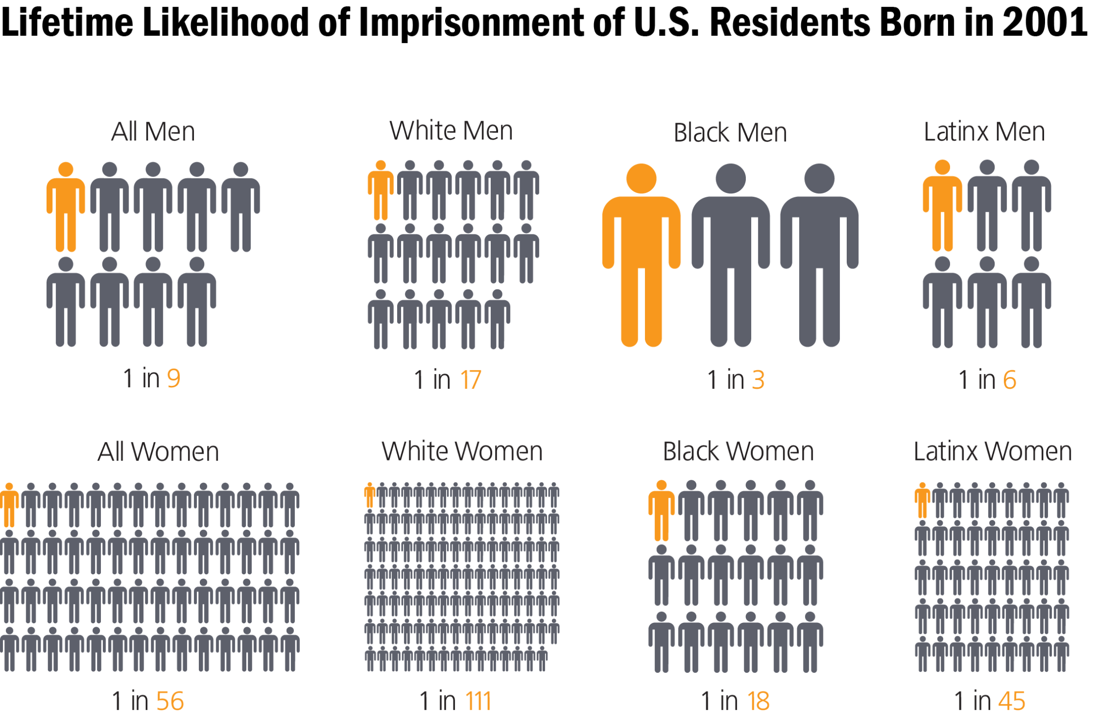
National Snapshot
Disproportionate impact of the criminal legal system on Black and Latinx people.
The Sentencing Project: Bureau of Justice Statistics. Download infographic
Notes:
Shawn
Between 1972-2009, the U.S. prison population increased nearly 700%. In the subsequent decade, there was an 11% decrease in the prison population. If this rate of decline continues, it will take 55 years, or until 2078 to cut the prison population in half.
During the 37 year explosion in incarceration rates (1972-2009), the rates of incarceration were vastly different for different racial and ethnic groups. ​
​
On December 31, 2014, Black males (1,072 prisoners per 100,000 black male residents ages 18 to 19) were 10 times more likely to be in state or federal prison than white males (102 per 100,000). ​
​
2016: Black males ages 18 to 19 were 11.8 times more likely to be imprisoned than white males of the same age. This age group had the highest black-to-white racial disparity in 2016.​
​
 The imprisonment rate for black females (96 per 100,000 black female residents) was almost double that for white females (49 per 100,000 white female residents).

Slide 8
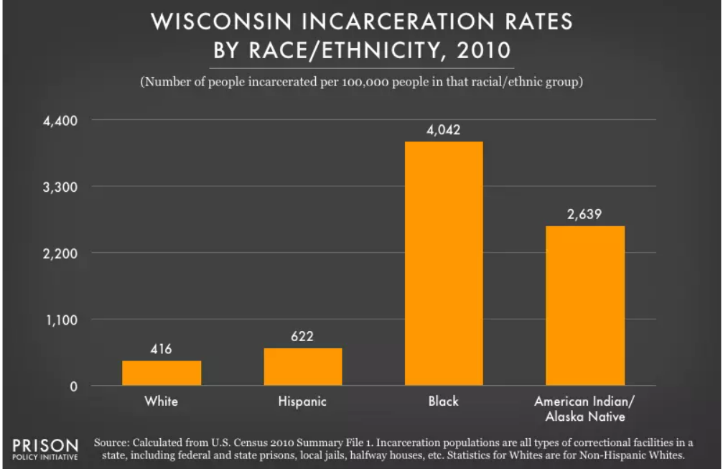
Racial Disparities in Wisconsin
Notes:
Shawn
This slide show Wisconsin specific incarceration rates (it’s based on 2010 data, so it is a bit dated).
The graph on the left shows incarceration rates per 100,0000 for whites, Hispanics, blacks, Indigenous people.
White 416 per 100,000
Hispanics: 622 per 100,000
Blacks: 4,042 per 100,000 (in Wisconsin, if you are black you are 10x's more likely to be incarcerated than a white person)
Indigenous: 2,639 per 100,000 (in Wisconsin, if you are indigenous you are about 6 times more likely to be incarcerated than a white person)
The graph on the right highlights the racial and ethnic disparities in prisons and jails in Wisconsin by comparing state’s population to the state’s prison / jail population.
Whites: 83% of state’s population; 52% of the state’s incarcerated population
Blacks: 6% of the state’s population; 38% of the incarcerated population
Latinos: 6% of the state’s population; 6% of the incarcerated population
Native / indigenous people: 1% of the state’s population; 4% of the state’s incarcerated population.

Slide 9
Racialized War on Drugs “Nothing has contributed more to the systematic mass incarceration of people of color in the United States than the War on Drugs.” -Michelle Alexander, The New Jim Crow (2010)
1830s: alcohol (Indigenous peoples)
1870s: opium (Chinese immigrants)
1900s: cocaine (emancipated Black Americans)
1930s: cannabis (Mexican immigrants)
1970s: Nixon & the War on Drugs (poor Black Americans)
1980s: Reagan & Crack (100:1 sentencing)
Drug criminalization and racial disparities as of 2018 (via DPA)
Notes:
Shawn
This slide shows the history of how the War on Drug has been racialized.
This is a condensed timeline of significant moments in the history of prohibition. While it's not exhaustive, it's clear that drug users have been disproportionately targeted throughout these flashpoints. Each of these historical junctures is intricate and multi-faceted, and just barely touching on the highlights.
What's often been historically unspoken, but is better understood today, is that in every instance when a substance was criminalized or a new campaign against a specific drug was initiated, it served dual purposes.
First, it aimed to control the moral and physical well-being of society,
and secondly, it played a role in managing or even subjugating one or more societal groups. Supporting prohibition doesn't necessarily equate to favoring the subjugation of certain groups, and 99.99% of individuals that support prohibition probably don't support subjugation of particular group. However, at each turn in drug policy, communities of color have borne the brunt of harm, policing, and undoubtedly of incarceration. There is no data to refute this pattern.
The War on Drugs:
Has NOT achieved a reduction in substance use. As witnessed it recent years, it has certainly not diminished fatalities related to substance use. (112,000 deaths per year; 306 per day) Equivalent to losing a Boeing 777 airline each day.
Has undoubtedly contributed to mass incarceration and the racial disparities in the carceral system.
1830s: Alcohol (Indigenous Peoples)
1830: Indian Removal Act Signed by Andrew Jackson
Resulted in forced relocation of tribes to the Oklahoma Territory (Trail of Tears)
1834: The Indian Trade Act signed by Andrew Jackson
Meant to ”control” native populations who had already been recently displaced and traumatized, and who had been stereotyped as frequent abusers of alcohol.
Banned alcohol from reservations. Importantly, this didn’t result in cessation of alcohol use among native populations, it just pushed the market underground.
1870s Opium (Chinese Immigrants)
1870: San Francisco makes it a misdemeanor to “maintain or frequent” an opium den (first jurisdiction to regulate drug use in the United States)
1850-1870s: Influx of Chinese immigrants to the West Coast (particularly the Pacific NW down to Northern California)
Prohibition of opium and targeted enforcement of the prohibition exacerbated racist attitudes towards Chinese
1884: Chinese Exclusion Act of 1884
Halted Chinese immigration for 10 years, then permanently, wasn’t repealed until 1943
1880s-1890s: Above efforts didn’t stop opium use by any population.
Although the opium-related laws that criminalized opium specifically targeted Chinese immigrants, the majority of people addicted to opium, estimated at 60% of people with an opioid use disorder, were white women.
Dr. Frederick Heman Hubbard, in his landmark 1881 book “The Opium Habit and Alcholism” said that “uterine and ovarian complications cause more ladies to fall into the [opium] habit, than all other diseases combined”.
1900s: Cocaine (emancipated Black Americans)
Cocaine was predominately a problem in white communities
White communities promoted fear of black men using cocaine
Reinforced racist stereotypes about black men
Depicted them as more dangerous, murderous, and threatening to white women
Government Response:
In 1912 President William Taft labeled cocaine as Public Enemy No. 1
President Wilson signed the Harrison Act in 1914
Act regulated the distribution and sale of cocaine
Marked the beginning of the federal government involvement in the regulation of narcotics and and what would eventually be called controlled substances
[American history of subjugating or oppressing black communities]
Until 1865 – Slavery
1875 – 1964/1965 – Jim Crow
1970 – War on Drugs
Disproportionately targeted black and brown communities
Anti-Drug Abuse Act of 1986
100:1 Sentencing (Crack / Cocaine) The "Crack Cocaine 100:1 Disparity" was a significant and controversial sentencing policy in the United States that imposed much harsher penalties for offenses involving crack cocaine compared to offenses involving powdered cocaine. Under this policy, someone convicted of possessing or distributing a given amount of crack cocaine faced a mandatory minimum sentence 100 times greater than for the same amount of powdered cocaine.
_____________________________
1900’s cocaine: once black Americans and white Americans could no longer use slavery as their method of oppression, they turned to others methods. White communities stoked fears of black men using cocaine and becoming homicidal and unable to be stopped. Images long present in racists tropes about black men, that specifically try to impart unsubstantiated fear based on their skin and bodies, as being more dangerous, murderous, and will rape and terrorize white women. President William Taft proclaimed cocaine as Public Enemy No. 1, and in 1914 the Congress passed the Harrison act, which tightly regulated the distribution and sale of cocaine. Reality was that cocaine was overwhelmingly a white problem at this time.
1870’s and opium: Chinese immigrants were coming to the US in larger numbers from 1850-1870s and working for lower wages (due to necessity and companies taking advantage of their immigration status) than white/US workers. Used attitudes towards Chinese immigrants use of opium as a method to stereotype Chinese immigrants. San Fransciso in 1870 was the first place to regulate drug use by making it a misdemeanor to maintain or frequent an opium den. Racism towards Chinese immigrants continue to grow and were propelled by the criminalization of opium and targeted enforcement, and it eventually helped lead to the Chinese exclusion act of 1884, limiting Chinese immigrants from entering the US for 10 years then permanently and not repealed until 1943. Did not stop opium use by any population. In fact by 1800s, women made up more than 60 percent of opium addicts. “Uterine and ovarian complications cause more ladies to fall into the [opium] habit, than all other diseases combined,” wrote Dr. Frederick Heman Hubbard in his 1881 book, The Opium Habit and Alcoholism.
Deeper history: Britain and China were currently engaged in the Opium wars- had been used medicinally for centuries and regulated differently in different countries. Opium smugglers were coming from the west. Hong Kong is ceded to the British in the Chinese defeat of the first opium war. Chinese immigrants were fleeing the opium wars which were being used in order to give Britain access to Opium trade.
Let’s start with the 1830’s and talk about prohibition- The Indian Trade Act was signed by Andrew Jackson in 1834 (modified the original from 1790), and it banned alcohol from reservations. This came not long after he had issued the Indian Removal Act of 1830 which forcibly relocated tribes to the Oklahoma Territory and resulted in what was known as the Trail of Tears. Meant to “control” native populations who had been displaced and traumatized and using the stereotype of alcoholism as a basis. Researchers at the University of Arizona have shown the incidence of problem drinking among Native Americans to be very similar to whites. Have been prohibited from establishing distilleries on reservations for the next 200 years. Did not stop native populations from drinking- American soldiers sold whiskey to the reservations under the table and then were able to enforce punitive laws if needed.
There are a lot of examples on this slide that I am going to gloss over for sake of time, but for New York we can focus in on the 1970’s and the Rockefeller drug laws. These which mandated lengthy prison sentences for people convicted of a range of felony drug offenses. These laws contributed to dramatic increases in state prison populations. Under the Rockefeller drug laws, the penalty for selling two ounces (57 g) or more of heroin, morphine, "raw or prepared opium", cocaine, or cannabis or possessing four ounces (113 g) or more of the same substances, was a minimum of 15 years to life in prison, and a maximum of 25 years to life in prison. on January 1, 2002, there were 19,164 inmates in New York State prisons under RDL (median age 35 years, 78% New York City residents, 94% black and Hispanic). Journal of Urban Health: Bulletin of the New York Academy of Medicine
Deeper history: Britain and China were currently engaged in the Opium wars- had been used medicinally for centuries and regulated differently in different countries. Opium smugglers were coming from the west. Hong Kong is ceded to the British in the Chinese defeat of the first opium war. Chinese immigrants were fleeing the opium wars which were being used in order to give Britain access to Opium trade.
1900’s cocaine: once black Americans and white Americans could no longer use slavery as their method of oppression, they turned to others methods. White communities stoked fears of black men using cocaine and becoming homicidal and unable to be stopped. Images long present in racists tropes about black men, that specifically try to impart unsubstantiated fear based on their skin and bodies, as being more dangerous, murderous, and will rape and terrorize white women. President William Taft proclaimed cocaine as Public Enemy No. 1, and in 1914 the Congress passed the Harrison act, which tightly regulated the distribution and sale of cocaine. Reality was that cocaine was overwhelmingly a white problem at this time.
Today- MOUD access
Here’s a truncated timeline of some prohibition flashpoints. It’s certainly not exhaustive, but drug user being targeted the most. Of course, each one of these flashpoints is a complex historical moment onto itself, and I hate to oversimplify, but taken altogether over two centuries, we’ve learned that drug prohibition has always sthese are arguably the most critical junctures in US drug and alcohol policy. What hasn’t always been talked about, but we have a better understanding of today, is that throughout history, every time a substance was made illegal, or a new campaign against a particular drug was being waged, there was a non-white erved two functions, one, to try and control the moral and physical health of society, and two, to help manage or even subjugate one or more groups within a society. If you favor prohibition does it mean you favor subjugating certain groups? Of course not, and most people probably/hopefully fall into that category. That said, at every single drug policy turn, communities of color have been harmed, policed, and jailed the most. There is no data to the contrary. So we certainly can’t call that kind of historical pattern an accident. ​
What the war on drug has NOT done is reduced substance use, and obviously as we have seen in the last two years, it has not reduces death due to substance use. But what it HAS done is contributed to mass incarcerated and disparities within the carceral system. ​
​
Carson, E. A. (2015). Prisoners in 2014. Washington, DC: Bureau of Justice Statistics.​ - Half of men (50%) and more than half of women (59%) in federal prison were serving time for drug offenses on September 30, 2014. Forty-seven percent (81,900) of sentenced federal prisoners on September 30, 2016 (the most recent date for which federal offense data are available) were serving time for a drug offense ​
​
A quarter (25%) of females serving time in state prison on December 31, 2015, had been convicted of a drug offense, compared to 14% of males.

Slide 10
National Landscape: Treatment Court Disparities
National Adult Best Practice Standard II: Equity and Inclusion
Covers access, retention, treatment, and graduation
Still, treatment courts have consistently produced disparate racial/ethnic outcomes in each area
WHAT WE KNOW:
Disparities have been identified in treatment, use of incentives and sanctions, and representation in recovery supports
Non-white participants experience lengthier sentences after program termination
Notes:
Shawn
We lay out this history to put into context our work in treatment courts. With all that I just showed you, we should have an overrepresentation of black and Hispanic participants in our programs—they are arrested and charged disproportionately. But we do not.
Alternatives to incarceration programs should be a way to address some of these disparities by ensuring that those who are overrepresented in the legal system are being off ramped and assessed and referred to services. Treatment court programs should have a high representation and graduation rate of black Americans based on all the information we just heard. But actually research shows the opposite.
RESEARCH HAS SHOWN WHAT WE SUSPECTED FOR YEARS, THAT ALTHOUGH THE NATIONAL BEST PRACTICE STANDARD 2 ADDRESSES EQUITY AND INCLUSION WITH A FOCUS ON EQUITABLE ACCESS, RETENTION, AND COMPLETION, TREATMENT COURTS HAVE CONSISTENTLY PRODUCED DISPARATE RACIAL AND ETHNIC OUTCOMES IN EACH OF THESE AREAS.
ADDITIONALLY, DISPARITIES WERE ALSO IDENTIFIED IN TREATMENT, INCENTIVES AND SANCTIONS, AND RECOVERY SUPPORTS AND NON-WHITE PARTICIPANTS EXPERIENCE LENGTHIER SENTENCES AFTER PROGRAM TERMINATION THAN THEIR WHITE COUNTERPARTS.
THE IMPLICATIONS ARE:
TREATMENT COURTS ARE CONTRIBUTING TO SYSTEMIC HEALTH AND LEGAL DISPARITIES
TREATMENT COURTS ARE CONTRIBUTING TO PARTICIPANT, COMMUNITY, AND SOCIETAL HARM

Slide 11
Interpersonal Disparities
Notes:
TAYLOR
NOW THAT WE HAVE A BETTER UNDERSTANDING OF THE SYSTEMIC AND THE HISTORY, ARE THERE ANY ADDITIONAL QUESTIONS?
SO, HOW DOES OUR HISTORY IMPACT OUR UNDERSTANDING OF INTERPERSONAL DISPARITIES?

Slide 12
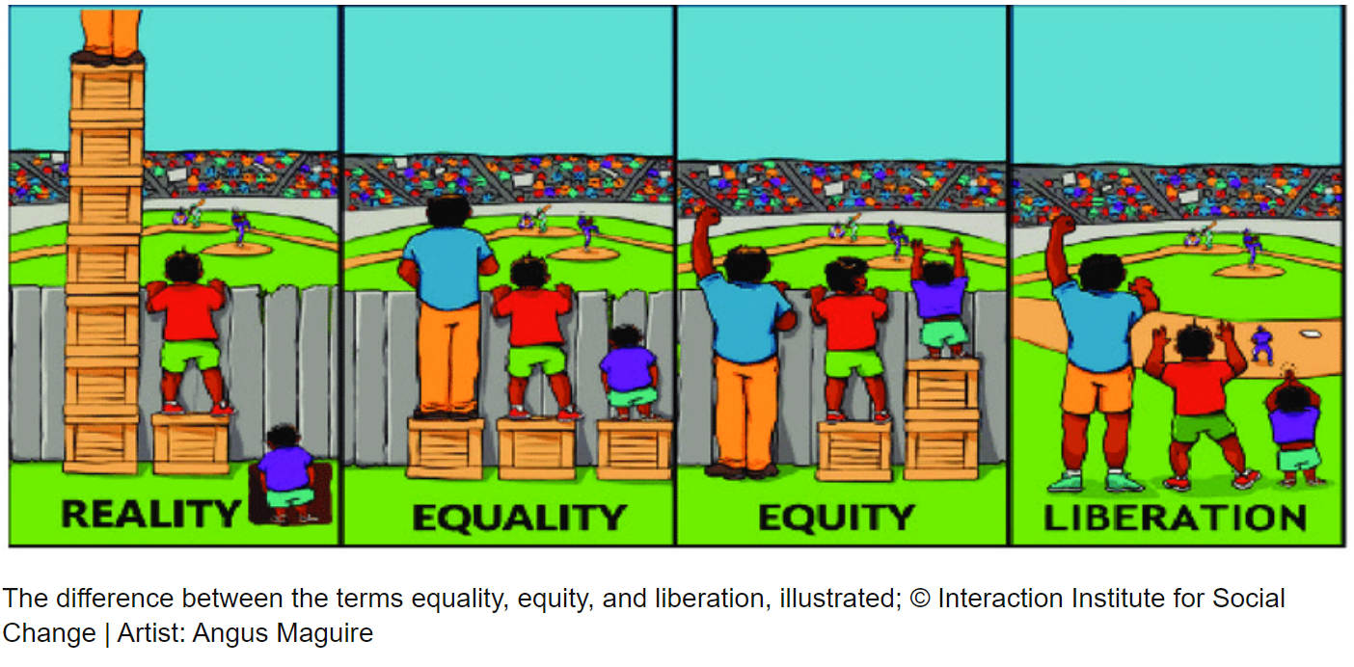
Notes:
TAYLOR
Additionally, when thinking about equality vs equity, these side-by-side images illustrate the difference between groups of people, our clients.
In the image to the left, here’s the reality of disparities. Our clients come to us with various needs and the needs change over the time they’re involved in our courts. The reality is some are trying to get out of the hole and get on solid ground, while others are on solid ground with supports and protective factors.
In the second image, you’ll notice an example of equality, each individual was given one box, the same. The one box represents the same equal service we offer. To make this more accurate, that one box would be given within the context of the first image, the reality. The person on the left would have another box added to the stack of boxes already available, the individual in the middle would have an additional box added to the one currently available, and the third would have a box under ground that may or may not get them to ground level. Those who could see over the fence can still see but better and the other couldn’t before and still can not. The one box, that one service doesn’t improve everyone’s ability to see.
In the image of equity, the individuals are given the appropriate number of boxes to see over the fence. Again, look at the first image of reality, to achieve equity is to provide the appropriate number of boxes to address each individual’s needs. So, the first individual will need fewer services, the middle individual will need more, and the final individual will need the most.
The final image is the removal of the fence. The fence can represent a rigid eligibility criteria that disproportionally impacts people of color, a lack of access to culturally appropriate treatment, or inadequate race and ethnic data collection by the court or other social determinants and disparities that negatively effect people of color. Removing the barriers will lead to equity.

Slide 13
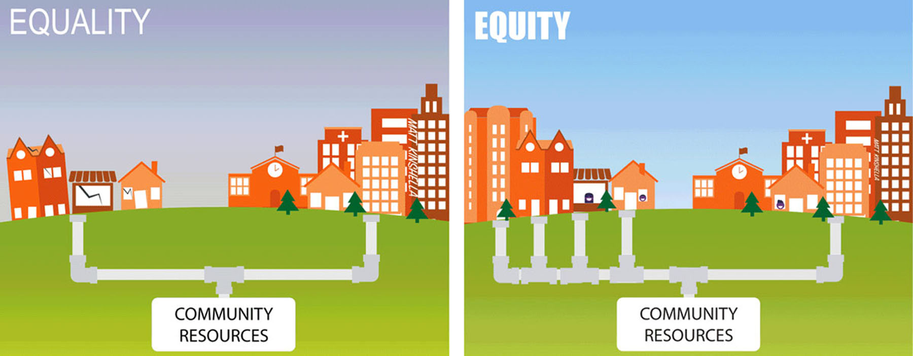
Notes:
TAYLOR
Therefore, when looking at this image of community resources, equality indicates a pipeline that is singularly focused, narrow and fixed, everyone gets the same (this may be the treatment providers you refer to)
While equity has diverse pipelines that addresses various client needs appropriately and accurately. What could some of the other pipelines include? Churches, fraternal organizations, community-based advocacy organizations, native american organizations.
Let’s take a second and ask ourselves, where do we get the one pipeline idea or the everyone gets a shoe concept vs diverse pipelines and everyone gets a shoe that fits?

Slide 14
What do you see? How many triangles do you see? How did you process or identify the number of triangles? Was the process easy or difficult?
Notes:
TAYLOR
Let do a little exercise: we’re going to challenge our brains and the way we do things: look at the image on the right, count how many triangles you see? When you’ve counted them out, shout out the number?
If i had the jeopardy music, i would play it. How many?
Great, how did you process or identify the number of triangles?
Was the process easy or difficult?
The number of triangles is zero, there are actually no triangle on the slide. None of the lines connect to form a complete triangle. So, what’s happening in our brains that allowed you to see triangles?
What it shows us is our brain is wired to fill in the gaps based our experiences, we know what triangles look like and when we see the making of what could be a triangle, our brains identify it as a triangle. That is an association and assumption. Our association and assumptions can lead to seeing people and events in a single or fixed manner, we can categorize individuals based on our associations or assumptions, this is what we call implicit bias.
We have to acknowledge that we all have implicit associations and bias based on what we’ve seen, experienced, and learned from others. Why is that important, implicit associations or biases, can prevent us from providing equitable treatment resulting in more disparities,

Slide 15
Notes:
TAYLOR
WE’RE GOING TO DO ANOTHER EXERCISE BASED ON THE STROOP EFFECT, HOW MANY OF YOU ARE FAMILIAR WITH THE STROOP EFFECT EXPERIMENT.
IN THIS EXPERIMENT, YOU ARE REQUIRED TO LOOK AT THE PICTURE OF AN ANIMAL AND SAY THE NAME OF THE ANIMAL. DO NOT READ THE WORD PLACED ON THE PICTURE. FOR EXAMPLE: IN THE FIRST PICTURE, YOU SHOULD SAY ‘COW’ BECAUSE THE ANIMAL IN THE PICTURE IS A COW. IN THE SECOND PICTURE, YOU SHOULD SAY “CAT” BECAUSE THE ANIMAL IN THE PICTURE IS A CAT.
WE’RE GOING TO DO THIS AS A GROUP, AS SOON AS THE PICTURES APPEAR ON THE SLIDE AND I SAY GO, IDENTIFY THE ANIMALS AS FAST AS YOU CAN, SAY IT OUT LOUD. REMEMBER IDENTIFY THE PICTURE OUT LOUD.

Slide 16
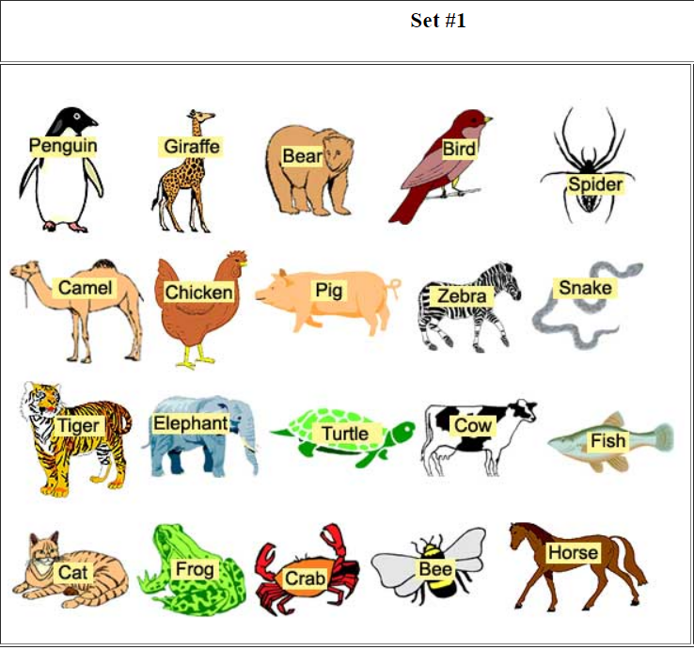
Notes:
TAYLOR
GO
How was it? Was that easy or hard to do?
Ok, we’re going to do it again, remember you’re going to say out loud the picture not the word.

Slide 17
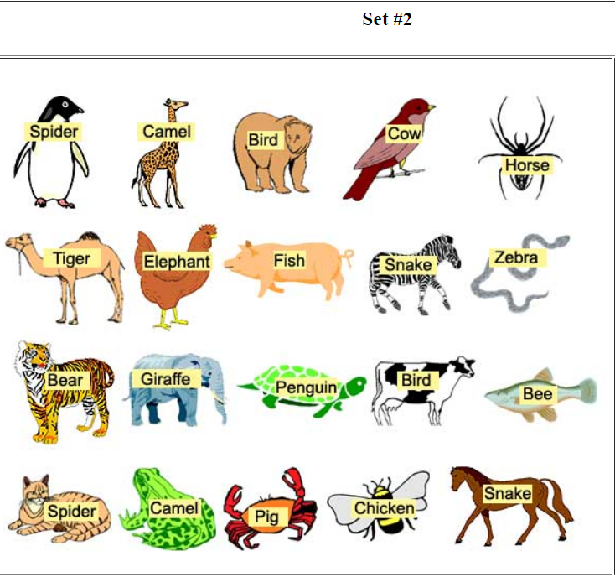
Notes:
TAYLOR
GO,
How was that the second time???? How difficult was it to tell your brain to answer for the animal and not the word? Who read the word vs the picture?
Why do you think we wanted you to say the animal out loud? We wanted you to say it out loud to hear yourselves and others around you to show how challenging it can be for everyone. We’re all in the same ocean, some of us have bigger boats.
It was much easier with the pictures and words matched. When the word was different from the picture, our brains took longer to override the words to focus on the picture. Changing our brain processing or conditioning is difficult.
Translating that to implicit bias, we have to continually work at addressing our subconscious processing, it’s more than just acknowledging them, we have to be proactive in address our biases and in the same token we have to proactive in addressing disparities, we have to continually work on ourselves and within our programs to address disparities since we see how difficult it can be to change brain processing.

Slide 18
Cultural Humility Exercise
PIGGY BANK, ADD OR SUBTRACT IF IT APPLIES:
If growing up, your friend group included a person of color
If you have ever felt unsafe in the presence of law enforcement
If you or a family member ever gone through the justice system
If you have ever been given a job because of your association with a friend or family member
If you were ever uncomfortable about a joke you overheard related to race, ethnicity, gender, appearance, or sexual orientation, but said nothing and/or felt unsafe
Notes:
TAYLOR
We’ve seen how the brain processes information and how learned behaviors are hard to change. We know IT TAKES WORK TO MAKE CHANGE but it’s possible and gets EASIER OVER TIME. Now let’s look at how your lens, or point of reference, could be different from someone elses. We’re going to do a cultural humility exercise, called CULTURAL HUMILITY PIGGY BANK, have any of you done a piggy bank exercise?
Ok, here’s how it works, I’m going to read 10 STATEMENTS, each statement has a dollar figure that you can add to your piggy bank or subtract from your piggy bank. Everyone is starting with ZERO IN THE BANK. You will add or subtract the amount I tell you that fits your experience. Once we go through all 10, you will calculate your total and then have a discussion about the results.
PIGGY BANK, ADD OR SUBSTRACT IF IT APPLIES:
If growing up, your FRIEND GROUP INCLUDED A PERSON OF COLOR – add $5
If you have ever felt UNSAFE IN THE PRESENCE OF LAW ENFORCEMENT – subtract $10
If you or a family member ever GONE THROUGH THE JUSTICE SYSTEM – subtract $10
If you have ever been GIVEN A JOB because of your association with a FRIEND OR FAMILY MEMBER – add $10
If you were ever UNCOMFORTABLE ABOUT A JOKE YOU OVERHEARD related to race, ethnicity, gender, appearance, or sexual orientation, but SAID NOTHING AND/OR FELT UNSAFE – subtract $20

Slide 19
Cultural Humility Exercise
PIGGY BANK, ADD OR SUBTRACT IF IT APPLIES:
If English is your first language
If a caretaker(s) spent any time unemployed (not by choice) that impacted your family’s lifestyle
If you have ever entered a criminal justice setting and been assumed to be a defendant or respondent while in your professional capacity
If you ever had a supervisor from an underrepresented racial or ethnic background
If you were raised with health insurance
Notes:
TAYLOR
PIGGY BANK, ADD OR SUBSTRACT IF IT APPLIES:
If ENGLISH IS YOUR FIRST LANGUAGE - add $20
If a caretaker(s) spent any time UNEMPLOYED (NOT BY CHOICE) that it impacted your family’s lifestyle - subtract $15
If you have ever entered A CRIMINAL JUSTICE SETTING and been assumed to be a DEFENDANT OR RESPONDENT while in your professional capacity - subtract $5
If you ever had a SUPERVISOR from an UNDERREPRESENTED RACIAL OR ETHNIC BACKGROUND - add $10
If you were raised with HEALTH INSURANCE - add $15
-$60 to +$60
How does this impact the way you do your work and how you work with participants
As you looked around the room, you noticed that some are statements are applicable to some of us and not others. It shows how your experiences or lens is different from others. In our work, we can not make assumptions based on our lens or implicit biases or perceptions, WE HAVE TO MAKE SURE THAT WE’RE SEEING EACH OTHER AND THE CLIENTS AS INDIVIDUALS WITH HIS OR HER OWN CULTURAL BACKGROUND, AWARENESS, AND EXPERIENCES. Having cultural humility and being culturally aware should lead to cultural responsiveness, which will reduce disparities in your courts.

Slide 20
Operational Disparities
Notes:
TAYLOR
NOW WE’RE GOING TO LOOK AT THE THIRD COMPONENT OF DISPARITIES TRAINING, OPERATIONAL DISPARITIES. HOW YOUR PROGRAMS ARE WORKING. THIS IS WHERE WE START TO LOOK AT DECISION POINTS WITHIN OUR PROGRAMS TO ADDRESS DISPARITIES.
The decision points are moments in the treatment court program where disparities can be addressed

Slide 21
The Framework: The National Adult Best Practice Standards II, III, IV, V, VIII, & X
https://www.nadcp.org/standards/
Notes:
TAYLOR
Treatment courts have the best practice standards that are used to operationalize court operations and fidelity to the model.
We’re going to review several of them for areas of decision points when addressing disparities.
All 10 standards have opportunities where disparities can be addressed; however, this conversation and work is ongoing so we wanted to cover several today with the limited time we have together. We’re going to discuss standards, 2, 3, 4, 5, 8 & 10.

Slide 22
Standard II: Equity & Inclusion
Equity & Inclusion Topic Areas
Equivalent Access;
Equivalent Retention;
Equivalent Treatment;
Equivalent Incentives & Sanctions;
Equivalent Dispositions;
Team Training
Decision Points
Admittance data: Access and analysis
Retention factors: lack of culturally appropriate services, policies, and procedures, trauma-informed practices
Application of sanctions, incentives, and therapeutic adjustments
Training requirements
Language access
Court fines and fees
Notes:
TAYLOR
Decision Points
Retention factors research: One practice, the provision of family/domestic counseling, was significantly related to lower racial disparity. Family counselors can obtain insight into the specific environment and circumstances each participant is experiencing, which may lead to better decisions for the team in responding effectively to each participant’s behavior, as well as increase support for the participant in his or her natural environment. In addition, family counseling is compatible with culturally specific values related to the importance of family.
In a comparison of graduation rates in treatment courts across regions, Black participants consistently exhibited the lowest graduation rates while White participants had the highest graduation rates, except in the Midwest, where Hispanic/Latino participants and participants of other races had higher graduation rates than Whites. The disparity between Black and White graduation rates was most pronounced in the Midwest, where White participants had a graduation rate that was 25 percentage points (or 68%) greater than the graduation rate for Black participants. In contrast, treatment courts in the South had graduation rates for White participants that were 12 percentage points (or 27%) greater than for Black participants. Although somewhat higher in the Midwest, Hispanic/Latino graduation rates were similar to those of Whites in other regions
Participants required to pay court fines and fees has shown, in at least one research study, to increase the disparities in graduation between black and white participants by 197%

Slide 23
Standard II: Equity & Inclusion
Equity & Inclusion RED Considerations
What is the role of the gatekeeper when determining eligibility?
Are you reviewing data to ensure incentives and sanctions, and therapeutic adjustments are equitable?
Is equity and inclusion included in the statewide standards, certification, or fidelity review process?
Do you have culturally responsive treatment and complementary services to refer to?
Are there policies and procedures that may disproportionately affect certain communities?
Notes:
TAYLOR
Some considerations related to racial and ethnic disparities here are: READ LIST
Others?
Role of gatekeeper- may not be able to change but you MAY be able to identify and start to train, educate, and start a conversation
Policies and procedures- if you require employment to graduate, we know the criminal legal system has disproportionally charged black individuals and they are more likely to have a felony. Or transportation, some neighborhoods do not have the resource infrastructure to provide public transportation
One study has show that a treatment court which has an advisory committee that includes community members can decrease disparities in graduation rates by 145%- who are you serving and do they have a voice in how they are served – challenge you to look at treatment courts not as a privilege for the participant but has the best public service we can give, the courts and their actors are public servants
Treatment and complementary services- specifically looking at retention, is this program made for everyone? Have referral sources that are culturally responsive and appropriate is vital
Incentives sanctions and therapeutic adjustments- this again goes to retention and also program integrity. Are you taking the first step to review, are you taking the affirmative step obligated by the standards
Equity inclusion- this is state focused a bit but also look at what training is identified and encouraged for team members to attend

Slide 24
Standard III: Role of the Judge
Role of the Judge Topic Areas
Professional Training;
Length of Term;
Consistent Docket; Participation in Pre-Court Staff Meetings;
Frequency of Status Hearings;
Length of Court Interactions; Judicial Demeanor;
Judicial Decision
Decision Points
Judicial demeanor: motivational interviewing, language use, length of interactions
Judicial education on RED
Judicial Decisions: application of incentives and sanctions, staffings, and leadership of the team
Notes:
TAYLOR
Decision Points
Monitor the judge to see if the range of incentives is a 4 to 1 ratio
Monitor if the judge is participating in voting during the staffing
Mandatory judicial education course on RED
Provide a language guide to judges with terms and sayings that have racial implications (maybe as part of a broader motivation interviewing training?) (CCI is considering putting this together)
Areas to identify
Demeanor and decisions: understating SUD BUT then also understating “system survivorship” and how many more systems may have impacted or treated your participants.

Slide 25
Standard III: Role of the Judge
Role of the Judge RED Considerations
Is your court monitoring the judge to see if the range of incentives is a 4 to 1 ratio equitably for all participants?
Is your judge participating in voting during the staffing?
Is your judge attending judicial education course on RED and cultural humility?
Does your court have a bench card that provides a language guide for the judge with terms and sayings that have racial implications?
Does your court offer motivational interviewing training for the judge?
Notes:
TAYLOR
Some considerations related to racial and ethnic disparities here are: READ LIST
Others?
Places where subjectivity and implicit bias are ripe are the application of incentive and sanctions. And looking at who is provided the lens of recovery and opportunity and given therapeutic adjustment for positive test or behavior and who is sanctioned.
Focus on building trust between two people with autonomy and choices- not fostering a paternal relationship where the judge is the savior

Slide 26
Standard IV: Incentives & Sanctions
Incentives & Sanctions Topic Areas
Advance Notice;
Opportunity to Be Heard;
Equivalent Consequences;
Professional Demeanor;
Progressive Sanctions;
Licit Addictive or Intoxicating Substances;
Therapeutic Adjustments;
Incentivizing Productivity; Phase Promotion;
Jail Sanctions;
Termination;
Consequences of Graduation & Termination
Decision Points
Application of incentives and sanctions
Application of therapeutic adjustments
Phase advancement barriers: employment, fees, transportation, housing
Trauma-informed training
Due process protections
Occurrence of jail sanctions
Notes:
TAYLOR
Topic Areas:
Decision Points
Develop a plan to reduce jail sanctions
Review the phase advancements for client engagement
Keep data on sanctions, specifically jail sanctions, applied or require data on incentives and sanctions by race to be reported in their certification
Offer state guidance on incentive and sanctions matrix—along with the ability to review programs written advanced notice given to participants to ensure language use and access
What do your policies say about application of incentives specifically and who informs the court of what incentives participants want or care about?
Phase advancement: Are you sanctioning for behavior or barriers?
Due process- you may think this is just for defense but the judge, prosecutor, and treatment all play a role in ensuring due process is protected. Sometimes most importantly this role is for probation/cso/case managers to ensure participants are not encouraged to implicate themselves without knowing their rights

Slide 27
Standard IV: Incentives & Sanctions
Incentives and Sanctions RED Considerations
Is your court reconsidering how jail sanctions are used?
Does your court have a written phase advancement goals for review with the participants?
Does your court have an equitable incentives and sanctions matrix?
Does your court have all documents in participant’s native language or access to interpreters?
Does your court track incentives and sanctions as performance measures, i.e., jail sanctions, incentives & sanctions by race & ethnicity and included in the fidelity review process?
Notes:
Are sanctions given to some participants where others are getting therapeutic adjustments for similar circumstances?
Do you have participant feedback in what incentives they would most want
Do you have generals participant feedback surveys to identify if there is a perception of differently applied incentives and sanctions
Jail sanctions: Are they being used, first off, as a last resort. And second for our conversation are they being applied consistently across demographics.
Going back to graduation disparities a study shows that four factors associated with decreased program completion as well as increased post-program recidivism: educational status, marital status, number of times treated for a psychological or emotional problem in a hospital, and number of incarceration sanction days.
Jail sanctions also invoke serious due process concerns. Is due process, which includes an evidentiary hearing and opportunity to be heard, being adhered to during the application of sanctions? Use SD as example

Slide 28
Standard V: SUD Treatment
SUD Treatment Topic Areas
Continuum of Care;
In-Custody Treatment;
Team Representation;
Treatment Dosage & Duration;
Treatment Modalities;
Evidence-Based Treatments; Medications;
Provider Training & Credentials;
Peer Support Groups;
Continuing Care
Decision Points
Offer a continuum of care that is culturally appropriate and includes peer supportive groups
Ensure clients are actively engaged in the goal setting process
Verify treatment providers are providing culturally competent services
Notes:
TAYLOR
Standard 5, substance use disorder treatment recommends standardized assessment of treatment needs.
Treatment is based on identified clinical goals and it is delivered by trained providers through a continuum of evidence-based interventions that are documented in manualized treatment.
It would be great if all jurisdictions and courts had equitable access to a full continuum of care and treatment options but we that’s not the case. Some areas depend heavily on 12 step meetings, which can be helpful, but not a treatment intervention or modality. So, the idea that we have every service in all jurisdictions is aspirational. That said, we do need to make sure our treatment options are culturally-supportive, cultural appropriate and culturally responsive, and not reproducing harms.
So looking at our decision points, we ask what do we know about our treatment partners? What are their policies around inclusion and anti-racism? Does their staff receive regular equity trainings? Do they offer language assistance for those who can’t find treatment in their primary language? Do they have a diverse team, including leadership? Do they have peers or people with lived experience as core team members?
It’s important to acknowledge that healthcare system has mistreated, neglected, and harmed communities of color. So clients maybe skeptical and mistrusting when hearing “we offer treatment instead of jail.” It is incumbent upon us as a field to be certain about the treatment we offer. So, as the best practices standards say, treatment plans should be individualized (not cookie cutter), based on validated assessment outcomes (not just inpatient for everyone) and incorporate client voice in their formation in a meaningful way.
In addition, we have also seen stark racial disparities in terms of access to opioid medications. Methadone is much more commonly prescribed in black and brown communities, whereas buprenorphine heavily marketed in whiter communities, and can be dispensed in doctor’s offices rather than in a clinic. So ensuring equitable access to moud medications and resources mapping of providers is necessary.
There are 10 topic areas:
Continuum of care; (highlight)
In-custody treatment;
Team representation;
Treatment dosage & duration;
Treatment modalities; (highlight)
Evidence-based treatments; medications; (highlight)
Provider training & credentials;
Peer support groups; (highlight)
Continuing care
Decision points include:
Offer a continuum of care that is culturally appropriate, and that includes peer supportive groups
Ensure clients are actively engaged in the goal setting– increase client voice in treatment planning process at every phase
Verify treatment providers are providing culturally responsive services

Slide 29
Standard V: SUD Treatment
SUD Treatment RED Considerations
Does your agency have a policy to incorporate and increase client voice in treatment planning?
Does your program offer a continuum of care that is culturally appropriate, and that includes peer support groups?
Do you regularly schedule meetings with your treatment provider to discuss staff credentialing and training?
Do clients have access to treatment providers in their native language? Is language access a barrier to treatment?
Notes:
TAYLOR
DECISION POINTS CONSIDERATIONS:​
DOES YOUR AGENCY HAVE A POLICY TO INCORPORATE AND INCREASE CLIENT VOICE IN TREATMENT PLANNING?
DOES YOUR PROGRAM OFFER A CONTINUUM OF CARE THAT IS CULTURALLY APPROPRIATE, AND THAT INCLUDES PEER SUPPORT GROUPS?
DO YOU REGULARLY SCHEDULE MEETINGS WITH YOUR TREATMENT PROVIDER TO DISCUSS STAFF CREDENTIALING AND TRAINING?
DO CLIENTS HAVE ACCESS TO TREATMENT PROVIDERS IN THEIR NATIVE LANGUAGE? IS LANGUAGE ACCESS A BARRIER TO TREATMENT?
DO YOU HAVE OR CAN YOU START PEER/ALUMNI SUPPORTS/ASSOCIATIONS?

Slide 30
Standard VIII: Multidisciplinary Team
Multidisciplinary Team Topic Areas
Team Composition;
Pre-Court Staff Meetings;
Sharing Information;
Team Communication and Decision Making;
Status Hearings;
Team Training
Decision Points
Review hiring practices and provide guidance on job postings and job sites that can increase diverse hiring
Create racial equity training policy
Monitor team dynamics and engagement
Require team training in racial equity for certification
Notes:
TAYLOR
STANDARD 8, MULTIDISCIPLINARY TEAMS, IN THIS STANDARD, WE WANT OUR TREATMENT COURTS TO HAVE A TEAM OF MULTIDISCIPLINARY PROFESSIONALS THAT REVIEW CLIENT PROGRESS THROUGH STAFFING MEETINGS, COURT HEARINGS, AND CONTRIBUTE TO PARTICIPANT RECOMMENDATIONS THROUGH THE LENS OF THEIR AREAS OF EXPERTISE. THIS IS THE BEST PRACTICE OF STAYING IN YOUR LANE AS A TEAM MEMBER. MULTIDISCIPLINARY TEAMS THAT WORK COLLABORATELY AND THAT HAVE DIVERSE TEAM MEMBERS BRING DIVERSE EXPERIENCES THAT CAN BETTER SUPPORT CLIENT OUTCOMES. REPRESENTATION MATTERS.
STANDARD 8 HAS 6 MULTIDISCIPLINARY TEAM TOPIC AREAS
TEAM COMPOSITION; (HIGHLIGHT)
PRE-COURT STAFF MEETINGS;
SHARING INFORMATION;
TEAM COMMUNICATION AND DECISION MAKING; (HIGHLIGHT)
STATUS HEARINGS;
TEAM TRAINING (HIGHLIGHT)
DECISION POINTS INCLUDE:
REVIEW HIRING PRACTICES AND PROVIDE GUIDANCE ON JOB POSTINGS AND JOB SITES THAT RECRUIT A DIVERSE RANGE OF PEOPLE
REVIEW RACIAL EQUITY TRAINING POLICY SO THAT TREATMENT COURT TEAMS RECEIVE ONGOING CULTURAL HUMILITY TRAINING AND NEW HIRES COMPLETE A FORMAL ORIENTATION AND FIDELITY TRAINING
3. MONITOR TEAM DYNAMICS AND ENGAGEMENT- THINK ABOUT YOUR TEAM STAFFING, IF SOMEONE OPPOSED A SANCTION DUE TO BIAS - WHAT WOULD HAPPEN?
4. REQUIRE TEAM TRAINING IN RACIAL EQUITY AS PART OF YOUR FIDELITY REVIEW PROCESS – IF YOU HAVE A CERTIFICATION FIDELITY REVIEW INCLUDE STAFF RED TRAINING COMPLIANCE AND/OR ADD SPECIFIC RED QUESTIONS TO THE REVIEW PROCESS.

Slide 31
Standard VIII: Multidisciplinary Team
Multidisciplinary Team RED Considerations
What are your team’s recruitment and hiring practices?
Do agencies have training on creating equitable and inclusive job postings and recruiting a diverse range of people?
Do new team members receive formal training on racial equity and cultural humility?
Do all team members receive ongoing training on racial equity and cultural humility? Is this a requirement of certification or re-certification?
Are team dynamics and engagement monitored; who speaks the most at staffing meetings, and how might that relate to racial and ethnic disparities?
Is there a procedure or mechanism in staffing, if someone believes a sanction is being unfairly imposed? Is it a supportive environment where team members are free to speak up to identify racial bias when they see it?
Has your team had meetings to develop shared values to demonstrate commitment to addressing RED?
Notes:
TAYLOR
DECISION POINTS CONSIDERATIONS:​
​
WHAT ARE YOUR TEAM’S RECRUITMENT AND HIRING PRACTICES?
DO AGENCIES HAVE TRAINING ON CREATING EQUITABLE AND INCLUSIVE JOB POSTINGS AND RECRUITING A DIVERSE RANGE OF PEOPLE?
DO NEW TEAM MEMBERS RECEIVE FORMAL TRAINING ON RACIAL EQUITY AND CULTURAL HUMILITY?
DO ALL TEAM MEMBERS RECEIVE ONGOING TRAINING ON RACIAL EQUITY AND CULTURAL HUMILITY? IS THIS A REQUIREMENT OF CERTIFICATION OR RE-CERTIFICATION?
ARE TEAM DYNAMICS AND ENGAGEMENT MONITORED; WHO SPEAKS THE MOST AT STAFFING MEETINGS, AND HOW MIGHT THAT RELATE TO RACIAL AND ETHNIC DISPARITIES?
IS THERE A PROCEDURE OR MECHANISM IN STAFFING, IF SOMEONE BELIEVES A SANCTION IS BEING UNFAIRLY IMPOSED? IS IT A SUPPORTIVE ENVIRONMENT WHERE TEAM MEMBERS ARE FREE TO SPEAK UP TO IDENTIFY RACIAL BIAS WHEN THEY SEE IT?
HAS YOUR TEAM HAD MEETINGS TO DEVELOP SHARED VALUES TO DEMONSTRATE COMMITMENT TO ADDRESSING RED?

Slide 32
Standard X: Monitoring & Evaluation
Monitoring & Evaluation Topic Areas
Adherence to Best Practices;
In-Program Outcomes;
Criminal Recidivism;
Historically Discriminated Against Groups;
Electronic Database;
Timely and Reliable Data Entry;
Intent-to-Treat Analyses;
Comparison Groups;
Time at Risk
Decision Points
Ensure data collection includes equity information
Review termination rates based on equity
Provide local jurisdictions the data metrics they should be capturing to identify disparate outcomes including arrest, referral, and graduation rates
Notes:
TAYLOR
THE LAST STANDARD IS OF COURSE MONITORING AND EVALUATION. TREATMENT COURTS SHOULD ROUTINELY MONITOR FOR ADHERENCE TO STANDARDS USING SCIENTIFIC METHODS AND PROCEDURES. ADEQUATELY COLLECTING AND REVIEWING DATA WILL ALLOW YOUR COURT TO IDENTIFY NEEDED PERFORMANCE MEASURES, IDENTIFY SERVICE GAPS, AND GUIDE OR UPDATE COURT PRACTICES.
THERE ARE 9 MONITORING AND EVALUATION TOPIC AREAS
ADHERENCE TO BEST PRACTICES;
IN-PROGRAM OUTCOMES; (HIGHLIGHT)
CRIMINAL RECIDIVISM;
HISTORICALLY DISCRIMINATED AGAINST GROUPS; (HIGHLIGHT)
ELECTRONIC DATABASE;
TIMELY AND RELIABLE DATA ENTRY; (HIGHLIGHT)
INTENT-TO-TREAT ANALYSES;
COMPARISON GROUPS;
TIME AT RISK
DECISION POINTS INCLUDE:
ENSURE DATA COLLECTION INCLUDES DEMOGRAPHIC INFORMATION
REVIEW AND EVALUATE ELIGIBILITY, REFERRAL, AND TERMINATION RATES BASED ON EQUITY
PROVIDE LOCAL JURISDICTIONS WITH THE DATA METRICS THEY SHOULD CAPTURE AND IDENTIFY DISPARATE OUTCOMES IN THE ELIGIBLE ARRESTEE POPULATION, THE REFERRAL PROCESS, INCENTIVES AND SANCTIONS, TREATMENT INTERVENTION, AND GRADUATION AND TERMINATION RATES

Slide 33
Standard X: Monitoring & Evaluation
Monitoring & Evaluation RED Considerations
Are programs collecting demographic information​?
Does your program review and evaluate termination rates based on equity​?
Are local jurisdictions aware of the data metrics they should capture to identify disparate outcomes including arrest, referral, and graduation rates?
How often are courts looking at data to make practice improvement?​
Notes:
TAYLOR
AND Decision Points considerations:​
​
ARE PROGRAMS COLLECTING DEMOGRAPHIC INFORMATION​?
DOES YOUR PROGRAM REVIEW ELIGIBILITY DATA AND EVALUATE TERMINATION RATES BASED ON EQUITY​?
ARE LOCAL JURISDICTIONS AWARE OF THE DATA METRICS THEY SHOULD CAPTURE TO IDENTIFY DISPARATE OUTCOMES?
HOW OFTEN ARE COURTS LOOKING AT DATA TO MAKE PRACTICE IMPROVEMENT?​

Slide 34
Next Steps
Each attendee will count off 1 – 5 (so there are five groups)
Each group will identify as many objectives as possible based on one of the standards we reviewed
Each group will report out the objectives
The Center will add to an action plan, clean up the text and send to all attendees so they can complete it with their courts
Notes:
Shawn
We are now going to an activity where you all be able to work to create a statewide action plan. We have created five goals based on the six standards we just reviewed.

Slide 35
Action Planning
Notes:
Shawn
This is what a typical action planning template looks like. Today, in groups, you will decide on objectives for each goal. The objectives should be more specific than the goal, and serve as a stepping stone to reach your goal.
SHAWN: ONLY DOING OBJECTIVES TODAY
Explain how the action planning template would be used.
For example, let’s say my goal is to dunk… there are a lot of smaller steps I have to take before I am dunking. I have to buy basketball shoes, practice my lay-ups, research exercise to increase vertical jumps.
We are only working on the objectives for this exercise, but as you can see there are more columns to an action plan. The action steps are where you will list out exactly what you need to do to complete the objective. The role is for the person/s, or group that are responsible with completing the action step. The timeframe is to get deadlines and decide on how long each action step will take. Lastly, the completed column is to check off when each objective is completed!

Slide 36
Goals
Remove non-evidence-based exclusion criteria including certain violence, drug-dealing, property, and financial crimes. (Target Population and Equity & Inclusion)
Ensure sanctions address behaviors and not barriers during all phases. (Incentives and Sanctions)
Provide culturally appropriate treatment to all participants. (SUD Treatment)
Recruit and hire team members that are representative of the treatment court population. (Multidisciplinary Team)
Assess for racial and ethnic disparities in treatment court operations. (Monitoring & Evaluation)
Notes:
Shawn
1. These crimes are often excluded from treatment courts, want to broaden
Reduce exclusion criteria including
Identify strategies for expanding who can participate in treatment court.
find non-bja funding, MOUs with district attorneys office to accept certain crimes, gather research on violent crime participation in treatment court programs.
From California for Goal 1: Remove non-evide

Slide 37
Questions?
Shawn Rogers, srogers@innovatingjustice.org
Taylor DeClerck, tdeclerck@innovatingjustice.org

Slide 38
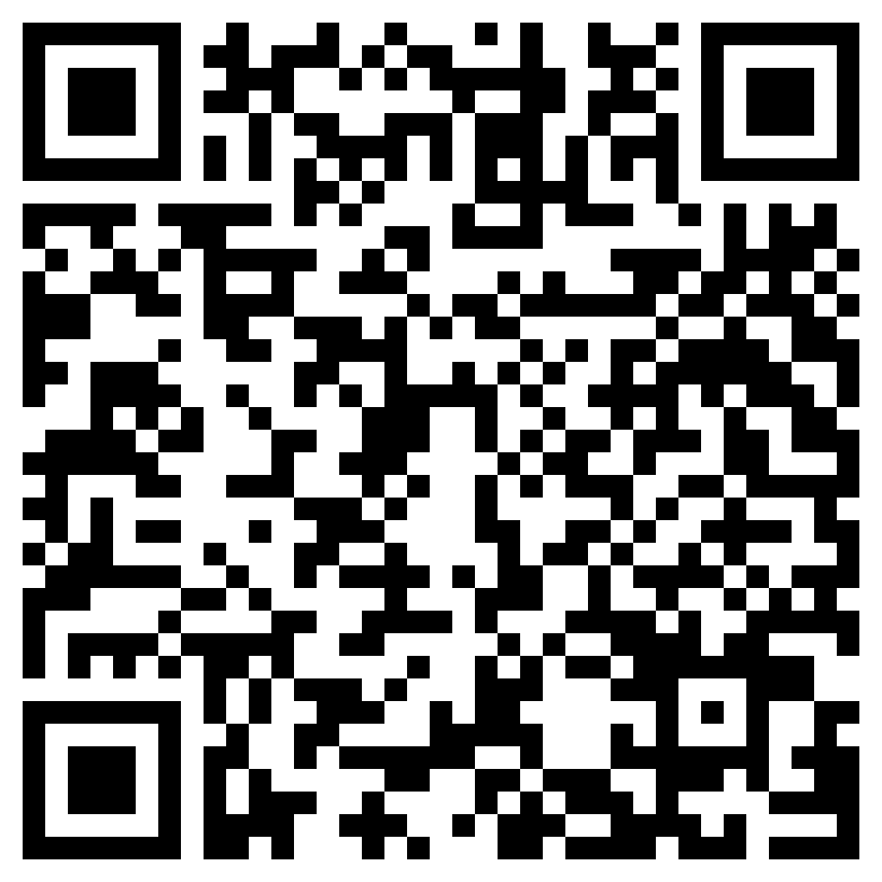
PowerPoint Slides
Equity Terms
RED Resources
Action Plan
Feedback Questionnaire

