Slide 1
CORE 201 Training
Presented by Kaley Horvath

Slide 2
What to do with CORE Data?
Evaluate your data as it relates to Wisconsin Performance Measures as defined in the:
Wisconsin Statewide Drug and Hybrid Court Performance Measures
Wisconsin Statewide Drug and Hybrid Court Performance Measures – Mental Health Track Supplement
Wisconsin Statewide OWI Treatment Court Performance Measures
Wisconsin Statewide Veterans Treatment Court Performance Measures
Decisions about funding
Policy changes
Identify training needs
Diversion Program Performance Measures – still in draft status but hoping to finalize by end of 2023

Slide 3
How do I Get the data for my Program
Existing reports in CORE
Program Admission Summary
Program Discharge Summary
Can narrow down by program status, funding source, and admission/discharge time frame
Case Summary
Single participant history – drug/alcohol testing, incentives/sanctions, phase changes, etc.
Data extract tutorial – this will be the focus during the breakout session immediately following this presentation

Slide 4
Drug and Hybrid Court Performance Measure & CORE Reports
Intersection of Performance Measures and CORE data utilization
What performance measures data can I “pull” from CORE?
Drug and Hybrid Court Performance Measure | CORE Report
Outcome Measures – Sobriety
1a. Average Percent of Positive Drug and Alcohol Tests (NRAC) | Case Summary, Data Extract
1b. Average Percent of Days with Positive Continuous Monitoring Tests | Case Summary, Data Extract
1c. Average Period of Time from Last Positive Drug Test to Discharge (Modification of NRAC measure). | Data Extract
2. In-program Recidivism | Case Summary, Data Extract
3. Post-program Recidivism | Not in CORE
4. Restitution | Discharge Summary, Data Extract

Slide 5
Performance Measure & CORE Reports
Drug & Hybrid Tx Crt Performance Measure | CORE Report
Processing and Admission Measures
5. Processing Time | Data Extract
6. Screening and Assessment | Data Extract
7. Discharge Type (NRAC) | Discharge Summary, Data Extract
8. Average Length-of-Stay | Data Extract
Dosage Measures
9. Incentives and Sanctions | Case Summary, Data Extract
10. Treatment Services | Case Summary, Data Extract
11. Frequency of Status Hearings | Case Summary, Data Extract
12. Frequency of Supervision | Case Summary, Data Extract
13. Frequency of Drug & Alcohol Testing | Case Summary, Data Extract

Slide 6
Performance Measure & CORE Reports
Drug & Hybrid Tx Crt Performance Measure | CORE Report
Perceived Procedural Fairness
14. Perceived Procedural Fairness | Completed yearly by DOJ
Social Functioning Measures
15. Improvement in Employment Status | Discharge Summary, Data Extract
16. Improvement in Educational Status | Discharge Summary, Data Extract
17. Improvement in Residency Status | Case Summary, Data Extract

Slide 7
Drug and Hybrid Court Performance Measure & CORE Reports – Mental Health Track Supplement
Mental Health Track Supplement | CORE Report
Outcome Measures – Sobriety
1. In-program Recidivism a. Rearrests b. Convictions | Case Summary, Data Extract Case Summary, Data Extract
2. Post-Program Recidivism Rearrests Convictions | Not in CORE Not in CORE
3. Average Time Between Arrests | Not in CORE
Processing and Admission Measures
4. Team Collaboration | Coming soon!

Slide 8
Drug and Hybrid Court Performance Measure & CORE Reports – Mental Health Track Supplement
Mental Health Track Supplement | CORE Report
Procedural Fairness Measures
5. Access and Fairness | Admission Summary, Data Extract
6. Availability of Services Average Time Waiting for Services Percentage of Services Unavailable | Case Summary, Data Extract Not in CORE
Social Functioning Measures
7. Medication Compliance | Coming soon!

Slide 9
Statewide OWI Treatment Court Performance Measures
Intersection of Performance Measures and CORE data utilization
What performance measures data can I “pull” from CORE?
OWI Treatment Court Performance measures have additional measures to the previously used Drug and Hybrid Court Performance Measures. Additional measures will be highlighted in red.
OWI Treatment Court Performance Measures | CORE Report
Outcome Measures – Sobriety
1a. Average Percent of Positive Drug and Alcohol Tests (NRAC) | Case Summary, Data Extract
1b. Average Percent of Days with Positive Continuous Monitoring Alcohol Tests | Case Summary, Data Extract
1c. Average Period of Time from Last Positive Drug or Alcohol Test to Discharge | Data Extract
2. In-program Recidivism | Case Summary, Data Extract
3. Post-program Recidivism | Not in CORE

Slide 10
Performance Measure & CORE Reports
OWI Tx Crt Performance Measures | CORE Report
Processing and Admission Measures
4. Processing Time | Data Extract
5. Screening and Assessment Percentage of Individuals with Applicable OWI Offenses screened Percentage of Referred Individuals Admitted to the Program by Risk/Need Category Percentage of Participants by Risk/Need Category and Program Track | Not in CORE Admission Summary, Data Extract Admission Summary, Data Extract
6. Percentage of Participants who Obtain Peer Sober Support | Coming soon!
7. Discharge Type (NRAC) | Discharge Summary, Data Extract
8. Average Length-of-Stay | Data Extract
9. Average Length-of-Stay per Phase | Case Summary, Data Extract
10. Team Collaboration | Coming soon!
11. Relapse Prevention Plan Development Compliance | Coming soon! Coming soon!

Slide 11
Performance Measure & CORE Reports
OWI Tx Crt Performance Measures | CORE Report
Dosage Measures
12. Incentives and Sanctions | Case Summary, Data Extract
13. Attendance at Scheduled Treatment Services | Case Summary, Data Extract
14. Frequency of Status Hearings | Case Summary, Data Extract
15. Frequency of Supervision Contacts | Case Summary, Data Extract
16. Frequency of Drug & Alcohol Testing | Case Summary, Data Extract
17. Frequency of Contact with Peer Sober Support | Coming soon!
Procedural Fairness Measures
18. Perceived Procedural Fairness | Completed yearly by DOJ
19. Access and Fairness | Admission Summary, Discharge Summary, Data Extract

Slide 12
Performance Measure & CORE Reports
OWI Tx Crt Performance Measures | CORE Report
Social Functioning Measures
20. Employment Stability | Discharge Summary, Data Extract
21. Transportation Stability Driver’s License Eligibility Driver’s License Status Transportation Plan | Data Extract Data Extract Coming soon!

Slide 13
Statewide Veterans Treatment Court Performance Measures
Intersection of Performance Measures and CORE data utilization
What performance measures data can I “pull” from CORE?
Veterans Treatment Court Performance measures have additional measures to the previously used Drug and Hybrid Court Performance Measures. Additional measures will be highlighted in blue.
Veterans Treatment Court Performance Measures | CORE Report
Outcome Measures – Sobriety
1a. Average Percent of Positive Drug and Alcohol Tests (NRAC) | Case Summary, Data Extract
1b. Average Percent of Days with Positive Continuous Monitoring Alcohol Tests | Case Summary, Data Extract
1c. Average Period of Time from Last Positive Drug or Alcohol Test to Discharge | Case Summary, Data Extract
2. In-program Recidivism Rearrests Convictions | Case Summary, Data Extract Case Summary, Data Extract
3. Post-program Recidivism Rearrests Convictions | Not in CORE Not in CORE
4. Average Time Between Arrests | Data Extract

Slide 14
Performance Measure & CORE Reports
Veterans Tx Crt Performance Measure | CORE Report
Processing and Admission Measures
5. Processing Time | Case Summary, Data Extract
6. Percentage of Participants by Risk/Need Category and Program Track | Admission Summary, Data Extract)
7. Ratio of Eligible Trained Mentors to Admissions | Data Extract
8. Discharge Type | Discharge Summary, Data Extract
9. Average Length-of-Stay | Data Extract
10. Team Collaboration | Coming soon!

Slide 15
Performance Measure & CORE Reports
Veterans Tx Crt Performance Measure | CORE Report
Dosage Measures
11. Incentives and Sanctions Incentive/Sanction Ratio Time between Negative Behavior and Response | Case Summary, Data Extract Data Extract
12. Attendance at Scheduled Treatment Services | Case Summary, Data Extract
13. Frequency of Status Hearings | Case Summary, Data Extract
14. Frequency of Supervision Contacts | Case Summary, Data Extract
15. Frequency of Drug & Alcohol Testing | Case Summary, Data Extract
16. Mentor Relationship Frequency of Contact with Mentor Length of Mentorship | Case Summary, Data Extract Not in CORE

Slide 16
Performance Measure & CORE Reports
Veterans Tx Crt Performance Measure | CORE Report
Procedural Fairness Measures
17. Perceived Procedural Fairness | Completed yearly by DOJ
18. Access and Fairness | Admission Summary, Discharge Summary, Data Extract
19. Availability of Services Average Time Waiting for Services Percentage of Services Unavailable | Case Summary, Data Extract Not in CORE
Social Functioning Measures
20. Improvement in Employment Status | Discharge Summary, Data Extract
21. Improvement in Educational Status | Discharge Summary, Data Extract
22. Improvement in Residency Status | Case Summary, Data Extract
23. Medication Compliance | Coming soon!
24. Military Benefits | Coming soon!

Slide 17
Questions

Slide 18
Contact information
CORE/TAD Program and Policy Analyst:
Kaley Horvath – horvathkm@doj.state.wi.us | (608) 267-8943 (email is best!)
TAD Grant Specialist:
Jacqueline Kamin – kaminjk@doj.state.wi.us | (608) 419-5878
TAD Program Specialist:
Mike Derr – derrmg@doj.state.wi.us | (608) 598-9876
Marsha Schiszik – schiszikmj@doj.state.wi.us | (608) 609-6741

Slide 19
Extracting Data from CORE – A how-to on formatting an excel spreadsheet with data elements from your CORE data Break Out Session

Slide 20
How do I run a Data Extract? Itinerary
Several performance measures and data points can be pulled out of CORE via the CORE Data Extract, which can be a bit complicated to use properly
We’ll be going over 2 examples from the CORE website
Number of drug and alcohol tests, per participant, and their results
Incentives and sanctions ratio, per participant/program
Showing necessary steps within Excel to transform data into something legible
End with Q&A

Slide 21
Drug and alcohol test data
Navigate to CORE Data Extract page and select all sections of CORE that you’d like to download and hit Submit
It will export all data entered into CORE since program’s creation – can filter by relevant dates in Excel
If you have access to multiple programs’ data, ensure you’ve selected the correct one in the Program dropdown at the top

Slide 22
Drug and alcohol test data
2.
Open .csv file from the zipped folder that will download – all the relevant data will be in a one row per instance format, with a record’s entire data contained in a single cell separated by semi-colons
To transform the data:
Highlight Column A
Navigate to Data tab
Select Text to Columns
3.
1.

Slide 23
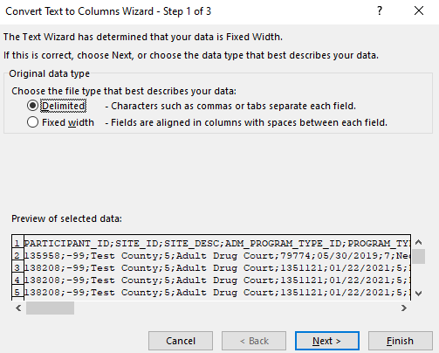
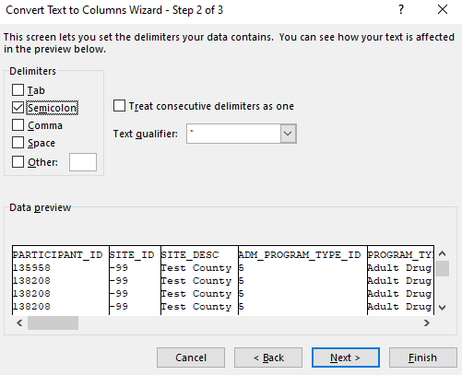
Drug and alcohol test data
5.
[
4.
6.
4. Select “Delimited” file type, then Next
5. Unselect “Tab” from delimiters, select “Semicolon”
6. Finish

Slide 24
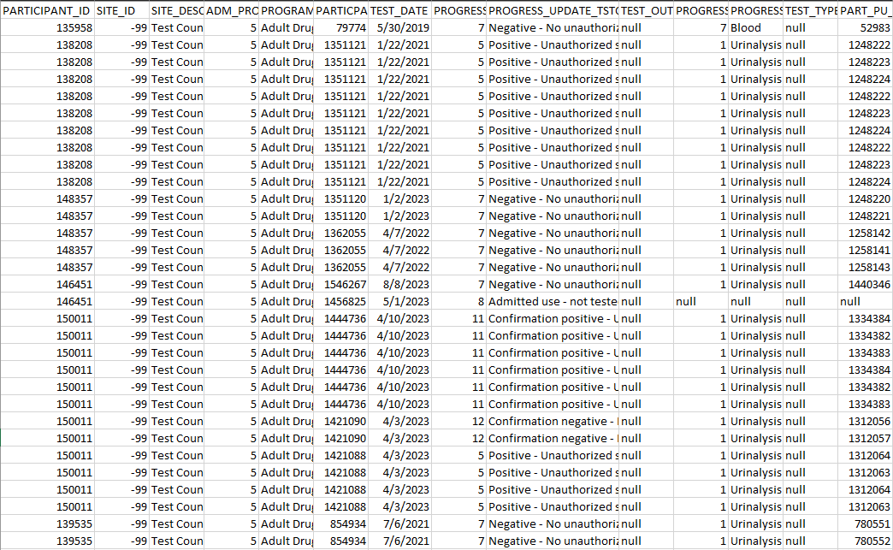
Drug and alcohol test data
Your data should now be separated in a one row per record, one column per variable format
Be wary of using semi-colons in the Notes sections of CORE, as it may complicate this process
If multiple substances detected or drug panels have been selected, you will have to transform the data in the way described in the Incentives & Sanctions section

Slide 25
Incentives and sanctions data
Follow steps 1-6 for both the Incentives and Sanctions files that will be present within the zipped ‘Progress Updates’ folder you download
This data is different from most drug and alcohol data in that there will be one row for every listed sanction, as well as for every listed reason for the sanction
For example, if a sanction instance has Reasons A and B that resulted in Sanctions X, Y, and Z, there will be 3 rows present for both Reason A and B, resulting in 6 rows for the single instance (breakdown below)
Reason A, resulting in Sanction X
Reason A, resulting in Sanction Y
Reason A, resulting in Sanction Z
Reason B, resulting in Sanction X
Reason B, resulting in Sanction Y
Reason B, resulting in Sanction Z
}
One single sanction instance
This can also be seen by looking at the PARTICIPANT_PU_SANCTION/INCENTIVE_ID* (Column F) → all 6 rows will have the same ID number
*make sure you are not looking at the PARTICIPANT_ID (Column A), as one participant will likely have several incentives/sanctions assigned to their ID

Slide 26
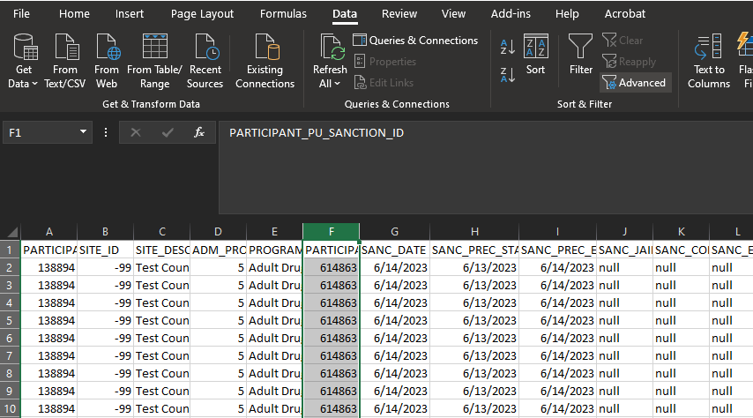
Incentives and sanctions data
2.
To filter by single, unique sanction/incentive instances in Excel:
Highlight Column F (PARTICIPANT_PU_SANCTION/INCENTIVE_ID)
Navigate to Data tab
Select Advanced in Sort & Filter section
3.
1.

Slide 27
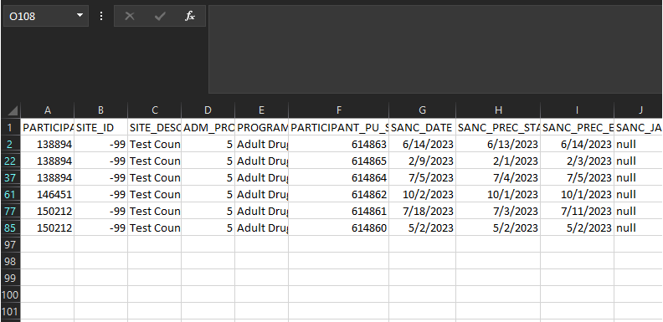
Incentives and sanctions data
4. Keep “Filter the list, in-place” selected
5. Select “Unique records only”
6. Select Okay
Your data will now be filtered by single sanction/incentive instances, with the Participant ID of each sanction/incentive in Column A
- Filtering can be done by Participant ID to find the number per participant for incentives/sanctions and subsequently the ratio

Slide 28
Questions

Slide 29
Contact information
CORE/TAD Program and Policy Analyst:
Kaley Horvath – horvathkm@doj.state.wi.us | (608) 267-8943 (email is best!)
TAD Grant Specialist:
Jacqueline Kamin – kaminjk@doj.state.wi.us | (608) 419-5878
TAD Program Specialist:
Mike Derr – derrmg@doj.state.wi.us | (608) 598-9876
Marsha Schiszik – schiszikmj@doj.state.wi.us | (608) 609-6741

