Slide 1
Case Management for Justice Professionals
2023 WACP Coordinator Conference
How to lead from the front line
Shawn Rogers
Senior Program Manager
Center for Justice Innovation
Taylor DeClerck
Program Manager
Center for Justice Innovation

Slide 4
Learning Objectives
Understand the impact of language use on individuals, starting at initial engagement
Become client oriented
Develop case management plans
Assist with needs outside of SUD treatment
Serve as a single point of contact for client
Notes:
Shawn
Before we get started, who here is a case manager? Are you employed by the court or outside agency?
Who wears multiple hats and one of them is as case manager?
This slide lists the learning objectives, what we hope you are able to take away from this presentation:
An Understanding of how the language that you use, from the very first engagement, affects the individuals that you work with.
We hope that you’ll walk away from this presentation client-oriented, or if you already consider yourself client-oriented, then more client oriented
A Better understanding about how to develop case management plans
How to assist with needs other than those related to Substance Use Disorder
How you can serve as a single point of contact for the client.

Slide 5
What is the most important part of being a case manager? What is the biggest challenge as a case manager?
Notes:
Shawn
Advocacy – Communication - Transparency - Referral to treatment
Challenges:
Not enough time - not enough resources - lack of funding

Slide 6
Case Management Principles
Offers the client a single point of contact with the health and social services systems
Client-driven and driven by client need
Involves advocacy
Community-based
Pragmatic
Anticipatory
Must be flexible
Culturally sensitive
Notes:
Taylor
Offers the client a single point of contact with the health and social services systems
Client-driven and driven by client need
Involves advocacy
Community-based
Pragmatic
Anticipatory
Must be flexible
Culturally sensitive

Slide 7
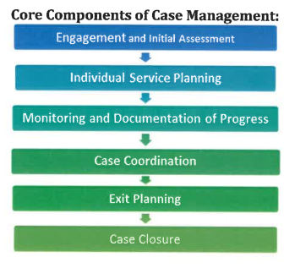
Notes:
Taylor
Assessing the client’s needs
Developing a service plan
Linking the client to appropriate services
Monitoring client progress
Advocating for the client as needed

Slide 8
Initial Engagement and Assessment
Notes:
Shawn
We are going to start at the beginning, and walk through the key concepts for initial engagement and assessment, and we are going to start by discussing language
Key concepts for initial engagement and assessment
Strength-based – person-centered process
Culturally sensitive
Interactive
Individualized
Professionally Responsible
Start with the impact of language from the first point of engagement

Slide 9
Stigmatizing language can reinforce negative public perceptions of substance users
Impact of Language
Notes:
Shawn
Stigmatizing language can reinforce negative public perceptions of people who use substances
Language is an important tool. Like most tools, it can lead to improvements when used properly. Misused, it can have damaging consequences, often unintended.

Slide 10
Use of person-centered and inclusive language may build trust and strengthen communication between participants and providers.
Notes:
Shawn
Use of person-centered and inclusive language may build trust and strengthen communication between clients and providers. I like to think of trust and communication as the foundation upon which a strong therapeutic alliance can be built. Taylor is going to go into more depth about the importance of the therapeutic alliance,
In treatment court contexts, failure to use person-centered language may impede communication and enact implicit and explicit negative bias, thus affecting quality of care.
Self-labeling should be differentiated from professional use and should not be modeled.¹²
I’m in recovery myself…

Slide 11
Person-First or Person-Centered Language
This language prioritizes the individual over their health condition, disability, or disease.
Notes:
Shawn
Person-First or Person-Center Language
This language prioritizes the individual over their health condition, disability, or disease
Also, person-first language can be used when discussing people involved with the criminal legal system. “A person involved with the criminal legal system” is less stigmatizing and can be used instead of de-humanizing words such as “offender,” “convict,” or “ex-con.” The way that I like to think of this: “is don’t label people”. Labels are often stigmatizing and it’s best to try and steer clear of them as much as possible.

Slide 12
https://www.recoveryanswers.org/research-post/the-real-stigma-of-substance-use-disorders/
Addict
Abuser
A person with substance use disorder
A person with, or suffering from, addiction or substance use disorder
Notes:
Shawn
For example, “a person with a substance use disorder” can be used instead of stigmatizing words like “addict.”
If you need to be more specific, instead of “a person with a substance use disorder,” you could say: “a person with an alcohol use disorder” or “a person with an opioid use disorder”. Again, what we are trying to do here is to move away from labels. Labels are general bad; labels tend to stigmatize.
I’m not making this up, there is a substantial and growing body of research around how the use of language can improve outcomes for our clients.
Recovery Research Institute has went so far as to say:
“Reframing language about drug use, addiction, and overdose is essential to enacting behavioral change.”

Slide 13
Strengths-Based Approach
Using a strengths-based approach can also serve to reduce stigma and facilitate engagement with participants.
Notes:
Shawn
Using a strengths-based approach can also serve to reduce stigma and facilitate engagement with clients.
We are trying to do two things here: reduce stigma and facilitate engagement
For example, if treatment reports a positive urinalysis, the provider may say: “You received a positive test” instead of referring to clean/dirty results. Let’s save the use of clean and dirty for things like laundry, my car or my apartment.
Similarly, instead of saying a client has “slipped up” or “relapsed”, it would be appropriate to label their action as “a reuse”, or as “a recurrence of use”. Again, what we are trying to do here is distinguish the person form the symptoms of a disease or condition. This can help clients to reframe their action away from an internal failing; separating the action from the individual’s worth will help focus on treatment.
We should consistently be trying to do is to build up the protective factors that will make clients not only successful in our programs, but successful in the long-term, once they leave our programs.

Slide 14
Person-Centered Approach for Individualized Justice
Participants know themselves best
Important to incorporate a participant’s perspective and input into their plan
Driven by the participant
Link participants to tailored community-based services
Notes:
Shawn
Person-centered approach for indiviidualized justice
Person drives the case management plan
The theory behind this is that it creates buy-in from the client. If the client is taking an active role in the process, then they are identifying goals. What we really don’t want is case managers saying “you’re going to do XYZ”, or worse “DO XYZ!” That sort of paternalistic approach generally doesn’t lead to behavioral change in adults. What does lead to behavioral change is an engaged client, so that’s what we want to strive for.
Goals could be broader than recovery...Taylor will touch on this later, but it's helpful to have participants input for buy-in.

Slide 15
Therapeutic Alliance
Increases client retention, recovery buy-in, longer-term stability
Conducting strength-based assessments:
Friendly conversation, not interrogation
Actively listen to client’s perspectives and experiences and take their ideas seriously
Notice something positive about the person
Ask yourself if you are expecting strengths and not just challenges
Avoid blaming, diagnosing or labeling
Notes:
Taylor
Build Therapeutic Alliance from day 1 – starts at the time of assessment
Collaborative planning & therapeutic alliance increases client retention, recovery buy-in, longer-term stability
Here are ways to conduct a strength-based assessment to foster a therapeutic alliance

Slide 16
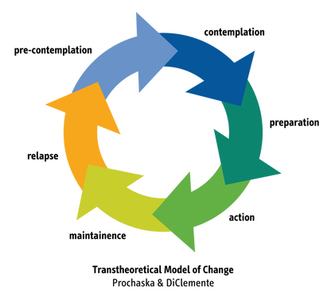
Motivational Interviewing
Helps mitigate power imbalance
MI requires slowing down, listening
Saying motivational things is not MI
Common misstep: the ‘pep talk’
MI misuse consequence: clients are compliant, but not invested
Notes:
Taylor
Who here is trained in Motivational Interviewing?
When conducting assessments, it is important to use motivational interviewing.
MI helps mitigate a power imbalance, shows a genuine interest in the individual and what is going on
MI must be done slowly to truly hear the participant and what they are sharing. It often goes beyond just hearing the words and digging deeper.
We have the transtheoretical model of change up here because often during the assessment phase participants are in pre-contemplation. MI is a great tool that can help move a participant through the different stages of change and are ready to make behavioral changes.

Slide 17
Example questions to elicit strengths during assessment
Resilience: How have you managed to overcome/survive the challenges that you have faced? What have you learned about yourself during those times?
Support: Who are the people that you can rely on? Who makes you feel understood, supported, or encouraged?
Esteem: What do you feel proud of? What positive things do other people say about you?
Perspective: What are your ideas about your current situation?
Change: What do you think is necessary for things to change? What can you do to make it happen?
Notes:
Taylor
These are some example questions to ask during an assessment
The answers to these questions can help a participant through the program. Who/what are their supports? Circle back to these supports when struggles come up through the program.

Slide 18
INTEGRATED PLANNING
Social
Personal
Culture & Community
Well-Being
Personal
Human: values, skills, self-esteem, self-knowledge
Physical/financial: income, housing, food stability, mobility, system navigation
Social
Family, friends, partners, colleagues
Groups: recovery-oriented; activity or skill/interest-based
Well-Being
Hope for the future; happiness; future-orientation
Managed stress, anxiety, MH
Cultural & Community
Shared experiences, values, spiritual/religious orientation;
Recovery-oriented services; visible and accessible
Notes:
Taylor
Want to be looking at the whole person: Recognizing the importance of family, social networks, and community systems in the treatment and recovery process and understanding the value of an interdisciplinary approach
These different buckets should be incorporated into the case management plan

Slide 19
Case management must be flexible
Case management requires an ability to understand the natural course of addiction and recovery, to foresee a problem, to understand the options available to manage it, and to take appropriate action.
Notes:
Taylor
Case management must be flexible.
Pivot/examples
A participant came in for a journaling session, disclosed his mother just passed away, sent him home. Applauded him for still coming in and sent him home.

Slide 20
Culturally Sensitive
Valuing diversity
Making a cultural self-assessment
Understanding the dynamics of cultural interaction
Incorporating cultural knowledge
Adapting practices to the diversity present in each setting
Notes:
Taylor
Understanding diverse cultures and incorporating the relevant needs of culturally diverse groups, as well as people with disabilities, into clinical practice Valuing diversity
Making a cultural self-assessment
Understanding the dynamics of cultural interaction
Incorporating cultural knowledge
Adapting practices to the diversity present in each setting
EXAMPLE: Offering to shake hands with Hasidic Jewish man, learned, provided Kosher snacks at graduation

Slide 21
Identify Problem Statement, Goal, Objectives, and Interventions to Create a Plan
Notes:
Shawn

Slide 22
Challenges/problem statements
Problem statements are based on information gathered during the assessment
Look at the most significant issues present in the client’s life
Identify the challenges that are most acute or troubling to the clients functioning and balance this with their priority areas
Notes:
Shawn
Identifying Challenges / Problem Statement
Problem statements are based on information gathered during the initial assessment (ASK TAYLOR IF THESE SHOULD BE OUTSIDE OF SUD-SPECIFIC CHALLENGS)
Look at the most significant issues present in the client’s life (e.g., housing insecurity, employment or education, transportation, substance use, legal involvmenet)
Identify the challenges that are most acute or troubling to the clients, and balance this with the priority areas.

Slide 23
Creating a Goal
A brief statement of the problem/situation you expect to change
Tied to the assessment and challenges/problem statement
Goals are based on challenges and reasonably achievable
If you can see the client do something (i.e.-complete a journal entry, attend appointment, etc.) then it is an objective.
If you can’t see a client do something (i.e.-reduce anxiety) it is a goal
Notes:
Shawn
A goal is simply a brief statement of the problem or situation you expect to change, and that’s tied to the assessment and the challenges / problem statement.
Goals need to be based on challenges that the client is confronting, and Goals need to be achievable.
“Achievable” is important here. Remember the people that we are working with are often at a very low point in their lives. Really, everything that that we are talking about today is centered around building them up, and in particular building up the protective factors.
The last thing we want to do is to establish a set of unachievable goals for a client. If we do that, we are only setting them up for more failure, which will add to layers of guilt and shame.
If you CAN see a client doing something, it’s an objective. (e.g., completing a journal entry, attending a support group meeting)
If you CAN’T see a client doing something, it’s a goal
Example of a Goal include:
Reduce my anxiety
Increase my employability
On the next slide, I’m going to discuss objectives

Slide 24
Creating Objectives
Objectives are what the client will do to meet those goals
Objectives (visible) must be stated in measurable language, and it should be very clear when the client has completed the objectives.
Should be clearly stated
Objectives are the skills developed by the client and, when accomplished, will result in the achievement of the long-term goal.
Each objective should include a target end date for completion
Notes:
Shawn
Objectives are what the client will do, the steps that a client will take, to achieve a goals (think skill development).
Objectives (visible) must be stated in behaviorally measurable language and it should be very clear when the client has completed the objectives. (e.g., attend a treatment session, write a journal entry, etc.)
Objectives should be stated so clearly that almost anyone would know when he or she saw it.
Objectives are the skills developed by the client and, when accomplished, will result in progress towards the achieving the long-term goal.
Each objective should include a targeted end date for completion. (e.g., complete two journals each week in November, attend 3 support group meetings each week in November).

Slide 25
Think SMART
Write exactly what the client will be doing to develop skills
Specific
Generally, use numbers to quantify. Could someone else observe the skill and determine if it was completed?
Measurable
Attainable
Is the objective attainable/realistic within time in treatment?
The objective must be related to the assessment, problem statement, and goal. Is it related?
Realistic
Time
Limited
Is the target completion date reasonable and individualized?
9
Notes:
Shawn
You’ve maybe heard of SMART Goals; Here we want to use SMART Objectives!
Using SMART Objectives as part of care coordination can help to build rapport between the case manager and client. It improves communication and collaboration while demonstrating self-management skills. SMART Objectives can enhance morale as individuals see incremental steps and build momentum toward their intended health outcomes.
SPECIFIC Write exactly what the client will be doing to develop skills
MEASURABLE: Generally, use numbers to quantify. Could someone else observe the skill and determine if it was completed?
ATTAINABLE: Is it possible to achieve the objective within the allotted time in treatment?
REALISTIC: The objective must be related to the assessment, problem state, and goal. Is it related?
TIME LIMITED: Is the target completion date reasonable and individualized?

Slide 26
Identified needs
Sam and the case manager work together to develop a list of needs to be addressed, related goals, and objectives. The case manager discusses with Sam a list of services intended to address these needs and meet her goals. These services include:
Outpatient treatment (indicated by a standardized tool)
High School Equivalency Exam
Prosocial recovery groups/activities
Case conferences with a social worker assigned to child custody cases to coordinate services and court orders
Notes:
Shawn
Here's a case study....read through it.

Slide 27
Goals
Develop a statement with the client about his/her hopes, wishes, and /or intentions for the future. If possible, help client connect their objectives with their larger vision for the future
Sam’s Goal:
To become more employable / increase her job prospects
Example questions for goals:
What needs to happen for your future to become what you want it to be?
How will you notice when things are on track to the future you want?
Objectives Action-oriented with individualized indicators appropriate for your program Sam’s Objective: Sam will obtain her HSE within 6 months Example questions about objectives: - What specifically do you need to accomplish to reach this objective? - What resources do you need to reach this objective?
Notes:
Shawn
Goals Develop a statement with the client about his / her hopes, wishes, and / or intentions for the future. If possible, help the client connect their objectives with their larger vision for the future.
Sam's Goal: To become more employable / increase job prospects
Example questions for goals:
What steps do you need to take to reach your goal, to increase your job prospects? (e.g., resume updating class, )
What resources do your need to take reach your goals? (e.g., financial, transportation, childcare, etc).
Objectives:
Action-oriented with individualized indicators appropriate for your program
Sam’s Objective: Obtain her HSE within 6 months
Example questions about objectives:
What specifically do you need to accomplish this objective?
What resources do you need to take reach this objective? (e.g., financial, transportation, childcare, etc).

Slide 28
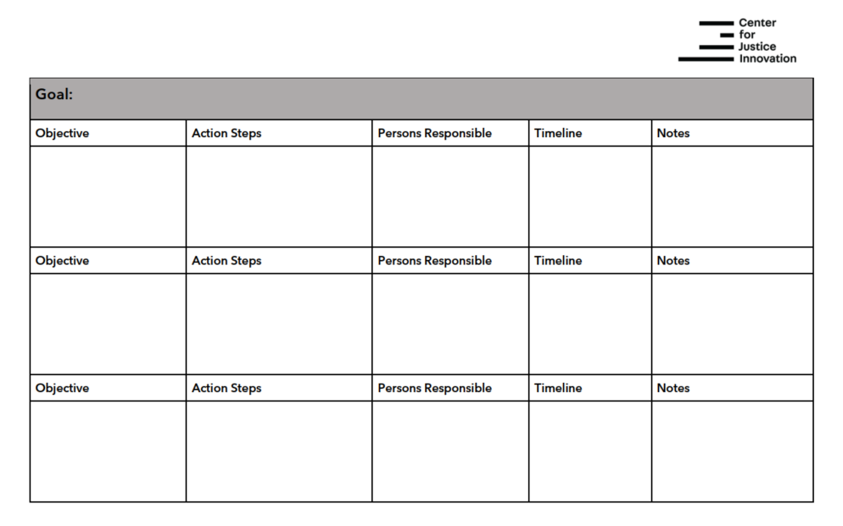
Notes:
This is an example of a table that could be used to record goals, objectives.

Slide 29
Needs Outside of Substance Use
Notes:
Taylor
Although case managers are members of the treatment court team, there are many responsibilities for case managers that are outside of substance use treatment.

Slide 30
Functions of Case Management
Assessment
Planning
Linkage
Monitoring
Advocacy
https://store.samhsa.gov/sites/default/files/d7/priv/sma15-4215.pdf
Notes:
Taylor
Assessment and planning are common parts of case management. As Shawn has touched on already, these are important functions of being a case manager. However, there is more to case management than conducting assessments and creating case management plans.
We want to highlight other functions of case management, like linkage, monitoring, and advocacy.
Let’s go into more depth about these three functions of case management.

Slide 31
LINKAGE
Notes:
Taylor
First, we are going to talk about LINKAGE. As I’m sure many of us know, linking participants to treatment is a vital function of treatment court. However, it is equally as important to link participants to additional support services.

Slide 32
The ‘Other’ SUD: System Underperformance Disorder
Consider individual’s history with:
Schools/teachers
Child welfare/social workers
Healthcare/doctors, nurses
Social services/housing
Psychiatry/doctors
Jails and prisons/police
Courts/judges, lawyers
Media/journalists, public opinion
Notes:
Taylor
As treatment court team members, we are familiar with SUD – substance use disorder. However, there is another SUD that impacts many of our participants – system underperformance disorder.
We often talk about "the systems" at play in an individual's life, but it is important to critically think about how these systems impact our participants and how they may react towards us.
Our participants may have had a history with any of these systems. How does this history impact our participants? ANSWERS: Resistance, frustration, anger, distrust
As case managers, although we did not cause these feelings, we can help mitigate and assist clients navigation through these systems

Slide 33
Linking Participants with External Agencies
Identifying a point of contact
Providing “soft” handoffs
Sharing pertinent case information
Notes:
Taylor
As case managers, we help refer our participants to a multitude of resources, many from the previous list. Linkage goes beyond merely providing clients with a referral list of available resources.
As case managers, we must work to develop a network of formal and informal resources and contacts to provide needed services for their clients.
When referring participants to external agencies it is important to have a point of contact. Having a specific staff person and knowing the referral process will make accessing the services far easier for the participant
A soft handoff is a way of informally introducing someone to the point of contact or the organization. Providing a soft handoff can help ease some tension for the participants and demystify the referral process. EXAMPLE: when referring participants, I would call and introduce them to the organization/point of contact.
As part of the soft handoff, I found it helpful to share agency information like location, proximity to public transportation, hours.
To take it a step further, visiting the agencies and meeting people in person goes a long way. You can see the agency, develop a more personal relationship with the point of contact/staff.

Slide 34
Single Point of Contact
Participants receive services from multiple agencies
Provide well-structured referrals
Offers continuity for participants
Notes:
Taylor
As a case manager, it is our responsibility to be a single point of contact for our participants who receive services from multiple agencies.
As we spoke, participants are receiving treatment but may also connect with other agencies for housing, social service/benefits, transportation, food, employment, education, etc.
Case management replaces a haphazard process of referrals with a single, well-structured service. In doing so, it offers the client continuity.
More work for the case manager but better outcomes for the participants

Slide 35
MONITORING
Notes:
Taylor
After linking and referring participants to treatment and additional support services, the next step is monitoring.
In treatment courts, monitoring has a different meaning depending on the team members role. Treatment views monitoring as following treatment plan. Probation view monitoring as public safety. Let’s discuss what monitoring looks like for case managers as part of the treatment court team.

Slide 36
Monitoring
Participant progress
Adjusting case management plans
Sharing information with relevant parties
Notes:
Taylor
Monitoring participant progress, and adjusting services plans as needed, is an essential function of case management. When adjustments are needed to the case plan, it is important to still include the participant in the new identified goals, objectives, or timeline.
Participant progress doesn’t only constitute phase advancement but progress in self-identified goals.
Example: Sam from our case example, her visitation time with her children conflicts with the HSE test prep classes. You sit down with her and ask how does she want to proceed. She decided to see her children and enroll in night test prep classes starting next month.

Slide 37
Basic Information to Share
Referral to treatment and behavioral heath, housing, and social services
Attainment and maintaining employment or enrolling in an educational program
Completion of case management goals
Notes:
Taylor
Coupled with monitoring is the need to share client information with relevant parties. As a member of the treatment court team, information that is shared should be related to case management goals.
For instance, if a client who is involved in the criminal justice system tests positive for drugs, both the treatment counselor and the probation officer may need to know.
Case managers bring a holistic approach to the participant
EXAMPLE: Sam’s adjustment to HSE test prep classes – participant called PO and got approval. Share new schedule with team and that the PO has approved.

Slide 38
Memorandums of Understanding
Include MOUs for each team role, including:
Role
Responsibility
Ethics
All team members should have the MOUs for each team role
https://www.ndci.org/resource/sample-documents/
Notes:
Taylor
Who has a MOU – written agreements with other agencies or organizations for services and coordination​.
This is a different MOU than sharing HIPPA and personal information sharing… Internal team dynamics, not external
​
If you don’t already have it, your team needs to have an MOU for team roles as soon as possible, including:​
​
ROLE​
RESPONSIBILITY​
ETHICS​
​
You can also include a description of this in the problem solving court context vs regular court, which might or might not change (ethics shouldn't change).​
​
NDCI has a template​
​
[Unrelated: Remember, policies and procedures manuals are not designed to be operations manuals (which tell you how to do things).]​
​

Slide 39
ADVOCACY
Notes:
Taylor
Through monitoring, case managers many needs to take additional steps on the client’s behalf. These next steps include advocating on behalf on the participant.

Slide 40
Advocacy
Address goals in the case management plan
Direct and professional
Individual, administrative, and policy
Notes:
Taylor
Client advocacy should always be geared toward achieving the goals established in the service plan.
Advocacy on behalf of a client should always be direct and professional. Advocacy can take many forms, from a straightforward discussion with a landlord or an employer, to a letter to a judge or probation officer.
Advocacy often involves educating service providers to dispel myths they may believe about substance use, or negative interactions that may have taken place between the participant and the service provider.
Three guidelines for advocating on behalf of a client are getting at least three “No’s” before escalating the advocacy effort, understanding the point of view of the organization that is withholding service, and consulting with supervisory personnel regularly before moving to the next level of advocacy.
Provide examples – DSS/Medicaid, education about employment barriers

Slide 41
Disengagement (Termination)
Not an event, but a process
Planned and deliberate
Review goals and accomplishments
Notes:
Taylor
Disengagement looks different working in a treatment court setting. The guidelines for completion should clear from the beginning of the program.
Disengagement should be discussed from the beginning of the program. The program is not forever and participants should be well informed of what will happen.
At this time, we discuss continuum of care. This looks different depending on your agency. Do you stay in contact with participants? What happens after the complete and they need assistance engaging with services?
Teaching skills like time management, keeping a schedule, advocacy

Slide 42
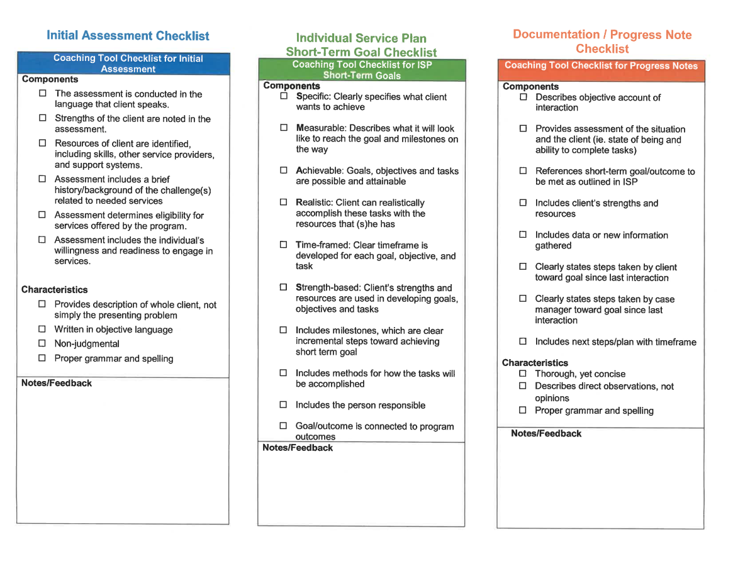
Notes:
This is a helpful checklist that you can use during your case management.

Slide 43
Questions?
Shawn Rogers, srogers@innovatingjustice.org
Taylor DeClerck, tdeclerck@innovatingjustice.org

Slide 44
