Slide 1
Understanding toxicology reports and latest drug trends
Sara Schreiber, PhD

Slide 2
Understanding Toxicology reports

Slide 3
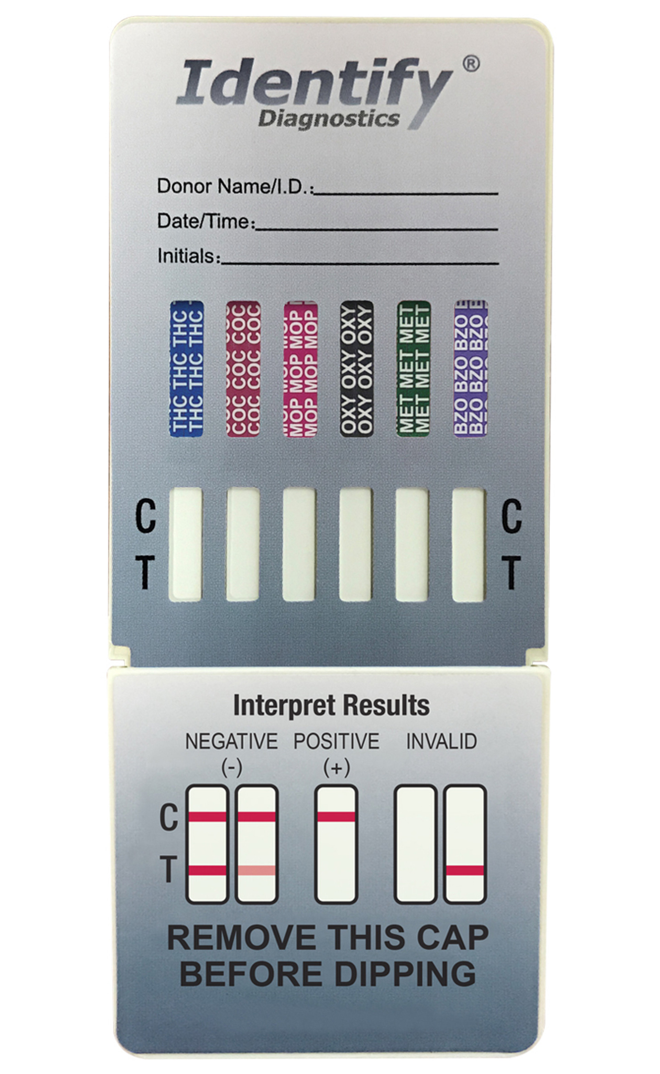
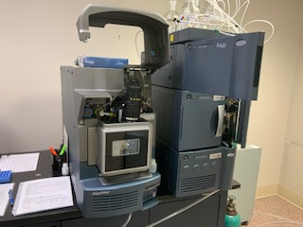
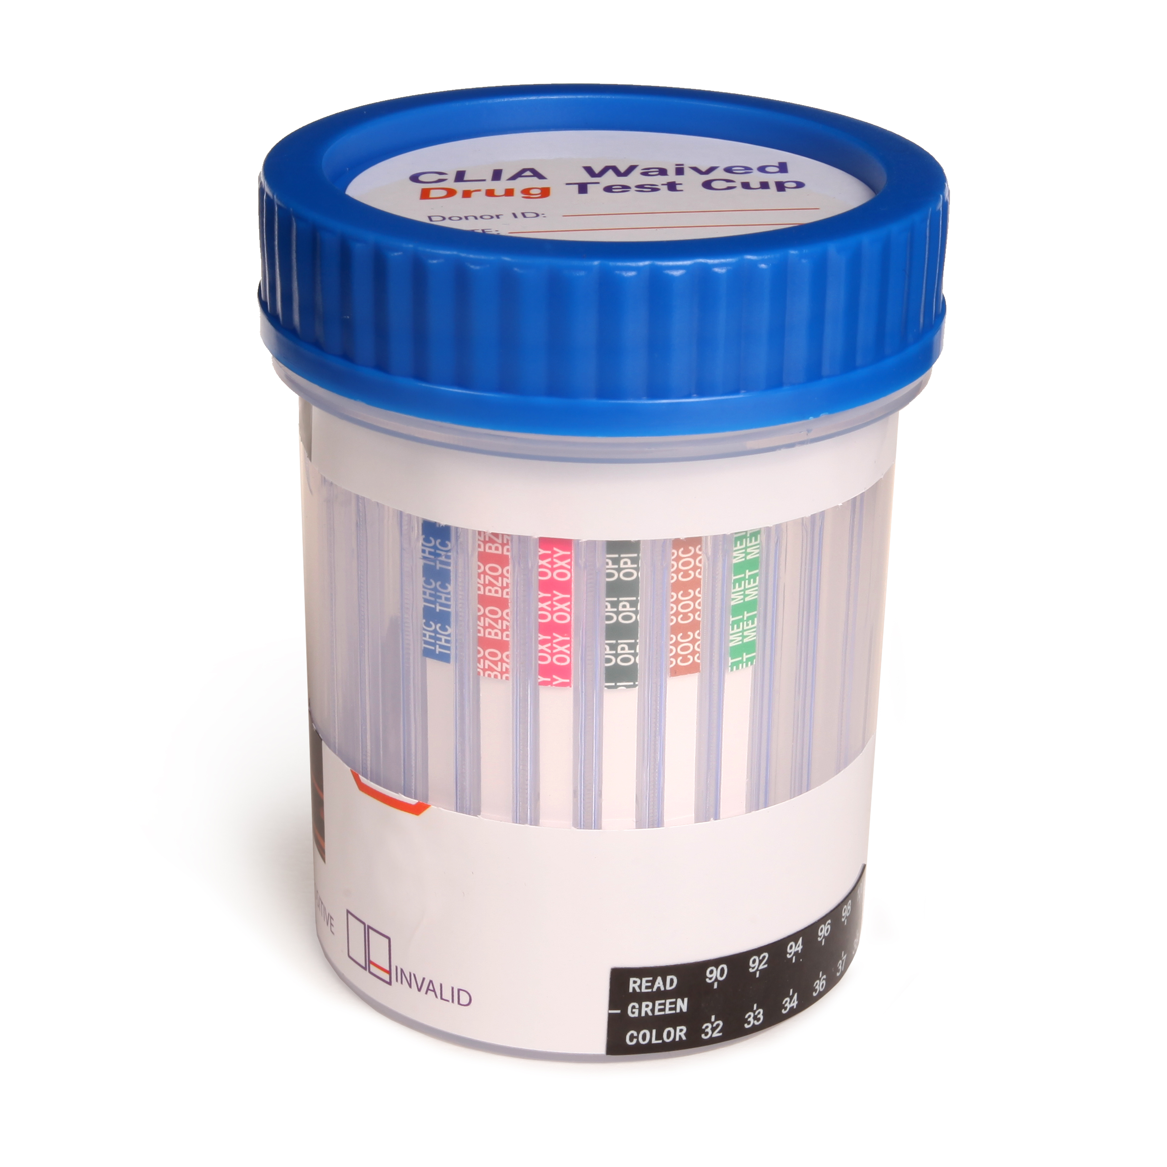
testing types
screening
Confirmatory
Multi-drug screen test cup
Cassette
Dip Card
Drug strips
Chromatographic analysis
Spectral identifications

Slide 4
Screening test
6-monoacetylmorphine
Amphetamine
Barbiturates
Buprenorphine
Benzodiazepines
Clonazepam
Cocaine
Cotinine
Methadone metabolite
Ethyglucuronide
Norfentanyl
Synthetic marijuana
AB-PINACA
Mitragynine
Ecstacy
Methamphetamine
Methadone
Morphine
Opiates
Oxycodone
Phencyclidine
Tricyclic antidepressants
Marijuana
Tramadol

Slide 5
Cross reactivities
What does it detect well
What does it not detect well
Studies done under optimal conditions
Did not evaluate for drug-drug interactions

Slide 6
6-monoacetylmorphine
Why important?
Detect well:
6AM
Does not detect well:
Morphine, heroin, codeine, oxycodone, oxymorphone

Slide 7
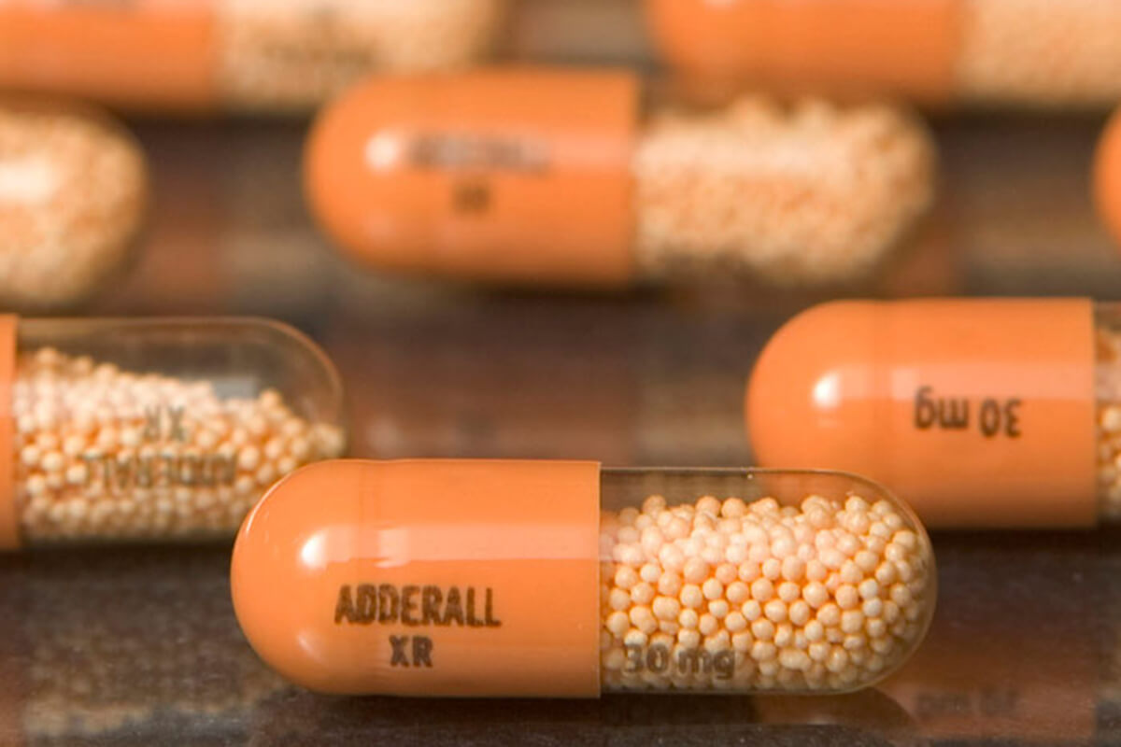
amphetamine
Why important?
Detect well:
amphetamine
Does not detect well:
MDA, phentermine, methamphetamine

Slide 8
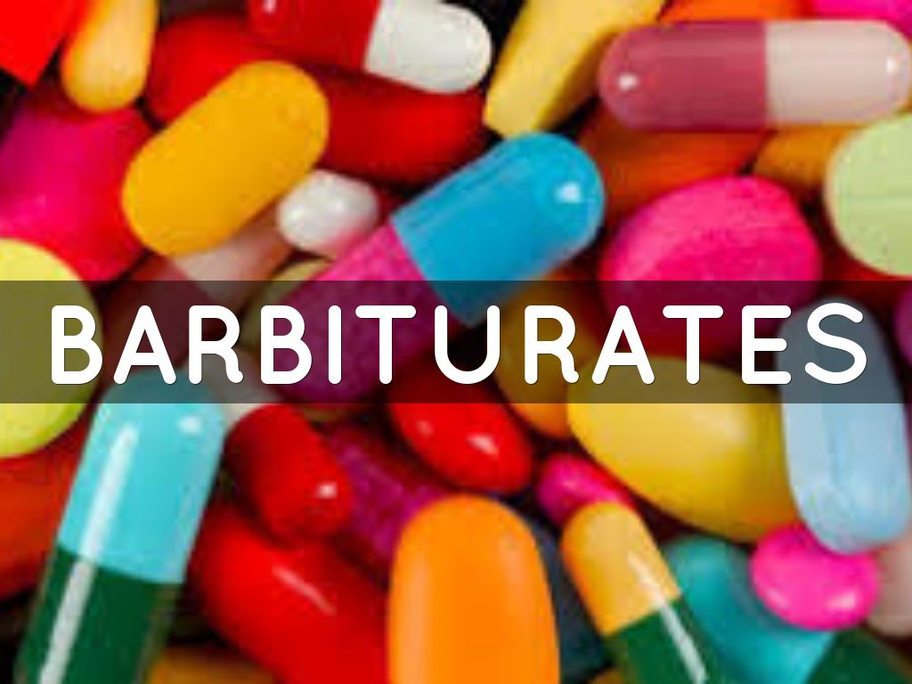
barbiturates
Why important?
Detect well:
Secobarbital
Butabarbital
Butalbital
Cyclopentobarbital
Phenobarbital
Aprobarbital
Does not detect well:
amobarbital

Slide 9
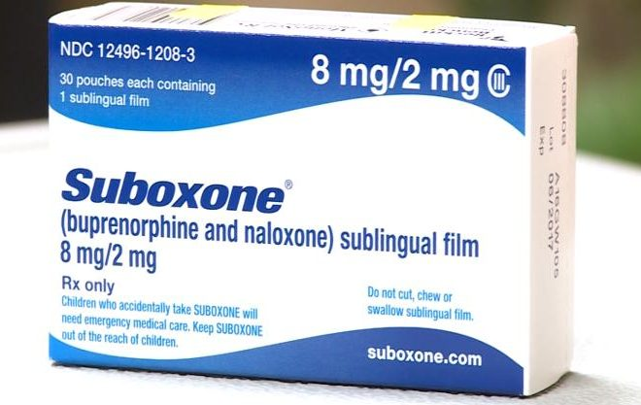
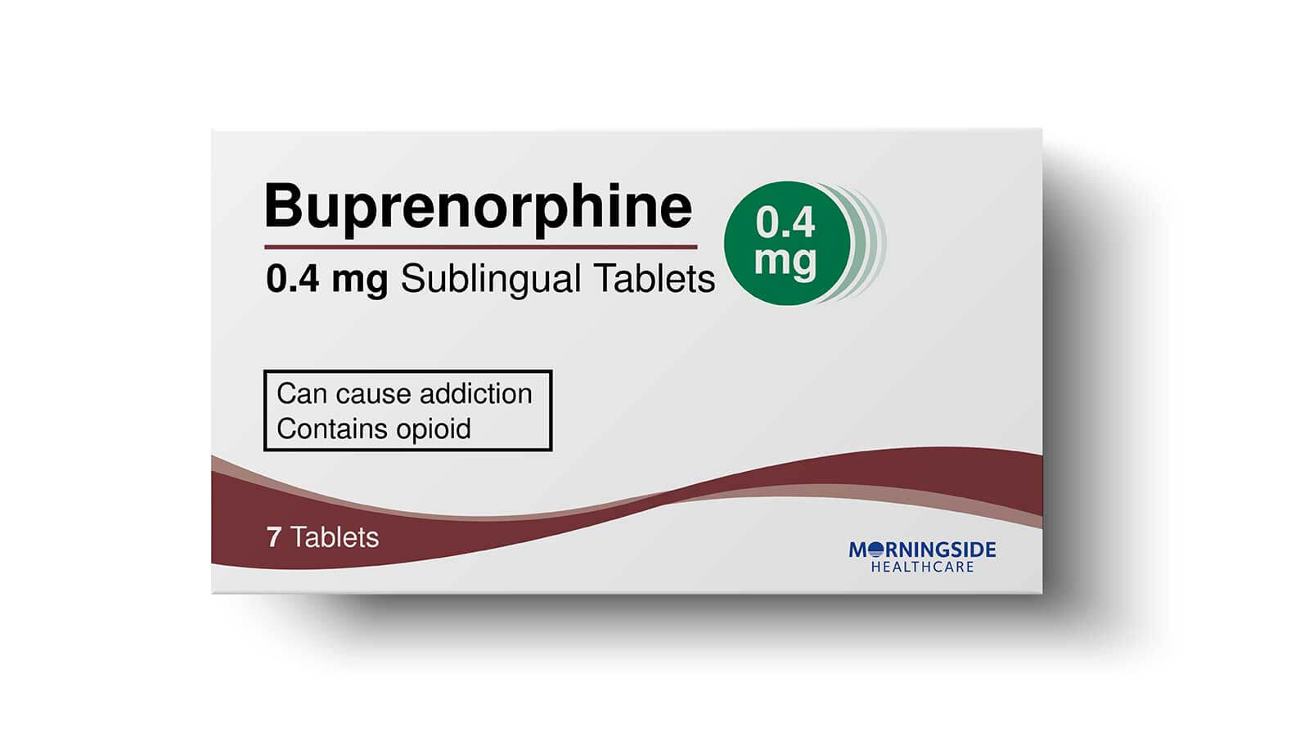
buprenorphine
Why important?
Detects well:
buprenorphine
No mention of metabolite

Slide 10
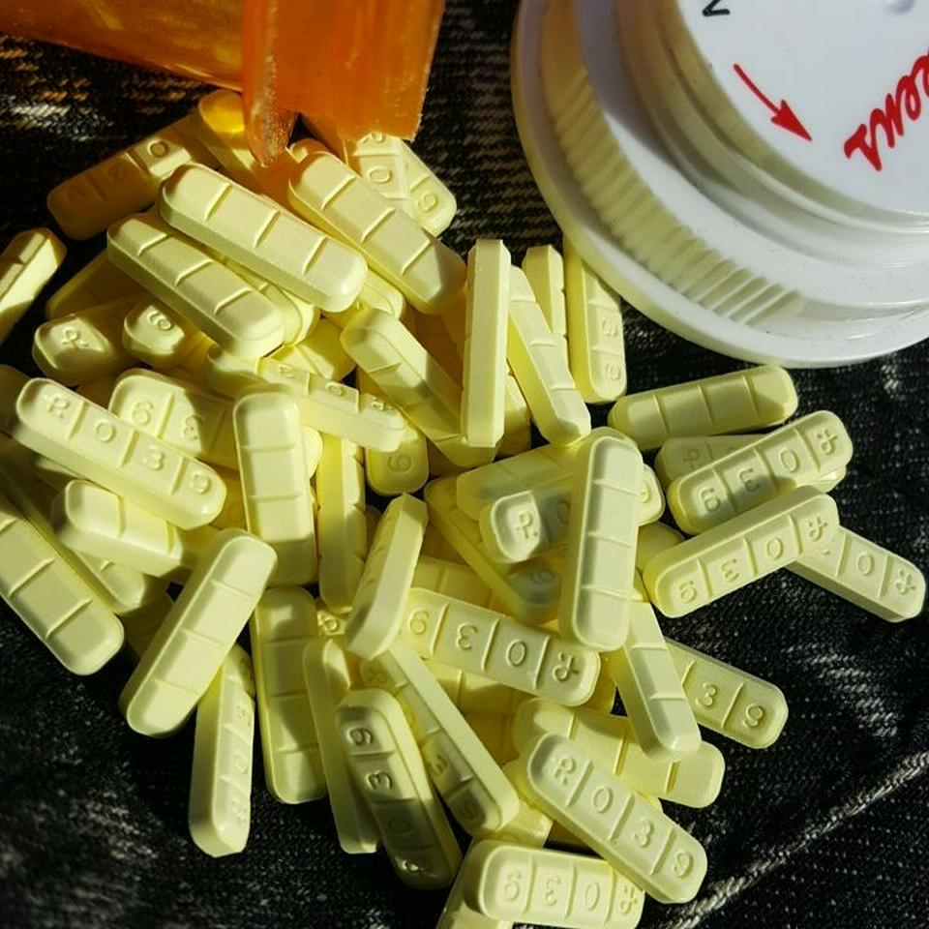
benzodiazepines
Why important?
Does not detect well:
Bromazepam, clorazepate, desalkylflurazepam, diazepam, a-hydroxyalprazolam, lorazepam, lorazepam-glucuronide, triazolam
Detect well:
Oxazepam, alprazolam, clobazam, flunitrazepam, nitrazepam, norchlordiazepoxide, nordiazepam, temazepam
What about designer benzos?

Slide 11
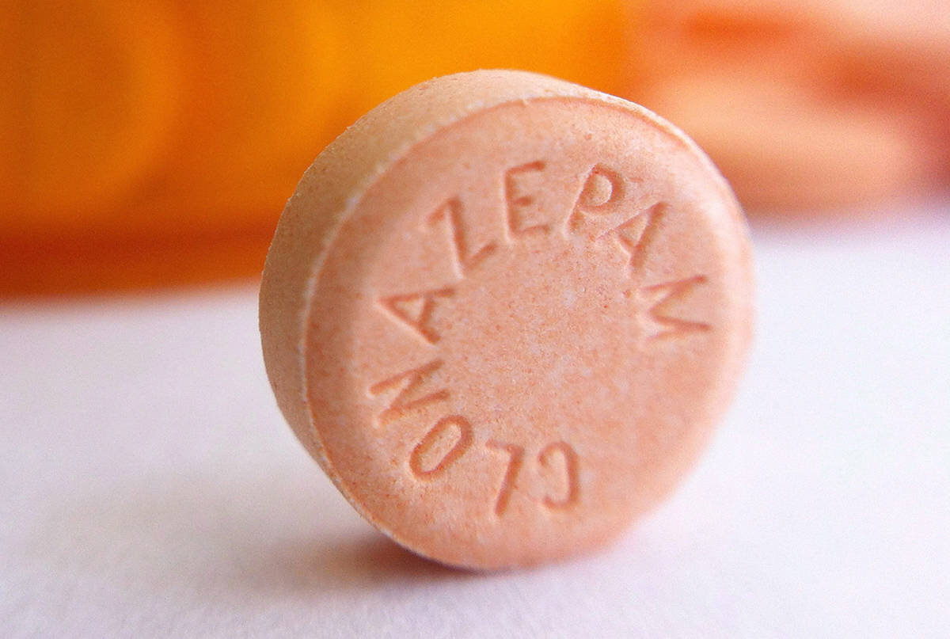
clonazepam
Why important?
Does not detect well:
Clonazepam
Meclonazepam
Alprazolam
Clobazam
Desalkylflurazepam
Flunitrazepam
Lorazepam
Nitrazepam
Nordiazepam
Triazolam
Oxazepam
Bromazepam
Clorazepate
Diazepam
A-hydroxyalprazolam
Lorazpem glucuronide
norchlordiazepoxide
Temazepam
Does detect well:
7-aminoclonazepam

Slide 12
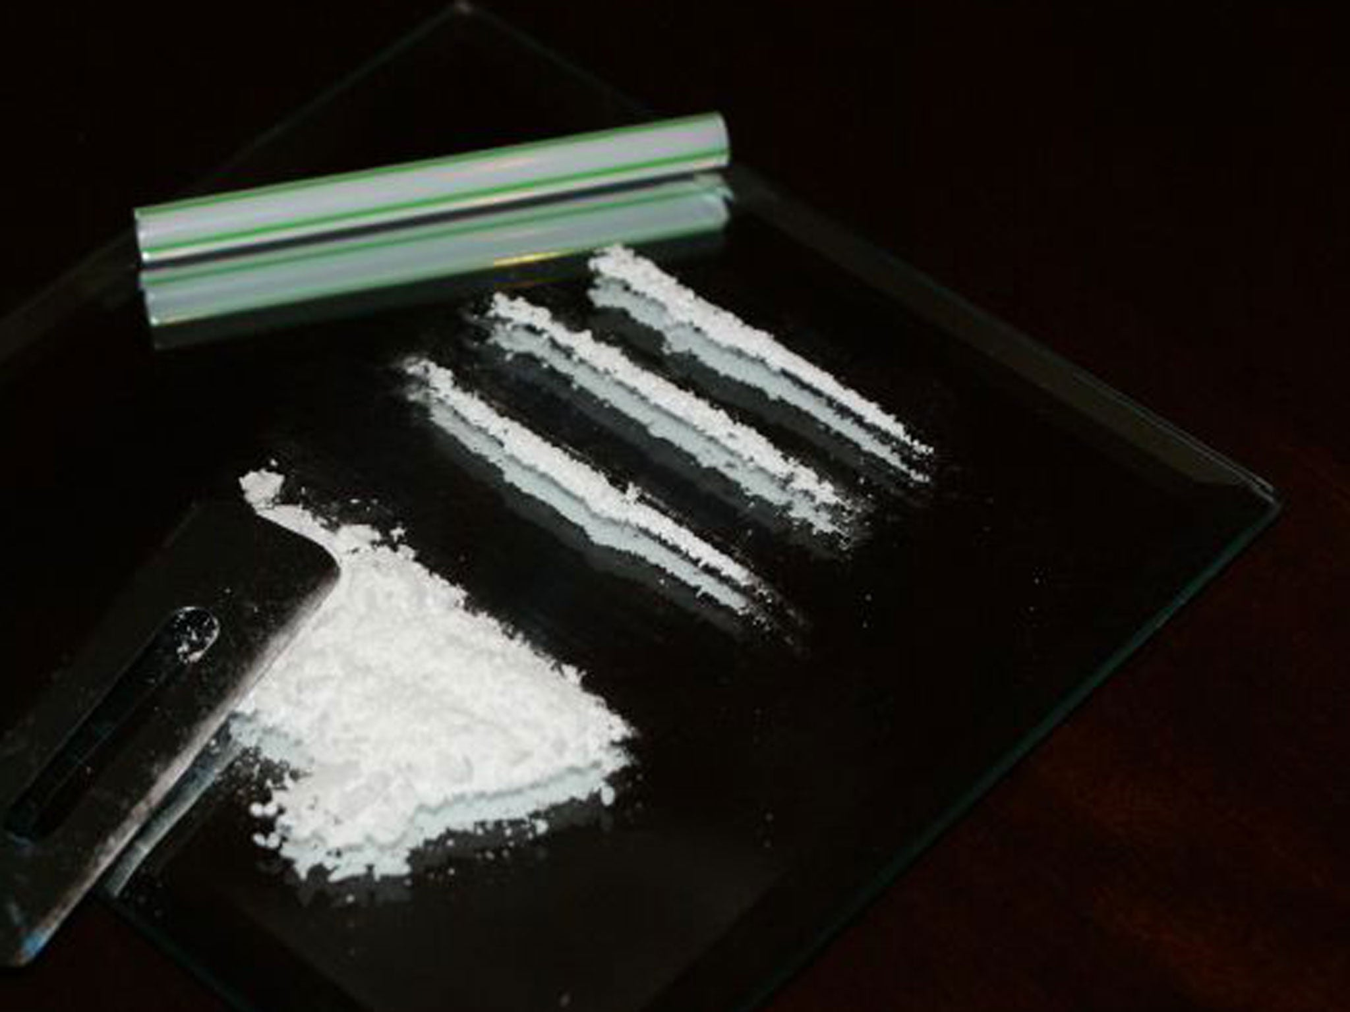
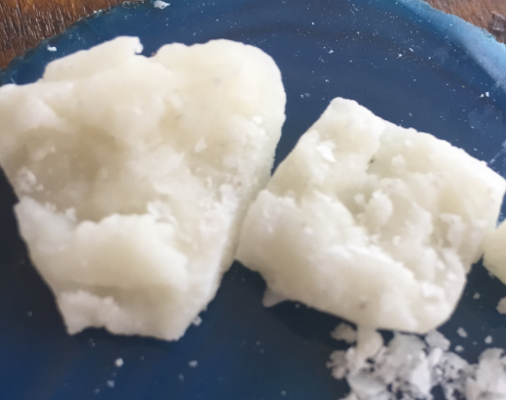
Cocaine
Why important?
Does not detect well:
Cocaine
Cocaethylene
Ecgonine
Does detect well:
Benzoylecgonine

Slide 13
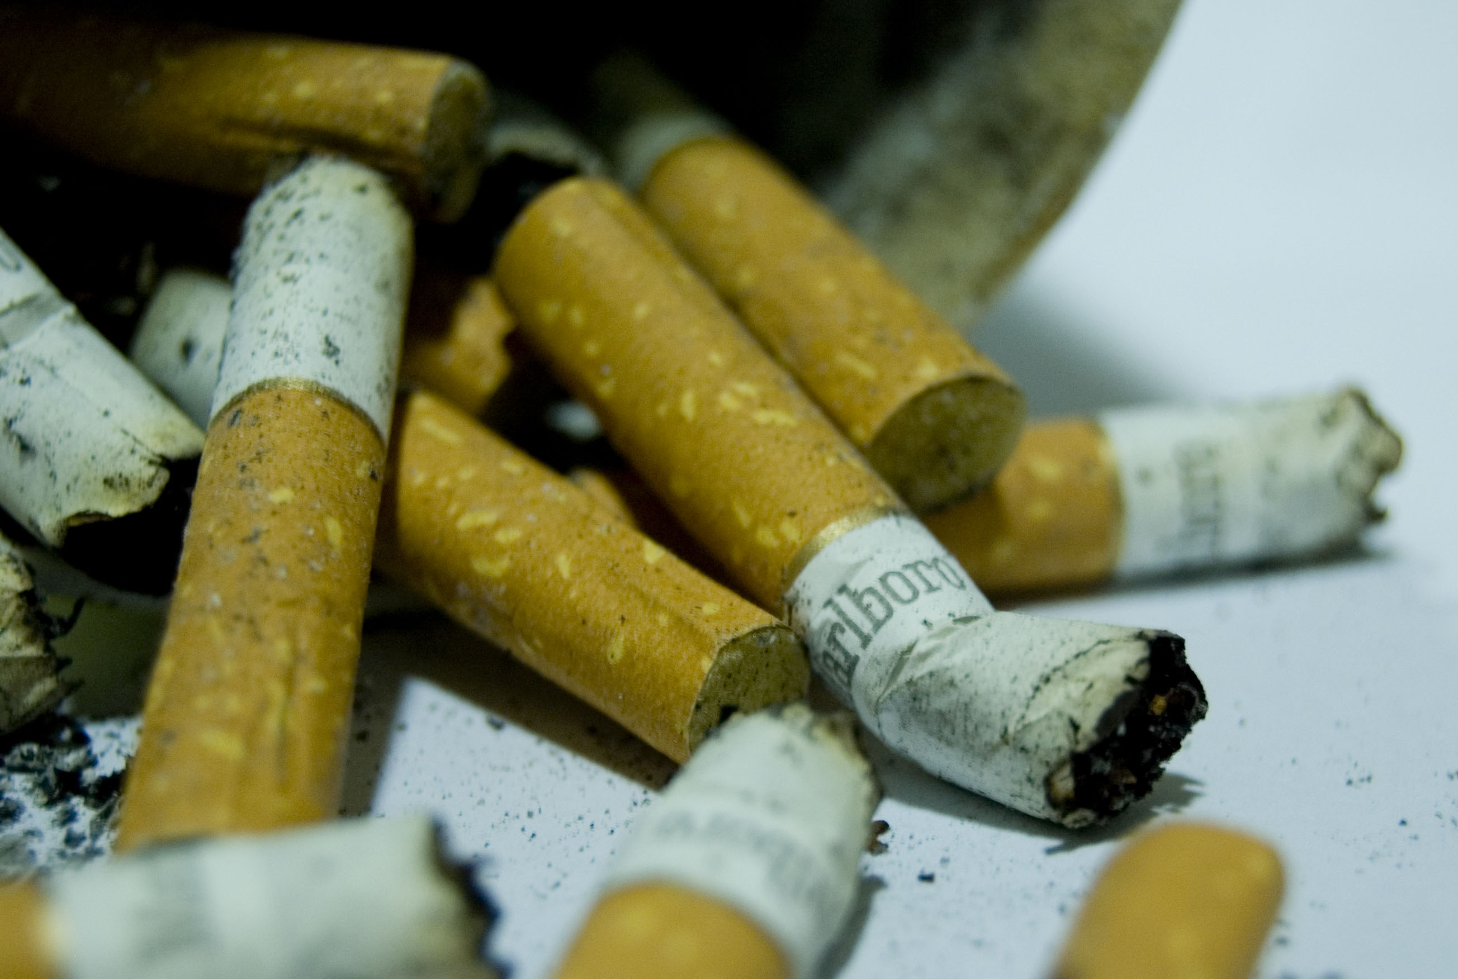
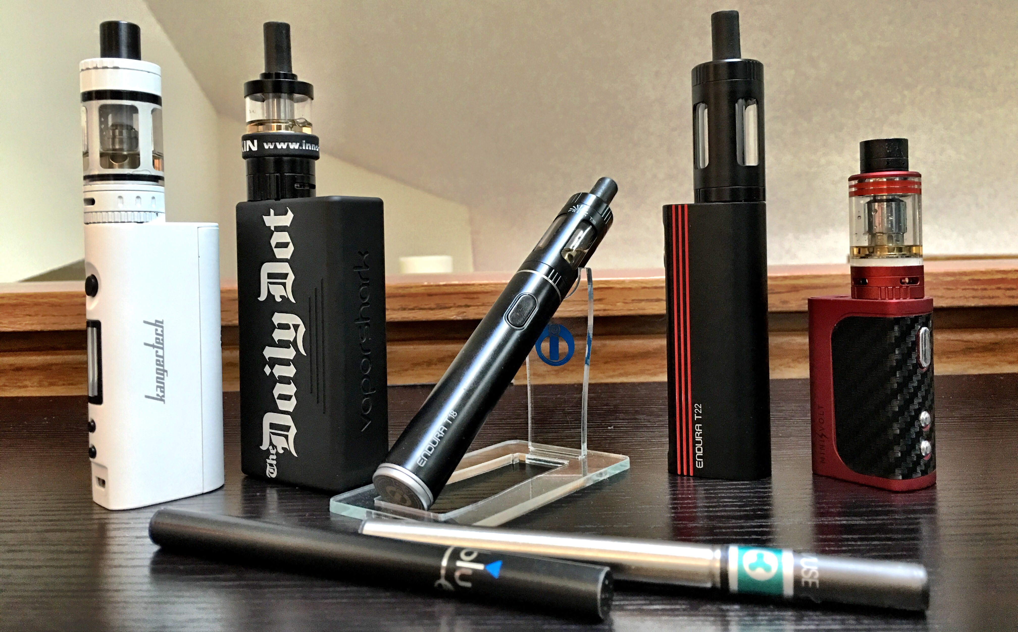
Cotinine
Why important?
Does detect well:
cotinine
Does not detect well:
Nicotine
Trans-3’-hydroxycotinine

Slide 14
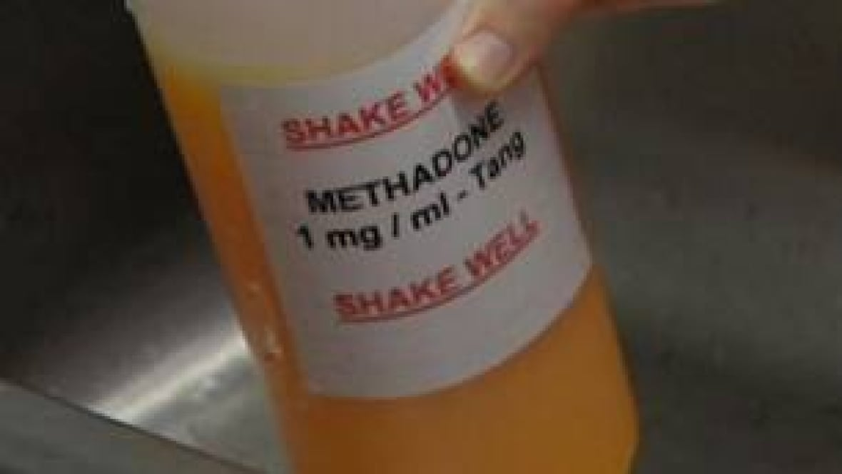
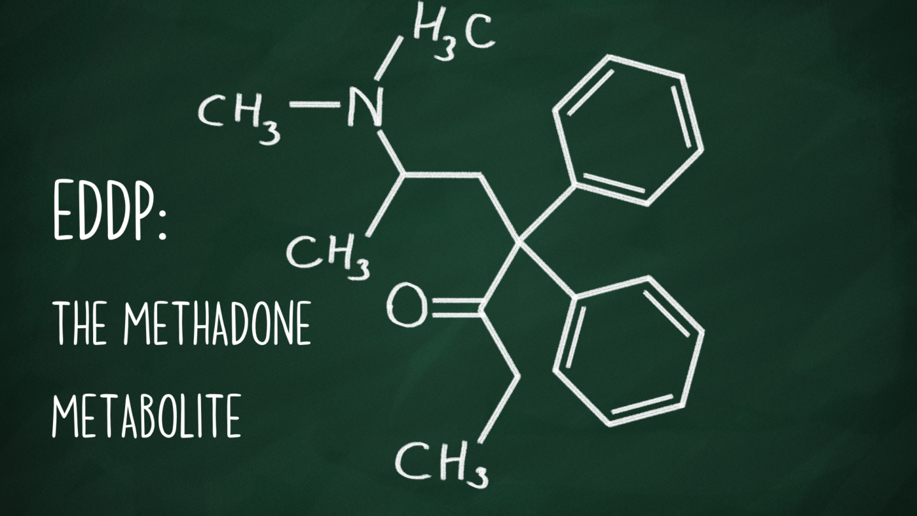
EDDP
Why important?
Does detect well:
EDDP

Slide 15
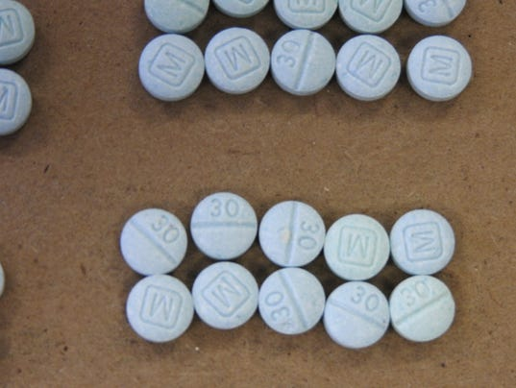
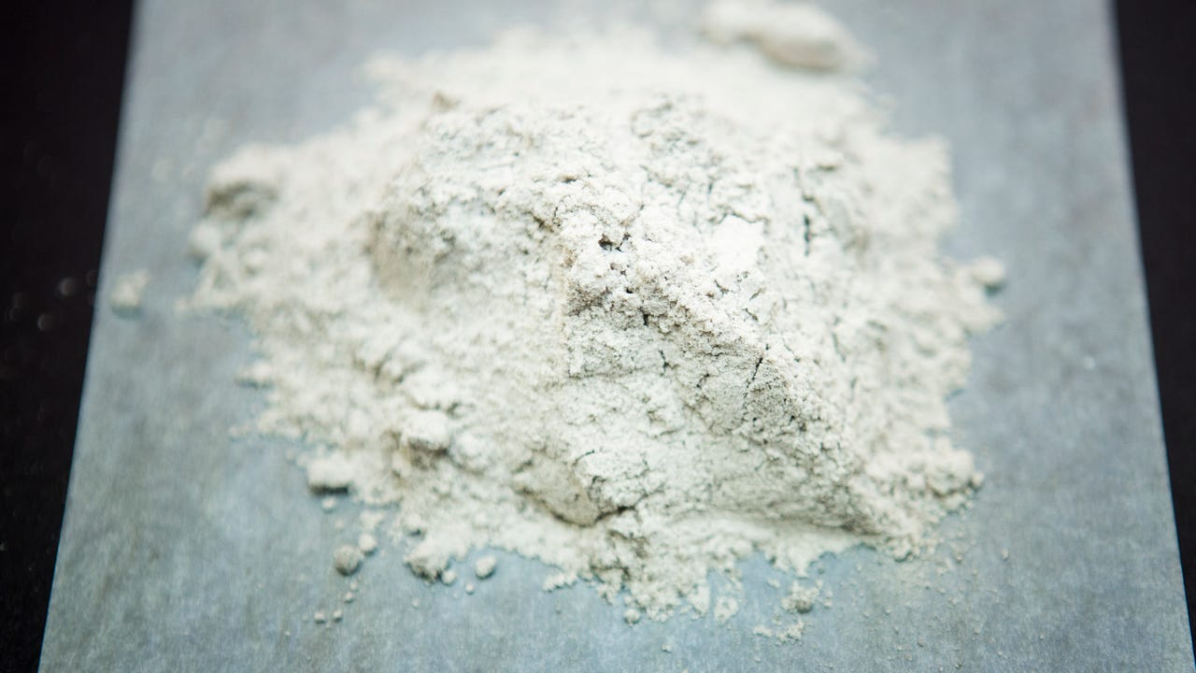
Fentanyl
Why important?
Does detect well:
Norfentanyl
Does not detect well:
Fentanyl
No mention of fentanyl analogs

Slide 16
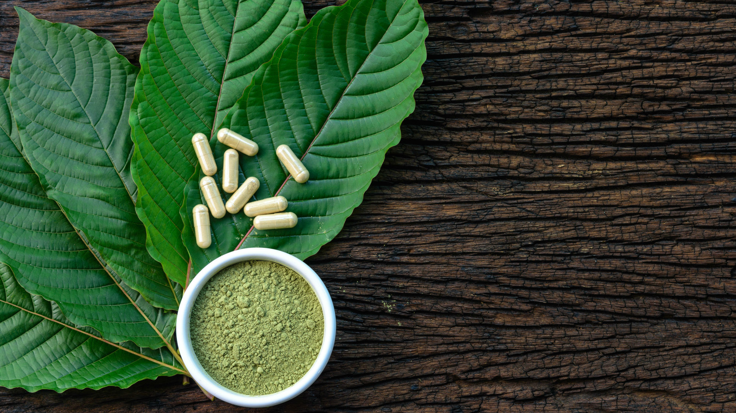
KRatom
Why important?
Does detect well:
Mitragynine
7-hydoxymitragynine

Slide 17
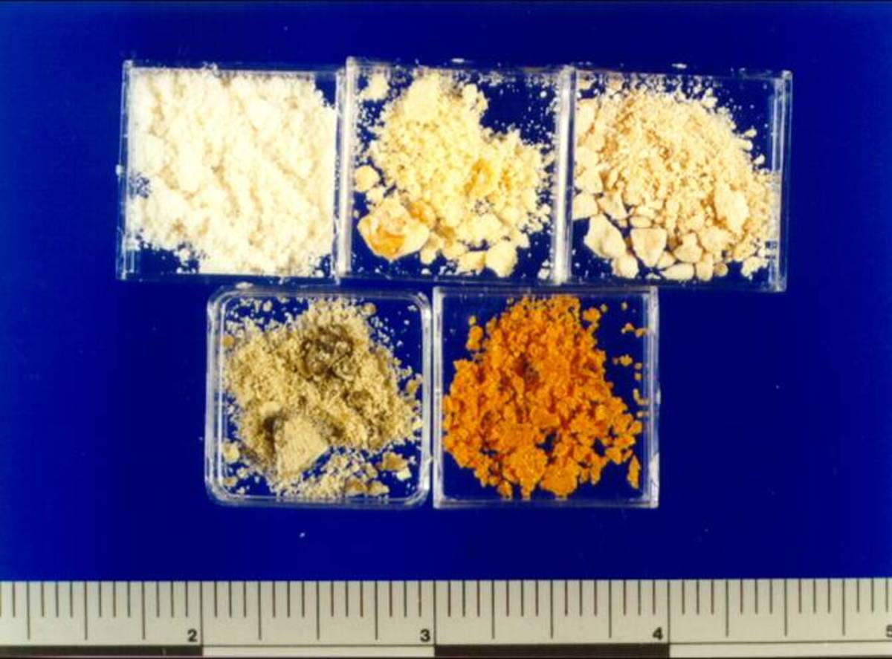
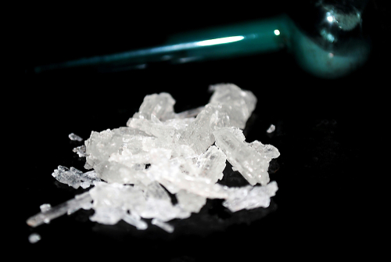
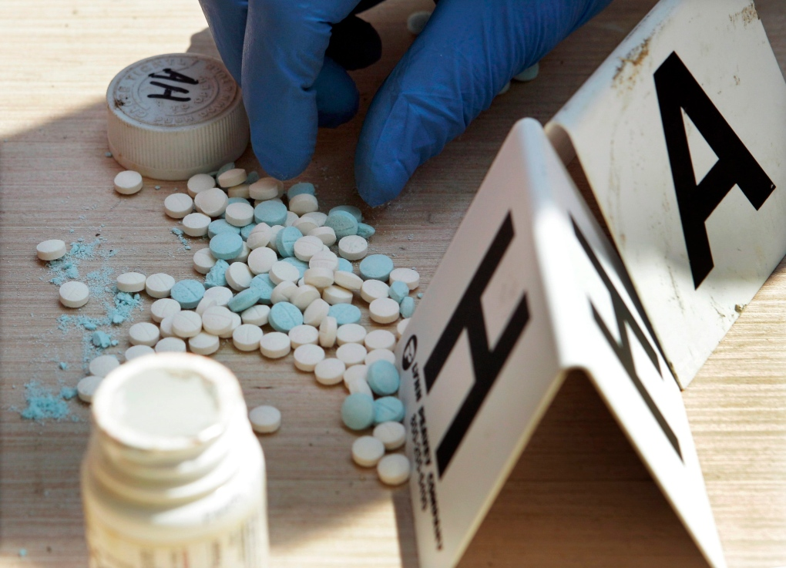
methamphetamine
Why important?
Does detect well:
Methamphetamine
Does not detect well:
Amphetamine
Ephedrine
MDEA
MDMA
Mephentermine

Slide 18
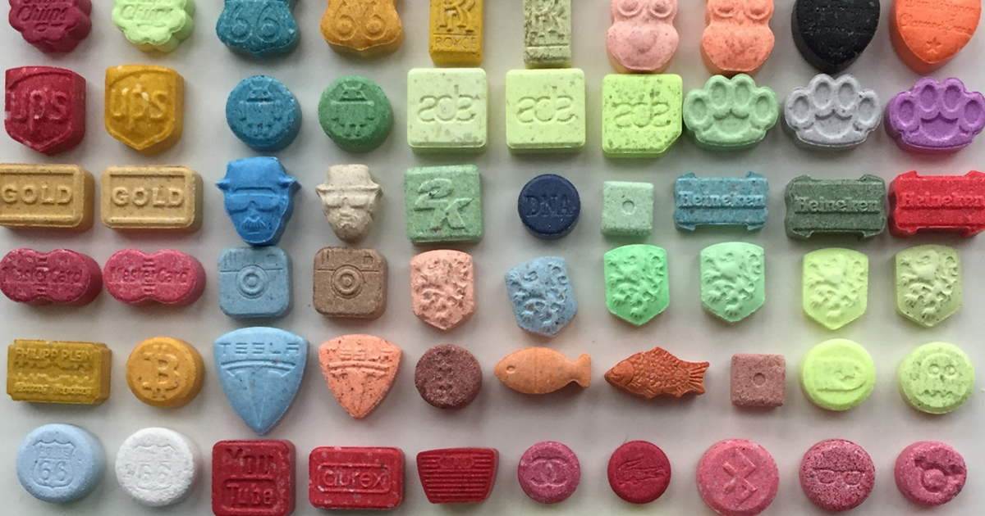
MDMA
Why important?
Does detect well:
MDMA, MDEA
Does not detect well:
MDA

Slide 19
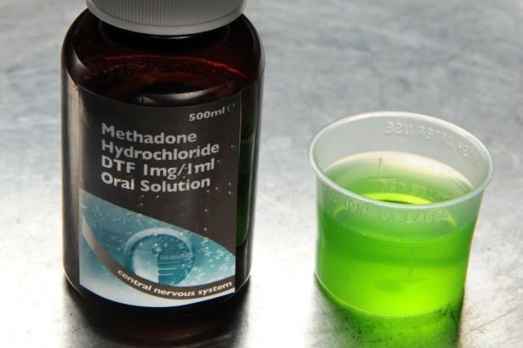
Methadone
Why important?
Does detect well:
methadone

Slide 20
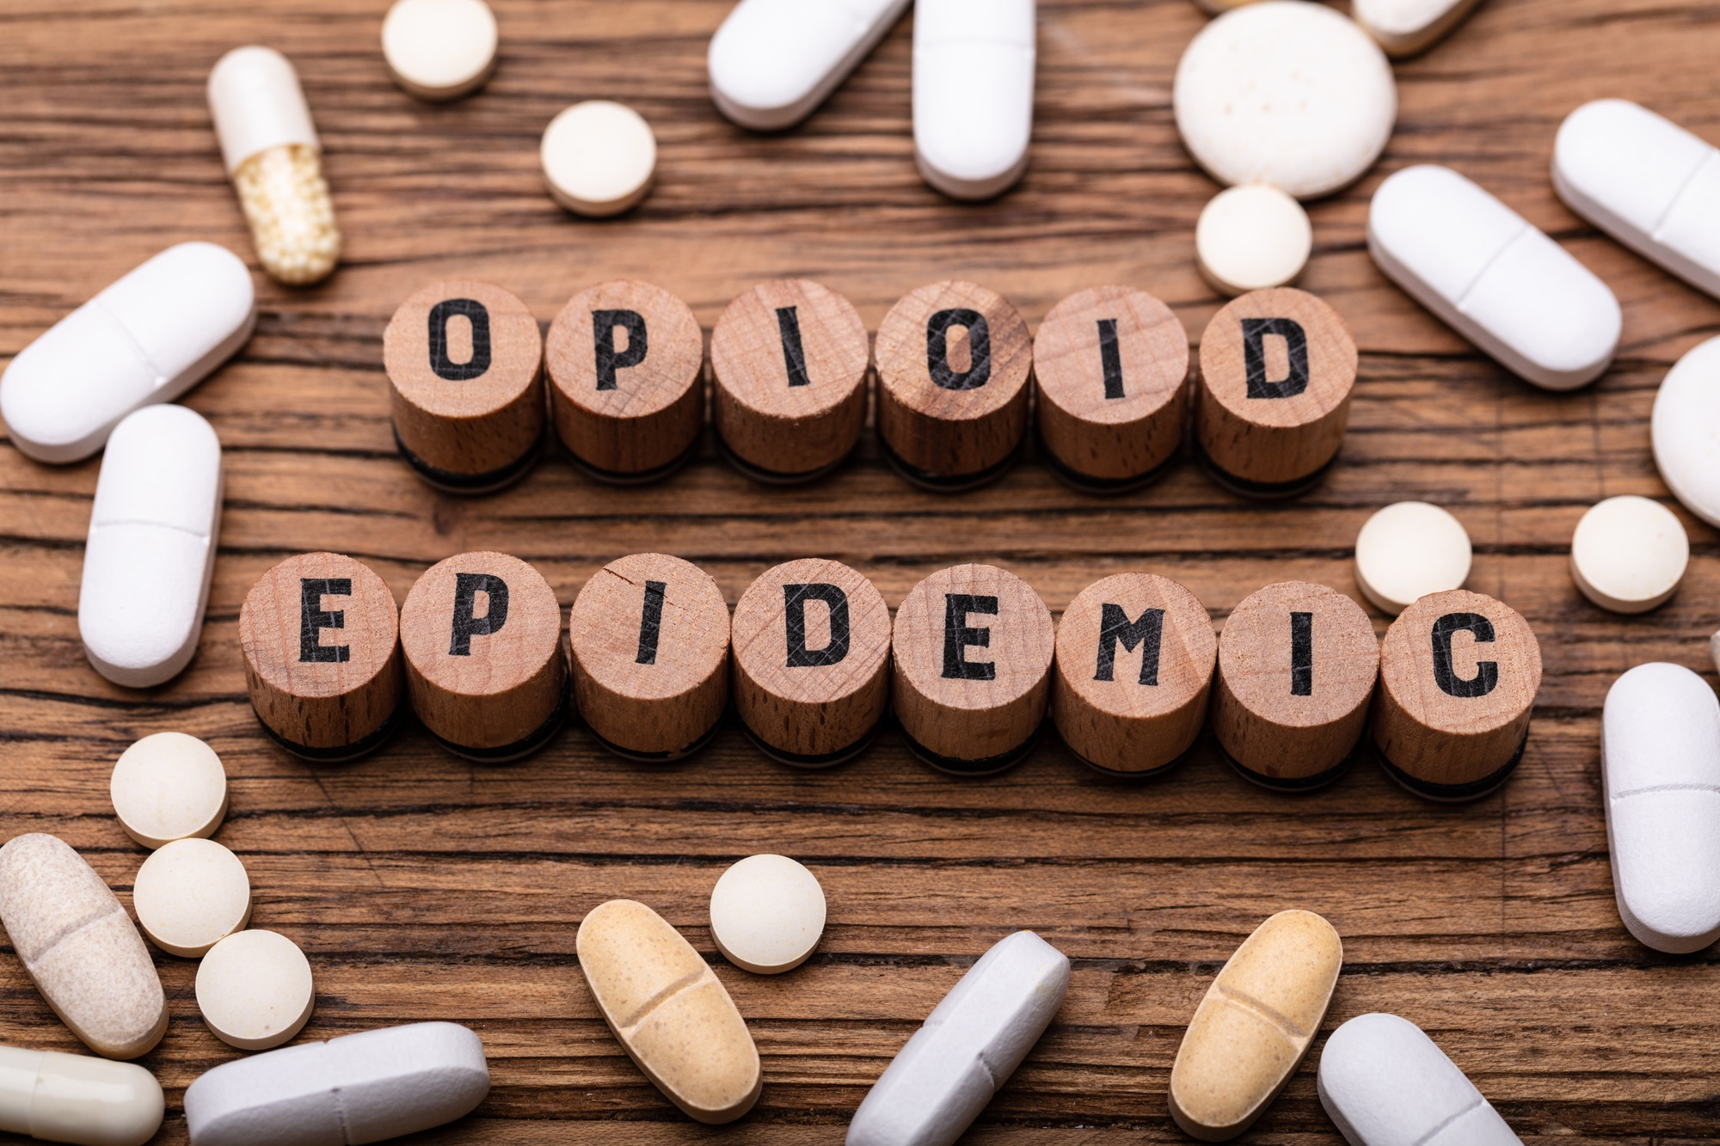
opiates
Why important?
Does detect well:
Morphine
Codeine
Ethylmorphine
Does not detect well:
Heroin
Hydrocodone
Hydromrphone
Levorphanol
Morphine 3-glucuronide
Nococaine
Oxycodone
Thebaine
No mention of designer opioids

Slide 21
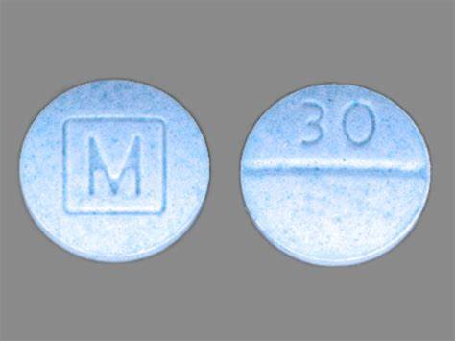
oxycodone
Why important?
Does detect well:
Oxycodone
Does not detect well:
Codeine
Ethylmorphine
Hydrocodone
Hydromorphone
Oxymorphone

Slide 22
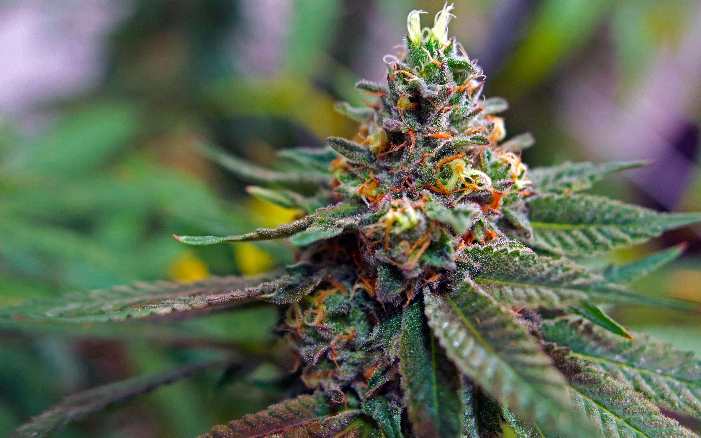
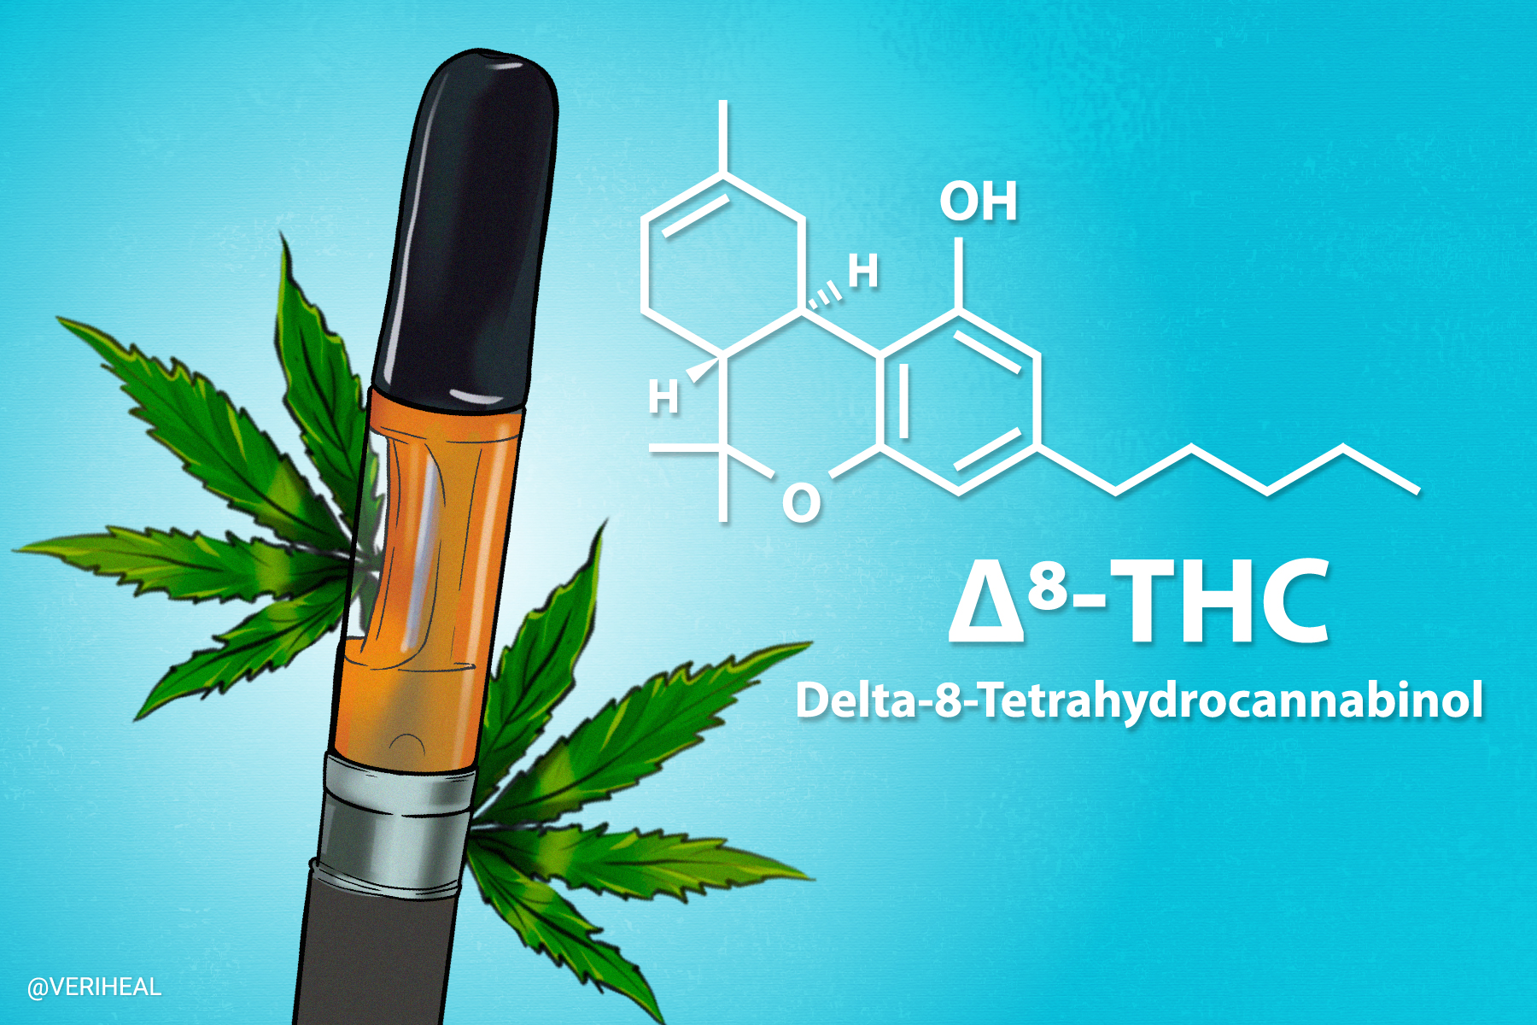
THC
Why important?
Does detect well:
11-nor-9-carboxy THC
Does not detect well:
Delta-9-THC
Delta-8-THC
Cannabidiol
Cannabinol
11-OH THC

Slide 23
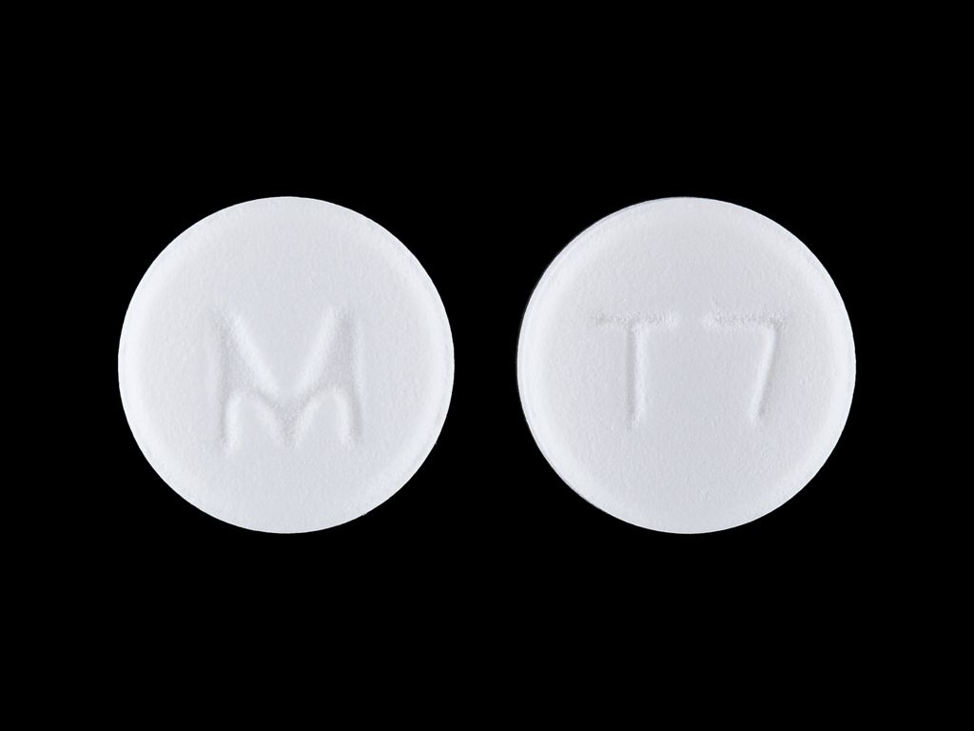
Tramadol
Why important?
Does detect well:
tramadol
Does not detect well:
N-desmethyltramadol
O-desmethyltramadol

Slide 24
What’s missing?
Unknown unknowns

Slide 25
Confirmatory testing

Slide 26
Analytical instrumentation
Liquid chromatography – mass spectrometry
Gas chromatography – mass spectrometry
Liquid chromatography – quadrupole-time of flight
Separation of the mixture, isolation of the analyte for identification
Be mindful of the scope

Slide 27
Understanding results
Actual results with some commentary

Slide 29
Metabolism of Opiates
HEROIN
CODEINE
6-MAM
MORPHINE
HYDROCODONE
(VICODIN)
OXYCODONE
(OXYCONTIN, PERCOCET)
Metabolism observed with chronic morphine administration at high doses
HYDROMORPHONE
(DILAUDID)
OXYMORPHONE
(NUMORPHAN, OPANA)

Slide 30
Heroin Metabolism
Heroin (2 - 6min)
6-MAM (6 - 25min)
Morphine (2 - 3 hrs)

Slide 32
Poppy seeds?

Slide 39
Oral fluid

Slide 40
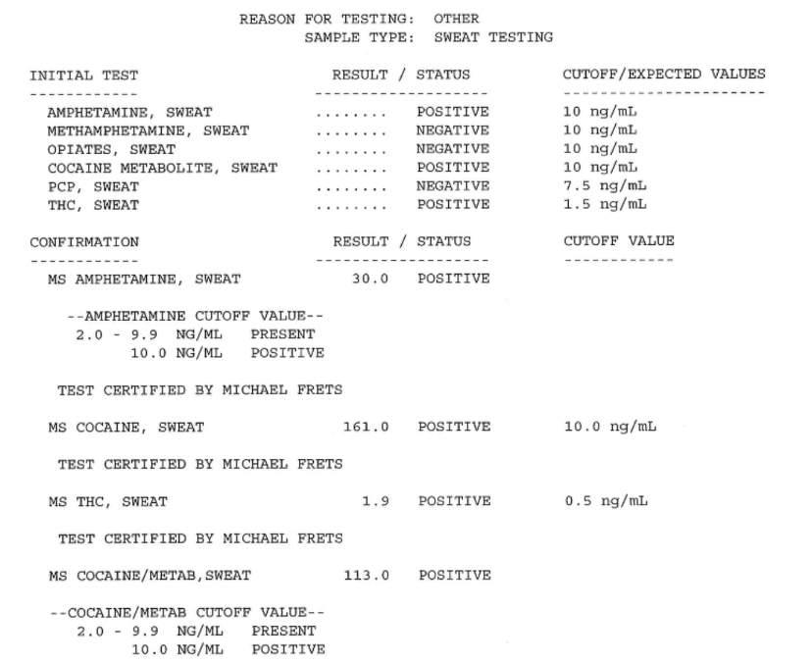

Slide 41
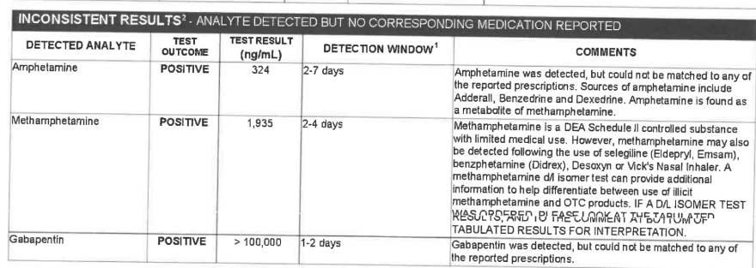

Slide 42
Oral fluid

Slide 43
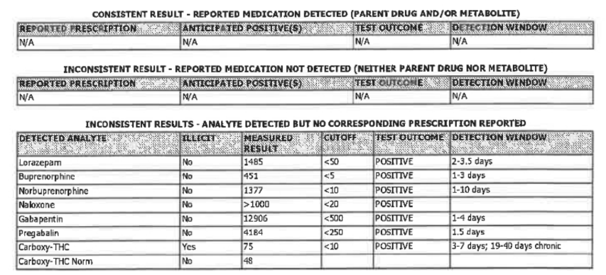

Slide 44
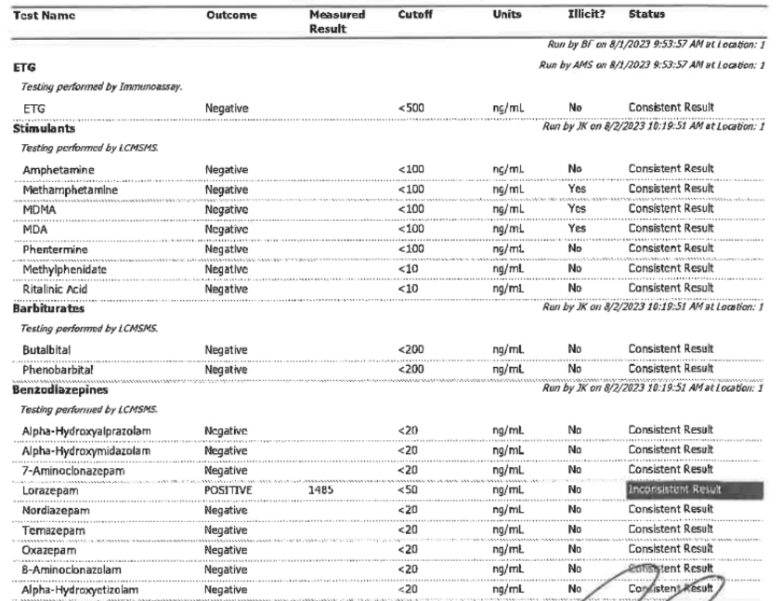

Slide 45
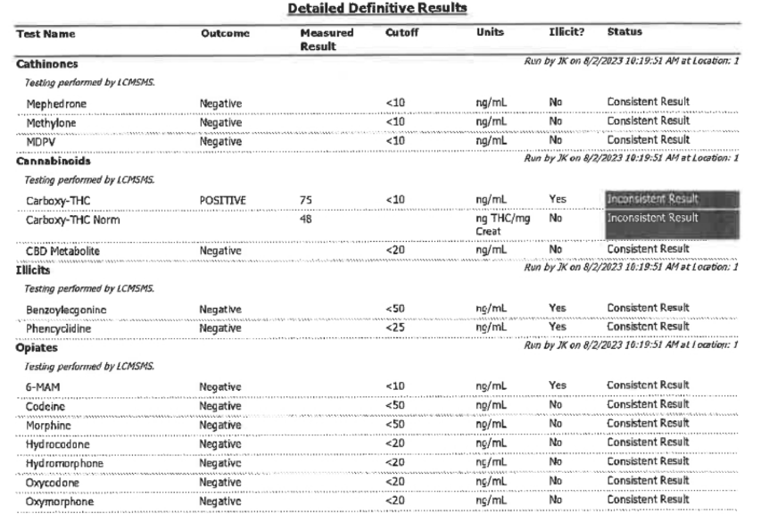

Slide 46
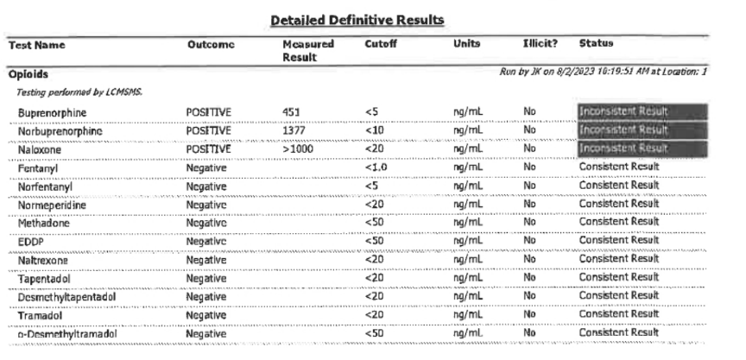

Slide 47
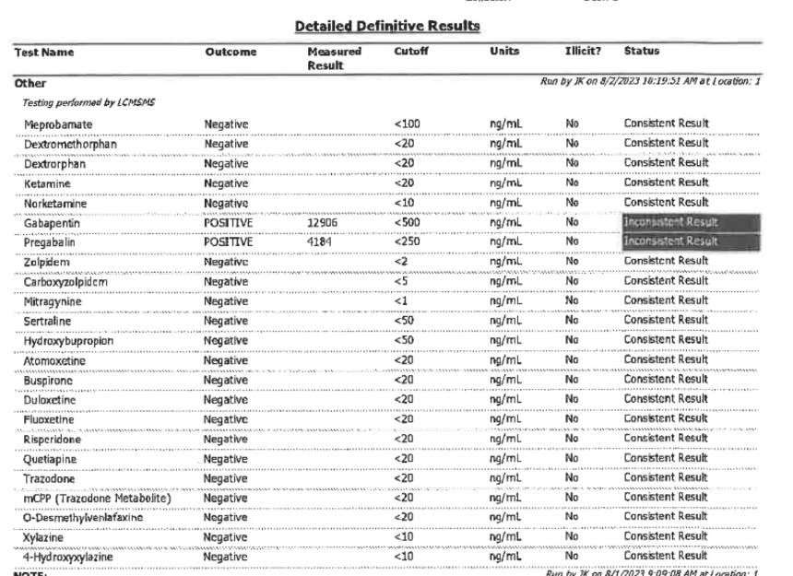

Slide 48
Drug trends

Slide 49
Currently upward trending
Opioids
Fentanyl
Designer opioids
Cocaine
Methamphetamine
Gabapentin

Slide 50
Currently downward trending
Heroin
Prescription opioids
Prescription benzodiazepines

Slide 51
Other analytes of concern
Loperamide
Kratom
Gabapentin

Slide 52
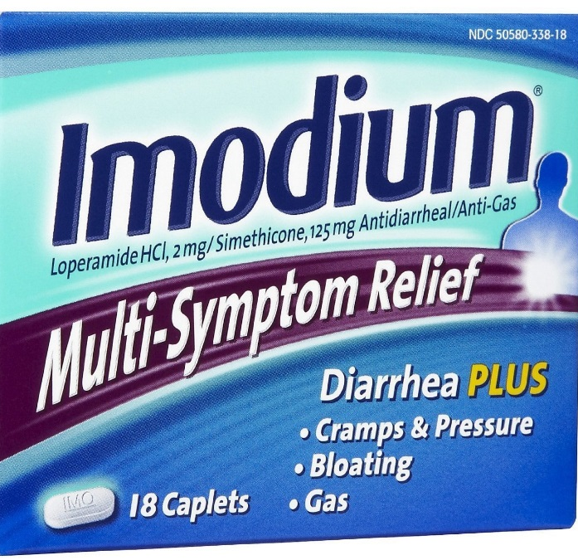
Loperamide
Imodium, Diocalm, Loperin, Lopex
Anti-diarrheal
Opioid-receptor agonist
Structurally similar to meperidine
Same receptors as morphine
Originally schedule II drug in 1970, schedule V in 1977, decontrolled in 1982
Binds to opioid receptors in the large intestine
Decreases colon motility allowing more water to be absorbed and thus producing constipation/treating diarrhea
Increases anal sphincter tone

Slide 53
kratom
Low dose – stimulant
High dose – depressant
Substitute for opioids?

Slide 54
Top Ten Medications Dispensed
Dispensened Presciptions |  | 2012 | 2013 | 2014 | 2015 | 2016 | % Change
1 | Levothryoxine | 112 | 117 | 120 | 120 | 123 | 10%
2 | Lisinopril | 99 | 102 | 104 | 106 | 110 | 11%
3 | Atorvastatin | 55 | 68 | 81 | 93 | 106 | 93%
4 | Acetaminophen/ hydrocodone | 136 | 129 | 119 | 97 | 90 | -34%
5 | Metoprolol | 82 | 84 | 85 | 86 | 88 | 7%
6 | Amlodipine | 69 | 75 | 78 | 81 | 87 | 26%
7 | Meformin | 68 | 73 | 77 | 80 | 87 | 28%
8 | Omeprazole | 67 | 72 | 75 | 77 | 76 | 13%
9 | Albuteral | 61 | 64 | 67 | 70 | 70 | 15%
10 | Gabapentin | 39 | 44 | 51 | 57 | 64 | 64%
Dispensened Presciptions |  | 2012 | 2013 | 2014 | 2015 | 2016 | % Change
1 | Atorvastatin | 55 | 68 | 81 | 93 | 106 | 93%
2 | Gabapentin | 39 | 44 | 51 | 57 | 64 | 64%
3 | Meformin | 68 | 73 | 77 | 80 | 87 | 28%
4 | Amlodipine | 69 | 75 | 78 | 81 | 87 | 26%
5 | Albuteral | 61 | 64 | 67 | 70 | 70 | 15%
6 | Omeprazole | 67 | 72 | 75 | 77 | 76 | 13%
7 | Lisinopril | 99 | 102 | 104 | 106 | 110 | 11%
8 | Levothryoxine | 112 | 117 | 120 | 120 | 123 | 10%
9 | Metoprolol | 82 | 84 | 85 | 86 | 88 | 7%
10 | Acetaminophen/ hydrocodone | 136 | 129 | 119 | 97 | 90 | -34%
Notes:
Synthroid
BP
Statin
Opioid Analgesic
BP
BP
T2 Diabetes
Acid Reflux
Brochodialator
Epilepsy/ Neuropathic Pain

Slide 55
Gabapentinoids
Gabapentin
(Neurontin®)
Pregabalin
(Lyrica®)
FDA-approved in 2004
•Indicated for neuropathic pain, post-herpetic neuralgia, seizures, and fibromyalgia
•Schedule V controlled substance
•3x faster absorption, 2.5x greater potency, non-saturable kinetics.
FDA-approved in 1993
• Indicated for herpetic neuralgia and epilepsy
• Up to 95% of prescribing is off-label • NOT a controlled substance
Both act as gamma-aminobutyric acid (GABA) analogues
Mechanism of action not entirely understood
• GABA-modulating drugs commonly abused: alcohol, benzodiazepines, Z-hypnotics
• Effects on dopaminergic system = euphoria

Slide 56
Erowid
Personal experiences
Staggered high doses over several hours (gabapentin/quetiapine)
Visual hallucinations
Body feels heavy
Happy/laughing/dancing
Loss of balance/bumping into walls
Staggered doses ending with opioid (gabapentin /oxycodone)
Visual hallucinations
Happy/talkative/uninhibited
Add oxy – lack of focus/sleepy, added ethanol-best video gaming EVER!

Slide 57
Experiences con’t
Several described sensory stimulations (carpet, hair, floating (like on a boat),
Emotional (mostly happy)
Starting with 1.8 grams, adding 300-600 mg each hour
Others very tired, pass out – sleep it off
Weaker doses cause sedation, higher doses stimulation/excitation
Long half-life, lengthened experience
Tolerance a consideration in dosing

Slide 58
Guidelines/ Recommendations
“CDC recommends clinicians consider several other medication classes before turning to opioids for patients with chronic noncancer pain”.
First Line Recommendations:
Acetaminophen (ineffective)
NSAIDs (contraindicated)
Gabapentinoids (Gabapentin or Pregabalin)

Slide 59
Take away summary
Scope
Sensitivity
Monitor and challenge current trends
Trust but verify

Slide 60
Answers to questions

