Slide 1
“Complex” PTSD Understanding and Working With
Presenters: Mackenzie Deffenbaugh, LPC, CCTP, EMDR, AOD Specialty
Sirissa Dalibor, APSW, CCTP, EMDR

Slide 2
Welcome
Mackenzie Deffenbaugh, LPC, CCTP
Bachelors in Psychology, Master’s in Mental Health Counseling
Sirissa Dalibor, APSW, CCTP
Bachelors in Social Worker, Master’s in Clinical Social Work
Special thanks to:
Melissa Walkowski, LCSW, SAC, CCTP
Bachelors in Psychology, Master’s in Clinical Social Work

Slide 3
What we will cover today:
Adverse Childhood Experiences assessment and discussion
PTSD vs. C-PTSD diagnostic criteria
Impact of trauma on development
Case presentation
Helpful interventions
Discussion

Slide 4
DISCLOSURE
Adverse Childhood Experiences Questionnaire can be upsetting
Feel free to step out if you are feeling distressed and need a moment to distract
Purpose is to help educate and prepare for some of the other slides to make it applicable to your life and work with the treatment court clients

Slide 5
Let’s Get ACE’d (Go to www.menti.com) 2193 3241
1. Did a parent or other adult in the household often swear, insult you, put you down or humiliate you OR act in a way in a way that made you afraid that you might be physically hurt?
2. Did a parent or other adult in the household often … Push, grab, slap, or throw something at you? OR Ever hit you so hard that you had marks or were injured?
3. Did an adult or person at least 5 years older than you ever… Touch or fondle you or have you touch their body in a sexual way? OR Try to or actually have oral, anal, or vaginal sex with you?
4. Did you often feel that … No one in your family loved you or thought you were important or special? or Your family didn’t look out for each other, feel close to each other, or support each other?

Slide 6
ACE continued
5. Did you often feel that … You didn’t have enough to eat, had to wear dirty clothes, and had no one to protect you? OR Your parents were too drunk or high to take care of you or take you to the doctor if you needed it?
6. Were your parents ever separated or divorced?
7. Was your mother or stepmother: Often pushed, grabbed, slapped, or had something thrown at her? OR Sometimes or often kicked, bitten, hit with a fist, or hit with something hard? OR Ever repeatedly hit over at least a few minutes or threatened with a gun or knife?
8. Did you live with anyone who was a problem drinker or alcoholic or who used street drugs?
9. Was a household member depressed or mentally ill or did a household member attempt suicide?
10. Did a household member go to prison?

Slide 7
-Notice the differences in the room
-Diversity in your settings
-Long-term effects
-More to the story…

Slide 8
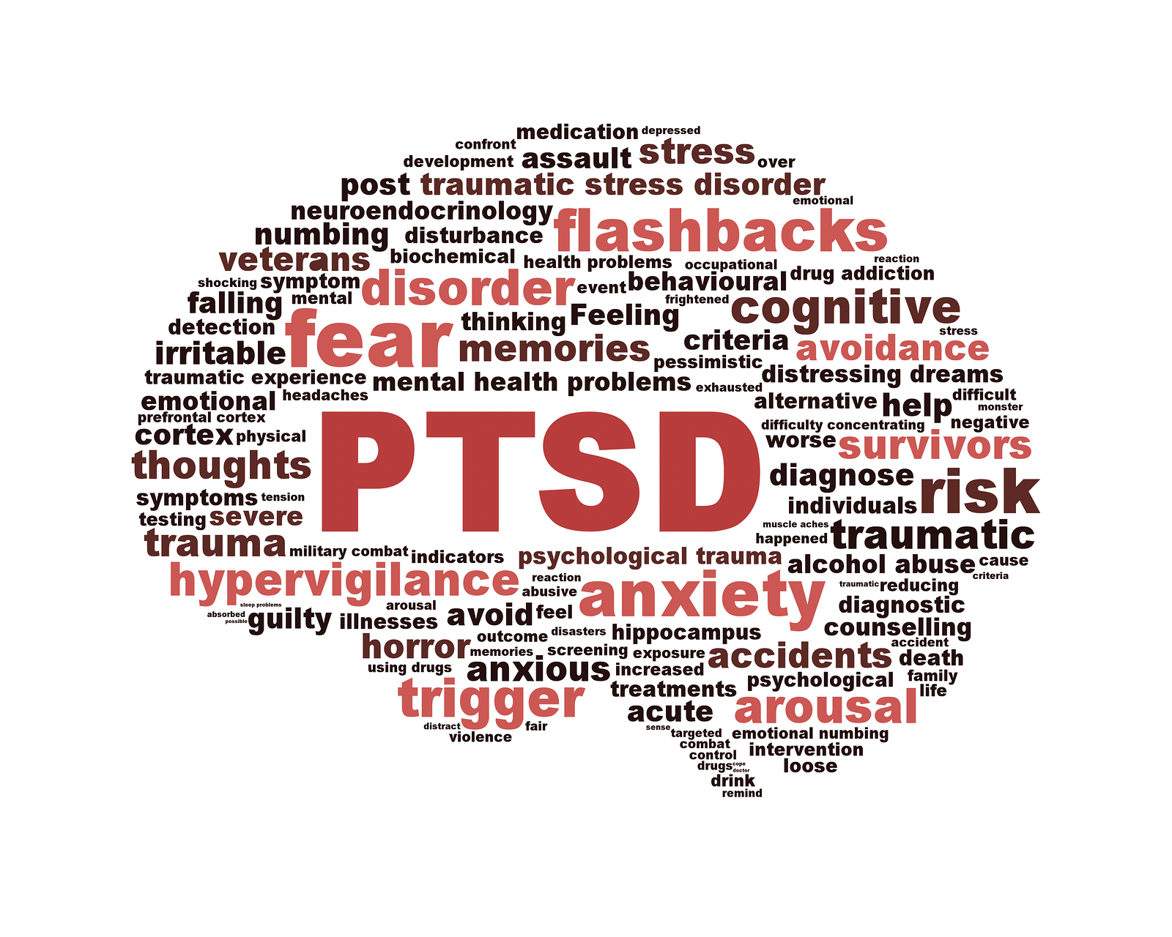
So, what makes a diagnosis of Post Traumatic Stress Disorder?
Current Definition
Current Criteria
Definition: A mental health condition that develops following a traumatic event characterized by intrusive thoughts about the incident, recurrent distress/anxiety, flashback and avoidance of similar situations.
Category A: Traumatic event(s) or vicarious trauma
Category B: Intrusive symptoms
Category C: Avoidance of internal and external reminders
Category D: Negative cognitions and moods
Category E: Arousal and Reactivity

Slide 9
Criteria for C-PTSD
Established by WHO as a formal diagnosis in ICD-11 (2022)
Not yet approved by the DSM
Criteria:
1. Exposure to an event or series of events of an extremely threatening or horrific nature, most commonly prolonged or repetitive events from which escape is difficult or impossible.
2. Re-experiencing, as in PTSD, w/o “prominent cognitive aspect”
3. Avoidance, as in PTSD
4. Hypervigilance, as in PTSD, may include a lack of reactivity
5. Persistent difficulties in relationships (avoidance, disinterest, disruption), unlike PTSD
6. Persistent beliefs about oneself as diminished, defeated or worthless, unlike PTSD
7. Severe and pervasive affect dysregulation, unlike PTSD (recklessness, dissociation, anhedonia)

Slide 10
Window of Tolerance

Slide 11
This is your brain on trauma
PTSD
All information goes to the base of brain up to the frontal cortex
Trauma sensitizes the base and middle brain
Trauma impairs frontal cortex- chemical changes (adrenaline, cortisol)
“Gut feeling” reactions
Any questions?

Slide 12
This is your brain on C-PTSD
Enduring feature of C-PTSD creates severity/persistence/complexity
All milestones after trauma are disrupted and impact functioning until the first milestone is repaired
Meanwhile, developmental gaps increase distress, maladaptive coping, adversity and trauma, complicating their presentation and experiences further

Slide 13
Life Impact
Childhood Trauma and the Brain | UK Trauma Council – YouTube

Slide 14
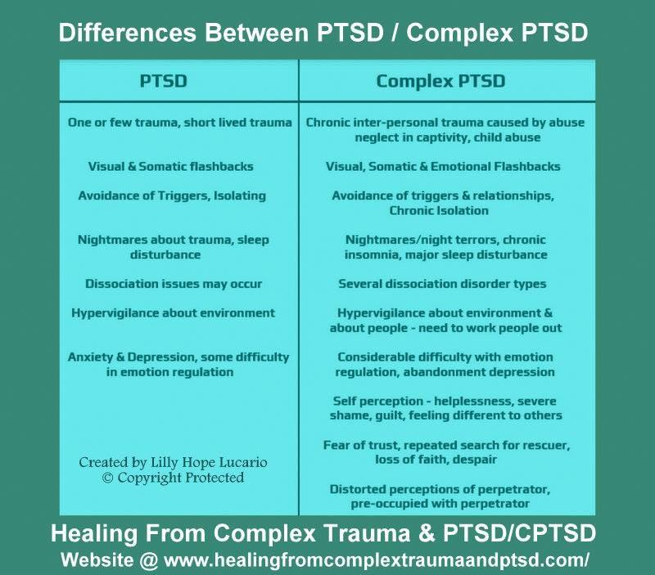
Simplified Differences Between PTSD vs CPTSD
This is not encompassing, but to give you a framework to within
Some main differences:
-Chronic nature of CPTSD
Increased dissociative experiences and symptoms
Fearing one’s environment chronically
Confusing presentations and interactions

Slide 15
Now you see it…
Now you Don’t
Symptoms seen and unseen

Slide 16
Adaptation Responses
-The Four “F” responses to distress
-Brain adapting to survive
-Not conscience choices
-Brain decides best option for survival given the situation
-Mackenzie’s response in court
-What do you see the most?

Slide 17
FLIGHT- what you see
Observable
Timid body language
No eye contact
Bouncy knee or tapping of a pen
Frequently looking at the door, watch, or clock
“Is this over yet?” or “Am I done?”
Absent
Fast/rushed talking
Constant body movement

Slide 18
FLIGHT- what you don’t see
Negative core beliefs
I can’t protect myself, I can’t cope, I will lose control or fail
Fear, shame, guilt, embarrassment, disgust
Urge to escape
Cognitive changes
Reduced problem-solving/planning
Reduced processing/organization
Reduced perspective taking/anticipation of consequences
Memory impairment
Biological changes
Heart rate, temperature, blood flow
Body/brain are set to survival
Can’t meet demands of environment fully
*** May or may not be in their awareness

Slide 19
FIGHT- what you see
Observable
Disagreeable
Swearing or threatening
Posturing
Clenched fists or jaw
Furrowed brow
Sarcastic responses
Eye rolling
Disrespectful comments
Throwing things, slamming doors
Stomping feet

Slide 20
FIGHT- what you don’t see
Negative core beliefs
I’m bad, I’m not good enough, I can’t be weak
Fear, rejection, envy, jealousy
Anger
urges to defend/attack
Cognitive changes
Biological changes
Body/brain are set to survival
Can’t meet demands of environment fully
*** May or may not be in their awareness

Slide 21
FREEZE- what you see
Observable
Stoic face
Slow moving
“Zoned out”
Procrastination
Non-verbal communication appears
Stunted
Uncaring
Apathetic

Slide 22
FREEZE- what you don’t see
Negative core beliefs
I’m powerless, I have no control, I’m trapped, I can’t protect myself
Fear, panic, helpless
Cognitive changes
Biological changes
2 systems conflict- escape and shut down
More complex trauma symptoms
Body/brain are set to survival
Can’t meet demands of environment fully
***may or may not be awareness

Slide 23
FAWN- what you see
Observable
Agreeable
Constantly apologizing and/or being very affirming/flattering others
Appears to be a victim- Victimized by narcissist or anti-social individuals
Difficulties with being assertive or disagreeable
Concerned about being accepted
“Yes” person
Self-neglect

Slide 24
FAWN- what you don’t see
Negative core beliefs
I deserve this, I’m not loveable
Emotional chameleon, dissociation
Fear, sadness
Urges to appease/submit
Cognitive changes
Biological changes
Body/brain are set to survival
Can’t meet demands of environment fully
*** may or may not be in their awareness

Slide 25
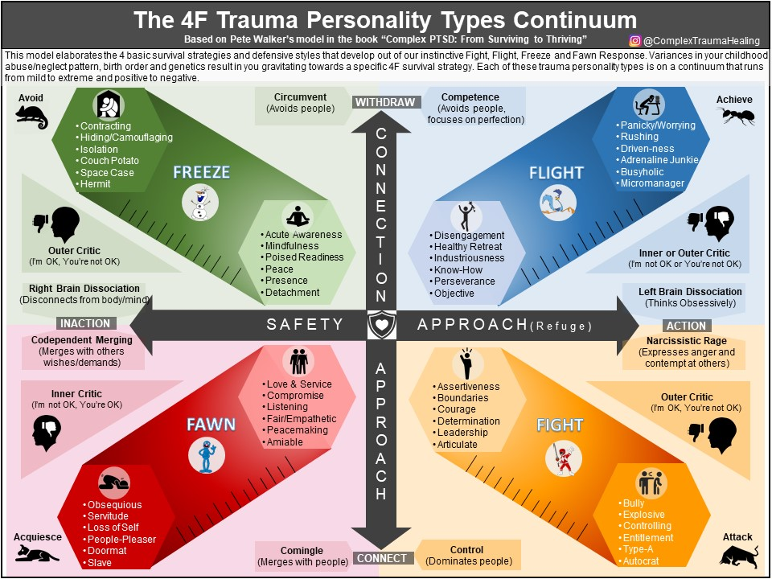
Questions?
Handout at the tables
Gives good information about the responses, symptoms, and reactions from the different types of survival states

Slide 26
So, where do you start?
Interpretations of behaviors and ways to intervene
Disclosure
Maladaptive behaviors
Is it traumatic or manipulative?
Triangulation
Regressive behaviors like tantrums
Avoidance
Resistance
Attacking
Inconsistency
Addiction
Somatic Symptoms

Slide 27
Resiliency
Video: Trauma and Resiliency PSA - Bing video
Bessel Van Der Kolk- “Even maladaptive coping is resiliency- they are still trying to survive”.
-Post Traumatic Growth differs from resiliency- they are not the same
-Stems from connection with others throughout life

Slide 28
Treatment Recommendations:
EMDR
DBT
Primary role: Desensitization
Aligns thoughts, emotions and body sensations to healing
8 step process
Longer treatment for CPTSD than PTSD due to complexity
**These are treatments we deliver. There are other trauma treatment options (e.g., IFS, Somatic Therapy).
Three primary roles:
Stabilization and prevention
Repairing developmental gaps
Preparing for trauma therapy
Modes
Insight development
Broad skill development

Slide 29
Treatment Recommendations:
Life Skills
Somatic approaches
Assessment
Learning self-efficacy skills
Life Coaching
Relationship skills
Daily living skills (e.g. prioritize, proper self-care)
Cognitive intervention
IQ/LD Assessment
Neuropsychological evaluation
“Bottom-up”
To reverse stress response and improve cognition/flexibility; to increase self-regulation skills
Clinical: EMDR (bilaterals, body awareness, right-brain attachment), Prolonged Exposure (activate/deactivate body), Somatic Experiencing Therapy
Non-Clinical: Alliance, body Mindfulness/ meditation, Progressive Muscle Relaxation, Yoga, Tai-chi, Qigong, exercise, breath work, any safe sensory activity

Slide 30
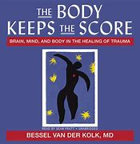
Questions
Questions?
-Sirissa Dalibor
Sirissa.Dalibor@eauclairecounty.gov
-Mackenzie Deffenbaugh
Mackenzie.Deffenbaugh@eauclairecounty.gov

Slide 31
References
Growth after trauma (apa.org)
For the ICD-11 C-PTSD Diagnostic Criteria:
World Health Organization (2022). International Classification of Diseases 11th Revision. <https://icd.who.int/enD-11 (who.int)>
Cloitre, M., Garvert, D. W., Weiss, B., Carlson, E. B., & Bryant, R. A. (2014). Distinguishing PTSD, complex PTSD, and borderline personality disorder: A latent class analysis. European Journal of Psychotraumatology, 5.
Hyland, M., Shevlin, P., Fyvie, C., & Karatzias, T. (2018). Posttraumatic Stress Disorder and Complex Posttraumatic Stress Disorder in DSM-5 and ICD-11: Clinical and Behavioral Correlates. Journal of Trauma Stress. 31(2).
Powers, A., Fani, N., Carter, S., Cross, D., Cloitre, M., & Bradley, B. (2017). Differential predictors of DSM-5 PTSD and ICD-11 complex PTSD among African American women. European Journal of Psychotraumatology, 8.
U.S. Department Of Veteran’s Affairs (n.d.). Complex PTSD. <https://www.ptsd.va.gov/professional/treat/essentials/complex_ptsd.asp>

