Slide 1
How to Support LGBTQIA+ Clients and Handle Adverse Attitudes
Presented by
James Parlow, Jessica Polacek, and Amanda Parlow
Notes:
I would like to welcome everyone to the 2024 WATCP Statewide Conference and our Equity and Inclusion Training: How to Support LGBTQIA+ Clients and Handle Adverse Attitudes. My name is Amanda Parlow, I am the Case Manager of the Monroe County OWI Treatment Court and President Elect of the WATCP Board of Directors.

Slide 2
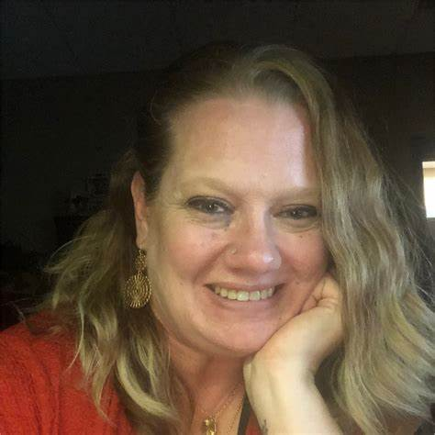
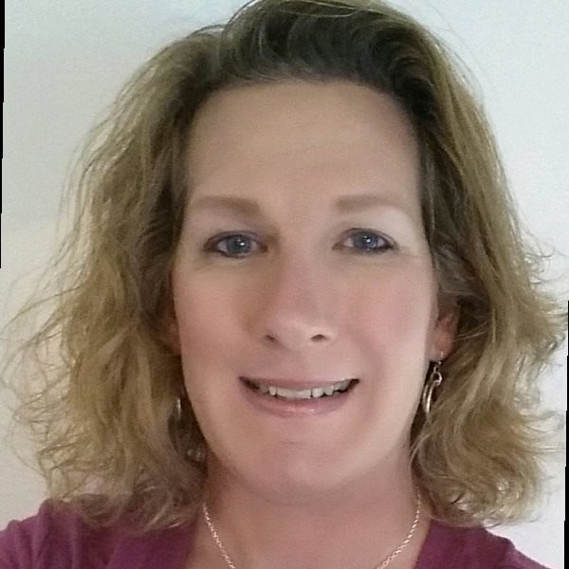
Your Presenters
Professor James Parlow
Amanda Parlow
Jessica Polacek
Notes:
Professor James Parlow is a Professor Emeritus from Winona State University in Sociology-Criminal Justice. He is a retired police officer from the LaCrosse Police Department. He holds a Bachelor's Degree in Law Enforcement and Corrections, and a Master's Degree in Criminal Justice. Additionally, he has provided training for Transgender Sensitivity in Law Enforcements to agencies nationwide.
Retired Sergeant First Class Jessica Polacek, Veteran of the US Army Reserves, US Regular Army, and Wisconsin National Guard, advocate for veterans and members of the LGBTQ community, as well as the former Director of Operations for The Center: 7 Rivers LGBTQ Connection in LaCrosse, committee member of Wisconsin Trans Health Coalition, and board member for Fair Wisconsin

Slide 3
Provide a better understanding of LGBTQIA+ Terminology.
Provide a better understanding of the Transgender community and what it means to be Transgender.
Provide gender affirming and effective communication with participants and team members.
Provide direction towards disciplines on working with LGBTQIA+ clients
Provide direction on dealing with clients and team members with adverse attitudes towards LGBTQIA+ communities
Notes:
Standard 2 of the Wisconsin Treatment Court Standards details how Treatment Courts should address Equity and Inclusion within their programs. Specifically, it states "ALL persons, including those who have experienced sustained discrimination or reduced social opportunities because of their race, ethnicity, gender, sexual orientation, sexual identity, physical or mental disability, religion, or socioeconomic status shall have the same opportunity to participate in treatment courts (NADCP, Vol 1, 2013)". For the last several years, we've received an abundance of valuable training on equity and inclusion regarding race and ethnicity. Now, we are bringing you training regarding the LGBTQIA+ community (sexual orientation and sexual identity). Our objectives for today's training are:

Slide 4
Who are LGBTQIA+?
L- Lesbian
G- Gay
B- Bisexual
T- Transgender
Q- Queer or Genderqueer, Questioning
I- Intersex
A- Asexual
+- All gender identities and sexual orientations that letters or words cannot yet fully describe
Notes:
First, let's define the letters of the LGBTQIA+ Community. We all are familiar with LGB, which are all terms related to sexual orientation (Lesbian, Gay, Bisexual). TQIA are terms related to Gender Identity. "+" is an all inclusive term for all gender identities and sexual orientations that letters or words cannot yet fully describe.

Slide 5
Current Populations (US)
4.2% are Bisexual
1.4% are Gay
1.0% are Lesbian
.06% are Transgender
.04% are Queer, Questioning, Intersex, Asexual, +

Slide 6
Current Populations LGBT (National)

Slide 7
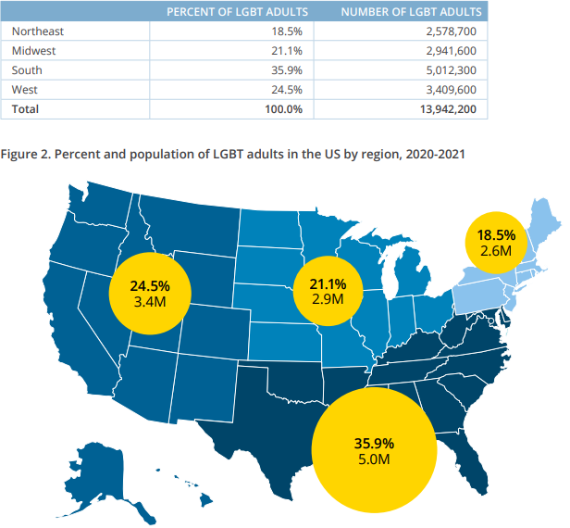

Slide 8
Current Populations LGBT (WI)

Slide 9
Basic LGBTQIA+ Terminology
Transgender- Term for those whose gender identity and/or gender expression differs from their sex assigned at birth.
Pansexual- Someone who feels attraction to anyone
Cis-Gender- Someone whose gender identity and sex assigned at birth are the same.
Gender Identity- How a person experiences gender in their heart, mind, soul
Sex- Sex assigned at birth
Notes:
Pansexual- could be described as attraction focusing on personality rather than gender

Slide 10
Basic LGBTQIA+ Terminology
Sexual Orientation- Who someone is physically, sexually, and/or romantically attracted to
Gender Expression- How someone communicates their gender to the world
Non-Binary- doesn't identify as either male or female.
Genderqueer- Those who have non-binary, gender-fluid, or gender non-conforming identities
Intersex- Having one or more innate sex characteristics
Asexual- experiencing little or no sexual attraction to others and/or lack of interest in sexual relationship
Notes:
Gender Identity: Cis-, Trans-, Non-Binary
Sex Assigned At Birth- Male, Female, Intersex based on genitalia and chromosomes. She/Her, He/Him, They/Them
Sexual Orientation- Heterosexual, Lesbian, Gay, Bisexual, Genderqueer, Pansexual, Asexual
Gender Expression- Masculine, Feminine, Gender Non-Conforming
Intersex- This could be genitalia, internal reproductive organs, and/or chromosomes. Not to be confused with Transgender

Slide 11
Terms To Avoid
Do Not Use
Instead Use
Homosexual
Gay, Gay Man, Lesbian, Lesbian Woman, Bisexual Man/Woman
Homosexual Relationship, Homosexual Couple
Relationship, Gay Couple, Lesbian Couple
Sexual Preference
Sexual Orientation

Slide 12
Terms to Avoid
Do NOT Use:
Instead Use:
Transsexual
Transgender
Transvestite
Cross-Dresser
Gender Identity Disorder
Gender Dysphoria
Transgenders, a transgender, transgendered
Transgender man, transgender woman, trans man, trans woman
"Identifies As"
Is
Sex Change, Pre-Op, Post-Op
Transition

Slide 13
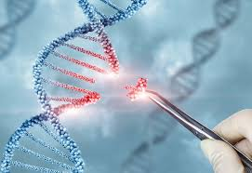
First... A Science Lesson...

Slide 14
Why Do We Discuss Science?
Dispel myths and misconceptions
Mental Illness
Attention Seeking
Trend
Genetic Proof- error in DNA
Chimera
Intersex
Guevedoces
https://watcp-store.printify.me/
Notes:
Many people believe that being transgender is a mental illness, or a need for attention, or wanting to be part of a crowd like smoking was
Sight based sex identity at birth could be wrong- error in human DNA Code
Fetus gets the wrong dose of testosterone or estrogen
Neurological female develop male genetalia, neurological male does not develop male genetalia (remains physically female)
Chimera- person who has two completely different sets of DNA
Intersex- Person who has neither, both, or incomplete genetalia
Guevedoces- Person born with female genetalia but develops male genetalia during puberty

Slide 15
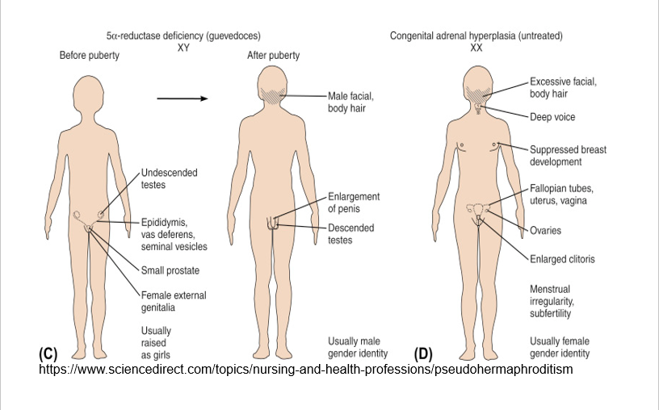
Guevedoces

Slide 16
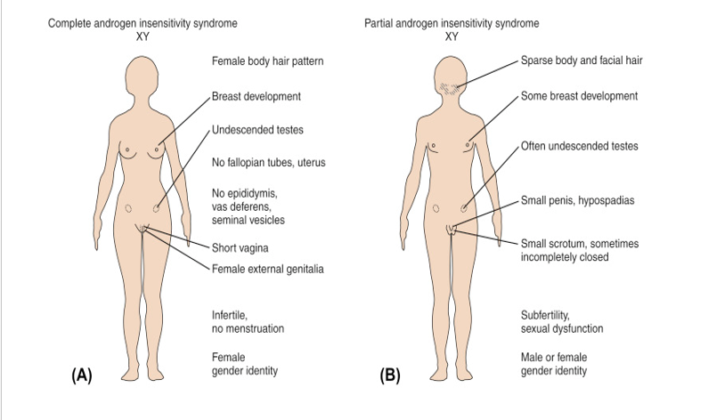
Guevedoces

Slide 17
Old Societal Myths
Left-Handedness- "Devil's Spawn"
Herbal Medicine- Witchcraft
Falling Uterus
Hysteria Cures​
Male Blindness​
Laptop or Phone Infertility
Notes:
Society had all of these wrong- scientifically dispelled myths. Could we have transgenderism wrong too?

Slide 18
Current Sex-Ed Instruction
X and Y are the Chromosomes related to determining human sexual characteristics
Y is the determinate Chromosome
There are usually 23 pairs of the 46 individual human chromosomes
At conception 23 chromosomes will bind with 23 other chromosomes – but this is not perfection
During Meiosis a 46X or 46Y divides into 2 23chromosome cells (Egg or Sperm)
Some Chromosomes can be damaged, lost or misaligned
Genetic Errors: Deletion, duplication, translocation, inversions and rings
Notes:
Either female or male
Based solely on observed external genetalia

Slide 19
Possible DNA Combinations
•X 45 Chromosome ( Turner syndrome)
•XX and XY 46 Chromosomes
•XXY 47 ( Klinefelter syndrome )
•XXX 47 ( Trisomy X )
•XYY (Meta Male)
•XXYY 48 Chromosomes
•XXXY 48
•XXXX 48
•XXXXY 49 Chromosomes
•XXXXX 49
•46, XY/47, XXY and 45X/47XXX ( Mosaicism )

Slide 20
A Quick Test...

Slide 21
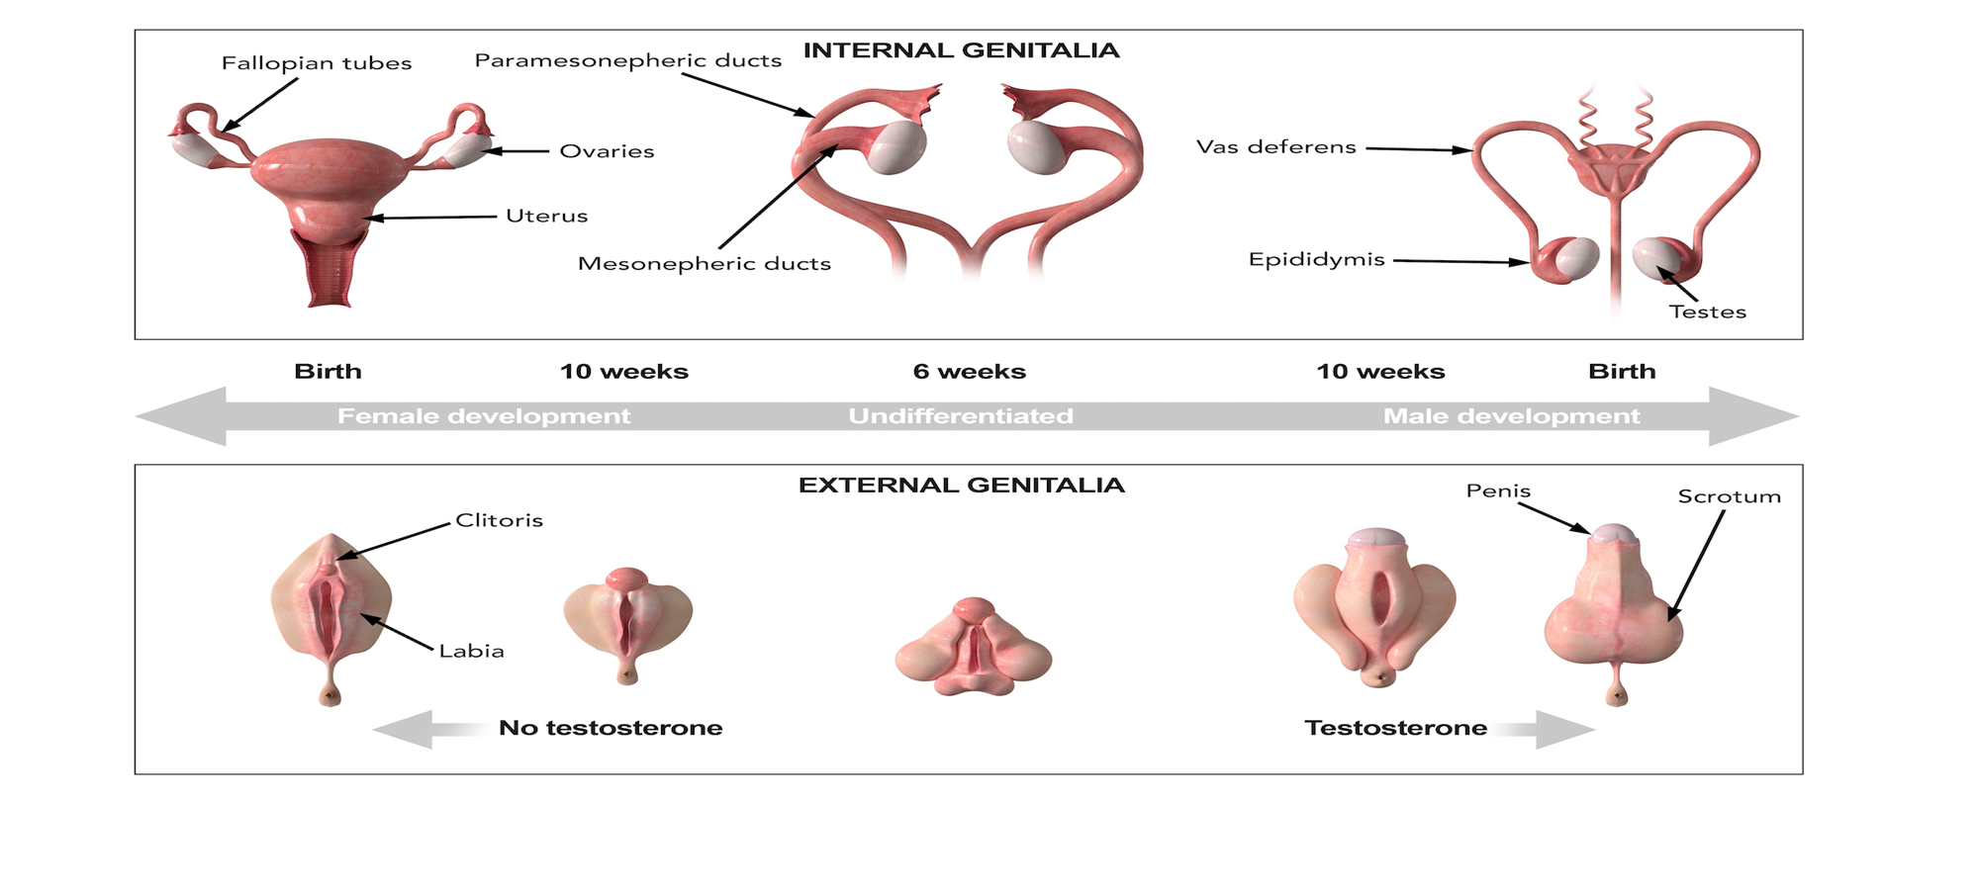
A Simpler Explanation

Slide 22
21st Century Science
Genome Editing- CRISPR/CAS
https://health.clevelandclinic.org/crispr-gene-editing
Switch function of testes/ovaries
https://www.npr.org/sections/health-shots/2023/12/08/1217123089/fda-approves-first-gene-editing-treatments-for-human-illness
Deaf can hear by switching one gene
https://news.harvard.edu/gazette/story/2024/01/gene-therapy-breakthrough-allows-congenitally-deaf-children-to-hear/
Cystic Fibrosis, Congenital Lung Disease, Genetic Liver Disease, Inherited Blood Disorders, Inherited Eye Disease
https://www.ncbi.nlm.nih.gov/pmc/articles/PMC7150498/

Slide 23
21st Century Science
Brain Structures of Transpeople-similar to brains of experienced gender
https://www.scientificamerican.com/article/is-there-something-unique-about-the-transgender-brain/
Potential Biological Basis for Transgender
https://www.hudson.org.au/news/written-in-dna-study-reveals-potential-biological-basis-for-transgender/
https://www.sciencedaily.com/releases/2020/02/200205084203.htm
Not a Choice, but Way of Being
https://dnascience.plos.org/2018/03/22/20-gene-variants-and-transgender-identity-what-does-it-mean/

Slide 24
Gender Dysphoria
Experience a marked difference- gender identity vs assigned gender for at least 6 months
Gender identity vs genitals or secondary sex characteristics
Strong desire to be "rid" of genitals or secondary sex characteristics (or prevent development of)
Strong desire to have genitals and secondary sex characteristics of another gender
Strong desire to be, or be treated as, another gender
Strong belief of having feelings typical of another gender

Slide 25
Leslie Feinberg
"Are you a guy or a girl?"
"I've heard the question all my life. The answer is not so simple, since there are no pronouns in the English language as complex as I am, and I do not want to simplify myself in order to neatly fit one or the other. There are millions like me in the United States alone."

Slide 26
Emily Skidmore
Associate Professor of History- Texas Tech University
"What undergirds a lot of the political rhetoric about trans bodies is the idea that they are new and threatening. Trans history can have incredible power because it suggest that trans people are not new; they've been around for a long time."

Slide 27
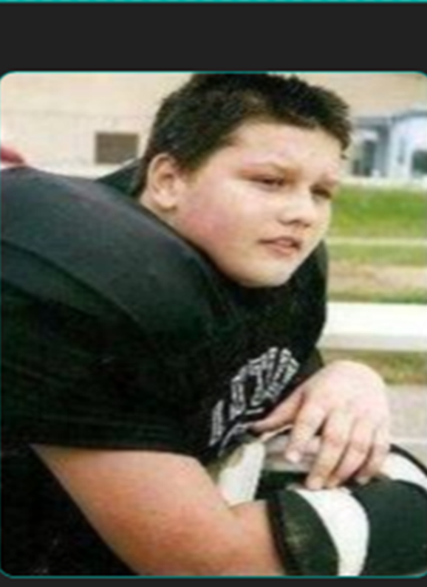
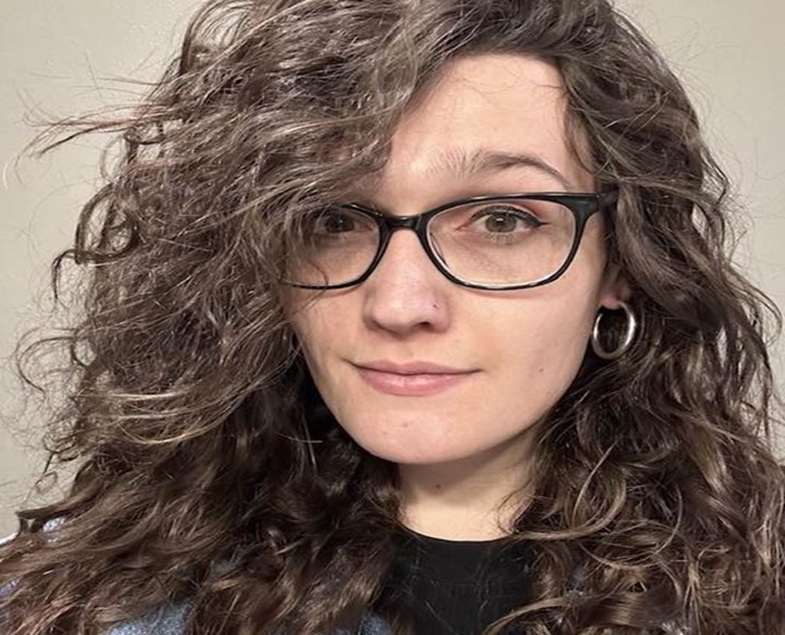
My Kids
2006
Potential All-State Linebacker
2023
Quality Control Software Engineer, BA Political Science, Denver Bad Apples WFTRD, MMA Participant
2008

Slide 28
Inspiration

Slide 29
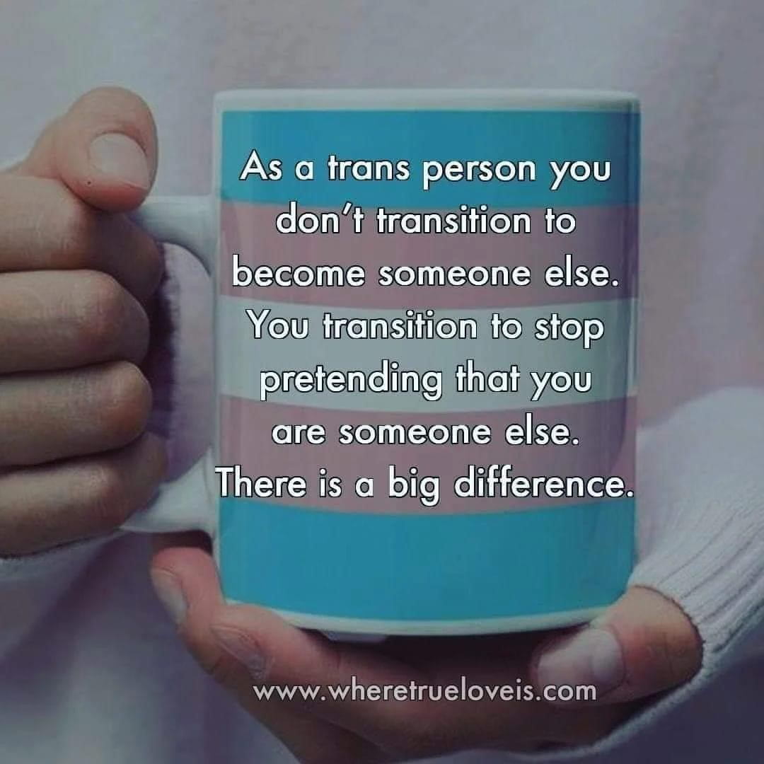
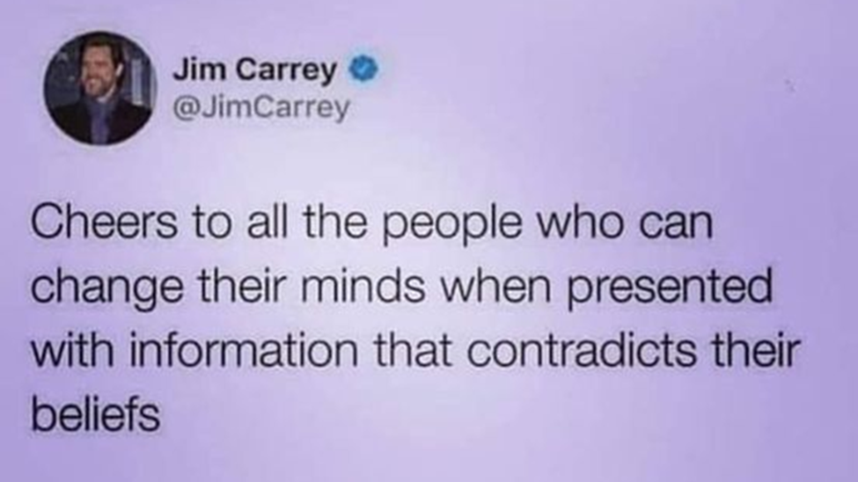

Slide 30
How does this apply to
Treatment Courts?

Slide 31
Keep In Mind...
LGBTQIA+ individuals rely on nonverbal cues
Clients may be guarded at first
Clients may distrust the medical establishment and authority figures
Double-Stigmatization
Confidentiality of Sexual Orientation
Clients may be dealing with other issues
Notes:
Such as rainbow colored flags posted, bumper stickers, mission statements that commit to honoring diversity or commitment to treating LGBTQIA+ clients
It may take time for them to gain trust and fully open up
May be wary of authority figures due to abuse by most systems of law, health, housing, employment, etc
as a person with a substance use disorder and as LGBTQIA+
Establish policies that keep sexual orientation information confidential to anyone outside of the program unless the client consents
Such as divorce, child custody, lack of legal protections or assistance programs, discrimination

Slide 32
LGB Adults are more than 2x as likely to experience a mental health condition.
40% of Trans Adults have attempted suicide in their lifetime.
More than 1 in 4 Trans people face bias-driven assault.
LGBT Adults are 2x as likely, or more, for suicidality.
Trans Adults are 4x as likely to experience a mental health condition.
Notes:
According to The National Alliance on Mental Illness:
LGB adults are more than twice as likely as heterosexual adults to experience a mental health condition
Transgender adults are nearly four times as likely than cisgender adults to experience a mental health condition
LGB and T adults are twice as likely or more to suicidality
40% of Trans adults have attempted suicide in their lifetime- compared to 5% of general population.
National Center for Transgender Equality:
More than 1 in 4 Trans people face bias driven assault (higher for trans women and trans people of color)

Slide 33
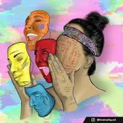
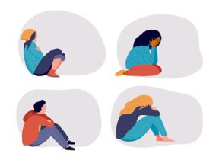
LGBTQIA+ Mental Health Concerns
Depression/Anxiety
Gender Dysphoria
PTSD
Bipolar Disorder
Suicidal Ideation
OCD
Mood Disorders
Self-Harm
Eating Disorders
Sexual Trauma
Notes:
According to The National Alliance on Mental Illness:
LGB adults are more than twice as likely as heterosexual adults to experience a mental health condition
Transgender adults are nearly four times as likely than cisgender adults to experience a mental health condition
LGB and T adults are twice as likely or more to suicidality
40% of Trans adults have attempted suicide in their lifetime- compared to 5% of general population.
More than 1 in 4 Trans people face bias driven assault (higher for trans women and trans people of color)

Slide 34
Substance Use Disorders/Substance Abuse
25% of LGBTQ individuals abuse alcohol
30.7% of LGBTQ adults report using marijuana in the past year
39.1% used illicit drugs within the past year
10.4% misused prescription pain relievers
Up to 1/3 of LGBTQ men, 2/3 of LGBTQ women had or have substance abuse problems
Injection drugs, cocaine, methamphetamine, and marijuana most commonly used by transgender individuals
Notes:
This cannot be overstated- self- medicating is often a way to escape the pain of abuse, neglect, abandonment, and discrimination. LGBTQ+ also have a higher prevalence of smoking

Slide 35
Reasons for Substance Use
Higher rates of emotional or psychological disorders
Higher prevalence of physical health challenges
Employment discrimination
Lack of access to affordable healthcare
Elevated levels of stress related to social isolation
Increased probability of discrimination in treatment centers
Lack of support from family, friends, public
Victimization through discrimination, hate crimes, bullying, harassment
Notes:
Stress- Dealing with social predjudice, rejection, discriminatory practices in housing/employment/services. Chronic stress leads to depression, anxiety, fear, anger.
Coping Mechanism- relying on substances to help deal with the stress
Stimulants- used to increase energy, sex drive, sexual performance
Self Confidence Booster- Dopamine release produced by opioids increases self confidence,
Lack of Support: Feeling of living a double life due to having to hide their identity,
Internalized Homophobia: self loathing, inability to feel comfortable in their own skin- use quiets negative thoughts.

Slide 36
Treatment Court Teams
Use gender affirming language- "How would you like to be addressed?" "What pronouns do you prefer?"
Never make assumptions as to what a client's gender identity or sexual orientation are.
Use appropriate terminology/verbiage
Have discussions with participant in private about preferences
Never "out" a participant in a group setting
Avoid Microaggressions/Microassaults
Notes:
•Microassaults- Behaviors that are intentional and deliberately hurtful.
•Deliberately using the wrong name or pronouns
•Name-Calling, avoidant behavior, hateful speech
•Making derogatory statements or threatening gestures
•Microinsults- Rude statements that are usually unintentional or unconscious that indicate ignorance or bias
•Asking inappropriate questions (How did you become gay? Are you going to have a crush on me now? Which one of you is the guy in the relationship?)
•Redirecting someone to another bathroom
•Facial expressions that reveal confusion or disgust
•Microinvalidations- Statements or actions that are usually unintentional or unconscious that ignore, minimize, or nullify a person’s identity.
•Having only two options for sex/gender on forms
•Telling gender non-conforming people they should not be upset if people are confused by their gender
•Saying “I am sure they didn’t mean it that way” in response to a report of anti-transgender prejudice
•“You are not a real (man or woman)”. “Why would you choose to be this way?”

Slide 37
Treatment Court Teams
Advocate for team training annually- Be PROACTIVE, not REACTIVE
Add policy/procedure for handling discrimination based on gender identity, sexual orientation
Advise clients that discrimination or hate speech/comments towards people of the LGBTQIA+ community will not be tolerated.
Make sure handbooks, policy and procedure manuals, etc. include LGBTQ inclusive language.
Notes:
•Microassaults- Behaviors that are intentional and deliberately hurtful.
•Deliberately using the wrong name or pronouns
•Name-Calling, avoidant behavior, hateful speech
•Making derogatory statements or threatening gestures
•Microinsults- Rude statements that are usually unintentional or unconscious that indicate ignorance or bias
•Asking inappropriate questions (How did you become gay? Are you going to have a crush on me now? Which one of you is the guy in the relationship?)
•Redirecting someone to another bathroom
•Facial expressions that reveal confusion or disgust
•Microinvalidations- Statements or actions that are usually unintentional or unconscious that ignore, minimize, or nullify a person’s identity.
•Having only two options for sex/gender on forms
•Telling gender non-conforming people they should not be upset if people are confused by their gender
•Saying “I am sure they didn’t mean it that way” in response to a report of anti-transgender prejudice
•“You are not a real (man or woman)”. “Why would you choose to be this way?”

Slide 38
Treatment Coordinators
SAMHSA Suggests:
Empower the client
Honor Diversity
Use non-judgmental language
Avoid labeling
Do not confront, but support and explore
Respect the client's position
Respect some LGBTQIA+ clients' unwillingness to attend AA/NA, or other support meetings (Find LGBTQIA+ friendly alternatives
Notes:
Self report survey fields: preferred name if different from legal name, gender identity, personal pronouns, sexual orientation and sexual identity, partnership/marital status
Legal Documents- only use preferred name if it's been legally changed. All other documents (progress summaries, emails, phasing applications, assignments, phasing/graduation certificates, etc) use preferred name. Best always to ask the client how to address them in court and around other clients.

Slide 39
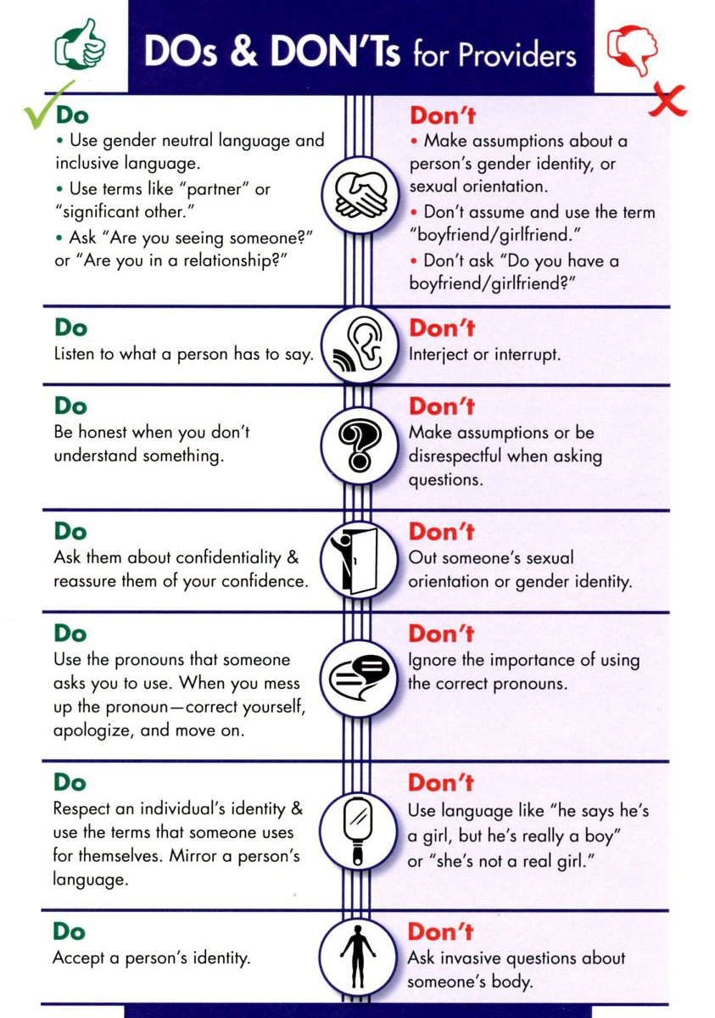
Treatment Coordinators
www.diverseandresilient.org/resources/lgbtq-competency-toolkit

Slide 40
Case Managers/Coordinators/Probation
Offer your name and personal pronouns
Have a question on intake forms and/or self-report surveys
Make sure that clients are not put in situations that may cause conflict or discomfort for any participant
Legal Documents (Violation Reports, Court Documents, etc.) use legal name, otherwise use preferred name.
Make sure to have lists of LGBTQIA friendly support meetings, housing, churches, and other resources.
Notes:
I am Amanda and I will be your Case Manager. My pronouns are she/her/hers. What pronouns do you prefer?
What pronouns the client uses, what their gender identity and sexual orientation are
(putting them in groups that correspond with sex assigned at birth instead of gender identity, putting them in groups where people are avidly anti-LGBTQ, etc)

Slide 41
Drug Testing
Discreetly inquire if they have fully transitioned or not.
Ask the client who they would prefer to have them observe the test
If the client asks for a staff member that does not match the sex assigned at birth perform an oral swab test.
If a staff member of the same sex assigned at birth is not available, perform an oral swab test.
Notify the supervisor that the client will be switched to oral swab testing for future tests.
Even if you don't currently have a Transgender participant, have policies and procedures in place beforehand.
Notes:
If a client is required to test, and staff is aware that they are transgender- (Do not ask where other clients can hear. Let the client know you want to make it as safe as possible for them)
a male or female staff member.
and they have not yet fully transitioned
Have Corporation Counsel review them as well.

Slide 42
Judges
Assure the participant
Let the client know issues will be addressed
Do not "out" a participant in Court.
Get input from the participant
Make a statement to the participant group as a whole
Use their preferred name in Court
Notify the Court Reporter and Clerk privately
Notes:
Assure the participant you want to be respectful and want to use their preferred name and pronouns
Let the client know that any issues or instances of discrimination or disrespect by participants, staff, etc will be addressed appropriately
Notify the clerk and court reporter privately that you will be using the client's preferred name in court.

Slide 43
Best Practices-Verbiage
Avoid
"The story is about a teenager who transitions from male to female in high school."
Practice
"The story is about a teenage trans girl who transitions in high school."
Avoid
"Beth grew up male and became a woman at age 25."
Practice
"When Beth was younger, she was perceived to be male by others. At age 25, she disclosed that she is a trans woman and began her transition."
Avoid
"The school board dismissed the parents’ complaint that Imani, a transgender girl, was participating in school athletics with biological females."
Practice
"The school board dismissed the parents’ complaint that Imani, a transgender girl, was participating in school athletics with cisgender girls."

Slide 44
MicroAggressions
Microassaults
Microinsults
Microinvalidations
Notes:
Microassaults
Behaviors that are intentional and deliberately hurtful
Deliberately using the wrong name or pronouns
Name-Calling, avoidant behavior, hateful speech
Making derogatory statements or threatening gestures
Micro Insults
Rude statements that are usually unintentional or unconscious that indicate ignorance or bias
Asking inappropriate questions (how did you become gay? Are you going to have a crush on me now? Which one of you is the guy in the relationship)
Redirecting someone to another bathroom
Facial expressions that reveal confusion or disgust
Microinvalidations
Statements or actions that are usually unintentional or unconscious that ignore, minimize, or nullify a person's identity
Having only two options for sex/gender on forms
Telling gender non-conforming people they should not be upset if people are confused by their gender
Saying "I am sure they didn't mean it that way" in response to a report of anti-lgbt prejudice
" You are not a real (man or woman)", "Why would you choose to be this way?"

Slide 45
Microaggressions
*** Occasional Foul Language

Slide 46
Dealing With Clients With Adverse Attitudes
Explain that you understand they have strong feelings
Set Boundaries.
You don't have to understand someone's identity to respect it.
Try to educate them, but don't force
Discuss the discrimination policy with client group as a whole.

Slide 47
Dealing With Team Members With Adverse Attitudes
DON'T
Repeat or acknowledge anti-LGBT messages
Use highly charged language (bigotry, prejudice, hatred)
Inadvertently validate anti-LGBT attitudes
Use language of conflict (war, battle, fight)
DO
Use language that is measured and relatable to create empathy
Say "I understand how talking about these issues can be difficult".
Talk about injustices LGBT people experience and importance of ensuring equality for all

Slide 48
Dealing With Team Members With Adverse Attitudes
Discuss the situation with the team member 1:1.
Have the Judge address the situation with the team member.
If the Judge is the one making the comments, go to your department supervisor.
If it still doesn't stop, address the issue with Personnel/HR.

Slide 49
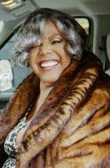
"Passing became so important simply because you get tired of being beaten up and chased and harassed and berated for who you are everyday."- Miss Major Griffin-Gracy, Transgender Advocate
"I've been through too much in my life to not be who I am in the world. It's not worth it for me to hide any portion of myself anymore. As long as I'm being responsible, being loving, taking care of things as things go, I don't need to make excuses so that people won't be upset, and I don't need to explain away my life."- Doc Duhon- Longtime AIDS Survivor, Polyamorist, Volunteer and Activist

Slide 50
"I said, 'These are people, we can't be prejudiced; we shouldn't be prejudiced. We've got to be kind and good to them."- Jean Tretter, Gay Historian
"The gay community is a very giving, loving community. I think for people who don't see that or who are trying to put that down, they are depriving themselves of the great opportunity to serve and to love each other and to help each other."- Emma Colquitt-Sayers- Community Organizer, Activist

Slide 51
Additional Training Resources
SAMHSA: A Provider's Introduction to Substance Abuse Treatment for Lesbian, Gay, Bisexual, and Transgender Individuals, 2nd Edition (A Provider's Introduction to Substance Abuse Treatment for Lesbian, Gay, Bisexual, and Transgender Individuals, 2nd Edition | Addiction Technology Transfer Center (ATTC) Network (attcnetwork.org))
National LGBTQIA+ Health Education Center (Webinar Archives » LGBTQIA+ Health Education Center)
Whitman-Walker Institute (Request a Training - Whitman-Walker (whitmanwalkerimpact.org))
Center of Excellence LGBTQ+ Behavioral Health Equity Webinars (Session Recordings (lgbtqequity.org)

Slide 52
LGBTQIA+ Substance and Mental Health Treatment Resources
Inspire Recovery LGBTQIA+ Program 561-621-3984
SAFE Project www.safeproject.us
American Addiction Centers 313-209-9575
The Trevor Project 866-488-7386
LGBT National Help Center 888-843-4564
Transgender and Intersex Specialty Care Clinic in MN 507-538-3270
Pride Institute 888-492-2194 (Minneapolis, MN)
Hazeldon Betty Ford Foundation (MN) 866-530-5157
Serenity Lodge (WI) 877-593-7838
Shorewood House (WI, Women Only) 414-977-5890
Our Safe Place (WI, Men Only) 414-933-7689

Slide 53
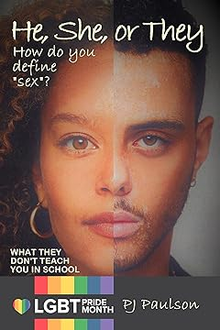
Additional Reading
https://pjpaulson.com/about/

Slide 54
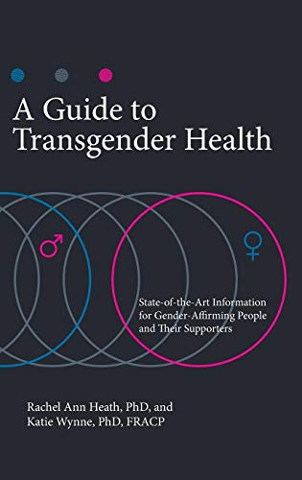
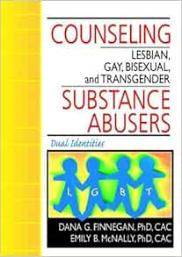
Additional Reading

Slide 55
