Slide 1

Prosecutor and
Defense Counsel
Working Effectively on the Treatment Court Team
Notes:
Start w/ roles of attendees

Slide 2
DISCLOSURE
This plenary is being made possible by funding from the Bureau of Justice Assistance (BJA); opinions or points of view expressed in this plenary by the speaker do not necessarily represent the official position or policies of the United States Department of Justice, Bureau of Justice Assistance.

Slide 3
About Us

Slide 4

If not us, then who?
In treatment courts, our roles provide the opportunity for a unique collaboration to effectuate positive change within the criminal justice system.
While prosecutors and defense counsel may disagree on individual participants and legal matters, we have the common goal of ensuring that the treatment court produces the best possible outcomes.

Slide 5

If not us, then who?
The Prosecutor and the Defense Counsel also have the shared goals of reduced recidivism and increased community safety.
Effective collaboration between the prosecutor and the defense counsel is vital for ensuring the treatment court operates effectively, avoids pitfalls, identifies areas needing improvement, and provides equal opportunities to participate.

Slide 6
The ABA Criminal Justice Standards
Standard 3-1.2 Functions and Duties of the Prosecutor:
(e) The prosecutor should be knowledgeable about, consider, and where appropriate develop or assist in developing alternatives to prosecution or conviction that may be applicable in individual cases or classes of cases……
Standard 4-1.2 Functions and Duties of Defense Counsel:
(f) Defense counsel should be knowledgeable about, consider, and where appropriate develop or assist in developing alternatives to prosecution or conviction that may be applicable in individual cases, and communicate them to the client.
Notes:
The ABA Criminal Justice Standards are intended to provide guidance for the professional conduct and performance of prosecutors and defense counsel. The prosecutor and defense counsel share fundamental duties.

Slide 7
The ABA Criminal Justice Standards
Standard 3-1.2 Functions and Duties of the Prosecutor:
…The prosecutor’s office should be available to assist community efforts addressing problems that lead to, or result from, criminal activity or perceived flaws in the criminal justice system.
Standard 4-1.2 Functions and Duties of Defense Counsel:
…Defense counsel should be available to assist other groups in the community in addressing problems that lead to, or result from, criminal activity or perceived flaws in the criminal justice system.

Slide 8
The ABA Criminal Justice Standards
Standard 3-1.2 Functions and Duties of the Prosecutor:
(f) The prosecutor is not merely a case-processor but also a problem-solver responsible for considering broad goals of the criminal justice system. The prosecutor should seek to reform and improve the administration of criminal justice…
Standard 4-1.2 Functions and Duties of Defense Counsel:
(e) Defense counsel should seek to reform and improve the administration of criminal justice…

Slide 9
Areas for Effective Collaboration
Target Population
Program Structure
Eligibility Criteria
Entry Process
Common Legal Issues
Drug Testing Issues
Effective Communication
Crisis Management
Equity and Inclusion
Written Materials
Sustainability
Ongoing Team Training
Notes:
Topics to be reviewed in this presentation.
This is a general overview of areas that the prosecutor and defense counsel should be working together to examine and improve. We don’t have the time to go depth in on each topic, but we will provide you the resources to provide you with additional information and research.

Slide 10
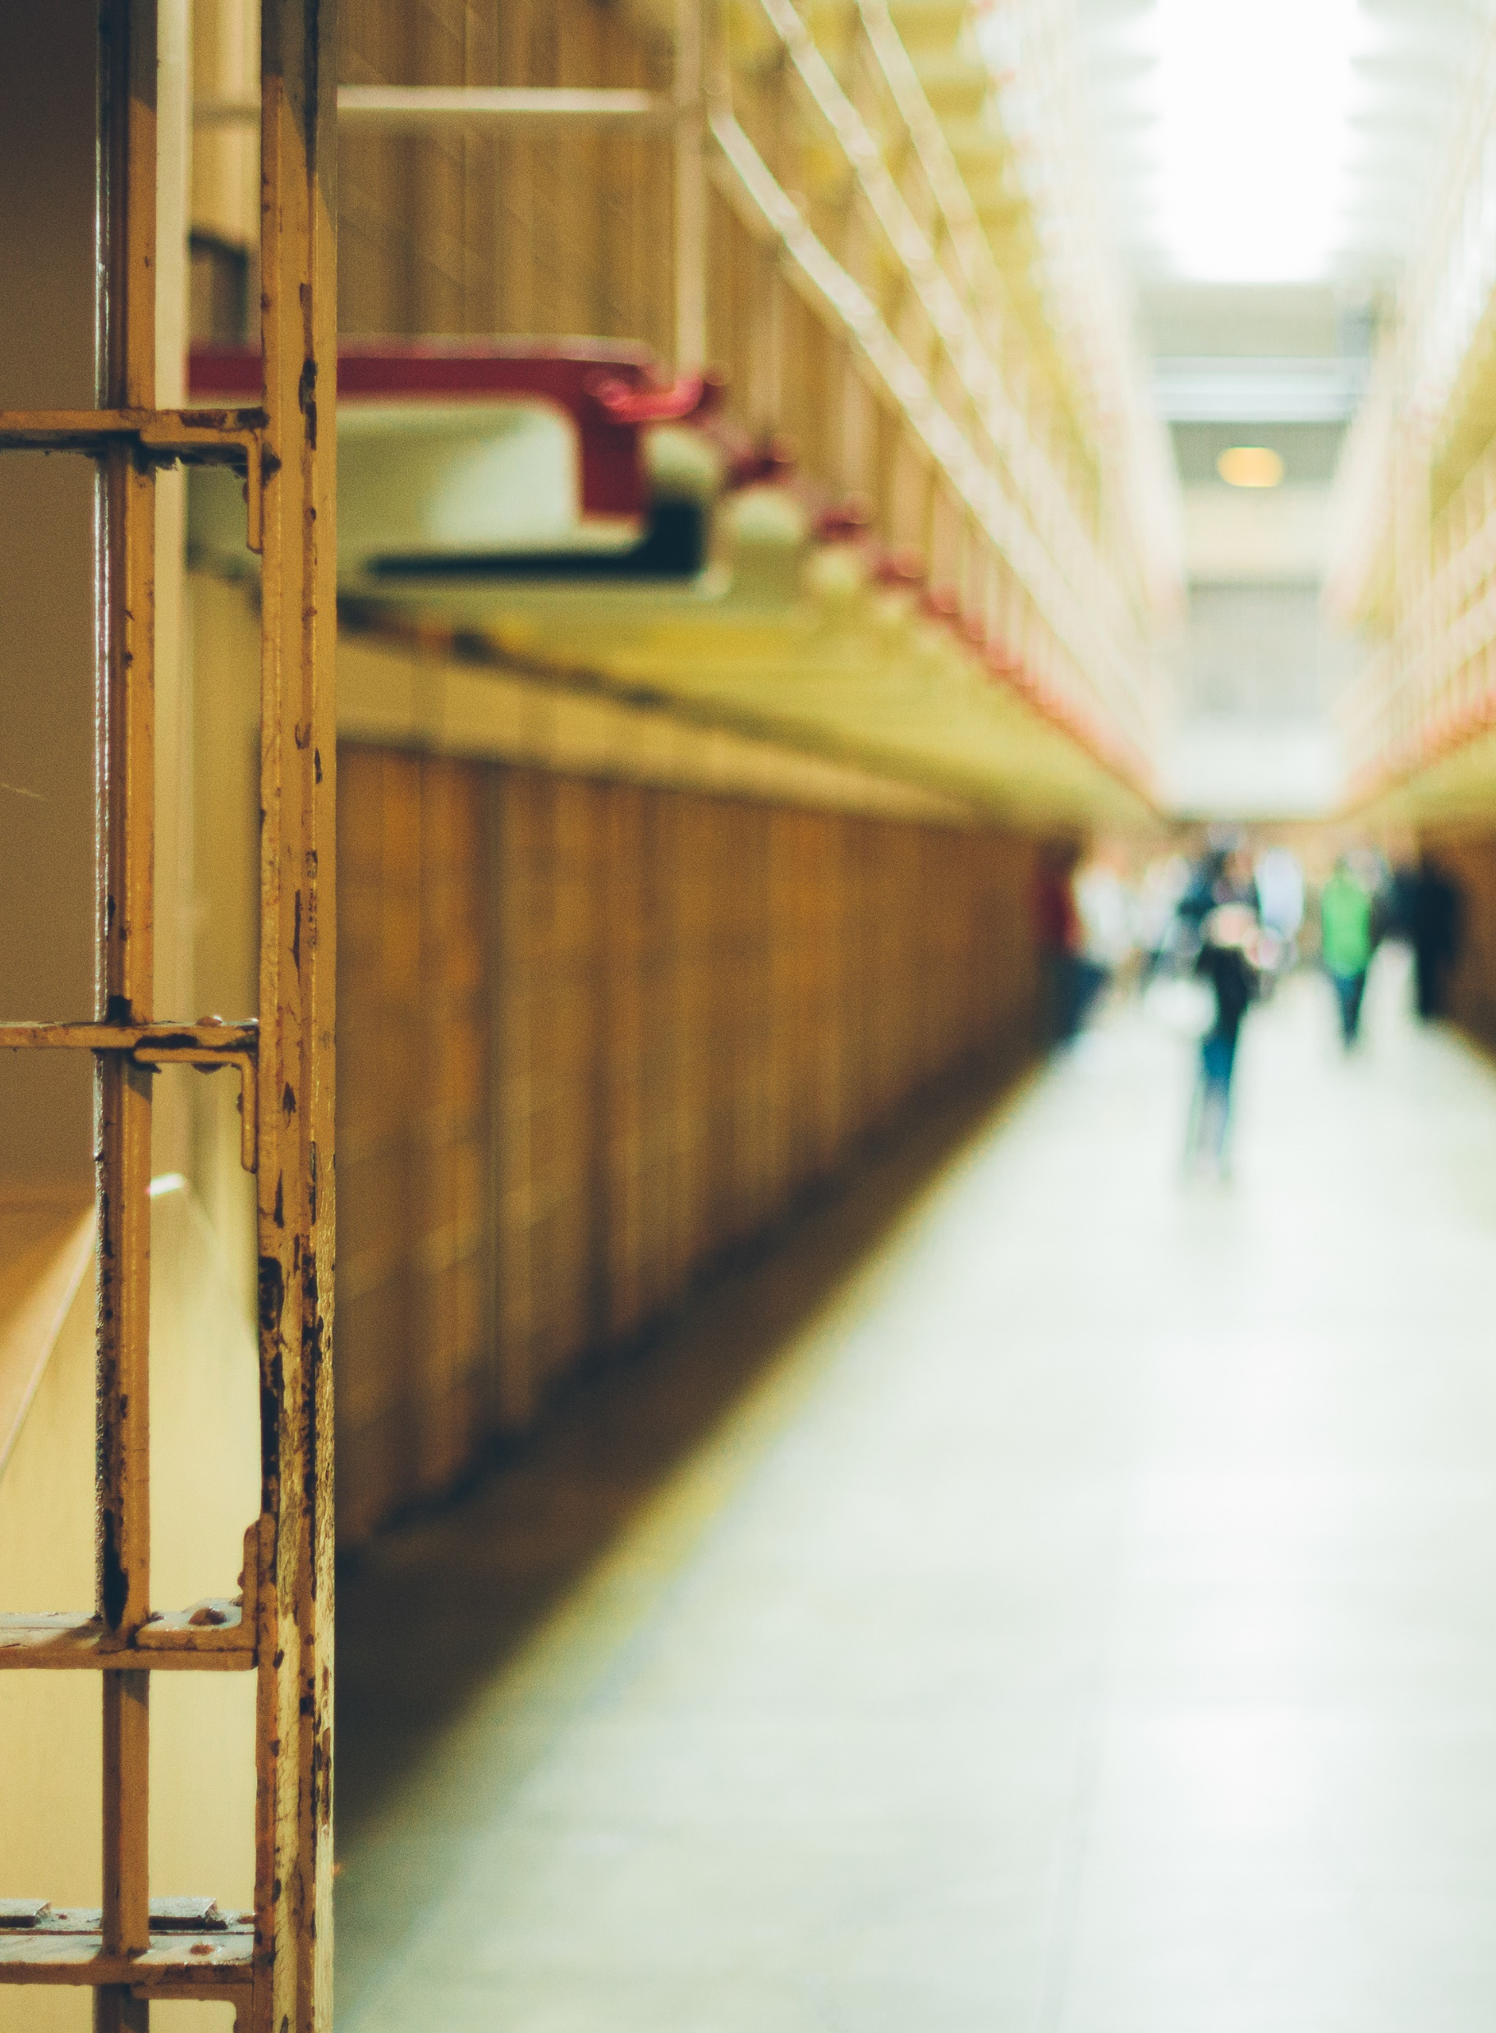
Target Population
Examine data of justice population
  Who's on community supervision?
  Who’s in jail?
  What offenses, other than drug possession, are being committed because of substance use or mental health issues?
    Felonies? Misdemeanors? DWIs? Probation Violators?
Are we targeting the population that will generate the greatest impact in our community?
Notes:
Prosecutors and Defense Counsel should collaborate to examine the date of your community’s criminal justice population. Who do we want to participate in our program? Who are the targeted offenders in our community’s criminal justice population?
Let’s look at the data for the offenders and type of offenses committed in our community. Who is on community supervision? Who’s in jail and why? What offenses, other than drug possession, are being committed because of substance use or mental health issues?
we want to target the population of offenders that we can have the greatest impact.
Who better than the prosecutor and defense counsel to examine the data and identify the target participant population?
We also don’t want to waste time creating a solution for a problem we don’t have.
Evolving. Changes in perceptions of CJ system.

Slide 11

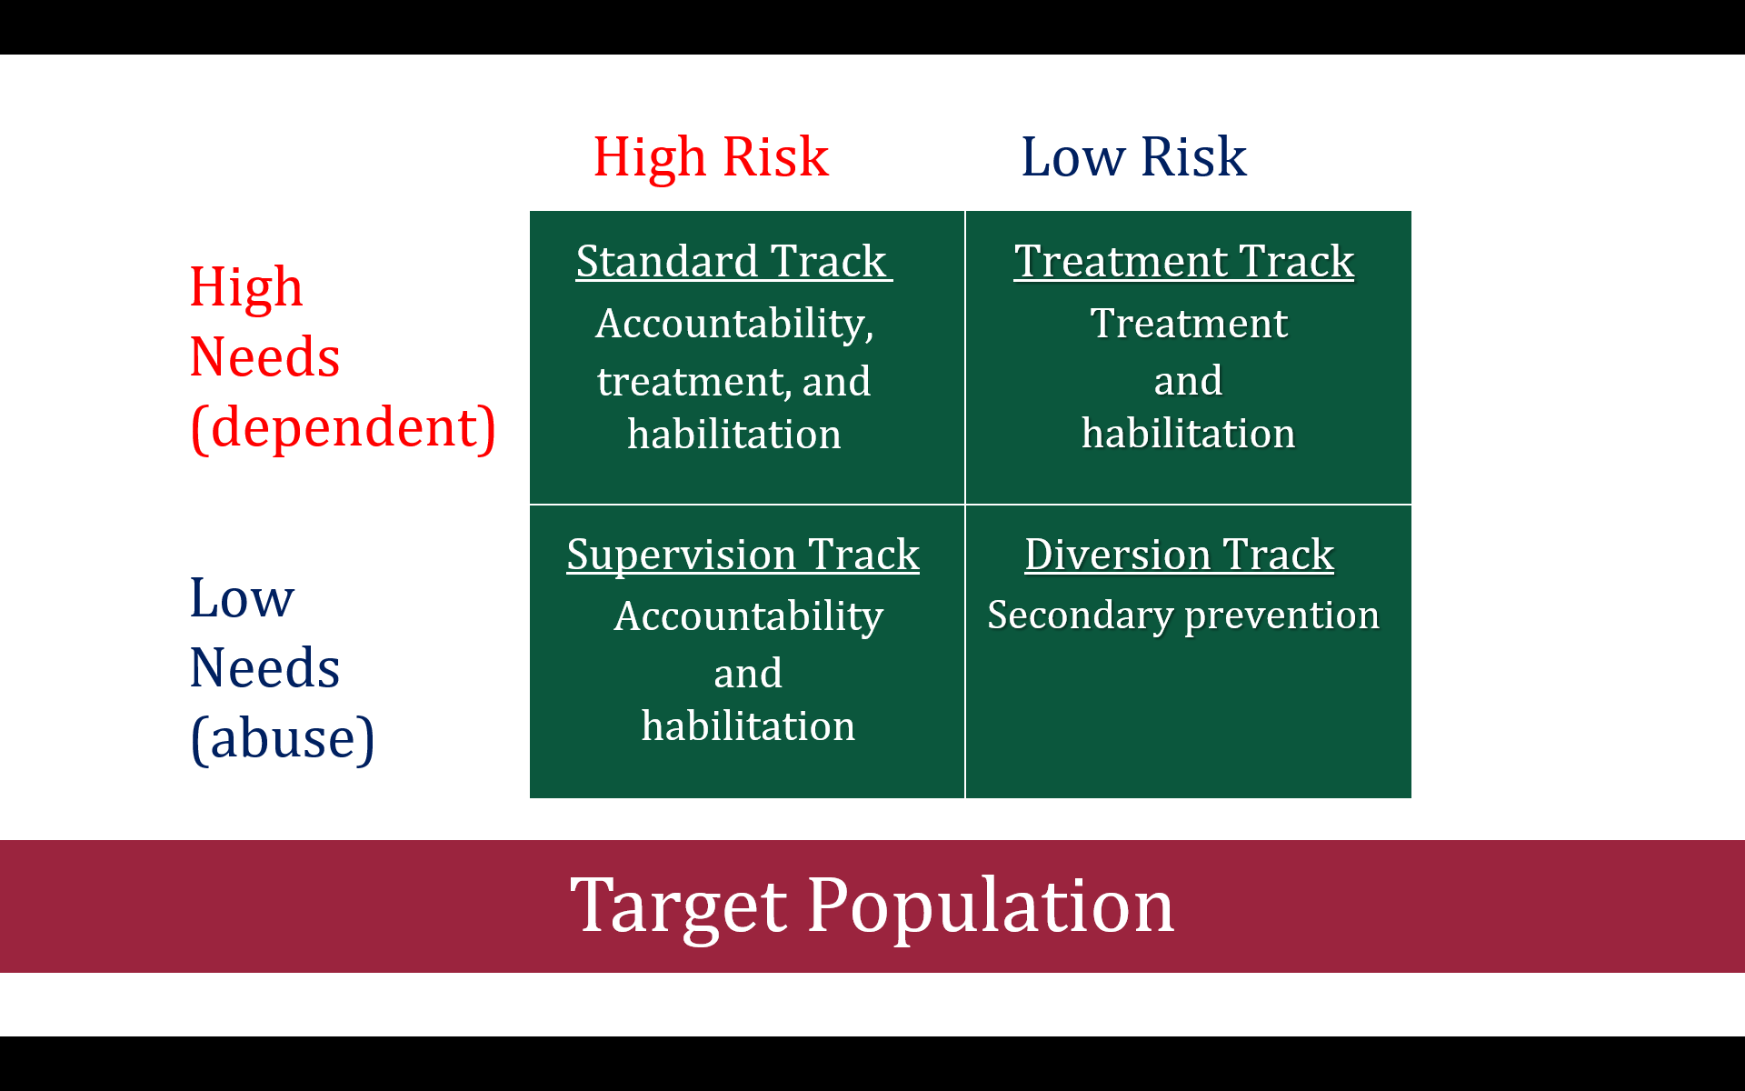
Who are we bringing into our treatment courts?
Notes:
It is the high risk/high need individuals we should be taking into Treatment Courts.
Risk – there are two aspects to risk. First, that criminal behavior can be predicted. The second aspect is that we should match the level of service to that client’s risk.
Separate tracks
Need – there is actually a distinction between criminogenic and noncriminogenic needs. Criminogenic needs are a subset of a client’s risk level. They are dynamic factors that, when changed, are associated with a decrease in the likelihood of recidivism. Noncriminogenic (e.g., physical activity) needs are also dynamic and changeable but are weakly associated with recidivism reductions. In other words, the client has many needs deserving of treatment, but not all of those treatments or interventions/responses impact recidivism.
When teams focus on the wrong risk level, and noncriminogenic needs, they actually can increase the likelihood of recidivism for an individual. In contrast, services delivered to high risk/high need clients are five times more likely and effective in reducing recidivism.

Slide 12

Risk Level
Reminder
“Risk” refers to the likelihood that the offender will not succeed adequately on standard supervision and will continue to engage in the same behavior that got him or her into the trouble in the first place.
Risk does NOT refer to danger to the community.
Risk levels need to be separated.
Notes:
As a reminder when we discuss “risk” in context of treatment courts, we are talking about prognostic risk, i.e. risk of recidivism and not dangerousness.

Slide 13

Clinical Need
Reminder
“Need” is whether the client needs treatment and what kind of treatment he/she needs.
The higher the need level, the more intensive the treatment or rehabilitation services should be, and vice versa.
Notes:
If you give substance abuse treatment to somebody who doesn’t need it, you will increase the likeliness of their addiction and lessen your ability to intervene with that person.
At the same time, if you don’t intervene with someone with substance addiction or mental illness, then the person is probably not going to refrain from crime.

Slide 14
Eight Central Factors of Criminal Behavior
History of Antisocial Behavior
History of Antisocial Personality Patterns
Antisocial Cognitions
Antisocial Associates
Known as the Big Four. These are most likely to reduce recidivism if directly addressed.
Family/Marital Circumstances
School/ Work
Leisure/Recreation
Substance Use
Treatment Courts usually focus on these
four factors.
The Psychology of Criminal Conduct, Bonta & Andrews, 6th edition.
Notes:
Citation: The Psychology of Criminal Conduct, Bonta & Andrews, 6th. Edition.
Andrews and Bonta refer to the criminogenic needs most highly correlated with reductions in recidivism as the Central Eight. They further divide the Central 8 into the “Big Four” and the “Moderate Four”
The Big 4 are major predictors and should be addressed in case planning and management of the client. In the drug court context, we tend to focus solely on SUD, when we need to address the big 4. This includes such programs as MRT, Thinking for a Change, and the use of the core correctional practices, EPICS or SOARING.
The Big 4 include:
History of Antisocial Behavior – this is early involvement in antisocial behaviors in a variety of settings, include the home, school, and community. Prior offenses, probation violations, and warrants are all used to calculate this score. While clearly, we cannot change this criminogenic factor (it is the only static one of the 8), we can focus on dynamic needs and build intermediate targets of change, including bui8lding up new non-criminal behaviors in high risk situations and building self-efficacy.
Antisocial Personality Patterns – these behaviors include impulsivity, pleasure seeking, aggressiveness, disregard for others, and low harm avoidance. So with this criminogenic need area, we want the treatment court case manager (probation, treatment, etc.) to focus on building up self-control (not just as it relates to SUD), provide anger management if appropriate, and teach problem solving skills (probation)
Antisocial Cognitions – these are the attitudes, values, beliefs, rationalization and personal identity that is favorable to crime. The client often feels irritated, resentful, and defiant. They hold negative attitudes towards authority and law. Again, teams and case managers need to focus on this antisocial thinking and allow the client to develop an awareness of this thinking and practice less risky thoughts/feelings.
Antisocial Associates – association with those who commit or are prone to crime. The client also isolates themselves from anti-crime others or positive influences. Here, it is important to enhance positive peers/associates. Think social capital!
The Moderate 4 include:
Family/Marital Circumstances
School/work
Leisure/Recreation (prosocial leisure activities)
Substance Abuse
While we must address the substance use disorders of our clients, it is important to remember that if we are actually serving HR/HN population, then we must address the Big 4 in a coordinated and integrated manner.

Slide 15
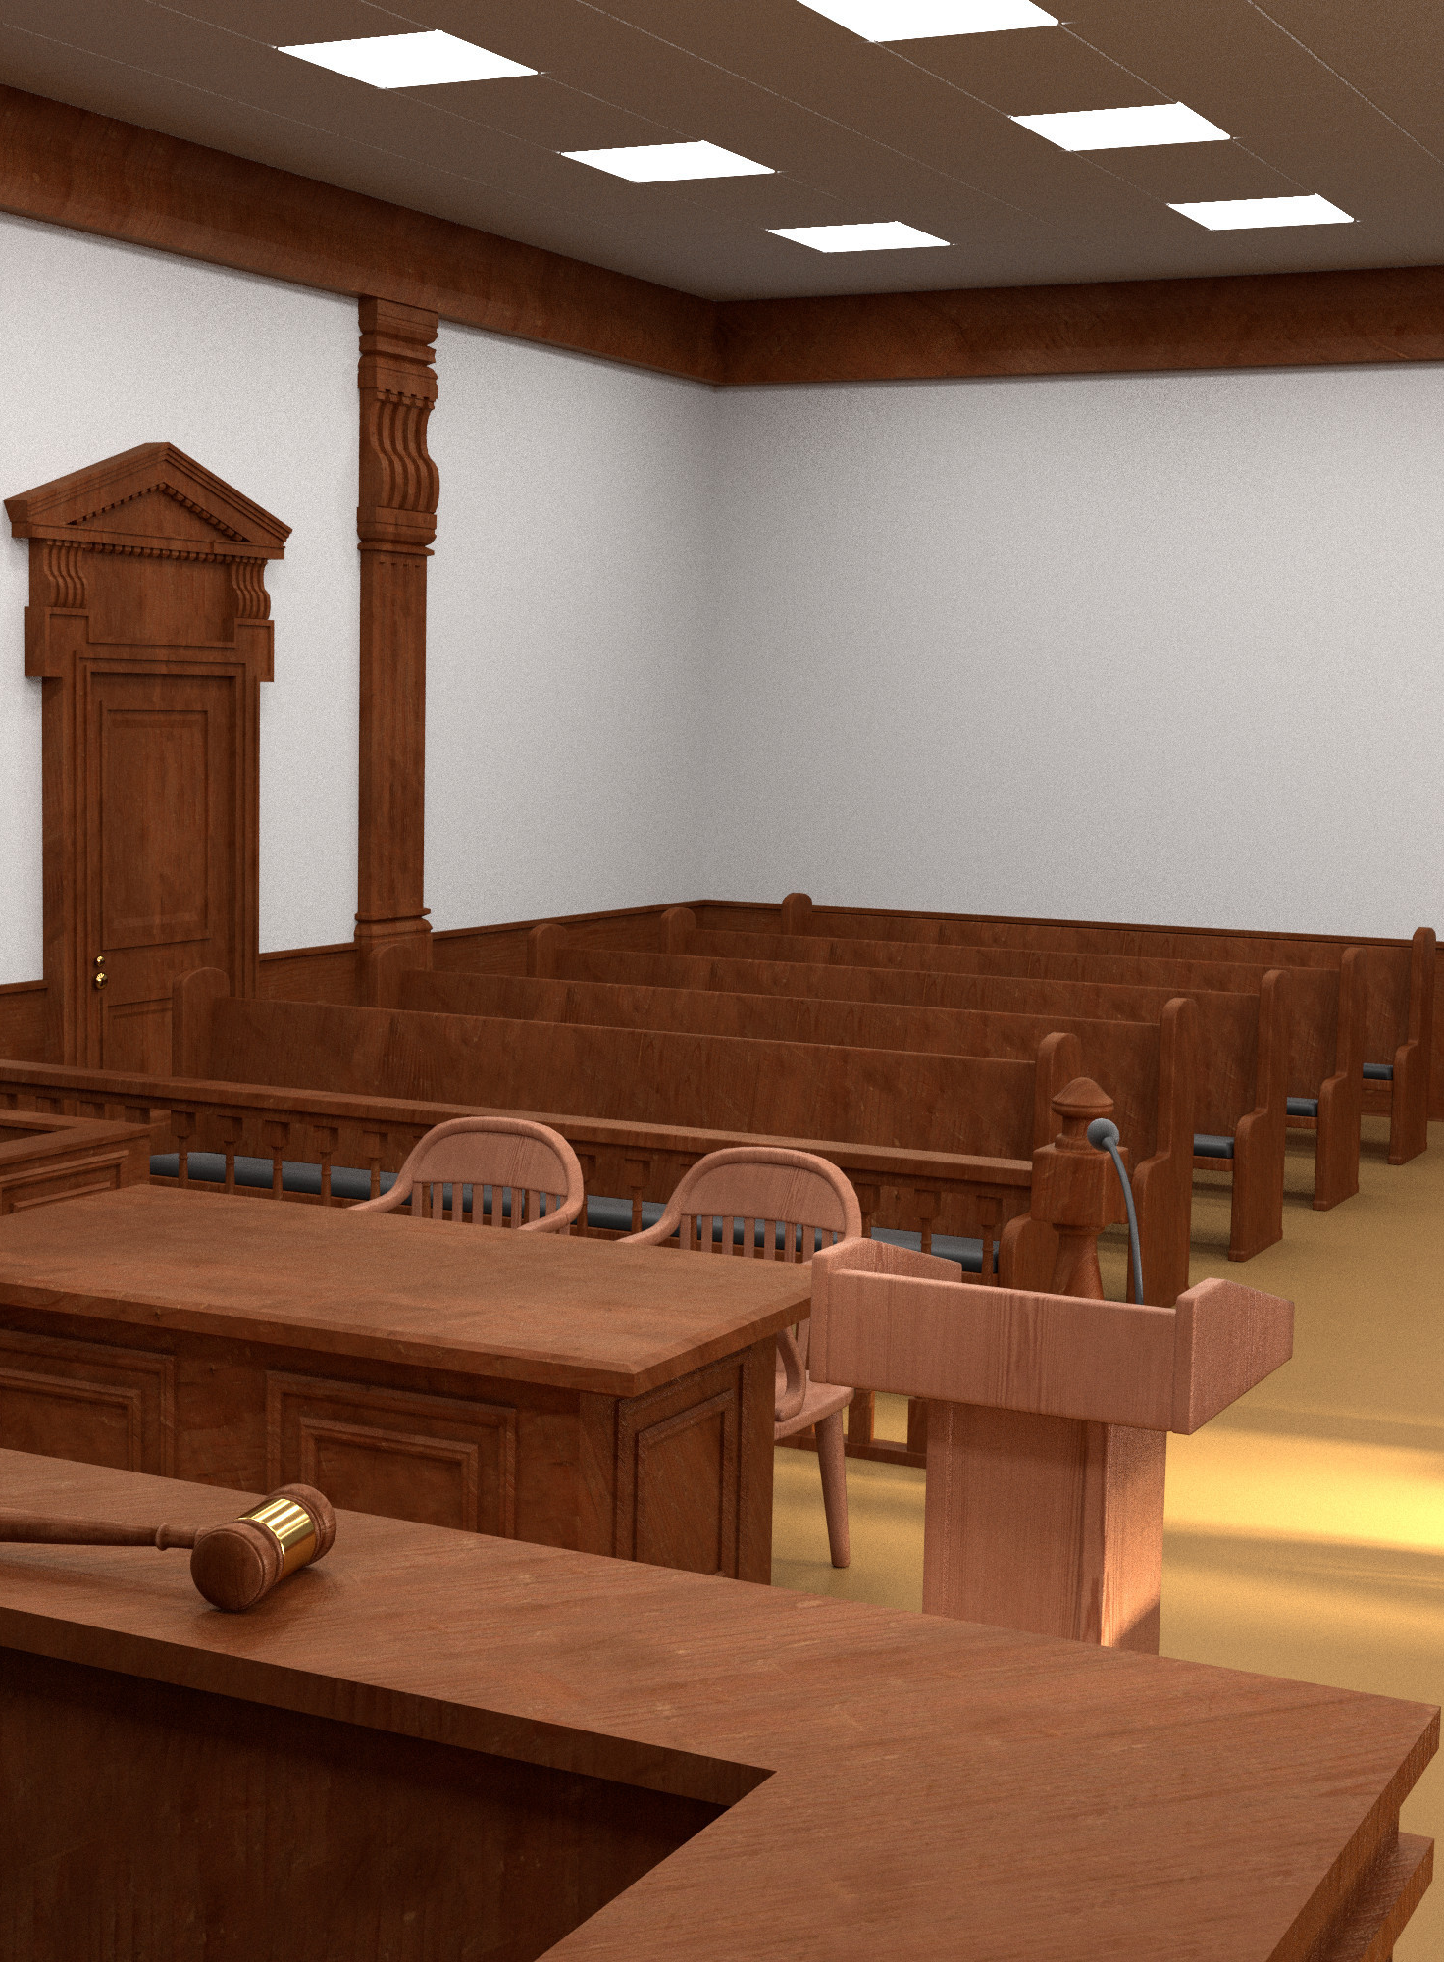
Program Structure
Examine Program Structure
  Pre-Plea/Diversion
  Post-Plea
    Deferred Sentencing
    Probation
  Probation Revocation
  Re-Entry
  Mixed Models
  What’s the legal incentive to participate?
Notes:
What is the legal carrot that is going to entice your targeted offenders into the program? Why would someone agree to this program as opposed to taking regular probation?
MA OUI example
If you finding that the defense attorneys in your justice community are not recommending that their clients enter your program, then the program may not be offering a viable legal option for the attorneys to recommend to their clients?
The research has shown that offenders who enter a treatment court program because it gets them out of jail, and not because of a motivation to change, do just as well as or better than motivated patients.
You need motivation by the time of graduation, not the time of entry. Plus, we are not good at assessing motivation

Slide 16

Eligibility Criteria
Eligibility Criteria – written and objective characteristics that define who within your offender population may be admitted to treatment court.
Legal Eligibility
Risk Level
Clinical Need
No voting!
Notes:
After examining your community’s offender population, what are the characteristics of the offenders you want to target for your treatment program?
Prosecutors and Defense counsel need to collaborate in examining the program’s eligibility and exclusionary criteria to ensure that it is defined objectively, specificized in writing, and communicated to all potential referral sources.
The treatment court does not apply subjective criteria or personal impressions to determine participants’ suitability for the program . There is no voting! Either the client meets all the criteria or he/she does not.
Subjectivity only leads to inequity and Prosecutors and Defense Counsel have the shared duty to fight inequity in the justice system. We will discuss Equity and Inclusion issues more specifically later in this presentation.
No gut calls

Slide 17

Legal Eligibility
Only Drug Possession Cases?
  Greater effects with theft and property offenders
  Often not jail or prison bound
Dealers?
  Do just as well in treatment court.
Violent Offenders?
  Do just as well in treatment court.
Barring legal prohibitions those charged with dealing or violent histories should not be excluded automatically
Notes:
The research is clear that the “higher value” cases do very well in treatment courts.
Drug courts should not only take drug charges, but also drug driven charges, especially considering the ever-changing drug laws and sentencing guidelines. Research has shown that drug courts which include property crimes in their target population have twice the cost effectiveness of programs which only target drug possession cases.
Baring legal prohibitions those charged with drug dealing or violent histories are not excluded automatically.
What about dealers? Do they typically deal in small quantities to support their habit? If the answer is yes, and you exclude dealers (with the thought that “dealer” conjures up images of cigarette boats and Miami Vice types of offenders), does the program and community benefit? And, by the way, offenders in drug court with charges for dealing do just as well.
And, many of your drug possession cases may not be prison bound offenders, and they may respond to other alternative, not as intensive programs
There is a growing body of research that suggest drug courts do just as well with violent offenders. But many Drug Courts don’t take violent offenders. Why?
Historically, Drug Courts shied away from violent offenders from the outset. This may have had two causes: first, most of the initial drug courts involved first time offenders who were rarely violent. Second, the initial federal funding from the federal government contained restrictions on including violent offenders. Buy now a huge part of the drug court funding from the federal government doesn’t come from funding streams with the restrictions on violent offenses.)

Slide 18

Keep in mind….
Prosecutors must accept that defense attorneys will advocate for the admission of probation violators and other aggravating cases with clients who have substantial records.
Defense attorneys must accept that prosecutors may be required to consider the wishes of victims and the community.
Notes:
Legal eligibility is obviously an area for effective collaboration, but each role must appreciate the challenges of the other.
Defense attorneys always want the best possible legal outcomes for their clients. Defense attorneys also want legal outcomes that provide their clients with the best opportunity for success. Therefore, prosecutors must stop complaining that defense attorneys will always advocate for the admission or those most list to be incarcerated. And, since the research supports the participation of these clients, prosecutors should always be open to their admission.
And, on the other side, defense attorneys must accept that there are going to be offenses that the victims or the community leaders just is not going to accept into a treatment court.

Slide 19
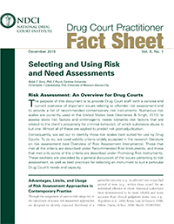
Fact Sheets
Targeting the Right Participants:
Fact Sheet: Targeting the Right Participants for Adult Drug Court - All Rise
Alternative Tracks in Drug Courts:
Fact Sheet: Alternative Tracks in Adult Drug Courts - All Rise
Selecting and Using Risk and Need Assessments:
Fact Sheet: Selecting and Using Risk and Need Assessments - All Rise

Slide 20

Entry Process
What process gets clients into the treatment court?
Referral/Application
  Who and When?
Legal Screening
  Who and When?
Risk and Clinical Assessments
  Who and When?
Notes:
The research has established that there is a 63% decrease in recidivism when the time between arrest and program entry is 50 days or less.
The process starts with a referral or a formal application and then the legal screening, risk assessment and clinical assessment must all be completed prior to program acceptance.

Slide 21

Entry Process
What barriers must be overcome along the way?
Court processes or procedures?
Lack of buy in by defense counsel?
Limited resources?
Notes:
Importance of data from your program, not just what state requires
Importance of team mtgs. Outside of court to review policies and procedures

Slide 22
Common Legal Issues
Confidentiality
  42 CFR Part 2
  HIPPA
  Staffings
  Open Courtrooms
  Law Enforcement
Ex Parte Communication
Judicial fraternization and impartiality
Due Process
First Amendment
Probation Restrictions
Preventive Detention
Jail Sanctions
Medication Assisted Treatment
Medical Marijuana
Notes:
This is not intended to be a comprehensive legal presentation, but here are the common legal issues facing treatment courts. Prosecutors and defense counsel collaborate to address these legal issues and potential pitfalls.
(make note of dates and time of other presentations that specifically address the legal issues)

Slide 23

Treatment Courts and MAT
The Dept. of Justice is actively investigating treatment courts in violation of American Disabilities Act (ADA) by prohibiting or limiting the use of medication to treat Opioid Use Disorder.
Courts denying MAT or requiring discontinuance as condition of program completion are creating liability.
Notes:
A quick highlight of two DOJ actions.
Pennsylvania – PA courts and probation departments required participants to discontinue MAT to successfully complete drug court and probation terms. DOJ demanded written policies explicitly stating that no court may discriminate against qualified individual with opioid used disorder and appropriately train all court staff on ADA’s requirements. PA did not respond, DOJ filed lawsuit in federal court.
Massachusetts – Mass. Drug courts were permitting MAT, but Vivitrol only. State reached agreement where in all the state’s drug courts adopted new policy that drug courts and their personnel may only required the participants with OUD to comply with the treatment recommendations of a licensed prescriber. Additionally, drug courts will ensure compliance with the policy, including implementing a new procedure for reviewing complaints about decisions related to MOUD.

Slide 24
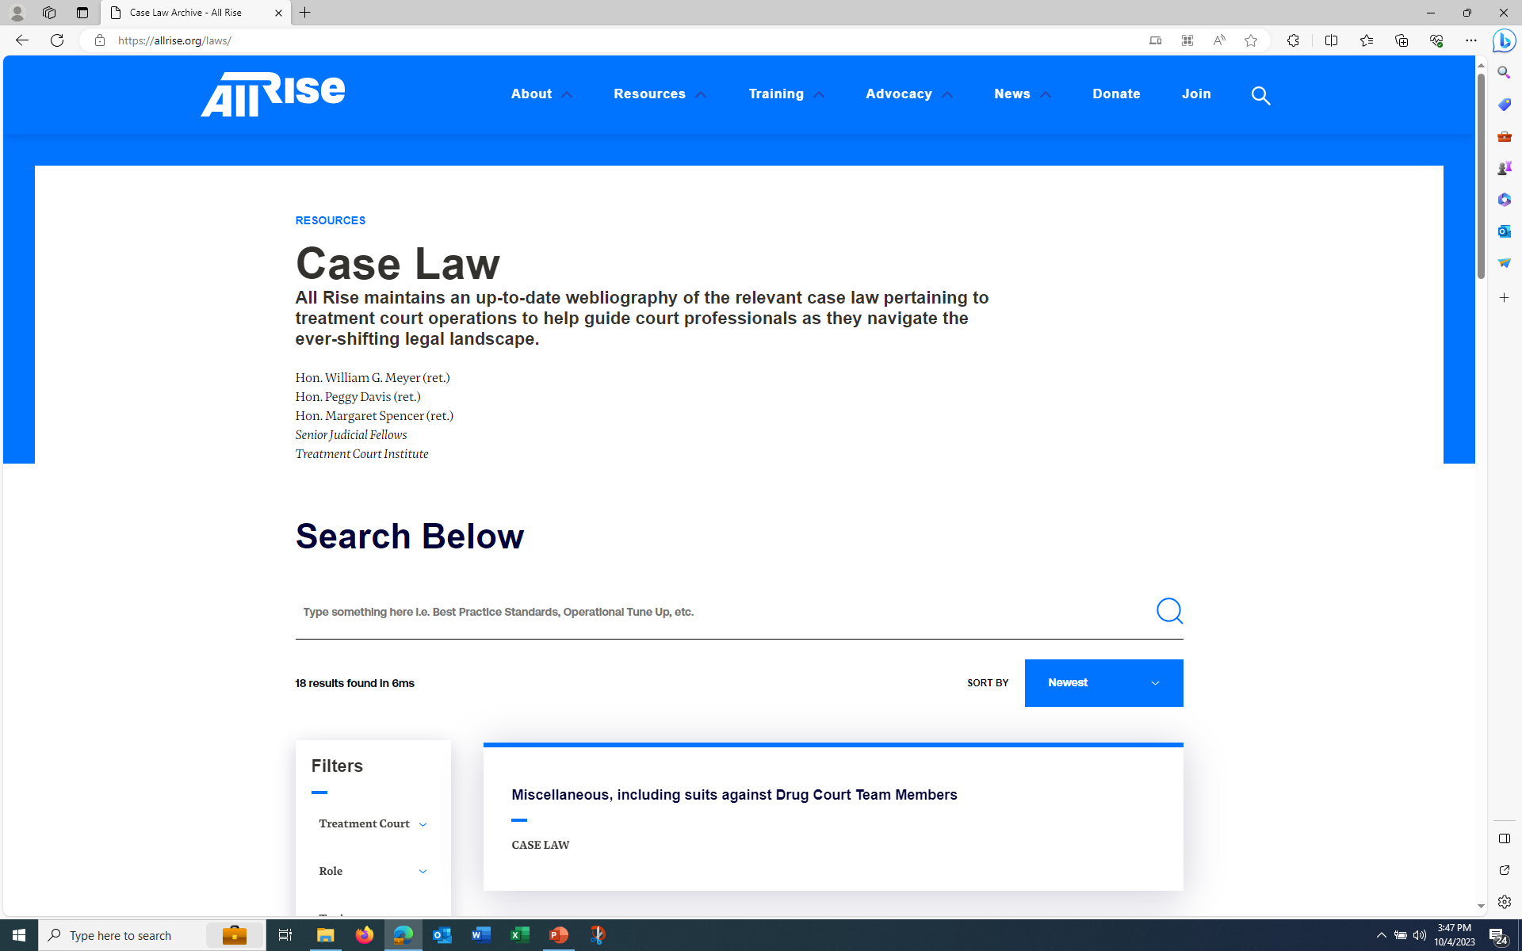
All Rise Caselaw Resource https://www.allrise.org/laws
Notes:
The All Rise website is updated regularly with current legal issues and legal issues in treatment courts.

Slide 25
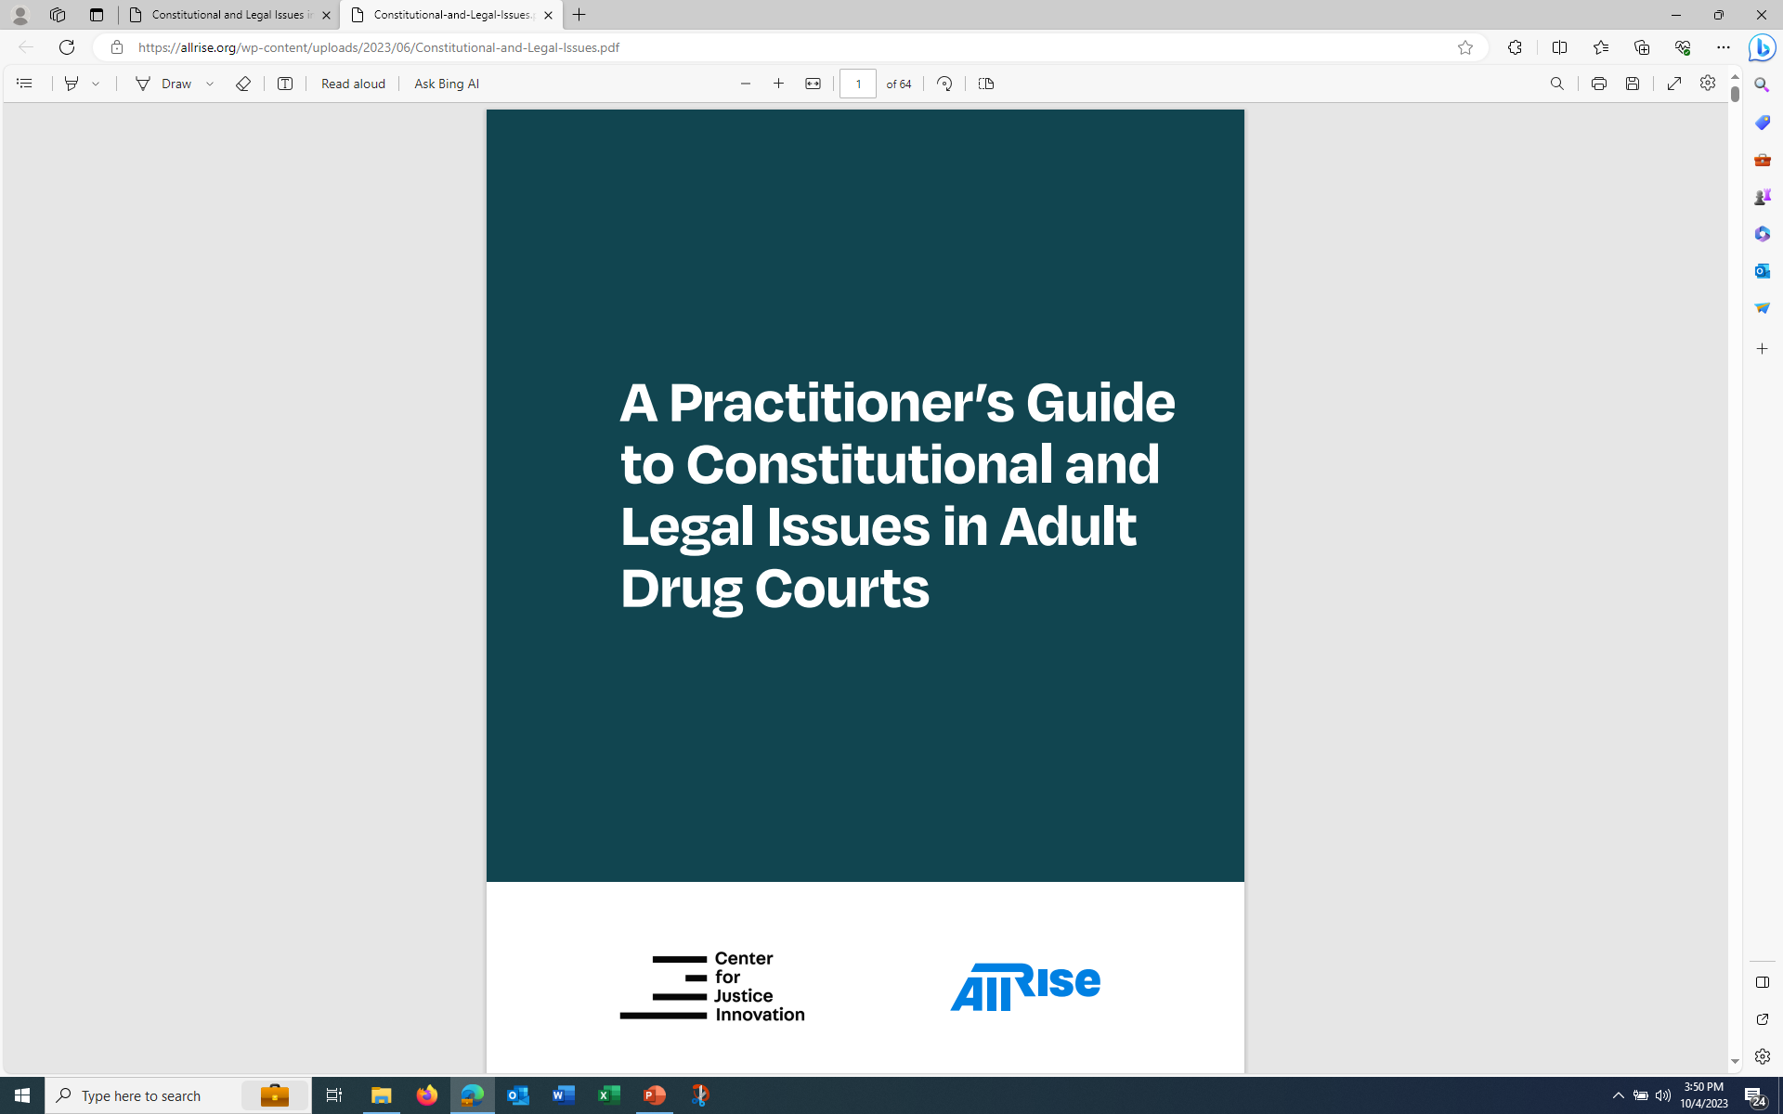
New Publication https://www.allrise.org/publications
Notes:
The All Rise website is updated regularly with current legal issues and legal issues in treatment courts.

Slide 26
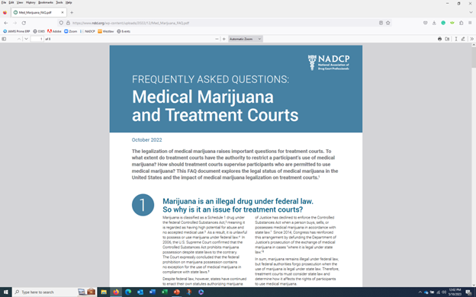
Medical Marijuana Fact Sheet https://www.allrise.org/publications/medical-marijuana-faq/

Slide 27
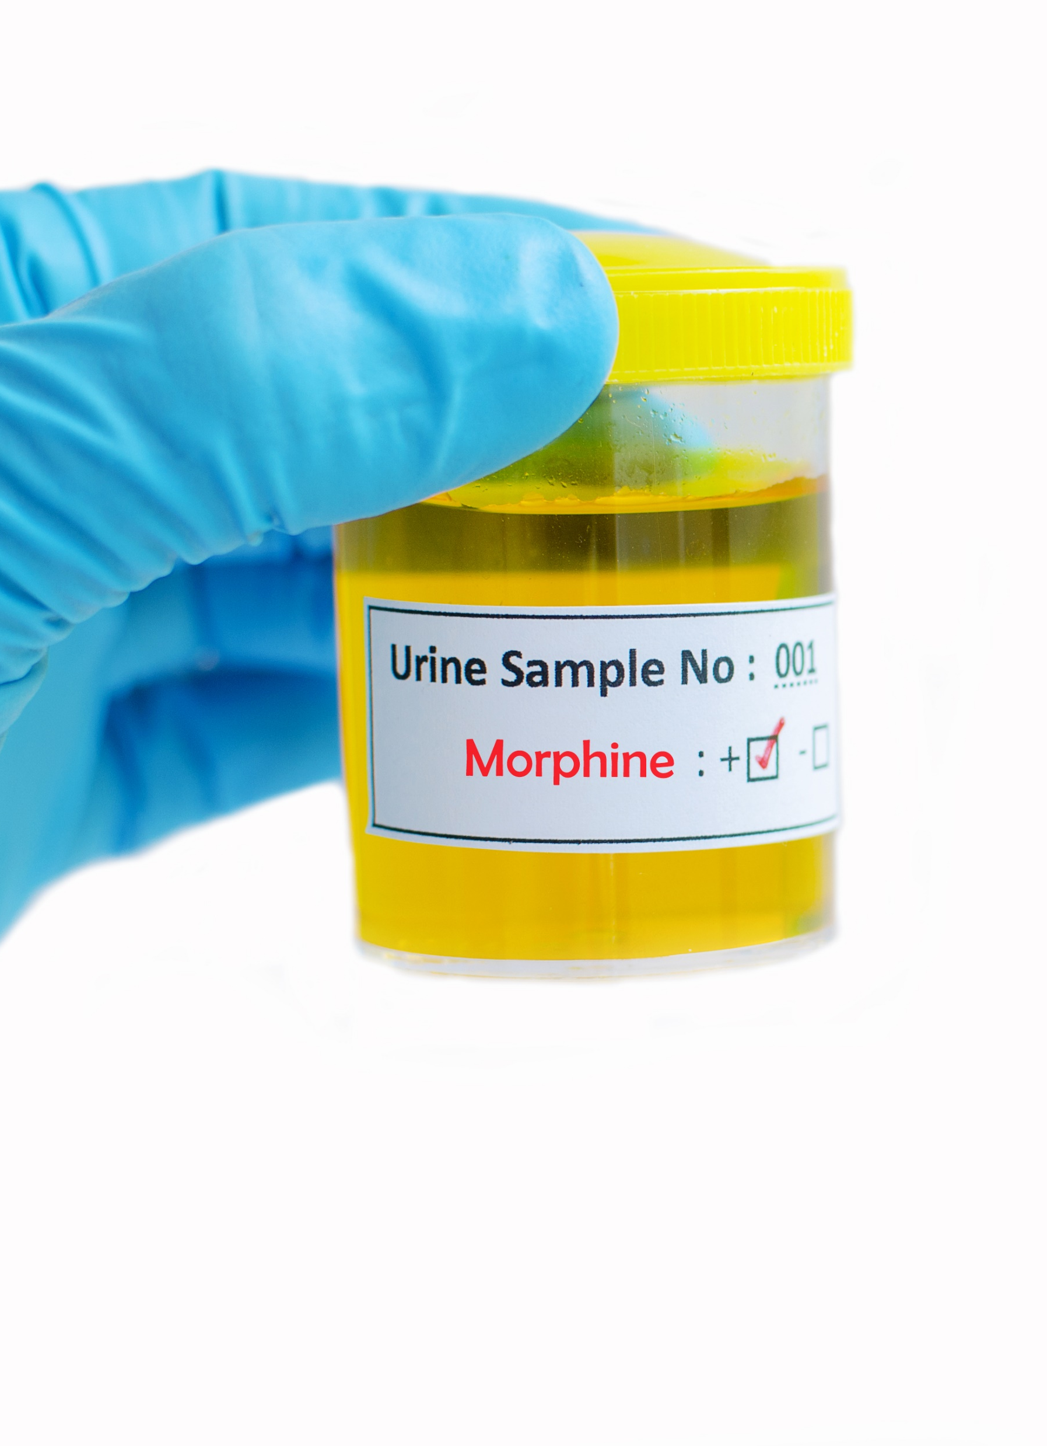
Drug Testing
Characteristics of a Good Drug Test:
Scientifically Valid
  Employs proven methods & techniques and accepted by scientific community
Legally Defensible
  Able to withstand challenge of legal review
Therapeutically Beneficial
  Provides accurate profile of client’s drug use and rapid results for appropriate response.
  Best Practices Review: Drug & Alcohol Testing, Paul Carey , MS (2020)
Notes:
Drug testing is important to for our programs because:
They act as a deterrent for future drug use
They identify participants who are maintain abstinence
They identify participants who have relapsed, allowing for rapid intervention
They provide incentive, support, and accountability for participants
They are adjunct to treatment and frames sanction decisions
Best Practices Review: Drug Testing, Paul Carey, MS (2020)
Prosecutors and Defense Counsel need to collaborate to ensure that the program’s drug testing is meeting these characteristics of a good drug test. Afterall, we are the ones who will either be defending a test result, or challenging a testing result, in a formal court proceeding.
In everyone’s best interest that testing be accurate.
Further, we need to be on top of drug testing because we know the participants are doing their research, i.e. internet, High Times Magazine, Other clients

Slide 28
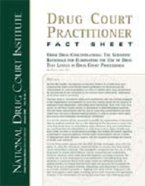
Drug Testing Fact Sheets
FAQ: Drug Testing:
FAQ: Drug Testing - All Rise
Urine Concentrations:
Fact Sheet: Urine Drug Concentrations - All Rise
THC Window Detection:
Fact Sheet: The Marijuana Detection Window - All Rise

Slide 29

Effective Communication
Staffing:
Yes!
Ensure Inclusiveness
Ensure everyone “stays in their own lanes”
No!
Regularly engage in adversarial behavior
“Voting” on client eligibility
Notes:
The prosecutor and defense counsel should work together to ensure the staffings are think centers to actively problem solve varied issues with the participants.
We need to work together to ensure that all team members weigh in on subjects within their areas of expertise or experience. Ensure that all team members have an equal opportunity to speak.
The prosecutor and defense attorney need remind team members to stay in their own lanes. Team members make recommendations based upon their expertise. I know we think that because of experience that we have an instinctual feeling of what “works” with rehabilitating clients. Judges are just as guilty of this too.
The prosecutor and defense counsel also need to work together in resisting the urge to be adversarial. Both the prosecutor and defense counsel should strive to develop a problem- solving style and reserve their adversarial approach when addressing issues that warrant them.
It is worth mentioning again that eligibility is based upon objective criteria. Either an applicant meets the criteria based upon the objective factors or not. There is not discussion become that.

Slide 30

Effective Communication
Email Communication
Yes!
For updates on clients
Arrange special staffing sessions
Keep team updated on any changes
No!
Arguing Positions
Sarcasm
Notes:
Send only emails you Ok with being printed in the newspaper or viewed by state ethics/disciplinary counsel

Slide 31

Crisis Management
Crisis Response Plan:
Suicide, Overdose, Re-offense, Relapse
Media Plan
Proactive Planning rather than Reactive
NADCP Guide:
Managing the message during a crisis: A guide to planning and implementing your response (wicourts.gov)
Notes:
Eventually, something is going to happen that threatens to undermine public confidence in your treatment court program. The onset of a crisis is not the time to develop a crisis response plan.
The prosecutor and defense attorney can effectively collaborate to develop a crisis response plan for the program. We are already effective of managing the narratives for the cases we handles.
Here is a link to a NADCP guide that offers strategies to help your court team prepare for a crisis and provides instructions for how to manage the narrative is a crisis occurs.

Slide 32
Standard II: Equity and Inclusion
Regularly Review Data:
Referrals
Admissions
Exits
  Absconders
  Voluntary withdrawals
  Involuntary Termination
  Successful Completion
Notes:
There are three main focuses of Standard II – Equity ad Inclusion: 1) Ensure equal opportunity for everyone to participate and succeed regardless of race, ethnicity, or gender. 2) Take affirmative steps to detect and correct disproportionate census, inequitable services, and disparate outcomes involving those who have historically faced discrimination, and 3) teams are responsive to the cultural differences within their population.
This is accomplished by looking at 6 areas: 1) equivalent access, 2) equivalent retention, 3) equivalent treatment; 4) equivalent incentives and sanctions; 5) equivalent dispositions and 6) team training.
Your program should be maintaining data at three processing points: referrals, admissions, and exit.
Whose being referred to the program?
Whose being admitted, and rejected?
Whose exiting and how?
The prosecutor and defense attorney should regularly examine this data for the demographics of age, sex, race, and ethnicity. Does a pattern emerge?
Nationwide, 50% of drug arrestees are African American, and 35% of treatment court participants are African American
The number of women having access to treatment courts was 33.4% in 2021 PCP data. Female participants also successfully completed treatment courts at rates below those of male treatment court participants

Slide 33
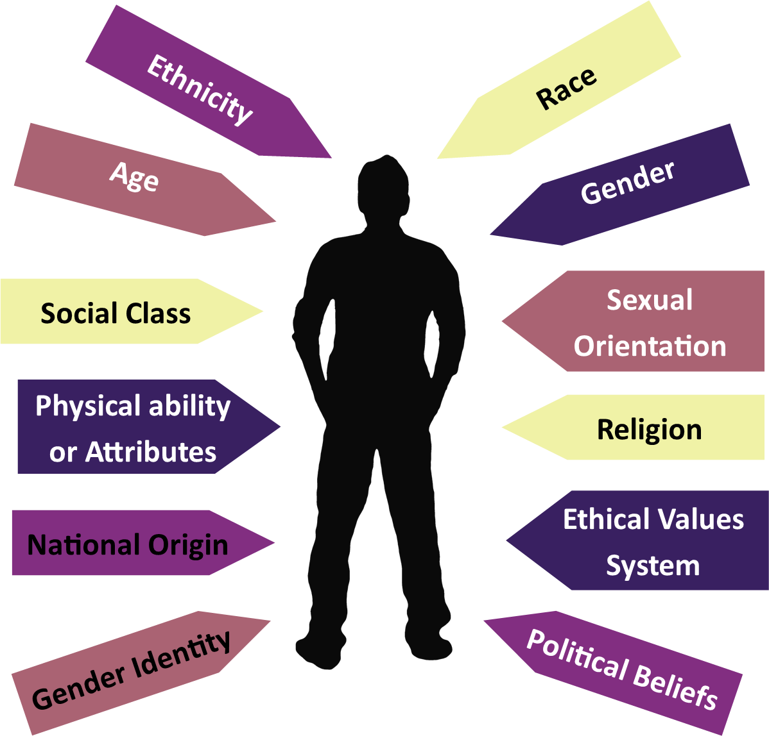
Diversity is a Fact
Diversity is the range of human differences
Inclusion is an act and takes practice
Equity is the goal
Notes:
Diversity is a fact. Diversity is more than just race and gender, it is the range of human differences. We should always be looking through the “lens” of diversity, inclusion, and equity. It is essential to always be aware and acknowledging the diversity and aware of what inclusion looks like. How do you show inclusion? The goal is to reach equity and it will take work.

Slide 34

Equity and Inclusion
Regularly Review Criteria:
Legal Criteria
Program Fees
Transportation
Housing
Sobriety
Intent vs. Impact
Notes:
Well intentioned criteria can be producing unintended consequences that lead to inequities. The prosecutor and defense counsel should continually strive to eliminate inequities in our community’s criminal justice system.
Legal eligibility: Are your requirements regarding current offenses and prior history preventing certain groups of people from participating? Are you terminating participants for receiving new possession charges? Treatment courts that do so are statistically more likely to terminate African-American participants
Program Fees: some programs charge exurbanite fees that clients just can’t pay
Transportation: The program should be assisting the participants with transportation to meet the requirements for the program. Requiring transportation for admission will disenfranchise poor people and in many communities this may be people of color.
Housing: obtaining housing is something the program should be assisting with.
Sobriety: If a client can maintain a period of 30 days sobriety, then he/she probably doesn’t need the treatment court program.

Slide 35
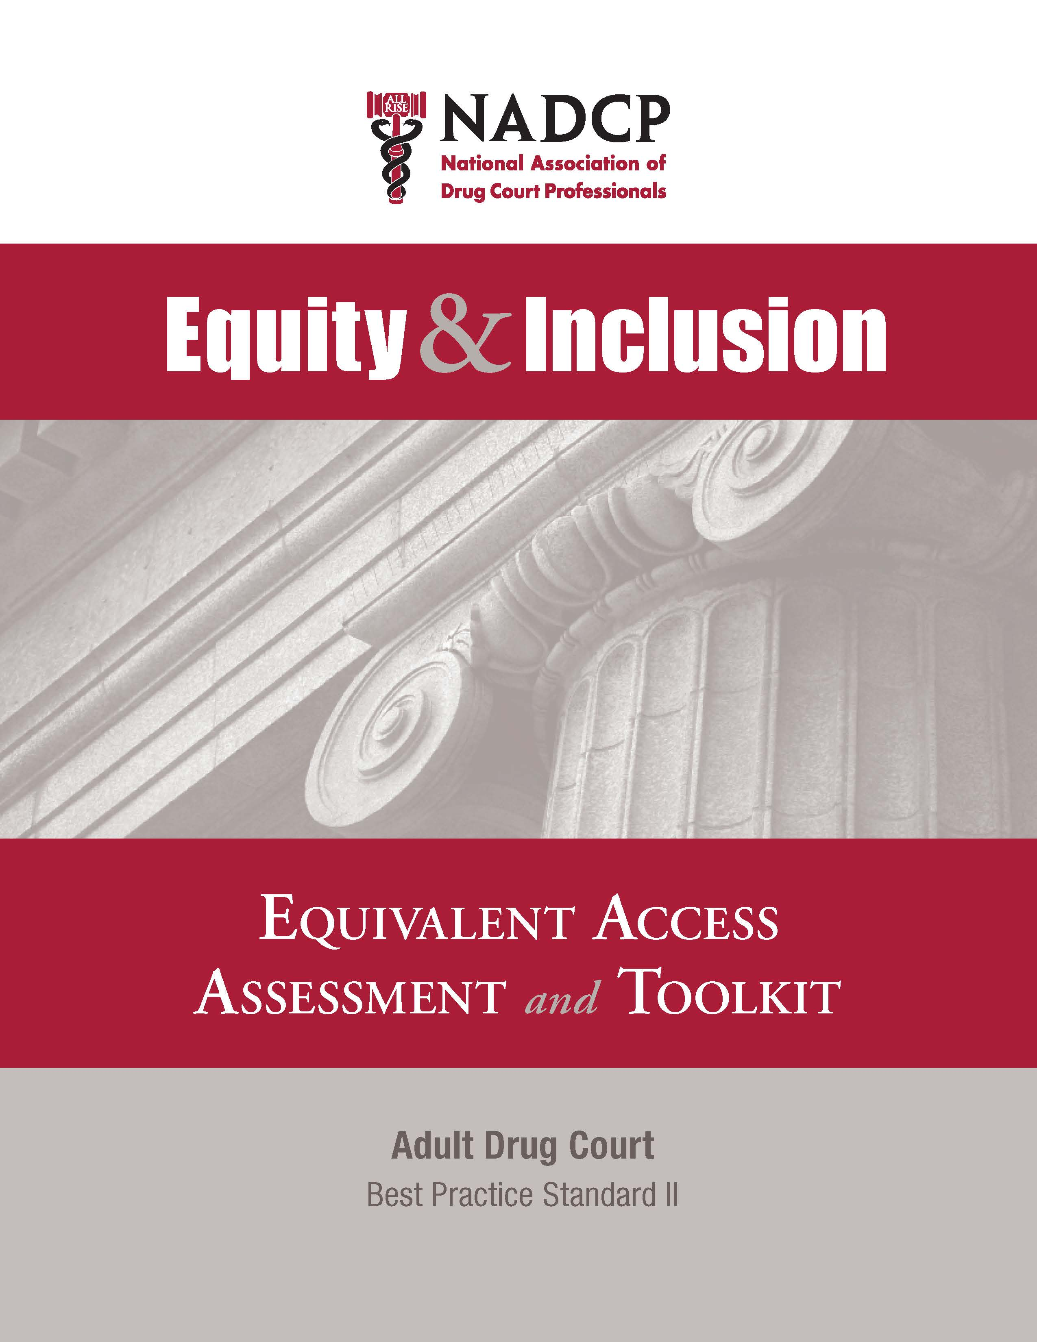
Equity and Inclusion Resources
Journal of Advancing Justice:
The Journal for Advancing Justice - All Rise
Equity and Inclusion Toolkit:
Equity and Inclusion Toolkit - All Rise
Notes:
The journal outlines some of the promising practices for courts to employ to combat racial disparities.

Slide 36

Regularly Review Program’s Written Materials
Policy and Procedures Manual
  Updated and Accurate?
Participants Manual
  Understandable resource?
Participants Contract
  Explains expectations and consequences?
Memorandums of Understanding
  Identifies specific responsibilities?
Notes:
When was the last time you read your program’s policy and procedures manual? The prosecutor and defense counsel need to ensure that this manual accurately reflects the program’s eligibility criteria as well as the services and operation of the program. This manual needs to be updated as the program evolves.
The participant’s manual needs to be written in a manner that it easily understood by a participant (7th grade level) and can used as a resource for the participant. It should NOT be a re-write of the policy and procedures manual.
Participant’s contract: Does it accurately set forth the participant’s requirements for successful completion as well as the legal response to completion? Does it discuss legal procedures for rule violations or termination hearings? Does it explain the legal consequences for withdrawing or being terminated?
MOUs: Each organization participating with the program should execute a MOUs, including the prosecutor’s office, public defender’s office (defense bar), probation department, treatment providers, etc. The MOU should establish the specific responsibilities and expectations of each stakeholder or other agencies.

Slide 37
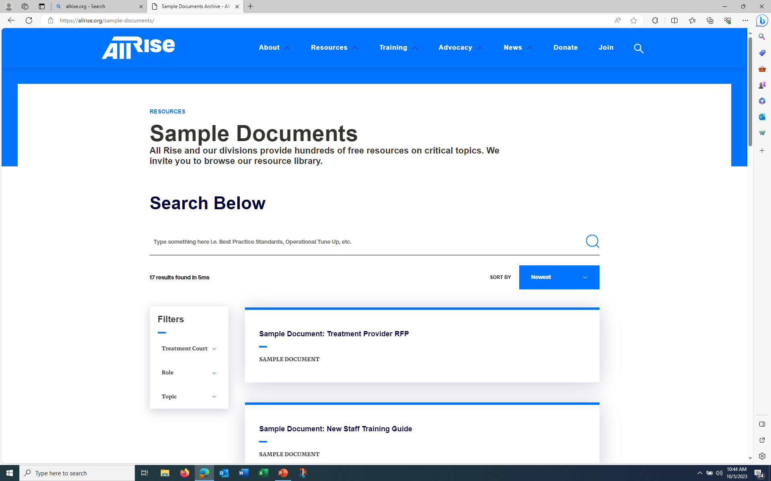
Sample Documents https://www.allrise.org/resource/sample-documents/
Notes:
The NDCI website is updated regularly with current legal issues and legal issues in treatment courts.

Slide 38

Sustainability
Contribute to the program’s efforts in community education and local resources acquisition.
- Speak to Community Organizations
- Organize a CLE
Notes:
The prosecutor and defense counsel should work together to service as spokespeople for the program in the community setting. Educate peers, colleagues, the judiciary, victims advocates, and the community on the efficacy of treatment courts.

Slide 39
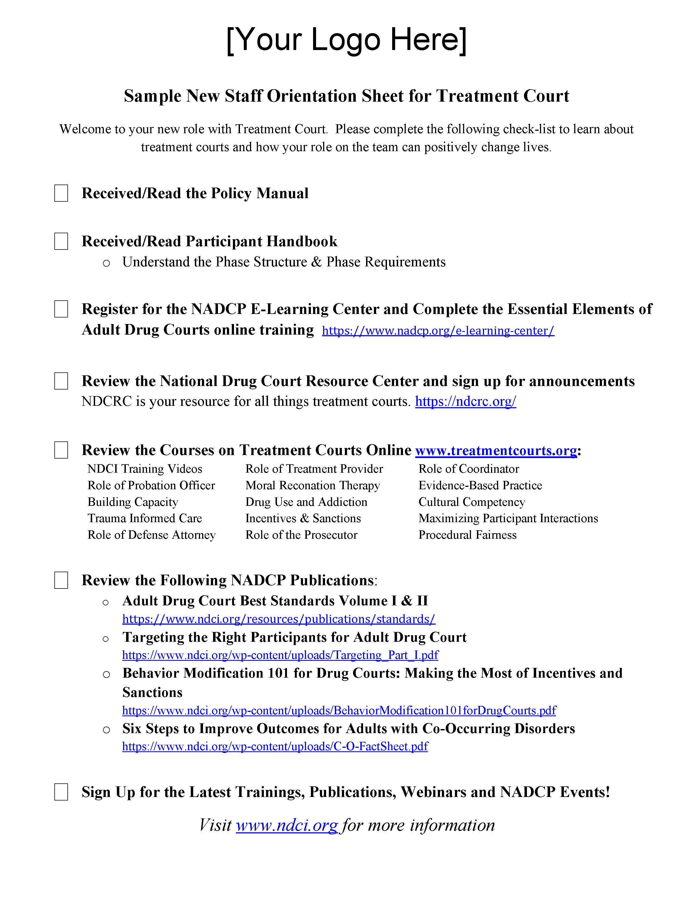
Ongoing Team Training
E-learning:
E-Learning Center - All Rise
10 Key Components:
Defining Drug Courts: The Key Components - All Rise
Drug Court Best Practice Standards Vol. I & II:
Adult Drug Court Best Practice Standards - All Rise

Slide 40
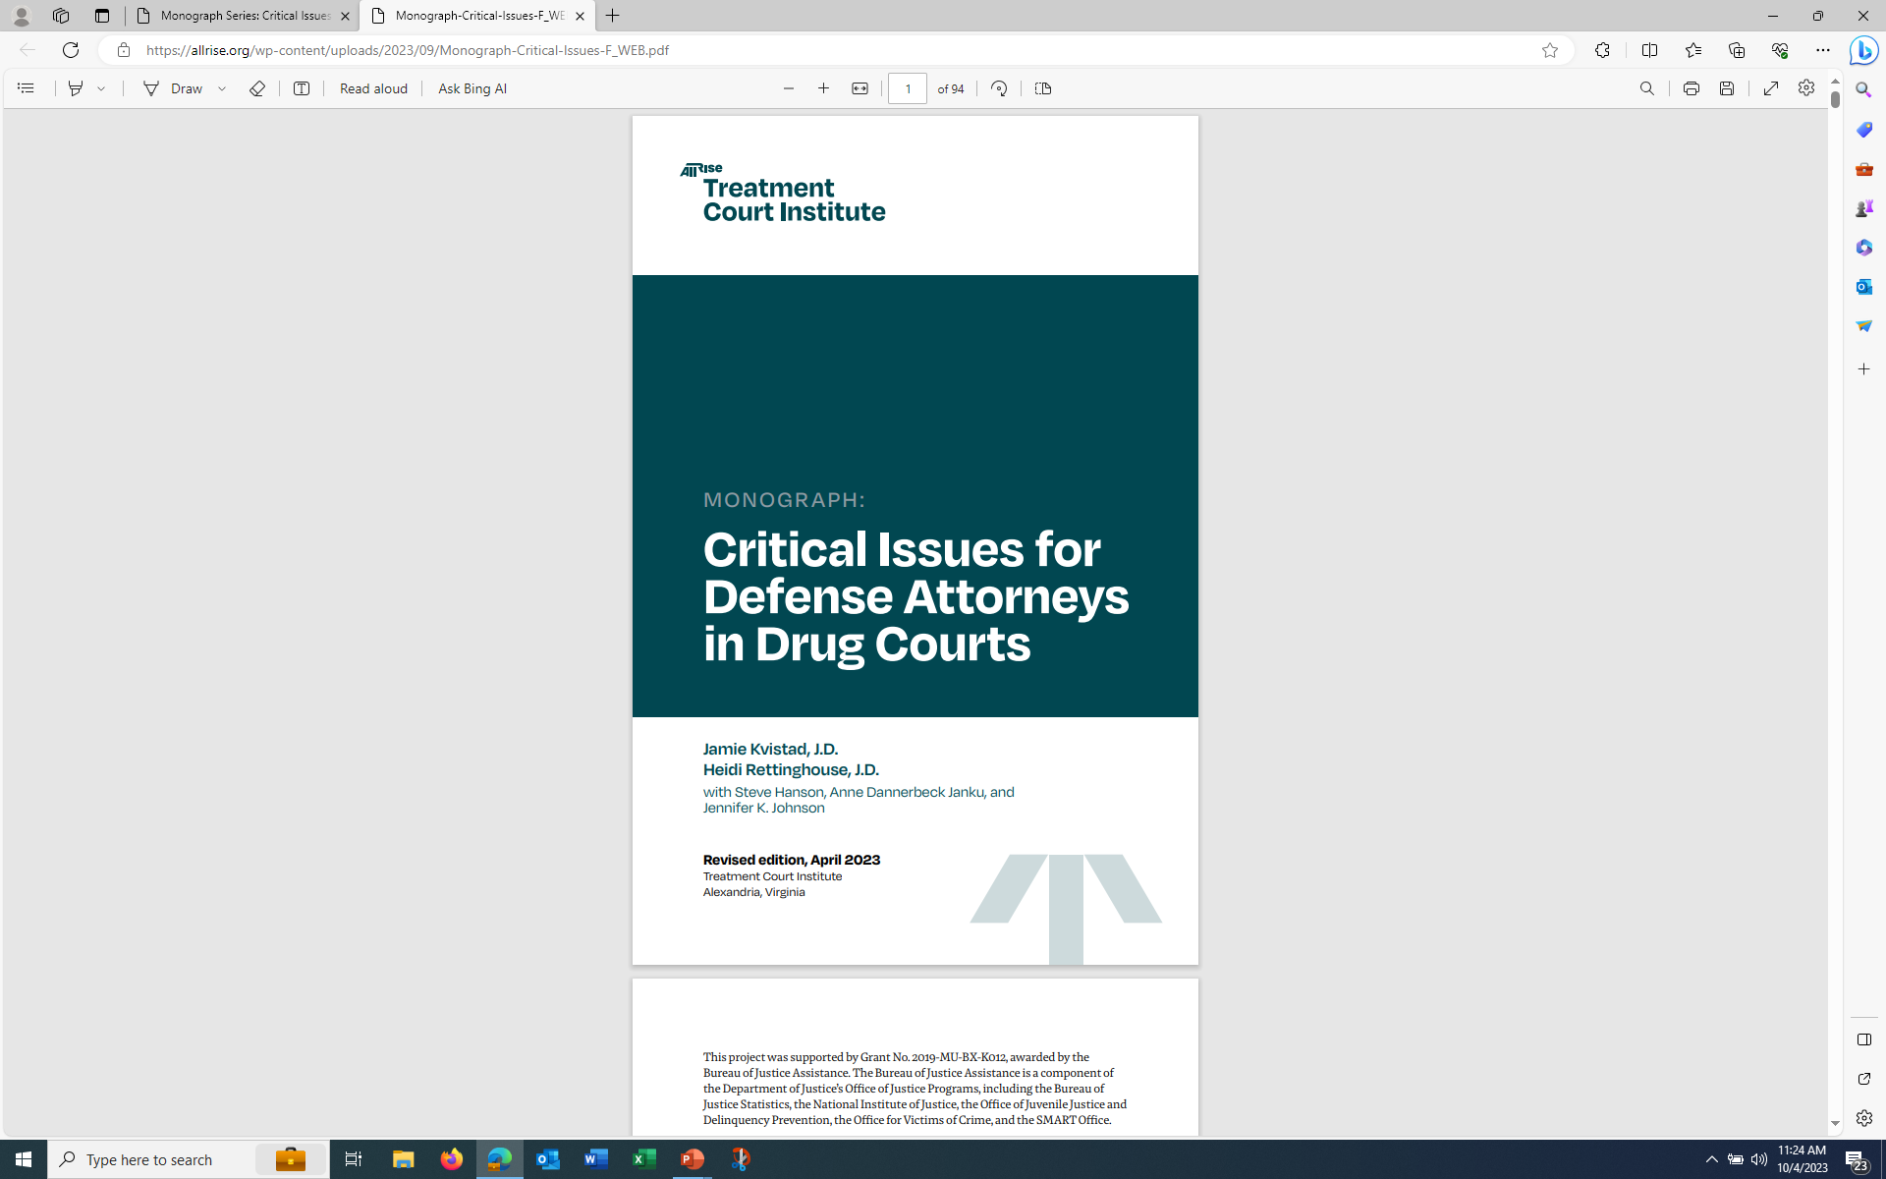
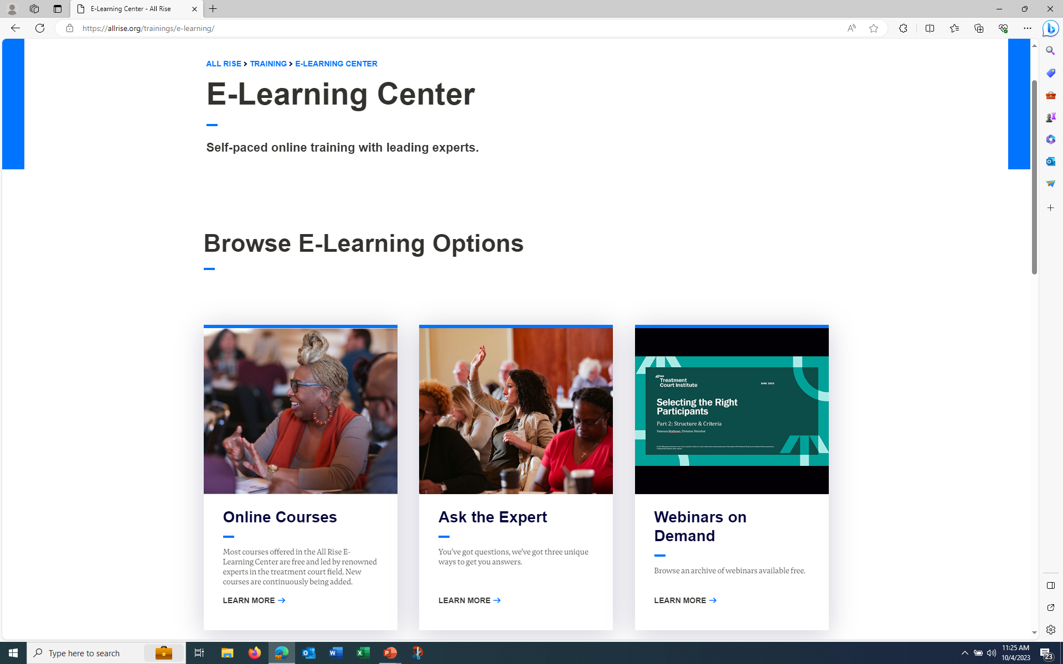


Slide 42

Contact Information
Hon. Mary Hogan Sullivan (Ret.)
marysullivan5755@gmail.com

Slide 43
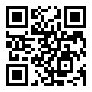
Evaluation
On your compatible phone or tablet, open the built-in camera app.
Point the camera at the QR code.
Tap the banner that appears on your phone or tablet.
Follow the instructions on the screen to complete the evaluation.
After completion, you will be provided with a certificate that can be saved and printed.
https://cvent.me/PYyZmm

