Slide 1

So… You Want To Start a Family Treatment Court?
Arielle Andrews | Program Associate
Center for Children and Family Futures
April 25, 2024 | WATCP Conference
Notes:
Welcome, introduce self, years at CFF, related work experience; why this topic is important to you;

Slide 2

Panel Introduction
Karla Broten, Youth and Families
Program Manager, Barron County
Laura Doebereiner, Lead CPS Worker,
Barron County
Kendra Schiffman, Senior Analyst,
Rock County
Elizabeth Pohlman McQuillen,
Justice System Strategist, Rock County
Notes:
1 minute/each
Name | Role | Organization/Treatment Court | How long FTC has been operational and how long have you been part of the team
What is your “why” for doing this work?

Slide 3

Acknowledgment
This presentation is supported by Grant #15PJDP-22-GK-03559-DGCT awarded by the Office of Juvenile Justice and Delinquency Prevention, Office of Justice Programs, U.S. Department of Justice.
This project is supported by grant number 15PJDP-22-GK-03559-DGCT awarded by the Office of Juvenile Justice and Delinquency Prevention, Office of Justice Programs, U.S. Department of Justice. The opinions, findings, and conclusions or recommendations expressed in this publication/program/exhibition are those of the author(s) and do not necessarily reflect those of the Department of Justice.
Notes:
Thank JJ for funding FTC and this presentation

Slide 4



Priorities
www.ojp.ojjdp.gov
Open up Opportunities for System-Involved Youth
Treat Children as Children​
Serve Children at Home, With Their Families, in Their Communities​
Notes:
JJ priorities – how they relate to this session;
More information on their website

Slide 5


Center For Children and Family Futures (CCFF) strives to prevent child abuse and neglect while improving safety, permanency, well-being and recovery outcomes with equity for all children, parents and families affected by trauma, substance use, and mental health disorders.
Notes:
Our mission statement – share this in nearly every presentation we do; grounds us in our work; mission we all believe in

Slide 6

Learning Objectives
Identify 5 key implementation and planning decisions for FTCs
Explore the importance of governance structure, leadership, and data during the planning process ​
Learn from practitioners who have successfully planned and launched FTCs
Notes:
Here are our 3 learning objectives for today’s session
(Click) Identify key implementation and planning considerations for FTCs
(Click) Explore the importance of governance structure, leadership, and data during the planning process ​
(Click) Learn from practitioners who have successfully planned and launched FTCs

Slide 7
Where are you in the planning process?
Shh, I’ve only talked to myself about this idea
I’ve mentioned the idea to some colleagues, but only within my agency
I’ve talked with 1-2 partner agencies about the idea
I’ve gotten full support from all partner agencies (child welfare, treatment, court), and we are ready to do this!
I’m part of an operational FTC
Somewhere else in the planning process
Notes:
Menti-Multiple Choice/select one
Give audience reminder to save question til the end or they can submit questions through menti

Slide 8

Instructions
Go to
www.menti.com
Enter the code
9472 9347
Or use QR code
Notes:
Share about how to join the session;
Answer questions at your own pace
I will prompt you on when to answer the questions; however, if you are an overachiever and want to skip ahead, you are welcome to do so;
some questions may not make sense until we get there;
You are able to make multiple submissions on the same device; so if the person next to you is having some difficulty and you’d like to help them out, you can do so
Option for Q & A
Submit questions here throughout the presentation; will take them as time allows and/or at the end of the presentation during the Q & A Portion
Where are you in the planning process?
Which key decision point are you at?
What are your next steps following today’s session?

Slide 9
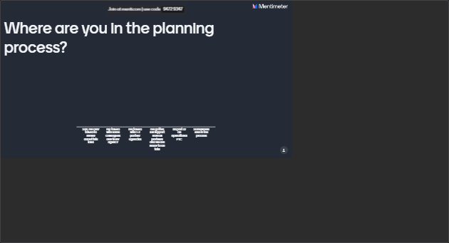
Notes:
Share about how to join the session;
Answer questions at your own pace
I will prompt you on when to answer the questions; however, if you are an overachiever and want to skip ahead, you are welcome to do so; some questions may not make sense until we get there;
Option for Q & A
Submit questions here throughout the presentation; will take them as time allows and/or at the end of the presentation during the Q & A Portion
Where are you in the planning process?
Keep these questions in mind as we go through today’s presentation:
Which key decision point are you at?
What are your next steps following today’s session?
Summarize the poll results

Slide 10

An estimated 21.6 million children (16.2%) < 18 live with a parent who misuses substances
Notes:
Citation:
Ghertner, R. (2022). US Department of Health and Human Services. National and State Estimates of Children with Parents Using Substances, 2015-2019 (Issue Brief 27). Office of the Assistant Secretary for Planning and Evaluation. https://aspe.hhs.gov/sites/default/files/documents/f34eb24c1aff645bed0a6e978c0b4d16/children-at-risk-of-sud.pdf

Slide 11
Parental Alcohol or Drug Abuse as a Condition Associated with Removal by State, 2021
National Average: 39.1%
N = 603,823
38.2 %
Note: Estimates based on all children in out of home care at some point during Fiscal Year
Source: AFCARS Data 2021, as of 03/21/23
Notes:
Animated to show WI after click
By show of hands, how many of you are familiar with AFCARS data?
Adoption and Foster Care Analysis and Reporting System (AFCARS) – each state is required to submit data
So this slide is showing you, from 2021 the % of removals by state where parental substance use was identified as a condition associated with the removal
National data – 39.1%
Any guesses on what that % was for Wisconsin?
38.2% - is this higher/lower than what you expected? What you experience?
Often when we present this slide – many states tell us this feels like an under representation of cases affected by substance use in OOH care
A lot of this has to do with data entry, reporting, and universal screening of substance use which is a whole other presentation.
The take away here is to be knowledgeable of what your data says and ensuring your data is reliable;
Which is a good segue into our first key planning decision
For more info, see CWLA Kristen Seay article and Child Maltreatment Journal Young, Boles article.
Numerator represent the # of kids, NOT # of cases, who were in OOHC in FY2019 and had parental alcohol or drug abuse as a condition associated with removal.
Denominator = total removal reason for those who reported parental AOD
In 2021, there are 603,823 children in OOHC and 236,143 with parental AOD as a condition associated with removal (2,364 missing AOD information; 0.4%).
Staff Notes:
States typically don’t agree w/what this slide says in terms of their prevalence – it’s part of the You Can’t Fix What You Don’t Count messaging. This issue is related to:
Lack of protocols re. identification (screening and assessment)
Lack of protocols re. data entry
Variation in data systems
How AOD is captured in data systems (e.g.: neglect; is there a AOD box?)
Point in time in which the AOD is identified; and then entered in the data system
Often, at the local level, multiple CA/N reasons are reported and sometimes only the primary reason is reported by the Fed system(s).
Good ending points/reason to share these slides;
Opens the conversation re. data collection and what that means for resources, sustainability, etc.
Total N with ANYAOD (numerator):
AK 67.2% 2768
AL 46.8% 4250
AR 50.3% 3610
AZ 34.3% 7640
CA 11.7% 8379
CO 49.9% 4063
CT 43.4% 2189
DC 15.7% 127
DE 19.6% 142
FL 51.8% 18745
GA 44.7% 7161
HI 35.4% 855
IA 60.0% 4448
ID 41.9% 1130
IL 11.1% 3033
IN 61.7% 13504
KS 35.5% 3654
KY 41.6% 5678
LA 1.9% 109
MA 34.5% 4685
MD 31.2% 1715
ME 51.5% 1638
MI 39.3% 5693
MN 51.2% 6187
MO 51.3% 9924
MS 48.0% 2668
MT 39.4% 1984
NC 44.0% 6745
ND 42.6% 1053
NE 36.4% 2003
NH 15.4% 260
NJ 43.6% 2303
NM 43.6% 1319
NV 15.9% 1133
NY 30.9% 6181
OH 30.9% 7974
OK 52.9% 6088
OR 57.3% 4747
PA 36.8% 7896
RI 38.6% 1113
SC 17.3% 1162
SD 57.9% 1522
TN 40.1% 5843
TX 65.7% 29523
UT 61.3% 2374
VA 33.8% 2562
VT 31.6% 512
WA 44.5% 5944
WI 38.2% 4049
WV 55.2% 6574
WY 50.8% 813
Puerto Rico 17.5% 471
Total US 39.1% 236143

Slide 12
Key Planning Decision:
Do You Need a Family Treatment Court?
Notes:
Do you need an FTC?
Use data to establish the need
Garner multidisciplinary support
Analyze community assests

Slide 13
Do you need an FTC?
Use
Use data to establish the need for FTC
Garner
Garner Support
Analyze
Analyze Community Assets
Notes:
Using Data to Establish the Need
Strong data establish a clear picture of who, what, when, where, and how substance use is affecting children and families in the child welfare and family court systems.
Gathering this data will aid you in your efforts to bring together stakeholders and to create a proposal for and establish a more effective treatment court.
In addition, it will be useful in convincing funders and for writing grants applications and thereby establishing funding, because funders usually ask for problem statements and supporting data.
Garner Support
The operation of a family treatment court program requires the full commitment of the partners that will make up your planning team.
This includes, at minimum, child welfare, treatment, and the courts. But there are other essential partners you’ll need throughout the planning and implementation process.
Team members should be decision makers from each partnering organization with the ability to make policy decisions for their agency.
The family treatment court model is more than just partners cooperating as different disciplines; this approach brings together the justice, child welfare, and substance use disorder treatment systems, as well as other providers, into a seamless program supported by interagency protocols and practices.
Analyze Community Assets
This is an opportunity for the team to work together to discover what exists in the community and to deliberate on how best to utilize these partnerships to improve outcomes.

Slide 14
Use Data to Establish the Need for FTC
Scale
Substance Use Screening Protocols
Caseloads
Children in out-of-home care
Outcomes
Notes:
Strong data establish a clear picture of who, what, when, where, and how substance use is affecting children and families in the child welfare and family court systems.
Gathering this data will aid you in your efforts to bring together stakeholders and to create a proposal for and establish a more effective treatment court.
In addition, it will be useful in convincing funders and for writing grants applications and thereby establishing funding, because funders usually ask for problem statements and supporting data.

Slide 15

Garner Support

Slide 16

Analyze Community Assets
Assess strengths and challenges of community agencies
Conduct community resource mapping
Notes:
Animated and gray out after each point for contrast

Slide 17
Panel
Karla Broten, Youth and Families Program Manager, Barron County
Laura Doebereiner, Lead CPS Worker, Barron County
Kendra Schiffman, Senior Analyst, Rock County
Elizabeth Pohlman McQuillen, Justice System Strategist, Rock County
Notes:
Key decision 1: Do you need any FTC?
Kendra, do you want to start us off and talk about the strategies you used to determine if you needed an FTC?
Rock County:
Data
how many CPS involved families were affected by substance use
how many children were being removed as a result of substance use
Judicial leadership:
Champion in high places
Juvenile judge – seeing families coming back in the system
Other treatment courts – OWI court judge
Trends
CPS families not getting connected to treatment fast enough; FTC was a way to prioritize this and help families get connected sooner
Barron County:
Trends
Increase in methamphetamine use
Lack of engagement
Data
end outcomes, most cases going to TPR were affected by substance use
Multidisciplinary support
Road to reunification
Feel like were doing a good job – 3 months later have a re-removal, parent relapse
missing piece - Treatment
history of trying to get at the problem
Other treatment courts in our county
community support – need to look at how we work with families differently

Slide 18
Panel Questions
What data did you collect to establish the need to start an FTC?
What strategies did you use to garner support in starting an FTC?
What is/was your relationship like with child welfare and/or attorneys (or other relevant stakeholders)?
Describe ways you leveraged community assets when developing your FTC.
What other factors did you consider when deciding to implement an FTC?
What lessons did you learn through this part of the process?
Notes:
For Reference: Will be hidden for presentation

Slide 19
Key Planning Decision:
How will you organize your work?
Notes:
Roadmap:
So once you’ve established you need an FTC and garnered support, then you need to organize your work; lets talk about some steps to do that.

Slide 20
How Will You Organize Your Work?
Assemble
Assemble a planning team
Conduct
Conduct a kickoff meeting
Create
Create a governance structure
Visit
Visit an FTC
Notes:
For Reference: use 23-24 with a panel; without a panel – use 25-30; (24 outlines 25-30)
How will you organize your work?
Assemble a planning team
Establish your purpose – gather information, develop the operational plan, eventually evolves to resolve policy and procedure issues once up and running
Identify your team members – child welfare, treatment, the courts – at minimum; you’ll hear from panelists on who was part of their planning teams and lessons learned
Conduct a kickoff meeting
Define roles and responsibilities – both traditional and non-traditional
Ensure an educational foundation and conduct systems cross-training
Is everyone education on what SUD looks like? What about the foundational principles of a treatment court?
ASFA timelines – give AB example of being treatment and not knowing about ASFA
Create a governance structure
This is the multi-system, multi-level structure that will support and sustain the FTC; Typically made up of 3 tiers – executive oversight, steering committee, operational team; how this looks in each community is unique, but the overall function and purpose is the same. We’ll hear from the panelists what this looks like and the lessons they learned through this process
Visit an FTC
This can be one of the most beneficial activities for a planning team to participate in. It helps to take some of these abstract ideas and put them into practice.
Do this more than once if you can – Rock and Barron would be glad to host you, other Wisconsin FTCs, CFF hosts the PLC program;
As many team members observe as possible, debrief with the team you are observing to learn about the behind-the-scenes processes.

Slide 21


Assemble a Planning Team
Establish a purpose
Identify team members

Slide 22
Assemble a Planning Team
Judicial Officer
Planning Coordinator/ Administrator
Child Welfare Professional
Agency/Prosecuting Attorney
Parent Attorney or Defense Counsel
Child Attorney or Representative
SUD Treatment Provider
Mental Health Representative
Child Development Specialist
Public Health Representative
Evaluator
Notes:
Animated bullet points

Slide 23




Conduct a
Kickoff Meeting
Roles and Responsibilities
Educational foundation and cross-systems training
Confidentiality, communication, and information sharing
Legal and ethical mandates
Notes:
Animated, grays out after each point

Slide 24

Create a governance structure
Executive or Oversight
Committee
Multi-
level
Multi-agency
Planning
Team
Steering
Committee
Operational Team
Notes:
Animated

Slide 25
Levels of Governance
Membership
Meeting Frequency
Primary Functions
Oversight/ Executive Committee
Director Level
Quarterly
Sustainability
Final approval
Information Flow
Steering Committee
Management Level
Monthly/Bi-weekly
Remove barriers
Operational Team
Front-line Staff
Weekly/Bi-weekly
Staff cases
Ensure family success
Subcommittees/Working Groups – to resolve specific, emerging issues (e.g., data, recruitment)
Notes:
Animated – starting with operational, steering, then oversight
If you have ever worked with our FTC TTA team, you have heard us urge you to develop a strong, three-tiered collaborative governance structure. We simply can’t emphasize enough the critical importance of this structure to ensure the sustainability of your FTC.
Each level involved different people for different purposes and we will talk about each one.
Has a collaborative structure composed of stakeholders from across systems been developed?
Do core members agree on a shared mission?
Have roles and responsibilities been identified?
FTCs that don’t effectively use a multi-level governance structure
Lack of clarity of roles and responsibilities
Lack of understanding of function of different committees and how they interact
Loss of momentum and commitment by members over time
Missing partners or wrong levels of authority at the table
Ineffective or inadequate information flow
When you don't have 3-level governance structure – groups that remove barriers and approve practice/policy changes – you spend staffing time on these topics which reduces the time you have to staff cases and serve your families

Slide 26
Visit a FTC
Judicial interaction with parents and children
Structure of court
Staffing process
Operational team composition
Court environment

Slide 27
Panel
Karla Broten, Youth and Families Program Manager, Barron County
Laura Doebereiner, Lead CPS Worker, Barron County
Kendra Schiffman, Senior Analyst, Rock County
Elizabeth Pohlman McQuillen, Justice System Strategist, Rock County
Notes:
Key Decision 2: How will you organize your work?
Rock Co (Elizabeth) Once you determined you needed an FTC, what next steps did you take?
Rock County:
Started using the Planning Guide
Reached out to CFF for technical assistance, had 3-4 calls to help guide process
Started planning without a grant; applied for DHS grant when ready to start serving families
Strategies for Training:
Initial training, but then team members changed – plan to address staff turnover
Some team members visited another FTC and others did not
Evolution of planning/FTC team over time
Lesson learned:
Training cant be optional,
plan for ongoing training
Institutionalizing Onboarding training:
treatment court model
understand SUDs
Roles and Responsibilities
What is each person’s role on the team – clear, explicit, and document it!
Dual role in the beginning, but may change over time
Data Infrastructure
Knew to do this because of other treatment courts models; set up through administrative side
Barron County:
Pursued a grant for implementation, provided structure
Received TA support from CFF
Make sure partners understand and are ready to commit
Lesson learned:
Dynamics of Covid: Became child welfare heavy due to implementation during COVID – needed more multidisciplinary input at the beginning; working on this now;
Planning team:
Judge, attorneys, CPS, treatment – minimum partners
Lesson Learned – Consumer voice
Finance, IT (folks you don’t really think about)
Strategies for Training:
Planning team players
operational team players
Evolution of planning/FTC time over time
Roles and Responsbilities
Standard CPS worker vs FRC CPS worker roles
Trust within the team
Data Infrastructure
Grant driven; got us into good habits
Arielle
Highlighting these two courts, join Wisconsin CoP if interested in learning from others

Slide 28
Panel Questions
Who was part of your planning team? How did you decide?
What strategies did you use to ensure education foundation and cross-systems training?
Describe how you formed and used your governance structure.
What value did observing another FTC add to your planning process?
Any other lessons learned regarding how you organized your work?

Slide 29
Key Planning Decision:
What direction will you go?
Notes:
Roadmap:
So once you’ve established you need an FTC and garnered support, then you need to organize your work; lets talk about some steps to do that.

Slide 30
What direction will you go?
Set
Set a planning timeline
Determine
Determine vision, mission, goals, and objectives
Notes:
What direction will you go?
Set a planning timeline
Realistically this can take 1-2 years;
Don’t let perfection be the enemy progress – but make sure you have your bearings, and the team is on the same page before you start serving families
Identify who will do what by when – key tasks that will serve as milestones
Meeting frequency – what is realistic for your group?
Determine vision, mission, goals, and objectives
Critical step in the process – help to build a strong foundation
Every discipline should be represented to bring in the different perspectives regarding core values, beliefs, and operating principles
Although all these fields share the vision of permanency, safety for children, and healthy, functioning families, their key differences have the potential to create misunderstandings, engender mistrust, and undermine cooperation.
Do not delegate this to one person or even a few people – do not copy/paste from another treatment court
You can do this – we can help!

Slide 31
Set a Planning Timeline
Who will do what by when
Meeting frequency

Slide 32

Determine
Vision, Mission,
Goals, and Objectives

Slide 33
Panel
Karla Broten, Youth and Families Program Manager, Barron County
Laura Doebereiner, Lead CPS Worker, Barron County
Kendra Schiffman, Senior Analyst, Rock County
Elizabeth Pohlman McQuillen, Justice System Strategist, Rock County
Notes:
Key Decision 3: What direction will you go?
Barron County, Tell us about your planning timeline and how you set your direction for your FTC
Barron County:
Planning timeline:
Spreadsheet/Matrix – with tasks to be completed – assigned staff/team members
Driven by the grant
Somewhat siloed due to timing/covid; delegated as we could
Prompted Annual meetings to continue the work/improvements; everyone attends;
Vision/Mission:
Initial vision/mission – process for updating/rewriting
Rock County:
Planning timeline:
Self-motivated; did our own research; had a worker with prior FTC experience in Milwaukee; access to CFF materials
Got materials from other FTCs, visited/observed other FTCs – both in WI and outside of WI
Planning process – 2 years; got more into it meetings got more frequent; got more structured with the planning guide;
Looking at what other successful treatment courts have done
Vision/Mission:
Evolved and morphed over time;
Arielle:
OJJDP Solicitation
No wrong door approach – grant funded vs not
PLC program
Willingness to share materials

Slide 34
Panel Questions
What was your planning timeline like?
How did you decide who would do what and by when?
How often did you meet?
What process did you use to establish a vision and mission/goals and objectives? How has this changed over time?
What lessons did you learn through this process?

Slide 35
Key Planning Decision:
How will you set the course for families?
Notes:
So now that we’ve set the planning timeline, and determined our vision, mission, goals and objectives, its time to think about how we will set the course for families
This is one of our lengthier sections of the presentations; we cannot cover everything, so feel free to submit questions via the menti or and/or we can follow up after the presentation

Slide 36
How will you set the course for families?
Select
Select a structural design
Develop
Develop key processes
Outline
Outline participant expectations
Notes:
How will you set the course for families?
Select a structural design
Integrated, Parallel, Hybrid?
Develop key processes
Identification
Target population, eligibility and exclusionary criteria
Entry, intake, orientation
Access to treatment
Referral, screening and assessment
Recovery support
Peer support specialists (parents supporting parents, peer mentors, etc.)
Recovery community
Outline participant expectations
Phases/Milestones
Parenting responsibilities
Responding to behavior
Drug testing

Slide 37
How will you set the course for families?
Define
Define program exit
Provide
Provide comprehensive case coordination and services for families
Set
Set up staffing and court structure
Notes:
How will you set the course for families?
Define program exit
Graduation
Successful discharge
Neutral/administrative discharge
Unsuccessful discharge/termination
*Team should be in agreement with these definitions, and they should be developed collaboratively. We can provide examples. Termination should be used sparingly.
Provide comprehensive case coordination and services for families
Case plan/case management
Family group conferences or family team meetings
Treatment, recovery, and aftercare
Rx Med/MAT policy
SUD continuum of services
Peer support
Mental health
Trauma
DV/IPV
Services for Pregnant People (POSC)
Parenting and Reunification
Parenting time
Parent education
Parent- child therauptic services
Children services
Treatment
Developmental, educational interventions
Basic needs
Medical, dental, housing, etc.
*Outline how families are referred to these services, who manages the referral, how the information is communicated to the team, etc.
Set up staffing and court structure
Determine the date/time of each – will you meet weekly or every other week?
Staffing – agenda/structure:
Discuss case status and parent progress.
Children in-home or out-of-home care?
Identify parents’ and children's needs.
Develop team-based responses to behaviors.
Problem-solving, not problem reporting; staffing preps the judge for interactions with the participants during court
Lots of TA resources around this topic
Court:
At least twice a month in the first phase
At least 3 minutes of 1:1 interaction with the judge, motivational interviewing strategies
The judge provides feedback on accomplishments and challenges since the last court hearing.
What went well? What could be going better? How can the team help you?
Also, an opportunity for the judge to monitor service delivery and help to break down any barriers to service access for parents and children.
Participant accountability and system accountability.

Slide 38



Select a
Structural Design
Parallel
Integrated
Somewhere in between

Slide 39
Develop
Key Processes
Identification
  Target population
  Eligibility criteria
Access to treatment
  Referral, screening, assessment
Recovery support
  Entry, intake, orientation Recovery community

Slide 40




Outline Participant Expectations
Phases or Milestones
Parenting Responsibilities
Responding to Behavior
Drug Testing

Slide 41
Define Program Exit
Graduation
Successful Discharge
Neutral or Administrative Discharge
Unsuccessful Discharge or Termination

Slide 42

Provide Comprehensive Case Coordination and Services for Families
Case Plan & Case Management
Treatment, Recovery, and Aftercare
Parenting and reunification
Children Services
Basic Needs

Slide 43
Set Up Staffing and Court Structure
Court
≤ twice monthly in the first phase
≤ 3 min 1:1 interaction
with judicial officer
Feedback on accomplishments
and challenges
Staffing
Discuss case status and parent progress
Identify parents’ and children’s needs
Develop team-based responses to behaviors

Slide 44
Panel
Karla Broten, Youth and Families Program Manager, Barron County
Laura Doebereiner, Lead CPS Worker, Barron County
Kendra Schiffman, Senior Analyst, Rock County
Elizabeth Pohlman McQuillen, Justice System Strategist, Rock County
Notes:
Key decision 4: how will you set the course for families?
Tell us about your FTC model
Barron County:
FTC Model:
Initially – 3 judge model – integrated
Pro: all judges were trained, part of building FRC; shifted to 2 judges, then 1 when one retired; keep community partners happy; and what is best for participants
Con: 3 judge model – participants in court every 3 weeks
1 judge model – hybrid – oversees FRC and some CHIPS/not all CHIPS
Serving in-home and out-of-home families
Rock County:
FTC Model:
Integrated – 1 juvenile judge, oversees all CHIPs related cases
FRC terminations if contested, goes to another treatment court judge (not TPRs)
Serving in-home and out-of-home families
Tell us about how you identify and refer families to FTC
Barron County:
Identification of Substance Use
Data- Perception 80%, data was way less (maybe 7%?)
Added Uncope screening to IA team – all adults in family as part of initial assessment; offered AODA asmt if screen yes to 2 or more
Triggers referral to FRC – consistent, strengths-based messaging about FRC
Referral to FRC
Recovery coaches with IA worker talks with family about benefits
Participant shadows court process prior to committing/enrolling
Assigned worker attends along with recovery coach, makes intro to coordiantor/CPS worker or other court partners
Rock County:
Identification of Substance Use
No tool being used – we need to do this; came up in site visit; having discussion about implementing this
Challenge – no consistent screening for substance use, relying on CPS worker to identify SU, but not always documenting it
Data
Perceptions vs actual documentation
Referral to FRC
Lesson Learned
recently changed referral process, without notifying team
need a consistent way of messaging the program and identifying families
CPS refers to Connections which is front door to behavioral health system
All FRC treatment is in-house with human services so its all the same, except for very specific exceptions
Challenge – stop referrals due to lack of staff/staff capacity
Connections screens for what level of SU needs, offered an array of treatments including FRC but not exclusively FRC
Tell us about your process in developing your phase/milestone structure
Rock County:
Phases/milestones
Phases to milestones, keep tweaking to make as useful
Phase 5 milestone – optional; participants stay on to mentor new participants coming in;
More explicit in incorporating parenting, return conditions, associating with each milestone, helpful shift
Barron County:
Phases/Milestones
Team met with Adult drug court; made several revisions, have to be okay with that, expect to make revisions – if its not working, its okay to change it, rely on your governance structure
Consumer voice – graduates, now recovery coaches, gave us invaluable feedback to help us prioritize and order the phases/milestones
Pillars of recovery – health, home, purpose, community; value of health, early success – whole person, whole self;
Arielle:
Phases – ADC model – dropped into dependency system to see what happened; seeing a national shift to milestones – based on reunification; help families complete CW case plan/tx plan
Tell us about how you respond to participant behavior
Barron County
Responding to behavior
Incentives
What behavior earns an incentive? Coming to court, planner, etc.
What reward is given as an incentive? Gift card, verbal praise, etc.
Accountability
Asking to change the way we think about stuff
Quit job without notice and quit going to meetings – phase 4 vs phase 1 expectations
FTC without accountability is a waste of time – what does accountability look like?
Jail example
End of the day, frustrated, you don’t want to listen
Give yourself some grace
A lot of mending – no one felt good about this – staff, participants, observers; take ownership that it shouldn’t have happened?
Examples of accountability responses :
30 day contracts – outlines behavior change team wants to see
Response matrix – tool
Focus on next thing vs response pile on
Updated policy & procedures to reflect that jail is not a sanction in FTC
Rock County
Responding to behavior
Not a drug court, it’s a family recovery court
Training the whole team, doing this training together, same training – SU recovery, treatment court model, ongoing training
What structure to use; philosophies on how to respond
Clear explanation – incentives and responses that will be used and why – judge reinforcing this; be consistent; individualized
What is the why? valuable for everyone to hear
Response matrix – tool
Proximal vs distal discussion
Examples of Incentives:
Examples of Accountability responses:
Arielle:
Doing a session later on behavior response strategies – come check it out
PO experience/accountability mindset

Slide 45
Panel Questions
What model is your treatment court? What are the pros/cons of this model? How did your team decide on this model?
What strategies does your county use to identify substance use for families involved with child welfare?
Describe your referral, screening, intake, and entry processes.
Share how you came up with your phase/milestone system. Have you made any changes to your phases? If so, why? What changes?
Describe how parenting responsibilities are incorporated into FTC expectations.

Slide 46
Panel Questions
Describe your process for responding to participant behavior.
What are your parents’ expectations for drug testing?
How does your FTC define success? How many ways can participants exit the program? (e.g. graduation, successful discharge, neutral discharge, termination. etc.)
Describe your comprehensive case planning process.
What is your staffing and court structure like?

Slide 47
Key Planning Decision:
How will you sustain your FTC?
Notes:
Roadmap:
So once you’ve established you need an FTC and garnered support, then you need to organize your work; lets talk about some steps to do that.

Slide 48
How will you sustain your FTC?
Conduct
Conduct training
Collect
Collect data and conduct ongoing evaluation
Secure
Secure funding
Garner
Garner Community Support
Plan
Plan for Success
Notes:
How will you sustain your FTC?
Conduct training
New team member orientation – consistent training plan so new staff are up to speed when they join the team
Ongoing training – team retreats, annual conferences, trainings, staying up to date on best practices
Collect data and conduct ongoing evaluation
Performance monitoring
Are you meeting your goals and objectives?
Continuous quality improvement
If you implement new process, protocols, strategies – how do you know its working?
Example: Identify areas of improvement (time to FTC referral), implement a strategy, check to see if the strategy is working.
Outcome evaluation
5 R’s – Recovery, Remain at Home, Reunification, Repeat maltreatment, Re-entry into foster care – are these improving because families are participating in FTC?
Fidelity monitoring
How well are you operating in alignment with the BPS?
Secure funding
Monetary and nonmonetary
Short-term and long-term funding
Right now vs long term plan
Look at existing local, state, and federal funding sources
Grants are great, grants are not a sustainability plan
Garner community support
Local government officials
News media
Community organizations
Plan for success
Transition planning team to your operational and steering committee – finalize your governance structure once operational
Create a legacy – stregthen your community; FTCs are catalysts for systems change; help families break free of the intergenerational systems of substance use by providing access to supports; Help families experience success;

Slide 49
Conduct Training
New Team Member Orientation
Ongoing Training

Slide 50

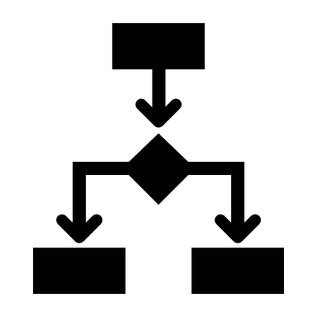


Collect Data and Conduct Ongoing Evaluation
Continuous Quality Improvement
Performance Monitoring
Outcome Evaluation
Fidelity monitoring

Slide 51

Secure Funding
Monetary funding
Nonmonetary funding
5-year funding plan

Slide 52

Garner Community Support
Local Government Officials
News Media
Community Organizations

Slide 53

Plan for Success
Transition the planning team to an operational team and steering committee
Create a legacy

Slide 54
Panel
Karla Broten, Youth and Families Program Manager, Barron County
Laura Doebereiner, Lead CPS Worker, Barron County
Kendra Schiffman, Senior Analyst, Rock County
Elizabeth Pohlman McQuillen, Justice System Strategist, Rock County
Notes:
Key decision 5: How will you sustain your FTC?
Share some strategies you’ve used to sustain your FTC
Rock County:
Data/Evaluation
Needs structure/commitment from the team to use on a regular basis for a specific purpose
Can be hard to get the team to engage
Be data-informed
FTC BPS drive measures
Deciding on the definition of success – and then defining measures based on this;
Offer data materials/examples
Longer meetings on a quarterly basis
What are we doing and why – focus on program processes
Other successful treatment courts
Still getting footing with CPS/treatment footing
Commitment to be successful – gaining support from partners
Grant to help you, wont sustain you
Positions in Rock are sustained
Coordinator – initially grant funded, sustained through county funds
Barron County:
Funding
Grant – Coordinator
How do we do this absent grant money?
Out of home care budget going down
Opioid dollars
1-2 times per year talking about FRC – Human services committee meetings – data
Mayo hometown health grant – family activities
Time commitment – steering committee, other time commitments
Annual Workshop
Previously called Retreat – now workshop
Review data, Activity – SWOT, reflect on program; recovery coaches participate to bring in consumer voice
SWOT – Laura was a Threat with data
Survey for participants – every 3 months
Annual survey of partners prior to annual meeting
Running it – be humble – goal may not be end result; opportunity for shared conversation
Goal – others to run the meeting or have other team ownership
Thank you Panel!
Now it is time for Q & A

Slide 55
Panel Questions
Describe your orientation/onboarding plan for new team members.
What ongoing training does your team participate in?
Describe your data and ongoing evaluation processes.
  Do you review data on a monthly, quarterly, or annual basis?
  Share any examples of data-informed decision-making.
  Describe any outcome evaluation results demonstrating FTC’s effectiveness.
  Does the team participate in any type of SWOT analysis?
Describe the funding sources for your FTC.
What strategies have you used to engage local officials, the media, or the community in supporting your FTC?
Describe the process of transitioning your planning team to an operational team and steering committee.

Slide 56

Q&A and Discussion
What questions do you have?
What takeaways do you want to share?
What next steps have you identified?
NADCP 2019 | All Rise | Better Together
Notes:
What questions do you have?
What takeaways do you want to share?
What next steps have you identified?
Mentimeter:
Which key decision point are you at?

Slide 57
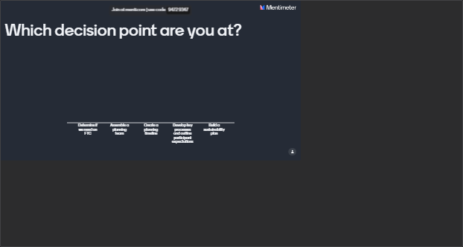
Notes:
Share about how to join the session;
Answer questions at your own pace
I will prompt you on when to answer the questions; however, if you are an overachiever and want to skip ahead, you are welcome to do so; some questions may not make sense until we get there;
Option for Q & A
Submit questions here throughout the presentation; will take them as time allows and/or at the end of the presentation during the Q & A Portion
Which key decision point are you at?
What are your next steps following today’s session?

Slide 58

Key Takeaways
The power of an FTC lies in its collaborative, family-centered, multidisciplinary approach
FTC team members must have foundational knowledge
across systems
Sustainable FTCs maintain a
governance structure
Notes:
Animated with graying out for contrast

Slide 59
Key Takeaways
A strong FTC foundation is built on a collaborative vision and mission
FTCs support families in successfully achieving safety, permanency, well-being,
and recovery
Cross-system outcome measures are essential for effective
FTC collaboration
Notes:
Animated with graying out for contrast

Slide 60

Call to Action
Determine if you need a family treatment court
Assemble a planning team and conduct
a kickoff meeting
Create a planning timeline and hold
each other accountable
Develop key processes and outline
participant expectations
Build a sustainability plan for your FTC
Notes:
Mentimeter:
What are your next steps following today’s session?

Slide 61
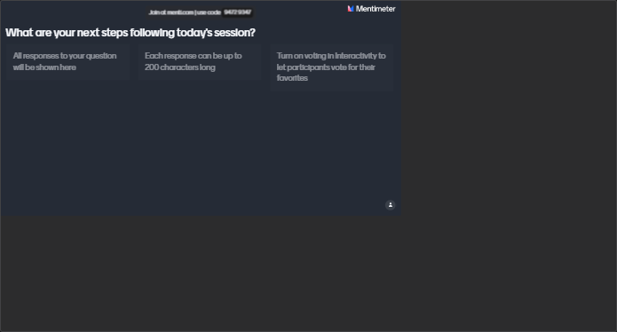
Notes:
Panelists, in 1-2 sentences, what advice would you give practitioners who want to start an FTC?
Karla
Laura
Elizabeth
Kendra

Slide 62

Do the best you can until you know better.
Then when you know better, do better.
Maya Angelou
Notes:
FTCs are the way to serving families better!

Slide 63

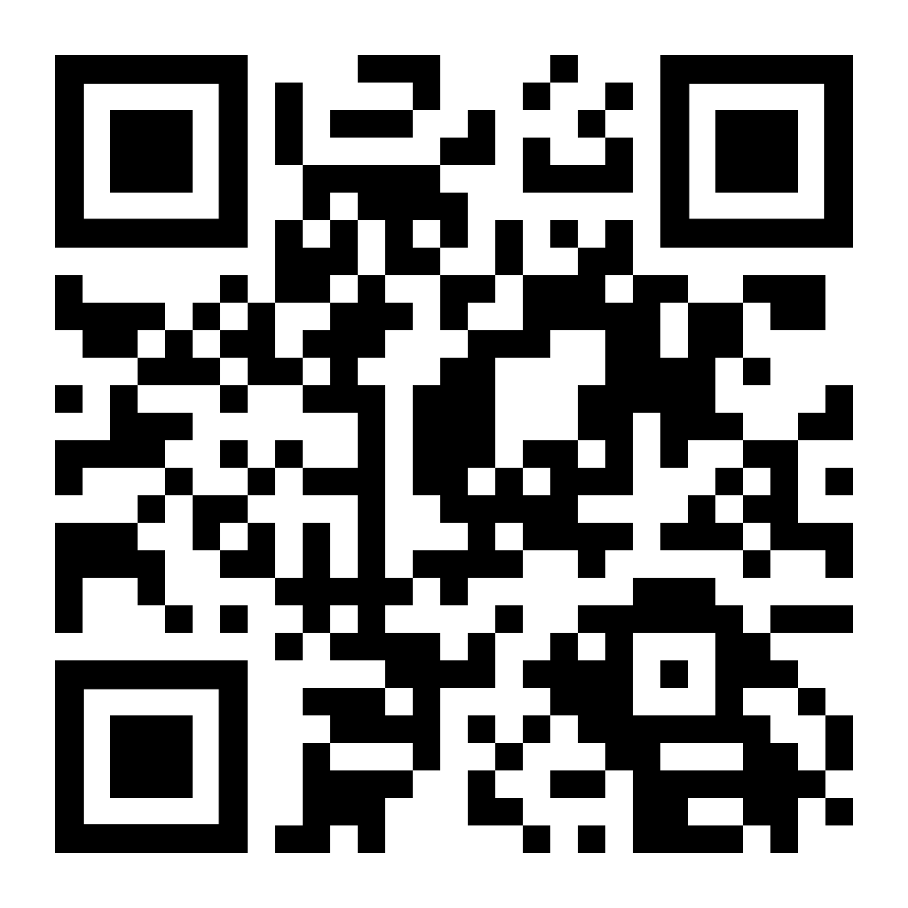
Wisconsin
Family Treatment Court
Community of Practice
Notes:
You do not have to be an operational FTC to join the CoP! If you are considering starting and want to learn more from your peers, you are welcome to join!
1 hour meetings on 4th Wednesday
Remaining 2024 meeting dates:
June 26
Aug 28
Oct 23
Have a flyer available if you are interested in that

Slide 64



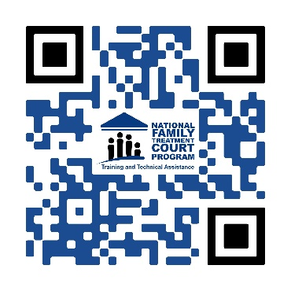
Join Our
CCFF listserv
https://www.cffutures.org/membership-join/newsletter/
Visit Our ​
Website ​
http://www.cffutures.org ​
Join Our FTC TTA
Program listserv
Email us: FTC@cffutures.org
Notes:
To stay up to date on the latest events and resources, join our listserv or visit our website

Slide 65
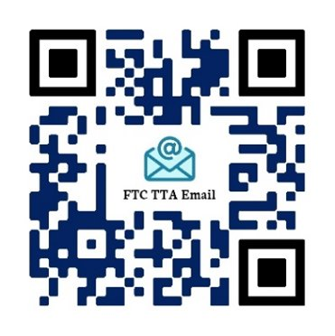
Contact Us
Center for Children and Family Futures
National FTC TTA Program
www.cffutures.org
FTC@cffutures.org
Notes:
If you are interested in any materials or resources discussed today feel free to stop by and I’ll make sure we connect to get them in your hands! Thanks for participating in the session!

Slide 66
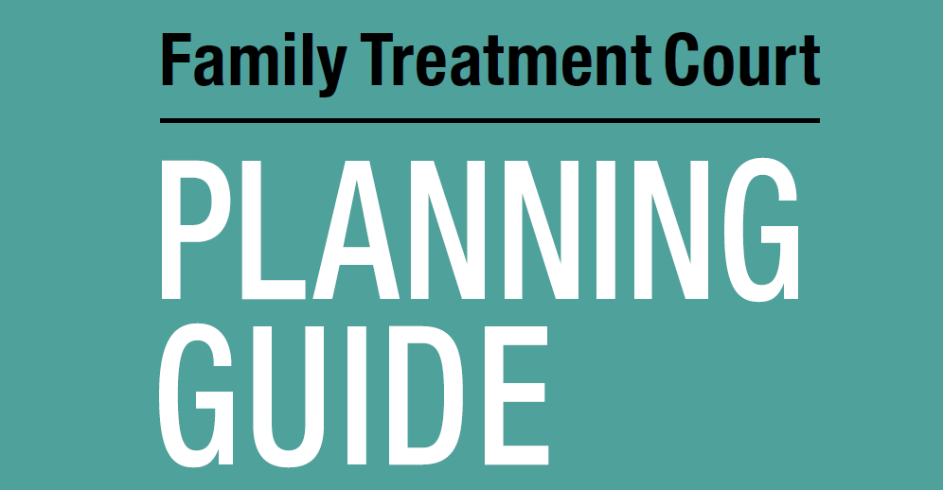
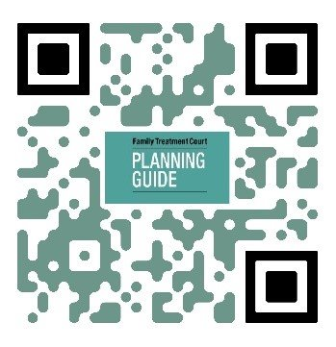
Designed to provide step-by-step instructions for a team planning to start and implement an FTC in their community
Includes worksheets with concrete steps to support teams in meeting their implementation and enhancement goals
www.cffutures.org/fdc-tta/planning-guide-2018/

Slide 67
Helpful Worksheets
Worksheet | Topic:
#2 | Gathering Relevant Data
#3 | Community Resource Mapping
#4 | Planning, Steering, and Operational Teams
#5 | Visiting a Family Treatment Court
#8 | Vision, Mission, Goals, and Objectives
#10 | Structural Program Design, Target Population, and Eligibility Criteria

Slide 68
Helpful Worksheets
Worksheet | Topic:
#12 | FTC Entry Process
#13 | Developing Your FTC Phase Structure
#14 | Comprehensive Service Delivery for Parents, Children, and Families
#16 | Responding to Behavior
#17 | Graduation/Termination from the Program
#18 | Monetary and Nonmonetary Funding

Slide 69


2018 – Better Together
Ready, Set, Go! 5 Key Planning Decisions to Help You Successfully Launch Your Family Treatment Court
Identify key decision and planning points for all FTCs
Explore the importance of governance structure, leadership, and data during the planning process
Learn from the experience of FTC teams that have successfully planned and launched an FTC
www.cffutures.org/ftc-practice-academy/

Slide 70


8 Best Practice Standards
https://www.cffutures.org/home-page/ftc-best-practice-standards-2019/

Slide 71
Family Treatment Court
Best Practice Standards
Training Videos
Team Discussion Guide
Action Plan Template
FTC BPS Toolkit
Contact us to access these materials!
ftc@cffutures.org

Slide 72

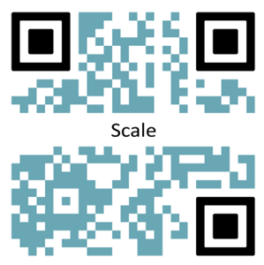
2023 – Building Strong Futures
Increasing FTC Capacity and Scale
Summarize why FTC teams must understand their capacity and scale
Calculate the FTC’s scale and how it relates to the overall community’s need
Adopt strategies to close the gap between the FTC’s enrollment and the community’s need
www.cffutures.org/ftc-practice-academy/

Slide 73

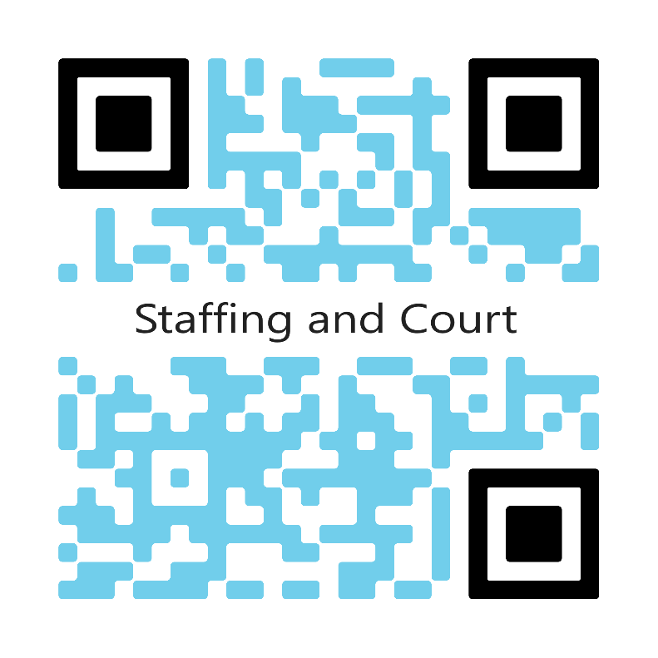
2021—Putting the Pieces Together
Applying a Family-Centered, Problem-Solving Approach to Staffing and Court Hearings
Learn how staffing and court hearings shape the path for families working toward reunification and successful case closure
Learn how to use staffing and court to address the family’s needs
Examine strategies to shift from “problem reporting” to “problem solving” in pre-court staffing
www.cffutures.org/ftc-practice-academy/

Slide 74

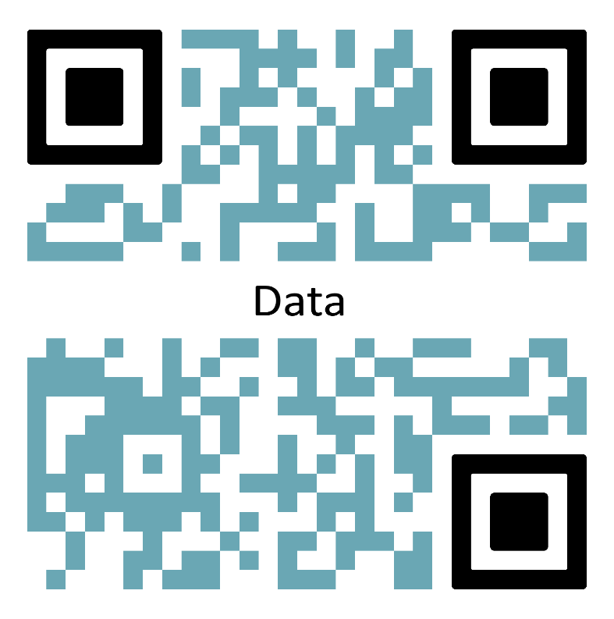
2022—Beyond Collaboration to Results
Beyond Counting: Strategies to Collect and (Actually) Use Your FTC Data
Explore five foundational steps to use your FTC data
Learn how data-driven decision making improves outcomes for families
Design a data dashboard that meets your FTC’s performance monitoring needs
www.cffutures.org/ftc-practice-academy/

Slide 75

Harnessing the Power of Family Treatment Courts
Brief 2: Using Data as a Tool For Change
Opportunities to use data
Strategies for FTC teams to integrate monitoring and evaluation activities as core program operations
Practical considerations with a focus on equity and inclusion
Visit website:
https://www.cffutures.org/publication/harnessing-the-power-of-ftcs/

Slide 76

Harnessing the Power of Family Treatment Courts
Brief 1: Funding and Sustaining Crucial Services for Families
The importance of family-centered services
How the intersection of relationships, resources and results are foundational to securing resources
Practical considerations and strategies to fund and sustain FTCs
Visit website:
https://www.cffutures.org/publication/harnessing-the-power-of-ftcs/

Slide 77

Data Capacity:
What Is It and Does Our Family Treatment Court Have It?
Putting Ideas Into Action – Knowledge Application Series | 2021
Assess cross-systems data capacity
Use data to improve programs
Communicate successes to various audiences
Visit website:
https://www.cffutures.org/pfr/round-2-prevention-and-family-recovery-knowledge-application-series/

Slide 78



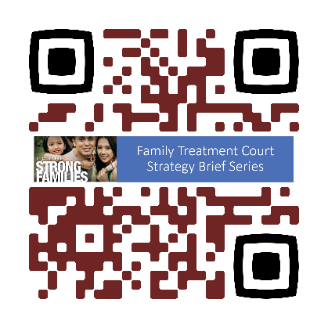

Family Treatment Court Strategy Brief Series
Brief 1: What are Family Treatment Courts and how do they improve outcomes for families?
Brief 2: What can we learn from Family Treatment Courts about improving practice for families affected by substance use disorder?
Brief 3: What can we learn from Family Treatment Courts to support systems change?
Website: https://www.cffutures.org/publication/ftc-strategy-brief-series-strong-families/

Slide 79


Conveying Your Message
Strategies for Promoting Your Program
Conveying the message of your program is an essential part of sustainability and growth. The story you tell needs to convey the value of your program to the families you serve, community stakeholders, and policy makers in a way that justifies resources and inspires change. Check out these resources!
  Webinar
  TA tool
  One-pager marketing template
  Sample Slide Deck
Website: https://www.cffutures.org/qic-main-page/qic-conveying-your-message/

Slide 80






Sustainability Toolkit
Five Steps to Build a Sustainability Plan For Systems Change
  Available @ https://ncsacw.acf.hhs.gov/collaborative/budgeting-program-sustainability.aspx

Slide 81
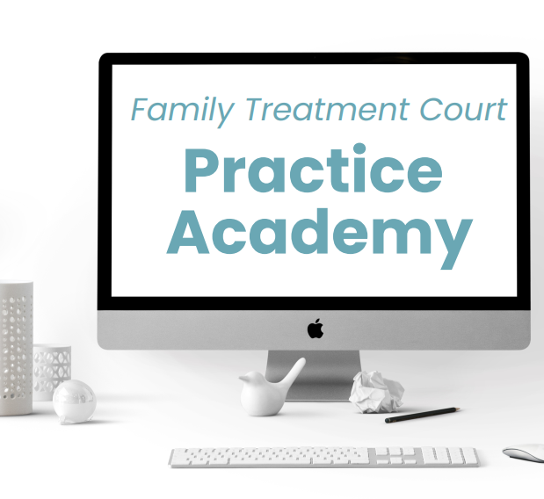





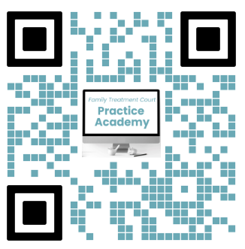


Launched in 2010
Web-based training courses at no cost
Relevant and emergent issues to the FTC field
Flexible courses for teams or individuals
Access live or whenever there is a need!
Access full course library at
www.cffutures.org/ftc-practice-academy!

Slide 82
References
Center for Children and Family Futures. (2023). Analyses of the 2021 Adoption and Foster Care Analysis and Reporting System (file number 274) [Data set]. National Data Archive on Child Abuse and Neglect. https://www.ndacan.acf.hhs.gov/
Center for Children and Family Futures and National Association of Drug Court Professionals. (2019). Family treatment court best practice standards. Supported by Grant #2016-DC-BX-K003 awarded by the Office of Juvenile Justice and Delinquency Prevention, Office of Justice Programs, U.S. Department of Justice. https://www.cffutures.org/files/OJJDP/FDCTTA/FTC_Standards.pdf
Ghertner, R. (2022). US Department of Health and Human Services. National and State Estimates of Children with Parents Using Substances, 2015-2019 (Issue Brief 27). Office of the Assistant Secretary for Planning and Evaluation. https://aspe.hhs.gov/sites/default/files/documents/f34eb24c1aff645bed0a6e978c0b4d16/children-at-risk-of-sud.pdf
National Drug Court Institute and Center for Children and Family Futures. (2018). Family treatment court planning guide. Supported by Grant #2016-DC-BX-K003 awarded by the Office of Juvenile Justice and Delinquency Prevention, Office of Justice Programs, U.S. Department of Justice. https://www.ndci.org/wp-content/uploads/2018/03/18803_NDCI_Planning_v7.pdf

