Slide 1
Treatment Court transgender training
The whats, hows and whys of interacting with this population
Jessica M. Polacek
PCPs: she/her/hers

Slide 2
Ground Rules
This is a safe, judgment-free space intended for education
Your presence here implies a desire to learn, understand, and better serve your communities
No question is off-limits so long as it is done in the spirit of knowledge and with an intent of better comprehending the material
Experiences shared are solely my own. Everybody’s history is different.

Slide 3
Identities overview – Why are they so important?
They define our surroundings
They help us understand our place in relationship to our environment
Mother
Father
Child
Judge, Attorney,
Counselor,
Administrator

Slide 4
Identities Overview - Definitions
Basic Concepts
Gender identity – a person’s inner sense of being, usually developed at a young age and expressed as male or female
Gender expression - the way in which a person outwardly displays gender identity, typically through their appearance, dress, and behavior
Sexual orientation - an inherent or immutable enduring emotional, romantic or sexual attraction to other people
Common usage
Lesbian and Gay Community
LGBT or LGBTQ
LGBTQQIAAP…

Slide 5
Identities Overview - Sexuality
Gay
Lesbian
Bisexual
Pansexual
Asexual
Queer
Questioning
Same Gender Loving (SGL) – academic term
(see handouts)

Slide 6
Identities Overview – Gender Concepts
Gender Binary – the idea that gender exists solely as male/female (generally reinforced through cultural conditioning)
question asked when a woman announces her pregnancy
clothing colors and designs, toy marketing, bathroom usage
Gender Spectrum – gender conceived as a linear model with extremes of100% man to 100% woman and various states of androgyny between
Gender Matrix or Continuum - a multidimensional extension of the gender spectrum that includes additional gender identities outside of the spectrum

Slide 7
Identities Overview – Gender Concepts

Slide 8
Identities Overview – Transgender or Trans*
Definition - An umbrella term for people whose gender identity differs from what is typically associated with the sex they were assigned at birth and/or whose gender expression exists outside stereotypical societal norms
Relating to medical transition
Transsexual
Trans Man (Trans-masculine)
Trans Women (Trans-feminine)
Non-Traditional Identities
Genderqueer
Gender Fluid
Gender Bending
Gender Non-conforming
Genderless/Agender
Cross Dresser
Two Spirit

Slide 9
Identities Overview – Intersex
Definition - General term for a variety of conditions in which a person is born with reproductive or sexual anatomy that doesn’t align with conventional expectations of either male or female
Manifestations of the condition vary between individuals
Why is it included in the LGBTQ community?
Similar misunderstanding, discrimination and marginalization
Medical treatments like those for transsexual patients
Falls within the larger scope of personal identity

Slide 10
Pronouns
Male Gender Identity Pronouns – He/His/Him
Female Gender Identity Pronouns – She/Her/Hers
Non-Conforming Pronouns:
They/Them/Their/Theirs
Ze/Zir/Zir
Ze or Xe/Hir/Hirs
Usage Example: _____ is going to watch the game on Sunday.
Usage Example: This soda isn’t mine, it’s ______.
How would you ask someone about their pronoun usage?

Slide 11
Transitioning
Medical transition - the process of permanently aligning one's physical gender presentation in accord with their internal sense of gender through hormonal and surgical means
Must typically follow strict guidelines
Can take many years to accomplish
Differing degrees
Implications
Body parts do NOT determine gender
Careful consideration must be given to confinement
Search procedures should be according to stated gender
Daily prescribed medications

Slide 12
Transitioning
Legal transition - the process of updating all personal documentation to reflect true gender identity
Starts with legal name change
Must typically follow strict guidelines
Varies from state to state
Can create problems with disclosure of trans status
Examples
Birth certificate
Drivers license/State ID
Passport
Social Security
Military, school, financial, wills…

Slide 13
Unique needs of Trans People
Physical
Safety
Proper lock up population
Constant monitoring
Medical
Access to transition medications
Access to healthcare professionals
Emotional
RESPECT – name and pronoun use
Medical
Access to psych meds
Access to mental health professionals

Slide 14
Gender, Sexuality and Society
The Impact of Language
Think about the times you hear the words “GAY” or “TRANNY”
How are some of the ways you hear these words used?
Frequency?
Implied meaning?
Can you imagine…

Slide 15
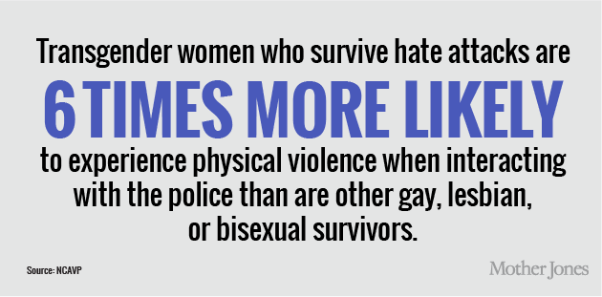
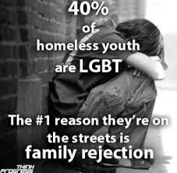
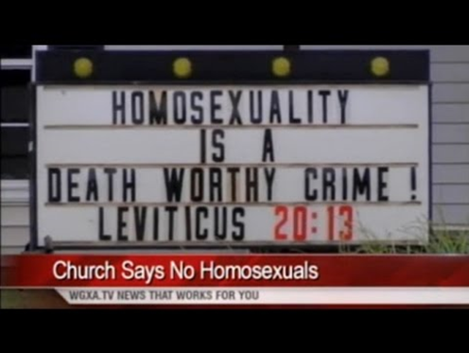
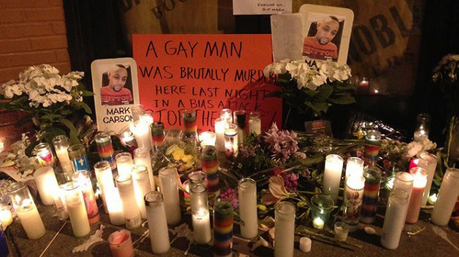
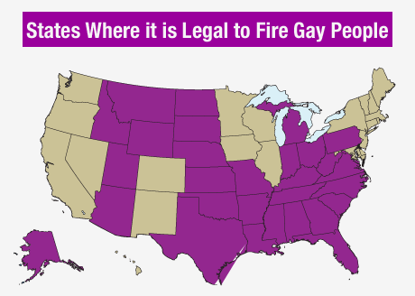
Gender, Sexuality and Society
Cultural Messaging

Slide 16
Gender, Sexuality and Society
Mental and Emotional Impact
Anxiety (33.2%)
Depression (44.1%)
Somatization (27.5%)
Causes
Societal stigma
Violence/Harassment
Employment/housing concerns
Loss of family, friends and support circle
Financial stressors associated with transition

Slide 17
ORIGINS OF LGBTQ DISCRIMINATION A condensed history
Sexism - prejudice or discrimination based on sex
Women viewed as property and “lesser” beings
Last to receive voting rights
African Americans – 14th and 15th Amendments (1868 and 1870)
Women – 19th Amendment (1920)
Financial “captivity” - Equal Credit Opportunity Act 1975
Repeal of Roe v. Wade 2023
Misogyny - hatred of, aversion to, or prejudice against women
Men are the superior gender
Women are incapable of…
Still no Equal Rights Amendment

Slide 18
ORIGINS OF LGBTQ DISCRIMINATION How it translates
Transgender people are going against “natural law”
Transgender women are choosing to:
Become the lesser sex/give up male privilege
“Castrate” themselves
Invade female only spaces
Transgender people are defective and deserve:
Punishment
Institutionalization
Death

Slide 19
Law enforcement and the trans experience
Assumptions (transgender people are)
Sex workers
Drug users
Mentally ill
HIV/AIDS positive
Marginalization
This is a small population – why worry?
Perverts and freaks who deserve what they get

Slide 20
Law enforcement and the trans experience
Harassment/Victimization
3.7x more likely to experience police violence
Race increases this likelihood to 6x more likely
Misidentifying/Misreporting
Skews statistical data
Creates potential for harm by others in custody
Establishes barriers to cooperation
Exacerbates anxiety and other mental health issues
External reporting multiplies all these issues (i.e. newspaper legal section)

Slide 21
Legal Rights of Trans Individuals
HIPAA
Being transgender is a medical condition
HIPAA protects from disclosure of documented health information
“Hate Laws”
Civil Rights Act of 1968 - permits federal prosecution of anyone who "willingly injures, intimidates or interferes with another person, or attempts to do so, by force because of the other person's race, color, religion or national origin“
Violent Crime Control and Law Enforcement Act (1994) - increases penalties for hate crimes committed on the basis of the actual or perceived race, color, religion, national origin, ethnicity, or gender of any person
Matthew Shepard and James Byrd, Jr. Hate Crimes Prevention Act (2009) - expanded existing United States federal hate crime law to apply to crimes motivated by a victim's actual or perceived gender, sexual orientation, gender identity, or disability, and dropped the prerequisite that the victim be engaging in a federally protected activity

Slide 22
Legal Rights of Trans Individuals
Title IX - prohibits sex-based discrimination in schools and other education programs that receive federal funding. Given that the vast majority of schools receive some form of federal funding, Title IX's reach is wide. Although many people associate Title IX with college and high school athletic programs, the law applies to participation in other extracurricular activities such as school bands and clubs, and it protects students from sex-based discrimination in general.
Due Process
Found in 5th and 14th Amendments to the US Constitution
Deals with the administration of justice and thus the due process clause acts as a safeguard from arbitrary denial of life, liberty, or property by the Government outside the sanction of law
Ensures the rights and equality of all citizens

Slide 23
Legal Rights of Trans Individuals
Coffin vs United States (1895) - an appellate case before the United States Supreme Court which established the presumption of innocence of persons accused of crimes
State Laws - California, Colorado, Connecticut, Delaware, Hawaii, Illinois, Iowa, Maine, Maryland, Massachusetts, Minnesota, Nevada, New Jersey, New Mexico, Oregon, Rhode Island, Vermont, Washington, and the District of Columbia
Varies by state
Clarifies transgender as a protected legal status
Common Sense

Slide 24
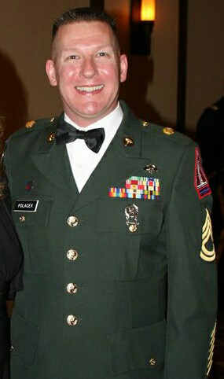
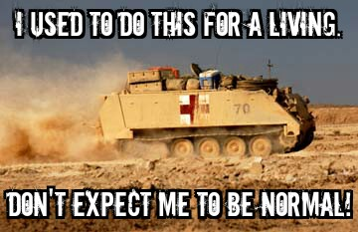
The Good, The Bad and the Ugly – a personal narrative

Slide 25
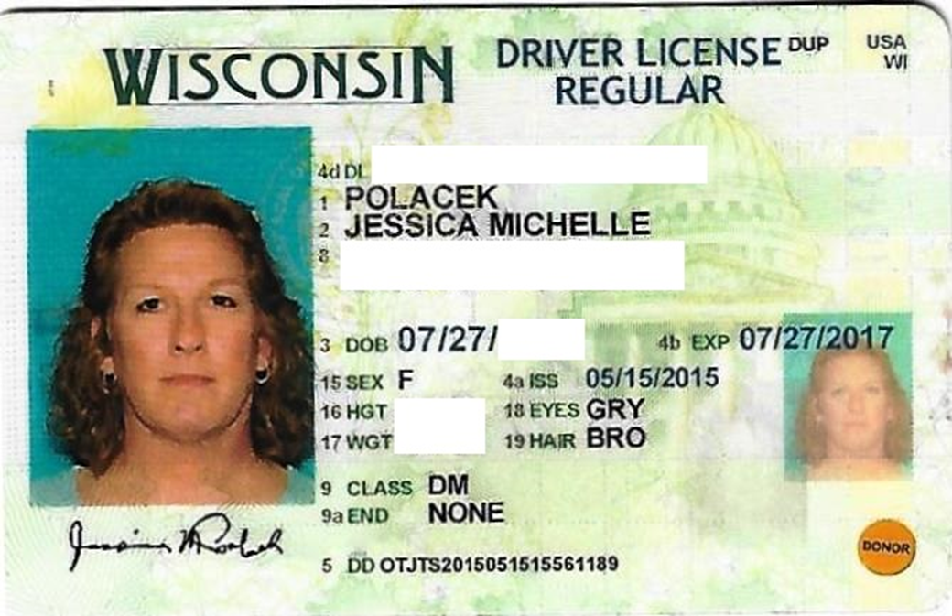
The Good, The Bad and the Ugly – a personal narrative

Slide 26
What the Future Holds
Bathroom Bills
More calls to public facilities for transgender criminal trespassing
Increased physical violence against both trans and cis-gender citizens
Misidentification of persons based solely on appearance
Legal Transition
Birth certificates are a primary challenge
Passports will also create difficulties for trans people
TSA
Body scanners
Pat downs
Sports
Increased annual homicide statistics

Slide 27
Resources
FAIR WISCONSIN
122 East Olin Avenue, Suite 100
Madison, Wisconsin 53713
608.441.0143
https://fairwisconsin.com/our-work/
https://www.niot.org/project/resources-law-enforcement-engage-transgender-community
https://www.youtube.com/watch?v=gfGPx4xJHvM&t=331s
https://leb.fbi.gov/2015/june/law-enforcement-and-transgender-communities
http://www.policemag.com/blog/training/story/2013/01/dealing-with-transgender-subjects.aspx
https://www.americanbar.org/groups/criminal_justice/publications/criminal-justice-magazine/2024/winter/crisis-behind-bars-legal-issues-impacting-transgender-people-prisons/
https://www.justice.gov/crs/our-work/training/engaging-building-relationships-with-transgender-community
http://www.inquiriesjournal.com/articles/1753/the-criminal-justice-systems-mistreatment-of-transgender-individuals-a-call-for-policy-reform-to-assist-a-marginalized-prisoner-community
https://www.lgbtbarwis.org/about

