Slide 1
Best Practice Standards and Resource Development in Rural Treatment Courts
Wisconsin Association of
Treatment Court Professionals
2024 Conference
April 24-26, 2024
Norma D. Jaeger Ph.D. (ABD)
20th Anniversary
Notes:
This template can be used as a starter file for presenting training materials in a group setting.
Sections
Right-click on a slide to add sections. Sections can help to organize your slides or facilitate collaboration between multiple authors.
Notes
Use the Notes section for delivery notes or to provide additional details for the audience. View these notes in Presentation View during your presentation.
Keep in mind the font size (important for accessibility, visibility, videotaping, and online production)
Coordinated colors
Pay particular attention to the graphs, charts, and text boxes.
Consider that attendees will print in black and white or grayscale. Run a test print to make sure your colors work when printed in pure black and white and grayscale.
Graphics, tables, and graphs
Keep it simple: If possible, use consistent, non-distracting styles and colors.
Label all graphs and tables.

Slide 2
Ten Key Components What We Do

Slide 3
Ten Key Components (Summarized)
Integration of criminal justice and treatment
Non-adversarial approach
Early identification and quick acceptance
A continuum of treatment
Random, observed, frequent drug testing

Slide 4
Ten Key Components - continued
Coordination of responses to compliance
Ongoing judicial interaction
Monitoring and evaluation of effectiveness
Continuing interdisciplinary education
Forging partnerships

Slide 5
Best Practice Standards, Second Edition How we do it

Slide 6
Overview
Adult Treatment Court Best Practice Standards are based on a comprehensive body of research
Much of the research comes directly from evaluations of adult drug courts
Research and evaluation of other treatment court types have confirmed many earlier drug court findings
Additional findings come from other behavioral science or criminal justice research
The research is not distinguished by urban vs. rural
Rural treatment courts have advantages and disadvantages
Notes:
Give a brief overview of the presentation. Describe the major focus of the presentation and why it is important.
Introduce each of the major topics.
To provide a road map for the audience, you can repeat this Overview slide throughout the presentation, highlighting the particular topic you will discuss next.

Slide 7
Rural Treatment Courts: Advantages / Disadvantages
Closer working relationships
Greater team stability
Greater likelihood of knowing of available resources and more creativity
Grant resources offer better scale
Access to local media
Fewer treatment options available locally
Personal and familial relationships
More limited recovery and mutual self-help resources
Dependent on fewer leaders and team members
Limited transportation and housing
Stigma

Slide 8
Adult Treatment Court Best Practice Standards Vol 1, Second Edition
https://allrise.org/wp-content/uploads/2023/12/All-Rise-Adult-Treatment-Court-Best-Practice-Standards-2nd-Ed.-I-VI_final.pdf
Go to All Rise: Best Practice Standards

Slide 9
Some updates include:
High need has been broadened beyond addiction for application to other treatment courts
Equity and Inclusion considers removing eligibility restrictions, proactive outreach, providing culturally proficient treatments and complementary services
Hearing frequency has been adjusted and procedural fairness principles are detailed for judges
Strategies for addressing proximal and distal goals, advice on use of jail and on low cost incentives, and an example of phase structure with advancement criteria is provided
Role of psychiatric and addiction medications and of recovery management interventions
Recovery capital as well as health risk prevention measures are addressed.

Slide 10
Adult Treatment Court Best Practice Standards – A Rural Perspective Volume I (Second Edition)
Target Population
Equity and Inclusion
Roles and Responsibilities of the Judge
Incentives, Sanctions, and Service Adjustments
Substance Use, Mental Health, and Trauma Treatment and Recovery Management
Complementary Services and Recovery Capital

Slide 11
Adult Treatment Court Best Practice Standards – A Rural Perspective Volume II (coming soon)
Stay Tuned

Slide 12
Overall Application / Considerations
All of the “Standards” now apply to all adult treatment courts
No previous standards were repealed
Rural applications require creativity in adaptation and emphasis
Risk / Need / Responsivity Model (RNR) principles remain foundational principles
Co-occurring mental and substance use disorders are the expectation not the exception
High risk/ High need remains the recommended target population for which the standards have been found most effective
Juvenile and Family Drug Courts require separate consideration and have separate guideline resources

Slide 13
High-risk / High-need: What does this really mean?
High-risk refers to the level of probability that an individual will reoffend or will be unsuccessful on standard probation (criminogenic risk)
“Risk” does not refer to dangerousness or risk of violence
High-need refers to an individual having a competently diagnosed disorder that requires significant clinical intervention (high need = need for treatment)
Mixing risk groups remains a particular threat to recidivism for the low risk individual
Low risk individuals require significant changes to the court procedures and practices (separate from high risk)
Serving multiple risk levels requires “separate tracks” with different elements

Slide 14
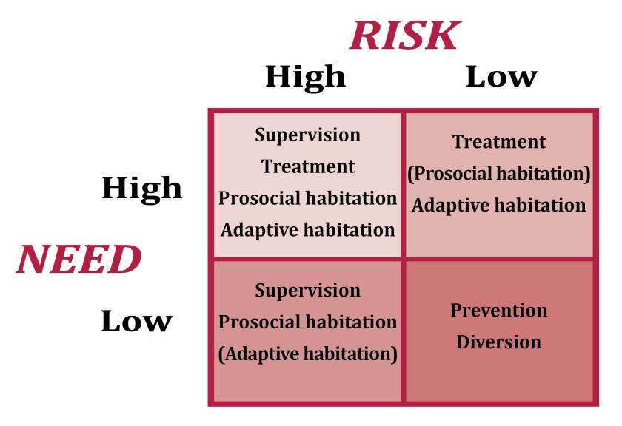
Quadrant Model = 4 Tracks

Slide 15
How to do tracks when you think you can’t do tracks
Alternate weeks
15 minute break between track calendars
Recognize different structure for different tracks
High risk / High need vs
Low risk / High need
Separate participants with different levels
Intensive intervention for low risk individuals can do harm and increase recidivism

Slide 16
Addressing Specific Rural Resources

Slide 17
Identify and Expand Pro-social Resources
Resource development committee (formerly often called “steering committee”)
White board – Community activity board
Community mapping exercise
Connect with your recovery community
Check with findhelp.org (Once known as Aunt Bertha)

Slide 18
www.findhelp.org
Search for free or reduced cost services like medical care, food, job training, and more.

Slide 19
To have a partner / Be a partner
Seek out community efforts that relate to the resources participants need
Join community service coordinating bodies
Leverage other community partnerships
Collaborate on grants
Develop and host a networking “breakfast”
Organize a military legal alliance (for Veterans court or if other treatment court has veterans

Slide 20
Mock Drug Court Staffing
Participants take on roles of team members, staff a group of cases and plan responses (incentives and sanctions, complementary services, recovery management activities)

Slide 21
Guide to improving health for rural residents – Access to current resources and tools

Slide 22
Attend the National Rural Institute on Alcohol, Drugs, and Addictions - June 9-13, 2024 Menomonie Wisconsin UW-Stout
National Rural Institute on Alcohol, Drugs and Addictions: June 9-13, 2024
The annual Conference and Meeting of NRADAN, Inc Training for Addiction Prevention, Treatment, and Recovery Professionals
Institute RegistraNational Rural Institute on Alcohol, Drugs and Addictions: June 9-13, 2024
: June 9-13, 2024
The annual Conference and Meeting of NRADAN, Inc Training for Addiction Prevention, Treatment, and Recovery Professionals
Institute Registration
The 2024 annual Institute The Rural," scheduled for June 9 - 13, 2024, will be a hybrid event. We will be hosted at the University of Wisconsin-Stout in Menomonie, Wisconsin. For the convenience of those unable to participate in person, we are offering both real-time and on-demand virtual alternatives. Attendees of The Rural can earn 2.4 Continuing Education Units (CEUs) through their participation in the in-person event. Additionally, they have the opportunity to access recorded content at their convenience.
al Institute The Rural," scheduled for June 9 - 13, 2024, will be a hybrid event. We will be hosted at the University of Wisconsin-Stout in Menomonie, Wisconsin. For the convenience of those unable to participate in person, we are offering both real-time and on-demand virtual alternatives. Attendees of The Rural can
n 2.4 Continuing Education Units (CEUs) through their participation in the in-person event. Additionally, they have the opportunity to access recorded content at their convenience.
To register for The Rural, visit NRADAN.org/the-rural. Clicking "Apply" or "Register" on this page will register you for classes at UW-Stout.
Information about the HYBRID 2024 Institute can be found at NRADAN.org

Slide 23
Great Lakes Addiction Technology Transfer Center
https://attcnetwork.org/center/great-lakes-attc/
Comprehensive site with wide variety of educational resources dealing with addiction, treatment, recovery management
Technical assistance resources available

Slide 24
Extension Institute of Health & Well-Being = Green County Extension
Bridget Mouchon
Extension Green County Health & Well- Being Educator
608-328-9440 blmouchon@wisc.edu
Catalyze positive change in Wisconsin families through evidence-based programs focused on nutrition, food security and safety, chronic disease prevention, mental health promotion, prevention of substance abuse and health insurance literacy.

Slide 25
Overdose Prevention – Response Toolkit - SAMHSA
Store.samhsa.gov/product/overdose-prevention-response-toolkit/pep23-03-00-001
A downloadable toolkit, designed to augment overdose prevention and reversal training. It provides guidance on the role of opioid overdose reversal medications, including naloxone and nalmefene, and how to respond to an overdose. It also contains appendices for specific audiences, including people who use drugs (PWUD), people who take prescription opioids, first responders, healthcare practitioners, and others.

Slide 26
Housing Resources – Rural Housing Experts
United States Department of Agriculture – Rural Development
Midwest Region: Eric Siebens, Reg.Director MFHFODMidwest@usda.gov IA, IL, IN, KS, MI, MN, MO, ND, NE, OH, SD, WI
MultifamilyHousing@usda.gov
Technical Assistance , Multi-family Home Loans, Community Organization support

Slide 27
Collaborate with Tribes
Tribal Court Clearinghouse
Project of the Tribal Law and Policy Institute
http://www.tribal-institute.org/index.htm
Share training resources
Share information on services
Tribal Healing to Wellness Courts
https://www.tribal-institute.org/lists/drug_court.htm

Slide 28
Explore Technology
On line recovery support groups
Telehealth behavioral health treatment resources
Apps / Apps / Apps
Establish your own drug testing lab/ collaborate with others needing testing
Remote Alcohol Testing (monthly rate)
CheckBAC
Appoint a drug-testing “guru” – to explore myriad of technology options (All Rise Conference)

Slide 29
One County’s Testing Solution - CheckBAC
When a client is tested they will receive a text message stating that they must provide a sample. The client then opens up the "ChekcBAC" app on their phone and turns on their Bluetooth equipped breathalyzer and proceeds to hold up their phone, which uses the camera to record their face and the participant blowing into their device. The test results will be displayed to the participant, as well as recorded and sent to the online program used for monitoring. The BAC level, GPS location (in google maps) and the video and time stamp will all be recorded and saved for future reference.

Slide 30
Don’t forget the faith community
Faith community is a resource for support groups
Faith community is a resource for prosocial activities
Faith community can be a resource for addressing needs such as child and youth services, parenting classes, housing, transportation, food, and clothing

Slide 31
One community service model
Innovative practice
Non-profit agency managed community service
Individuals ordered to perform community were service allowed to “buy” up to one half of the ordered hours. Funds are paid to the nonprofit which in turn purchases “gift cards” donated to be used as behavioral rewards or to meet urgent needs of participants

Slide 32
Friends of the Treatment Court
Develop as a separate 501 (c) 3 organization
Can conduct fund raising
Can host prosocial activities
Could be a housing development resource
Can solicit donations
Can assist with public relations and public information

Slide 33
It is really all about relationships
Relationships with team members
Relationships with participants & graduates
Relationships with stakeholders
Relationships with partners
Relationships with service groups
Relationships with other agencies
Relationships with the recovery community
Relationships with the community (one at a time)

Slide 34
An Important Final Note
Secondary or vicarious trauma is a reality
Self-care is critical
Self-care is a personal responsibility
Self-care is a professional responsibility
Self-care is an ethical responsibility
You need a plan for self care and you need support

Slide 35
And, So:
Ten Key Components still matter – What We Do
Best Practice Standards now apply to all treatment courts – How We Do It
Rural treatment courts have advantages and disadvantages
There are a wide variety of resources available to enhance success for your participants
Partnerships are critical – To have a partner, be a partner
Self-care is important
AND, Remember, what you do matters!
Norma Jaeger / norma@recoveryidaho.org

