Slide 1
Alphabet Soup: Understanding Treatment Language, Reports & Phasing Up

Slide 2
Introductions
Krysti Deines, LPC, SAC
Eau Claire County DHS
Treatment Court Liaison
Kimeko Hagan, MS, CSAC, ICS
Executive Director
Options Treatment
Keri Fatzinger, CSAC, LCSW, ICS
Treatment Provider
Grant County OWI and Drug Courts

Slide 3
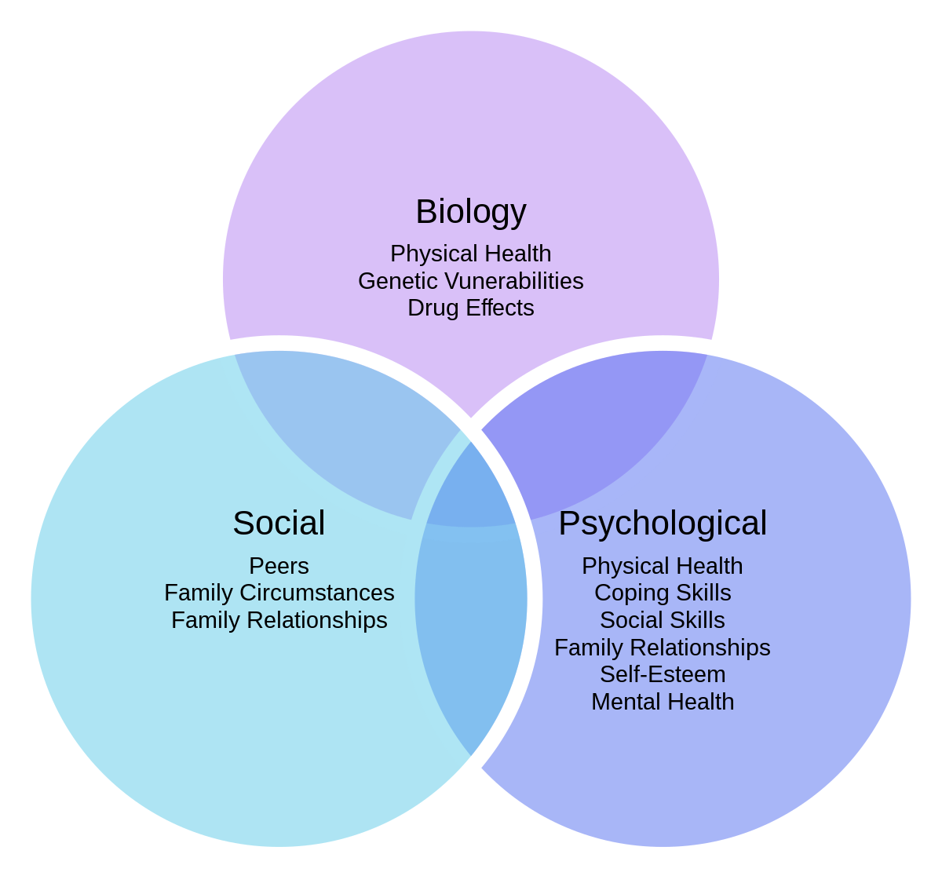
Treatment providers
Role on the team
Attend staffings and status hearings
Report on progress towards treatment goals
Conduct assessments
Determine appropriateness for treatment court
Determine level of care
Advocate for teams to refer to Evidenced Based Practices
Our training
Meet them where they’re at
Harm reduction
Biopsychosocial approach
All Rise Standard V, Section A
Notes:
Keri

Slide 4
Evidenced Based Practice
Behavioral therapy or cognitive behavioral therapy
Interventions are documented in treatment manuals
Treatment providers are trained to provide within fidelity
Adherence to the treatment is maintained
All Rise Standard V, Section E
Notes:
Keri

Slide 5
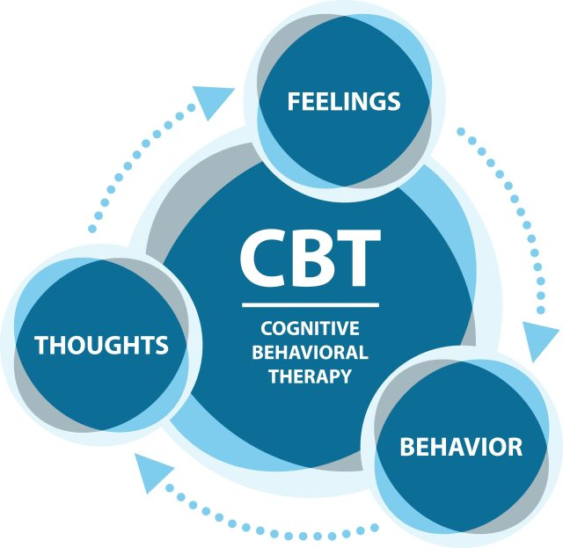
Cognitive Behavioral Therapy (CBT)
CBT is the basis to many treatment modalities
Interrupting this cycle helps lead to more prosocial behavior
All models we discuss today are CBT based
Notes:
Keri

Slide 6
Matrix
Elements of Matrix
The Matrix Model Intensive Outpatient Program is a treatment approach for substance use.
Treatment includes:
Relapse Prevention Group
Family Education Group
Early Recovery Skills Group
Social Support Group
Individual Counseling
Duration:
- 23 weeks
When should someone be referred
This program is where participants often start
If a participant returns to use while in the program, a return to a portion of Early Recovery Skills group is recommended
Participants should be encouraged to remain in Social Support post-graduation as long as it is mutually beneficial
Notes:
Krysti

Slide 7
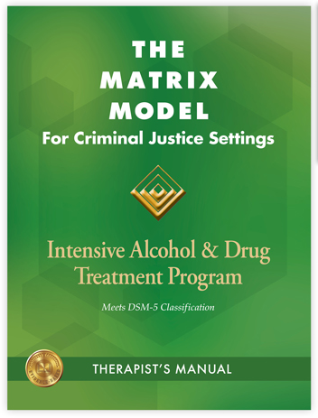
Matrix
When completed, participants should be able to:
Identify triggers
Identify coping skills
Identify warning signs of relapse
Identify and use sober supports
Notes:
Krysti

Slide 8
Moral Reconation Therapy
Summary of program:
MRT is a cognitive based group
Focus is to address criminal thinking and increase healthy decision making
Group should be gender specific
Duration:
- About 24 weeks
When to refer:
Early in the program
Consider schedules and clinical stability
Notes:
Krysti

Slide 9
MRT Steps
Participants will progress through
Honesty
Trust
Acceptance
Raising Awareness
Healing damaged relationships
Helping others
Long term goals and identity
Short term goals and consistency
Commitment to change
Maintain positive change
Keeping moral commitments
Choosing moral goals
Notes:
Krysti

Slide 10
CBI-SA: Cognitive Behavioral Interventions – Substance Abuse
CBI-SA is a curriculum designed for individuals who are moderate to high need in the area of substance use. The University of Cincinnati Corrections Institute (UCCI) developed the curriculum, it refers frequently to the legal effects of substance use and works well with those involved in the criminal justice system.
Notes:
Kimeko

Slide 11
CBI-SA
Elements of CBI-SA
Cognitive, social, emotional, and coping skills development
Duration:
- 39 Sessions
Focus:
Pre-Treatment
Motivational Engagement
Cognitive Restructuring
Emotional Regulation
Social Skills
Problem Solving
Success Planning
Notes:
Kimeko

Slide 12
CBI-SA
When should someone be referred
Moderate to High need on COMPAS
ASAM level of care
Notes:
Kimeko

Slide 13
CBI-SA
When completed, participants should be able to:
Tell you the components of a behavior chain and in the proper order
Share with you a variety of social skills and how they use them
Identify which emotion regulations skills they use most often and how to stack emotional regulation skills
State the components of problem solving and how they have used it when they have two conflicting wants
Tell you what makes up their Success Plan
At the end, participants should be able to identify a risky situation and be confident in navigating the situation to make a responsible decision
Notes:
Kimeko

Slide 14
Advance Practice - AP
Aftercare for CBI-SA
Notes:
Kimeko

Slide 15
AP
Purpose of AP:
Structured way to assist participants in practicing skills they learned in CBI-SA
Refer when:
Participants have completed all components of CBI-SA, including their success plan
Duration:
Average 6-12 weeks
Individualized based on participant need
Notes:
Kimeko

Slide 16
AP
Four levels of AP:
Graduated Practice
Skill Selection
Multiple Skill Use
Unguided Practice
When completed, participants should be able to:
Recognize and manage high risk situations on their own – within the community – with confidence and accuracy
Notes:
Kimeko

Slide 17
Thinking 4 Change
Elements of T4C
Gender specific group
90 minute groups
Duration:
26 sessions
Weekly or twice weekly depending on agency
Notes:
Kimeko

Slide 18
T4C
When should someone be referred
Someone struggles with antisocial thinking, antisocial personality disorder, or antisocial peers, and/or someone struggles with criminal thinking
When completed, participants should be able to:
See a risky criminal situation and know how to reduce or eliminate risks using skills they learned
Skills include thinking reports and social skills

Slide 19
Seeking Safety
Summary of program:
Present-focused coping skills group
Focuses on trauma and addiction
Group should be gender specific
Duration:
25 topics, generally done in a weekly group
When to refer:
Anytime! This group is stabilization focused
Considerations
Ability to attend/schedule
Sobriety
Notes:
Krysti

Slide 20
Seeking Safety Topics
Interpersonal topics:
Honesty, Asking for Help, Setting Boundaries in Relationships, Getting Others to Support Your Recovery, Healthy Relationships, Community Resources
Cognitive topics:
PTSD: Taking Back Your Power, Compassion, When Substances Control You, Creating Meaning, Discovery, Integrating the Split Self, Recovery Thinking
Behavioral topics:
Taking Good Care of Yourself, Commitment, Respecting Your Time, Coping with Triggers, Self-Nurturing, Red and Green Flags, Detaching from Emotional Pain (Grounding)
Combination topics:
Introduction/Case Management, Safety, Life Choices, Termination
Notes:
Krysti

Slide 21
Dialectical Behavioral Therapy Skills Group
Elements of DBT
Educational and skills based group
Modules
Mindfulness
Interpersonal Effectiveness
Emotion Regulation
Distress Tolerance
Duration:
About 34 weeks (8 months)
When should someone be referred:
Able to maintain some periods of sobriety
In need of coping skills for strong emotions
Identifying and regulating emotions
Notes:
Krysti

Slide 22
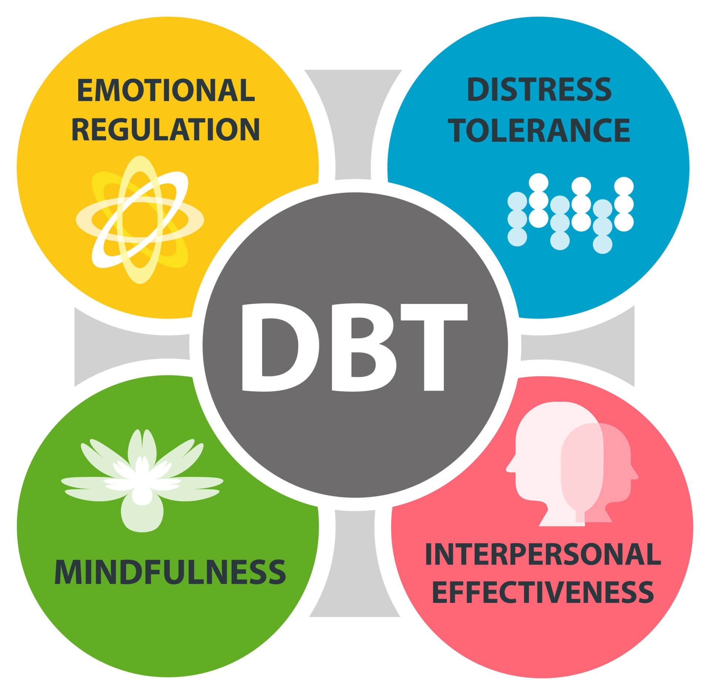
Dialectical Behavioral Therapy Skills Group
When completed, participants will be able to :
Have improved relationships
Regulate emotions
Apply skills to future situations
Notes:
Krysti

Slide 23
Individual Therapy
Notes:
Keri

Slide 24
Individual Therapy
Treatment Court Standards indicate this should be weekly in initial phases
Modalities
Eye Movement Desensitization and Reprocessing (EMDR)
Cognitive Behavioral Therapy (CBT)
Solution Focused
Motivational Interviewing
All Rise Standard V, Section D
Notes:
Keri

Slide 25
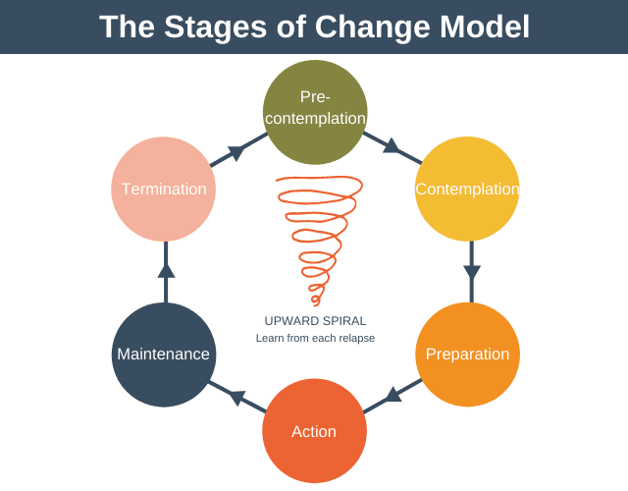
Individual Therapy
How do we know it’s working?
Increased use of coping skills
Recognition of triggers and warning signs
Decrease in substance use
Progression through stages of change and motivation
Notes:
Keri

Slide 26
Putting it together
How to facilitate these conversations with teams
Be curious!
Does your treatment program use the ASAM?
What treatments do your programs provide?
Are you aware of some of the evidenced based practices in this area or open to training?
Notes:
Kimeko

Slide 27
Phase Structure Changes
Clinical stability
Determined by treatment provider
“No longer experiencing clinical symptoms that are likely to interfere with their ability to attend sessions, benefit from the interventions, and avoid substance use, including withdrawal symptoms, persistent substance cravings, anhedonia, executive dysfunction, and acute mental health symptoms like depression or anxiety.”
(p. 76 All Rise Standards, Standard IV, Section A)
Notes:
Krysti

Slide 28
Phase Structure Changes
Abstinence
Phase 1: Distal Goal
Phase 2: Distal Goal
Often can have a few days or weeks sober
Phase 3: May be a Proximal Goal
Phase 4: Proximal Goal
This phase is the only one with a time requirement
Phase 5: Managed Goal
Always verify with treatment!
Notes:
Krysti

Slide 29
Phase Structure Changes
Sanctions v. Service Adjustments
Use service adjustments NOT sanctions until distal goals become proximal
This is after participants are in early remission
Early remission is 90 days without clinical symptoms that interfere with ability to attend sessions, benefit from interventions, or avoid substance use
Treatment providers notify team when the participant has been clinically stable long enough for abstinence to be considered a proximal goal
Treatment provider also notifies team if the goal returns to being a distal goal
All Rise Standard IV, Section A
Notes:
Krysti

Slide 30
Phase Structure Changes
Psychosocial stability
Stable housing
Reliable attendance
Therapeutic alliance
Clinical stability
All Rise Standard IV, Section I
Notes:
Krysti

Slide 31
Thank you!
Krysti Deines, LPC, SAC
Krysti.Deines@eauclairecounty.gov
Kimeko Hagen, MS, CSAC, ICS
khagen@optionstx.com
Keri Fatzinger, CSAC, LCSW, ICS
kfatzinger@unifiedservices.org
Notes:
Krysti

