Slide 1
Peer support in treatment courts
Coordinators Conference

Slide 2
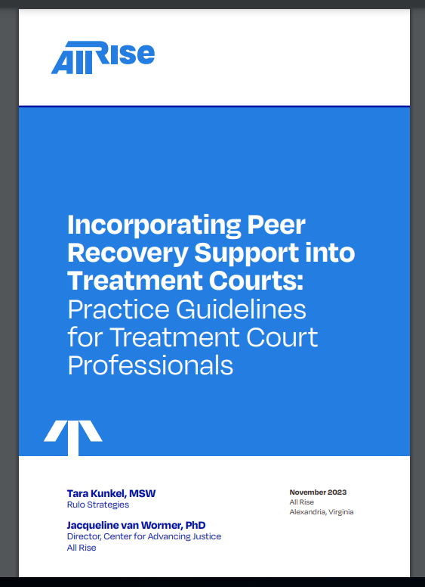

Slide 3
Peer support specialist vs. alumni
Peer support
alumni
Receive specialized training
Sharing experiential knowledge, hope, and skills mentoring and assisting the individual with problem solving, goal setting, building recovery capital, and skill building
Formal relationship
Facilitate alumni groups
Organize and host prosocial activities
Increase community awareness
Provide ad hoc mentorship to current participants

Slide 4
Guideline 1: treatment court staff receive training on the core competencies of peer recovery support
Notes:
Prior to implementing peer support, training is provided for all treatment court team members addressing the following topics:
What is peer support?
What is a peer support specialist, and what do they do?
What are the benefits of peer support?
How are peer support specialists trained?
How is the peer support specialist’s role different from other roles on the team, including alumni?
Treatment court staff are given the opportunity to discuss any concerns they have about incorporating peer support services into the program
Peer support is incorporated into the program as an optional recovery support service designed to improve participant engagement and achievement of long-term prosocial behavior and recovery

Slide 5
Guideline 2: the treatment court has written roles and responsibilities that align with peer recovery support services’ nationally recognized competencies and ethics
Notes:
Program has a written description of the roles, responsibilities and typical appropriate tasks for the peer support specialist and a job description that is specific to the treatment court
Specialists are not used as a substitute for case managers, van drivers/transportation assistants, clinicians, 12-step sponsors or community supervision
Specialists do not monitor treatment court compliance
Carefully consider the pros and cons of having the specialist attend staffing
When establishing an appropriate and reasonable caseload size for a specialist, it is essential to consider the responsibilities of the specialist and the complexity of the needs of the clients in the program. Typical caseload is about 20. Watch out for secondary and vicarious trauma

Slide 6
Guideline 3: The treatment court program has established processes for recruiting, hiring, and orienting peer recovery support specialists to the treatment court
Notes:
Supervision is important!
Partner with an organization to provide supervision or make sure the supervisor has expertise in peer support
Consider compensation, rates, hours and benefits
Create a written orientation plan
Plan introductory activities to allow the specialist to interact with the team outside of staffing and court
Treatment court has fully oriented all team members to the work that will be done by a peer support specialist

Slide 7
Guideline 4: the treatment court ensures that peer recovery support specialists receive regular and ongoing external supervision from qualified staff
Notes:
Supervisor has fundamental understanding of the principles of recovery and the role of peer recovery support services
Supervisor understands the core competencies of peer recovery support specialists
Supervisor has been trained on best practice standards associated with treatment court
Supervisor understands the differences in roles on the team
Supervisor advocates for the role of peer recovery support services
Specialists regularly network, meet and debrief their roles in support of each other

Slide 8
Guideline 5: peer recovery support specialists receive annual ethics training, and policies and procedures are in place to address ethics issues
Notes:
Policies and procedures are in place that address appropriate confidentiality, boundaries and dual relationships
Peer recovery support specialists participate in annual ethics training
Agencies have policies and procedures in place to protect the confidentiality and rights of any peer support specialists who also currently receive services from the agency
Treatment courts that use properly trained graduates have policies and procedures in place to protect the confidentiality of the specialist and his/her records

Slide 9
Appendix Topics
Summary of national practice guidelines for peer supporters
Common myths and concerns about peer recovery support services
Sample job description
Sample interview questions

