Slide 1
Assessments, Results, and Case Planning
WATCP Coordinators’ Conference
2024

Slide 2
Why risk assessment
Non-Professional Estimate
Professional Judgement
Actuarial Assessment
43%
48%-63%
65%+
IN VIRTUALLY ALL decision-making situations that have been studied, actuarially developed devices outperform human judgments. This is true with respect to psychiatric judgments; graduate school admissions; prognostic judgments made by sociologists and psychiatrists relative to a parole-violation criterion; parole board decisions; mental health and correctional case worker judgments of offender risk, spousal assault and in other areas, including the analysis of credit risk. Indeed, a recent review and meta-analysis of 56 years’ accumulation of research on the “clinical vs. statistical” prediction “problem” conducted as part of a Festschrift for Paul E. Meehl, a pioneer in the field, again confirms that statistical models outperform clinical decision-makers.
-Gottfredson & Moriarty 2006
Actuarial Assessment Average of 13% Better

Slide 3
Risk Assessment Generations
1st Generation
Professional Judgement
2nd Generation
Actuarial Assessment
3rd Generation
Actuarial Assessment
Dynamic Factors
(Needs)
Static Factors
(Risk)
Static Factors (Risk)
4th Generation
Actuarial Assessment
Static Factors
(Risk)
Dynamic Factors
(Needs)
Structured Decision Making for Case Management
5th Generation
Machine Learning
Complex Interactions
Static Factors (Risk)
Dynamic Factors (Needs)

Slide 4
What is being communicated in risk assessments
Prognostic
Correlation
Causation
Classification
Arrest
Diagnostic
Prediction
Criminal Behavior
Specific Timeframe
All Future Behavior
Risk
Stakes

Slide 5
What does risk mean?
Rates depend on assessment and sub-group
High Risk
Multiple factors likely to cause recidivism
Lack of protective factors
Anti-Social Cognition/Personality traits present
More likely than not to recidivate
Moderate Risk
Mixture of anti-social and pro-social/protective factors
A few criminogenic needs present
Approximate rate of recidivism 30%-50%
Low Risk
Expected to self-correct
Pro-social/Protective factors greatly outweigh any minor risk factors
Approximate rate of recidivism <10-20%

Slide 6
Risk assessment language
[Name] has been assessed as having similar traits to groups that recidivate at a high level.
[Name] is high risk

Slide 7
Bridging the gap: assessment to case planning
Criminal History
Anti-Social Cognition
Anti-Social Personality
Anti-Social Associates
Drop static factors
Family/Marital
Criminogenic Needs
Substance Use
Employment
Education
Leisure

Slide 8
Bridging the gap: assessment to case planning
Low Risk Moderate Risk High Risk
2) Use assessed domain areas to identify which needs have highest risk levels
3) Now we are ready to case plan
Anti-Social Cognition
Anti-Social Personality
Anti-Social Associates
Family/Marital
Criminogenic Needs
Substance Use
Employment
Education
Leisure

Slide 9
Why Case Plan
The use of case plans has been shown to reduce new arrests and technical violations
Collaboration among team members leads to better outcomes
Case plans enhance an individual’s perception of fairness and compliance
Gossner, Rector, & Ruddell (2016)

Slide 10
What is a Case Plan
Case Plan
Requirements
Goals
Responsibility
Accountability
Strengths
Needs
Supports
Triggers
The case plan is really when the supervision starts.
A case plan is:
Collaborative
Engages the client in behavior change
Keeps team members on track
A guide to success
A method to monitor progression (or lack of)
An early warning system

Slide 11
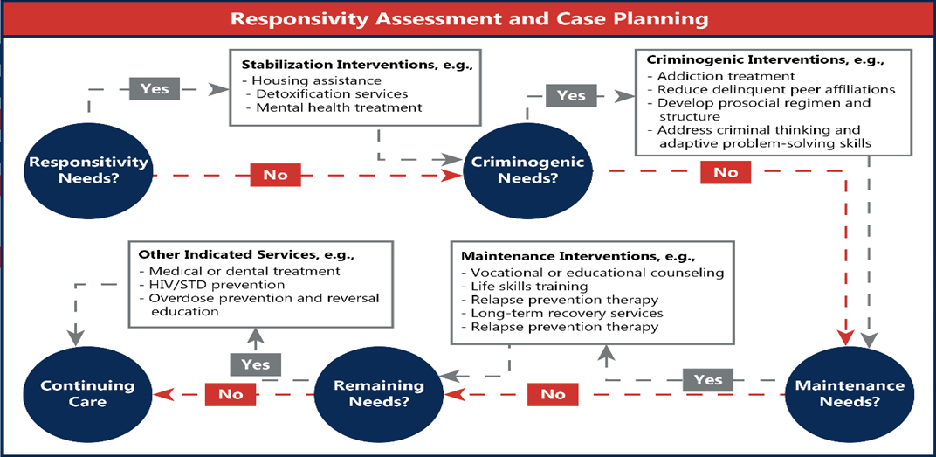
Responsivity and priority
Reassess at every meeting

Slide 12
Consider Specific Responsivity factors
Barriers
Severe Mental Health
Substance Dependance
Challenges
Moderate Mental Health
Trauma History
Strengths
Pro-Social Family/Peers
Community Connections
Lack of Housing
Low Motivation
Transportation
Etc.
Etc.
Skills
Prior Successes
Interests
Learning Style
Must stabilize before treatment progress (refer out)
Must address (refer out) or accommodate during programming
Incorporate into programming choices whenever possible

Slide 13
Build around criminogenic needs
A systematic review found that treatment programs targeting criminogenic needs have effect sizes ranging from .20 to .30, while treatment programs targeting non-criminogenic needs had effect sizes ranging from -0.01 to .04. (Smith, Gendreau, and Swartz, 2009)

Slide 14
drivers
High presence does not mean high priority
What is driving the behavior?
Primary Needs
Derivative Needs
Anti-Social Cognition
Substance Use
Anti-Social Personality
Employment
Anti-Social Associates
Education
Family/Marital
Leisure

Slide 15
Prioritizing criminogenic needs
1) Prioritize Needs in order of assessed risk level
2) Remove low-risk needs unless there is a specific reason they need to be addressed
3) Elevate moderate risk Primary Needs over high-risk Derivative Needs
4) Elevate the possible Driver. Review reasoning if it is believed to be a Derivative Need
5) Elevate any Needs that reinforce each other
Collaborate With Client

Slide 16
Example of prioritizing
1) Prioritize Needs in order of assessed risk level
Anti-Social Cognition
Employment
Substance Use
Anti-Social Personality
Leisure
Anti-Social Associates
Family/Marital
Education

Slide 17
Example of prioritizing
Anti-Social Cognition
High Risk
Employment
2) Of those Needs, prioritize by assessed risk level
1) Which Needs are criminogenic for the individual
2) Remove low-risk needs unless there is a specific reason they need to be addressed
Substance Use
Moderate Risk
Anti-Social Personality
Leisure
Low Risk
Non-Criminogenic for individual
Possible strength
Anti-Social Associates
Family/Marital
Education

Slide 18
Example of prioritizing
Anti-Social Cognition
3) Elevate moderate risk Primary Needs over high-risk Derivative Needs
Anti-Social Personality
Employment
Substance Use
Leisure

Slide 19
Example of prioritizing
Anti-Social Cognition
4) If there is a specific reason a Derivative Need is believed to be the driver elevate it.
4) Elevate the possible Driver. Review reasoning if it is believed to be a Derivative Need
3) Elevate moderate risk Primary Needs over high-risk Derivative Needs
Anti-Social Personality
Employment
Substance Use
Leisure
Collaborate With Client

Slide 20
Example of prioritizing
Anti-Social Cognition
4) If there is a specific reason a Derivative Need is believed to be the driver elevate it.
5) Elevate any Needs that reinforce each other
3) Elevate moderate risk Primary Needs over high-risk Derivative Needs
Anti-Social Personality
Substance Use
Leisure
Employment
Collaborate With Client

Slide 21
List distal goals and purpose
S
M
Measurable
Specific
A
Achievable
R
Relevant
T
Time-Bound
1) Client’s Treatment Goals
Add mutually acceptable goals to the case plan
2) Court Graduation Requirements
Have clients explain the purpose of each requirement
Clarify or explain the purpose of any requirements
3) Criminogenic Needs
Add each identified Criminogenic Need
Get client feedback on assessment results
Have the client identify the purpose or benefit of each goal.
Add all requirements to the case plan
Clarify or explain the inclusion of Criminogenic Needs
With client, define behaviors that demonstrate change in Need areas

Slide 22
What to target first
Responsivity Barriers
Stabilize
Highest Priority Criminogenic Need
Ideal target
Highest Priority Mutually Agreed Criminogenic Need
Encourages client buy-in
Easiest Activities in Case Plan to Make Progress
For highly resistant or low motivation clients
Engage in a dialogue with the client AND team to determine where to start the case plan
Share and discuss assessment results
Find areas of agreement
Explain your priorities and reasoning
Ask about client’s thoughts, feelings, and concerns

Slide 23
Minimize targets
Mutually choose 3 or fewer objectives at a time
Behavior
Requirement
Responsivity
Criminogenic Need
Client Goal

Slide 24
Proximal & Distal Behaviors
Mastered
Client does the behavior easily or habitually
Proximal
Client can do the behavior on their own or with minimal assistance
Distal
Client cannot do the behavior independently without extraordinary effort
Distal
Final Goal w/ high-magnitude reward
Proximal
Mastered
Mastered

Slide 25
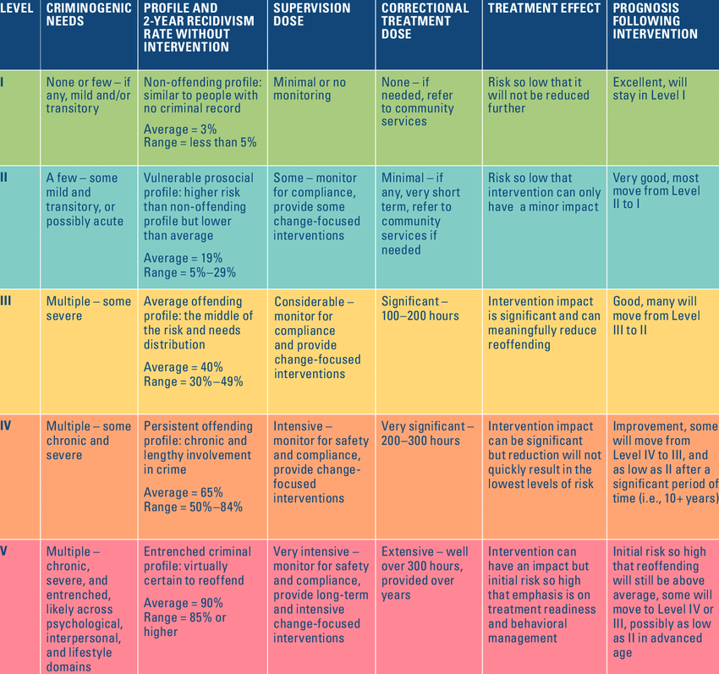
General responsivity and dosage
Individual Criminogenic Needs
Fidelity
EBP

Slide 26
Choosing an intervention/Action
1) Does the intervention lead toward a distal goal for the client?
2) Does the intervention incorporate general responsivity?
3) Does the intervention incorporate specific responsivity?
4) Is the intervention a proximal behavior for the client?
5) Is the client more likely than not to succeed?

Slide 27
Double-dip whenever possible
Community Service at Food Pantry
Court Requirement
Responsivity
Leisure
Cognitive Behavioral Group
Anti-Social Cognition
Anti-Social Personality
Potentially other needs as well
Social Skill Roleplays
Anti-Social Personality
Family/Marital
Anti-Social Peers
Employment
12 Step
Anti-Social Cognition
Substance Use
Leisure
Anti-Social Peers

Slide 28
Example of proximal goals
S
M
Measurable
Specific
A
Achievable
Proximal
R
Relevant
Responsivity, Criminogenic Need, Program Requirement
Leads to Distal Goal
T
Time-Bound
[Client] will schedule a therapy appointment by next [Date]
[Client] will demonstrate pro-social appearance and behavior in the next meeting by:
1) free of marijuana odor and not wearing any clothing or items that depict drug use. 2) focused throughout the entire meeting a) staying on topic
b) providing a clear summary of the topics discussed by the end of the meeting.
Progress will be evaluated during the following meeting to ensure compliance.
Responsivity, Anti-Social Cognition, Anti-Social Personality
Responsivity, Anti-Social Cognition, Substance Use
At the next meeting, [Client] will complete a thinking report with their case manager about Their most recent drug use event. They will complete an additional thinking report in response to a temptation to use before [date].
Anti-Social Cognition, Anti-Social Personality, Substance Use

Slide 29
When to change targets
Why isn’t “Has the client accomplished their goal” on the list of reasons to change targets?
1) Is there a new responsivity issue that must be prioritized?
2) Has the client progressed enough that they can meet future goals on their own?
3) Is there an upcoming deadline that requires a change in target?
4) Is there evidence that the prioritization of criminogenic needs has changed?

Slide 30
Relax
Case Plan
Goals:
Get clean: Within 5 [date] months I will test negative on all my drug tests
Get a job: By the end of DTC, I will be working at least 10 hours per week
Complete DTC: I will successfully graduate from DTC without needing an extension
Pay restitution by 8/4
Complete community service by the end of the year
Pro-Social Thinking: I will complete a cognitive behavioral group within 4 [date] months and demonstrate behavior change by avoiding violations over the remainder of DTC.
Coping Skills: I will connect with a therapist within the first [date] month and complete Seeking Safety by the end of DTC
Free Time: By the end of DTC, I will be involved in at least one organized pro-social activity
Targets:
I will schedule a therapy appointment by the end of this week
I will demonstrate pro-social appearance and behavior in the next meeting by:
being free of marijuana odor and not wearing any clothing or items that depict drug use
focused throughout the entire meeting
staying on topic, providing a clear summary of the topics discussed by the end of the meeting
Progress will be evaluated during the following meeting to ensure compliance.
At the next meeting, I will complete a thinking report with their case manager about Their most recent drug use event. I will complete an additional thinking report in response to a temptation to use before [date].

Slide 31
Next steps
Plan ahead
Include projected start dates for each goal
Include incentives and consequences when possible
For every potential consequence there must be an incentive for the opposite action
Track overall dosage
Ideally, track dosage by Criminogenic Need domain
Involve all team members and social supports
Plan a series of proximal steps that build upon each other
Consider assigning tasks to team members as well as the client
Track and celebrate milestones
Find ways to visually highlight milestones and successes
List client strengths
Add strengths as the client progresses

Slide 32
Putting the plan to work – Start of the meeting
Clearly mark completed goals with date of completion
If a goal is due and incomplete
Reconsider if the action is proximal
Consider if there is a responsivity issue involved
Consider adjusting completion date
Add supports (roleplaying, problem solving, etc.) to the contact
Consider adding explicit incentives and consequences if it remains incomplete
Allows for both visual and verbal praise
Use the case plan to prepare the client for the focus/structure of the meeting
Helps to keep both case manager and client on track
Include intended case manager interventions for next session and follow through
Occasionally review completed items to make sure the target behavior has been maintained

Slide 33
Putting the plan to work – at the end
Check-Off Case Manager Intervention
Agree on next steps
Review and adapt the next steps of the case plan
Closes every session with some progress
Always assign the client an action to perform between sessions
“Commitment”
Look ahead
Review upcoming deadlines and adjust if necessary
Give the client a clear signal when switching change targets
Indicate what intervention will be planned for next session
Link upcoming goals with distal goal and remind client of purpose, benefits, and progress

Slide 34
Returning to the case planning model

Slide 35
Contact Information
Jason Chapman
Training and Quality Control Coordinator
jchapman@justicepoint.org
Cell: 262-825-4245

