Slide 1
Addiction and the Brain:
What Treatment Court Professionals Need to Know

Slide 2
Learning Objectives
.
*Describe how addiction affects key parts of the brain involved in judgment, decision-making, and self-control.
*Explain why individuals with addiction may continue to use substances despite negative consequences.
*Recognize that addiction is a chronic condition, not a moral failing, and how this understanding can reduce stigma.
*Identify ways treatment court responses can better support recovery by taking brain-based challenges into account.
*Apply basic brain science to support more effective, compassionate, and realistic decision-making within the treatment court setting.

Slide 3
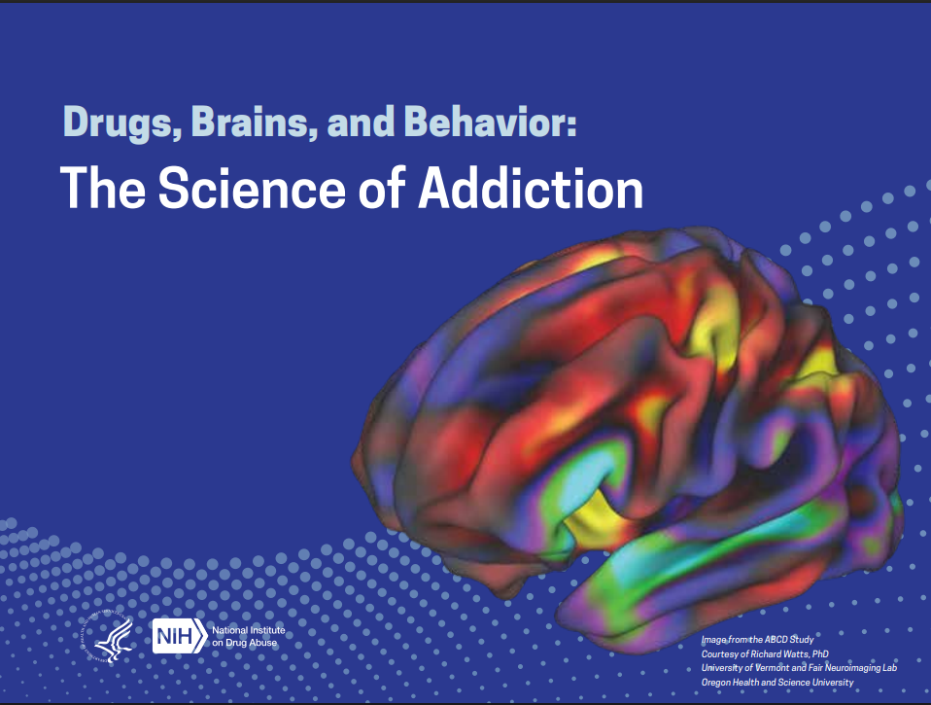

Slide 4
Definition of Addiction
-Addiction is defined as a chronic, relapsing disorder characterized by compulsive drug seeking and use despite adverse consequences. It is considered a brain disorder, because it involves functional changes to brain circuits involved in reward, stress, and self-control. Those changes may last a long time after a person has stopped taking drugs.
-Addiction is a lot like other diseases, such as heart disease. Both disrupt the normal, healthy functioning of an organ in the body, both have serious harmful effects, and both are, in many cases, preventable and treatable. If left untreated, they can last a lifetime and may lead to death.
*NIDA. 2020, July 6. Drug Misuse and Addiction. Retrieved from https://nida.nih.gov/publications/drugs-brains-behavior-science-addiction/drug-misuse-addiction on 2025, July 20
Notes:
The book uses both disease and disorder. Disease refers to the more long-term functional changes and that we can never be “cured” from addiction. Disorder refers to the more right now or “Acute” challenges.

Slide 5
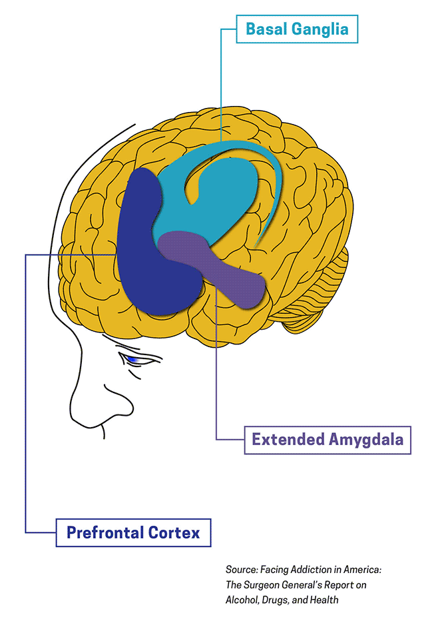
The basal ganglia, which plays an important role in positive forms of motivation, including the pleasurable effects of healthy activities like eating, socializing, and sex, and are also involved in the formation of habits and routines. These areas form a key node of what is sometimes called the brain’s “reward circuit.” Drugs over-activate this circuit, producing the euphoria of the drug high. But with repeated exposure, the circuit adapts to the presence of the drug, diminishing its sensitivity and making it hard to feel pleasure from anything besides the drug.

Slide 6
The extended amygdala plays a role in stressful feelings like anxiety, irritability, and unease, which characterize withdrawal after the drug high fades and thus motivates the person to seek the drug again. This circuit becomes increasingly sensitive with increased drug use. Over time, a person with substance use disorder uses drugs to get temporary relief from this discomfort rather than to get high.

Slide 7
The prefrontal cortex powers the ability to think, plan, solve problems, make decisions, and exert self-control over impulses. This is also the last part of the brain to mature, making teens most vulnerable. Shifting balance between this circuit and the circuits of the basal ganglia and extended amygdala make a person with a substance use disorder seek the drug compulsively with reduced impulse control.
Notes:
The prefrontal cortex is the last part of the brain to mature at age 25 for females and 27 for males. How many of you did not use any substances problematically until after these ages? This is what people are talking about when they say you are the same age as when you started using. If I started using at 13- when I get sober, usually much later in life, I have these problem solving, communication skills and impulse control of a teenager.
It takes time and intentional behavior to skill build around these things. Activities such as using support system with help making decisions, talking about our struggles with professional and natural supports, learning new things and keeping a daily schedule will all help us to improve the functioning in this part of the brain.

Slide 8
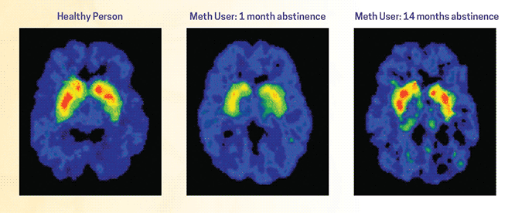
*NIDA. 2020, July 6. Drug Misuse and Addiction. Retrieved from https://nida.nih.gov/publications/drugs-brains-behavior-science-addiction/drug-misuse-addiction on 2025, July 20
Notes:
Page 22- Here is the next set of PET scans we will take a look at. This shows the improved dopamine production after 14 months sober from methamphetamine. The “holes” in this slide are only due to the slice of the scan they chose and are not holes in the brain.
What other things can you do to support dopamine production and healing of the brain?
Exercise- is the most beneficial activity for natural dopamine release.
Sunlight- get outside and taking Vitamin D supplements
Sleeping
Eating
Accomplishing tasks

Slide 9
What other things can you do to support dopamine production and healing of the brain?
Exercise- is the most beneficial activity for natural dopamine release.
Sunlight- get outside and taking Vitamin D supplements
Sleeping
Eating
Accomplishing tasks- break all goals into much smaller tasks
Eating healthy
Meditation, music, learning new things, laughter …
Notes:
When we are working with Treatment Courts Participants….

Slide 10
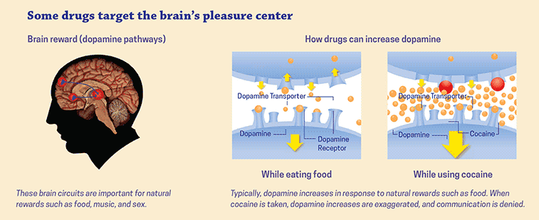
Dopamine
NIDA. 2020, July 6. Drugs and the Brain. Retrieved from https://nida.nih.gov/publications/drugs-brains-behavior-science-addiction/drugs-brain on 2025, July 27
Notes:
Pleasure or euphoria—the high from drugs—is still poorly understood but probably involves surges of chemical signaling compounds including the body’s natural opioids (endorphins) and other neurotransmitters in parts of the basal ganglia (the reward circuit). When some drugs are taken, they can cause surges of these neurotransmitters much greater than the smaller bursts naturally produced in association with healthy rewards like eating, hearing or playing music, creative pursuits, or social interaction. It was once thought that surges of the neurotransmitter dopamine produced by drugs directly caused the euphoria, but scientists now think dopamine has more to do with getting us to repeat pleasurable activities (reinforcement) than with producing pleasure directly.

Slide 11
How does dopamine reinforce drug use?
Pleasure
Formation of Habits
Cravings and triggers
Notes:
The feeling of pleasure is how a healthy brain identifies and reinforces beneficial behaviors, such as eating, socializing, and sex. Our brains are wired to increase the odds that we will repeat pleasurable activities. The neurotransmitter dopamine is central to this. Whenever the reward circuit is activated by a healthy, pleasurable experience, a burst of dopamine signals that something important is happening that needs to be remembered.
This dopamine signal causes changes in neural connectivity that make it easier to repeat the activity again and again without thinking about it, leading to the formation of habits.
Just as drugs produce intense euphoria, they also produce much larger surges of dopamine, powerfully reinforcing the connection between consumption of the drug, the resulting pleasure, and all the external cues linked to the experience. Large surges of dopamine “teach” the brain to seek drugs at the expense of other, healthier goals and activities.
Cues in a person’s daily routine or environment that have become linked with drug use because of changes to the reward circuit can trigger uncontrollable cravings whenever the person is exposed to these cues, even if the drug itself is not available. This learned “reflex” can last a long time, even in people who haven’t used drugs in many years. For example, people who have been drug free for a decade can experience cravings when returning to an old neighborhood or house where they used drugs. Like riding a bike, the brain remembers.

Slide 12
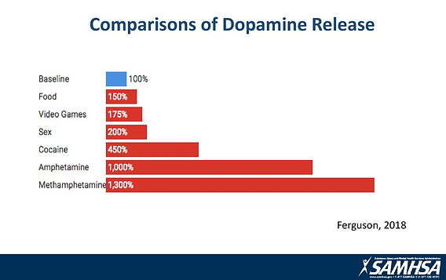
Why are drugs more addictive than natural rewards?
Notes:
For the brain, the difference between normal rewards and drug rewards can be likened to the difference between someone whispering into your ear and someone shouting into a microphone. Just as we turn down the volume on a radio that is too loud, the brain of someone who misuses drugs adjusts by producing fewer neurotransmitters in the reward circuit, or by reducing the number of receptors that can receive signals. As a result, the person's ability to experience pleasure from naturally rewarding (i.e., reinforcing) activities is also reduced.
This is why a person who misuses drugs eventually feels flat, without motivation, lifeless, and/or depressed, and is unable to enjoy things that were previously pleasurable. Now, the person needs to keep taking drugs to experience even a normal level of reward—which only makes the problem worse, like a vicious cycle. Also, the person will often need to take larger amounts of the drug to produce the familiar high—an effect known as tolerance.

Slide 13
Road Map to Recovery
Stage 1: Withdrawal
Stage 2: Early Abstinence (“Honeymoon”)
Stage 3: Protracted Abstinence (“the Wall”)
Stage 4: Adjustment/Resolution
Notes:
With the new standards for phase structure, we will see this roadmap and stages fit more appropriately with the recovery process.

Slide 14
Early Abstinence (“Honeymoon”)
Honeymoon stage occurs only for Stimulant use and happens about 2-3 weeks after last use.
The honeymoon stage occurs when the brain releases dopamine as part of the healing process.
This stage of recovery includes:
Concern about weight gain
Overconfidence
Difficulty concentrating
Continued memory problems
Intense feelings
Mood swings
Other substance use
Inability to prioritize
Mild paranoia
Increased energy and optimism

Slide 15
The WALL
This stage of recovery happens with all substances and occurs often between 4-6 weeks after last use.
Dopamine production is shut down again as healing continues.
This stage of recovery includes:
Increased emotionality
Behavioral “drift”
Decreased ability to feel pleasure
Low energy/fatigue
Secondary drug use
Breakdown of structure
Interpersonal conflict
Loss of motivation
Insomnia
Paranoia
Relapse justification

Slide 16
Adjustment and Resolution Stage
Developing balance is important during this stage.
It can take 2-5 years for your brain to return to a “normal” level of dopamine production.
Use this time to address substance use, mental health and trauma in therapy and build healthy support system.

Slide 17
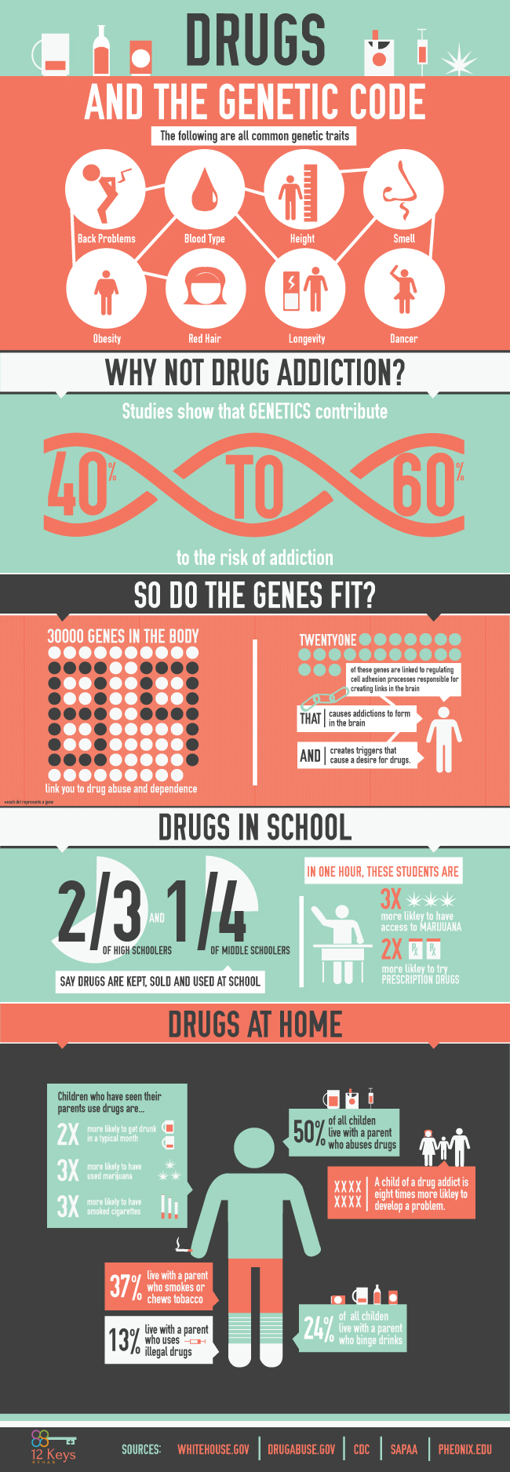
Genetics and Brain Chemistry
Infographic by 12 Keys Rehab
Notes:
Here are some of the many things that get passed down to us genetically.
Issues with bones and muscles
How tall you will be and the size and shape of our bodies
Sense of smell, eyesight and hearing
How long we will live
Physical abilities like singing dancing and artistic ability.

Slide 18
Notes:
If you have a first or second generation relative- parents or grandparents, then you have an increased risk of developing addiction of 40-60% at the time of conception. This includes behavior addictions also. For example, if grandpa has a gambling addiction or substance addiction- which also causes functional changes to the brain- you will have the increased risk of developing addiction to behaviors or substances.

Slide 19
Notes:
21 specific Genes link us to processes that cause addiction to form in the brain and create triggers.

Slide 20
Nature (DNA) and
Nurture (Environment)
Nature: Genetic Vulnerabilities Epigenetic Influences Brain Region Involvement | Nurture: Environmental Influences Stress Trauma and Adverse Childhood Experiences
Notes:
Epigenetic influences on addiction involve environmental factors, such as stress and drug use, altering gene expression without changing the underlying DNA sequence. These chemical modifications, like DNA methylation and histone modifications, can increase vulnerability to addiction, intensify drug craving, and contribute to relapses by changing how genes involved in the brain's reward circuitry function. These changes can be long-lasting, potentially passed on to future generations, and offer targets for new interventions and treatments for addiction.
How Epigenetics Influences Addiction:
Environmental Triggers:
External factors like chronic stress, early life trauma, and parental substance use can induce epigenetic changes.
Drug Exposure:
Repeated exposure to drugs of abuse directly alters epigenetic markers in the brain, especially in reward-related areas like the nucleus accumbens.
Gene Regulation:
Epigenetic mechanisms, such as DNA methylation and histone acetylation, turn genes "on" or "off". In addiction, this leads to changes in gene expression that influence:
Brain structure and function
The reward system
Behavioral responses to drugs
Increased Susceptibility and Relapse:
These altered gene expressions make an individual more vulnerable to developing an addiction and can increase the risk of relapse, even when aware of the consequences.

Slide 21
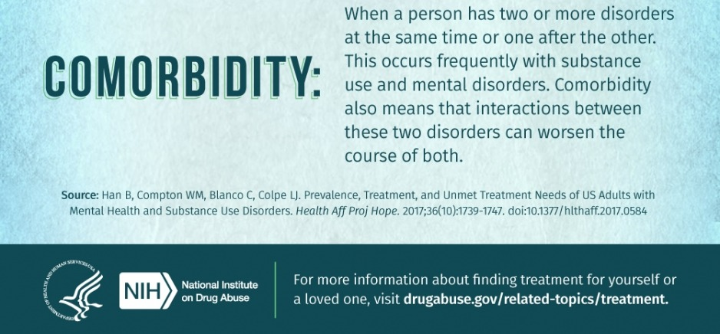
Mental Health and Addiction
Notes:
Does drug use cause other mental disorders, or vice versa?
Drug use and other mental illness often co-exist. In some cases, mental disorders such as anxiety, depression, or schizophrenia may come before addiction. In other cases, drug use may trigger or worsen those mental health conditions, particularly in people with specific vulnerabilities.^{43,44}
Some people with disorders like anxiety or depression may use drugs in an attempt to alleviate psychiatric symptoms. This may exacerbate their mental disorder in the long run, as well as increase the risk of developing addiction.^{43,44} Treatment for all conditions should happen concurrently.

Slide 22
Behavioral Addictions
Internet addiction Video game addiction Gambling addiction Food addiction Pornography addiction Sex addiction Shopping addiction Exercise addiction Relationships/Love | Love addiction Plastic surgery Problematic smartphone use Internet Compulsive buying disorder Food Work
Notes:
The pleasures of any addiction can be diverse because what is pleasurable to one person may not be enjoyable to another. In addition to promoting an increase in a positive mood, such as feeling more relaxed or feeling more “up”, the addiction may also be a means to decrease negative moods such as “If I do this, I won't feel stressed, anxious, angry, depressed, bored, lonely, afraid or frustrated.”
What is common to ALL addictions is the desire to take or do something that changes how a persona feels as quickly as possible. Even thinking about addictive behavior can bring about the desired effects like feeling alert, confident or high. An addiction can also allow the person to ignore reality, at least temporarily. Activity or behavior addictions take hold in the same ways that substance addictions take hold. They impact dopamine and have tolerance and withdrawal.
Addictive activities such as gambling, sex and food addictions also cause neurotransmitter alterations. Gambling, risk taking, stealing, dealing drugs and other excitement types of behaviors cause the norepinephrine rush that results from the release of excitatory neurotransmitters.
Individuals become addicted to compulsive behaviors due to changes in brain chemistries as a result of their behavior. This rewarding rush of energy will temporarily lift depression and may substitute for feelings of inadequacy.

Slide 23
Behavior Addictions
The inability to stop or control behavior.
Feeling shame or embarrassment after doing the activity.
The inability to stop addictive behaviors despite knowing how they impact the body and mind.
Doing more risk-taking and increasing risky activities to thrill seek.
Needing more exposure to feel the highs one used to feel while doing the activity.
Experiencing cravings for doing the activity.
Using a certain activity in conjunction with drugs and alcohol.
Using the activity and justifying it to deal with trauma or poor mental health versus getting professional help.
Notes:
Someone engaging in activities like gambling and video games doesn’t necessarily signal an addiction. However, if it impacts their everyday life and becomes a crutch for underlying mental and emotional problems, it may need closer examination. Addictions occur when someone needs large amounts or constant exposure to the stimuli. Those with a behavioral addiction will constantly seek the thrill or rush of endorphins by frequent and increased activity. Secondly, behavioral addictions become serious if the individual cannot control or stop the activity.

Slide 24
What now?
Moving away from compliance-driven programming
Moving away from time-driven programming and progress
Focus on recovery-driven programming
Focus on adherence-driven progress
Sequence and timing
Empowering treatment – putting the treatment back in treatment court
Notes:
From Julie Seitz- All Rise

Slide 25
But Our Treatment Court is Time-Limited
Treatment court programs offer 12-18 months of treatment, support and accountability.
It is often the foundation and connections to building a long-term recovery plan for the individual

Slide 26
References
Julie Seitz, All Rise Project Director, Impaired Driving Solutions
12 Keys Rehab
National Institute on Drug Abuse (NIDA)
NIDA. 2020, July 6. Drugs and the Brain. Retrieved from https://nida.nih.gov/publications/drugs-brains-behavior-science-addiction/drugs-brain
SAMHSA

Slide 27
THANK YOU
Tonny Strong CSAC
tstrong@arborplaceinc.org
arborplaceinc.org

