Slide 1

Complementary services panel

Slide 2
Thomas Doughman
Comprehensive treatment centers

Slide 3
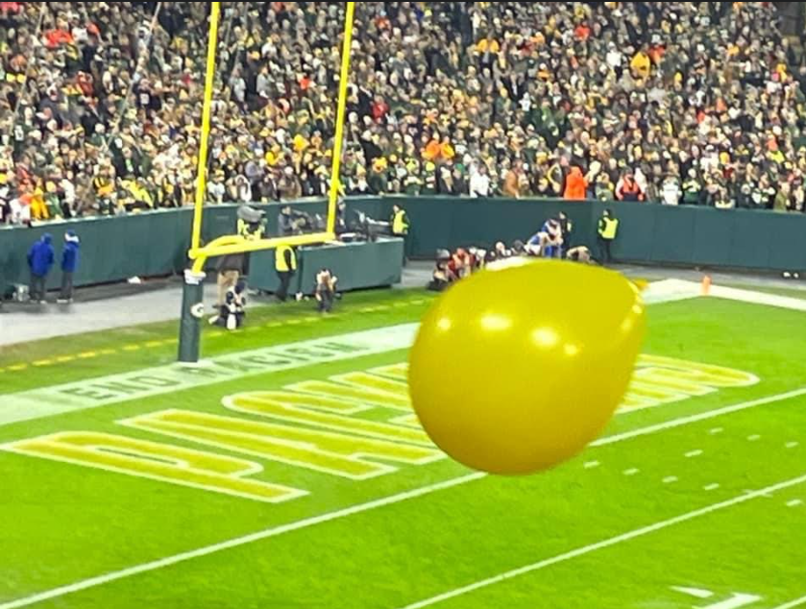
Section Yellow
Notes:
John
Jam band movement - Yellow balloon groups
Approach the Packers
Started in 2019 4 home games, we had to pay for tickets to get in to be set up in the concourse.
2020 - Pandemic
2021-First full season
2022 - Became part of the Fan experience at Lambeau
2023 - Kiosk and other Lambeau field events
2024 - Every home game and invited to the
2025- Draft

Slide 4
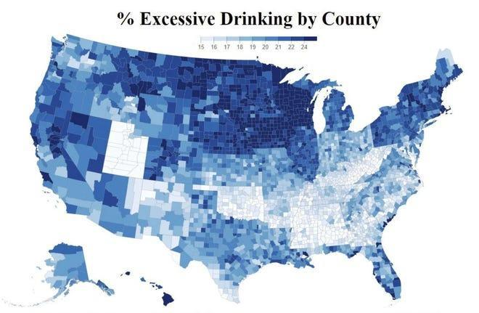
Green Bay Is The Drunkest City, WI The Drunkest State!
Notes:
John
Green Bay is the epicenter of the alcohol culture. You can see that WI in general has the majority of the 10 drunkest cities in the USA.

Slide 5
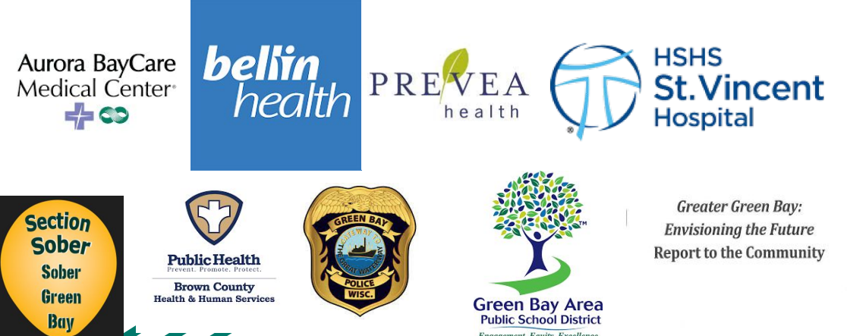
Original Brown County Coalition Partners
Notes:
Tom
Started in 2011
4 major health care providers at the time (Aurora, Bellin, Prevea, HSHS)
Law enforcement
Greater Green Bay
GB area School district
Brown County public health
Area treatment providers

Slide 6
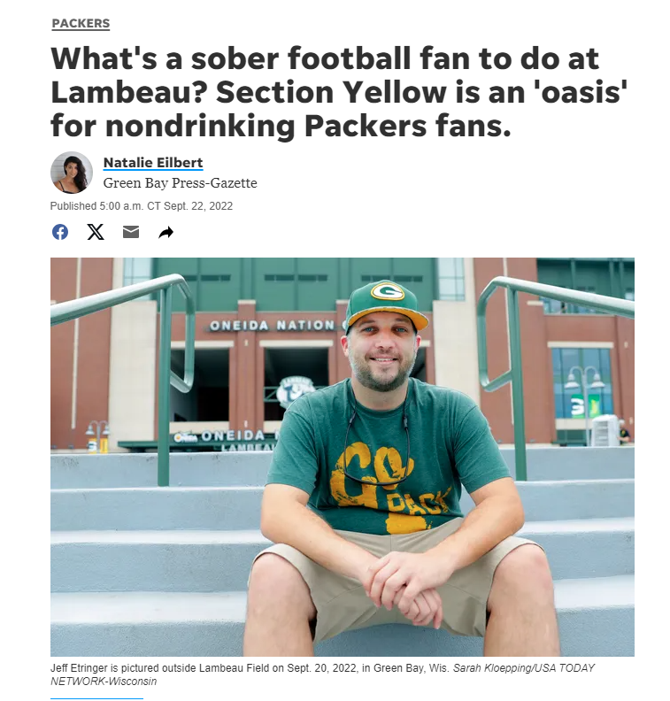
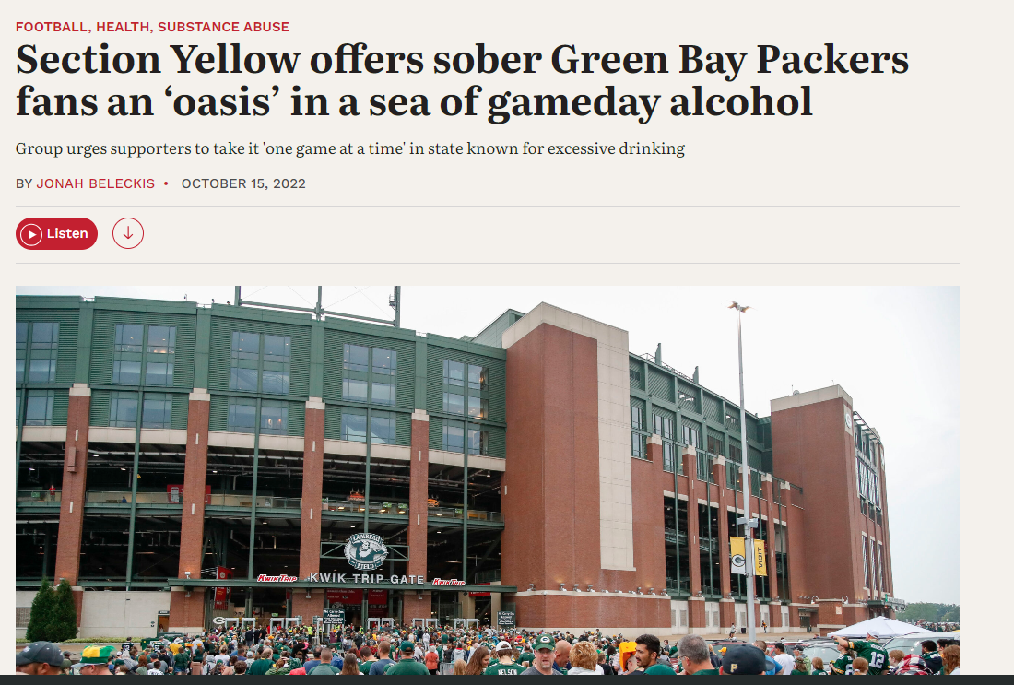
Local/State Wide Media
Notes:
Tom
9/22/2022 - Green Bay Press Gazette’s Natalie Eilbert ran a story locally. It was picked up by the Gannett news across the State of Wisconsin.
Producers from WPR saw the article and invited John and I to be on the air for an 8 minute spot. This garnered widespread attention throughout the State.
https://www.greenbaypressgazette.com/story/sports/nfl/packers/2022/09/22/lambeau-field-section-yellow-oasis-packers-fans-sobriety/10357381002/

Slide 7
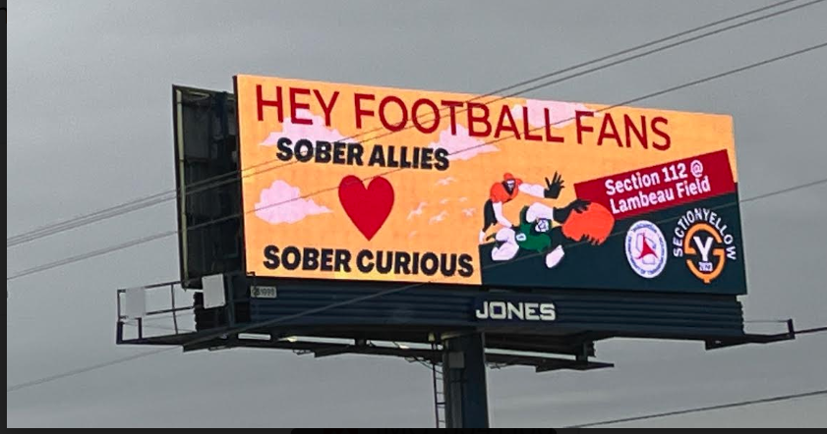
Ripple Effect Creative campaigns
Notes:
Tom 30 seconds:
And our Billboard campaign was born. We strategically utilized digital advertising to promote awareness about Section Yellow, and sober support, sober awareness events across the Green Bay Metro area.
4 ads per minute 7 seconds per ad with the ability to switch out ads at no extra charge! About $15,000

Slide 8
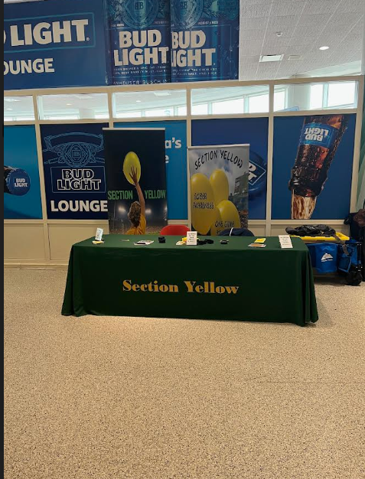
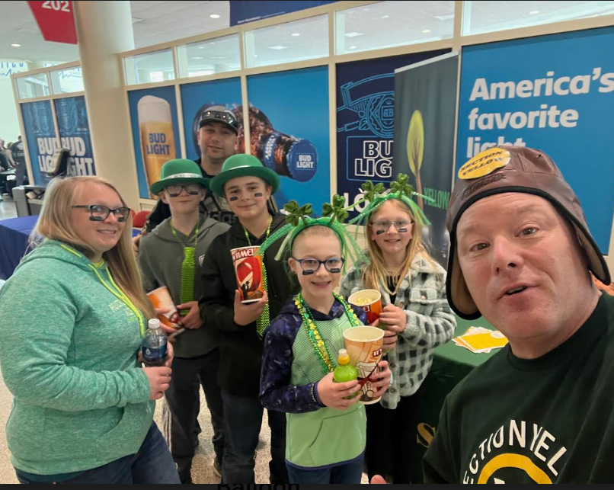
Green Bay Blizzard Arena Football
Notes:
John 30 seconds
Sober support table at all home games at the GB Blizzard
Family oriented venue. Still surrounded by alcohol, but spreading the message of recovery.
Designated driver sponsorship
Sober ally and sober support awareness.

Slide 9
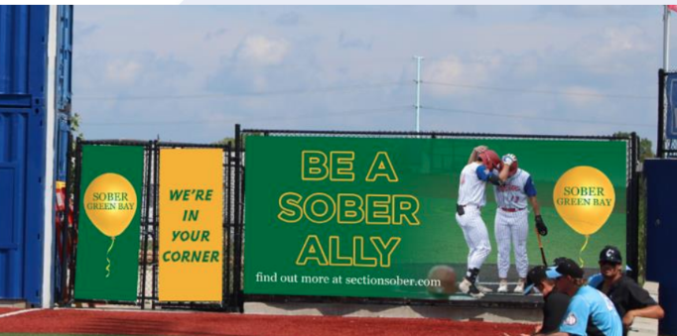
Green Bay Rockers Baseball
Notes:
Tom 30 seconds
Began partnership with the Rockers in 2023 with sponsoring signs in the outfield and pitch clock behind home plate

Slide 10
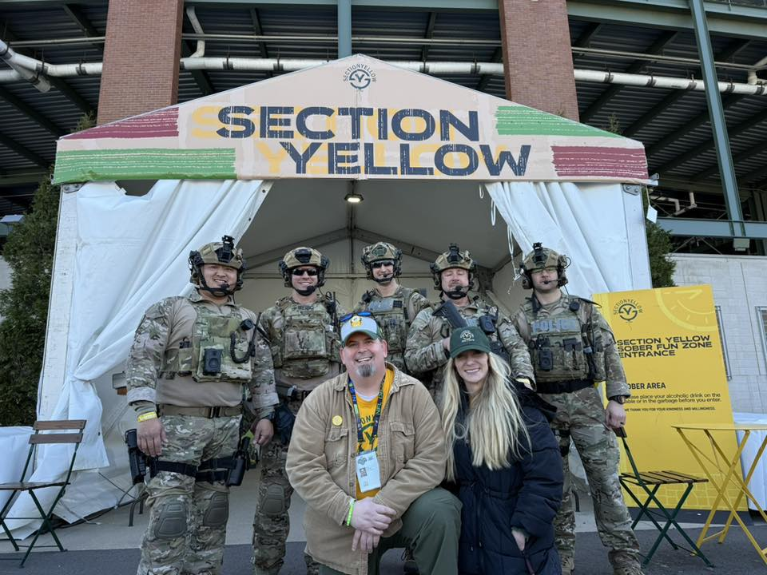
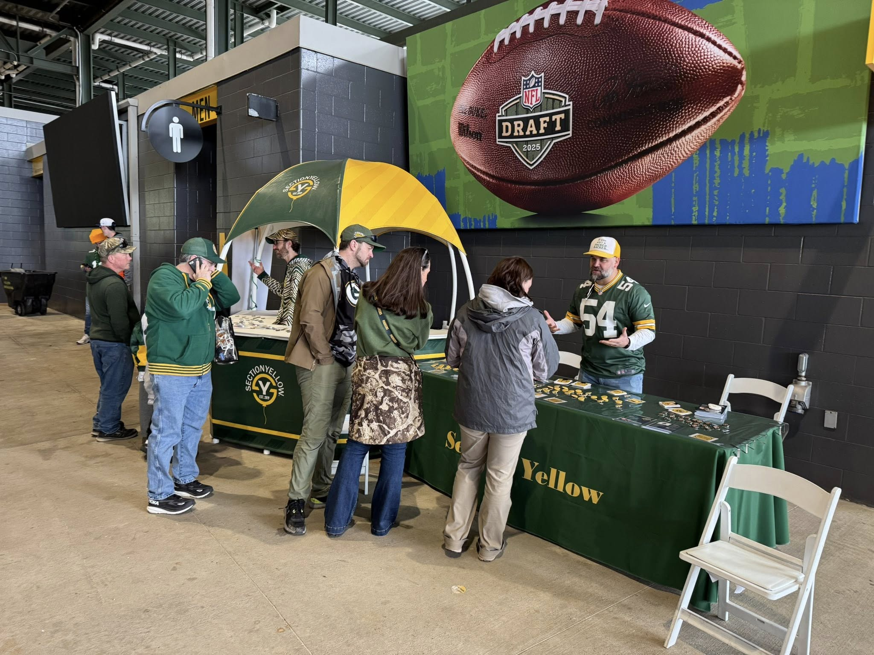
2025 NFL Draft
Notes:
John 60 seconds Draft

Slide 11
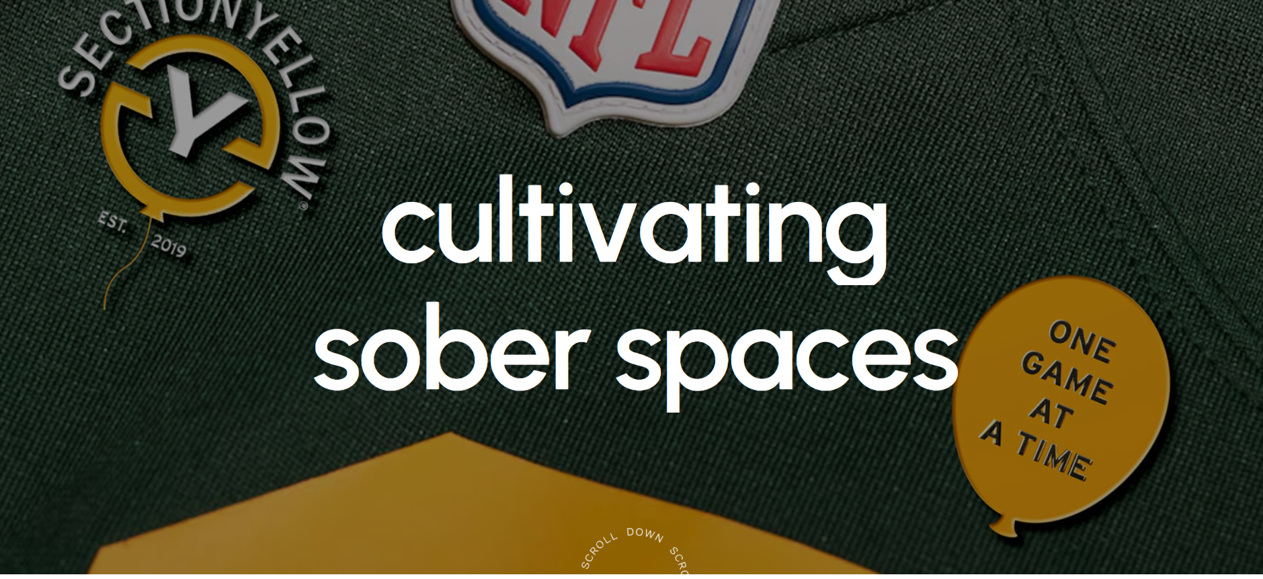
SectionYellow.com
Notes:
Tom 90 seconds:
On your paper, list one or two things you may want to try to make happen in your community?
What is the first thing you can do when you get back to your community to start the process of making this happen?

Slide 12
Ronda davis
UW-Extension

Slide 13

UW Madison Division of Extension Complimentary Services Panel
Ronda Davis
Justice-Involved Families State Specialist
Human Development & Relationships Institute
September 18, 2025

Slide 14
UW Madison Division of Extension
Our Mission is to connect people with the University of Wisconsin. We teach, learn, lead and serve, transforming lives and communities. We embody the general principle of the WI Idea: education that influences people’s lives beyond the boundaries of the classroom.

Slide 15
Six Institutes
Agriculture | Crops & Soils, Dairy and Livestock, and Farm Management
Community Development | Local Government Education, Community Food Systems, and Organizational Leadership Development
Health & Well-Being | Behavioral Health (WeCOPE), Covering WI, Healthy Eating & Active Living, and FoodWIse
Natural Resources | Community Engaged Science & Education, Water Program and Upham Woods Outdoor Learning Center
Positive Youth Development | Experiential Learning, Youth Empowerment (4-H), and College & Career Readiness
Human Development & Relationships | Family Engagement & Relationships, Financial Security and LifeSpan
Notes:
Agriculture, Community Development
Health & Well-Being
Human Development & Relationships
Natural Resources
Positive Youth Development

Slide 16
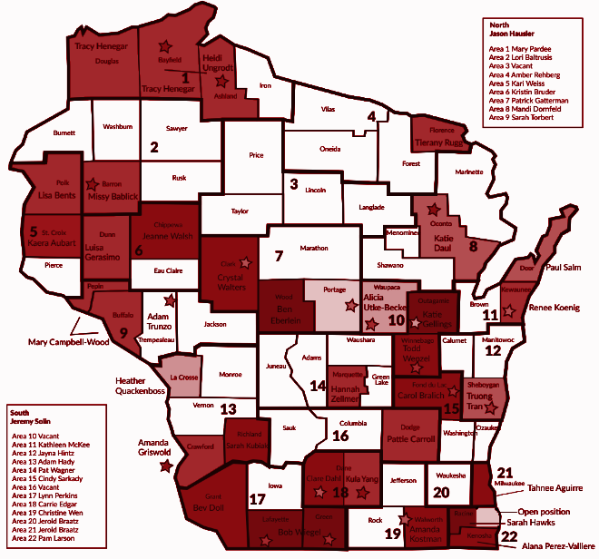
HDRI’s Statewide Impact
We have approximately 35 County-based educators that cover over 40 of our 72 counties offering in-person programming, in addition to covering the state through virtual programs.
Notes:
In our goal to preserve and nurture family bonds during incarceration, reentry and community reintegration, we will:
**Establish formal partnerships with organizations in education, mental health, housing, child welfare and workforce development to create a coordinated network of support.
**Engage individuals with lived experience in various roles to include: advisory, co-collaborators and leaders in program development and evaluation (ex: Reentry Focus on Finances curriculum evaluation project).
**Internal Community of Practice addressing the professional development needs of Extension colleagues working with justice-impacted individuals and their families. A collective designed to provide colleagues access to current research in the field, practical resources, as well as insights from individuals with lived experience and other practitioners/educators.
**Explore collaborations with on-campus faculty (SOHE, School of Social Work, School of Education, Criminal Justice Certificate Program, etc.) to assist in advancing some of our priorities (ex: facilitating remote programming, developing school-school based toolkits, designing child-friendly/affirming visiting model).

Slide 17






Complimentary Services
Family Engagement:
  The Literacy Link
  Triple P
  Strong Couples
Financial Security:
  Reentry Ready Focus on Finances
  Rent Smart
  1:1 Financial Coaching
**Evidence-Based; Evidence-Informed; Research-Based
Programming

Slide 18
Range of County-Based Support:
*Work directly w/ Judges, TAD’s, CJCC’s, Community Agencies
-Includes: Coordination, Facilitation and Oversight
*1:1 Financial Coaching
-Also, small group facilitation
-Topics: Budgeting; Debt/Credit Managment; Wage Garnishment;
Child Support, etc.
*Coordinate w/ Drug & Family Court Teams
-Providing updates on participant progress
-Helps to address barriers while maintaining consistency in
communication
Notes:
Judges
Treatment Alternatives and Diversion Programs (TAD)
CJCC’s

Slide 19


Slide 20
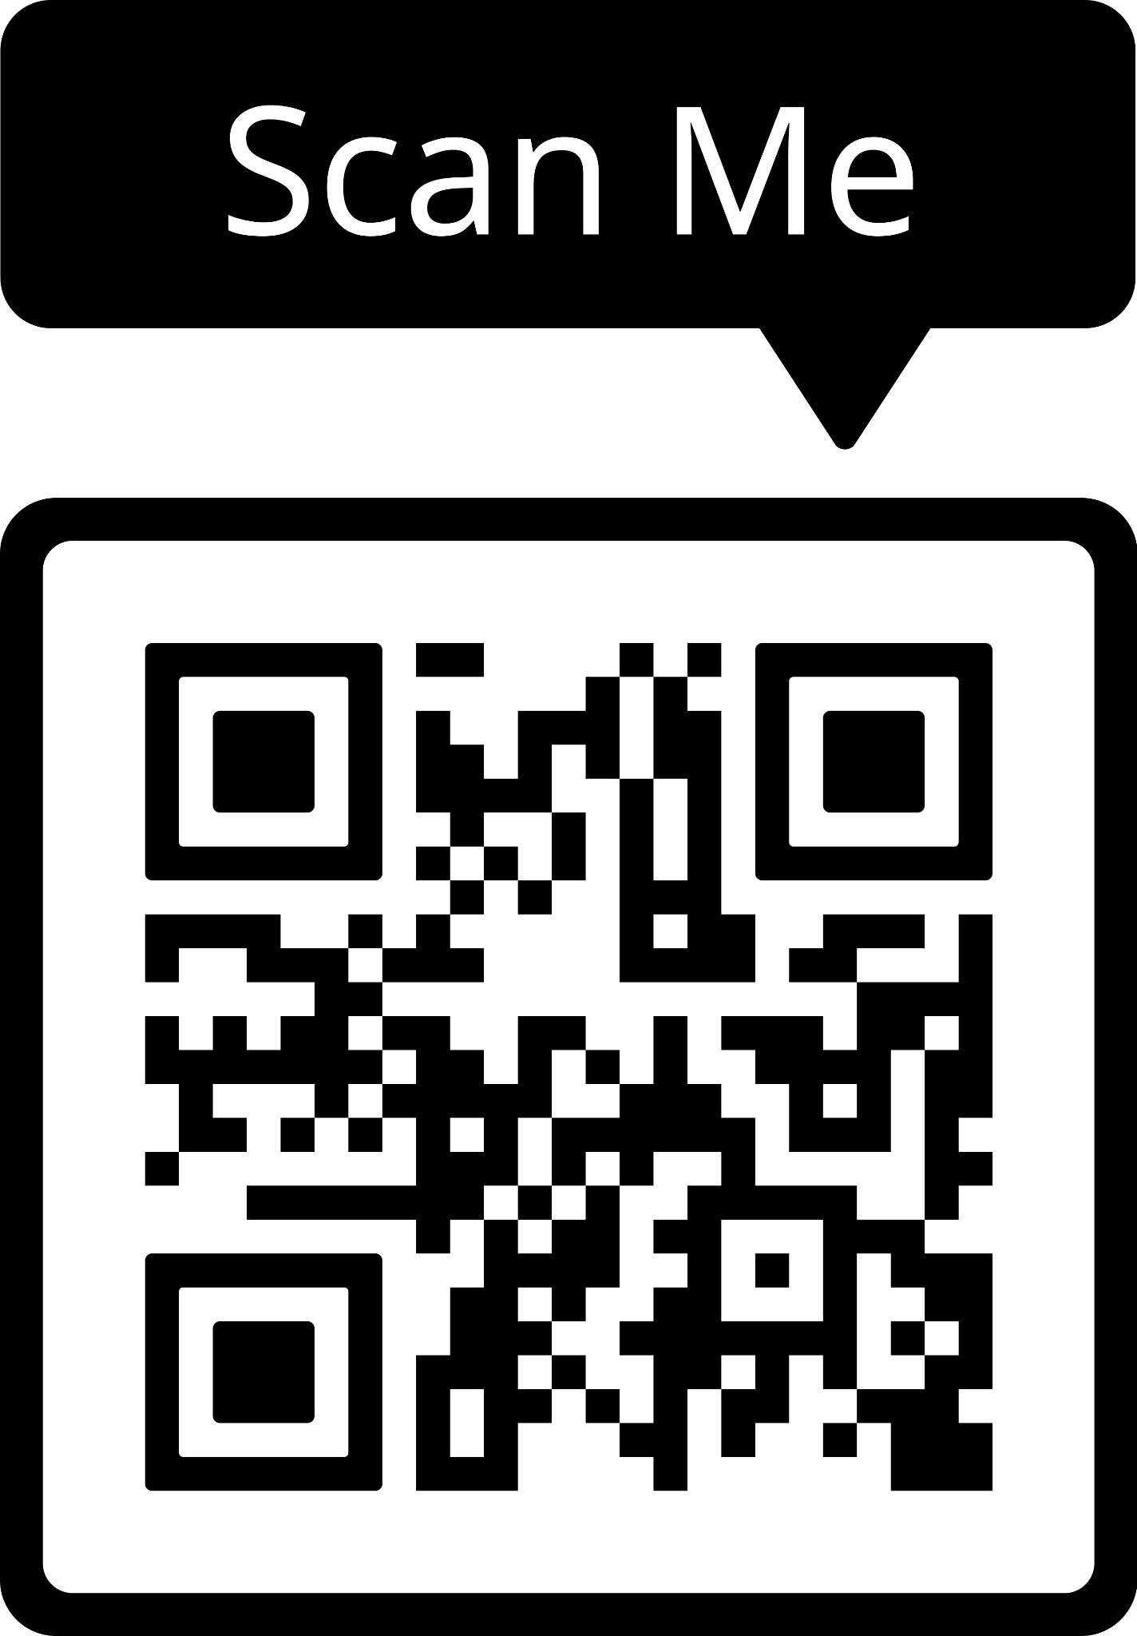
Contact Information:
Ronda.Davis@wisc.edu
(414) 488 - 7729
Human Development & Relationships Institute
Notes:
Ronda

Slide 21
Cori ann Richardson
Steve evans
Associated bank

Slide 22
Robert mann
Ho-chunk nation

