Slide 1
BEYOND THE BASICS: THE EXPANSION OF RNR
WATCP CONFERENCE 2026
Don’t forget to log into the app

Slide 2

JASON CHAPMAN
Training and Quality Assurance Coordinator, JusticePoint
Jason is a popular speaker at national conferences, he specializes in making behavioral interventions and peer support strategies practical for frontline justice and recovery professionals.

Slide 3
NOT A BASIC RNR TRAINING
Risk
Who
Needs
What
Responsivity
How
The challenge isn’t awareness – it is implementation and fidelity
Session Focus:
Critique and Defense of RNR
Expansion of RNR
Practical Application

Slide 4
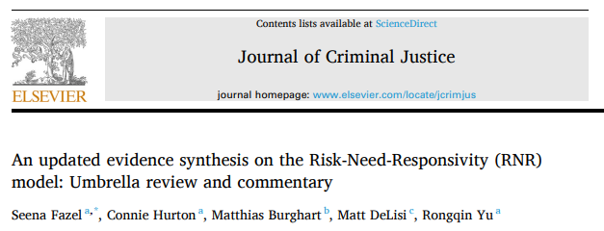
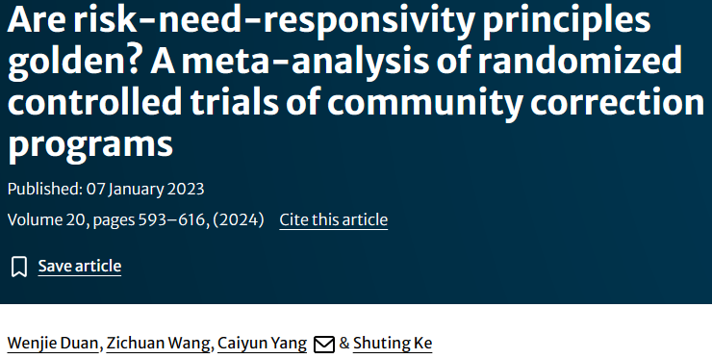
RNR – DOMINANT BUT DEBATED
Globally, RNR remains one the most influential framework
Critiques have been increasing in the academic literature
Strength and consistency of evidence
Methodological rigor of studies
Excessive self-referencing
Uneven support across principles
Weak operationalization
Correlation (Predicative) but not causal or able to explain desistance
(indent one more level) Not why people have those behaviors/traits
(same indent as above) Not how to change those targets
Deficit based

Slide 5
RNR REMAINS THE STANDARD
Sources of Mixed Findings
Fidelity
Measurement
Why RNR Remains the Standard
Consistency
Predictive
Model Reduction
Context Diversity
30+ years
Context Diversity
Fidelity Improves Outcomes

Slide 6
RNR REMAINS THE STANDARD
Sources of Mixed Findings
Fidelity
Measurement
Why RNR Remains the Standard
Consistency
Predictive
Model Reduction
Context Diversity
30+ years
Context Diversity
Fidelity Improves Outcomes
Risk
Needs

Slide 7
EXPAND, DON’T REDUCE
Overarching Principles
1) Respect for the Person
1) Respect for the Person
2) Theory
2) Theory
3) Human Service
3) Human Service
4) Crime Prevention
1) Respect for the Person
2) Theory
3) Human Service
4) Crime Prevention
4) Crime Prevention
RNR
5) Risk
7) Responsivity
Specific AND General
5) Risk
6) Need
5) Risk
6) Need
6) Need
Structural
8) Assess RNR
8) Assess RNR
9) Strengths
9) Strengths
10) Breadth
8) Assess RNR
9) Strengths
10) Breadth
10) Breadth
11) Professional Discretion
11) Professional Discretion
Program Delivery
12) Dosage
12) Dosage
Self-Practice
13) Relationship Skills
13) Relationship Skills
14) Structuring Skills
14) Structuring Skills
Organizational
15) Community Based
15) Community Based
16) Continuity of Service
17) Agency Management
18) Community Linkages

Slide 8
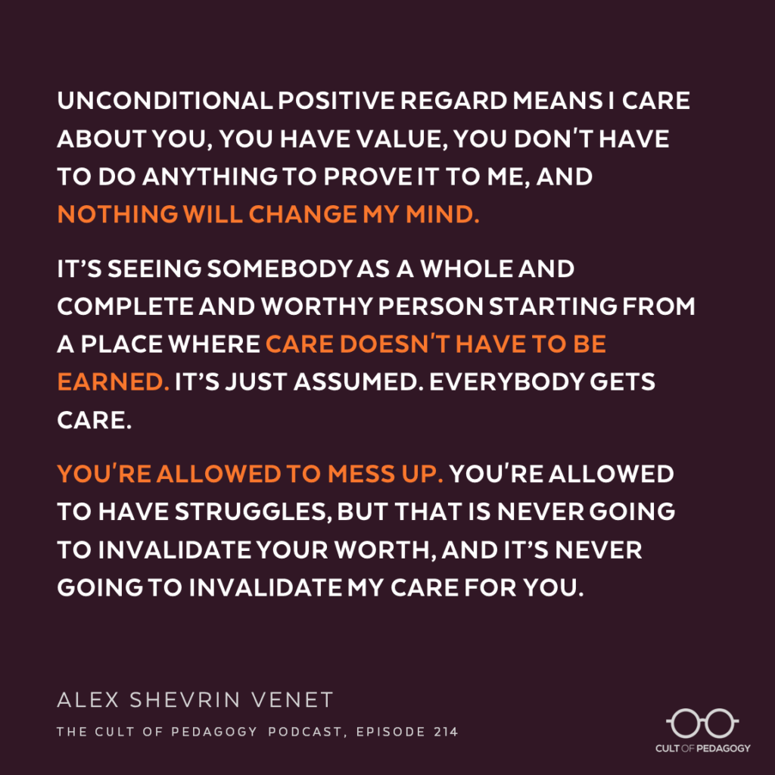
OVERARCHING: PRINCIPLE 1
1) Respect for the person
Humane, ethical, lawful, and respectful of autonomy
Serve the whole person
Minimal mandatory baseline
[indent one more level] Even if effective, not EBP if it fails to respect the person
Hope
Non-Judgmental Accountability
Whole Person

Slide 9
OVERARCHING: PRINCIPLES 2-4
2) Theory
Practices grounded in empirically supported psychological theory
EBP = Evidence AND Explanation
3) Human Service
Must include human services delivery
[indent] Must go beyond surveillance and sanctions
Change cannot occur through punishment alone
4) Crime Prevention
Crime prevention is a systems level goal
[indent] Requires providing services, access, coordination, and continuity

Slide 10
OVERARCHING PRINCIPLES TAKEAWAY
Big Picture
Everything connects – or nothing sticks
Concrete
Prioritize procedural justice
Collaborative comprehensive case plans
Replace directives with guided problem-solving
Self-assessment questions
Does this decision reflect our stated model—or is it driven by habit, frustration, or convenience?
Are we designing conditions for success or reacting to failure?
If I were in the client’s shoes, would this response: make sense to me, show that I was heard, and give me a path toward success?

Slide 11
RNR: PRINCIPLES 5-7
Not sharing anything new, but giving some reminders:
Risk Principle
[indent] Use the right assessment the way it is meant to be used
[same indent] Determines intensity
Needs Principe
[indent] Compliance is not the same as change
[same indent] Anything that is removed must be replaced
Responsivity
[indent] General responsivity is the default, not an option or suggestion
[same indent] Not about barriers, it’s about maximizing success
[same indent] Not a description nor an excuse. It is about adaptation, accommodation, and customization.

Slide 12
RNR TAKEAWAY
Big Picture
Don’t take it for granted, familiarity is not fidelity
Activity is not an intervention
Concrete
Track adherence across all aspects of the program
Self-assessment questions
Can I explain how each decision/policy is based in Risk-Need-Responsivity?
Are we implementing RNR as designed—or adapting it based on habit, preference, or convenience?
Are outcomes a reflection of system design—or individual staff effort?

Slide 13
STRUCTURAL: PRINCIPLES 8-9
Assess RNR
Decisions are based on validated assessment instruments
[indent] Disciplined and directed decision-making
[double indent] Allocation, targeting, delivery, sequencing
[indent] The purpose of assessment is to calibrate services not to label people
Strengths
Leverage strengths for success
Strengths are the answer to deficits
Build and affirm new strengths
Strengths determine longevity of change

Slide 14
STRUCTURAL: PRINCIPLES 10-11
10) Breadth
Breadth scales with risk
Criminogenic needs are like an “anti-social eco system”
[indent] Must address the “driver” AND as many associated needs as possible
Use to identify sequencing of interventions
Professional Discretion
Professional discretion must be structured and bounded
Only after risk and needs have been determined
Must be documented, based on evidence, and explainable
Less than 10%

Slide 15
STRUCTURE TAKEAWAY
Big Picture
Assessments are the foundation of the structure
Everything else builds on that foundation
Concrete
Track rates and reasons for overrides
Collaborative comprehensive case plan
The intervention choices and sequence are client specific not program specific
Self-assessment questions
Are strengths just listed in the case plan or are they being used?
Can we trace this decision back to the assessment data?
Is the plan based on assessed individual needs or program needs?

Slide 16
PROGRAM DELIVERY: PRINCIPLE 12
12) Dosage
Based on risk level
What counts?
[indent] Only counts time that is spent on a targeted criminogenic need of the individual
[indent] Must evidence based
[indent] Must meet general and specific responsivity
[indent] Must have active components
What doesn’t count?
[indent] Routine or procedural meetings
[indent] Passive presence or non-attendance.
What might count?
[indent]Secondary needs or protective factors AFTER primary criminogenic needs addressed

Slide 17
PROGRAM DELIVERY TAKEAWAY
Big Picture
Dosage drives change only when it is targeted, structured, evidence-based, and delivered with fidelity.
Concrete
Over-programming can increase recidivism time so every minute matters*
Design contacts at all levels around evidence-based interventions
Self-assessment questions
Could an observer identify which criminogenic need was the focus of this contact?
What was the specific intervention used and does that meet dosage standards?
Are we counting what is easy or what matters?

Slide 18
SELF-PRACTICES: PRINCIPLE 13-14
13) Relationship Skills
Working alliance is what matters
Conversational style is better than conformity or authoritarian style
14) Structuring Skills
Deliberate and predictable structure for interactions and interventions
Skills must be explicitly taught and practiced, not assumed
[indent] This means the inclusion of structured roleplay to teach and practice skills
Empathy | Active Listening | Transparency | Consistency
Respect | Collaborative | Authentic | Purposeful

Slide 19
SELF-PRACTICE TAKEAWAY
Big Picture
Alliance engages, but practice changes
Concrete
Over-programming can increase recidivism time so every minute matters*
Design contacts at all levels around evidence-based interventions
Self-assessment questions
Is what I’m doing increasing engagement or resistance?
From their perspective would they feel I am working with them or acting on them?
When was the skill modeled and practiced not just discussed?
From the client’s point of view, does the program feel predictable or inconsistent?

Slide 20
ORGANIZATION: PRINCPLES 15-18
15) Community Based
Interventions should by delivered in the least restrictive setting
Allows change to be practiced and sustained in the environment where risk is encountered
16) Continuity of Service
Alignment of RNR principles across settings and phases of care
Prevent interruption, dilution, reset
Continual reinforcement
17) Agency Management
Policies, procedures, supervision, training and QA all reinforce EBP
Fidelity is a function of organizational culture not only staff dependent
18) Community Linkages
Intentional, structured connections to external services and resources

Slide 21
ORGANIZATIONAL TAKEAWAY
Big Picture
Outcomes are a function of system design, not individual effort
Concrete
Internal fidelity AND external integration.
Intentionality behind each policy, procedure, and decision.
Self-assessment questions
Is fidelity embedded in our program or is it dependent on individuals?
Are we focused on progress in the program or sustained change in the community?
Are we strengthening their community support system or substituting for them?
Are we acting in coordination with the community or as a parallel system?

Slide 22

The RNR Ecosystem
RNR is not an acronym, it’s an eco-system.
What does this mean to you?

Slide 23
REFERENCES
Andrews, D. A., Bonta, J., & Wormith, J. S. (2011a). The Risk-Need-Responsivity (RNR) Model: Does Adding the Good Lives Model Contribute to Effective Crime Prevention? Criminal Justice and Behavior, 38(7), 735–755. https://doi.org/10.1177/0093854811406356
Bonta, J. (n.d.). The Risk-Need-Responsivity model: 1990 to the Present.
Bonta, J., & Gendreau, P. (2024). A commentary on Duan et al.: RNR’s luster remains. Journal of Experimental Criminology. https://doi.org/10.1007/s11292-024-09654-5
Canada, P. S. (2023, May 8). Transforming Community Supervision Through Evidence-Based Practice. https://www.publicsafety.gc.ca/cnt/rsrcs/pblctns/2023-r004/index-en.aspx?wbdisable=true
D’Amora, D. A. (n.d.). Understanding the Expanded Risk- Need-Responsivity Model. https://csgjusticecenter.org/wp-content/uploads/2023/03/RNR-Field-Wide-Webinar-Series-Part-1-Understanding-the-Expanded-RNR-Model-.pdf#:~:text=It%20is%20designed%20to%20improve%20responses%20to,who%20are%20involved%20in%20the%20criminal%20justice
Discussion: An Expert Panel Responds to the Umbrella Review of the Risk-Need-Responsivity Model by Seena Fazel, et al. (n.d.). Retrieved April 10, 2026, from https://www.myiacfp.org/discussion-an-expert-panel-responds-to-the-umbrella-review-of-the-risk-need-responsivity-model-by-seena-fazel-et-al/?utm_source=chatgpt.com
Don Andrews, James Bonta, and Stephen Wormith, “The risk-need-responsivity (RNR) model: Does adding the good lives model contribute to effective crime prevention?” Criminal Justice and Behavior 38, no. 7 (2011): 735–755.
Duan, W., Wang, Z., Yang, C., & Ke, S. (2024). Are risk-need-responsivity principles golden? A meta-analysis of randomized controlled trials of community correction programs. Journal of Experimental Criminology, 20(2), 593-616.
Fazel, S., Hurton, C., Burghart, M., DeLisi, M., & Yu, R. (2024). An updated evidence synthesis on the Risk-Need-Responsivity (RNR) model: Umbrella review and commentary. Journal of Criminal Justice, 92, 102197. https://doi.org/10.1016/j.jcrimjus.2024.102197
Fretz, R., & Bogue, B. (2023). Reconfiguring risk-need-responsivity (RNR) assessment based on the recent influx of research on trauma and recidivism. Journal of Community Justice, 32(3), 5-11.
Looman, J., & Abracen, J. (2013). The risk need responsivity model of offender rehabilitation: Is there really a need for a paradigm shift? International Journal of Behavioral Consultation and Therapy, 8(3–4), 30–36. https://doi.org/10.1037/h0100980
McGuire, J., Seto, M. C., Davies, J., & Lösel, F. (2025). Significantly off target: a commentary on Fazel et al.’s (2024) umbrella review of research on the risk–need–responsivity framework. Journal of experimental Criminology, 1-14.
Polaschek, D. L. (2012). An appraisal of the risk–need–responsivity (RNR) model of offender rehabilitation and its application in correctional treatment. Legal and criminological Psychology, 17(1), 1-17.

Slide 24

CONTACT INFORMATION
JASON CHAPMAN
Training and Quality Assurance Coordinator, JusticePoint
jchapman@justicepoint.org
Cell: 262-825-4245

