Slide 1
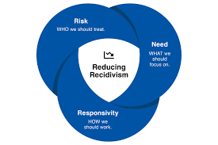
Risk, Needs and Responsivity Across the Sequential Intercept Model

Slide 2
Plan for the Day…
Speaker Introductions
Intro to Evidence-Based Decision Making
Intro to the Sequential Intercept Model
Intro to Risk, Needs, Responsivity Model
BREAK!!
Putting it all together

Slide 3
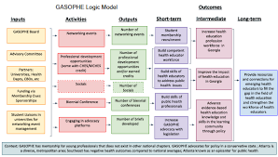
Evidence-Based Decision Making
Nick Sayner - CEO
Difference Principle

Slide 4
Why EBDM?
Growing body of evidence that can (and does) inform justice system agencies’ performance and increase effectiveness
Historically, there have been demonstrations of successful approaches/changes within individual operating agencies around the country, not system-wide
A primary perceived barrier is the lack of system collaboration around a common set of outcomes and principles

Slide 5
The Vision of the EBDM Initiative
What if we create and test a “Framework” for evidence-based decision making that
brings partners together in a new way, a truly collaborative way?
encourages these partners to find consensus around what the justice system in their community – however large or small – hopes to achieve?
led to a new way of making decisions – about individuals and about the system itself?

Slide 6
EBDM Overarching Goal
To create a framework for justice systems that will result in improved system outcomes
through true collaborative partnerships,
systematic use of research,
and a shared vision of desired outcomes.
“A permanent shift in expectations about what is possible.”
--Joe McCannon, Wisconsin EBDM Summit, Jan 2014

Slide 7
“To reach their full potential, evidence-based practices cannot simply be placed alongside past practice or through the piecemeal exchange of one past practice for a new one. Instead, an evidence-based decision making process—a systemic approach that uses research to inform decisions at all levels—offers the greatest promise for harm and risk reduction and the potential for a tremendous return…”
–EBDM Framework, p. 39

Slide 8
EBDM Principles
EBDM Principle 1: The professional judgment of criminal justice system decision makers is enhanced when informed by evidence-based knowledge.
EBDM Principle 2: Every interaction within the criminal justice system offers an opportunity to contribute to harm reduction.
EBDM Principle 3: Systems achieve better outcomes when they operate collaboratively.
EBDM Principle 4: The criminal justice system will continually learn and improve when professionals make decisions based on the collection, analysis, and use of data and information.

Slide 9
EBP vs. EBDM
EBPs are policies, practices, and/or interventions supported by research
Research finding: empirically-based tools predict risk better than professional judgment alone
EB practice: use of a risk tool to determine appropriate amount of intervention
EBDM is a disciplined approach to using data and research to inform and guide decision making across the justice system
Who do we divert?
What do we want to achieve by diverting?
What does the research tell us about the most effective method of achieving our goal?

Slide 10
Key Justice System Decision Points: State and Local Level EBDM
Local & State Institutional Release/Parole Release
Probation & Parole Interventions
Local & State Reentry Planning
Local & State Institutional Intervention
Diversion/Deferred Prosecution
Community Treatment Interventions
Pretrial Status
Discharge
Violation Response
Plea
Arrest
Charging
Sentencing

Slide 11
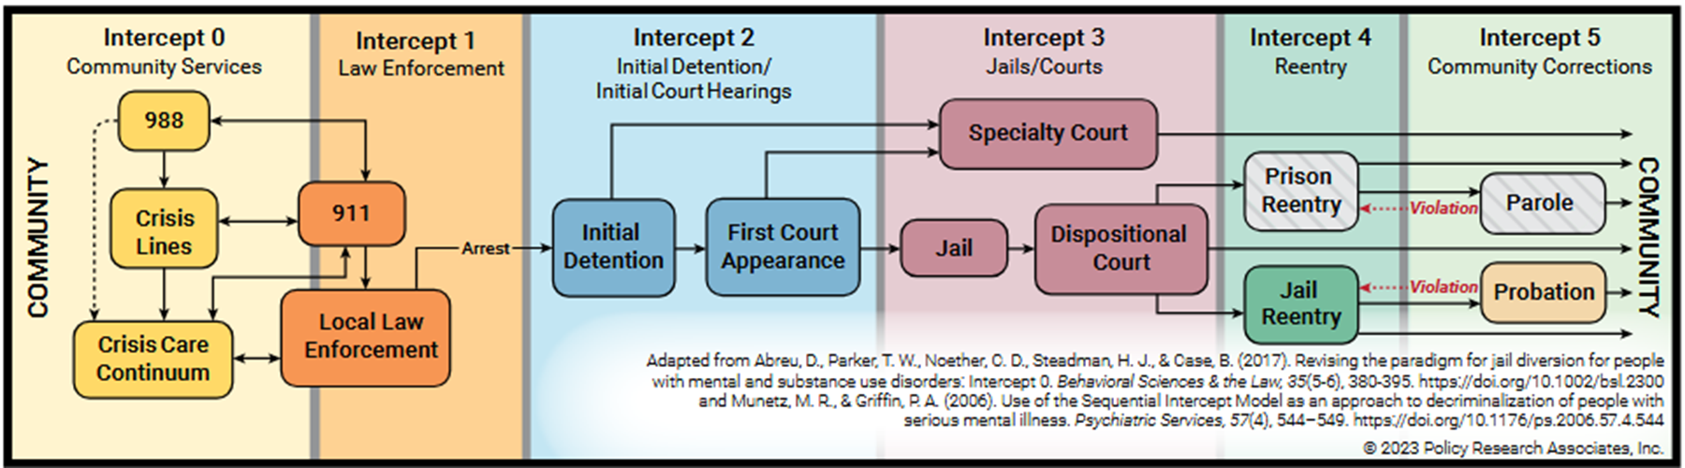
Sequential Intercept Mapping
Danielle Young - Senior Court Management Consultant
National Center for State Courts

Slide 12
Strategic Planning through SIM
Considerations
Getting Started
Existing councils and committees can be leveraged as a starting point and backbone to support your efforts:
CJCCs
Task Forces
County board or city council committees
Convene Collaborators
Judges should consider their jurisdiction’s available resources and infrastructure when identifying collaborators, and ensure collaborators at each intercept are included
Assess the Landscape
Inventory resources
Identify and document gaps
Map how people move through the justice system
Identify solutions
Collect Data
Identify data points needed to measure and assess the effectiveness of your chosen response(s)
Secure data sharing agreements
Leverage existing technology
Implement Responses
Jurisdictions can partner to leverage capacity and seek funding opportunities to overcome sparse resources. Action plan to address:
Strategies
Timelines
Barriers
Goals
Training
Funding
Sustain
Measure your outcomes
Regularly review progress
Make needed adjustments
Follow your communication plan
Facilitate training and cross-training
Celebrate successes

Slide 13

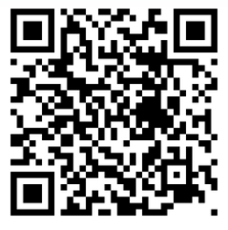
Sequential Intercept Model
Notes:
Overview of SIM:
SIM was developed by Policy Research Associates as a conceptual model to inform community-based responses to the involvement of people with mental and substance use disorders in the criminal justice system.
SIM is to be used as an applied strategic planning tool to improve cross-system collaborations to reduce involvement in the justice system
SIM is most effective when used as a community strategic planning tool to assess available resources, determine gaps in services, and plan for community change.
These activities are best accomplished by a team of stakeholders that cross over multiple systems, including mental health, substance use, law enforcement, pretrial services, courts, jails community corrections, housing, health, social services, people with lived experiences, family members, and many others.
SIM helps to develop a comprehensive picture of how people with mental and substance use disorders flow through the criminal justice system along six distinct intercept points
At each intercept we will identify resources, gaps, and opportunities for adults with mental health and substance use disorders
SIM is also used to develop priorities for action designed to improve system and service-level responses
This graphic is the most commonly used for SIM. It maps out a simple process across the intercepts, lists key issues at each intercept and gives best practices across the intercepts.
Community-based solutions
Cross-system collaboration
Reduced criminal justice involvement for individuals with mental illness and substance use
Community mapping framework
Review the Best Practices at each Intercept:
Intercept 0
Mobile Crisis Outreach Teams and Co-Responders
Emergency Department Diversion
Police Friendly Crisis Services
Intercept 1
Dispatcher Training
Specialized Police Responses
High-Utilizer Specific Intervention and Follow-Up
Intercept 2
Screening for Mental Health and Substance Use Disorders
Data Matching Initiatives Between the Jail and Community-Based Behavioral Health Providers
Pretrial Supervision and Diversion Services to Reduce Episodes of Incarceration
Intercept 3
Treatment Courts for High-Risk/High-Need Individuals
Jail-Based Programming and Health Care Services
Collaboration with the Veterans Justice Outreach (VJO) Specialist from the Veterans Health Administration
Intercept 4
Transition Planning by the Jail or IN-Reach Providers
Medication and Prescription Access Upon Release from Jail or Prison
Warm Hand-Offs from Corrections to Providers Increases Engagement in Services
Intercept 5
Specialized Community Supervision Caseloads of People with Mental Health Disorders
Medication-Assisted Treatment for Substance Use Disorders
Access to Recovery Supports, Benefits, Housing and Competitive Employment
Other suggestions? Peer Based Supports, Court Liaisons/ Navigators

Slide 14
Sequential Intercept Model
Intercept 0
Mobile crisis outreach teams and co-responders. Behavioral health practitioners who can respond to people experiencing a mental or substance use crisis or co-respond to a law enforcement encounter.
Emergency Department (ED) diversion. ED diversion can consist of a triage service, embedded mobile crisis, or a peer specialist who provides support to people in crisis.
Law enforcement-friendly crisis services. Law enforcement officers can bring people in crisis to locations other than jail or the ED, such as stabilization units, walk-in services, or respite centers.
Dispatcher training. Dispatchers should coordinate with 988 and understand triage protocols.
Intercept 1
Dispatcher training. Dispatchers can identify mental or substance use crisis situations and pass that information along so that Crisis Intervention Team officers can respond to the call. They should coordinate with 988 and understand triage protocols.
Specialized law enforcement responses. Law enforcement officers can learn how to interact with people experiencing a crisis in ways that promote engagement in treatment and build community partnerships.
Intervening with people who have frequent behavioral health crises and/or jail contact and providing follow-up after the crisis. Law enforcement officers, crisis services, and hospitals can provide specialized responses to people who frequently use 911 and ED services.
Intercept 2
Screening for mental and substance use disorders. Brief screens can be administered universally by non-clinical staff at jail booking, holding cells, court lock ups, and prior to the first court appearance.
Data matching initiatives between the jail and community-based behavioral health providers. Jail-led efforts to share information with community-based providers may be effective due to more restrictive rule related to information sharing for behavioral health providers.
Pretrial supervision and diversion services to reduce episodes of incarceration. Risk-based pre-trial services can reduce incarceration of people with low risk of criminal behavior or failure to appear in court.
Intercept 3
Treatment courts for high-risk/ high-need individuals. Treatment courts or specialized dockets can be developed, examples of which include adult drug courts, mental health courts, and veterans treatment courts.
Jail-based programming and health care services. Jail health care providers are constitutionally required to provide behavioral health and medical services to persons needing treatment..
Collaboration with the Veterans Justice Outreach specialist (VJO) from the Veterans Health Administration (VHA). VJO specialists can support Veterans by connecting them with VHA-provided services and other benefits to support recovery.
Intercept 4
Transition planning by the jail or in-reach providers. Transition planning improves reentry outcomes by organizing services around a person’s needs in advance of release.
Medication and prescription access upon release from jail or prison. People should be provided with a minimum of 30 days’ medication at release and have prescription in hand upon release.
Warm hand-offs from corrections to providers increase engagement in services. Case managers and peer support specialists can play an important role in supporting individuals in their recovery and community reintegration. They can assist with navigating the myriad demands placed on an individual, including transportation and scheduling, increasing positive outcomes.
Intercept 5
Specialized community supervision for people with mental and substance use disorders. Officers trained on the complexities of mental and substance use disorders can support connection to community-based services and supports.
Medication-assisted treatment (MAT) for people with substance use disorders. MAT approaches can reduce relapse episodes and overdoses among individuals returning from detention.
Access to recovery supports, benefits, housing, and competitive employment. Housing and employment are as important to criminal legal system-involved individuals as access to treatment services. Removing barriers to access is critical.
Notes:
Overview of SIM:
SIM was developed by Policy Research Associates as a conceptual model to inform community-based responses to the involvement of people with mental and substance use disorders in the criminal justice system.
SIM is to be used as an applied strategic planning tool to improve cross-system collaborations to reduce involvement in the justice system
SIM is most effective when used as a community strategic planning tool to assess available resources, determine gaps in services, and plan for community change.
These activities are best accomplished by a team of stakeholders that cross over multiple systems, including mental health, substance use, law enforcement, pretrial services, courts, jails community corrections, housing, health, social services, people with lived experiences, family members, and many others.
SIM helps to develop a comprehensive picture of how people with mental and substance use disorders flow through the criminal justice system along six distinct intercept points
At each intercept we will identify resources, gaps, and opportunities for adults with mental health and substance use disorders
SIM is also used to develop priorities for action designed to improve system and service-level responses
This graphic is the most commonly used for SIM. It maps out a simple process across the intercepts, lists key issues at each intercept and gives best practices across the intercepts.
Community-based solutions
Cross-system collaboration
Reduced criminal justice involvement for individuals with mental illness and substance use
Community mapping framework
Review the Best Practices at each Intercept:
Intercept 0
Mobile Crisis Outreach Teams and Co-Responders
Emergency Department Diversion
Police Friendly Crisis Services
Intercept 1
Dispatcher Training
Specialized Police Responses
High-Utilizer Specific Intervention and Follow-Up
Intercept 2
Screening for Mental Health and Substance Use Disorders
Data Matching Initiatives Between the Jail and Community-Based Behavioral Health Providers
Pretrial Supervision and Diversion Services to Reduce Episodes of Incarceration
Intercept 3
Treatment Courts for High-Risk/High-Need Individuals
Jail-Based Programming and Health Care Services
Collaboration with the Veterans Justice Outreach (VJO) Specialist from the Veterans Health Administration
Intercept 4
Transition Planning by the Jail or IN-Reach Providers
Medication and Prescription Access Upon Release from Jail or Prison
Warm Hand-Offs from Corrections to Providers Increases Engagement in Services
Intercept 5
Specialized Community Supervision Caseloads of People with Mental Health Disorders
Medication-Assisted Treatment for Substance Use Disorders
Access to Recovery Supports, Benefits, Housing and Competitive Employment
Other suggestions? Peer Based Supports, Court Liaisons/ Navigators

Slide 15
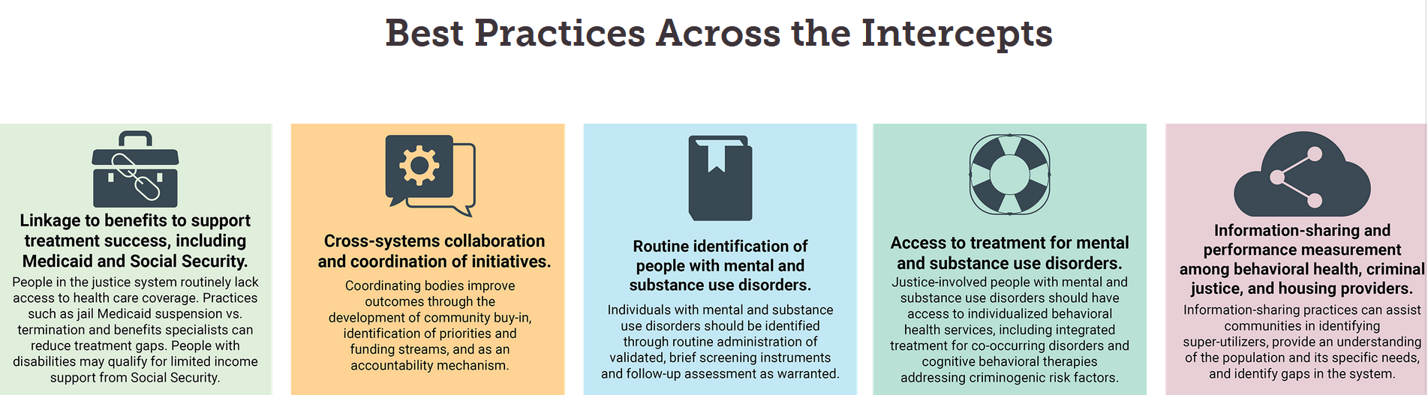
Sequential Intercept Model
Notes:
Overview of SIM:
SIM was developed by Policy Research Associates as a conceptual model to inform community-based responses to the involvement of people with mental and substance use disorders in the criminal justice system.
SIM is to be used as an applied strategic planning tool to improve cross-system collaborations to reduce involvement in the justice system
SIM is most effective when used as a community strategic planning tool to assess available resources, determine gaps in services, and plan for community change.
These activities are best accomplished by a team of stakeholders that cross over multiple systems, including mental health, substance use, law enforcement, pretrial services, courts, jails community corrections, housing, health, social services, people with lived experiences, family members, and many others.
SIM helps to develop a comprehensive picture of how people with mental and substance use disorders flow through the criminal justice system along six distinct intercept points
At each intercept we will identify resources, gaps, and opportunities for adults with mental health and substance use disorders
SIM is also used to develop priorities for action designed to improve system and service-level responses
This graphic is the most commonly used for SIM. It maps out a simple process across the intercepts, lists key issues at each intercept and gives best practices across the intercepts.
Community-based solutions
Cross-system collaboration
Reduced criminal justice involvement for individuals with mental illness and substance use
Community mapping framework
Review the Best Practices at each Intercept:
Intercept 0
Mobile Crisis Outreach Teams and Co-Responders
Emergency Department Diversion
Police Friendly Crisis Services
Intercept 1
Dispatcher Training
Specialized Police Responses
High-Utilizer Specific Intervention and Follow-Up
Intercept 2
Screening for Mental Health and Substance Use Disorders
Data Matching Initiatives Between the Jail and Community-Based Behavioral Health Providers
Pretrial Supervision and Diversion Services to Reduce Episodes of Incarceration
Intercept 3
Treatment Courts for High-Risk/High-Need Individuals
Jail-Based Programming and Health Care Services
Collaboration with the Veterans Justice Outreach (VJO) Specialist from the Veterans Health Administration
Intercept 4
Transition Planning by the Jail or IN-Reach Providers
Medication and Prescription Access Upon Release from Jail or Prison
Warm Hand-Offs from Corrections to Providers Increases Engagement in Services
Intercept 5
Specialized Community Supervision Caseloads of People with Mental Health Disorders
Medication-Assisted Treatment for Substance Use Disorders
Access to Recovery Supports, Benefits, Housing and Competitive Employment
Other suggestions? Peer Based Supports, Court Liaisons/ Navigators

Slide 16
Evidence-Based Practices
Promote robust community health systems, treatment, and services
Minimize justice involvement
Utilize crisis response systems and 988 to address the needs of people with serious mental illnesses
Reduce reliance on psychiatric boarding of individuals in emergency rooms/departments
Use jail only as a last resort for individuals in crisis, and only when based on an assed risk to public safety
Reduce competition and duplication of services, and expand the continuum of care to include as many levels and types of care as possible
Include ways to address common barriers to service, such as housing, transportation, and income, in any solution development
Emphasize coordinated community responses to common challenges faced by individuals with behavioral health issues
Create a continuum of diversion to treatment options, practices, and programs at pre-arrest, pre-adjudication, and post-adjudication

Slide 17
Evidence-Based Practices
Use validated screening tools to identify those needing behavioral health services for all individuals at the time of arrest, and throughout their involvement in the justice system
Work with community partners to screen for and treat trauma in the community
Screen for trauma and ensure trauma services are available for juveniles and adults in the criminal justice system
Ensure all judges, court personnel, and other staff are educated and trained about behavioral health disorders, being trauma responsive, and in any required system responses
Employ person-centered approaches rather than adversarial ones for individuals with behavioral health disorders in the courts
Support efforts to address chronic behavioral health workforce shortages
Limit the use of competency restoration to the most serious offenses and divert others to treatment and recovery in the community.
Pool resources to develop regional mental health diversion and treatment facilities when treatment is difficult to access

Slide 18
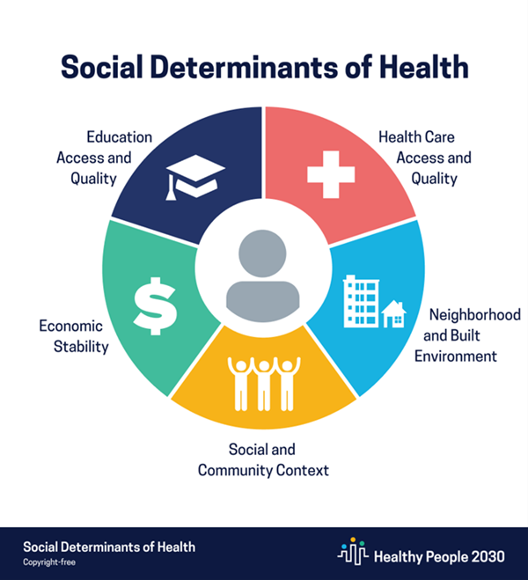
The environments in which we are born, live and spend our time affect our health, functioning, and quality of life.
SDOH have been shown to have a greater influence on health than either genetic factors or access to healthcare services (e.g., . poverty is highly correlated with poorer health outcomes and higher risk of premature death).
By addressing and improving areas in the five domains of SDOH, we are building communities where all people thrive.
Notes:
Examples: communities without access to grocery stores – communities without economic stability – with low paying jobs – people are less likely to purchase medical care or other things that can help support their health

Slide 19
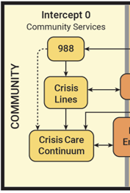
Intercept 0 – Crisis/Community Services
Framing the Discussion
What public outreach on mental health currently exists (e.g. hotlines, awareness campaigns, etc.)?
What public benefit assistance is available for mental and behavioral health services? What assistance exists for obtaining and maintaining it? (e.g., Medicaid eligibility)?
What resources are available in the community to provide mental health and substance use services? Outside the community?
Are dedicated stabilization units established in the community to handle mental health and substance use disorder crises? Who do they serve?
What levels of care are available in the community?
What options exist for establishing advanced directives (e.g., guardianships) for individuals at risk for mental and behavioral crises?
What processes are in place to initiate a civil commitment? Are family and the public made aware of these services?
What recovery supports and public health, social service, or rehabilitation services are available to address individuals’ health and welfare, help them to achieve goals, sustain recovery, and enhance their quality of life?

Slide 20
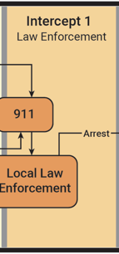
Intercept 1 – Law Enforcement
Framing the Discussion
What law enforcement agencies exist/have jurisdiction in the community?
What pre-arrest deterrence or redirection options are available in the community?
What law enforcement, dispatch, and first responder training and efforts exist related to crisis intervention (e.g., CIT, mental health first aid)?
Are there any specific co-responder models or alternatives to law enforcement response?
Does law enforcement have reliable places to take people in crisis besides jail?
What, if any, data are collected on mental illness during law enforcement responses? How are such data shared across agencies?
What information sharing protocols and agreements are established to access mental health information (e.g., past evaluations) across agencies?

Slide 21
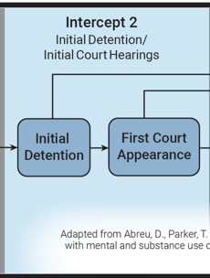
Intercept 2 – Initial Detention/Hearing
Framing the Discussion
What detention centers exist in/are utilized by the community?
What protocols are in place to identify mental health and substance use needs upon intake to detention?
What screening or assessment tools are used to identify mental health or substance use needs? Are these tools validated?
How are individuals with mental health or substance use disorders needs identified by courts?
What protocols are established to reduce redundancy in conducting and maintaining assessment and evaluation results?

Slide 22
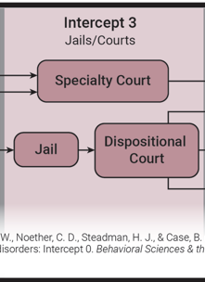
Intercept 3 – Jail & Courts
Framing the Discussion
Is there a behavioral health liaison position in the courts to connect with detention facilities and/or conduct evaluations?
What behavioral health services are provided in the jail (e.g., MAT, counseling, recovery groups, etc.)? Who provides those services, how often, and who can access them?
Do any treatment courts or prosecutorial diversion programs operate in your community?
How are individuals identified and referred for competency evaluations? What competency restoration, treatment, and education services are provided?
What outpatient restoration services are available? What, if any, restoration processes differ for lower-level offenses?
Are pretrial services available? What is the assessment and supervision process? What behavioral health information is provided to judges for pretrial release or sentencing decisions?
Is prescription continuity ensured throughout an individual’s progress through treatment and community, county, and state entities?

Slide 23
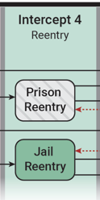
Intercept 4 – Reentry
Framing the Discussion
What re-entry services are available for those re-entering the community from jail? Who provides them?
What re-entry services are available for those re-entering the community from prison? Who provides them?
Does anyone do in-reach for pre-release planning? Are re-entry plans individualized to include treatment and social services specific to the person’s needs?
What is done to facilitate benefit (re)enrollment upon re-entry?
Are wrap-around services coordinated for individuals? Are “warm hand-offs” available upon release?
What community engagement strategies are provided upon reentry (e.g., employment, education, or pro-social activities)?

Slide 24
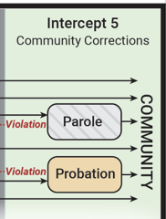
Intercept 5 – Community Corrections
Framing the Discussion
What pro-social behaviors or wellness indicators are monitored by supervision agencies (e.g., housing, health, peer support)?
What proactive measures are available to establish advanced directives/guardianship?
Are there specialized units or trained probation/parole officers to assign individuals to with behavioral health disorders?
What assessments are utilized to case plan and measure progress? Are case plans individualized to include treatment and social services specific to the person’s needs?
What activities does supervision entail (e.g., office/home/field visits, drug testing, core correctional practices, etc.)?
How are violations related to the person’s diagnosis (e.g., return to use or mental health crisis and the collateral consequences such as loss of housing/employment, missed treatment meetings, etc.), managed?

Slide 25
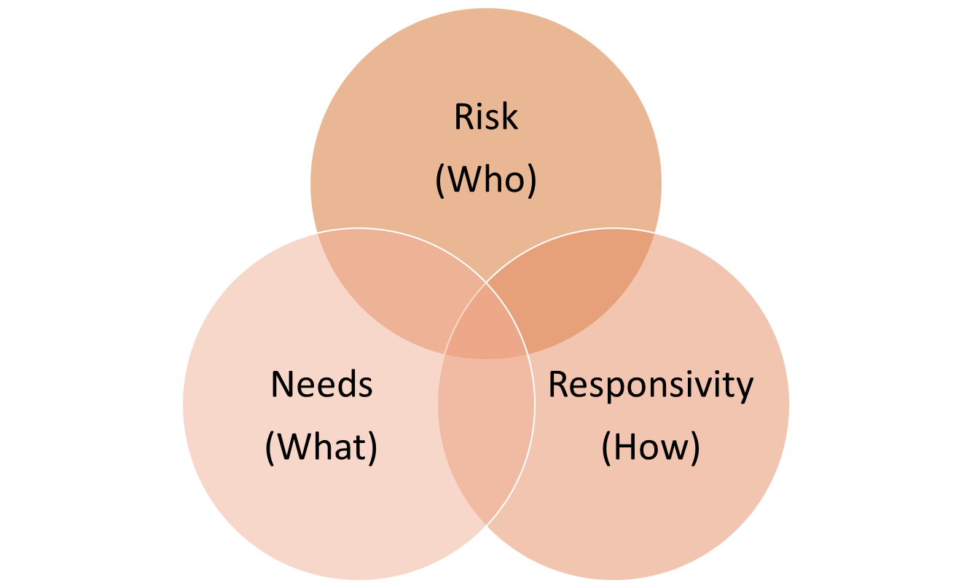
Risk, Needs, Responsivity
Jason Chapman - Training and Quality Assurance Coordinator
JusticePoint

Slide 26
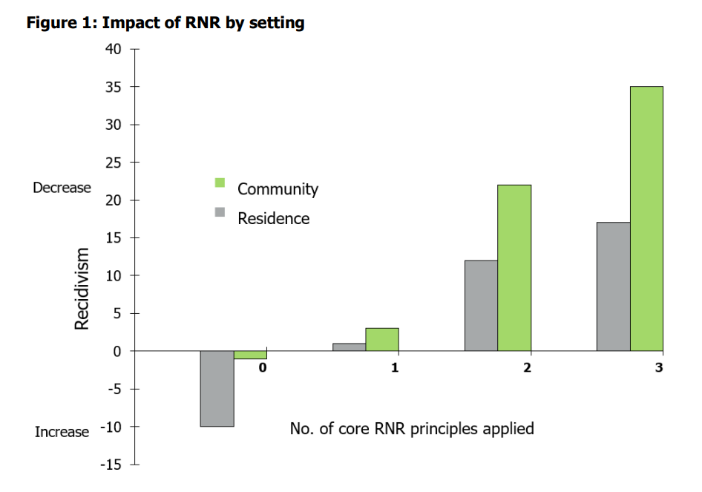

Risk-Need-responsivity model
Risk
(Who)
Responsivity
(How)
Needs
(What)
45% Difference!
Notes:
Chart from Bonta, J., & Andrews, D. A. (2007). Risk-need-responsivity model for offender assessment and rehabilitation. Rehabilitation, 6(1), 1-22. https://www.securitepublique.gc.ca/cnt/rsrcs/pblctns/rsk-nd-rspnsvty/rsk-nd-rspnsvty-eng.pdf

Slide 27
Defining risk
NOT level of harm, violence, or dangerousness!!!
Specific and narrow meaning
Term of art
Risk:
The probability of a specific event occurring
Criminogenic Risk
Could be arrest, charge, custody, or disposition
Usually 1-2 year timeframe
Pretrial Risk
Failure to appear AND/OR new arrest or charge
Usually 3-6 month timeframe
Use most specific risk tool (special populations – SO, DUI, DV, etc.)

Slide 28
What is being communicated by the term “risk”
Prognostic
Correlation
Causation
Classification
Arrest/Charge/
Conviction
Diagnostic
Prediction
Criminal Behavior
Specific Timeframe
All Future Behavior
Risk
Stakes

Slide 29
Language Matters
[Name] has been assessed as having similar traits to a group that recidivates at a high level.
OR
…that has a low likelihood of success.
[Name] is high risk

Slide 30
What goes into risk
Static = Can’t be changed
Dynamic = Can be changed
Substance Abuse
Enjoys risk taking
Parents’ criminal record
Lacks emotional regulation
Age of first arrest
Believes “Do unto others before they do onto you”
Victimstance
Lives in a high crime neighborhood
Record of juvenile delinquency
Co-defendants are all close friends
Static Risk
Dynamic Risk
Criminogenic Risk

Slide 31
Types of Risk
Criminogenic Risk
Static Risk
Dynamic Risk
Parents’ criminal record
Age of first arrest
Record of juvenile delinquency
Substance Abuse
Enjoys risk taking
Lacks emotional regulation
Believes “Do unto others before they do onto you”
Co-defendants are all close friends
Victimstance
Lives in a high crime neighborhood

Slide 32
What does risk Look like?
Rates depend on assessment and sub-group
High Risk
Multiple factors likely to cause recidivism
Lack of protective factors
Anti-Social Cognition AND Personality Patterns usually present
More likely than not to recidivate
Moderate Risk
Mixture of anti-social and pro-social/protective factors
A few criminogenic needs present
Usually, Anti-Social Cognition OR Personality Patterns
Approximate rate of recidivism 30%-50%
Low Risk
Expected to self-correct
Pro-social/Protective factors greatly outweigh minor risk factors
Usually, no Anti-Social Cognition or Personality Patterns
Approximate rate of recidivism <10-20%

Slide 33
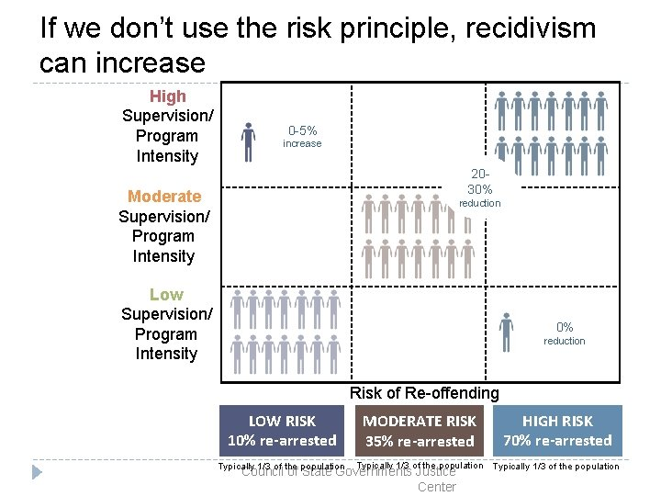
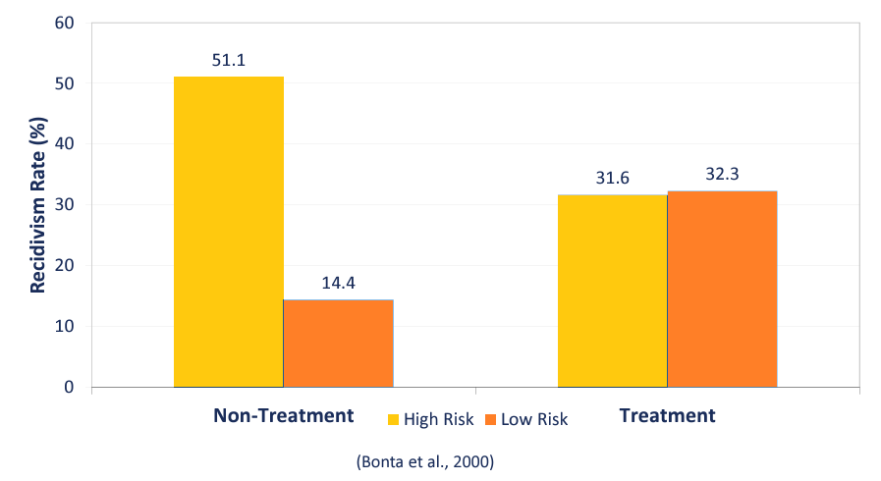
Risk – Implications
Why does categorizing matter?
Notes:
Pennsylvania Commission on Crime and Delinquency. (2016, September 27). The basics of risk-need-responsivity [PowerPoint slides] https://www.pa.gov/content/dam/copapwp-pagov/en/pccd/documents/training/documents/conferences-and-training/the%20basics%20of%20risk-need-responsivity.pdf
Bonta, J., Wallace-Capretta, S., & Rooney, J. (2000). A quasi-experimental evaluation of an intensive rehabilitation supervision program. Criminal Justice and Behavior, 27(3), 312-329. https://www.researchgate.net/profile/James-Bonta-3/publication/247744696_A_Quasi-Experimental_Evaluation_of_an_Intensive_Rehabilitation_Supervision_Program/links/5b9413874585153a530ab2e6/A-Quasi-Experimental-Evaluation-of-an-Intensive-Rehabilitation-Supervision-Program.pdf

Slide 34
Risk Principle
The risk principle:
Use a validated actuarial risk assessment to determine risk level.
Appropriately match the level of service to the assessed level of risk.

Slide 35

Criminogenic Needs = dynamic Risk Factors
Dynamic Risk = Criminogenic Needs
Criminogenic
Traits that are most closely linked to likelihood of criminal behavior
Needs
Factors that can be changed which result in decreasing risk of recidivism
Static Risk
Dynamic Risk
Criminogenic Risk
Risk Principle

Slide 36
Top criminogenic needs
Primary | Derivative | Non-Criminogenic
Antisocial Cognition (Thoughts & Beliefs) | Substance Abuse | Health Issues
Antisocial Personality Patterns (Coping, Self-Control Skills) | Employment | Mental Health
 |  | Trauma History
Antisocial Associates (Peers) | Education | Intelligence
Family/Marital Issues | Leisure | Self-Esteem
 |  | Personal Distress

Slide 37
Need Principle
The need principle has two main components:
Treatment programs should focus on criminogenic needs, or those factors directly relating to offending behavior that are amenable to change.
The dynamic nature of criminogenic needs makes them suitable targets for treatment programs with the desired goal of recidivism.

Slide 38
Responsivity
Program Components and Service Delivery
Professional Alliance and Service Provider Approach
Client Characteristics
Definition: What is required to maximize an individual’s ability to benefit from a habilitative intervention by using best practices AND tailoring the intervention to the individual’s barriers, environment, learning style, motivation, abilities, and strengths.
Responsivity is NOT part of Risk

Slide 39
General responsivity
Use evidence-based practices that have been shown to be effective across diverse client populations.
Appropriate Behavior Response
Cognitive Behavioral Interventions
Motivational Interviewing
Social Learning Theory (Structured Roleplay)

Slide 40




Specific Responsivity factors
Strengths
Pro-Social Family/Peers
Community Connections
Skills
Interests
Prior Successes
Learning Style
Barriers
Severe Mental Health
Substance Dependance
Homelessness
Etc.
Challenges
Moderate Mental Health
Substance Abuse
Trauma History
Low Motivation
Transportation
Etc.
Must stabilize before treatment progress (refer out)
Must address (refer out) or accommodate during programming
Incorporate into programming choices whenever possible

Slide 41
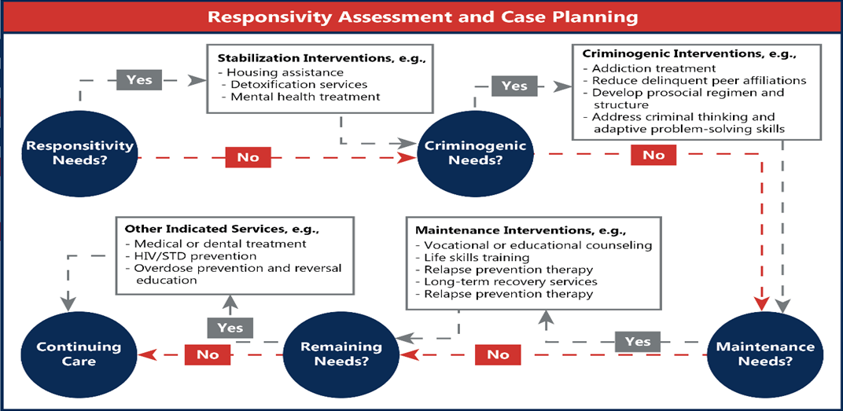
Responsivity and priority
Reassess at every meeting
Notes:
Marlowe, D. B. The Most Carefully Studied, Yet Least Understood, Terms in the Criminal Justice Lexicon: Risk, Need, and Responsivity July 17, 2018. https://www.prainc.com/risk-need-responsitivity/

Slide 42
responsivity Principle
The responsivity principle has two main components:
Maximize the effectiveness of interventions by using evidence-based services
Individually tailor interventions to meet the specific needs and traits of individuals.

Slide 43

RNR – The core principles
Risk
(Who)
Responsivity
(How)
Needs
(What)

Slide 44
BREAK
Notes:
30 Minutes

Slide 45

Putting It All Together!
Heather Kierzek, Evidence-Based Program Manager
Director of State Courts

Slide 46
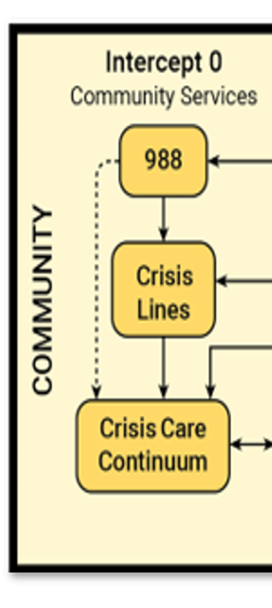
Intercept 0
Community Services

Slide 47
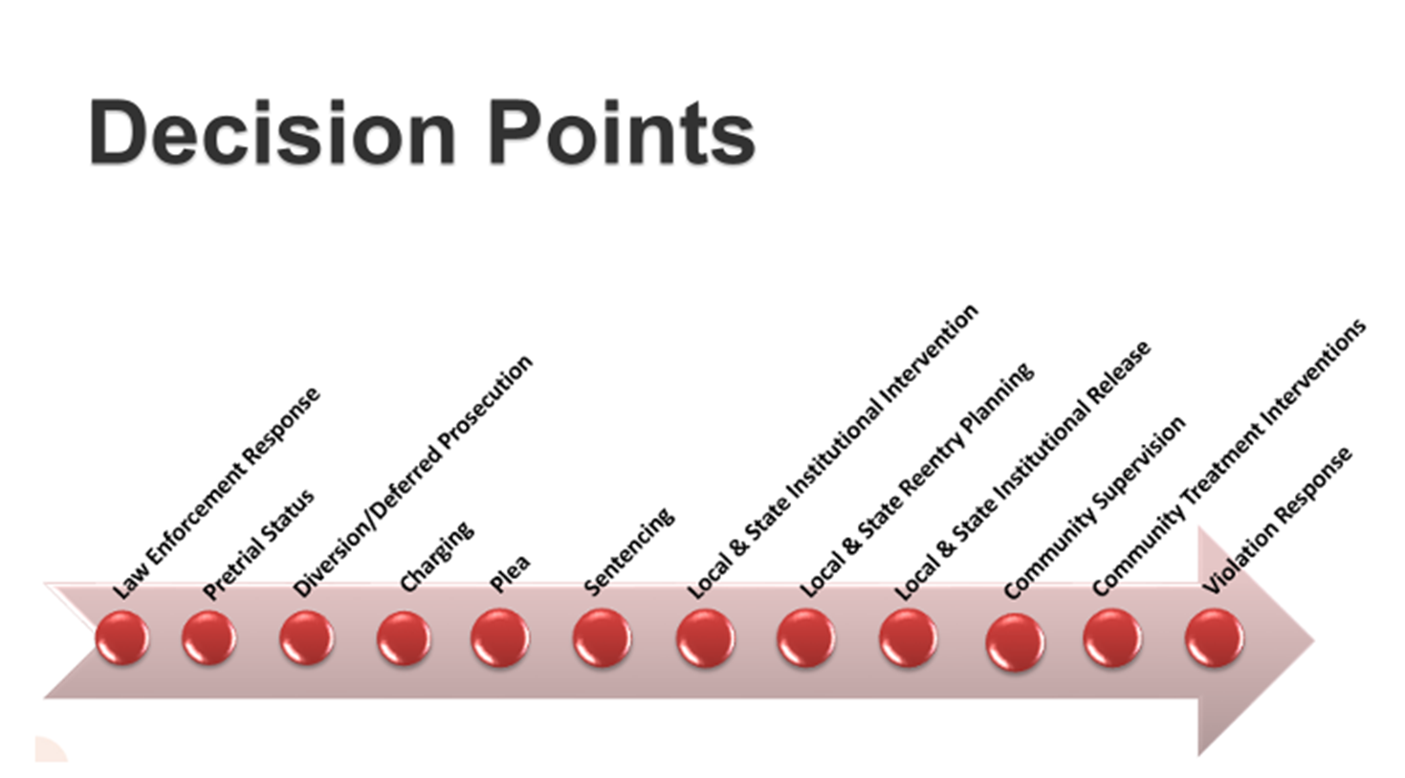
Notes:
Not on the decision point arrow, because this is outside the criminal justice system. This is not to say that decisions here don’t impact the CJ system!

Slide 48
Key System Stakeholders
Community Providers
Emergency Dispatchers
Emergency Room Providers
Crisis Teams
First Responders

Slide 49
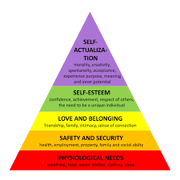
Need
Notes:
Maslow’s Hierarchy of Needs

Slide 50
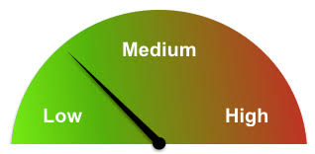
How Do We Determine Risk and Need?
Frequent Crisis Calls
Frequent Police Contacts
Frequent Overdose Calls

Slide 51
Responsivity
Learning and cognitive factors
Low IQ or cognitive limitations
Learning disabilities
Difficulty reading or understanding information
Short attention span
Mental health factors
Depression
Anxiety
PTSD
Personality disorders
Motivation and attitude
Low motivation to change
Resistance to authority
Lack of trust in staff
Communication and language
Language barriers
Limited English proficiency
Poor verbal skills
Cultural and social factors
Cultural background
Beliefs about authority or treatment
Gender-specific needs
Practical barriers
Transportation issues
Childcare needs
Physical disabilities
Medical conditions

Slide 52

Additional Interventions
Mobile crisis outreach teams and co-responders. Behavioral health practitioners who can respond to people experiencing a mental health or substance use crisis or co-respond to a police encounter.
Emergency department diversion. Emergency departments (EDs) can provide triage with behavioral health providers, embedded mobile crisis staff, and/or peer specialist staff to provide support to people in crisis.
Police-behavioral health collaborations. Police officers can build partnerships with behavioral health agencies along with the community and learn how to interact with individuals experiencing a crisis.

Slide 53

Sauk County Deflection
Amanda Hanson - Justice, Diversion and Supports Program Manager
Sauk County

Slide 54
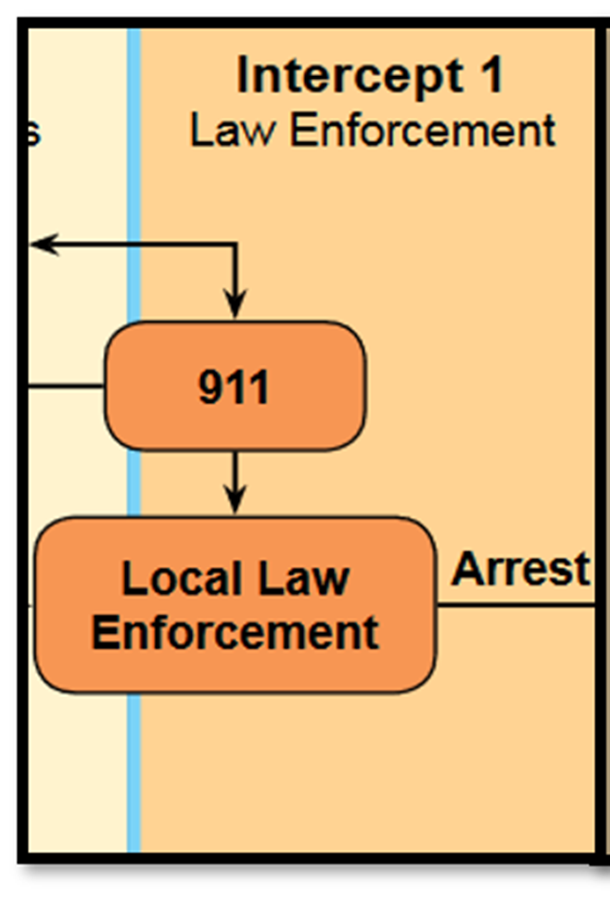
Intercept 1
Law Enforcement

Slide 56

Key System Stakeholders
Law Enforcement

Slide 57

Risk
Public Safety Risk
All risk levels will be present
Failure to Appear in Court
Notes:
Officer usually has discretion to determine verbal/written warning, cite and release, or bring to jail.

Slide 58
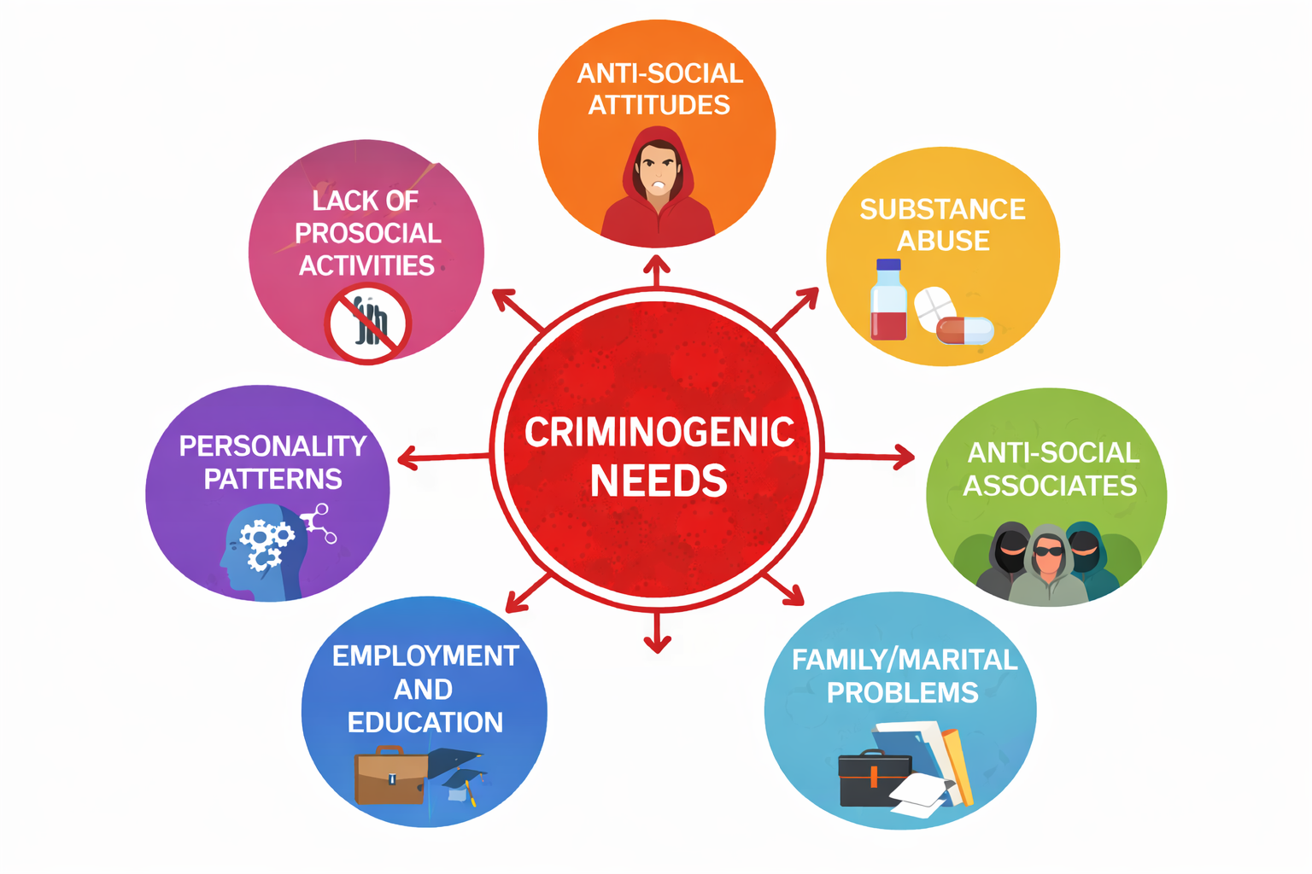
Need
Notes:
Pretrial and diversion conditions need to be based on the individual needs of the defendant. For example, requiring drug testing for someone who does not have a substance use disorder contributing to their criminal behavior does not improve outcomes.

Slide 59
How Do We Determine Risk and Need?
Risk Screening Tools
Hawaii PROXY
Level of Screening Inventory – Revised: Screening Version (LSI-R:SV)
Pretrial Assessment Tools
Public Safety Assessment (PSA)
Ohio Risk Assessment (ORAS) Pretrial Assessment Tool
Virginia Pretrial Risk Assessment Instrument (VPRAI)

Slide 60
Responsivity
Learning and cognitive factors
Low IQ or cognitive limitations
Learning disabilities
Difficulty reading or understanding information
Short attention span
Mental health factors
Depression
Anxiety
PTSD
Personality disorders
Motivation and attitude
Low motivation to change
Resistance to authority
Lack of trust in staff
Communication and language
Language barriers
Limited English proficiency
Poor verbal skills
Cultural and social factors
Cultural background
Beliefs about authority or treatment
Gender-specific needs
Practical barriers
Transportation issues
Childcare needs
Physical disabilities
Medical conditions

Slide 61
Additional Interventions
Dispatcher training. Dispatchers can identify mental health or substance use crisis situations and pass that information along so that Crisis Intervention Team officers can respond to the call.
Specialized police responses. Police officers can learn how to interact with individuals experiencing a crisis in ways that promote engagement in treatment and build partnerships between law enforcement and the community.
Intervening with frequent utilizers and providing follow-up after the crisis. Police officers, crisis services, and hospitals can reduce frequent utilizers of 911 and ED services through specialized responses.

Slide 62
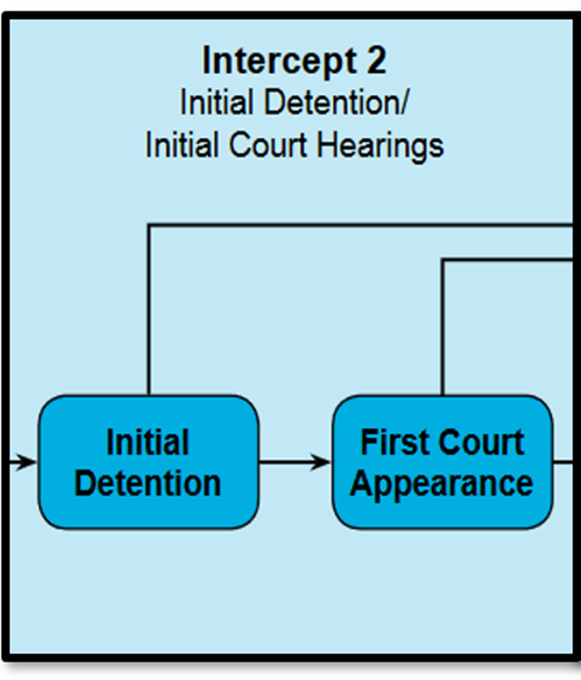
Intercept 2
Initial Court Hearing/Initial Detention

Slide 64

Key System Stakeholders
Judges/Court Commissioners
Prosecutors
Defense Attorneys
Diversion Coordinators
Pre-trial Supervision

Slide 65
Risk
Criminal Recidivism
All risk levels will be present
This is usually the first chance to screen and assess for risk and need level
Pretrial Risk
Failure to Appear
Public Safety Risk

Slide 66
A Quick Word About Low Risk…
Low-risk individuals are generally defined as having no prior convictions, no history of violence, and stable employment or housing.
Studies consistently show over 70% of low risk individuals will self-correct.
Notes:
Some studies have shown as high as 95% of low risk individuals will self-correct.

Slide 67
Impact of Pretrial Detention
Increase in new criminal arrest pretrial
Lowenkamp, C.T., VanNostrand, M., & Holsinger, A. (2013). The Hidden Costs of Pretrial Detention. Laura and John Arnold Foundation. New York City, NY
Notes:
Are the decisions judges are making inadvertently contributing to rearrest?
For low to moderate level defendants held pretrial as compared to those pretrial defendants that were released within 24 hours. The likelihood of New criminal arrest before trial increases
However high risk pretrial defendants there is no significant increase.
Could be because the arrest and detention creates instability in housing, employment, etc.

Slide 68
Impact of Pretrial Detention
Increase in 2-Year Recidivism
Lowenkamp, C.T., VanNostrand, M., & Holsinger, A. (2013). The Hidden Costs of Pretrial Detention. Laura and John Arnold Foundation. New York City, NY
Notes:
Even when the researches controlled for similar risk levels – similar charges, prior criminal histories, etc.
By not getting bail right we may be contributing to poor outcomes, exactly the opposite of what we say we are doing. Are we inadvertently causing harm?
Assessing pretrial risk correctly can help probation have better outcomes

Slide 69

Need
Notes:
Pretrial and diversion conditions need to be based on the individual needs of the defendant. For example, requiring drug testing for someone who does not have a substance use disorder contributing to their criminal behavior does not improve outcomes.

Slide 70
How Do We Determine Risk and Need?
Risk Screening/Assessment Tools
Pretrial Risk
Public Safety Assessment (PSA)
Ohio Risk Assessment (ORAS) Pretrial Assessment Tool
Virginia Pretrial Risk Assessment Instrument (VPRAI)
General Risk
ORAS
Misdemeanor Screening Tool and Misdemeanor Assessment Tool
Level of Screening Inventory – Revised: Screening Version (LSI-R:SV)
General Need
Screening, Brief Intervention and Referral to Treatment (SBIRT)
Brief Jail Mental Health Screen
Texas Christian University Drug Screen V (TCU-V)
Notes:
Why do we use assessment tools? COMPAS correctly predicted recidivism 89% of the time, compared to 60% for humans who were not provided case-by-case feedback on their decisions. When multiple risk factors were provided and predictive, another risk assessment tool accurately predicted recidivism over 80% of the time, compared to less than 60% for humans.

Slide 71
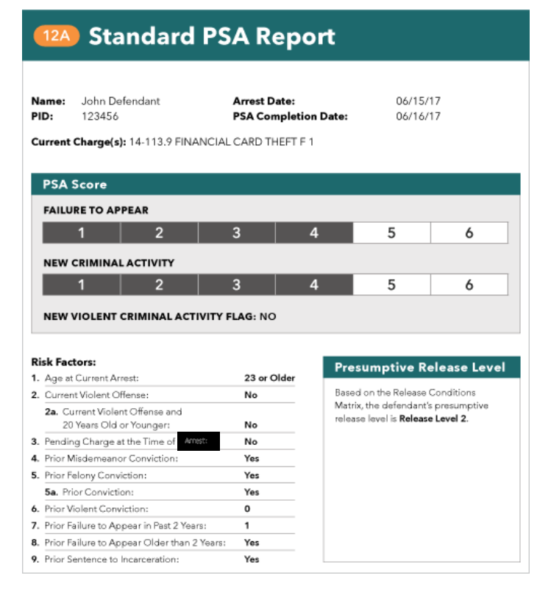
PSA Report
Example
Notes:
COMPAS Assessment

Slide 72
Responsivity
Learning and cognitive factors
Low IQ or cognitive limitations
Learning disabilities
Difficulty reading or understanding information
Short attention span
Mental health factors
Depression
Anxiety
PTSD
Personality disorders
Motivation and attitude
Low motivation to change
Resistance to authority
Lack of trust in staff
Communication and language
Language barriers
Limited English proficiency
Poor verbal skills
Cultural and social factors
Cultural background
Beliefs about authority or treatment
Gender-specific needs
Practical barriers
Transportation issues
Childcare needs
Physical disabilities
Medical conditions

Slide 73
Additional Interventions
Screening for mental health and substance use disorders. Brief screens can be administered universally by non-clinical staff at jail booking, police holding cells, court lock ups, and prior to the first court appearance.
Data-matching initiatives between the jail and community-based behavioral health providers.
Pretrial supervision and diversion services to reduce episodes of incarceration. Risk-based pre-trial services can reduce incarceration of defendants with low risk of criminal behavior or failure to appear in court.

Slide 74
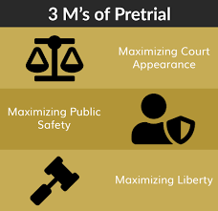
Pretrial Supervision
Elizabeth Pohlman-McQuillen - Justice Systems Strategist
Rock County

Slide 75
Goals of Pretrial
Maximize public safety & law-abiding behavior
1
Maximize court appearance
2
Maximize pretrial release/Minimize pretrial detention
3
Notes:
Goals of pretrial system
Highlight:
Maximize Release
Maximize Court Appearance
Maximize Community Safety
Efficient use of resources
Keeping family together
Strengthening the community
Maximizing equity, or maybe reducing racial disparities

Slide 76
Two Purposes of Pretrial
short-term criminogenic risk
Likelihood to attend court appearances

Slide 77
Pretrial Assessments
The PSA is an actuarial pretrial assessment—it uses research-based factors to predict pretrial success or failure.
The factors are characteristics (such as a prior conviction) that, when present, indicates an increased likelihood of pretrial failure.
Pretrial assessment results, along with other information, can help inform pretrial decisions.
PSA results help inform decisions and do not drive or make the decisions.
Notes:
We’ve said that the only two constitutionally valid purposes for limiting pretrial freedom are court appearance and public safety.
An actuarial pretrial risk assessment is an objective resource that is based on statistics and uses pretrial risk factors to predict pretrial success or failure. For our purposes, pretrial success means returning to court and not engaging in any new criminal activity while on pretrial release. Pretrial failure means either failing to return to court or being arrested for a new crime.
A pretrial risk factor is a characteristic that, when present, indicates an increased risk of pretrial failure. For instance, one risk factor is a history of prior convictions.
Pretrial risk assessments provide additional information to judges and other professionals to help them make pretrial decisions. An assessment does not replace a judge’s discretion. It provides judges with more information to help them make decisions.

Slide 78
Release Conditions Matrix
Matches pretrial release conditions to a person’s scores on the PSA.
Developed by Wisconsin.
Encourages decisions to be based on:
Assessed likelihood of pretrial success
Risk principle
Locality’s laws and rules
Available resources
Notes:
Release Conditions Matrix helps you translate the PSA scores into actionable conditions of release.

Slide 79
Pretrial in Rock County
County contracts with JusticePoint
JusticePoint completes PSA
Need NCIC
No Interview Necessary
PSA only on those in-custody
E-Filed & Sent to DA/PD/Judges-Commissioners
JusticePoint also conducts interviews for Alternative Justice Programs
LSI-R: SV
UNCOPE
JusticePoint Provides Pretrial Supervision
Case Management
Electronic Monitoring

Slide 80
Pretrial Statistics as of March 1, 2026
2026 Appearance Rate: 95%
2026 Safety Rate: 81%
Electronic Monitoring: 49/50 units (SCRAM & GPS)
2026 Jail Bed Days Averted: 4,762
Total Jail Bed Days Averted (2022-March 1, 2026): 187,332 (Jail Bed Day cost established by the County Board is $135.95)

Slide 81

Marathon County Diversion
Ruth Heinzl - Diversion Supervisor
Marathon County

Slide 82
Marathon County
Prosecutor-Led Diversion Programs

Slide 83
DEFLECTION ≠ DIVERSION
Deflection
Diversion
“Build recovery capital and reduce law enforcement repeat encounters.”
“Reduce system costs and reoffending through accountability and support.”
Build Recovery Capital
Smart Prosecution
Community
Housing
Employment
Healthcare
Food Security
Clothing & Basic Supplies
Victims
Justice
Restitution
Repair Harm
Personal
Coping Skills
Thinking Patterns
Individualized Treatment
Offender
Accountability
Natural Consequence
Address Root Cause
Social
Public Safety
Prosocial Activities
Peer Support
Recovery Groups
Recidivism
Crime Education
Law Enforcement Led
Prosecutor Led

Slide 84
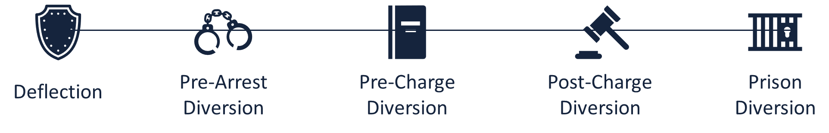
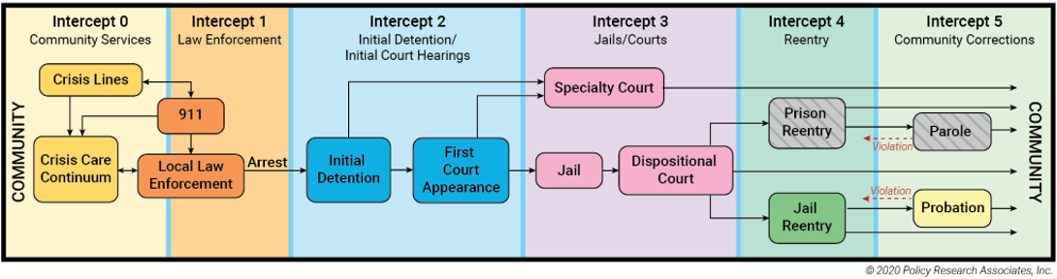

DEFLECTION/DIVERSION & THE SEQUENTIAL INTERCEPT MODEL (SIM)
Specialty Courts

Slide 85
Understanding the problem: intercept 2 & 3
Prosecutor perspective
How can we best serve victims?
Can we connect people with the right systems?
Can we prevent recidivism through smart prosecution?
Preservation of resources
Notes:
Nikki – 120 seconds
Understanding the problem from Prosecutor perspective
How can we best serve victims?
Can we connect people with the right systems?
Can we prevent recidivism through smart prosecution?
Victims: Bond, Restitution
Right systems: APS, Mental Health, Knowledge of the System
Prevent Recidivism: Pulling people from the pipeline and offering them an alternative pathway that leads away from collateral consequences
Preservation of Resources: Using alternative programming to reduce court backlog and bottle-necking which in turn saves money on court time while maintaining meaningful prosecution

Slide 86
Participant Contracts
Common Contract Conditions
Substance Use Assessment
Mental Health Assessment
Restitution
Letters of Apology
Cognitive and Decision-Making Skills Coursework;
Parenting Coursework
Screening Tool: Justice Systems Assessment
Risk/Need
Mental Health
Substance Use
Individualized Plans
Victim Restoration
Notes:
Nikki

Slide 87

PRE-CHARGE DIVERSION
Pre-Charge Diversion
First-time Offender
OAR/OWL Program
Truancy Program
Benefits
No CCAP/Arrest Record
Faster
Connection to Treatment
Victim Repair
Nikki Delatolas

Slide 88

FIRST-TIME OFFENDER
Most Crimes Eligible
All Ages – Mostly Young Adult
Short Length
Natural Consequences

Slide 89

OAR/OWL PROGRAM
20% of Attorney Caseload
Obtain Valid License
Assist with Navigating System
Budgeting

Slide 90

TRUANCY PROGRAM
Faster Connection to Needed Resources
Swifter Accountability

Slide 91
PRE-CHARGE DATA
Restitution Collected
$162,147.12
Success Rate
73%
Average Recidivism
16%
Annual Referrals
Active Cases
219
Average = 293
Notes:
Nikki

Slide 92
DEFLECTION/DIVERSION & THE SEQUENTIAL INTERCEPT MODEL (SIM)
Specialty Courts

Slide 93
Understanding the problem: intercept 2 & 3
Prosecutor perspective
How can we best serve victims?
Can we connect people with the right systems?
Can we prevent recidivism through smart prosecution?
Preservation of resources
Notes:
Nikki – 120 seconds
Understanding the problem from Prosecutor perspective
How can we best serve victims?
Can we connect people with the right systems?
Can we prevent recidivism through smart prosecution?
Victims: Bond, Restitution
Right systems: APS, Mental Health, Knowledge of the System
Prevent Recidivism: Pulling people from the pipeline and offering them an alternative pathway that leads away from collateral consequences
Preservation of Resources: Using alternative programming to reduce court backlog and bottle-necking which in turn saves money on court time while maintaining meaningful prosecution

Slide 94
Diversion: Post-Charge (Intercept 3)
Post-Charge/Pre-Conviction
Traditionally for First-Time Offenders
Consequences of a Criminal Record
Defendant on Bond throughout Agreement
Prosecutor Considerations
How can we best serve victims?
Is bond needed for safety?
First-time felony? First-time misdemeanor/felony domestic?
Notes:
Nikki

Slide 95
Participant Contracts
Screening Tool: Justice Systems Assessment
Risk/Need; Mental Health; Substance Use
Individualized Plans
Victim Restoration
Common Contract Conditions
Substance Use Assessment; Mental Health Assessment; Restitution; Batterer’s Intervention; Psychosexual
Notes:
Nikki

Slide 96

POST-CHARGE FIRST-TIME OFFENDER
Most Crimes Eligible
All Ages – Mostly Young Adult
Bond Considerations

Slide 97

FIRST-TIME FELONY
Most Crimes Eligible
Misdemeanor Probation
Minimal Involvement

Slide 98

OTHER SMART PROSECUTION
Best-Outcome
Plea Negotiations
Victim Considerations

Slide 99
POST-CHARGE DATA
Restitution Collected
$976,620.41
Success Rate
73%
Average Recidivism
18%
Annual Referrals
Active Cases
401
Average = 263
Notes:
Nikki

Slide 100
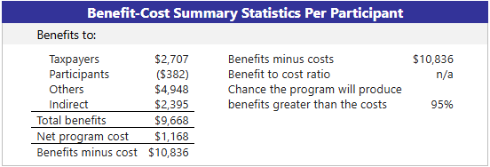
RESEARCH ANALYSIS
Notes:
Average Cases Diverted Pre-Charge Per Year = 163

Slide 101

COST – BENEFIT ANALYSIS
2024 Cost
2024 Savings
Benefit
Tax Levy = $414,642.67
Participant fees = $37,000
Successful Participants =
Pre-Charge: 149
Post-Charge 202
$10,386 x 351 = $3,645,486
Cost
Net Savings= $3,645,486 + 37,000 - $414,642.67
$3,230,843.33
Notes:
Average Cases Diverted Pre-Charge Per Year = 163

Slide 102

PRE-FILING FUNDING
Smart Prosecution Grant = $100,000 per year
1 Diversion Specialist
Tax Levy = $21,450.78
20% Diversion Supervisor

Slide 103

PRE-FILING DIVERSION
Pre-Filing Diversion
Expedited Program
SVU Program
Veteran Program
Benefits
Faster
More Informed Prosecution
Veteran Multi-Disciplinary Teams
Criminal History Continuity
Abby Plachetka

Slide 104

EXPEDITED PROGRAM
Sentencing 30-60 Days from Incident
Most cases eligible

Slide 105

SVU PROGRAM
Late Report SA
Victim Request

Slide 106

VETERAN PROGRAM
Multi-Disciplinary Team
Veteran Involvement
Expedited Services

Slide 107
OTHER DIVERSION
Other Diversion
Warm Handoff
Informal Victim Reparation
Benefits
Informed System Connection

Slide 108

WARM HANDOFF
Public Safety
Chapter 51 Alternatives
Guardianship Needs

Slide 109

INFORMAL VICTIM REPARATION
Victim Request
Low-level Crime
Natural Consequence

Slide 110

Questions?
Contact Information:
Ruth Heinzl
Diversion Supervisor
715-261-1115
Ruth.Heinzl@da.wi.gov
Notes:
All

Slide 111
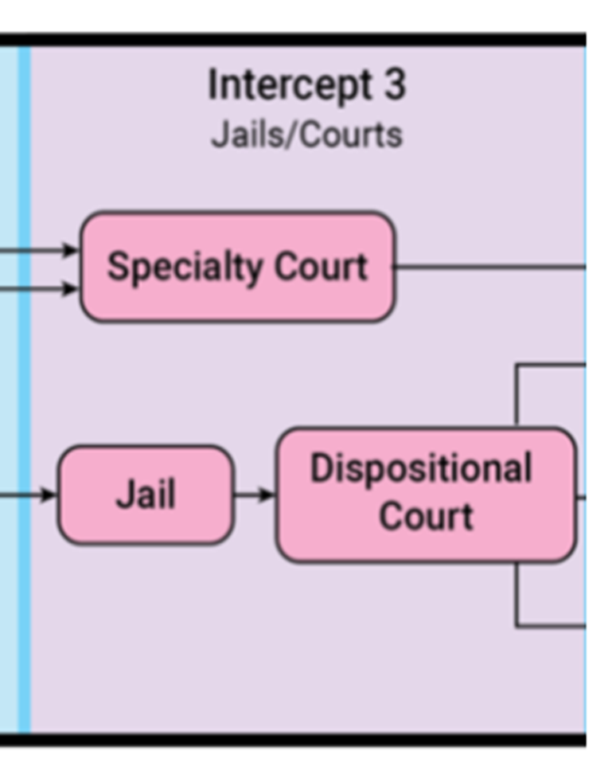
Intercept 3
Jails and Specialty Courts

Slide 113

Key System Stakeholders
Judges
Prosecutors
Defense Attorneys
Jail Administrators
Forensic Clinicians
Specialty Court Teams

Slide 114

Risk
Criminal Recidivism
Hopefully mostly medium- to high-risk individuals because the low-risk individuals have been diverted earlier in the system or have self-corrected

Slide 115
Need

Slide 116
How Do We Determine Risk and Need?
Validated Risk Assessment Tools
General Risk
Correctional Offender Management Profiling for Alternative Sanctions (COMPAS)
Ohio Risk Assessment System (ORAS-CST)
Level of Service Inventory (LSI-CMI or LSI-R)
Specialized Population Risk
OWI
Impaired Driving Assessment (IDA)
Wisconsin Risk Need Assessment (WRNA)
Computerized Assessment and Referral System (CARS)
Sex Offender
Static-99

Slide 117
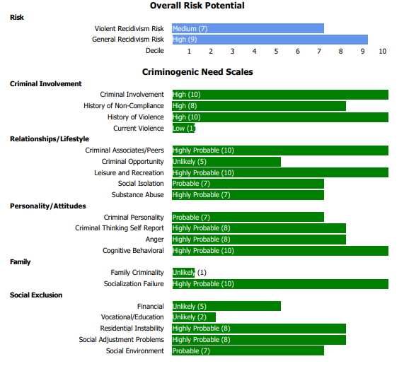
COMPAS-R Assessment
Notes:
COMPAS Assessment
Criminal associates/peers; opportunity; personality; cognitive behavioral – MRT
Anger – Anger management
Substance abuse – AODA treatment
Residential instability – housing 101, application/denial assistance
Drug testing - 2x’s/week

Slide 118
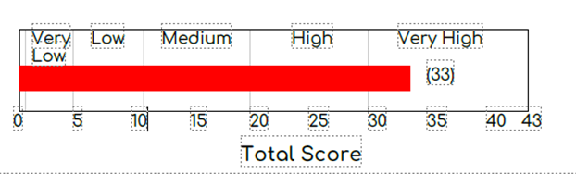
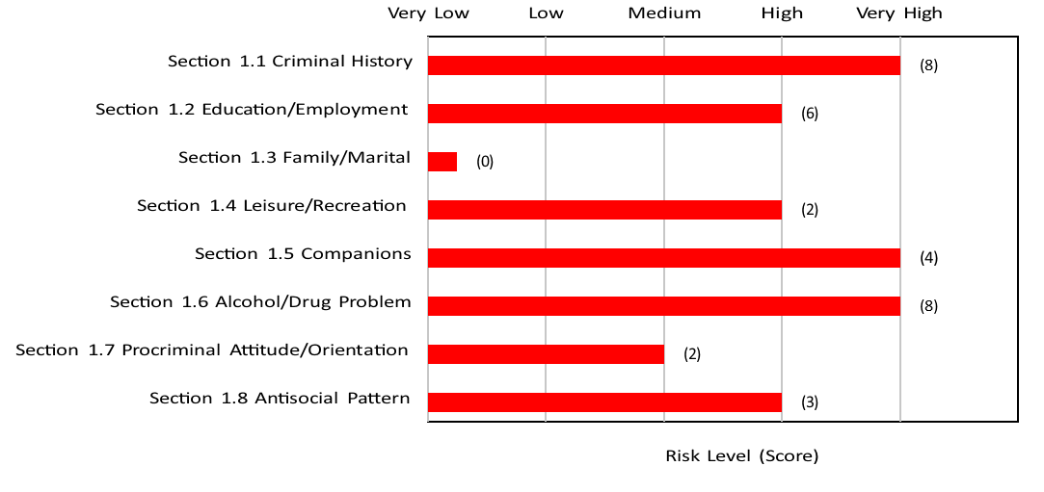
LSI-CMI Assessment
Notes:
LSI-CMI Assessment

Slide 119
Responsivity
Learning and cognitive factors
Low IQ or cognitive limitations
Learning disabilities
Difficulty reading or understanding information
Short attention span
Mental health factors
Depression
Anxiety
PTSD
Personality disorders
Motivation and attitude
Low motivation to change
Resistance to authority
Lack of trust in staff
Communication and language
Language barriers
Limited English proficiency
Poor verbal skills
Cultural and social factors
Cultural background
Beliefs about authority or treatment
Gender-specific needs
Practical barriers
Transportation issues
Childcare needs
Physical disabilities
Medical conditions

Slide 120
Specialty Courts
Drug Treatment Courts
OWI Treatment Courts
Hybrid Treatment Courts
Veteran Treatment Courts
Mental Health Courts
Healing to Wellness Courts
Family Treatment Courts
Juvenile Treatment Courts
Opioid Treatment Court

Slide 121
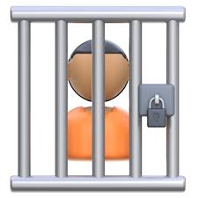
Jail Services
Jail-based Programming
Health/Medical Services
GED
AA/NA/Smart Recovery
Recovery Pods
Parenting Classes
Therapy Dogs
Employment Skills/Certificate Programs
Peer Support
Religious Services
Re-entry Services
Psychiatric Medications
MOUD
Pregnancy/Postpartum Support

Slide 122
DOC Services in Prison
Anger Management
Cognitive Behavioral Program (Thinking 4 Change, DBT)
Domestic Violence
Employability
Substance Use Disorder (CBI-SUA, T4C, Helping Women Recover, Seeking Safety, Connections, Moving On)
Dual Diagnosis
Challenge Incarceration Program
Earned Release Program
Sex Offender Treatment
Education

Slide 123

Dispositional Court
Individualize sentence structures and requirements to protect public safety and meet individualized needs
Identify special population needs (e.g. Veterans, OWI offenders, DV offenders)
Utilize assessment results to help determine appropriate supervision and sentencing requirements

Slide 124
Additional Interventions
Alternatives to prosecution
Diversion programs for those with mental health or substance use issues
Develop “in-reach” partnerships with community providers
Increases the likelihood an individual will continue with services once released from the jail
Collaboration with Veterans Justice Outreach
Increases access to services for the justice-involved Veteran population
Mental health jail liaisons/re-entry specialists
Assist with making connections to community providers

Slide 125

Rock County Treatment Courts
Elizabeth Pohlman-McQuillen - Justice System Strategist
Rock County

Slide 126
Who Do Treatment Courts Serve? High Risk-High Need Individuals
High Risk: High Likelihood of Recidivism
High Need: High Clinical Need (severe substance use)
Use of Validated Risk Assessment to Determine Eligibility
Drug Court-General Criminal Recidivism
OWI Court-Risk of Future OWI Offenses
Use of Validated Clinical Screening/Assessment Tools
Performed by Trained Clinicians

Slide 127
Treatment Courts in Rock County
Drug Court (2007)
Veterans Court (2009)
OWI Court (2012)
Family Recovery Court (2019)—Non-Criminal

Slide 128
Rock County Drug Court

Slide 129
Rock County Drug Court
High-Risk/High-Need
High General Criminogenic Risk (LS-CMI)
High SUD Need (GAIN-SS & ASAM)
In-House Treatment/Case Management Services
Access to Higher Levels of Care if Needed
Meets Weekly

Slide 130
Who are our Drug Court Clients?
Significant exposure to the Criminal Justice System, including previous unsuccessful attempts on probation and time in jail/prison
Significant Poly Substance Use Disorder & Exposure from a Young Age
Significant Trauma History
Significant Family Disfunction
Significant Fiscal Constraints
Significant Lack of Consistent Employment
Significant Lack of Education
Significant Medical/Dental Issues
Significant ties to other Justice-Involved Individuals

Slide 131
DRUG COURT STATISTICS As of February 4, 2026
Current Clients: 33
Total Graduates: 349
Total Terminations: 392
Jail/Prison Bed Days Averted: 160,896
Referrals Refused: 420
Not meet risk-need
Violent Offense Prohibition
Client Refusal/DA Refusal

Slide 132
Recidivism Statistics from 2020-2025 Graduates—Post-Program Convictions
- | Convictions Within 1 year of Graduation | Convictions Within 3 years of Graduation | Convictions Within 5 years of Graduation
45 | 3 (of 45) | 11 (of 29) | 1 (of 16)
* A majority of post-program convictions were misdemeanors and several only for retail theft.

Slide 133
Rock County Veterans Court

Slide 134
Rock County Veterans Court
Currently, not using Criminogenic Risk Assessments for Eligibility but VA may use for MRT Access
Any Veteran Potentially Eligible
Rely on VA for Treatment Services
Meets Bi-Monthly
Veteran ID Comes from VRSS, Self-Report, Pretrial Report

Slide 135
Rock County Veterans Court
Started September 2009
First Veterans Court in Wisconsin
Not All Clients have Substance Use Disorder
Partner with Veterans Administration for Treatment Services
Engages with Veterans Mentors
Connects Participants with What Made them Successful in the Military

Slide 136
Veterans Court Statistics
Vet Court Total Number of Clients: 103
Current Participants: 7
Graduations: 74
Terminations: 20
Administrative Discharges: 2
Maximum Census: 10 Clients

Slide 137
Vets Court Graduate Recidivism Statistics -Convictions
While in Vets Court | Within 1 year of Graduation | Within 3 years of Graduating | Within 5 years of Graduating
0 (of 74) | 6 (of 72) 8.3% | 5 (of 66) 7.5% | 7 (of 60) 11.6%

Slide 138
Rock County OWI Court

Slide 139
Rock County OWI Court
High Risk/High Need
High Risk for Future OWI (IDA)
High SUD Need (GAIN-SS & ASAM)
Full Criminogenic Risk Assessment Also Completed after Entry (COMPASS)
3rd & 4th OWIs Eligible
In-House Treatment/Case Management Services
Access to Higher Levels of Care if Needed
Meets Weekly

Slide 140
OWI Court Recidivism Statistics
 | Participants with New OWI Convictions after Graduation from the OWI Court Program
OWI 3rd | 17 (of 143) 12%
OWI 4th (& 5th) | 1 (of 25) 4%

Slide 141
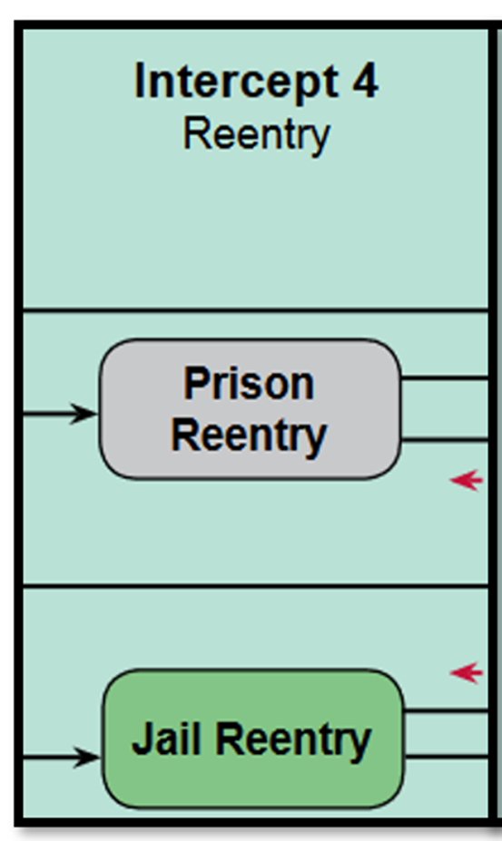
Intercept 4
Reentry

Slide 143


Key System Stakeholders
Jail Administration
WI Department of Corrections
WI Department of Health Services

Slide 144
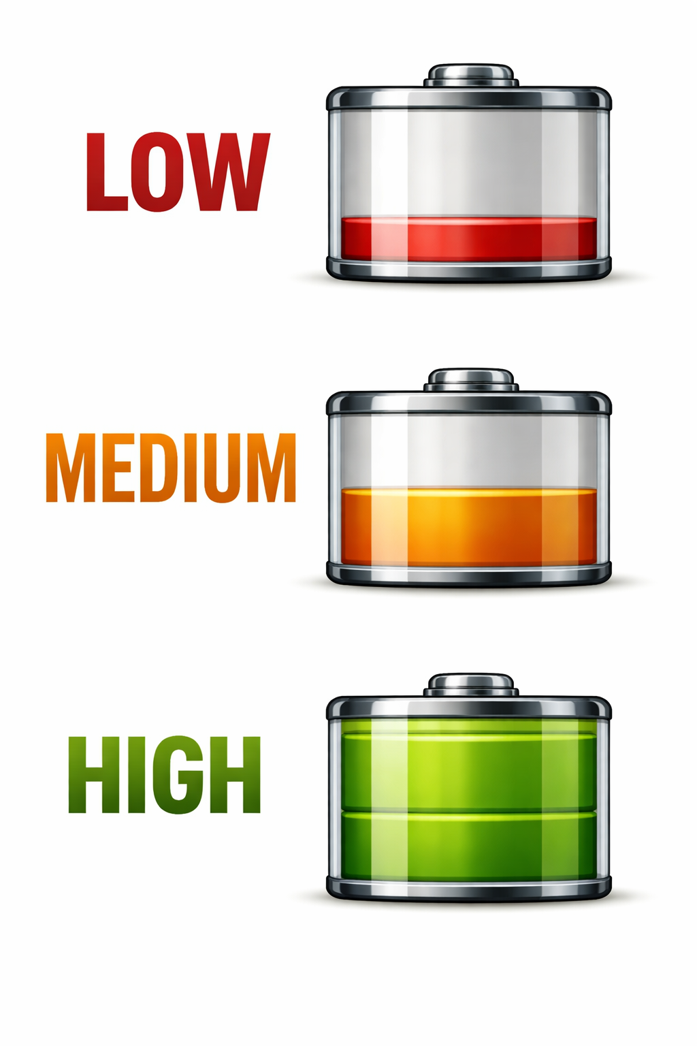
Risk
Criminal Recidivism
Hopefully risk levels have decreased due to interventions completed in jail/prison

Slide 145
Need

Slide 146
How Do We Determine Risk and Need?
Validated Risk Screening/Assessment Tools
Risk/Need
ORAS
Re-Entry Tool (ORAS-RT)
Supplemental Re-Entry Tool (ORAS-SRT)
COMPAS
LSI-R

Slide 147
Responsivity
Learning and cognitive factors
Low IQ or cognitive limitations
Learning disabilities
Difficulty reading or understanding information
Short attention span
Mental health factors
Depression
Anxiety
PTSD
Personality disorders
Motivation and attitude
Low motivation to change
Resistance to authority
Lack of trust in staff
Communication and language
Language barriers
Limited English proficiency
Poor verbal skills
Cultural and social factors
Cultural background
Beliefs about authority or treatment
Gender-specific needs
Practical barriers
Transportation issues
Childcare needs
Physical disabilities
Medical conditions

Slide 148
Additional Interventions
Transition planning by the jail or in-reach providers. Transition planning improves reentry outcomes by organizing services around an individual’s needs in advance of release.
Medication and prescription access upon release from jail or prison. Inmates should be provided with a minimum of 30 days’ medication at release and have prescriptions in hand upon release, including MAT medications prescribed for substance use disorders.
Warm hand-offs from corrections to providers increase engagement in services. Case managers that pick an individual up and transport them directly to services will increase positive outcomes.
Notes:
DOC begins re-entry planning 6-9 months before someone is released. DOC also utilizes the Opening Avenues to Reentry Success (OARS) program which supports the prison-to-community transition of individuals living with a serious and persistent mental illness who are medium-to-high-risk of reoffending. This is a partnership between DOC and DHS.

Slide 149
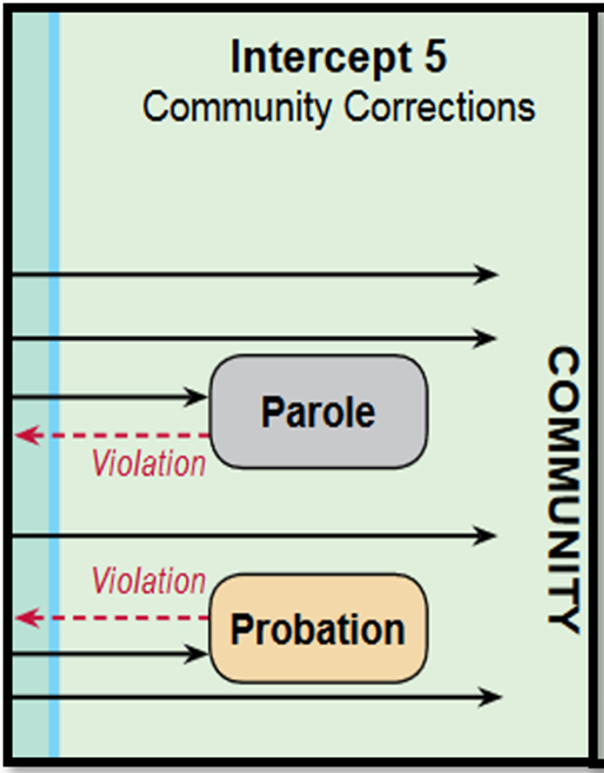
Intercept 5
Community Corrections

Slide 151


Key System Stakeholders
WI Department of Corrections
WI Department of Health Services
Administrative Law Judges

Slide 152

Risk
Criminal Recidivism
Hopefully risk levels have decreased due to interventions completed in jail/prison

Slide 153
Need

Slide 154
How Do We Determine Risk and Need?
Validated Risk Screening/Assessment Tools
Risk/Need
ORAS
COMPAS
LSI-R

Slide 155
Responsivity
Learning and cognitive factors
Low IQ or cognitive limitations
Learning disabilities
Difficulty reading or understanding information
Short attention span
Mental health factors
Depression
Anxiety
PTSD
Personality disorders
Motivation and attitude
Low motivation to change
Resistance to authority
Lack of trust in staff
Communication and language
Language barriers
Limited English proficiency
Poor verbal skills
Cultural and social factors
Cultural background
Beliefs about authority or treatment
Gender-specific needs
Practical barriers
Transportation issues
Childcare needs
Physical disabilities
Medical conditions

Slide 156
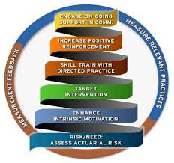
Wisconsin DOC - EBP
Core Correctional Practices
Specialized Caseloads
Evidence-Based Response to Violations
CBT Interventions
Peer Support
Psychiatric Services
Housing (TLPs, vouchers)

Slide 157
Additional Interventions
Specialized community supervision caseloads of people with mental health disorders.
MAT for substance use disorders. MAT approaches can reduce relapse episodes and overdoses among individuals returning from detention.
Access to recovery supports, benefits, housing, and competitive employment. Housing and employment are as important to justice-involved individuals as access to mental health and substance use treatment services. Removing criminal justice-specific barriers to access is critical.

Slide 158

Questions?

