Slide 1
Coordinator 101
Presented by:
Heather Kierzek, Evidence-based Program Manager
Taylor Geske, Outagamie County Treatment Court Coordinator
Jessy Prokosch, Douglas County Treatment Court Coordinator

Slide 2
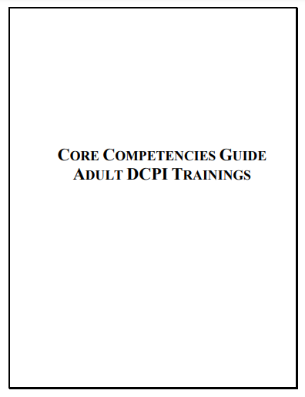
Learning Targets
Understand the complicated role of a treatment court coordinator
Understand the unique responsibilities of a coordinator in Wisconsin
Notes:
Engage audience: ask years of experience, rural or urban

Slide 3
“A drug court coordinator oversees the activity of the team, conducts quality assurance of each team member, maintains client data, remains informed regarding budgetary concerns of the drug court and coordinates services from each discipline, and the local community, in a manner that is most therapeutic to the drug court participant.”
Notes:
Discuss how this could vary in counties - if you are a new coordinator discuss your specific role with your supervisor / judge / team.

Slide 4
Core Competency 1
Participates fully as a Drug Court team member, committing him or herself to the program mission & goals and works as a full partner to ensure their success.
Notes:
Schedule regular meetings focused on program structure, revisits program mission, goals & objectives w/team, arranges team building activities, conducts quality assurance of all services
“How do you work to ensure your program’s mission and goals are being met?”

Slide 5
Core Competency 2
As part of the drug court team, in appropriate non-court settings (i.e. staffing), the coordinator reports on previous incentives and sanctions or lack thereof.
Notes:
Assists, in selection of participants, works w/ the team to create appropriate incentives/sanctions, creates files for each participant, maintains a log of incentives/sanctions and assures consistency of incentives/sanctions
“Discuss your incentive structure. How do you track you incentives/sanctions?”

Slide 6
Core Competency 3
Is knowledgeable of addiction, alcoholism and pharmacology generally and applies that knowledge to suggest responses.
Notes:
Creates open dialogue w/treatment provider to ensure appropriate treatment, gathers information to keep team members informed, conducts quality assurance to ensure appropriate treatment and actively participates in staffings.
“What trainings do you attend?”

Slide 7
Core Competency 4
Is knowledgeable of gender, age and cultural issues that may impact the offender’s success.
Notes:
Arranges training opportunities to inform team members about cultural competence and conducts quality assurance to assure application of cultural competence by all team members
“Do you arrange any specific trainings for your team members? Has your team done any implicit bias or similar training? Have you provided specific resources for specific participants due to their culture?”

Slide 8
Core Competency 5
Develops team resource strategy to acquire funding. Writes grant applications and manages the program’s budget. Creates opportunities to obtain funding and build linkages by supporting team in community outreach and lobbying activities.
Notes:
Obtain training on grant seeking and writing, create long-term funding plan, with team, not solely dependent upon grant funding, research potential funders and other sources of revenue for program, investigate how other programs obtained and maintained funding, practice grant writing in advance of actually submitting applications, create effective book keeping system including an inventory of drug court supplies
“Discuss your involvement with grant writing, reporting, budgeting, etc.”

Slide 9
Core Competency 6
Participates in the planning process to create and memorialize program eligibility standards, operating procedures and rules. Assist in the development of the client contract, confidentiality releases and entry procedures. Create MOUs and linkage agreements.
Notes:
Scheduling planning meetings, brainstorms with entire team on ideal program structure then compromises with team
members regarding structure of program during planning process meetings, Memorializes all agreed upon terms of the program structure, Gathers information needed for team members to make informed decisions
“How often do you review your policies and procedures and what does that process look like?”

Slide 10
Core Competency 7
Negotiates and monitors treatment and ancillary service contracts. Conducts site visits, reviews progress reports and assists in audits and certification monitoring. Creates and monitors standards for urine collection and compliance reporting. Ensure gender, age and culturally specific treatment services.
Notes:
Researches best practices for treatment and ancillary services, Informs treatment provider about expectations including appropriate progress reports for treatment court purposes, works with team members from treatment, community supervision and law
enforcement to create most effective urine collection and compliance reporting model
for the treatment court program then seeks input from other team members before finalizing a method, helps to promote a productive work environment where each team member can
participate, gathers information needed to keep team members informed
“How do you assist with ensuring your participants are receiving evidence-based services and interventions?”

Slide 11
Core Competency 8
Create and maintains a data collection system to monitor client compliance, identify trends and provide a basis for evaluation.
Notes:
Seeks out Management Information Systems (MIS) to collect data, works with Evaluator to create an effective method of data collection, consistently inputs data - CORE
Reviews information collected and shares with team members
Works with Evaluator to interpret statistical relevance -
“Discuss your data collection. What do you collect? How do you monitor your performance measures?”

Slide 12
Core Competency 9
Create interagency linkages to address client’s ancillary needs in the areas of culture, age and gender needs, medical and mental health provision, educational, vocational, skills training and employment training and placement.
Notes:
Maps out providers in community, arranges meeting with providers to begin process of building a relationship, develop memoranda of understanding with providers willing too offer services to treatment court clients, monitor treatment court participant’s involvement with ancillary services
“What complementary services does your program offer? How do you increase recovery capital with your participants?”

Slide 13
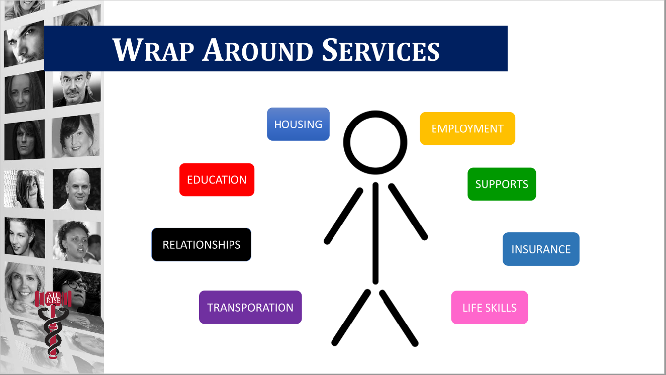
Wrap Around Services
TRANSPORTATION
Notes:
The more wrap around services your program can provide, the more successful your participants will be. Reducing barriers for your participants is one of the main priorities of a treatment court program.

Slide 14
Core Competency 10
Develop police and corrections linkages to improve supervision and agency coordination.
Notes:
Keep law enforcement informed about progress of treatment court clients and supervision
efforts, extend invitations to all drug court events, share statistical data showing positive impact of drug court on local community
“How do you assist with community supervision and maintaining your relationship with law enforcement?”

Slide 15
What Does All This Actually Look Like?
Finding common goals and rolling with resistance
Facilitating difficult conversations with team members
Building and fixing relationships with community members, agencies, employers, county leaders
Finding money and resources to support your clients many and varied needs
Grant reporting, data entry/management, budgeting, program evaluation

Slide 16
What Does All This Actually Look Like?
Case flow management
Document, document, document
Training, training, training
Notes:
“What do you wish you knew starting as a brand new coordinator that would have been helpful?”

Slide 17
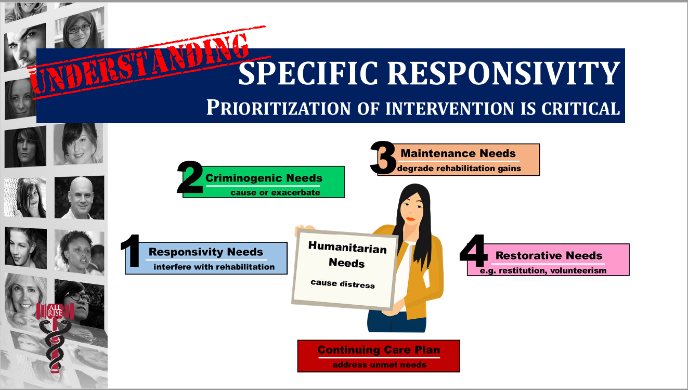
Case Flow Management
Notes:
It’s important to intervene at the right time. Failing to address responsivity needs first, will not allow your participants to address any of the other needs they have. Addressing needs in this order will increase engagement in the program which will increase successful program completion and lower recidivism.

Slide 18
Special Requirements for Wisconsin Coordinators
If you are TAD funded
  CORE reporting
  WebGrants reporting

Slide 19
Challenges
Managing multiple directives across diverse team member agencies/organizations
Having responsibility but not authority to make changes
Directing the work of team members but not having supervisory authority
Lack of resources (financial, treatment providers, judicial, etc)
Notes:
“What are some challenges you have faced as a coordinator and how did you overcome them?”

Slide 20
HELP!!
Coordinator listserv
State courts website
WI CJCC Website: TAD Resources
WATCP Coordinator Netwebs
All Rise Practitioner Training

Slide 21
Contact Information
Heather Kierzek | State Courts | heather.Kierzek@wicourts.gov
Taylor Geske | Outagamie County | taylor.geske@outagamie.org
Jessy Prokosch | Douglas County | jessy.prokosch@douglascountywi.gov

