Slide 1

The Mentor Coordinator Readiness & Operational Training (MCROT)
Basics and Tactics of Fundraising
  Presenter: Mark Panasiewicz,
  Sunchaser Solutions LLC
Basics and Tactics of Fundraising

Slide 2
Training Objectives
Purpose of Training — Fundraising as relationship-building, not begging.
Training Objectives — Understand donor types, fundraising methods, messaging, follow-up, and ethics.

Slide 3


Why This Matters
Fundraising helps turn a court program into a community-supported recovery network.

Slide 4
Why This Matters
Fundraising helps turn a court program into a community-supported recovery network.
Fundraising can help pay for things such as mentor training, background checks, transportation assistance, meals at mentor events, recovery-support activities, emergency needs, recognition events, printed materials, outreach, and community-building activities. It can also help programs respond quickly when a veteran has a practical barrier that could interfere with treatment or court participation.

Slide 5
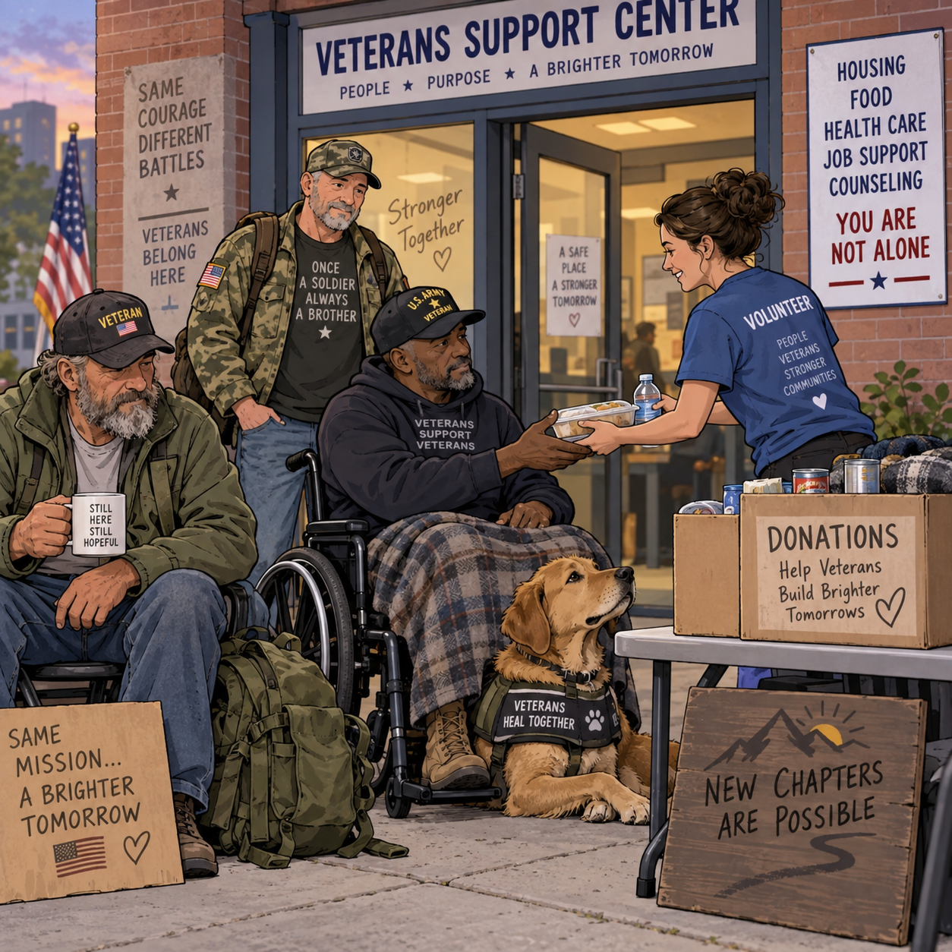
The Fundraising Mindset
People give to impact, trust, relationships, and clear need.

Slide 6
Know Your Mission
Fundraising starts with explaining who you serve and why it matters.
SAMPLE: Veterans Mentor Treatment Court gives justice-involved veterans a real chance to rebuild their lives through accountability, treatment, and support from fellow veterans who understand military culture. Your contribution helps provide trained mentors, transportation, recovery support, emergency assistance, and activities that strengthen connection and reduce isolation. Every dollar invested supports veterans as they work toward sobriety, stability, employment, healthier relationships, and successful completion of the court program. By supporting this program, you help veterans move from crisis to purpose—and remind them they don't have to face that journey alone.

Slide 7
Know Your Mission
The Case for Support — Problem, solution, impact, and what donations make possible.
SAMPLE: Veterans Mentor Treatment Court gives justice-involved veterans a real chance to rebuild their lives through accountability, treatment, and support from fellow veterans who understand military culture. Your contribution helps provide trained mentors, transportation, recovery support, emergency assistance, and activities that strengthen connection and reduce isolation. Every dollar invested supports veterans as they work toward sobriety, stability, employment, healthier relationships, and successful completion of the court program. By supporting this program, you help veterans move from crisis to purpose—and remind them they don't have to face that journey alone.

Slide 8
Model: United Way Workplace Campaigns
Use employer/community networks and team-based giving.
A business agrees to run a short internal campaign—often for a week or a month—where employees learn about the cause and are invited to give individually, participate in team challenges, or volunteer.
The company may also match employee donations, sponsor a specific need, or create friendly competition between departments. This works well because it uses an existing network of employees, payroll systems, internal email, staff meetings, and company culture to reach many donors at once.

Slide 9
Model: United Way Workplace Campaigns
A local employer names one week “Support a Veteran Week.”
Employees hear a 5-minute presentation or watch a short video about the mentor court.
Staff can donate $5, $10, or more, or sign up for recurring giving.
Departments compete to raise the most money.
The employer matches donations up to a set amount.
The campaign can include activities such as a jeans day, pancake breakfast, fishing-event sponsorship, raffle, or “sponsor a mentor” challenge.
At the end, the company publicly recognizes employees and announces the total raised.

Slide 10
Model: Red Cross Peer-to-Peer Fundraising
Let supporters create their own fundraisers.
The Red Cross Peer-to-Peer Fundraising model shifts part of the fundraising work from the organization to its supporters. Instead of the Veterans Mentor Treatment Court having to personally ask every donor, supporters create their own mini-fundraisers and ask their friends, family, coworkers, social media contacts, or community groups to contribute

Slide 11
Model: Red Cross Peer-to-Peer Fundraising
A mentor, graduate, veteran, family member, court supporter, or local business creates a personal fundraising page or campaign.
They choose a goal, such as “Help me raise $500 to support veteran mentors.”
They explain why the program matters to them and share the fundraiser through Facebook, email, text, workplace groups, veteran organizations, churches, or civic clubs.
Supporters can create birthday fundraisers, memorial fundraisers, fitness challenges, fishing-event fundraisers, motorcycle rides, walkathons, or “$22 for Veterans” campaigns.
The program provides ready-made graphics, sample messages, donation links, and talking points so supporters do not have to create everything themselves.
Friendly competition can be added, such as recognizing the mentor, team, business, or community group that raises the most.

Slide 12
Model: World Central Kitchen “Fundraise Your Way”
Fitness challenges, birthdays, clubs, hobbies, and special occasions.
The model is built around making fundraising fit into activities people already enjoy. Instead of asking supporters to participate in one official event, the organization encourages them to create a fundraiser around a birthday, hobby, fitness goal, club activity, community event, or personal milestone.

Slide 13
Model: World Central Kitchen “Fundraise Your Way”
A supporter turns a birthday into a fundraiser and asks for donations instead of gifts.
A veteran organizes a fishing tournament, golf outing, motorcycle ride, or hunting-related event.
A gym creates a push-up, ruck march, or mileage challenge where participants collect pledges.
A bowling league, softball team, motorcycle club, church group, or veterans organization chooses the program as its charity for an event.
A restaurant hosts a percentage-of-sales night.
Someone dedicates a marathon, hike, bike ride, or weight-loss challenge to supporting veterans.
Families can create memorial or anniversary fundraisers in honor of a veteran.
The program supplies logos, graphics, talking points, donation links, and simple fundraising instructions.
The strength of this model is flexibility. People are more likely to fundraise when they can connect the cause to something they already care about instead of being asked to participate in an unfamiliar event.

Slide 14


Body Language Matters
Open posture
Calm facial expression
Non-threatening stance

Slide 15
There are TONS OF WAYS to Fundraiser
Model: PTA Community Fundraising — Use committees, board approval, and fundraisers tied to a budget need.
Model: Recurring Giving Programs — Build monthly donors for predictable support.
Diversify Funding Sources — Individual donors, grants, sponsors, events, businesses, faith/community groups.
The Donor Pyramid — Small gifts, repeat donors, major donors, legacy donors.
The Fundraising Cycle — Identify, cultivate, ask, thank, report, renew.
Identify Donor Prospects — Who already cares about your mission?
Warm vs. Cold Donors — Start with relationships before strangers.
The Power of Storytelling — Use real impact stories ethically and respectfully.
Creating the Ask — Specific amount, specific purpose, specific impact.
Individual Giving Tactics — Letters, calls, personal meetings, online giving, monthly giving.
Events — Breakfasts, dinners, walks, auctions, golf outings, veteran/community events.
Corporate Sponsorships — Offer visibility, community goodwill, mission connection, and recognition.
Grants — Match funder priorities to your mission; do not chase money that pulls you off mission. Grants.gov lists federal funding opportunities for eligible organizations.
In-Kind Donations — Food, space, printing, supplies, professional services.
Online Fundraising — Donation pages, QR codes, social media, email campaigns.
Peer-to-Peer Fundraising — Supporters ask their own networks.
Stewardship: Thank, Report, Repeat — Donor retention depends on appreciation and showing impact; tracking giving growth and retention is a major focus of the Fundraising Effectiveness Project.
Ethics and Transparency — Be honest about need, use funds as promised, protect donor trust.
Exercise: Build a Mini Fundraising Plan — Goal, audience, message, method, timeline, follow-up.

Slide 16
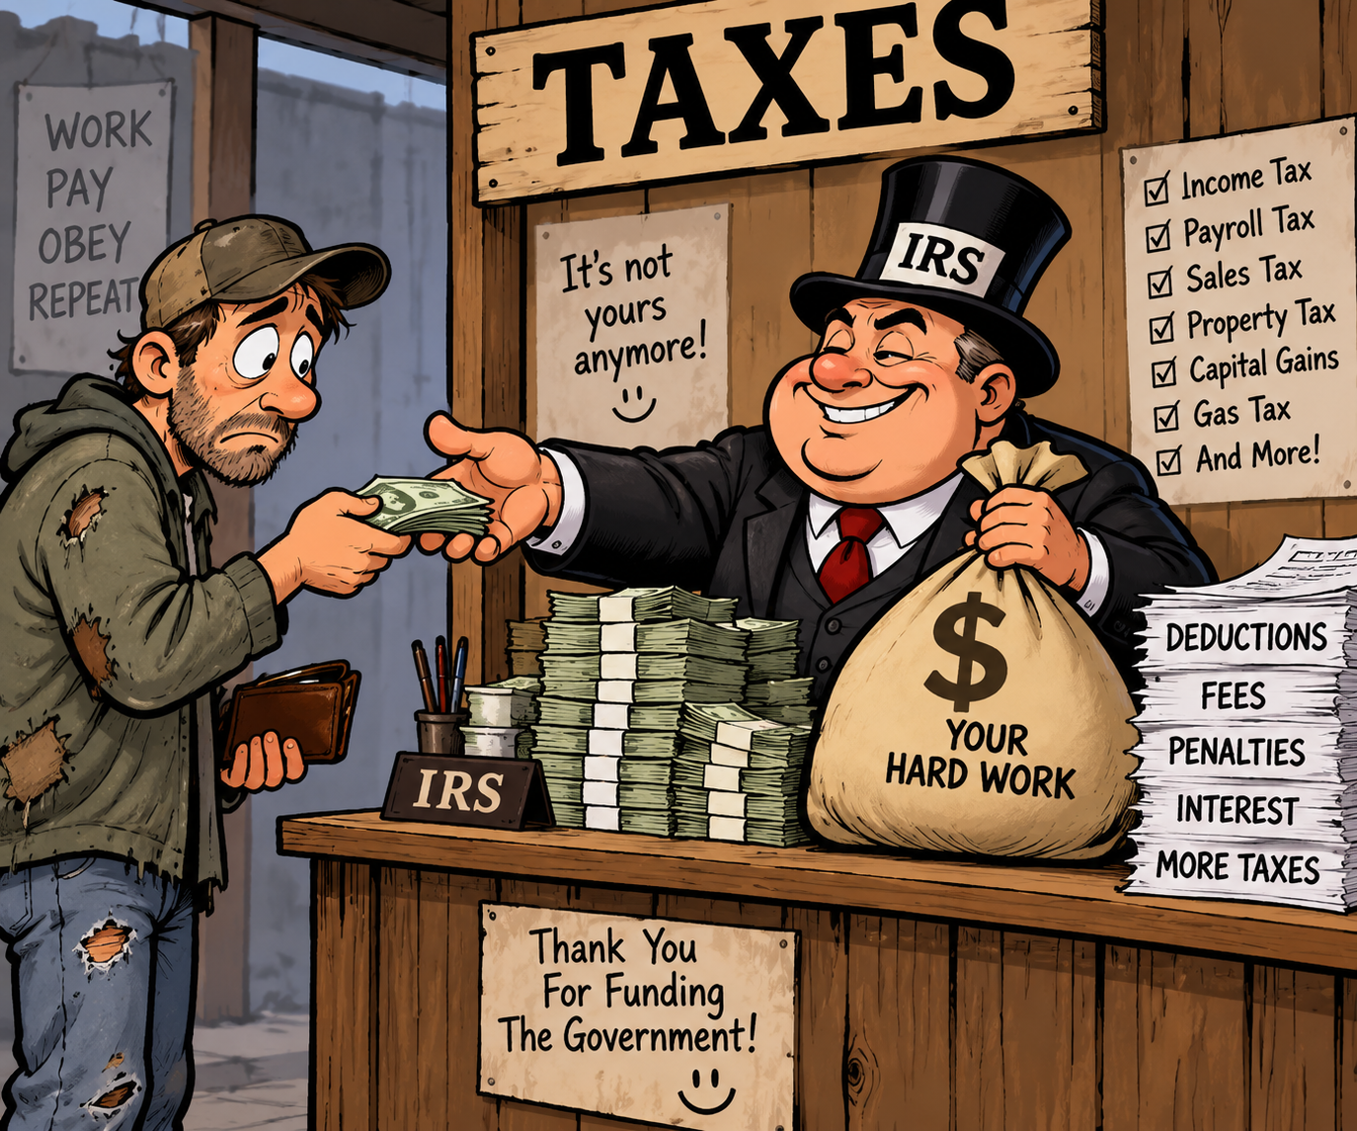
What Is a 501(c)(3)?
A nonprofit recognized by the IRS for charitable, religious, educational, scientific, literary, public-safety, amateur sports, or cruelty-prevention purposes

Slide 17

Why It Matters
501(c)(3) status can allow:
Tax-exempt recognition
Donor confidence
Eligibility for grants
Tax-deductible charitable contributions

Slide 18
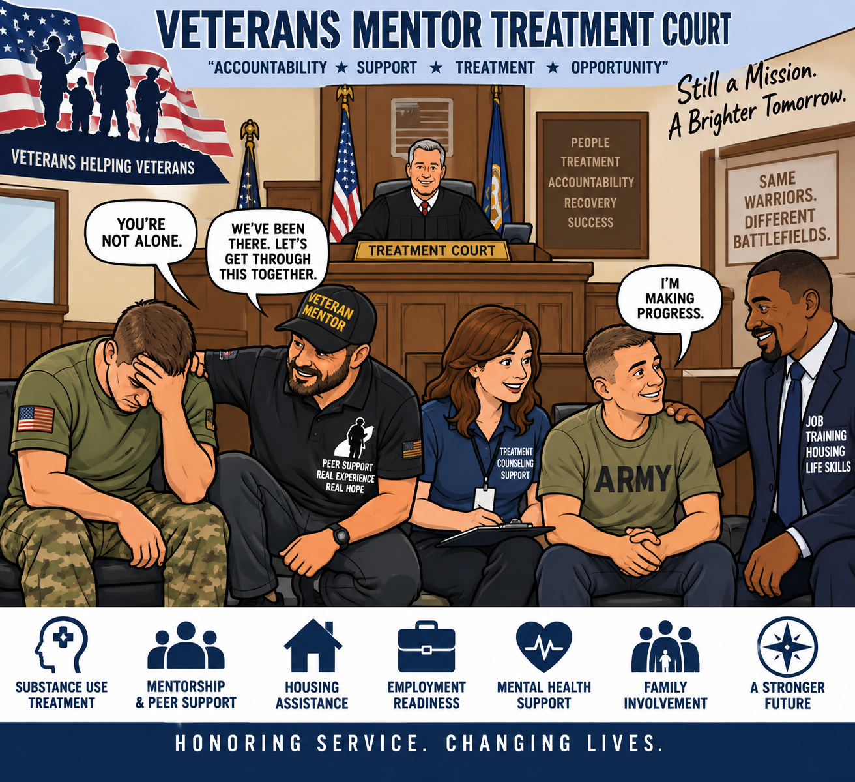
Step 1: Define the Mission
Who you serve
What problem you address
What services you provide
How the public benefits

Slide 19
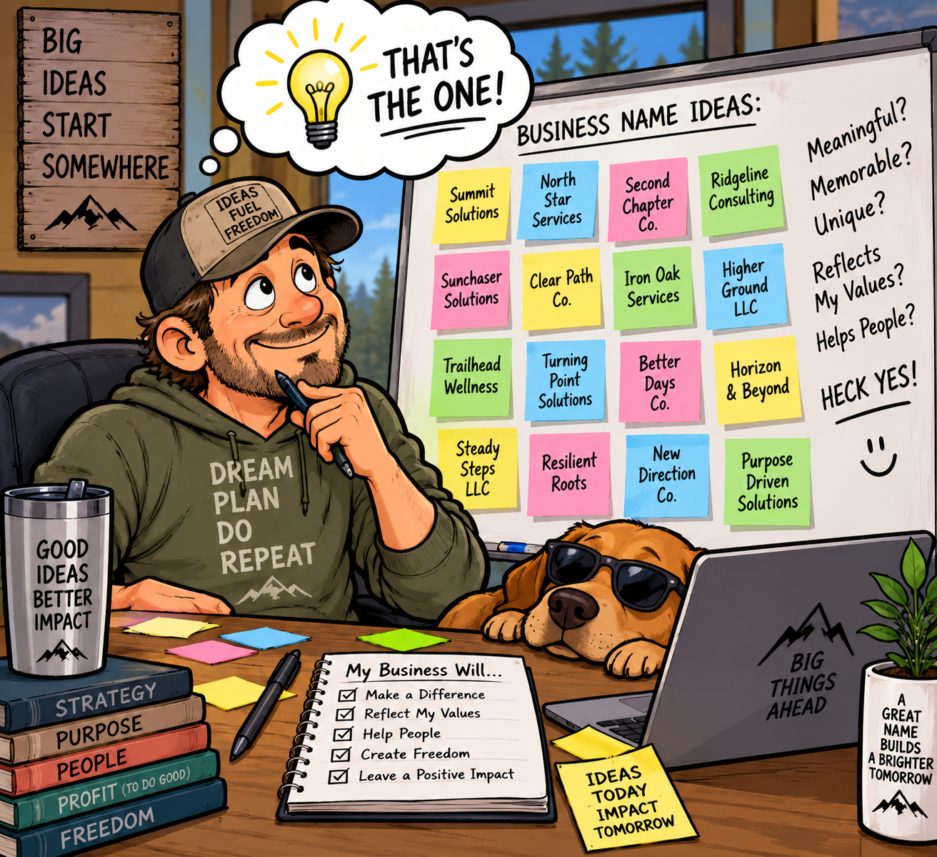
Form the Nonprofit Corporation
At the state level:
Choose a name
File nonprofit Articles of Incorporation
Include proper charitable purpose language
Include dissolution language required for 501(c)(3)

Slide 20
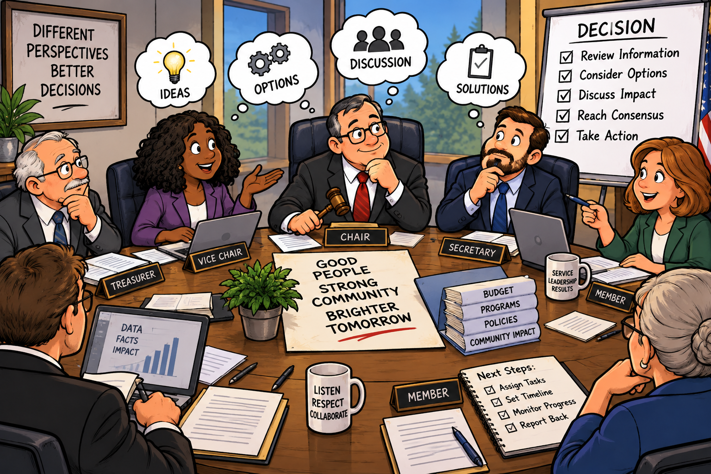
Step 3: Build the Board
Recruit board members who can provide:
Oversight
Financial accountability
Community credibility
Fundraising support
Ethical decision-making

Slide 21
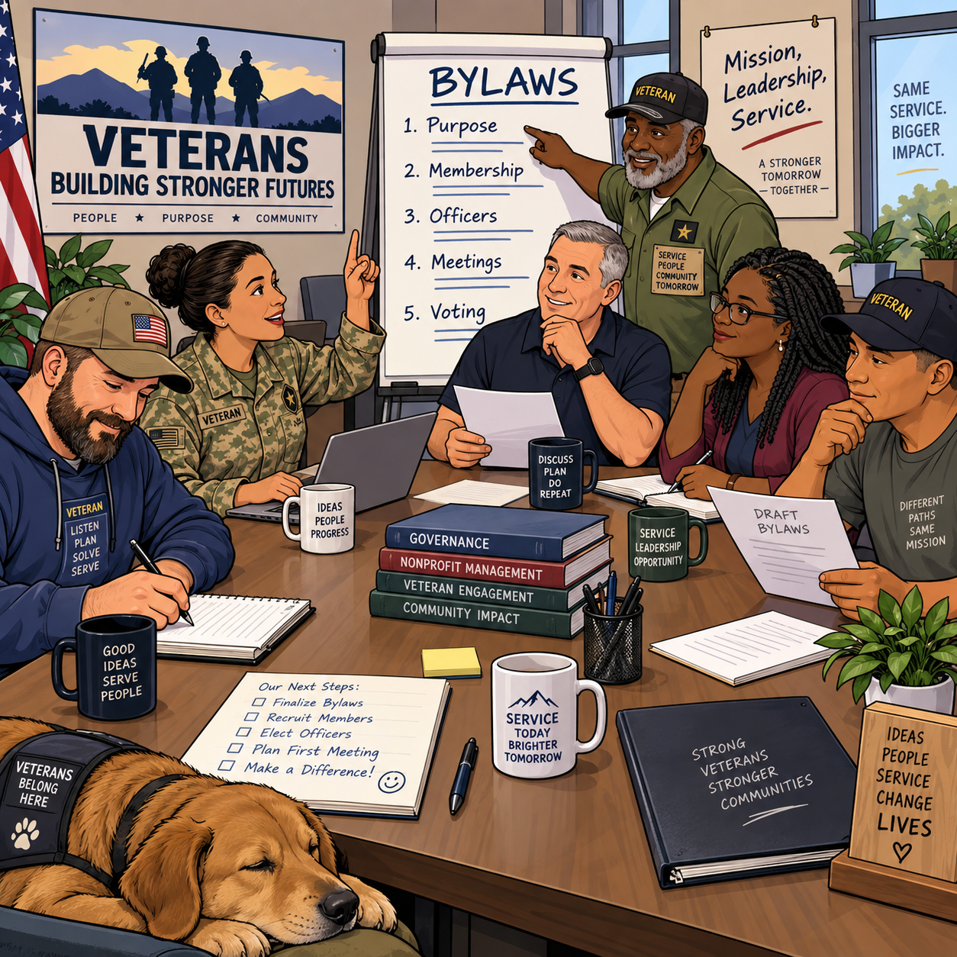
Step 4: Create Bylaws
Bylaws should explain:
Board roles
Officer duties
Meeting rules
Voting procedures
Conflict-of-interest policy
Financial controls

Slide 22
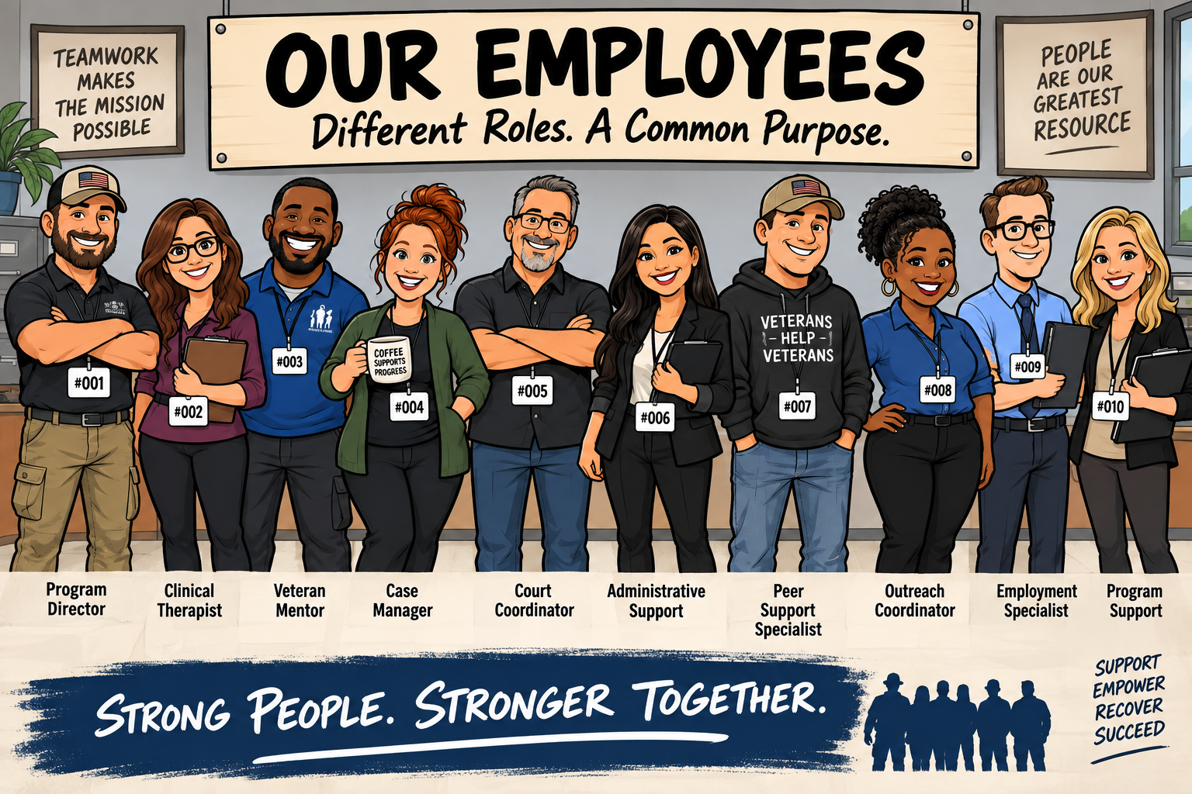
Step 5: Get an EIN
Apply for an Employer Identification Number from the IRS.
This is needed for banking, tax filings, and the IRS exemption application.

Slide 23
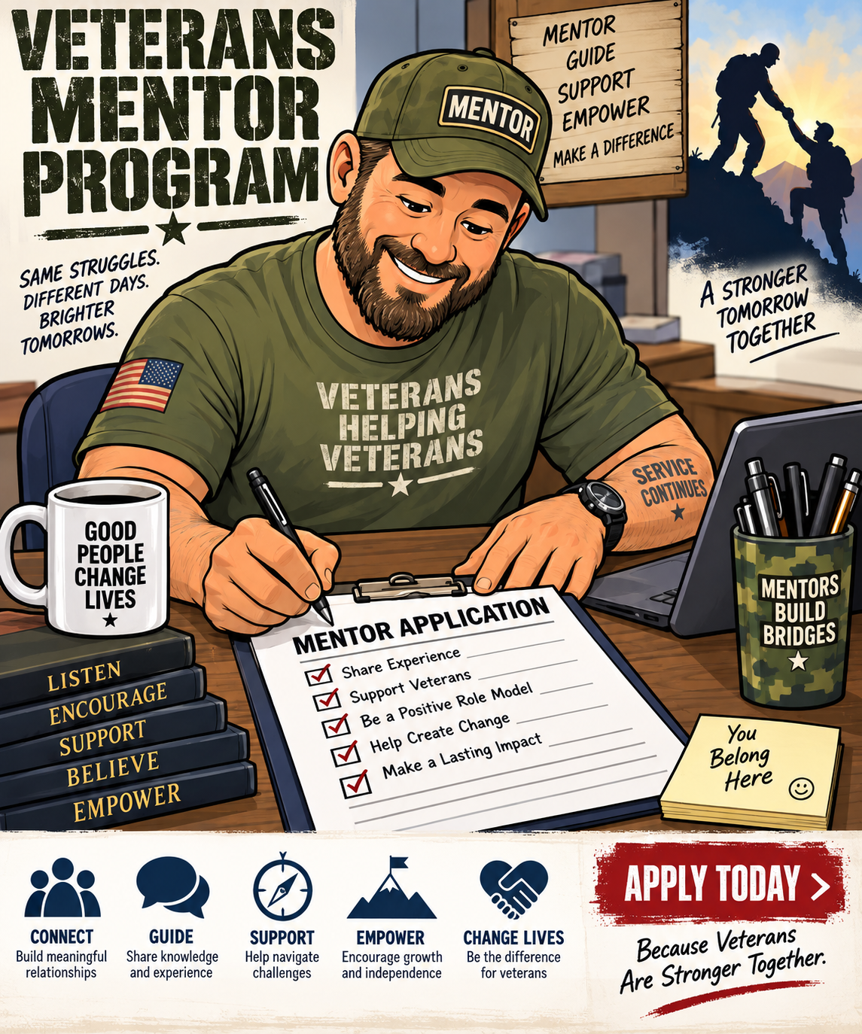
Step 6: Choose the Right IRS Application
Most organizations apply with either:
Form 1023 — full application
Form 1023-EZ — streamlined application for eligible smaller organizations
The IRS says organizations must complete the 1023-EZ eligibility worksheet first; if not eligible, they can still file Form 1023.

Slide 24
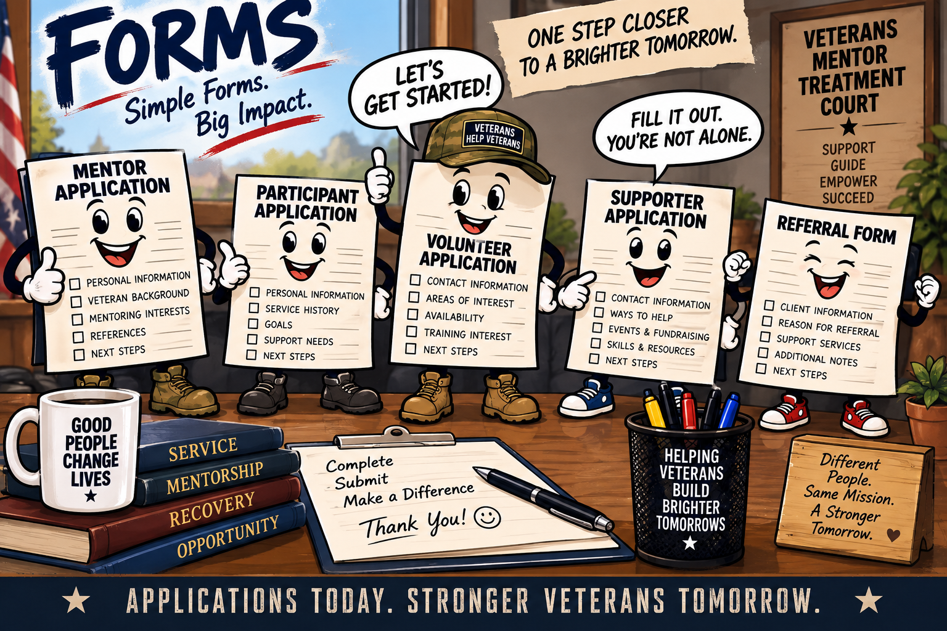
Step 7: Submit Through Pay.gov
Form 1023-EZ is submitted through Pay.gov after the organization confirms eligibility.

Slide 25
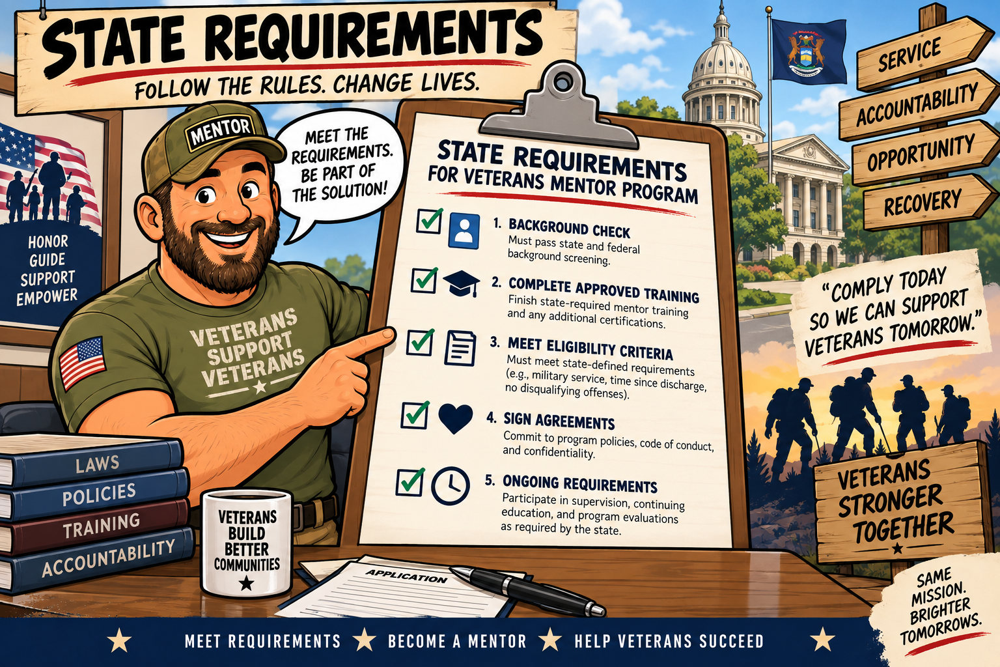
Step 8: State Requirements
After federal filing, check state requirements for:
Charitable solicitation registration
State tax exemption
Annual corporate reports
Fundraising rules
Local permits

Slide 26
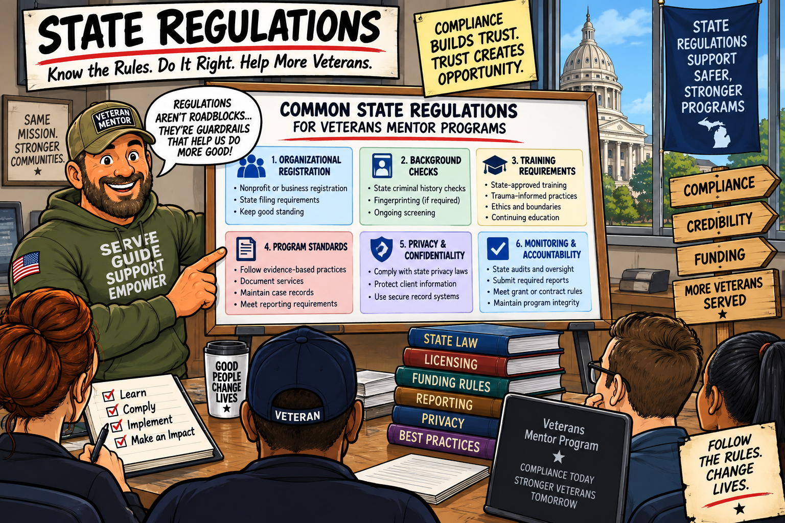
Step 9: Stay Compliant
Slide 11 —501(c)(3) organizations usually must file annual federal returns, such as Form 990, 990-EZ, or 990-N. The IRS lists required filings as part of tax-exempt organization responsibilities.

Slide 27
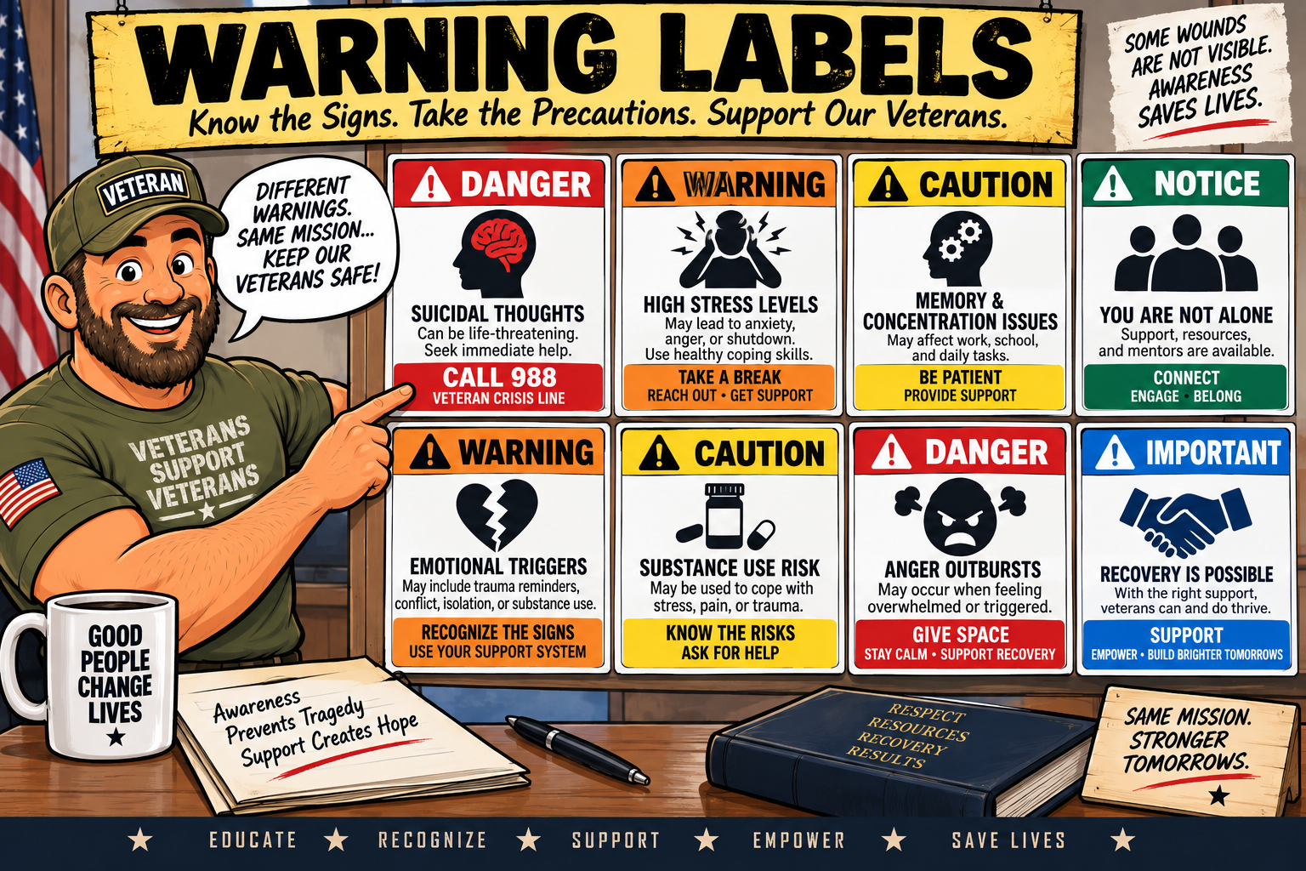
Key Warning
501(c)(3) organizations must follow rules on private benefit, lobbying limits, political campaign activity, annual filings, and proper use of funds. The IRS provides training for leaders and volunteers on maintaining exempt status

Slide 28
Sunchaser Solutions
Questions ???
Notes:
Summarize the core training message.

Slide 29
Sunchaser Solutions
Sunchaser Solutions 906-281-7554
markepana@gmail.com
We can handle all your training needs.
Notes:
Summarize the core training message.

