Slide 1
Hands on activities to teach our teams

Slide 2
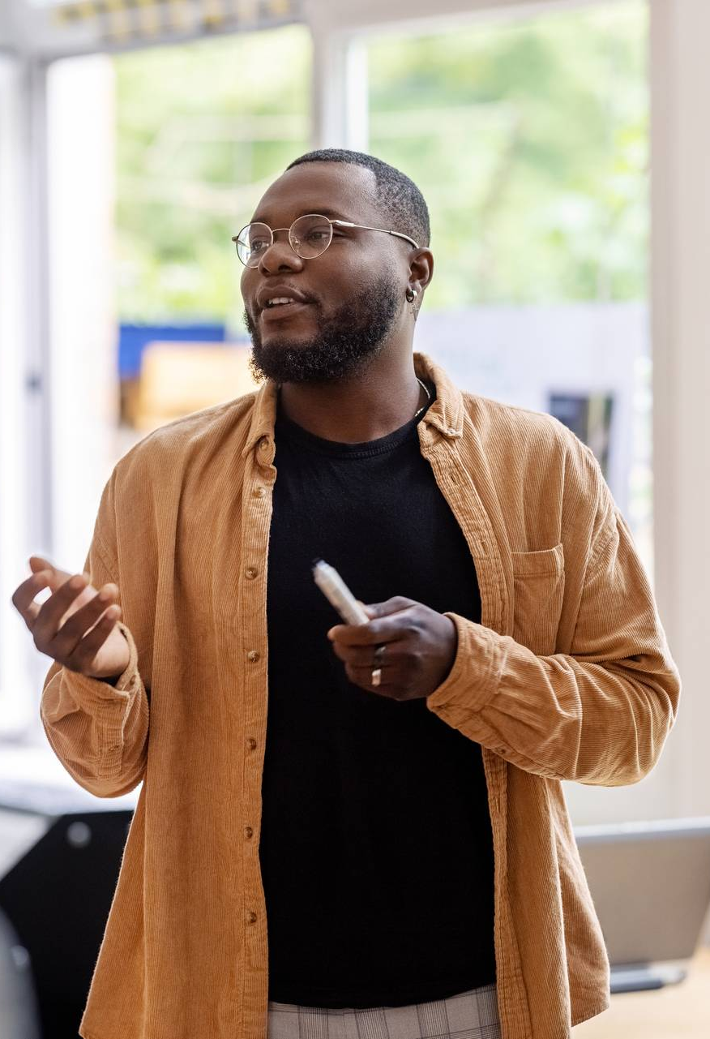
Quick activities
Activities that take no longer than 5-10 minutes

Slide 3
Don’t think about it
Lessons Learned
Telling people to, “Just stop it,” is often ineffective
Help people identify what TO DO, instead of what NOT to do.
Key Takeaway: The brain doesn’t respond well to “don’t think about it,” or, “just don’t do it.” Effective behavior change usually requires something to replace the behavior.

Slide 4
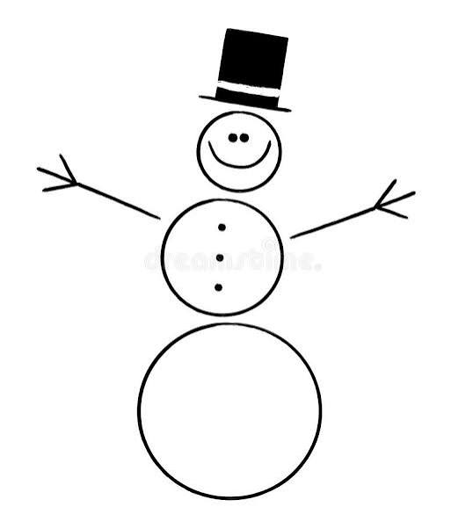
Fold the paper/Draw a picture

Slide 5
Fold the paper/Draw a picture
Lessons Learned
People interpret the same information differently
Clear communication matters
Everyone brings their own perspective
Assumptions can create unintended outcomes
Asking clarifying questions is important
The “right” result isn’t always obvious
Debrief Question: “Did anyone do exactly what they thought I asked them to do and still end up with something different from everyone else? What does this tell us about the way we communicate with the people we serve?”

Slide 6
Switch the rules
Lessons Learned
Constantly changing expectations creates stress, confusion, disengagement, and fear of failure
Key Takeaway: “People often aren’t resisting the task, they’re reacting to uncertainty, inconsistency, and shifting expectations.”

Slide 7
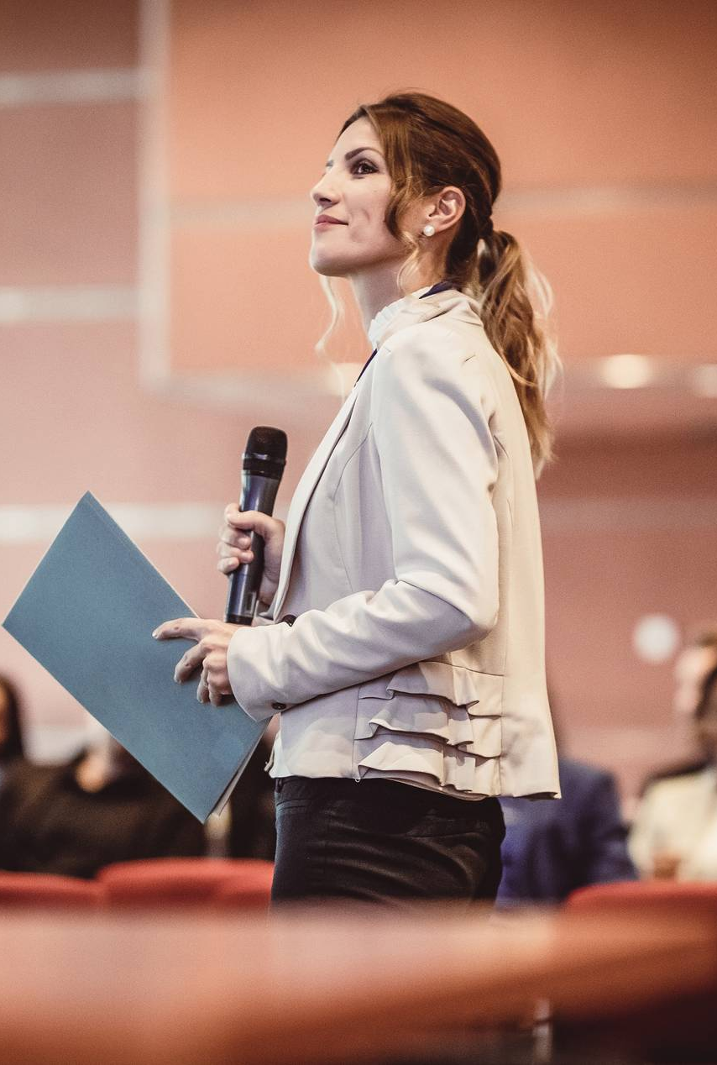
Longer activities
Activities that are perfect for longer staff meetings and retreats

Slide 8
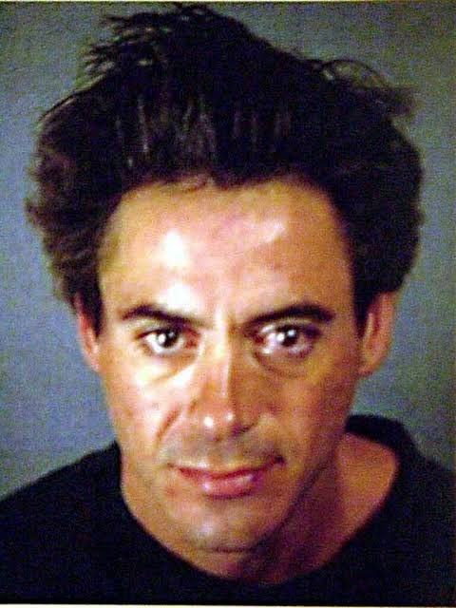
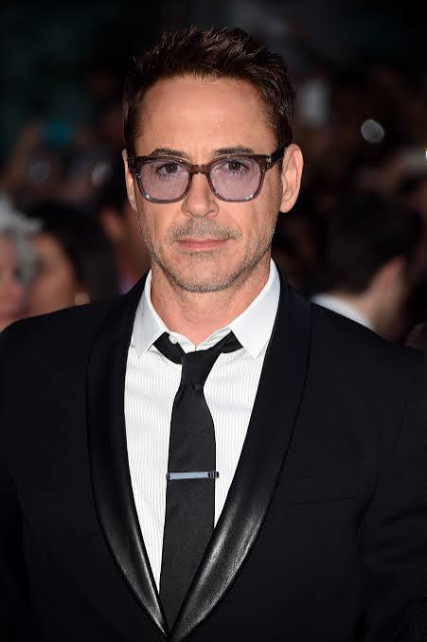
Words matter
Addict
Offender
Manipulative
Noncompliant
Resistant
Frequent Flyer
Drug Seeker
Criminal
Failed Treatment
Difficult

Slide 9
Words matter
He’s an addict | He has a substance use disorder
She’s noncompliant | She did not complete the required treatment sessions
He’s manipulative | He provided different information to different team members
She’s resistant | She expressed concerns about the recommended treatment
He’s a frequent flyer | He has had multiple contacts with the justice system
She failed treatment | The current treatment approach did not produce the desired outcome
He’s a drug seeker | He repeatedly requested medication and reported ongoing pain
He’s difficult | The team has experienced challenges engaging him in services
Notes:
Draw attention to the behavior, don’t label it.

Slide 10
Words matter
Lessons Learned
Language should describe the behavior – not define the person
Language is not just what we say – it shapes what we see
Key Takeaway: “If the language we use about someone influences how the team sees that person, we have a responsibility to choose our words carefully.”

Slide 11
Finish the puzzle
General Rules:
No sharing directions.
No helping others until you, yourself have successfully completed your own puzzle.
If/when you are helping others, you cannot touch their puzzle pieces;
you may only verbally communicate how to do it based on your memory and experience.
Special Rules:
If your first name begins with A, B, C or D, you may only use 1 hand,
it must be your non-dominate hand.
If your name starts with S or T, you cannot receive help from anyone.
If your name starts with M or R, you cannot start until 5 minutes have passed.
If you traveled greater than 5 hours to get here, none of the special or added rules apply to you.

Slide 12
Finish the puzzle
Lessons Learned
No two recovery journeys are identical;
While participant/program goals are generally the same/similar, not everyone will have the same needs and/or need the same interventions in order to reach & maintain these goals;
It could be a responsivity issue versus a compliance issue.
Considering this,
It is our role & responsibility to use validated assessments in order to make care recommendations;
It is our role & responsibility to create individualized treatment/care plans;
It is our role & responsibility to use evidence-based approaches in order to reach measurable outcomes.
Key Takeaway:
The folks @ All Rise carefully study treatment courts to provide us with evidence-based standards and WATCP & TAD both work hard to support & guide us in order to best do this work; so, use & trust the standards and train, train, and & retrain!

Slide 13
Recovery Capital
Lessons Learned
Everyone has different recovery capital
Individual with limited recovery capital will struggle to easily accomplish the same goals/expectations as someone with more recovery capital
Key Takeaway: “Recovery capital is unique to an individual. You can not compare one person’s recovery capital to another. Treatment court team members should also be cognizant of their own recovery capital and ensure they are not unintentionally projecting their bias onto participants.”

Slide 14
Communication styles
Lessons Learned
We all have different styles of communication
Understanding communication styles allows teams to leverage strengths and embrace their differences
Key Takeaway: “Understanding the communication style of your colleagues helps to build trust, collegiality and ultimately strengthens your relationships as a team.”

Slide 15
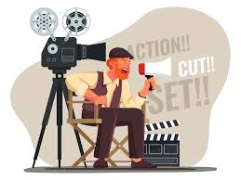
Director
People with this style talk about…
People with this style are…
Results | Responsibility
Objectives | Performance
Experience | Productivity
Achievements | Change
Challenges | Achievements
Moving ahead
Pragmatic (down to earth)
Feedback Direct (to the point)
Impatient
Decisive
Quick (jump from idea to idea)
Energetic (challenge others)

Slide 16

Communicating with a Director
Focus on the result first; state the conclusion at the outset
State your best recommendation; do not offer many alternatives
Be as brief as possible
Emphasize the practicality of your ideas
Use visual aids

Slide 17
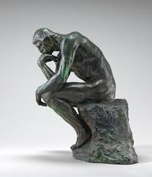
Thinker
People with this style talk about…
People with this style are…
Facts | Organizing
Procedure | Proof
Analysis | Details
Planning | Testing
Observations
Cautious
Systematic (step-by-step)
Logical (cause and effect)
Factual
Unemotional
Patient

Slide 18

Communicating with a Thinker
Be precise; state the facts
Break down your recommendations
Include options and alternatives with pros and cons
Do not rush them
Outline your proposal

Slide 19
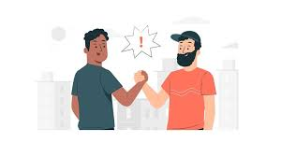
Socializer
People with this style talk about…
People with this style are…
People | Needs
Motivation | Teamwork
Feelings | Cooperation
Team spirit | Values
Understanding | Beliefs
Expectations | Relationships
Self-development
Spontaneous
Empathetic
Warm
Subjective
Emotional
Perceptive
Sensitive

Slide 20
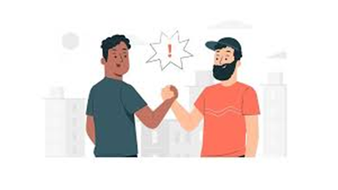
Communicating with a Socializer
Allow for small talk; do not start the discussion right away
Stress the relationship between your proposal and the people concerned
Show how the idea worked in the past
Indicate support from well-respected people
Use an informal writing style

Slide 21
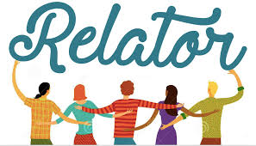
Relator
People with this style talk about…
People with this style are…
Concepts | Innovation
Interdependence | New ways
New methods | Improving
Problems | Creativity
Opportunities | Possibilities
Issues | What’s new
Potential Alternatives
Imaginative
Charismatic
Difficult to understand
Ego-centric
Unrealistic
Creative
Full of ideas
Provocative

Slide 22

Communicating with a Relator
Allow enough time for discussion
Do not get impatient when they go off on tangents
Try to relate the discussed topic to a broader concept or idea
Stress the uniqueness of the idea or topic at hand
Emphasize future value or relate the impact of the idea to the future
If writing, try to stress the key concepts that underlie your recommendation at the outset
Start with an overall statement and work towards the particulars

Slide 23
Thank you
Heather Kierzek
Evidence-Based Program Manager
Heather.Kierzek@wicourts.gov
Jessy Prokosch
Douglas County Treatment Court Coordinator
Jessy.Prokosch@douglascountywi.gov

