Slide 1
Incentives Workshop
Why they work, when to use them, and how to use more!

Slide 2
Behavior Modification 101
INCENTIVES: Increase or Encourage Behavior
SERVICE ADJUSTMENTS: Monitor and Treat Behavior
SANCTIONS: Decrease or Stop Behavior

Slide 3
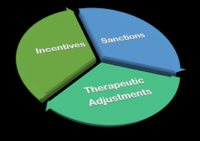
Quick Reminder!!
All 3 techniques are necessary for successful behavior modification
Notes:
Even though we will focus on incentives for this presentation, that doesn’t mean we don’t need to utilize sanctions and service adjustments to respond the participant behavior when necessary.

Slide 4
Behavior/Goal types
Proximal
Distal
Managed
Can be met in the short-term and sustained
Not easily achievable
Intermittent achievement but not sustainable
Behaviors have been met and sustained for a reasonable period of time

Slide 5
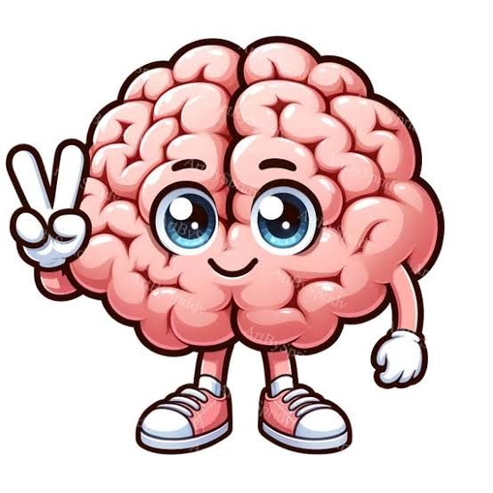
Why do incentives work?
Prefrontal Activation: Scans show that positive self-talk, encouragement, and gratitude light up the prefrontal cortex, which handles emotional control and decision-making.
Reward Circuitry: Kind words and positive affirmations stimulate the brain's reward pathways, similar to the physical response from real rewarding experiences.
Chemical Shifts: Positivity reduces the stress hormone cortisol while boosting serotonin and dopamine, lowering overall tension and building mental resilience.
Notes:
Incentives create new neural pathways and connections in the brain. Incentives light up the same reward pathways as drugs and alcohol.

Slide 6
Incentives
Verbal praise
Public recognition (applause, “‘atta boy” certificates, star boards)
Symbolic tokens (sobriety coins, phase advancement certificates)
Tangible prizes (gift cards, snacks, keychains)
Point systems
Fishbowl drawings
Financial waivers
Reduced nonservice obligations (reduction in community service hours, FIFO)

Slide 7
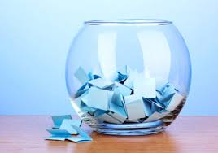
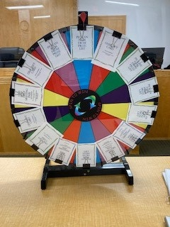
Fishbowl Drawings
“Research indicates that the fishbowl procedure can bring about comparable, or even better, outcomes than providing participants with rewards for every achievement.” –Judicial Benchbook
Can include a variety of low, medium, and high value incentives
Important for the participant to know the behavior they displayed, which allowed them to draw from the fishbowl
Important to be reinforced by the judge

Slide 8
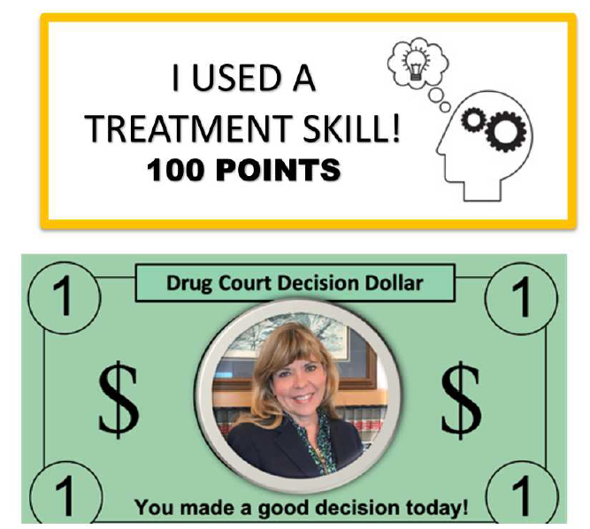

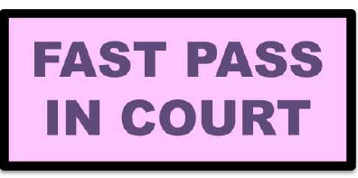
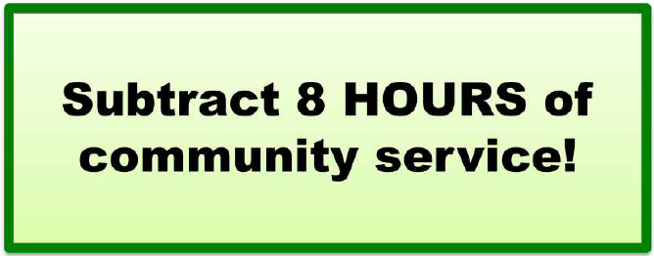
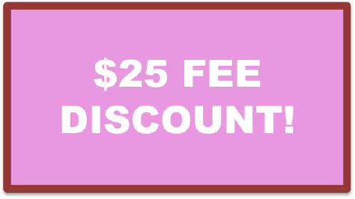

Other low-cost incentives

Slide 9
Incentives
Think about what would be motivating for your participants
  Survey your participants – individualize incentives
  Some of the most effective incentives include those that give participants more freedom (more time, less financial burden, fewer restrictions)
You will change behavior and improve the long-term functioning of your participants faster and more effectively with incentives than you will with sanctions
Notes:
More time: FIFO, appear virtually for court, sweat patch for a week)
Financial: Reduce fines/fees, gift cards for groceries/gas, activities they can do with their kids (movies, bowling, waterparks)
Fewer restrictions: Less community service, later curfew, travel approval, or removing electronic monitoring

Slide 10
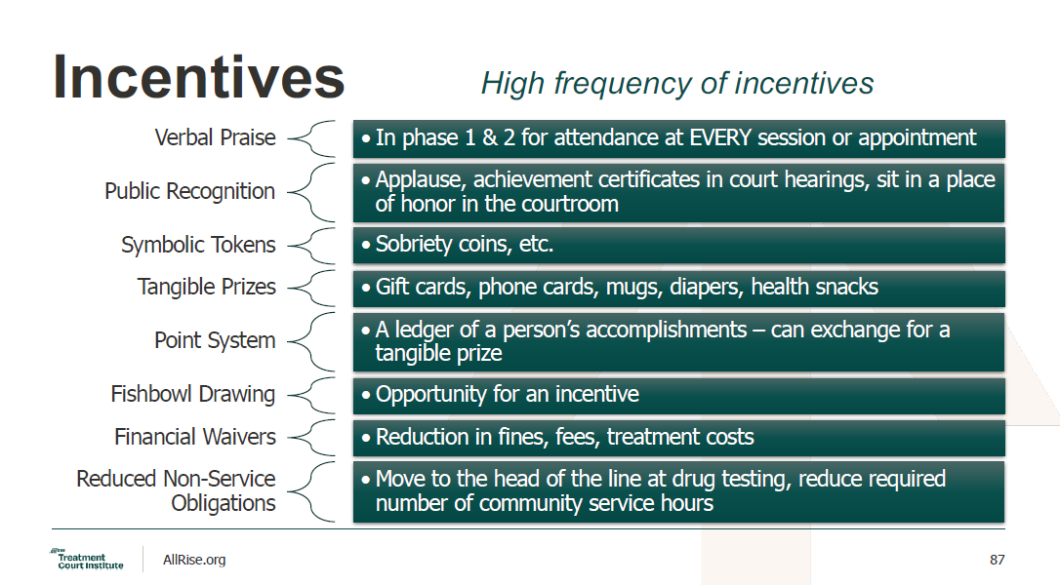

Slide 11
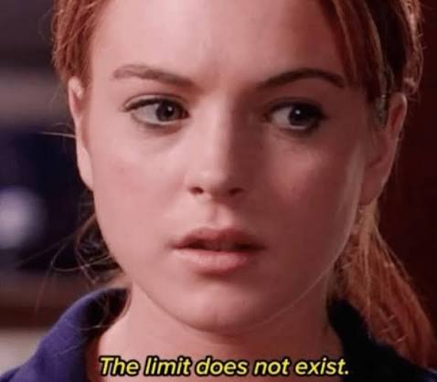
How much is too much?

Slide 12
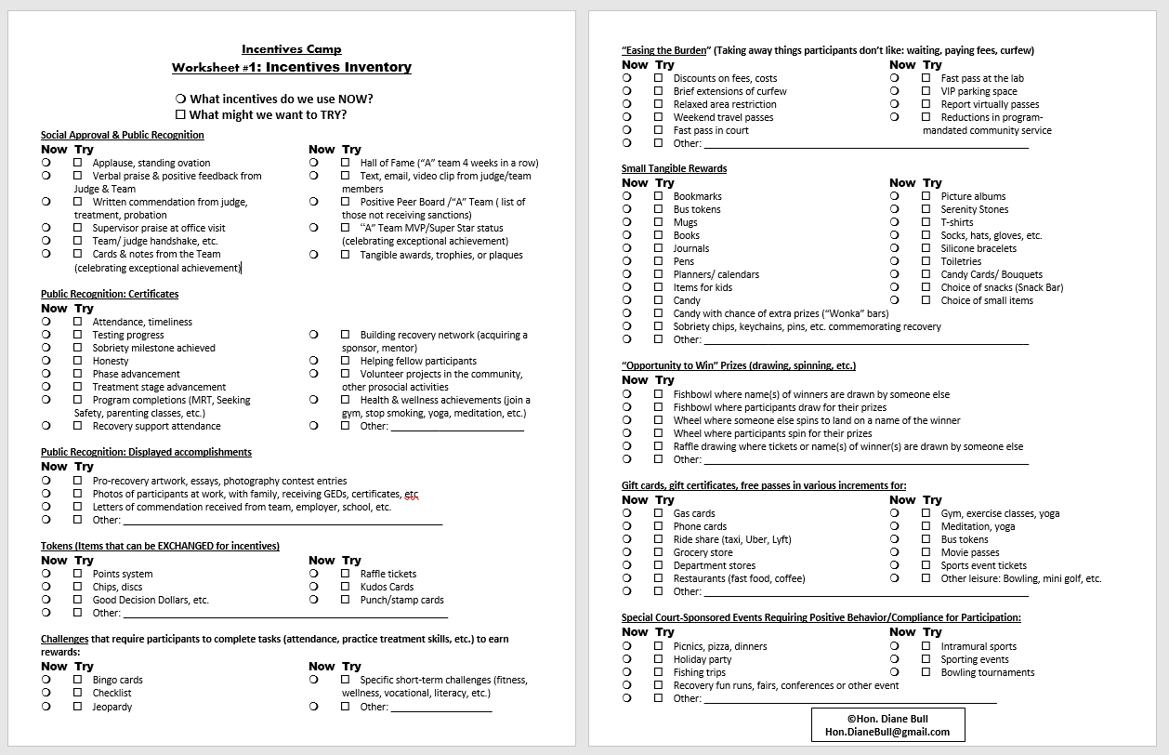

Slide 13
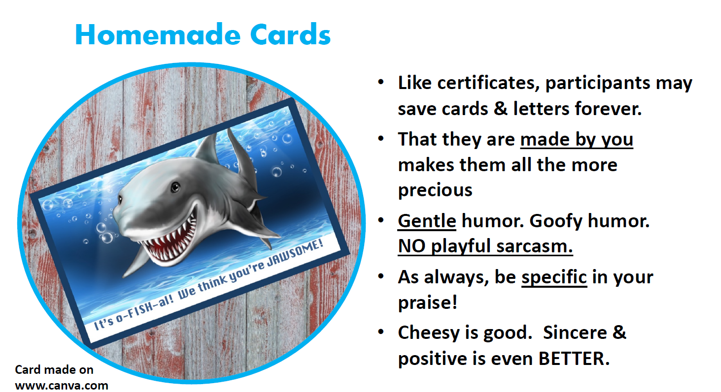

Slide 14
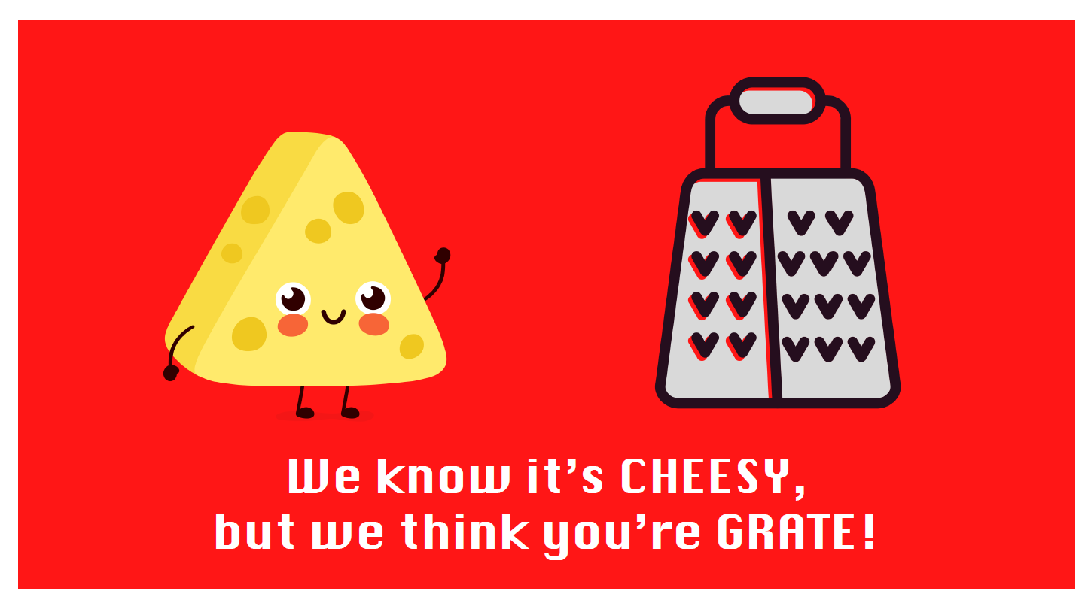

Slide 15
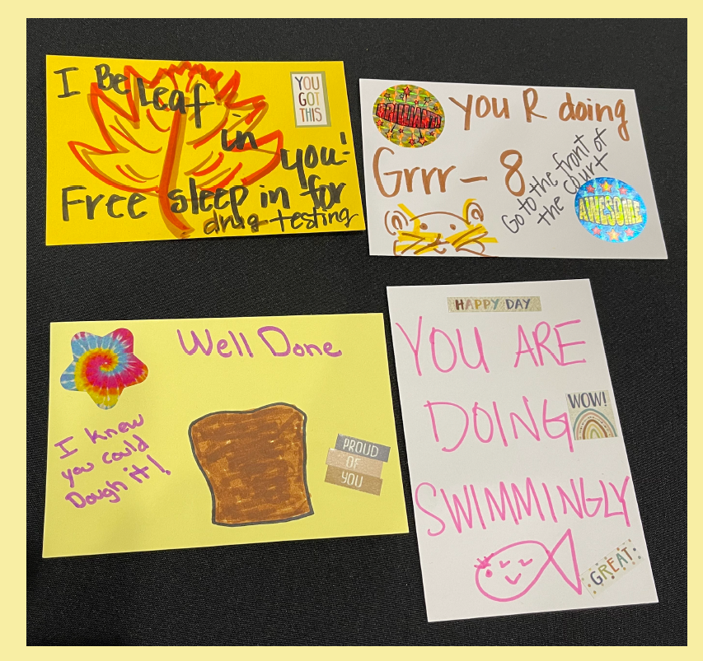

Slide 16
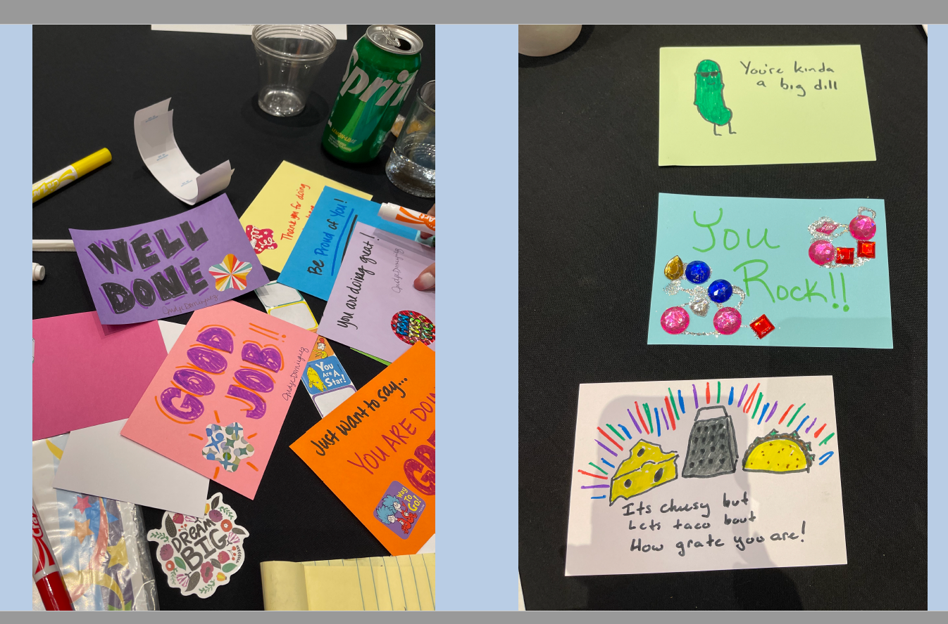

Slide 17
