Slide 1
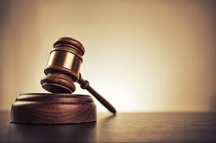
The Mentor Coordinator Readiness & Operational Training (MCROT)
Legal Issues 101
  Presenter: JC Moore,
  Sunchaser Solutions LLC
  Legal Issues 101

Slide 2
Training Objectives
Role of Veteran Mentors
Legal risks and responsibilities
Court structure and expectations
Boundaries and reporting requirements

Slide 3

Why This Matters
Protects the participant
Protects the mentor
Ensures ethical and legal compliance
Ensures ethical and legal compliance
Protects the mentor
Ensures ethical and legal compliance

Slide 4
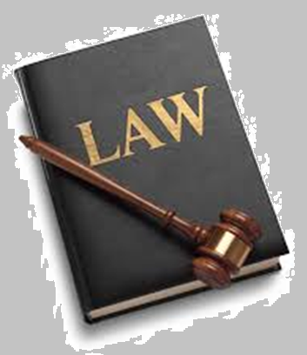
Traditional Court vs Treatment Court
Traditional Court: Punishment-focused
Adversarial
Limited follow-up

Slide 5
Traditional Court vs Treatment Court
Treatment Court: Rehabilitation-focused
Team-based approach
Ongoing monitoring

Slide 6

Key Characteristics of Treatment Courts
Judicial supervision
Treatment integration
Incentives and sanctions
Frequent check-ins

Slide 7

Why Courts Look This Way
Based on behavior change science
Focus on accountability + support
Designed to reduce recidivism

Slide 8
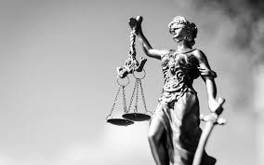
Mentor Role in Court Model
Support, not enforcement
Encourage compliance
Build trust and engagement

Slide 9
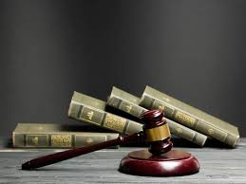
Why Entry Takes Time
Eligibility screening
Legal review
Clinical assessments
Coordination between agencies

Slide 10

Entry Process Breakdown
Arrest/charge
Referral to treatment court
Screening and assessment
Acceptance decision

Slide 11

Common Delays
Court backlog
Waiting for records
Clinical availability
Legal negotiations

Slide 12
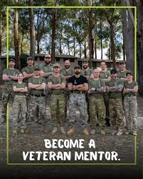
Mentor’s Role During Entry
Provide encouragement
Manage expectations
Avoid giving legal advice

Slide 13

Program Framework Overview
Phases of treatment
Regular court appearances
Drug/alcohol testing
Counseling requirements

Slide 14
Typical Participant Requirements
Attend treatment sessions
Remain substance-free
Follow court orders
Maintain contact with team

Slide 15
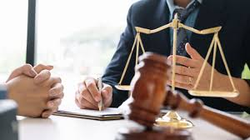
Phase Progression
Stabilization phase
Skill-building phase
Reintegration phase
Graduation

Slide 16
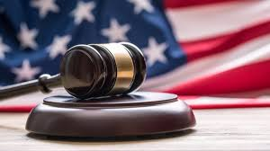
What’s In It For the Participant
Reduced or dismissed charges
Support system
Access to treatment
Improved life outcomes

Slide 17

Potential Downsides
Intensive monitoring
Time commitment
Strict accountability
Sanctions for noncompliance

Slide 18
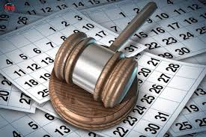
Incentives
Praise from the judge
Reduced supervision
Phase advancement
Tangible rewards

Slide 19
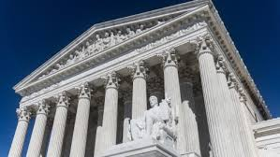
Sanctions
Increased testing
Community service
Short-term jail stays
Phase setbacks

Slide 20
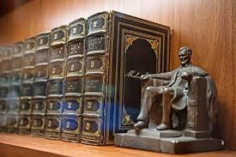
Mentor Role in Courtroom
Observe and support
Model appropriate behavior
Encourage accountability

Slide 21

Confidentiality Basics
Respect participant privacy
Share only with the Mentor Coordinator
Never share participant info, family/friends
Do not discuss outside the program

Slide 22

Team Confidentiality
Information shared from/with the Mentor Coordinator is protected in Wisconsin
Not for gossip or external discussion

Slide 23

Talking with the Judge
Only when appropriate, and it should Rarely Happen
Never advocate

Slide 24

When You Must Report
Threats of harm to self or others
Child or elder abuse
Serious criminal activity

Slide 25
Duty to Report
Legal obligation in specific situations
Overrides confidentiality
Protects safety

Slide 26

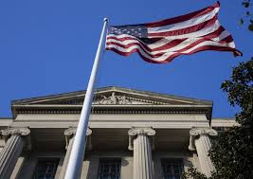
Sunchaser Solutions
Questions ???

Slide 27
Sunchaser Solutions
Questions ???

Slide 28
Sunchaser Solutions
Questions ???

Slide 29
What You Do NOT Report
Minor rule violations
Relapses (unless safety risk)
Personal disclosures without risk

Slide 30
Privilege vs Confidentiality
In what state do Mentors have legal confidentiality (like a priest or therapist)

Slide 31
Common Legal Mistakes Mentors Make
Giving legal advice
Over-reporting or under-reporting
Breaking confidentiality (sorta)
Acting outside role

Slide 32
Key Takeaways
Know your role
Protect confidentiality appropriately
Understand reporting obligations
Stay within mentor boundaries

Slide 33
Sunchaser Solutions
Questions ???
Notes:
Summarize the core training message.

Slide 34
Sunchaser Solutions
Sunchaser Solutions 906-281-7554
markepana@gmail.com
We can handle all your training needs.
Notes:
Summarize the core training message.

