Slide 1

LIFT Wisconsin and the Legal Tune Up Tool
WATCP Fall Summit
October 9, 2026

Slide 2

Legal Interventions for Transforming Wisconsin
Interdisciplinary Approach to find solutions
  LIFT developed the Legal Tune Up tool (LegalTuneUp.org) in 2020.
Technology as Amplifier
  It uses innovative technology to create a simple and free tool to help solve civil legal problems.
Unique
  It takes existing public data to easily resolve common legal issues.
  It started small and we’re adding more each year!

Slide 3


Access to Justice
Definition: A person facing a legal issue that has timely and affordable access to the level of legal help they need to get a fair outcome on the merits of their legal issue, and can walk away believing they got a fair shake in the process.

Slide 4
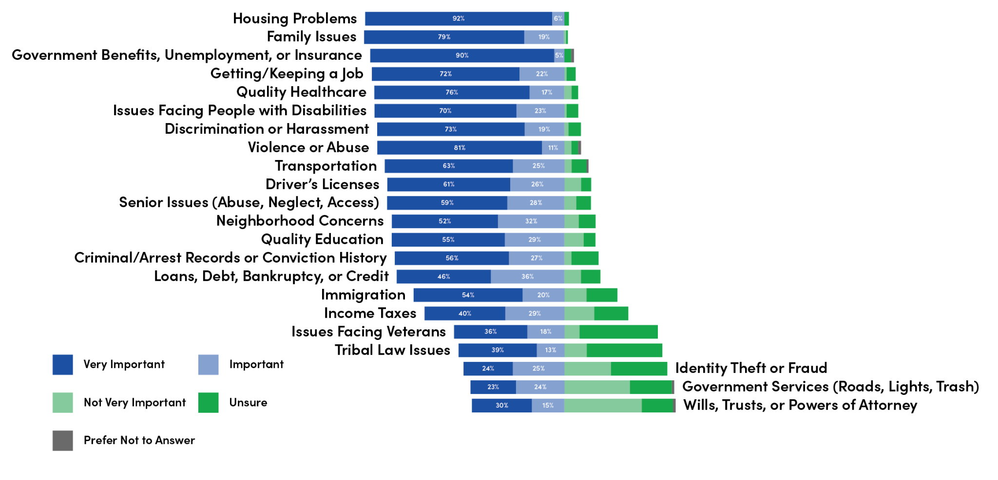
Low Income Legal Issues in WI
Survey from our friends at Judicare/Legal Action of Wisconsin
Notes:
Based on Needs Assessment

Slide 5
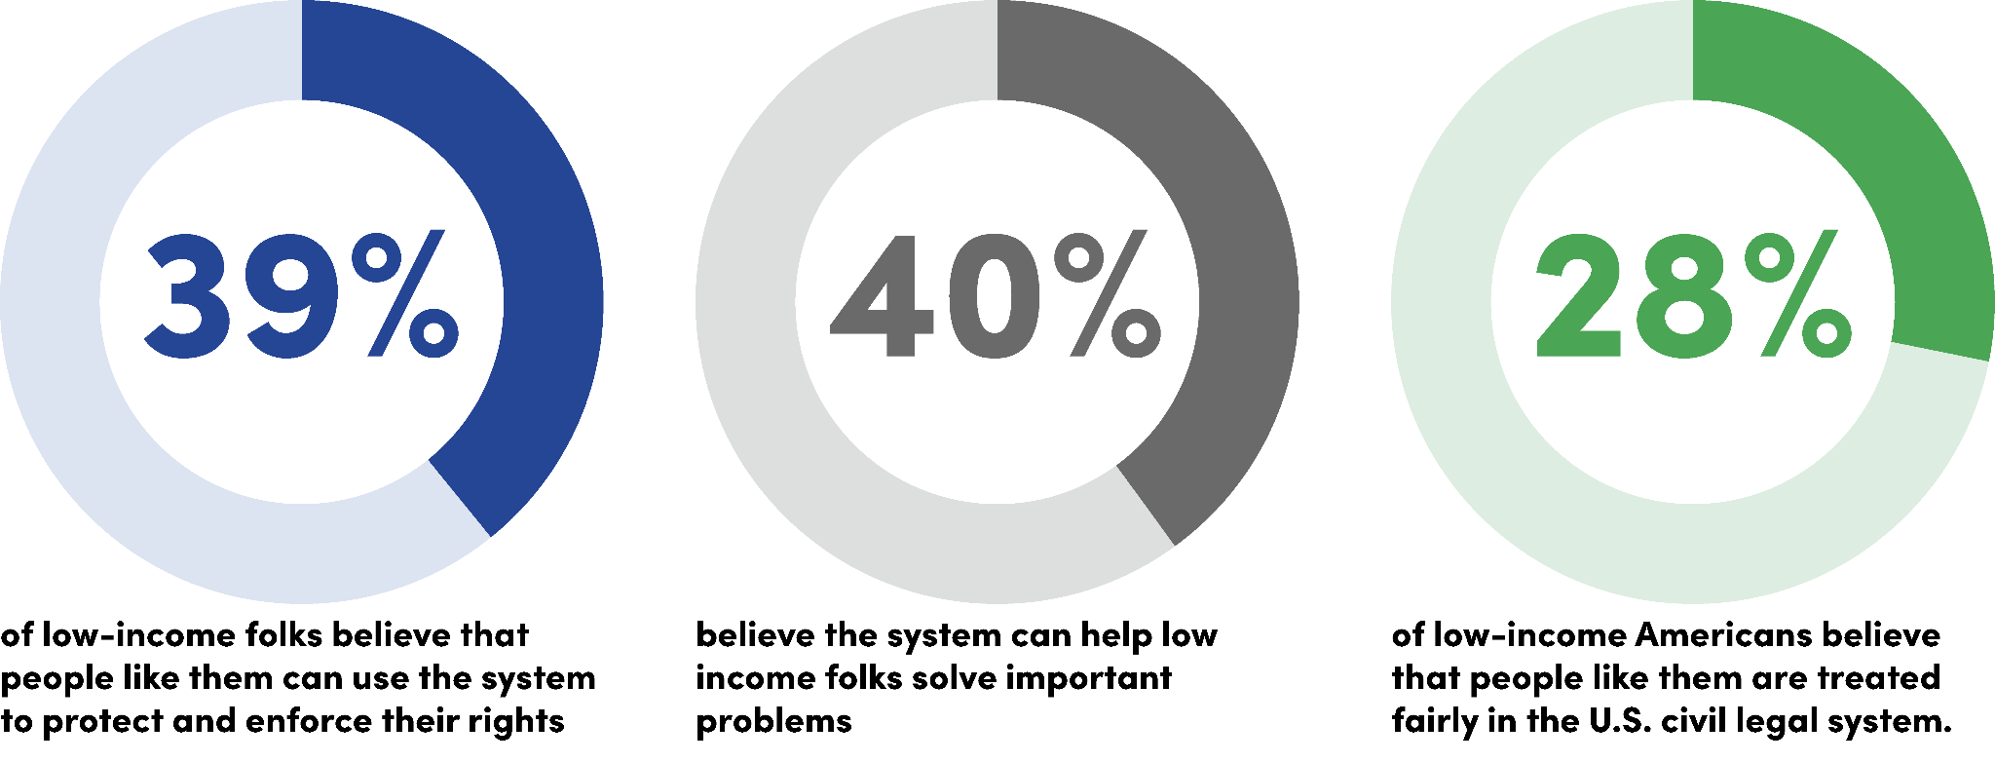
Low-Income Americans Don’t Trust the System

Slide 6
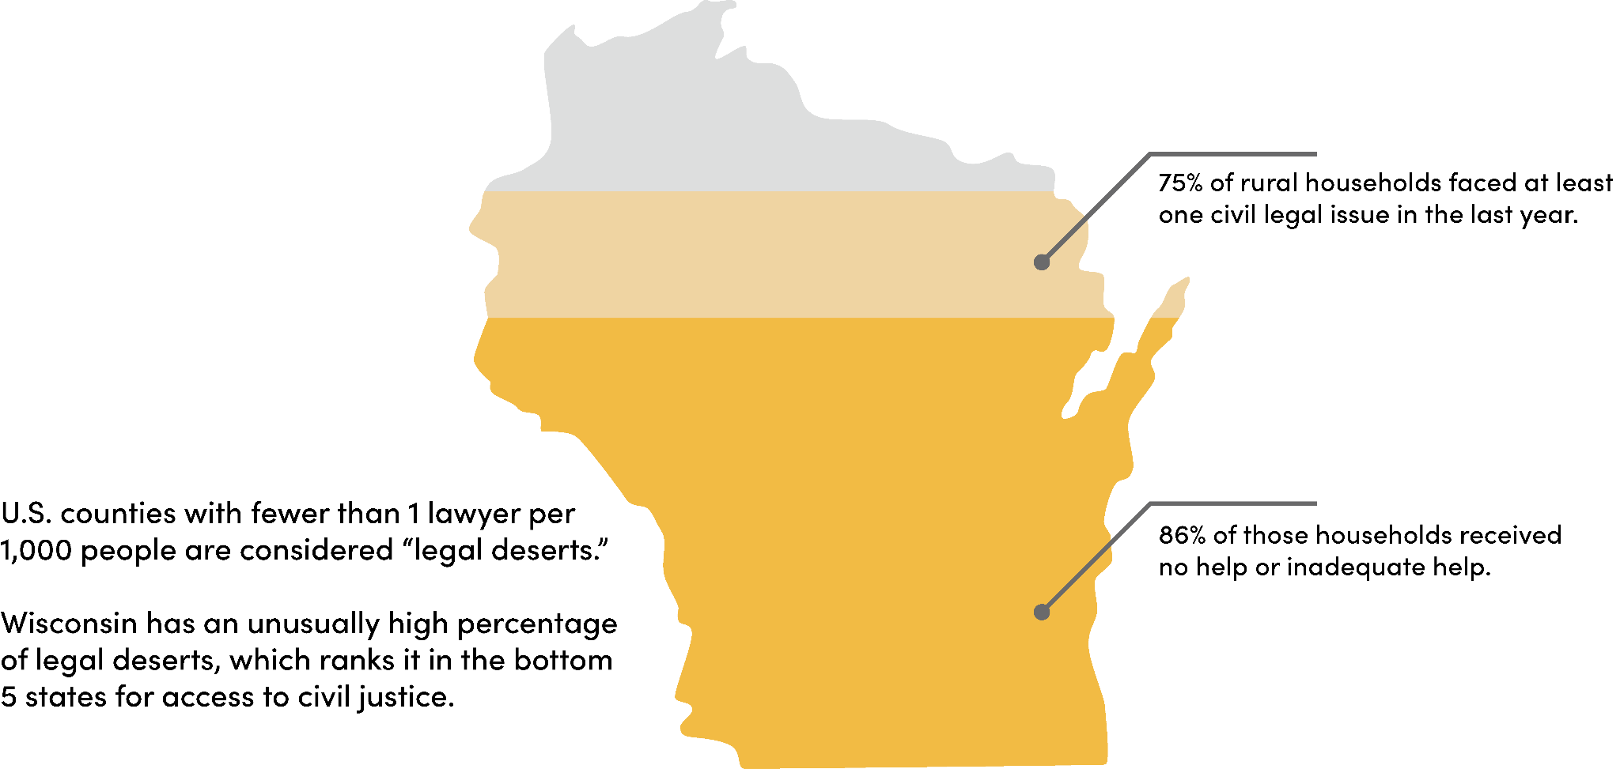
Rural Deserts in Wisconsin
Notes:
This gap is exacerbated in rural parts of the country and in the state of Wisconsin. In fact Wisconsin is considered a legal desert. graph about WI being one of the worst legal deserts in the country
challenges:
small town culture
travel for attorneys,
limited technology / access
mismatch between where the volunteers are and where the clients needs are
number of lawyers: go

Slide 7

LIFT’s Mission and Model
Elevating People. Expanding Justice.
Through our commitment to improving access to justice for everyone, we seek to transform and reform legal systems, increase personal agency, and democratize data.

Slide 8

What is the LegalTuneUp tool? ​
Legal Tune Up seeks to address economic inequities by assisting folks in navigating through vast and overwhelming public databases that house publicly available information that result in barriers to housing, employment, and economic stability.
Notes:
justice focused technology

Slide 9
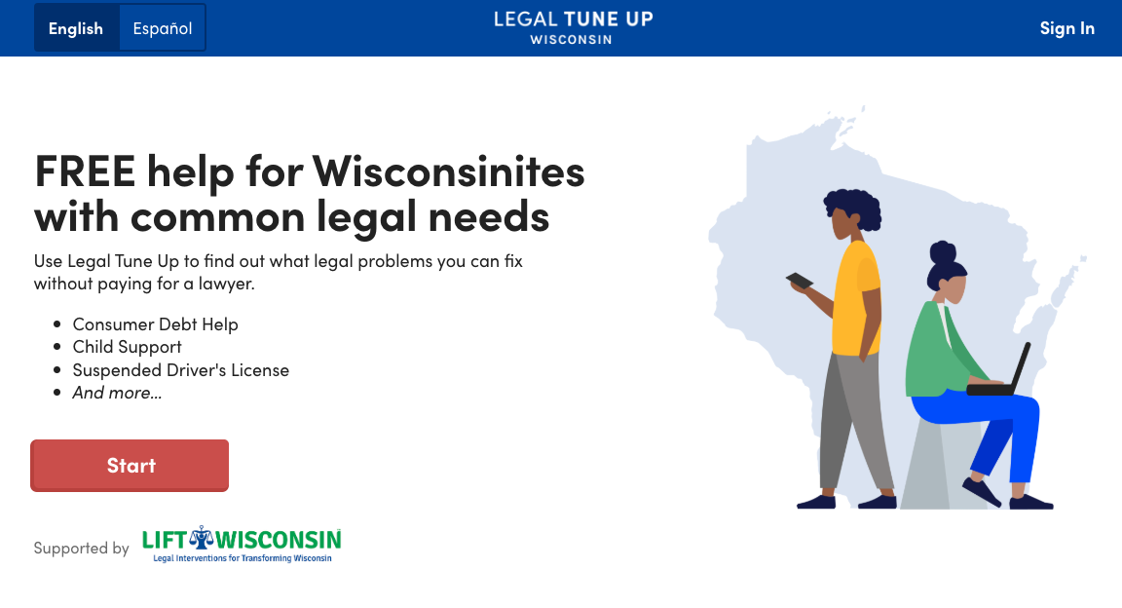
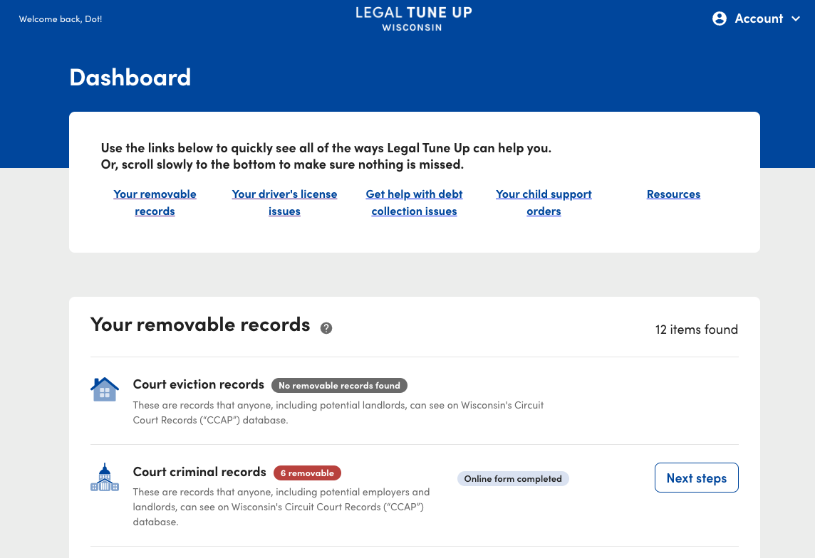
How it works
The Legal Tune Up tool searches and identifies issues related to driver’s license suspensions, evictions, convictions, child support arrears, and consumer debt. ​
Only tool (that we know of) that aggregates data from four different state agencies into one place.
User enters basic information
CCAP (Consolidated Court Automation Programs)
Dept. of Justice
Dept. of Transportation
CSOS (Child Support Online Services)
Notes:
“user experience” This is what the user sees!
LTU was designed to increase personal agency for it’s users and give them power over their own data
Understand the scope of what they are working with and barriers.
Try to make it accessible
Easy questions in order
Prepopulates forms for folks
Has links and resources throughout

Slide 10


BACKGROUND CHECKS - How the Legal Tune Up Tool can help
Some court records can be removed from CCAP. The Legal Tune Up tool can help by providing helpful information and guide your clients through the necessary paperwork.
It can inform users which records are eligible for removal now and which will be removable in the near future.
It can fill out and send the form GF-184A–Request to Correct Court Records.
Notes:
Knowing what is and is not eligible for removal
Finding the right form and where to file it
Nationwide
Furthermore, expungement and sealing can benefit the economy by providing individuals with criminal records a second chance at employment. Economists estimate that the cost of barring these individuals from the workforce is roughly $78 to $87 billion in lost gross domestic product annually.
Nearly 9 in 10 employers use background checks in hiring; an estimated 4 in 5 landlords use background checks on prospective tenants; and more than 3 in 5 colleges and universities use background checks in admissions.

Slide 11

CHILD SUPPORT - How the Legal Tune Up Tool can help
The Legal Tune Up Tool’s Child Support Module is focused on Child Support modification, not collection.
Our calculator can help your clients find out if they might be eligible for a modification and if a modification is right for them.
The Legal Tune Up Tool can also help them fill out the Child Support Modification form and it provides instructions on how to file it with the court and the other party.
Notes:
Given the detrimental impact a record of incarceration has on employability, it’s no surprise that formally incarcerated folks may have difficulties keeping up on previously ordered child support
Children who have had a parent incarcerated are nearly four to six times more likely to be expelled or suspended from school than children who have not.
The average child’s family income fell 22 percent when their father was placed behind bars compared with the preceding year—and remained 15 percent lower in the year after release.
Nearly 2 in 3 families with an incarcerated family member—70 percent of whom were caring for minor children—were unable to meet basic needs such as food and housing due to the financial burden of incarceration.
Research shows that low-income non-custodial parents are more likely to have child support orders that far exceeds their ability to pay.
Unpaid child support can result in a variety of sanctions ranging from intercepted tax refunds, suspension of a driver’s license, withholding of student aid, and even criminal charges and incarceration

Slide 12



CONSUMER DEBT - How the Legal Tune Up Tool can help
The Legal Tune Up Tool currently has three features that might be able to help with consumer debt problems:
If they are being sued in small claims court, the tool can help file an answer with the court if they wish to dispute the lawsuit.
It can help fill out and send letters to creditors to end debt collection harassment.
It can send your client text reminders for their upcoming court dates.
Notes:
Our newest module, launched last summer
Approximately 60 of small claims cases in wi end in default judgments
We want this tool to empower folks to take control of their civil legal health by making the small claims legal system easier to navigate

Slide 13

DRIVER’S LICENSES - How Legal Tune Up Tool can help
The Legal Tune Up Tool can guide folks to reinstatement who are experiencing the two most common types of driver’s license suspensions and revocations: Failure to pay forfeiture suspensions and point suspensions.
It can help by providing sample motions to reopen traffic cases, requesting payment plans, and community service requests.
In specific situations, LIFT Wisconsin may even be able to help pay the $60 reinstatement fee required by the DMV.

Slide 14

POAHC- How Legal Tune Up Tool can help
The Legal Tune Up tool’s newest module can assist folks in filling out a Wisconsin Power of Attorney for Health Care form with easy to understand, trauma-informed language.
The POAHC module guides users through the form, provides definitions throughout, gives instructions on witnesses, and how to let your family and doctor know about your wishes.

Slide 15
Let’s see how the LTU tool works!
Notes:
DRJ
Do Small Claims
(207) 423-1540 (theory and principle - DOT DATES small claims)
https://tuneup.theoryandprinciple.com/
SC: case #1 mail/hand deliver, no court date scheduled yet but we can’t send it for you
case #2 in person REQUIRED, no opportunity to fill out forms
case #3 we send it for you
Demonstration of the tool – multiple options – run it for evictions and consumer debt
Available in spanish as well
Evictions example
criminal justice example
John Dunn 1/1/2000 m - eviction records
Demonstration of the tool – multiple options – run it for evictions and consumer debt
Available in spanish as well
Evictions example
criminal justice example

Slide 16
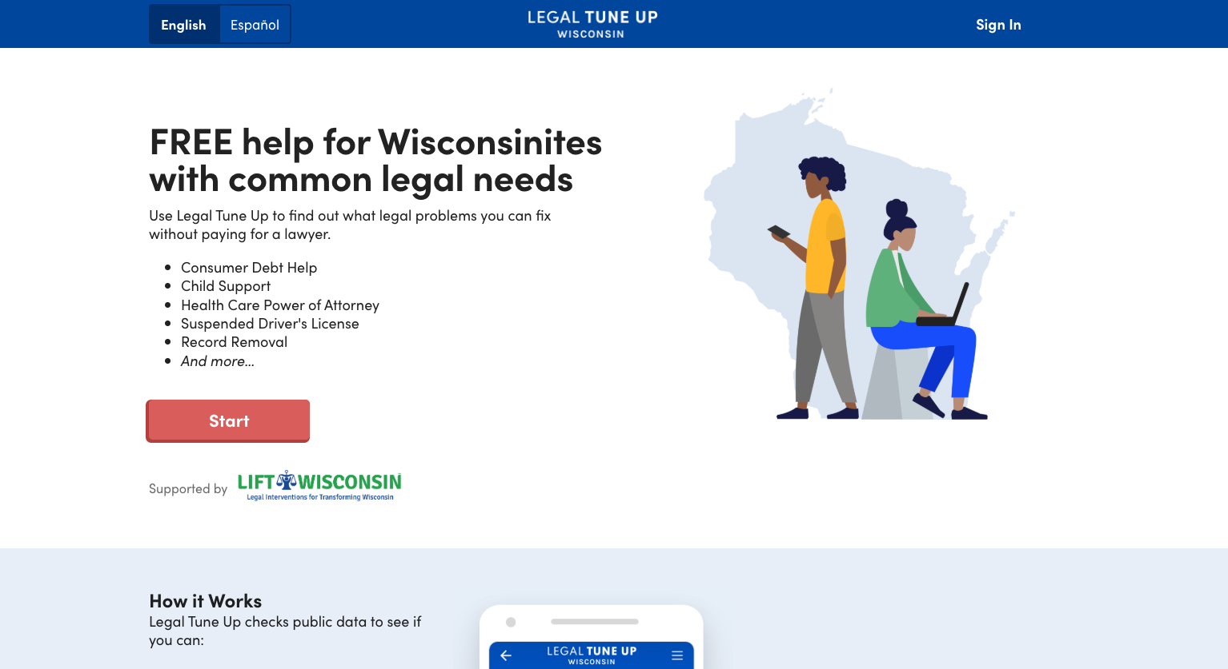
Sign in to come back and rework!
One-time users

Slide 17
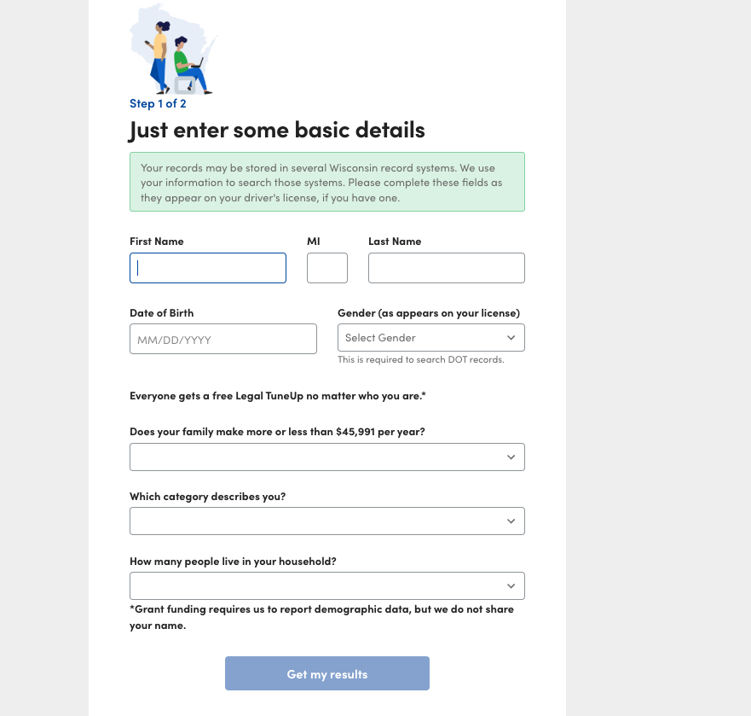
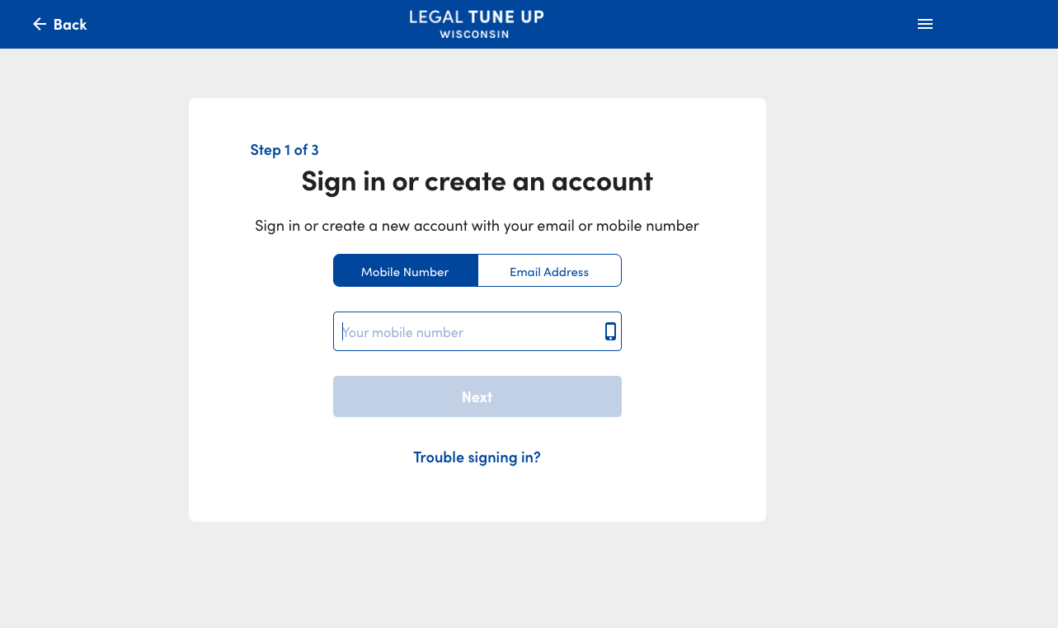
Sign in to come back and rework!
One-time users

Slide 18
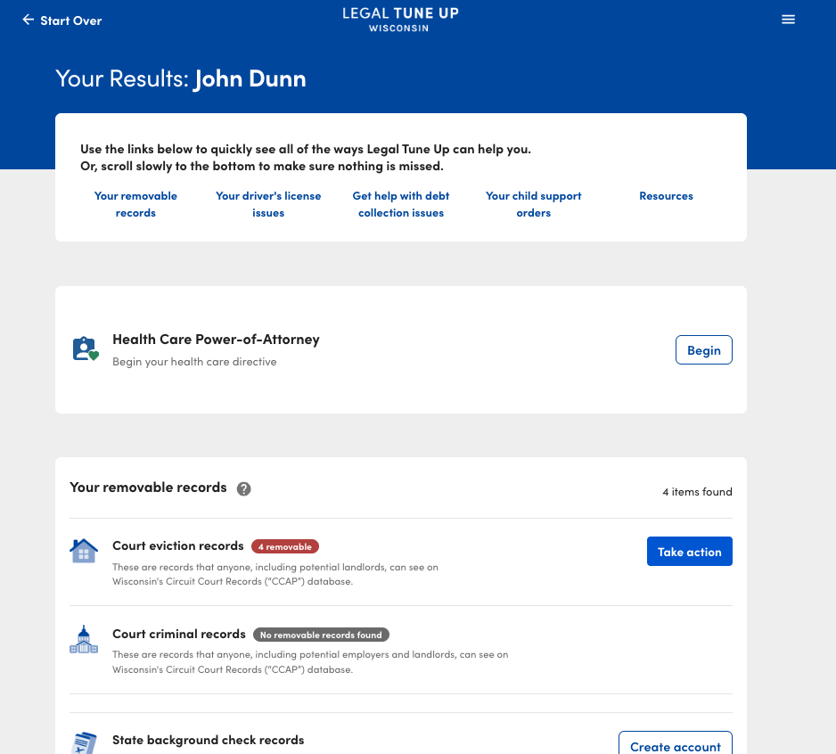
LTU Dashboard:
Power of Attorney for Health Care
Removable records from CCAP (eviction and criminal cases)
WI Driver’s license validity
Small claims response
Child support modification

Slide 19
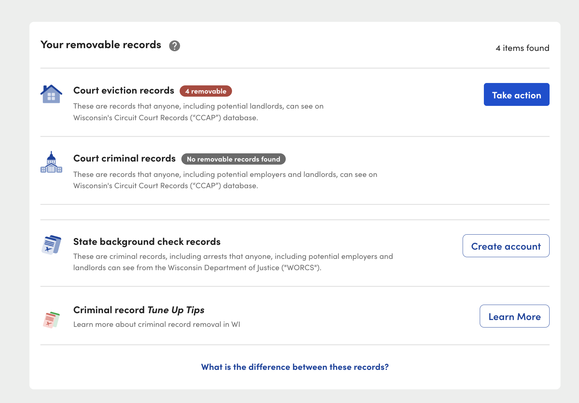
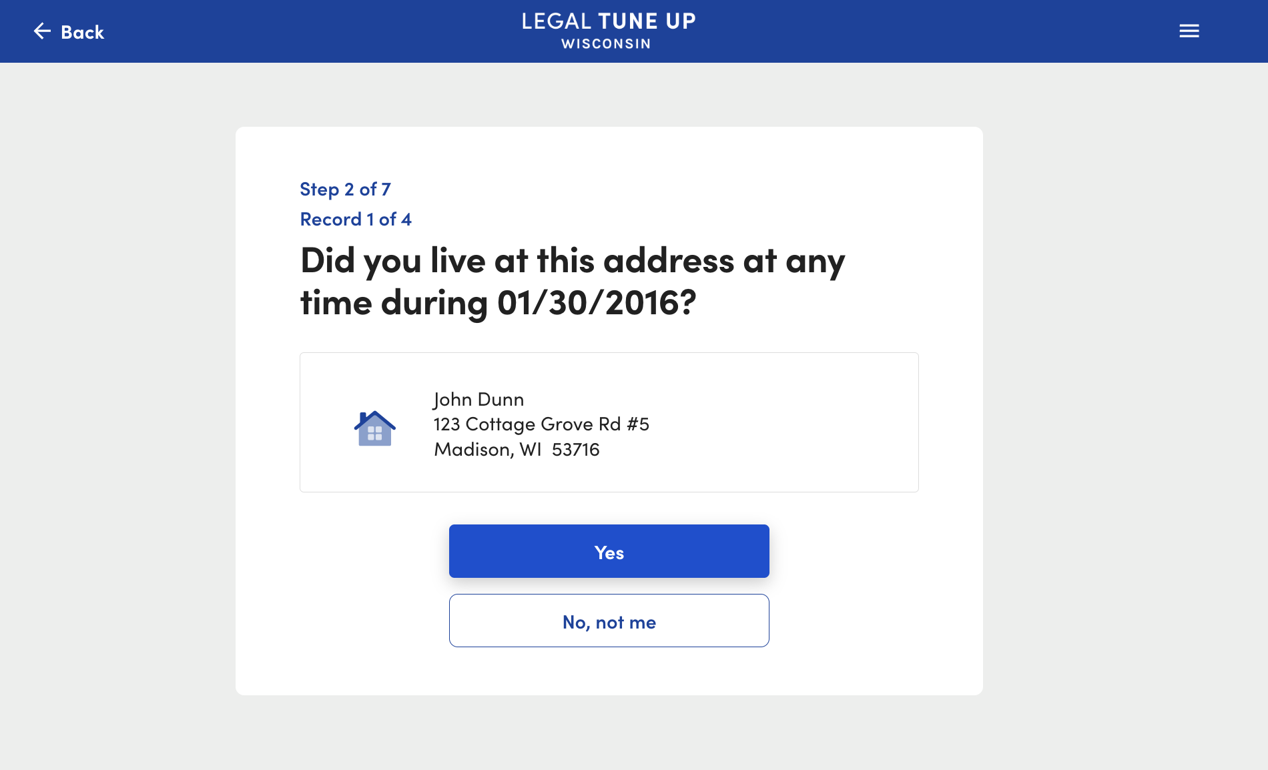
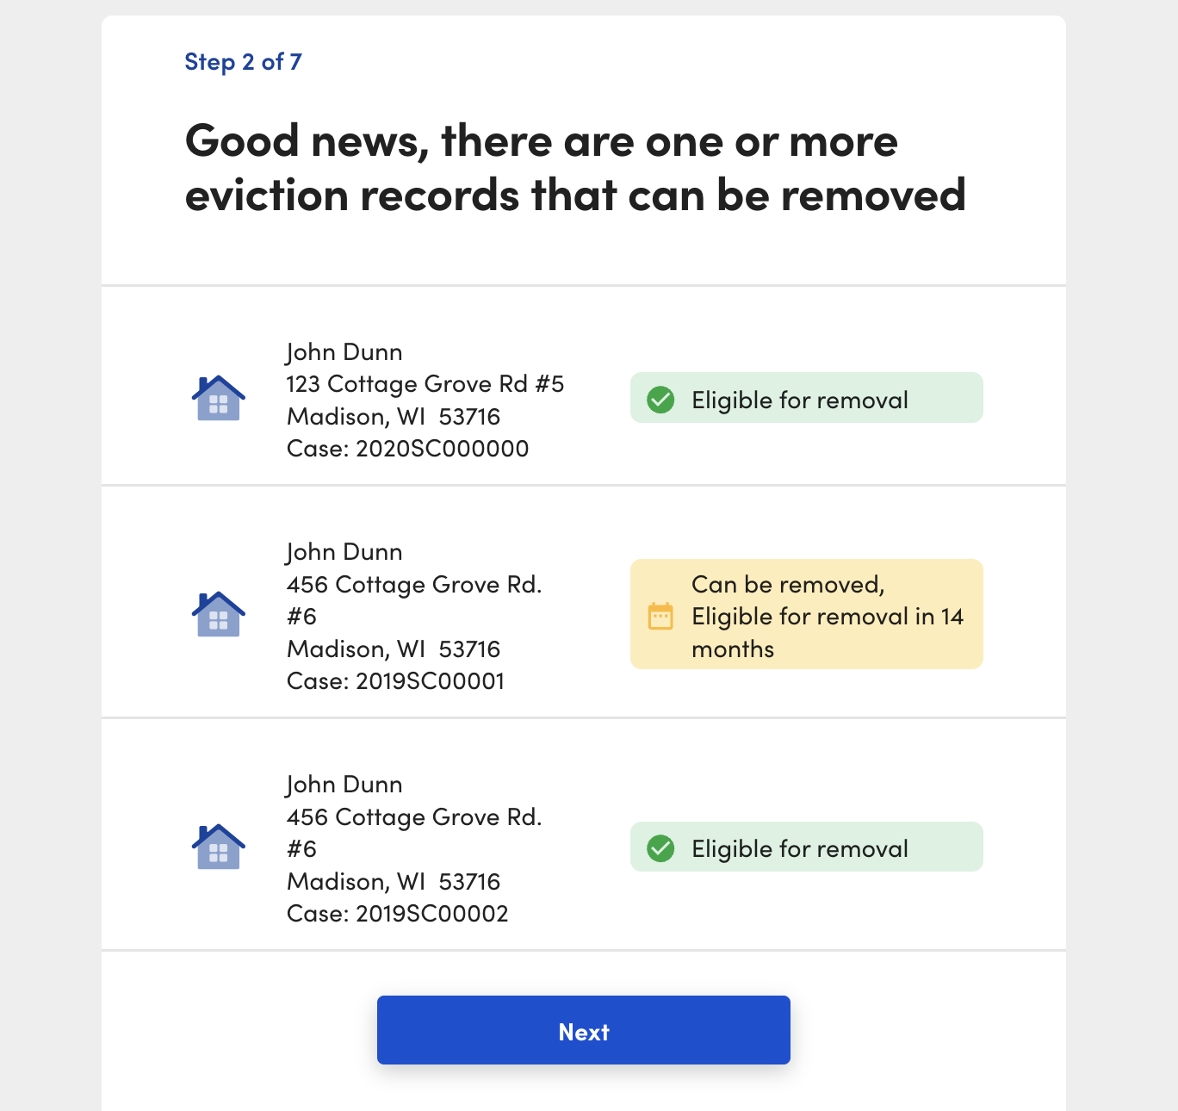
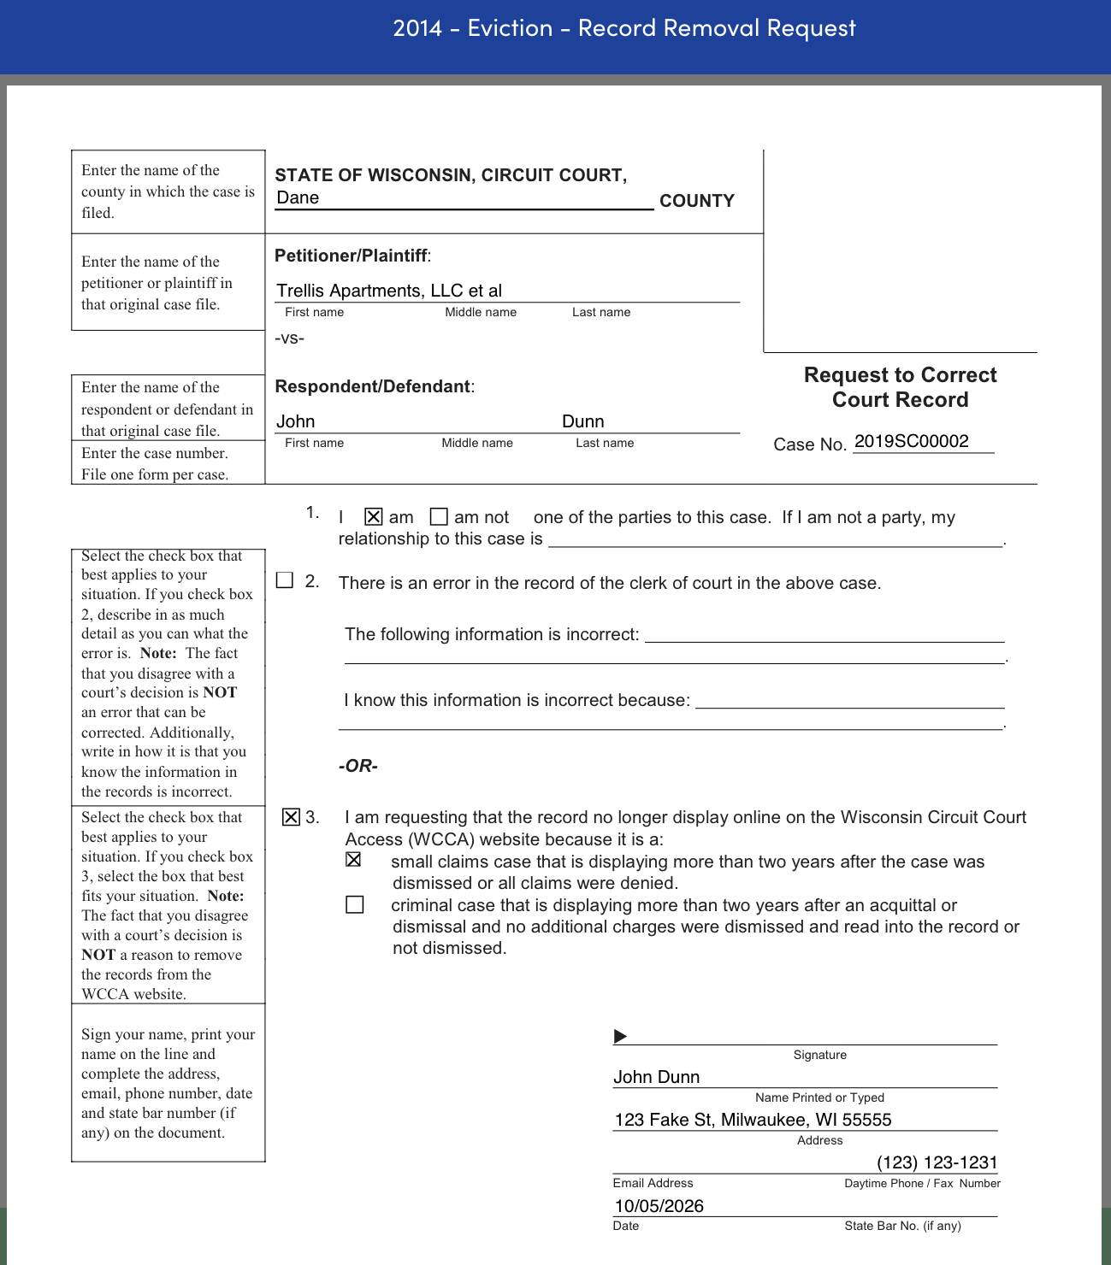
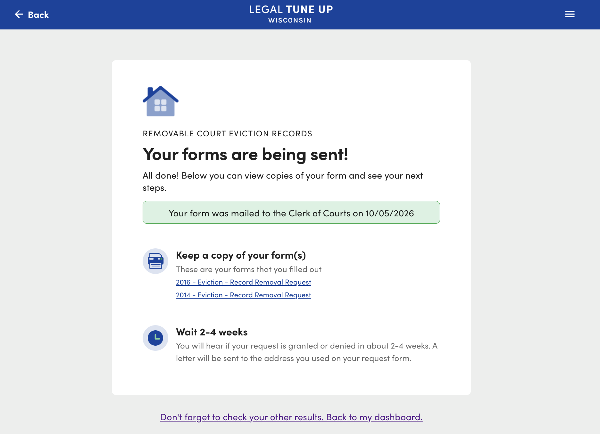
CRIMINAL & EVICTION RECORD REMOVAL

Slide 20
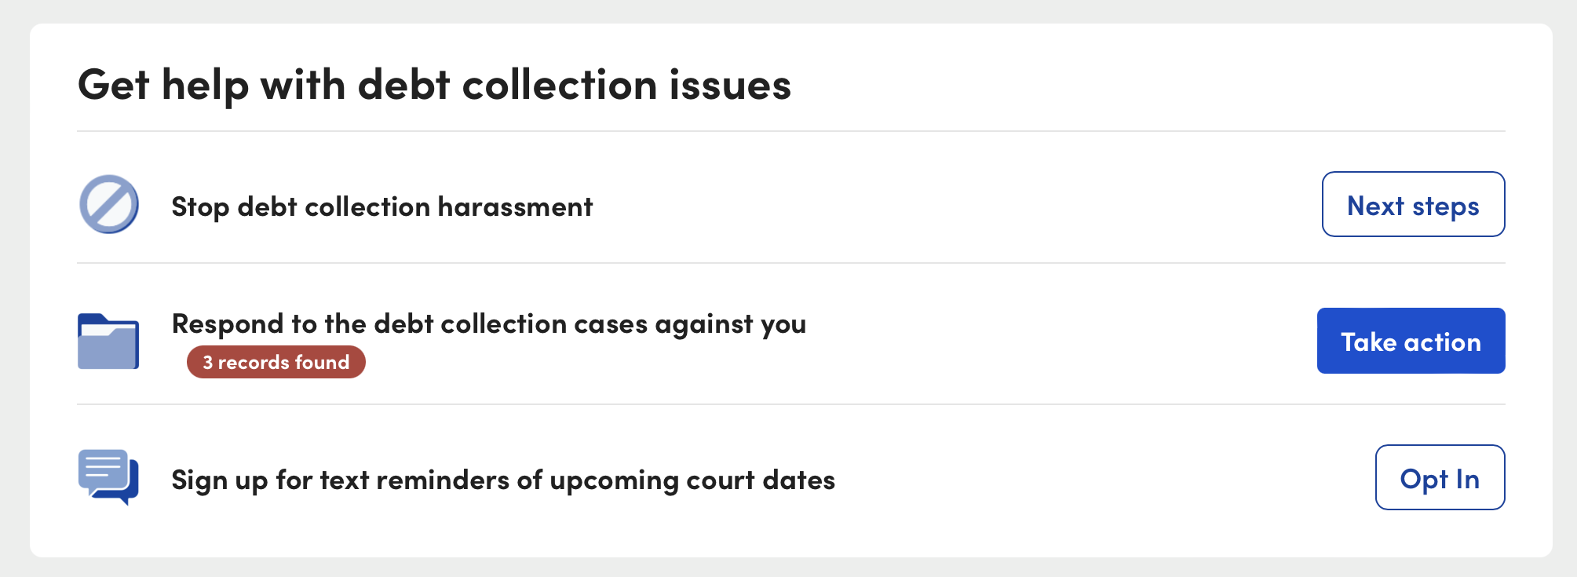
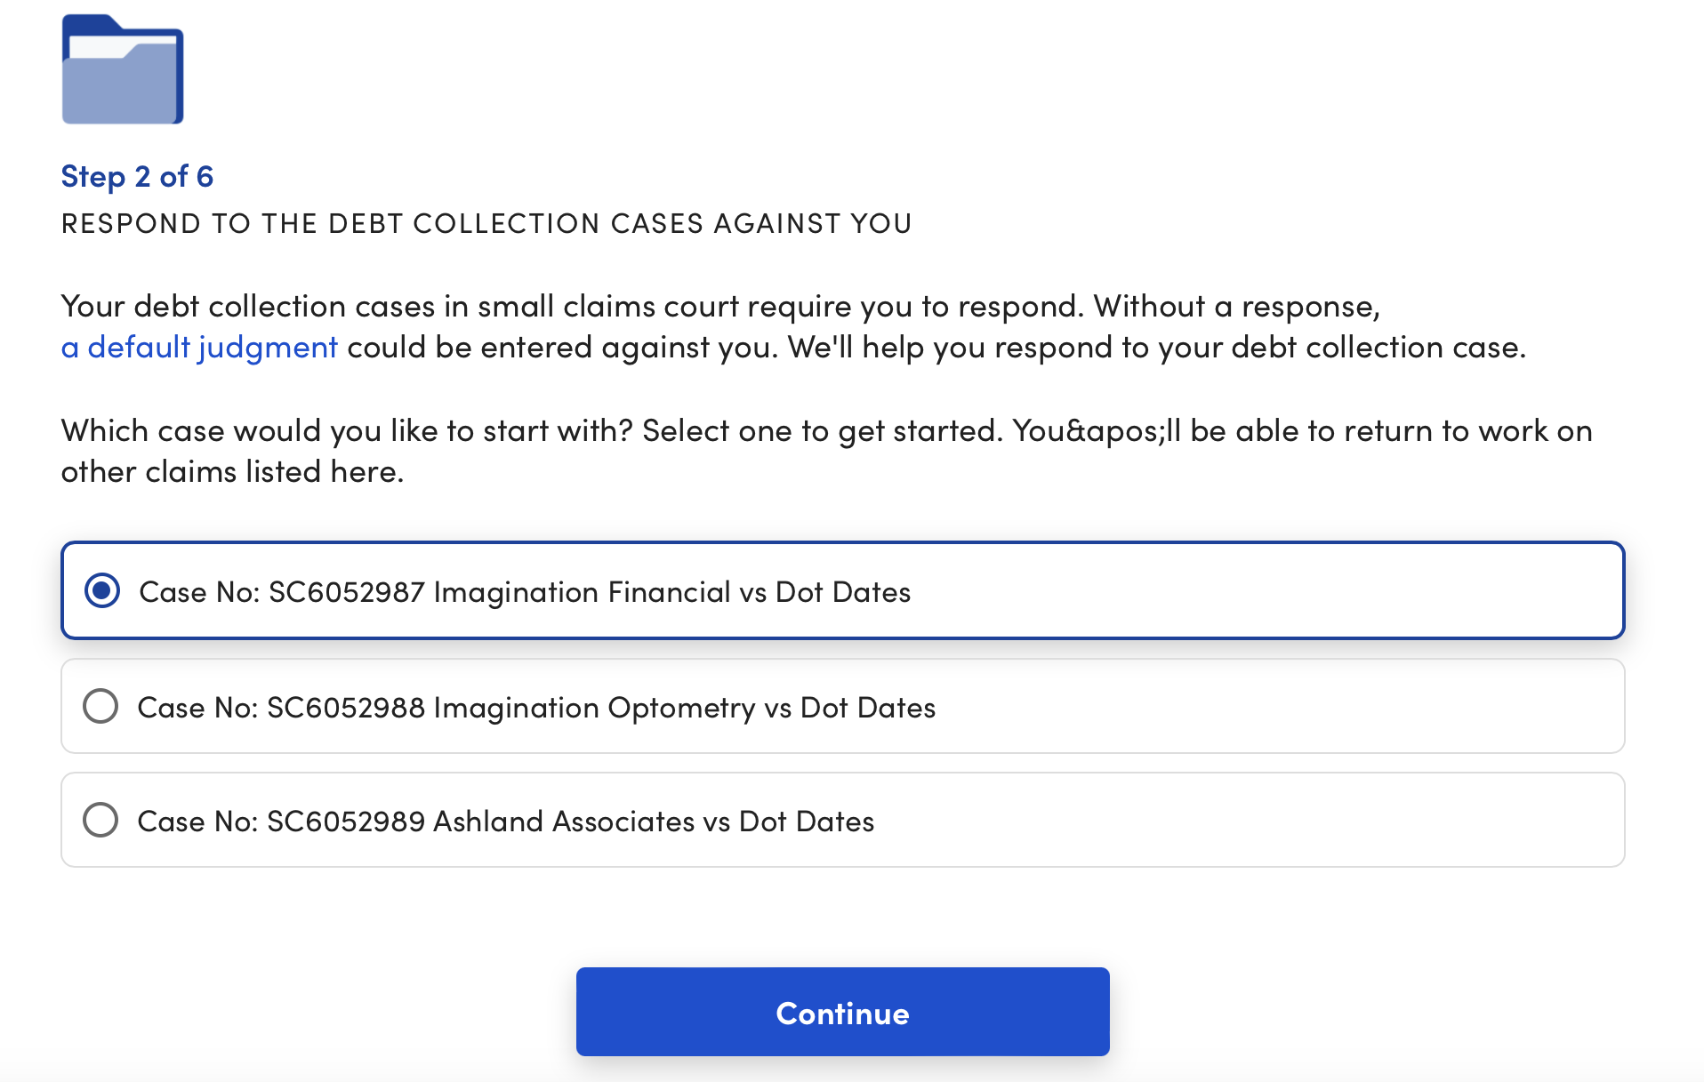
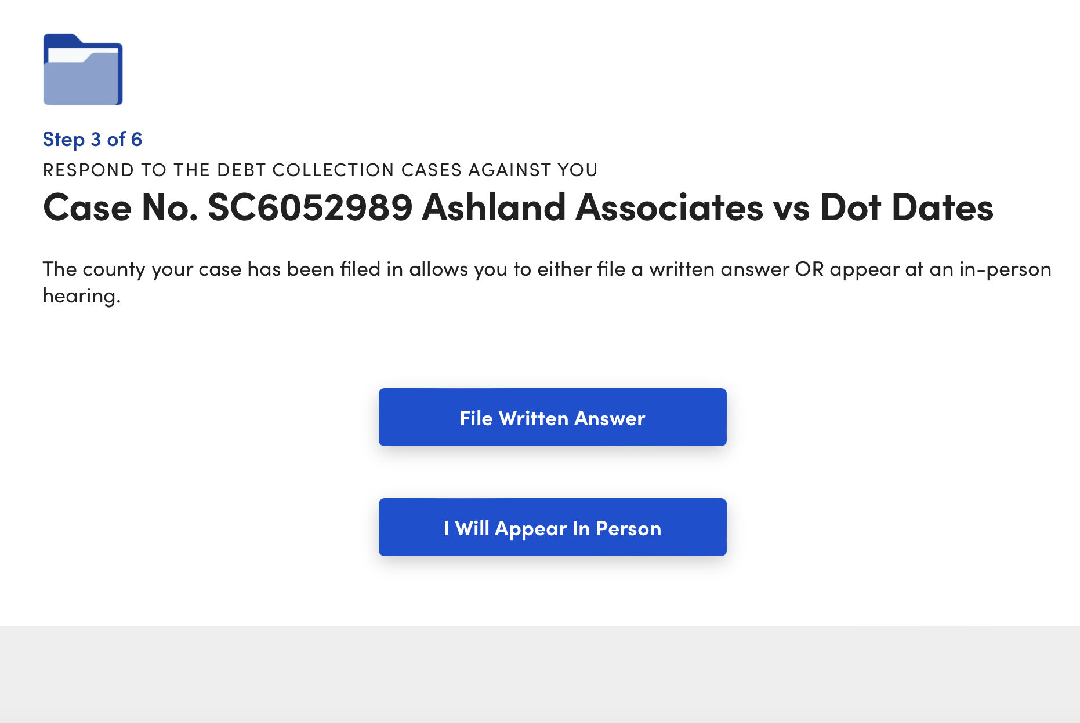
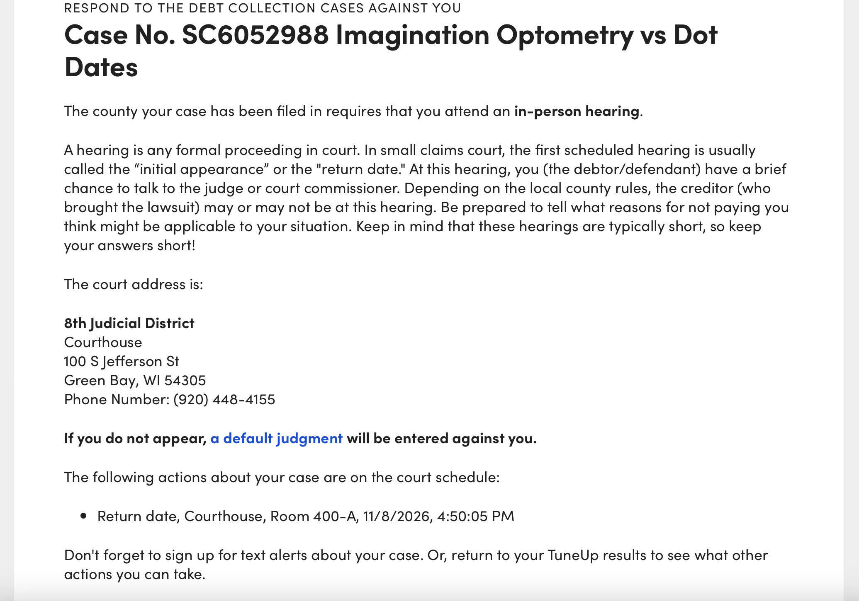
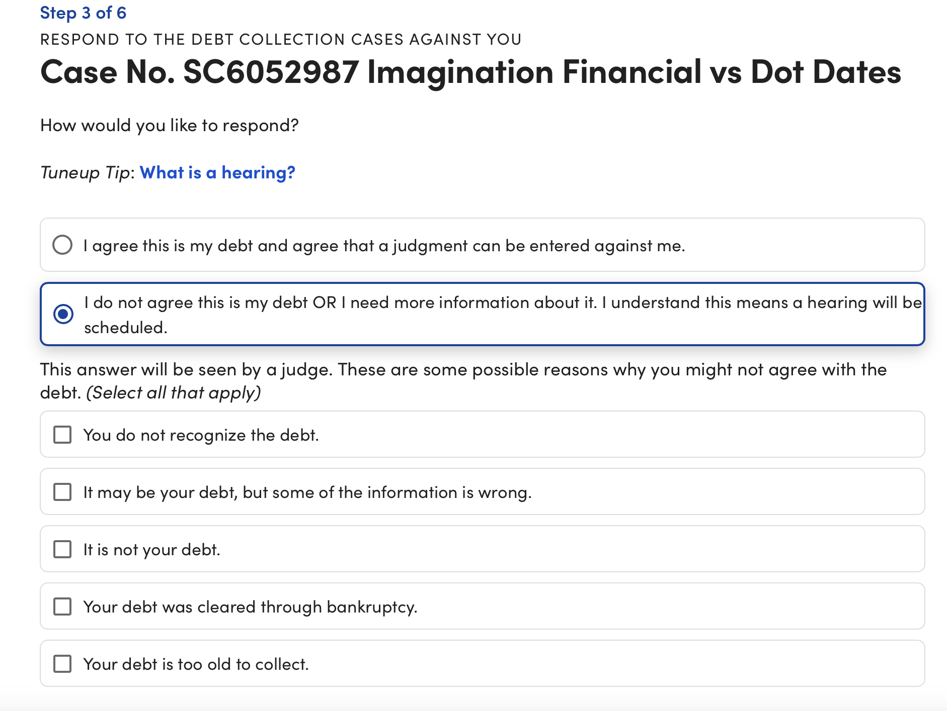
Cases to respond to
Depending on which county the case is in, LTU will direct user to answer
SMALL CLAIMS

Slide 21
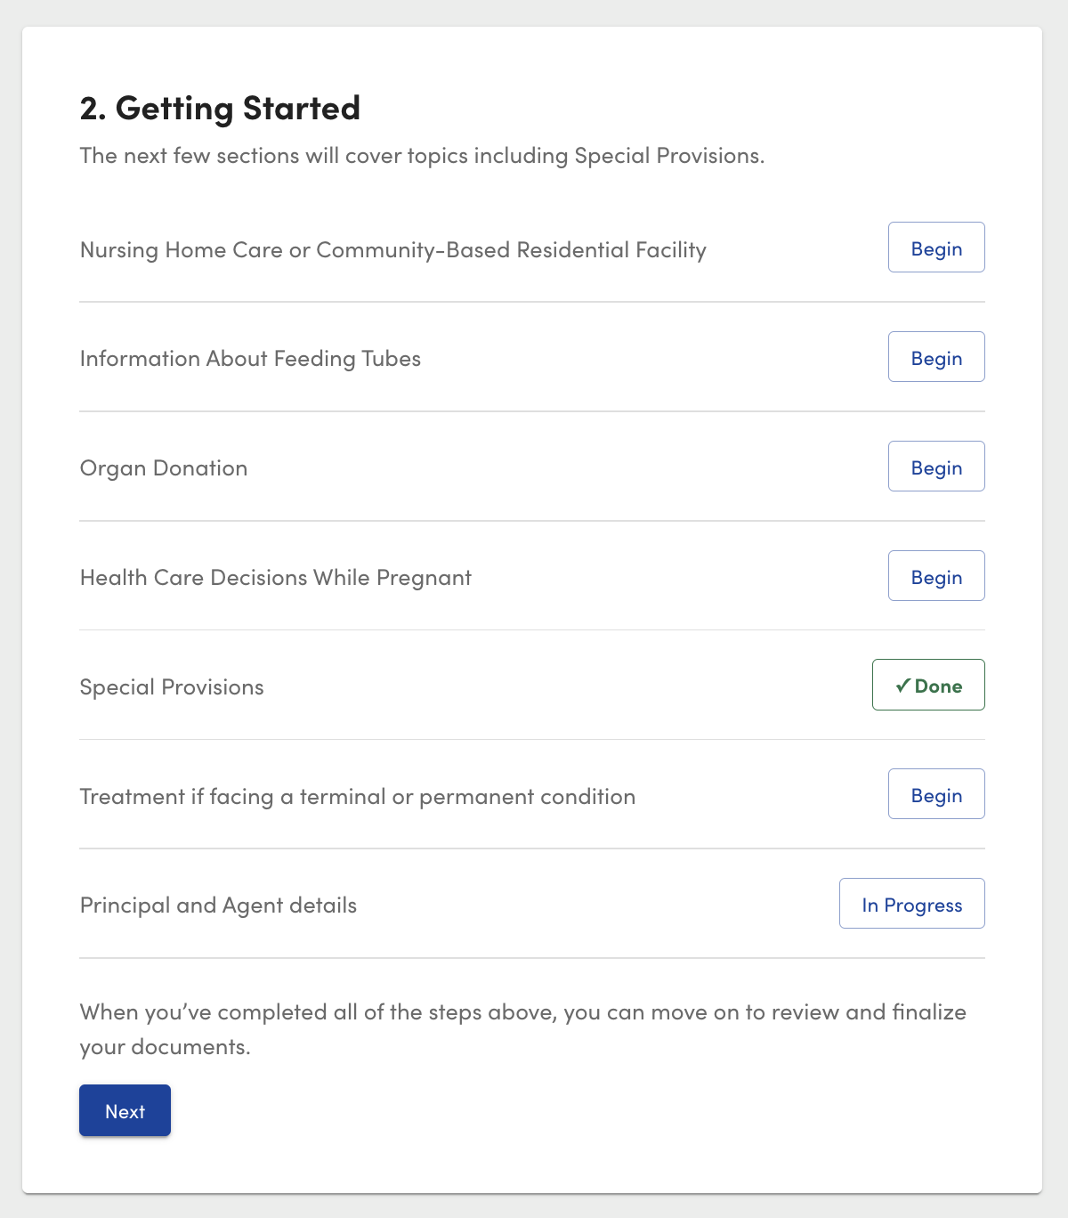
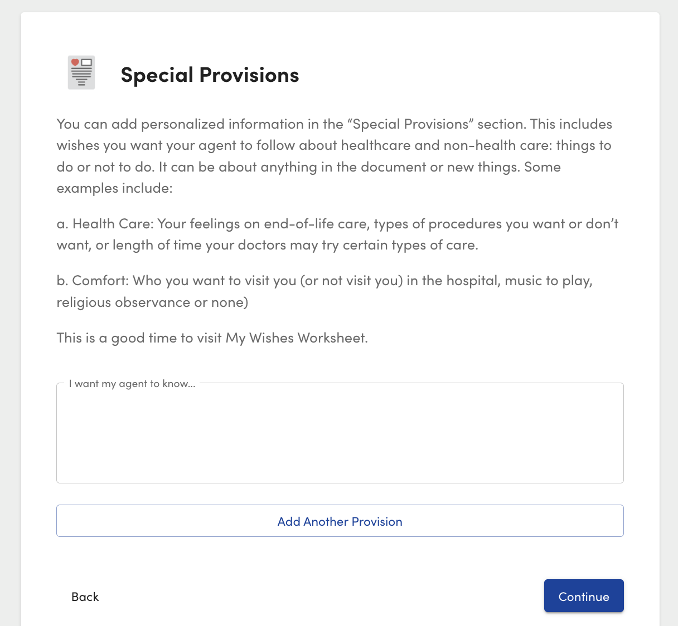
POWER OF ATTORNEY FOR HEALTH CARE

Slide 22
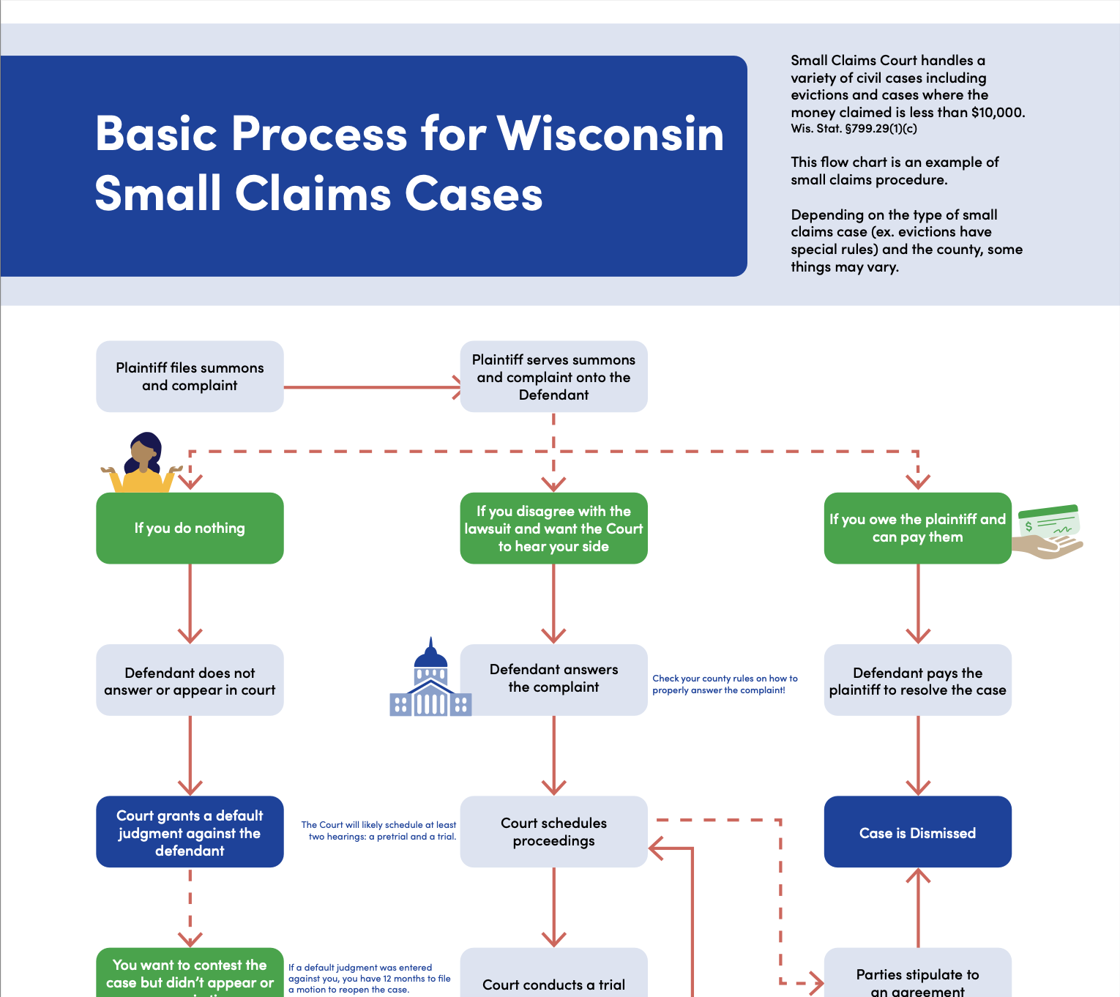
Let’s look at some of our self-help resources

Slide 23
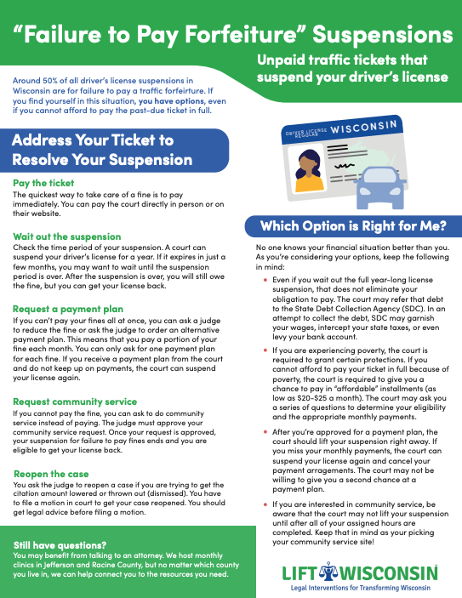
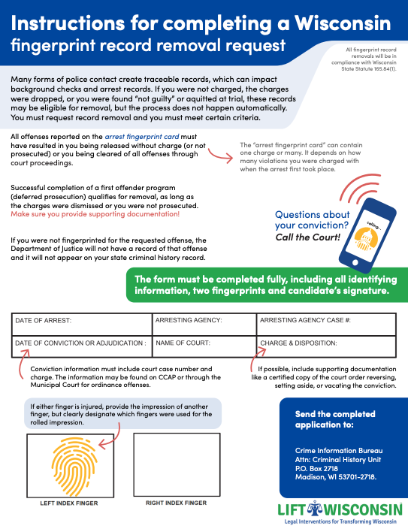
Our website has a variety of downloadable, sharable PDFs. Please distribute freely!
We also have a driver’s license reinstatement form, where LIFT will pay the $60 reinstatement fee if the user is eligible.

Slide 24

Collaborations
Notes:
One of LIFT’s main focuses is connecting to more organizations across Wisconsin to help address access to civil legal services. Our organization seeks to collaborate with state agencies, community-based organizations, and partnership with civil legal aid attorneys (primarily for driver’s license and child support clinics) – and now specifically with libraries for our LIFT Library initiative.
The collaborations we have with a lot of organizations is one centered education and support: we present and discuss access to justice issues in Wisconsin, teach the basics of the tool and guide users to better access educational information
Dont need to say:
State Agencies
Community-based organizations as partners who use LTU with their clients/participants and to create a cadre of community justice workers
Partnerships with civil legal aid attorneys
Driver’s license and child support clinics
LIFT Library Initiative and Legal Navigators

Slide 25
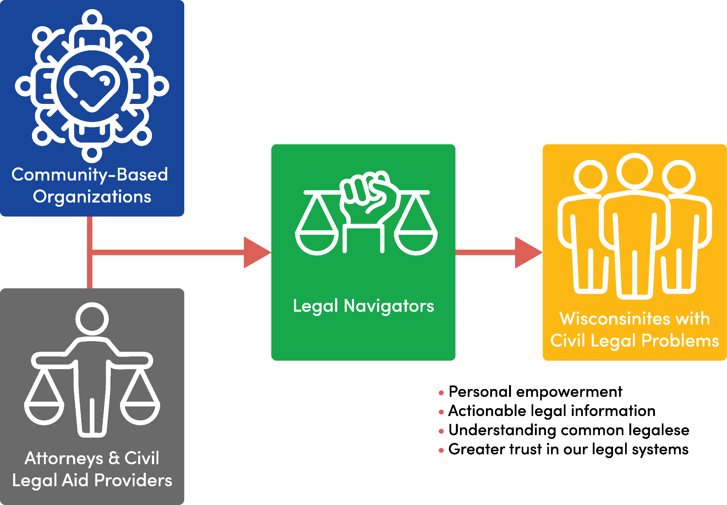
Legal Navigators Program
Notes:
This program is for interested volunteers to be fully trained on the Legal Tune Up tool and associated module topics, so they are better equipped to help community members. The training is cohort style and a total of 4 hours.
After finishing the training requirements, LNs get the option to be housed in Community-Based Organizations or libraries to attend events and provide Legal Health Check Ups, running folks through the tool, and providing clients with actionable legal resources and support to begin to tackle the barrier.
As was discussed earlier there are not enough lawyers to meet these need, so LNs step in where they can.
For our LIFT Library Initiative, we partner with librarians to train them to become Legal Navigators
Librarians, the keepers of knowledge, hold a very important role in local communities. A lot of folks go to their local libraries for a variety of services and reasons.
Uniquely qualified and able to spread this resource to folks in need!
dont need to say – MY ROLE:
I am the one who responds and coordinates with interested volunteers, conduct initial meeting, lead part of the training (on licenses), and have also been developing aspects of the program process!
Anyone an be a Legal Navigator, though we do tend to see folks in specific fields and sectors interested: students, librarians, social workers, non-profit folks, etc.
? what is this
Legal Navigators Program - creating 101s for those in CBOs

Slide 26
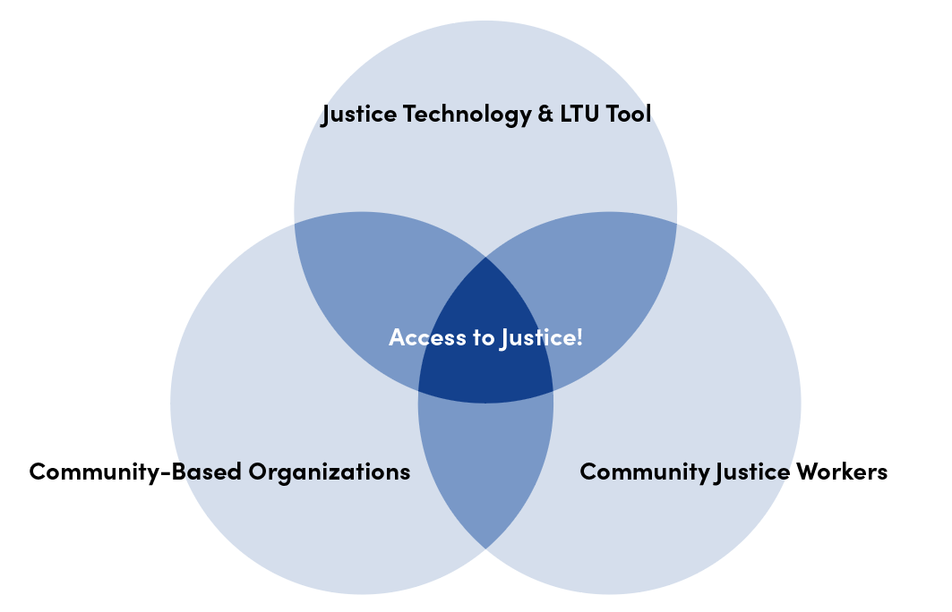
Notes:
Issues such as a suspended drivers license, medical and consumer debt, eviction records, and other costly civil legal issues trap citizens in a revolving door of overwhelming and complicated obstacles. Obstacles that cannot be overcome without support such as legal aid attorneys and expansion of information and resources on how to tackle them.
Those most buried by these issues are often those in our communities that are least resourced – seniors, veterans, those with disabilities, families with young children and rural Wisconsinites far from services. The limited number of civil legal aid attorneys also aggravates this issue.
750, 000 Wisconsinites face a legal issue each year and more then ½ million will not resolve these issues.
Only 28% of low-income Americans believe that people like them are treated fairly in the U.S. civil legal system.
only 40% believe the system can help low income folks solve important problems
Only 39% of low-income folks believe that people like them can use the system to protect and enforce their rights
-from LSC’s justice gap report
Attorneys cannot solve this crisis alone, every licensed atty in the us would have to devote 180 hours a year to provide 1 hour of legal assistance to each household.
LSC “Low-income Americans did not receive any or enough legal help for 92% of their civil legal problems. They are forced to “go it alone” without legal representation in disputes where they risk losing their job, their livelihood, their home, or their children, or seek a restraining order against an abuser.” (https://justicegap.lsc.gov/)
Concerns about the cost of legal help stand out as an important barrier to seeking and receiving legal help.
Nearly one-half (46%) of those who did not seek legal help for one or more problems cite concerns about cost as a reason why. Additionally, more than one-half (53%) of low-income Americans doubt their ability to find a lawyer they could afford if they needed one.
According to LSC’s Justice Gap Report, 75% of low-income folks never seek legal help for the legal problems that impact them substantially. For the 25% that do, 66% report that they did not receive all of the help they needed.
People in marginalized communities may not feel the legal system benefits them, power imbalance, so we’re trying to put power back in their hands
Criminal legal system is harsh yes, but civil legal system can, in many ways be similarly harsh. Unlike the criminal system, the civil legal system has less protections

Slide 27
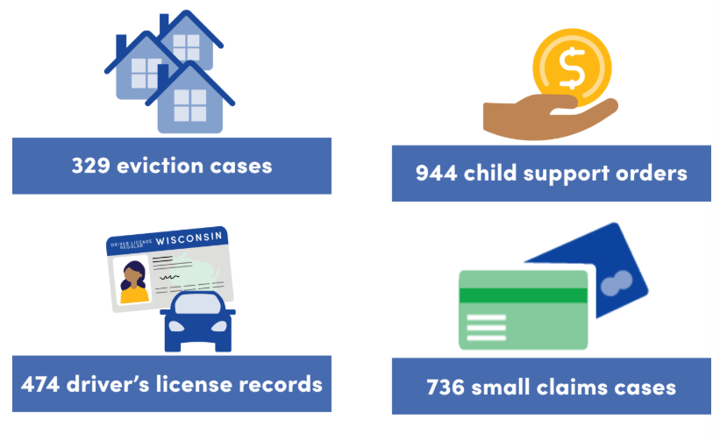
Our Impact in 2025
Notes:
Finally, here are just some numbers I wanted to share about LIFT’s impact!
In 2025, the LTU helped with:
329 eviction cases
474 driver’s license records,
736 small claims cases
And 944 child support orders!

Slide 28
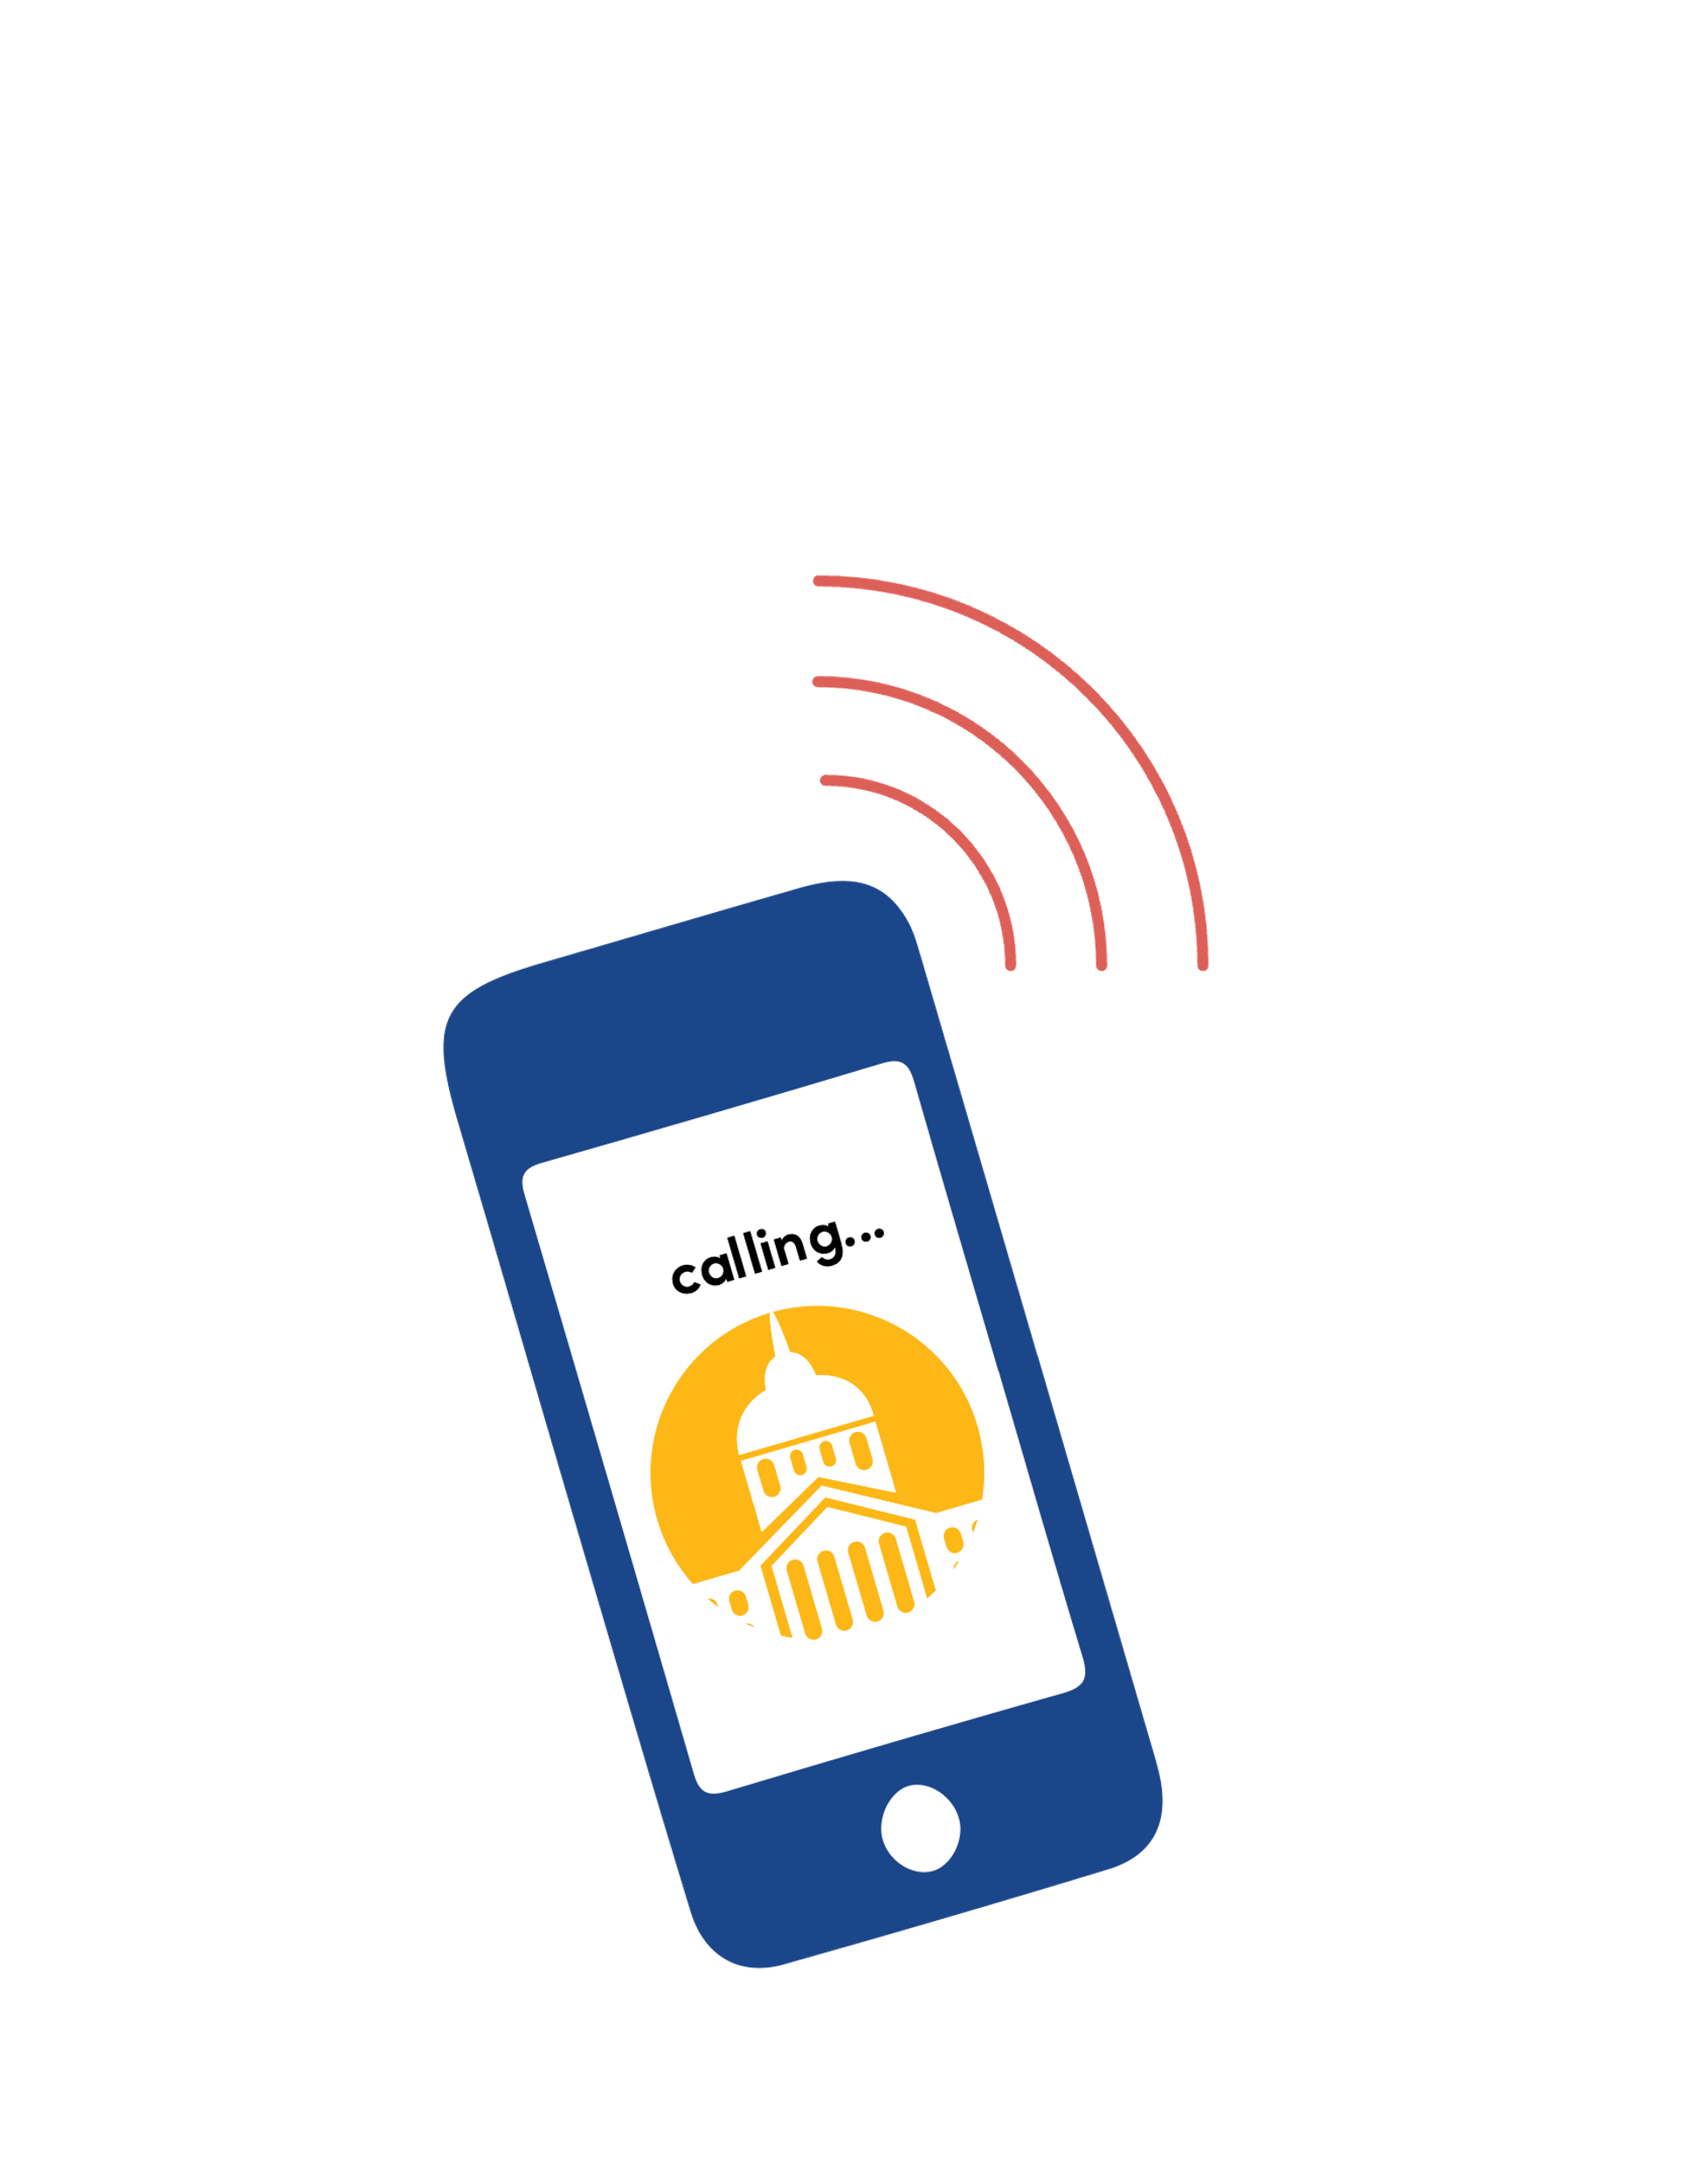



Challenges
Research, coordination, and organization
  Small claims modules uses all 72 WI counties’ local rules which are reflected in the LTU tool
Accessibility and legal literacy
Spreading awareness of the tool and building trust
Communication with some state agencies is spotty
Catching issues in the system requires regular awareness and check-ins
Skepticism from lawyers
Running the website and accessing to the data gets costly
Notes:
Challenges examples with consumer debt 72 counties and accounting for snail mail and child support interfaces with DCFs own system so a lot of review of the wireframes
Slow going requires patience
Making it clear and accessible - all done in wireframes
Communication with some state agencies is spotty
Catching bugs or clogs in the system requires regular awareness and check ins.
Its not perfect and therefore why bother feedback/criticism - distrust from lawyers
service if free now but expensive to maintain

Slide 29

Lessons Learned
Iterative process that requires constant learning and adjustment
  Evaluation
Focus groups are important to recognizing limitations on legal literacy for everyday people
People still need some guidance and assistance
Communication communication communication!
Notes:
Lessons learned:
Focus groups important to recognizing great limitations on legal literacy for everyday people
People still need some guidance and assistance - hence increased collaborations between community service groups, libraries and county social workers - so created these partnerships and offer introductions to the tool.
Is a lot to just run the site cost and maintenance wise on the day to day because CCAP charges nearly $12,500 for access
Working on a UW-Madison evaluation in conjunction with the IRP so we will learn more from there
Communication communication communication - people need to know the tool exists to use it but that also requires trust development and messengers that we can be trusted. Example EXPO and billboard campaign

Slide 30


Stay connected with us!
Looking for a ‘101’ training on our modules?
Email us at: info@liftwisconsin.org
Facebook: LIFT Wisconsin
Linkedin:LIFT Wisconsin
Instagram: liftwisconsin
Notes:
https://liftwisconsin.org/get-involved/?_gl=1*9240ih*_gcl_au*MTU0NDU1MTY2My4xNzM4OTQ2NTkz*_ga*MTc3NzAxMjgwOS4xNzE1OTA0MjE3*_ga_Q9TS64L49B*MTc0NTkzMjcwMy4xOC4wLjE3NDU5MzI3MDMuNjAuMC4wFlyers, follow-up, this was intro training we can do more in depth on any one of these issues or modules. We are seeking community based orgs to partner with to have a staff member become the resident expert in the tool and these modules and or related civil issues including truage

