Slide 1
The Mentor Coordinator Readiness & Operational Training (MROT)
Mentoring: What is their Job
  Presenter: Mark Panasiewicz, LMSW
  Sunchaser Solutions LLC
  Mentor Training for Veteran Justice Programs
Image Source: U.S. Department of Defense Public Domain
Notes:
Introduce yourself and the purpose of the MROT mentoring training.

Slide 2
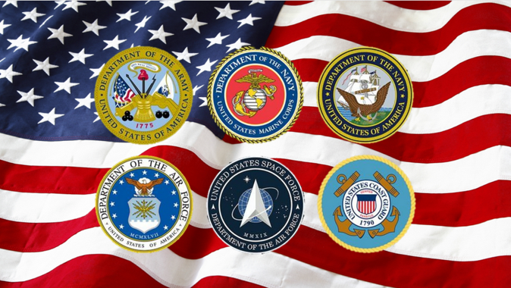
Training Objectives
  Understand the role of mentors
  Understand the difference between mentoring and peer support
OJJDP Mentoring Programs
Notes:
Explain what participants should learn.

Slide 3
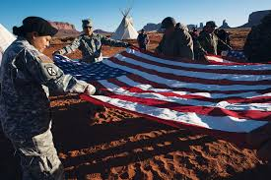
Why have a Veterans Treatment Court
• Began in 2008 in Buffalo, NY by Judge Robert Russell
• Over 600 courts nationwide
• 150,000+ veterans served
• Lower recidivism rates than traditional courts
Congressional Research Service
Notes:
Mentors connect veterans to help.

Slide 4
Growth of Veteran Treatment Courts
  450+ courts nationwide
More than 150,000–200,000 veterans have participated in Veterans Treatment Courts and veteran-focused court programs since the model began in 2008.
Today 600+ Veterans Treatment Courts are operating nationwide, which has allowed these programs to serve large numbers of justice-involved veterans.
  Thousands of veterans served annually
Justice for Vets Research
Notes:
Discuss national expansion.

Slide 5
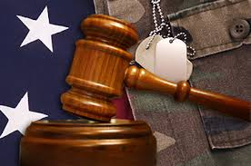
What Are Veteran Treatment Courts
Treatment-focused approach
  Specialized problem-solving courts
  Connect veterans with VA services
Justice for Vets / VA Reports
Notes:
Explain role of VTCs.

Slide 6

Veterans and the Criminal Justice System
  Veteran Treatment Courts provide alternatives
  Many justice-involved veterans struggle with PTSD
  Substance use and trauma increase risk
U.S. Department of Veterans Affairs Justice Programs
Notes:
Explain background of justice-involved veterans.

Slide 7
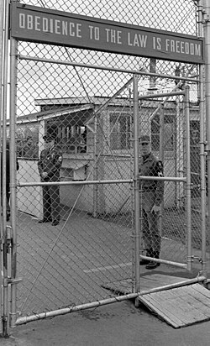
Outcomes of Veteran Treatment Courts
  Reduced recidivism
  Improved treatment participation
  Better housing stability
Justice for Vets Program Data
Notes:
Explain benefits of VTC programs.

Slide 8
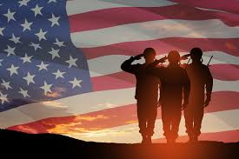
What is ?
Mentoring = an experienced person investing time and wisdom to help another person grow, make better decisions, and reach their potential.
Congressional Research Service
Notes:
Mentors connect veterans to help.

Slide 9
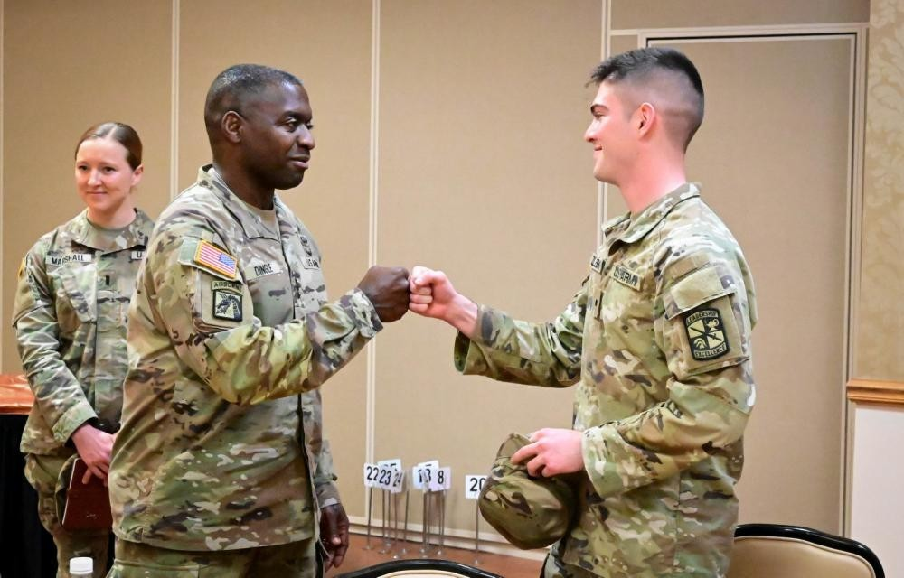
Role of Veteran Mentors
  Offer guidance
Provide Accountability
  Model successful reintegration
National Mentoring Resource Center
Notes:
Explain mentor importance.

Slide 10
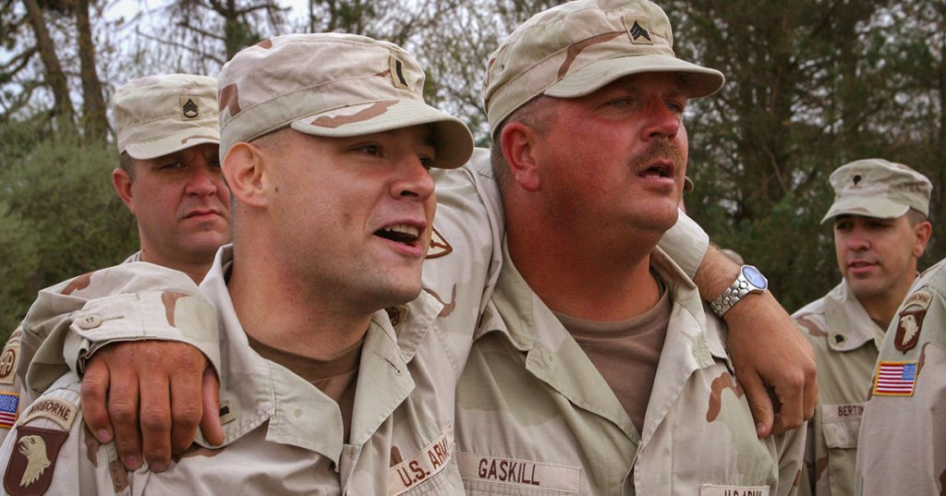
Definition of Mentoring
Developmental Relationship
Focus on growth
Guidance and Leadership
OJJDP Mentoring Programs
Notes:
Define mentoring.

Slide 11
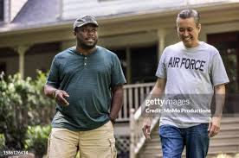
Why Mentoring Matters
Improves Confidence
Encourages stability
Supports recovery and growth
OJJDP Youth Mentoring Review
Notes:
Discuss evidence.

Slide 12
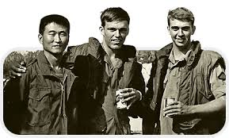
Role of Mentor: Role Model
Integrity
Leadership
Accountability
Congressional Research Service Mentoring Research
Notes:
Mentors model positive behaviors.

Slide 13
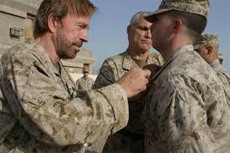
Role of Mentor: Guide
Goal Setting
Career direction
Decision making
National Mentoring Resource Center
Notes:
Mentors help navigate challenges.

Slide 14
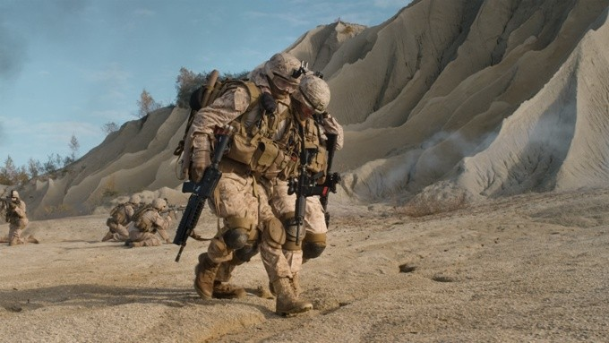
Role of Mentor: Supporter
The Mentor Readiness & Operational Training (MROT)
Mentoring Veterans in the Criminal Justice System
  Encouragement
  Motivation
  Resilience
Encouragement
Motivation
Resilience
OJJDP Mentoring Literature
Notes:
Encouragement helps change.

Slide 15
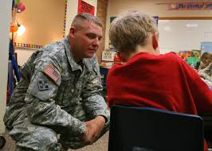
Role of Mentor: Teacher
  Leadership skills
  Communication
  Problem solving
National Mentoring Resource Center
Notes:
Mentors teach life skills.

Slide 16
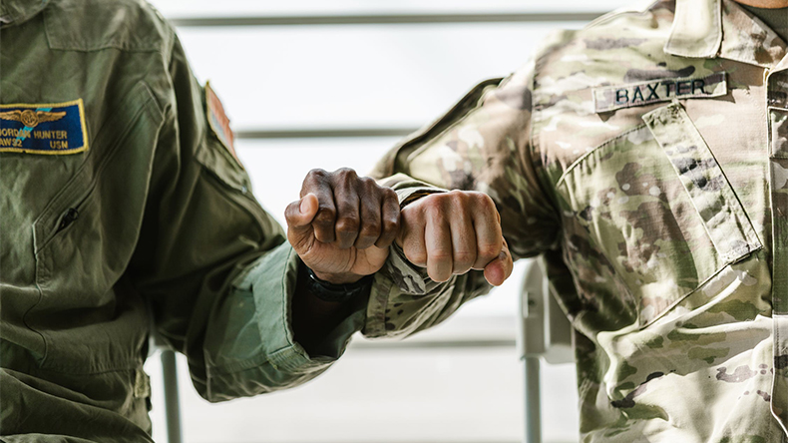
Role of Mentor: Connector
  Resources
  Community services
  Opportunities
Resources
Community Services
Opportunities
Congressional Research Service
Notes:
Mentors connect veterans to help.

Slide 17

Mentoring is usually
Ongoing (not a one-time conversation)
Relationship-based
Focused on the mentee’s growth, not the mentor’s agenda.
Congressional Research Service
Notes:
Mentors connect veterans to help.

Slide 18
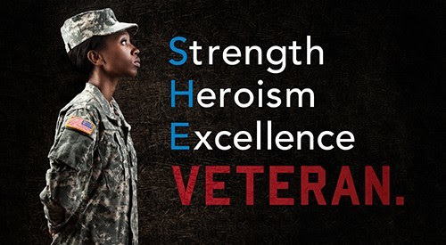
Mentoring
  Resources
  Community services
  Opportunities
Mentoring = an experienced person investing time and wisdom to help another person grow, make better decisions, and reach their potential.
Congressional Research Service
Notes:
Mentors connect veterans to help.

Slide 19
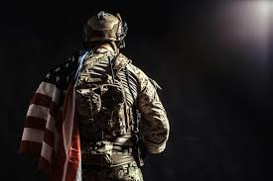
Model positive behavior
  Resources
  Community services
  Opportunities
Demonstrate accountability and integrity
Show that change and success are possible
In recovery or treatment court settings, mentors often model successful recovery and pro-social living
Congressional Research Service
Notes:
Mentors connect veterans to help.

Slide 20
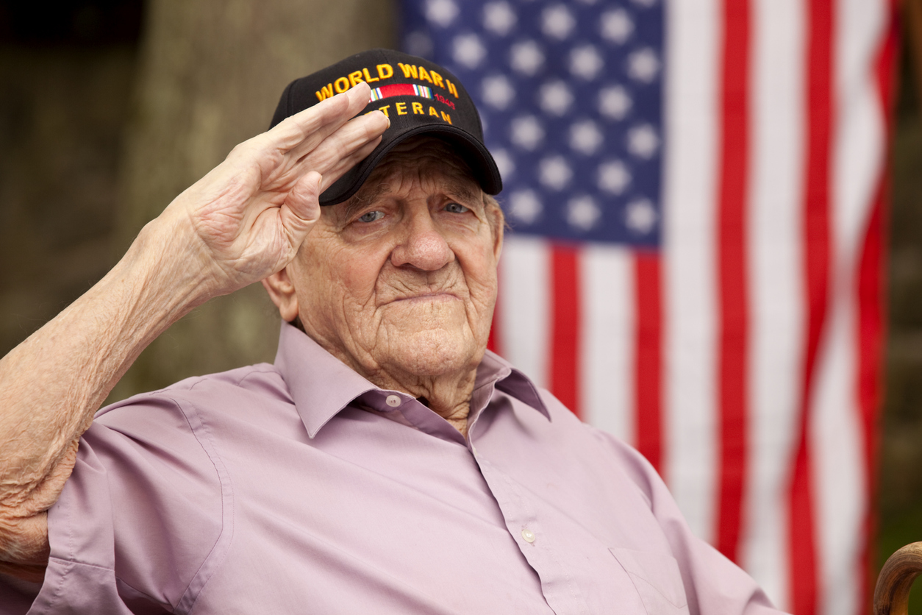
Words
  Resources
  Community services
  Opportunities
If you don’t have a mentor program you don’t have a veterans treatment court. You have a drug court with a Veteran track
Congressional Research Service
Notes:
Mentors connect veterans to help.

Slide 21
Mentoring vs Peer Support
Notes:
Explain clearly that mentoring is development-focused guidance, while peer support is based on shared lived experience.

Slide 22
Key Takeaways
Mentors Matter
If you don’t have mentors, you don’t have a veterans treatment court
Mentoring is not Therapy
Mentoring Supports Growth
National Mentoring Resource Center
Notes:
Summarize the core training message.

Slide 23
Sunchaser Solutions
Questions ???
National Mentoring Resource Center
Notes:
Summarize the core training message.

Slide 24
Sunchaser Solutions
Sunchaser Solutions 906-281-7554
markepana@gmail.com
We can handle all your training needs.
National Mentoring Resource Center
Notes:
Summarize the core training message.

