Slide 1
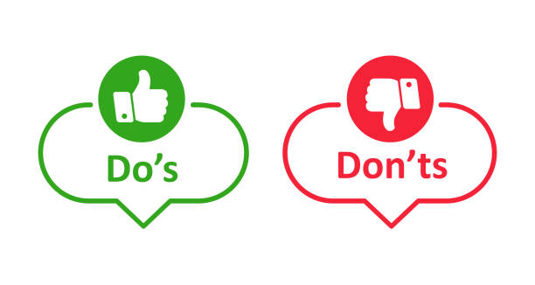
The Mentor Readiness & Operational Training (MCROT)
Mentors What they Should be Doing
  Presenter: Mark Panasiewicz, LMSW
  Sunchaser Solutions LLC
  Mentor Coordinator Training for Veteran Justice Programs
Notes:
Introduce yourself and the purpose of the MROT mentoring training.

Slide 2
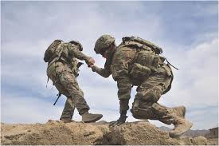
Mentors are most effective when they
:
Stay in their role
Build trust
Support accountability without taking control

Slide 3
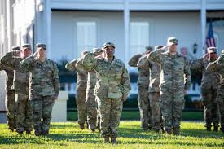
You are not
You are not probation. You are not a therapist. You are not there to fix problems
You are there to support, guide, and reinforce accountability

Slide 4

Provide Support & Connection
Be consistent and reliable
Show up and follow through
Reduce isolation
“I’ve got your back—but I won’t carry you.”

Slide 5
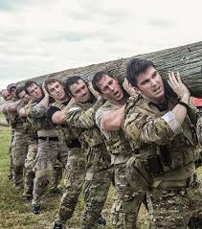
Model Recovery & Stability
Demonstrate accountability
Share appropriately—not over-share
Show what healthy behavior looks like

Slide 6
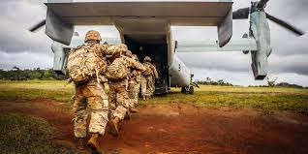
Encourage Accountability
Ask direct questions
Keep focus on behavior and choices

Slide 7
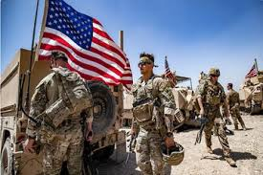
Encourage Accountability
What’s your plan this week?”
Did you follow through?”
Support does NOT mean letting things slide

Slide 8
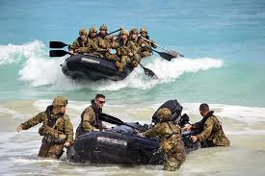
Let them Talk
Let them talk
Validate without agreeing with bad decisions
✘ “Yeah, they’re wrong”
✔ “That sounds frustrating

Slide 9
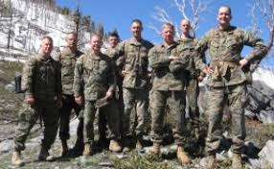
Reinforce the System
Encourage use of:
  Treatment
  Probation
  Case management
Mentors support the system—they don’t replace it

Slide 10
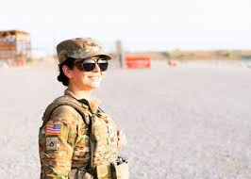
Recognize Risk & Escalate
Suicidal thoughts
Serious relapse
Dangerous behavior
You don’t manage crises alone—you act and involve the right people

Slide 11
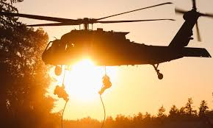
What Mentors DO NOT Do
Do NOT Act as a Therapist
No diagnosing
No trauma processing

Slide 12
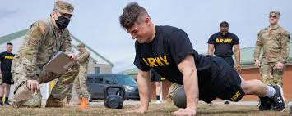
Do NOT Act as Probation
Do not enforce rules
Do not threaten consequences

Slide 13
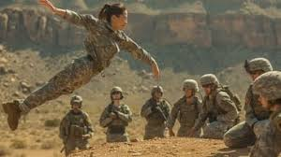
Do NOT Rescue or Fix
Do not solve all problems
Do not remove consequences
Growth requires ownership

Slide 14
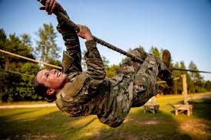
Do NOT Enable
No giving money
No making excuses
No covering behavior

Slide 15
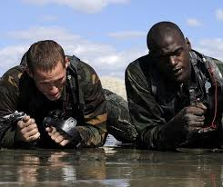
Do NOT Become the Only Support
You’re the only one I trust
Always redirect to broader support system

Slide 16
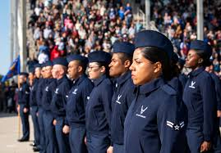
The Participants are not there to heal you.
Get into therapy! work on yourself first before others

Slide 17
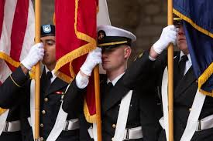
Do NOT Form Dual Relationships
No business deals
No romantic involvement
No blurred boundaries

Slide 18
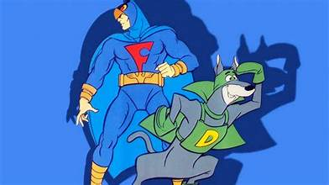
Do NOT Act as an Informant (“No Blue Falcon”)
Do NOT report misbehavior
Do NOT “update” the court on behavior
Do NOT monitor compliance
You don’t report behavior—you respond to risk

Slide 19
Mentors DO NOT Report
Missed appointments
Noncompliance
Attitude issues

Slide 20
Mentors DO
Address it directly with the participant
Encourage accountability
Guide them toward handling it

Slide 21
Key Take Aways
Good mentors don’t take over—they help Veterans take ownership
Trust is your greatest tool—don’t destroy it by acting like probation
Stay in your lane so you can stay effective

Slide 22

Sunchaser Solutions
Questions ???
Notes:
Summarize the core training message.

Slide 23
Sunchaser Solutions
Sunchaser Solutions 906-281-7554
markepana@gmail.com
We can handle all your training needs.
Notes:
Summarize the core training message.

