Slide 1
The Mentor Coordinator Readiness & Operational Training (MCROT)
Operational Readiness: Mentor Wellness, Burnout & Secondary Trauma
  Presenter: Mark Pansiewicz,
  Sunchaser Solutions LLC
  Operational Readiness: Mentor Wellness, Burnout and Secondary Trauma

Slide 2
Training Objectives
Understand burnout, compassion fatigue, and secondary trauma
Identify warning signs early
Learn practical prevention strategies
Build a sustainable mentoring approach

Slide 3
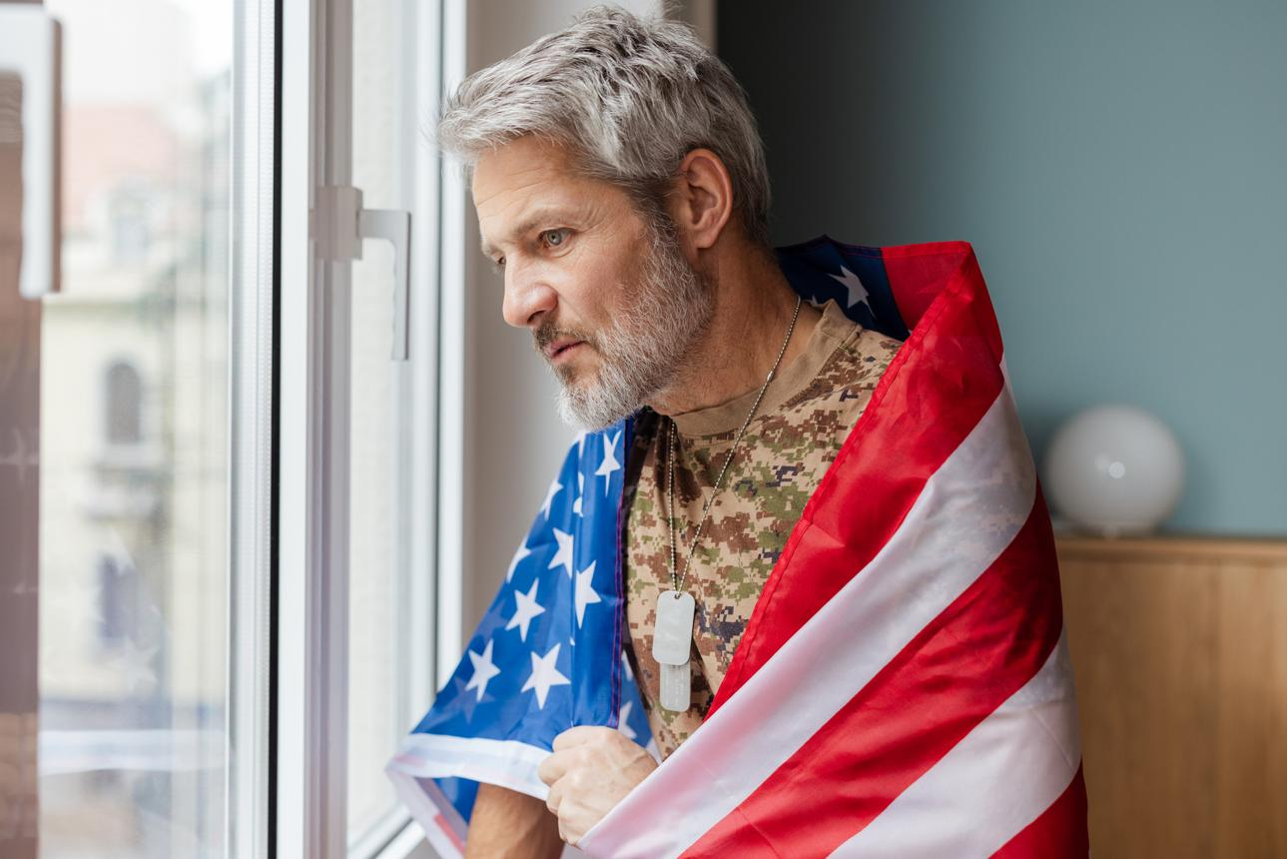
Why This Matters
Mentors are critical to participant success
Burnout and secondary trauma reduce effectiveness
Healthy mentors = effective mentors

Slide 4

What Stress Does to the Body
Activates fight/flight (sympathetic nervous system)
Releases cortisol and adrenaline
Increases heart rate and blood pressure
Tightens muscles and breathing

Slide 5

Effects of Chronic Stress
Irritability and mood swings
Difficulty concentrating and decision-making
Increased risk of anxiety, depression, and burnout
Sleep disruption and fatigue
Weakened immune system

Slide 6
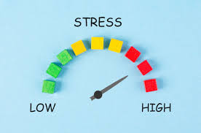
What Your Body Is Doing When You Think You're F.I.N.E
Elevated cortisol levels even at rest
Nervous system stuck in “on” mode
Shallow breathing and muscle tension
Reduced ability to recover after stress
Brain prioritizing threat over logic and patience

Slide 7

What is Burnout?
Emotional exhaustion
Reduced effectiveness
Detachment or cynicism
Feeling overwhelmed or drained

Slide 8

What is Compassion Fatigue?
Emotional strain from helping others
Gradual depletion over time
Loss of empathy or patience

Slide 9

What is Secondary Trauma?
Indirect exposure to trauma through others
Absorbing the emotional impact of mentee experiences
“Feeling like it happened to you.”

Slide 10
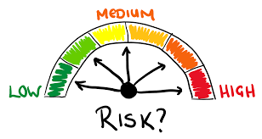
Why Mentors Are at Risk
Exposure to trauma stories
Strong emotional connection to mentees
Desire to “save” or protect
Lack of boundaries

Slide 11
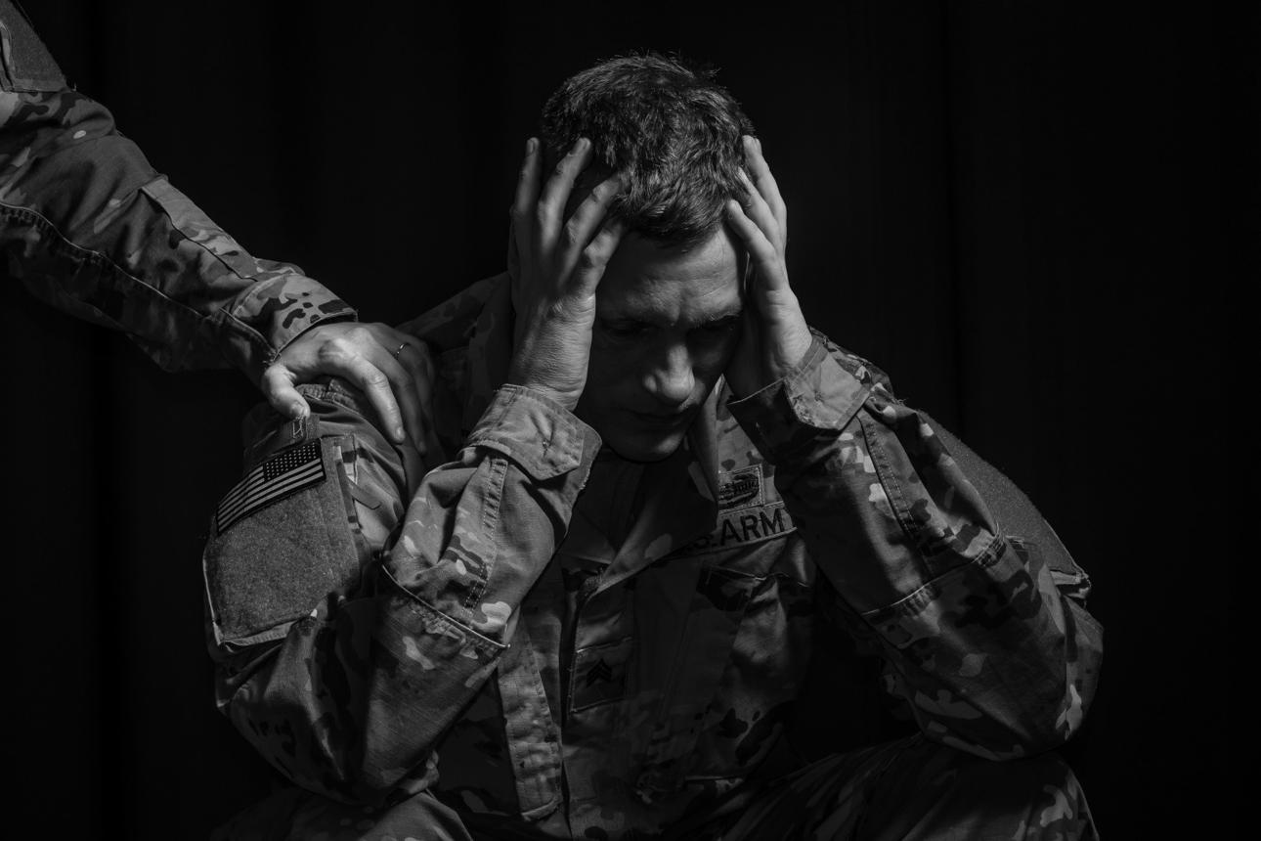
How Compassion Fatigue Shows Up
Frustration with repeated mentee issues
Decreased motivation to engage
Reduced empathy or patience
Feeling emotionally drained after helping

Slide 12
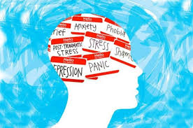
How Secondary Trauma Shows Up
Intrusive thoughts about mentee situations
Emotional over-identification
Difficulty “turning it off.”
Increased anxiety or vigilance

Slide 13

Early Warning Signs
Irritability
Fatigue
Loss of motivation
Avoiding mentee contact

Slide 14

Advanced Warning Signs
Emotional numbness
Cynicism toward participants
Feeling ineffective or hopeless
Sleep disturbances or headaches

Slide 15

Red Flag Indicators
Dreading mentor interactions
Anger toward mentee behavior (taking it personally)
Crossing boundaries
Thinking “Why do I even bother?”

Slide 16

The Helper Trap
“I have to fix this” mindset
Over-involvement
Taking responsibility for outcomes

Slide 17
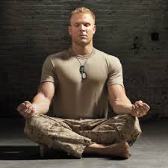
Mission Clarity
Your job: Support, not save
Encourage honesty and growth
Stay in your lane

Slide 18

The Power of Boundaries
Protects both mentor and participant
Creates clarity and consistency
Prevents burnout and trauma overload

Slide 19
Examples of Healthy Boundaries
Limiting availability hours
Not giving money
Not becoming primary emotional support

Slide 20
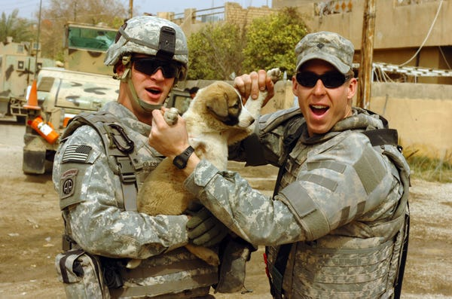
Emotional Boundaries
Care about, not carry
Do not internalize mentee trauma
Separate their story from yours

Slide 21

Time Boundaries
Set realistic meeting frequency
Protect personal time
Avoid “always on” mindset

Slide 22

Communication Boundaries
Define contact expectations
Set response times
Avoid late-night crisis engagement

Slide 23
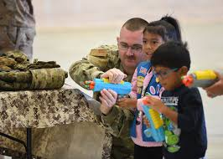
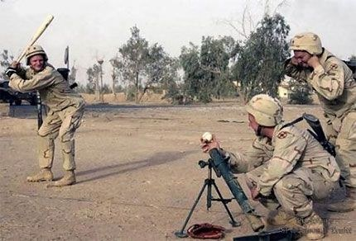
Have other Hobbies
Mentoring should not be your LIFE

Slide 24
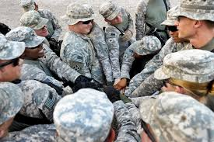
Self-Awareness Check
How do I feel thinking about this outside of mentoring?
Am I carrying their stress?
Am I stressed, unhappy, unfulfilled

Slide 25
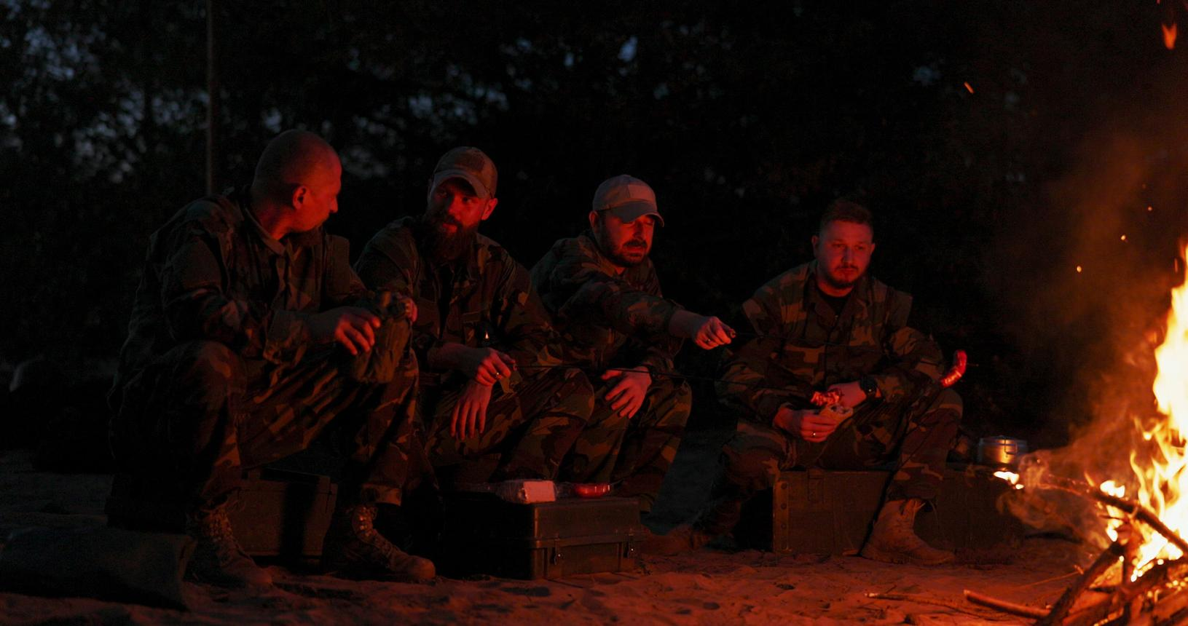
The 3-Part Self Check
Physical: Fatigue, tension, sleep
Emotional: Overwhelmed, numb, irritable
Mental: Distracted, intrusive thoughts

Slide 26
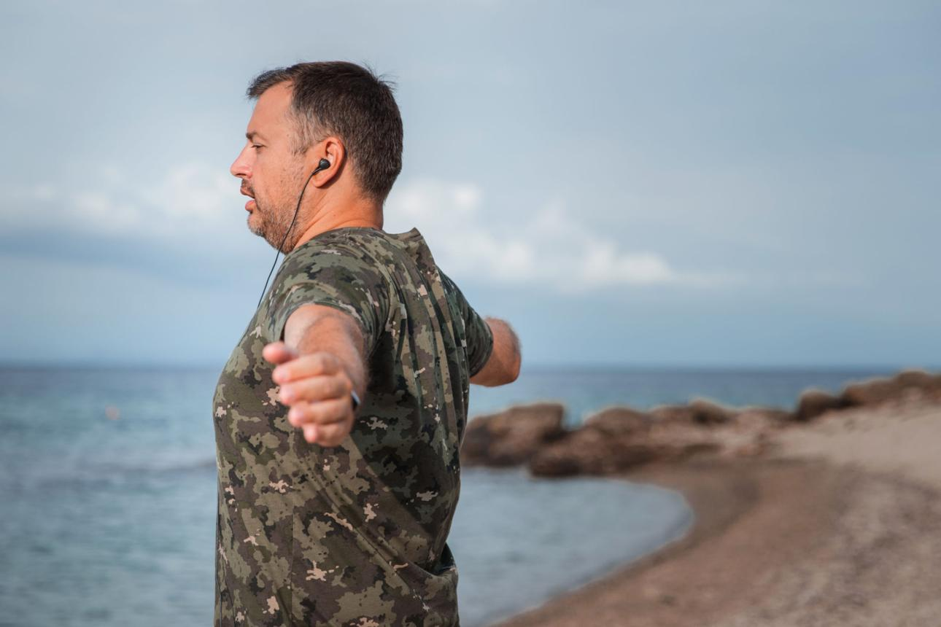
Daily Self-Care Basics
Sleep (7–8 hours)
Hydration and nutrition
Physical movement

Slide 27

Mental Reset Techniques
Deep breathing
Grounding exercises
Transition rituals after sessions
Sleep

Slide 28

INHALE aka Breathe
Deep Breathing resets the parasympathetic nervous system
. You should get 4-5 breath cycles in that minute by inhaling through the nose (fully), holding for 2-3 seconds, then exhaling slowly through the mouth for 10-15 seconds.

Slide 29
Grounding Exercises
Body Grounding
Say: “I am safe right now” while stretching or moving arms
Tension Release
Clench muscles for 5 seconds → release
Sensory
5-4-3-2-1 Method
5 things you see
4 things you feel
3 things you hear
2 things you smell
1 thing you taste
Cognitive Grounding
Orientation Statements
  “My name is ___. I’m in ___ (location). Today is ___.”
Category Listing
  Name 10 animals, 10 cars, 10 tools, etc.

Slide 30
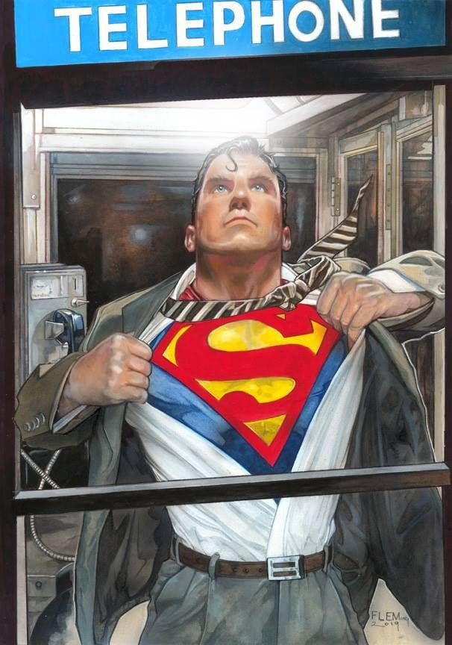
Transition Rituals After Sessions
Hard Stop Routine
Close laptop → say “Work is done”
Shower Reset
Mentally wash off the day (very effective for trauma exposure)
Clothing Change
“Mentor mode → personal mode”
Movement
Walk, gym, stretch (discharges stored stress)

Slide 31

Operational Readiness Mindset
Just like equipment, you must be maintained
You are a critical asset to the mission
Self-care = mission readiness, not weakness

Slide 32

Final takeaways from Uncle Sam
Stay in your lane.
Set and maintain boundaries
Monitor for secondary trauma
Take care of yourself first
Healthy mentors change lives
I WANT YOU TO

Slide 33
Sunchaser Solutions
Questions ???
Notes:
Summarize the core training message.

Slide 34
Sunchaser Solutions
Sunchaser Solutions 906-281-7554
markepana@gmail.com
We can handle all your training needs.
Notes:
Summarize the core training message.

