Slide 1
Problematic Dynamics in Treatment Court Teams
WATCP Conference 2026
Eric Olson olson8653@gmail.com
District Manager, Adult and Juvenile Mental Health Courts
State of Idaho’s 7th Judicial District

Slide 2
Issues that lead to Dysfunction in Teams
Learning Objectives:
1-Brief Overview of the Role of Each Team Member
2- Issues that lead to Team Frustration and Dysfunction
3- Options and Examples to Address and Overcome Team Dynamic Issues.

Slide 3
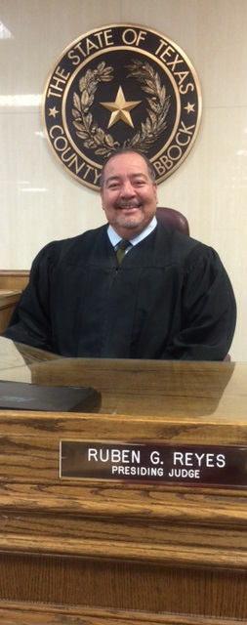

Team Composition
Judge
Program Coordinator
Community Supervision
Prosecutor
Law Enforcement Officer
Treatment Representative
Evaluator
Defense Counsel Representative
Notes:
This is a transition slide. Don’t start talking about each discipline hear.
**Multidisciplinary Team Activity**
Go to the next slide and begin the discussion.
Judge is typically a trial court judge leads the Drug Court team; however, in some jurisdictions a magistrate or commissioner may preside.
Program Coordinator is typically a court administrator or clerk; however, some Drug Courts may employ a senior probation officer, case manager or clinician as the coordinator. Coordinator is responsible for maintaining accurate and timely records and documentation for the program, overseeing fiscal and contractual obligations, facilitating communication between team members and partner agencies, ensuring policies and procedures are followed, overseeing collection of performance and outcome data, scheduling court sessions and staff meetings, and orienting new hires.
Prosecutor is typically an assistant district attorney serves on the team. Duties advocates on behalf of the public safety, victim interests and holding participants accountable for meeting their obligations in the program. The prosecutor may also help to resolve other pending legal cases that impact participants ‘ legal status or eligibility for Drug Court.
Defense Attorney is typically an assistant public defender or private attorney serves on the team. Duties: Ensures participants constitutional rights are protected and advocates for participants’ stated legal interests. Evidence suggest that participants may be more likely to perceive Drug Court procedures as fair when a dedicated defense attorney represents their interests in team meetings and status hearings. (Frazer, 2006)
Treatment Representative is typically an addiction counselor, social worker, psychologist, or clinical case manager serves on the team. Duties: Conduct screenings and assessment, and provide direct clinical services. However, in some Drug Courts, the courts may designate one or two providers to sit on the team and provide clinical information from programs treating the clients.
Community Supervision is typically a probation officer or pretrial services officer serves on the team. However, some Drug Courts may rely on law enforcement or specially trained case managers or social service professionals to provide community supervision. Duties: Performing drug and alcohol test, conducting home or employment visits, enforcing curfews and travel restrictions, and delivering cognitive-behavioral interventions designed to improve participants’ problem-solving skills and alter dysfunctional criminal-thinking patterns.
Law Enforcement is typically a police officer deputy sheriff, highway patrol officer or jail officer serves on the team. Law enforcement is often the eyes and ears of Drug Courts on the streets, observing participant behavior and interacting with participants in the community. They may assist with home or employment visits, drug testing, and serves as a liaison between the Drug Court and the police department, sheriff department, jail and/or correctional system.

Slide 4
The Team
Judge
Clerk
Coordinator
Treatment/Team
Attorneys
Probation Officers
Law Enforcement
Vocational Rehabilitation
Peer Support/ Recovery Coach
Jail Clinician
NAMI
Housing
Others as needed; Child Support, Inpatient SUD partners
All ACCOUNTABLE to Judge and Court…
Share info/Collateral Info

Slide 5
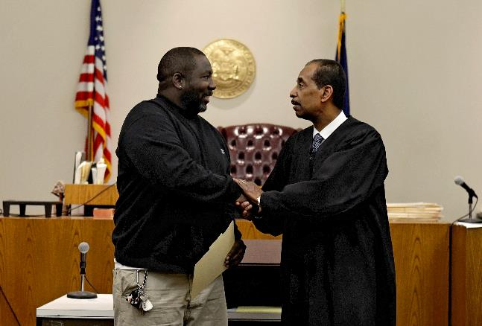
Judge
Message: “Someone in authority cares.”
Typically, a trial court judge leads the treatment court team; however, in some jurisdictions a
non-judicial officer such
as a magistrate or commissioner may preside over the treatment court.

Slide 6
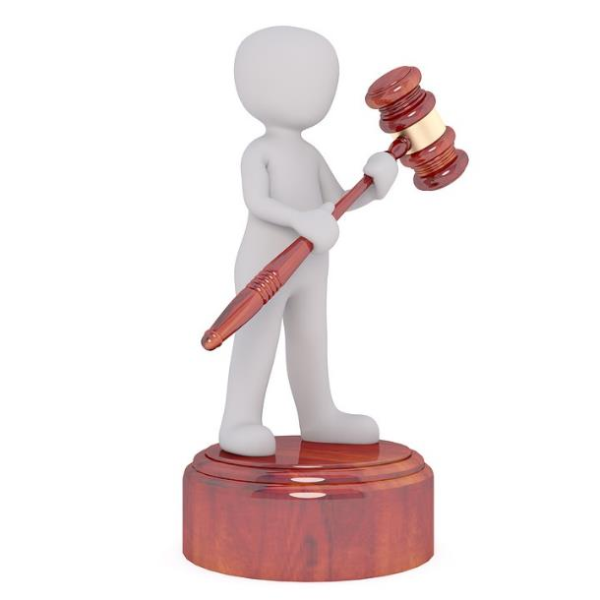

Judge - Duties
LEADER OF THE TEAM!
Knowledgeable about policies & procedures
Knowledgeable of client’s case
Know them by name
Encourage them to succeed
Emphasize treatment
Not intimidating, approachable
Let them tell their story
Treat them fairly and with respect
Impartial – do not prejudge
Cross training – 5th WEEKS!

Slide 7


Program Coordinator
Court Administrator
Senior Probation Officer
Case Manager
Clinician
Notes:
Typically a court administrator or clerk serves as the coordinator for the Drug Court program; however, some Drug Courts may employ a senior probation officer, case manager, or clinician as the coordinator.
Among many other duties, the coordinator is responsible for maintaining accurate and timely records and documentation for the program, overseeing fiscal and contractual obligations, facilitating communication between team members and partner agencies, ensuring policies and procedures are followed, overseeing collection of performance and outcome data, scheduling court sessions and staff meetings, and orienting new hires.

Slide 8
Program Coordinator - Duties
Maintaining accurate and timely records
Overseeing fiscal and contractual obligations
Facilitating communication between team members and partner agencies
Ensuring policy and procedures are followed
Overseeing collection of performance and outcome data
Scheduling court sessions and staff meetings
Orienting new hires
Cross training
Notes:
Typically a court administrator or clerk serves as the coordinator for the Drug Court program; however, some Drug Courts may employ a senior probation officer, case manager, or clinician as the coordinator.
Among many other duties, the coordinator is responsible for maintaining accurate and timely records and documentation for the program, overseeing fiscal and contractual obligations, facilitating communication between team members and partner agencies, ensuring policies and procedures are followed, overseeing collection of performance and outcome data, scheduling court sessions and staff meetings, and orienting new hires.

Slide 9
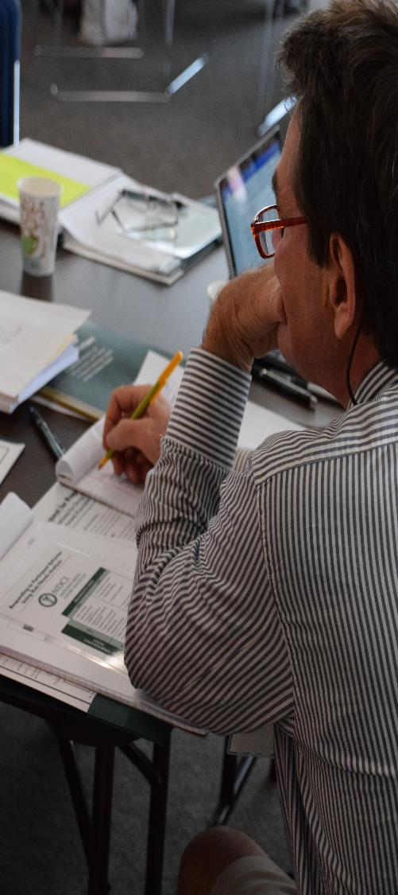
Prosecutor
“Non-Adversarial Approach”
Typically an assistant district attorney
Advocates for public safety
Advocates for victim interest
Holds participants accountable for meeting their obligations
May help resolve other pending legal cases that impact participants’ legal status or eligibility
Cross training

Slide 10
Defense Attorney
“Non-Adversarial Approach”
Typically an assistant public defender or private defense attorney specializing in treatment court cases
Ensures constitutional rights are protected
Advocates for participant’s stated interests
Handles day to day issues related to participants in the treatment court
Must define their role as “defense attorney” on the team
Cross training

Slide 11
Defense Attorney
“Non-Adversarial Approach”
Post conviction Treatment court role?
  Program participation is a condition of probation or part of a criminal sentence
  Ordinarily, participants are not entitled to defense representation at this stage....unless jail sanction, or revocation
  Research says..be there..better outcomes
  Greater perception of the process is fair, resulting in better outcomes

Slide 12
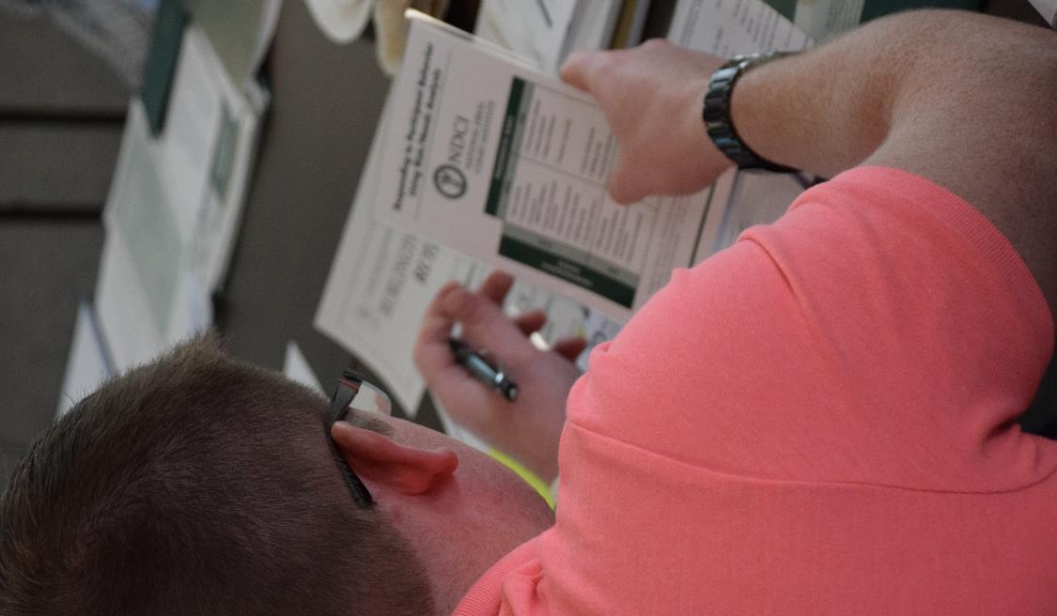
Community Supervision
Typically a probation officer or pretrial services officer
Performing drug and alcohol testing
Conducting home and/or employment visits
Enforcing curfews and travel restrictions
Intensive supervision
Cross training
Delivering cognitive-behavioral interventions
Help participants practice and build SKILLS!

Slide 13
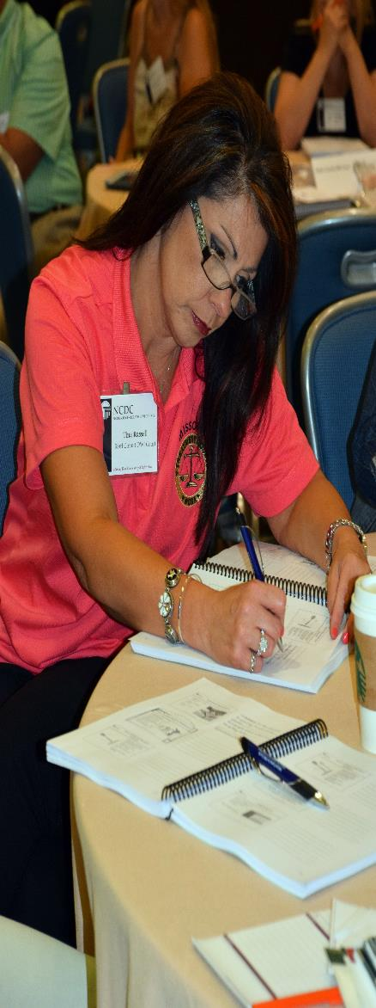

Treatment Representative
Integrated treatment is optimal
Psychiatrist or Psychologist?
Individual Caseworkers
Addiction/MH Counselor
High staff to participant ratio

Slide 14
Treatment Representative
Duties
Manage delivery of treatment services
Administer behavioral or cognitive-behavioral treatments that are documented in manuals and have been demonstrated to improve outcomes – integrated treatment is optimal
Provide clinical case management - at least one individual session per week during the first phase of the program

Slide 15
Treatment Representative
Duties
Medication Compliance and Collaboration with Prescriber
Focus on Skills and Skills building
Develop a Recovery plan with participants
Frequent contact and home visits
Work with family/supports of participant
Cross training

Slide 16
Peer Support Specialist
Peer Support/Recovery Coach
Provides Support for Participants
Someone with Relatable Experience
Can access Resources; Especially Recovery Related
Help them access and participate in Pro-social activities.
Can help participants practice and build SKILLS!
NOT – Case Manager; CBRS; etc.

Slide 17
Law Enforcement
Typically a police officer, deputy sheriff, highway patrol officer, or jail official serves on the team
Assist with home or employment visits
Observe participants in the community – “Eyes and Ears of team”
Liaison between treatment court and police department, sheriff’s office, jail and correctional system
Trained in CIT –Crisis Intervention Training
Cross training

Slide 18
Evaluator
Typically an independent skilled evaluator or professor from a local college, college student, statewide evaluator or local county evaluator
Examines if the treatment court is adhering to best practices and participant outcomes no less that every 5 years
Helps the team identify the performance data elements to be collected
Identifies a comparison group for the evaluation

Slide 19
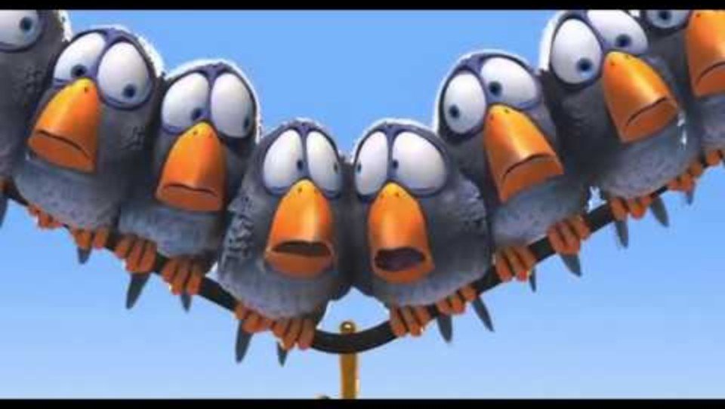
Issues that lead to Dysfunction in Teams

Slide 20
Issues that lead to Frustration and Dysfunction
Role confusion — When team members are unclear about their responsibilities and those of other team members
Team members need to be able to stay in their lane, yet understand what other team members do as well.
Can we question what others can or should be doing, we think?
The beauty of a multi-disciplinary team is getting many opinions and ideas, yet this can also be a cause of contention and frustration among team members…

Slide 21
Issues that lead to Frustration and Dysfunction
Role confusion — Continued….
Can other roles question or challenge another role’s perspective?
Judge is team lead; can he/she just decide what’s best?
            Treatment Level of Care
            Supervision levels
            Over-ride Drug Testing

Slide 22
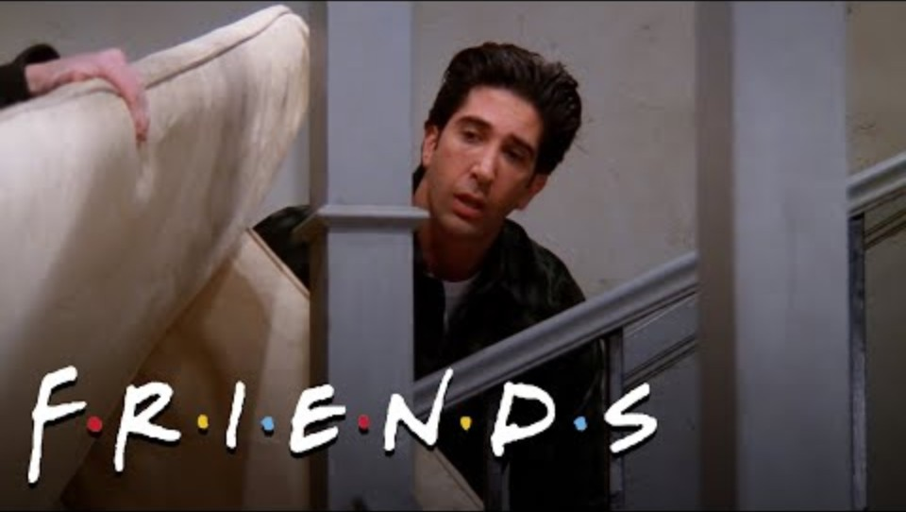
Issues that lead to Dysfunction in Teams

Slide 23
Issues that lead to Dysfunction in Teams
Poor communication —
Communication is key in treatment teams to keep team members updated
Being able to discuss difficult situations with participants
Mistrust; unresolved interpersonal issues
Being on time and prepared for staffings and with participants.

Slide 24
Issues that lead to Dysfunction in Teams
Acronyms can be a barrier to team communications; different acronyms used in different professions.
Timeliness is important in communication with team members; waiting can be problematic
Including all team members on team communications; multiple e-mail chains between team members can be very problematic….
      Leaving people out of the loop.
      Forgetting who already knows what?
      Purposefully leaving team members out for personal or professional reasons…

Slide 25
Issues that lead to Dysfunction in Teams
Team Communication
  Keep it professional
  Do certain team members dominate the staffing?
  Team members may disagree about how much and what information is appropriate to share with other team members.
  Are we using Group Think?
  How do we keep all team members involved and giving input?
  Be very aware of non-verbal cues and communication

Slide 26
Issues that lead to Dysfunction in Teams
Philosophical Differences among Team Members
Team members may not be on the same page with accountability for participants.
Members may disagree on the purpose and use of sanctions vs incentives…..vs service adjustments
Team may not agree on whether behavior is non-responsive or non-compliant

Slide 27
Issues that lead to Dysfunction in Teams
Team members may not agree on whether or not participants can or should stop using substances and whether that is a proximal or distal goal
MAT is often a contentious topic among team members
What if team members disagree with what they learned at a training and what research/evidence suggests is effective.
Is jail an effective or necessary tool or not? How much or little should we use incarceration as a response?

Slide 28
Issues that lead to Dysfunction in Teams
Inconsistent Application of Policies/Practices
Do team members or participants feel like some get preferential treatment compared to others.
Are sanctions applied evenly and fairly for all.
Does treatment or others favor some participants over others or show favoritism…or is it perceived as such?

Slide 29
Issues that lead to Dysfunction in Teams
Inconsistent Application of Policies/Practices
Do we have the same requirements for how all participants phase up or move quickly or slowly through the program?
Are all team members following the same policy and procedures? Do all team members have this info?
Do we apply UA results the same for all or….
    Do we “know” this participant really didn’t use
    We “are sure” they are being honest
    They certainly wouldn’t have diluted that UA…

Slide 30
Issues that lead to Dysfunction in Teams
Lack of Confidence in Treatment Providers
Lack of confidence in assessments/recommendations from treatment providers
Do Providers utilize EBP’s, do we feel confident in that?
Are we getting info from several Tx Team members or just is one person making all the calls?
Do we get accurate information on progress? Do we feel like participants are progressing and know why or why not?
Do we have understanding of what treatment providers do and the process or is all “secret” and “not our lane”

Slide 31
Issues that lead to Dysfunction in Teams
Lack of Confidence in Treatment Providers
Do we get timely and accurate information from providers
Do the participants have confidence in and feel they are getting good services from provider?
Is treatment responsive to team questions/feedback?
Does treatment treat and understand co-occurring, etc.
      Mental Health
      Substance Use
      Criminal Thinking

Slide 32
Issues that lead to Dysfunction in Teams
Leadership Challenges
The judge is the team leader.
Has there been judge turnover?
How long have they been with the team?
Have they had adequate and ongoing training?
Do they want to be there? Like the MHCT?
Does their style of Leadership have an impact on the team?

Slide 33
Issues that lead to Dysfunction in Teams
Leadership Challenges
How does the Judge, as Leader, become aware of issues within the team…
How does the Judge, as Leader, work to resolve issues within the team…
Lack of Leaderships or Disconnected Leadership can definitely create and/or foster team dysfunction.

Slide 34
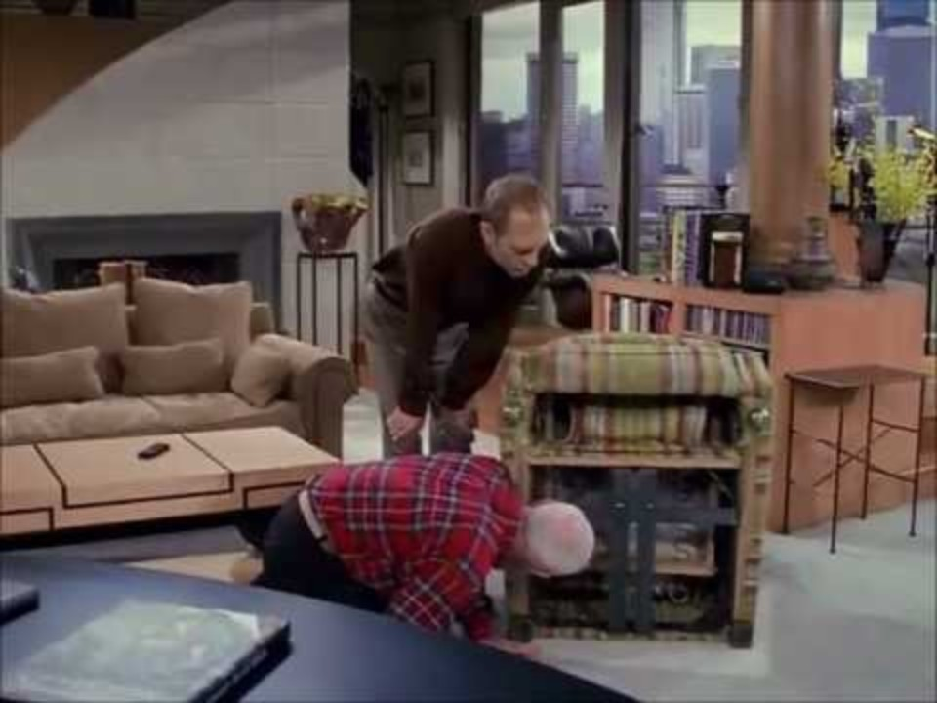
Issues that lead to Dysfunction in Teams

Slide 35
Issues that lead to Dysfunction in Teams
Lack of Team Cohesion
Have our teams worked through the developmental stages of Forming-Storming-Norming-Performing?
If not, do we know where we are in the process?
Do we struggle with Trusting each other and having Confidence in others fulfilling their Roles competently.
Do we like working with each other? Are we good team members?
Teams that do not progress through healthy development stages (forming → storming → norming → performing) struggle with many issues such as trust, collaboration, and unified decision-making.

Slide 36
Issues that lead to Dysfunction in Teams
Lack of Team Cohesion
Are we able to disagree on issues and have good, professional discussions about what should happen in a healthy way?
Do we back each other on the final decisions that are made?
      It will cause harm to participants and inhibit their progress if we blame other team members and do not back team decisions.
I believe a team that is functional and can have good discussions when they disagree and back each other will get better outcomes than more skilled team members that don’t function in a healthy way!

Slide 37
Issues that lead to Dysfunction in Teams
Burnout and Compassion Fatigue
Many things can lead to burnout/compassion fatigue. We have to remember this is very difficult work.
    High caseloads
    Exposure to client trauma
    Emotional issues and environment
    Conflict and chaos
    More Difficult if Team does not function in a healthy way!

Slide 38
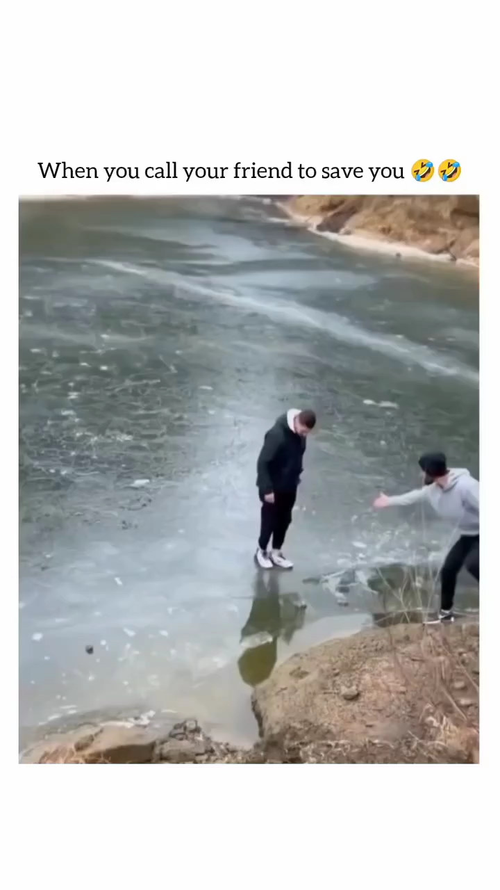
Issues that lead to Dysfunction in Teams
https://www.instagram.com/reel/DSHPHXKEx-y/?igsh=MXgxaTZuZTcxNnBkYQ%3D%3D

Slide 39
Issues that lead to Dysfunction in Teams
Burnout and Compassion Fatigue
Are we looking out for each other?
Can we recognize when team members are struggling?
Do we have trainings or retreats together as a team?
Are we doing things as a team to address our team issues, concerns, outcomes, etc.

Slide 40
Solutions? What do we do?
No Silver Bullet – Each team and each case is unique!
MOU’s are helpful
Advisory Boards are helpful!
Team Leader needs to be aware/guiding the solution
    Some smaller things are continually being resolved without Team Leader intervention
Try to resolve it and the ground level if possible.
    Try to go to the person/persons with the issue first and resolve it simply….if possible.

Slide 41
Examples
Prosecutor giving their expertise in treatment area and deciding what treatment was appropriate or should have been done, etc…
Poor feedback from participants about Treatment provider and counselor throwing other team members under the bus in groups, etc.
Team holds participants accountable for being late and missing appointments, while treatment staff is continually late and cancelling appointments at last minute…
Clinical Supervisor from treatment team very punitive with clients and checked out of team staffings, just believes “they need more consequences”

Slide 42
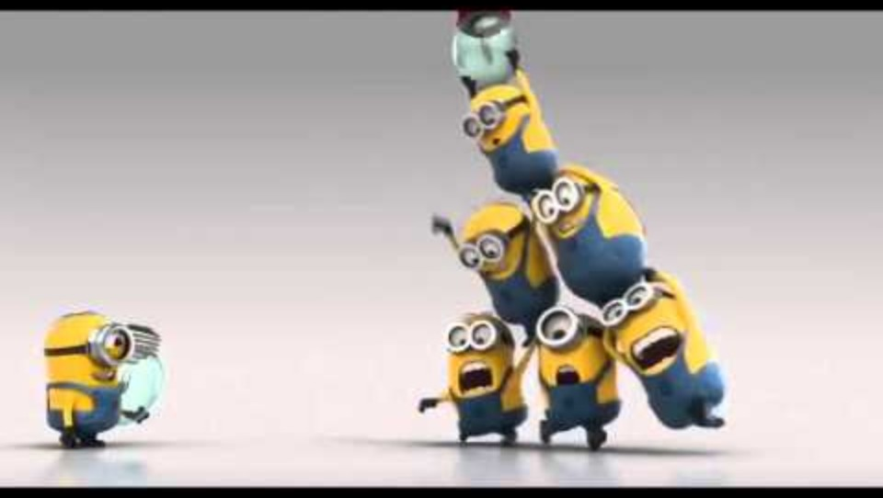
Issues that lead to Dysfunction in Teams

Slide 43
Thank you !
Any Questions?
Eric Olson, LCPC
olson8653@gmail.com PH: 208-360-0262
District Manager
Adult & Juvenile Mental Health Courts
Idaho’s 7th Judicial District

