Slide 1
Building
RECOVERY CAPITAL in treatment courts
Eric Olson, LCPC
Notes:
This template can be used as a starter file for presenting training materials in a group setting.
Sections
Right-click on a slide to add sections. Sections can help to organize your slides or facilitate collaboration between multiple authors.
Notes
Use the Notes section for delivery notes or to provide additional details for the audience. View these notes in Presentation View during your presentation.
Keep in mind the font size (important for accessibility, visibility, videotaping, and online production)
Coordinated colors
Pay particular attention to the graphs, charts, and text boxes.
Consider that attendees will print in black and white or grayscale. Run a test print to make sure your colors work when printed in pure black and white and grayscale.
Graphics, tables, and graphs
Keep it simple: If possible, use consistent, non-distracting styles and colors.
Label all graphs and tables.

Slide 2
Session Outline
Brief discussion of Recovery in MHC’s
Different types of Recovery Capital
Helping clients Build Recovery Capital
Notes:
Give a brief overview of the presentation. Describe the major focus of the presentation and why it is important.
Introduce each of the major topics.
To provide a road map for the audience, you can repeat this Overview slide throughout the presentation, highlighting the particular topic you will discuss next.

Slide 3
What are we Hoping to Achieve in RECOVERY?
What’s the GOAL???
  Improve Stability and Functional Level?
  Establish Sobriety?
  Stabilize Housing?
  Help folks find employment?
  Better Quality of Life?
  Reduce Recidivism?

Slide 4
Participants should be in Recovery
What does Recovery look like in MHCT?
  Skills to maintain Mental Health Stability
  Skills to maintain Sobriety beyond Graduation
  Engaged in ongoing Clinical and Support Services
      This will look different for each individual
      Recovery is very individualized
      Services and supports needed beyond graduation will look very different depending on each person’s functional level

Slide 5
Recovery Scenario #1
Is this person in Recovery?
  Jill is a 32 year old female who began MHCT with a Diagnosis of Bipolar Disorder and a Severe Methamphetamine Disorder.
  Jill graduated MHCT 5 years ago. She worked part-time when she graduated at the local Deseret Industries. She is now married, has 2 children. She is a stay at home mother with these children and volunteers her time in the community.
  She sees her Dr for follow up with her medications and has maintained that stability. She’s not engaged in any other services.

Slide 6
Recovery Scenario #2
Is this person in Recovery?
  Phil is a 35 year old male who entered MHCT with a Diagnosis of Schizoaffective Disorder and Severe Methamphetamine Disorder.
  Phil has SSD benefits and Medicaid and does not have employment, nor does he want to be employed. He did get married about 6 months after completing MHCT.
  Phil continues to see his Dr for medication follow up and has had some instability since graduation, but continues to work with his Dr. to adjust and maintain as much stability as possible. Phil also continues to see a CBRS worker weekly for continued skill building services and a CM. Phil also has a Peer Support Specialist that works with him weekly.

Slide 7

Integrate Information from Risk Assessment and Central 8 Risk Factors – Be Intentional!
Dynamic risk factors and associated needs
Dynamic Risk Factor
History of antisocial behavior
Antisocial personality pattern
Antisocial cognition
Antisocial associates
Family and/or marital discord
Poor school and/or work performance
Few leisure or recreation activities
Substance abuse
Need
Build alternative behaviors
Problem solving skills, anger management
Develop less risky thinking
Reduce association with criminal others
Reduce conflict, build positive relationships
Enhance performance, rewards
Enhance outside involvement
Reduce use through integrated treatment
Source: Andrews (2006)
Notes:
For each dynamic risk factor, this chart shows the associated need—or the WHAT to target to address that risk factor--to consider in sentencing/supervision.
BH providers’ work is founded in the bottom four—their bread and butter
Availability of integrated tx varies depending on the community, but it is a responsibility that BH community has embraced
Out of criminology and sociology literature, there are interventions that do address criminal thinking—addressing the things that have been shown to make a difference in mitigating the factors that drive people to jail and prison

Slide 8
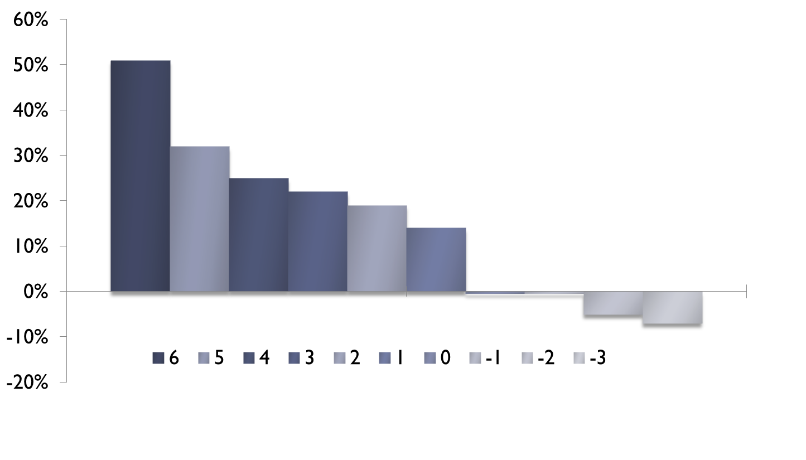
Recidivism Reductions as a Function of Targeting Multiple Criminogenic vs. Non-Criminogenic Needs*
Better outcomes
(Andrews, Dowden, & Gendreau, 1999; Dowden, 1998)
More criminogenic than non-criminogenic needs
More non-criminogenic than criminogenic needs
Poorer outcomes

Slide 9
University of California Irvine research
SPMI offenders are at double the risk of failing supervision.
More likely than their counterparts to fail because of technical violations.
The strongest risk factors for recidivism are shared by those with and without mental illness.
Risk reduction is not based on receiving more mental health services.
Relationship quality partially mediates relation between specialty supervision and arrests and revocation.
Avoid negative pressures and increase positive dual role relationship quality.(Salmon example)
More problem solving techniques and approach.
http://socialecology.uci.edu/faculty/skeem/

Slide 10
Types of Recovery Capital
Physical
Personal
Social/Family
Community
Notes:
We are going to learn about 4 types of Recovery Capital: Physical, Personal, Social/Family, and Community
**This is an overview slide. Do not go into each of these here. We will review each of them in detail in the following slides.

Slide 11
Physical/Economic
Recovery Capital
Tangible resources/assets that support stability: housing, transportation, employment, income/finances, healthcare access, and other material needs.
Notes:
Physical recovery capital refers to the tangible resources that help individuals meet their basic human needs and maintain stability in their daily lives.
These are the foundational supports that make it possible for someone to focus on recovery. When basic needs are unstable or unmet, it becomes much more difficult for individuals to maintain progress in treatment or pursue long-term goals.
Examples of physical recovery capital include personal safety, stable and secure housing, access to healthy nutrition, and overall medical wellness. These elements help create a stable environment where recovery can take root and grow.
Physical recovery capital also includes sustainable finances and reliable transportation. Having financial stability can reduce stress and increase independence, while transportation ensures individuals can attend treatment, court appointments, work, and recovery support meetings.
The key takeaway is that recovery does not happen in isolation from a person’s living conditions. When people have stable, safe, and supportive physical environments, they are far better positioned to engage in and sustain recovery.
As programs and professionals, part of our role is to help participants identify barriers in these areas and connect them with resources that strengthen this foundation of recovery capital.

Slide 12
Challenges with Sustainability of Physical/Recovery Capital
Medications – Money – Housing
Medications
  Anosognosia
  Changing Dr’s after the program
  Long-term buy-in
  Paying for meds; co-pays
Money
Housing

Slide 13
Challenges with Sustainability of Physical/Recovery Capital
Medications – Money – Housing
Money
  Is there Financial situation stable/sustainable
  Disability/Part-time work/etc
  SB example
  Payees?

Slide 14
Challenges with Sustainability of Physical/Recovery Capital
Medications – Money – Housing
Housing
  Is their Housing situation safe?
  Is their Housing situation sustainable?
  Do they have a Housing subsidy?
  Do they have Roommates?
    Will they Pay their portion?
    Will they Use and are they in Recovery also?

Slide 15
Challenges with Sustainability of Physical/Recovery Capital
Transportation
  How do they get around?
  Is this method sustainable?
  Do they have a car?
  Can they afford it?
  Do they have a license, is it at risk?

Slide 16
Challenges with Sustainability of Physical/Recovery Capital
Healthcare
  Do they have Medicaid?
    Does it cover all their expenses?
  Do they have Medicare only?
    What services are available?
    How do we fill in the gaps?
  Do they have co-pays?
    Can they pay them?
    If not, then what?

Slide 17
Personal Recovery Capital
Personal skills and attributes such as coping abilities, education, problem‑solving skills, self‑efficacy, mental and physical health, basic living skills, and resilience.
Notes:
Personal recovery capital refers to the internal strengths, abilities, and skills that individuals bring to the recovery process or develop over time. These are the personal tools that help someone navigate challenges, make healthy decisions, and move toward long-term stability. This type of recovery capital includes things like education, employment skills, and practical life skills. For example, skills such as budgeting, time management, communication, and household management can help individuals maintain stability in their daily lives.
Personal recovery capital also includes problem-solving and decision-making abilities (which also relates back to criminogenic risk). These skills help individuals handle stress, overcome setbacks, and respond constructively to difficult situations without returning to substance use. It’s important to remember that many individuals entering treatment or recovery programs may not have had opportunities to develop some of these skills earlier in life. Part of the recovery process often involves learning or strengthening these abilities over time.
As professionals, we can support the development of personal recovery capital by connecting participants to education programs, job training, life skills development, and coaching that builds confidence and self-efficacy. Strengthening these internal resources helps individuals become more independent and better equipped to sustain their recovery.”

Slide 18
Challenges with Sustainability of Personal Recovery Capital
Problem Solving and Coping Skills
  Have they demonstrated that they gained and can utilize skills to deal with Stressful situations?
    Roommates or Housing stressors
    Family stress (VH example)
  Have they dealt with difficult issues without resorting to use or relapse?
    Running into old friends and using skills?

Slide 19
Challenges with Sustainability of Personal Recovery Capital
Education and Employment
  Have they dealt with job stress successfully?
  Do they have support from employment?
  Do they need further progress in this area?
Basic Living Skills
  Can they maintain their hygiene and apartment in a manner that facilitates recovery?
  Can they maintain their budget and live within their means?

Slide 20
Challenges with Sustainability of Personal Recovery Capital
Mental Health
  Are they solid in taking their meds and locked into a Dr they trust?
  Have they demonstrated they can problem solve through persistent symptoms/adjustments?
Physical Health
  Can they navigate their physical health care and especially pain issues without falling back into addictive tendencies, meds, habits?
Resiliency

Slide 21
Social Recovery Capital
Supportive relationships and community connections that reinforce recovery, provide motivation, and encouragement. This includes family, sober peers, peer supports, mentors, positive leisure and recreational activities and recovery groups.
Notes:
Social recovery capital refers to the supportive relationships and networks that individuals rely on to maintain and strengthen their recovery. These are the people and connections that provide emotional support, encouragement, and practical assistance.
A strong social network can motivate ongoing recovery efforts, provide accountability, and help individuals navigate challenges without turning back to substance use. It’s not just about having people around—it’s about relationships that are positive, supportive, and recovery-oriented. Social recovery capital also includes opportunities for safe and rewarding recreational or leisure activities. Participating in hobbies, sports, community events, or social gatherings with supportive peers helps individuals build a sense of belonging and purpose, which reinforces their recovery journey.
As professionals, our role is to help participants identify, strengthen, and expand these supportive relationships, whether that means connecting them to peer support groups, mentorship programs, family counseling, or community-based social activities.

Slide 22
Challenges with Sustainability of Social Recovery Capital
Family Supports and Relationships
  Is the Family Supportive and Engaged supporting Recovery Efforts? (Football game Example)
  Is the family part of the problem or part of the solution?
  Ex’s and children together…
  Are some supportive and others not so much?
  This is one of the MOST IMPORTANT items in regards to long-term Recovery!
Peers/Friends

Slide 23
Challenges with Sustainability of Social Recovery Capital
Positive Peers/Friends
  This is THE MOST IMPORTANT factor (in my opinion) for Long-Term Recovery!
  Who are they hanging out with and what is their influence in their lives.
  Have they been able to change this while in the program and is it long-term change?
  Are their friends in the system and do they use currently or are they in active recovery?
  Are their friends Motivating and Encouraging?

Slide 24
Challenges with Sustainability of Social Recovery Capital
Positive Leisure and Recreational Activities
  What do they enjoy?
    Fishing….Camping….Diamond Art…Drawing
  How long has it been since they did these activities?
  Have they done them sober?
  Are the friends they do them with sober?
  Individualize this area…

Slide 25
Community/Cultural Recovery Capital
Assets, values, beliefs, norms, and community identity that support recovery—such as feeling a sense of belonging, having recovery‑supportive values, or being part of a cultural or spiritual activities that encourage sobriety. This should include prosocial activities with positive role models.
Notes:
Community recovery capital refers to the resources and opportunities within the broader community that help individuals feel connected, supported, and engaged in positive ways. This type of recovery capital includes access to role models and mentors who demonstrate healthy, prosocial behavior and can provide guidance, inspiration, and support.
It also encompasses prosocial activities—things like volunteering, community service, recreation, or organized group events—that allow individuals to participate in meaningful, structured activities with others who support recovery. Additionally, spiritual or cultural activities can play an important role, offering a sense of belonging, identity, and purpose. These activities may include participation in faith-based programs, cultural traditions, or community rituals that reinforce positive values and connections.
The key idea is that strong community connections help individuals feel supported, valued, and integrated into society, which strengthens their overall recovery journey. Programs can support community recovery capital by linking participants to mentors, community organizations, cultural programs, and structured recreational opportunities.

Slide 26
Challenges with Sustainability of Community/Cultural Recovery Capital
Having Recovery-Supportive Values
  What is this exactly?
  Do our folks change to this extent?
  Example of (football game guy-drinking…value)
Sense of Belonging
  Football Example continued
  Where do our folks feel they “belong”- “fit-in”
  How do they/we change this?

Slide 27
Challenges with Sustainability of Community/Cultural Recovery Capital
Do they have Spiritual Beliefs/Supports
  Do they belong to or attend a church?
  Do they do other things tied to this church or spiritual activities
Cultural Supports
  Do they have positive cultural ties?

Slide 28
Challenges with Sustainability of Community/Cultural Recovery Capital
Prosocial Activities
  Do they do any activities in the community?
  What do they do?
  Do they attend school?
Positive Role Models
  Peer Support Specialist/Recovery Coaches

Slide 29
Integrate Information from Risk Assessment and Central 8 Risk Factors – Be Intentional!
Dynamic risk factors and associated needs
Dynamic Risk Factor
History of antisocial behavior
Antisocial personality pattern
Antisocial cognition
Antisocial associates
Family and/or marital discord
Poor school and/or work performance
Few leisure or recreation activities
Substance abuse
Need
Build alternative behaviors
Problem solving skills, anger management
Develop less risky thinking
Reduce association with criminal others
Reduce conflict, build positive relationships
Enhance performance, rewards
Enhance outside involvement
Reduce use through integrated treatment
Source: Andrews (2006)
Notes:
For each dynamic risk factor, this chart shows the associated need—or the WHAT to target to address that risk factor--to consider in sentencing/supervision.
BH providers’ work is founded in the bottom four—their bread and butter
Availability of integrated tx varies depending on the community, but it is a responsibility that BH community has embraced
Out of criminology and sociology literature, there are interventions that do address criminal thinking—addressing the things that have been shown to make a difference in mitigating the factors that drive people to jail and prison

Slide 30
Recidivism Reductions as a Function of Targeting Multiple Criminogenic vs. Non-Criminogenic Needs*
Better outcomes
(Andrews, Dowden, & Gendreau, 1999; Dowden, 1998)
More criminogenic than non-criminogenic needs
More non-criminogenic than criminogenic needs
Poorer outcomes

Slide 31
Phase up Meetings
Review Central 8
Re-evaluate Risk levels with each area
Re-evaluate Needs and how they will be addressed
Responsivity issues
What have we missed? Further Tx needed? MRT level?
Who else needs to be at our meeting???
    Family
    Peer supports
    Friends???
    Child Support?
    Employer, etc..
    BE INTENTIONAL WITH RESPONSES

Slide 32
Thank you !
Any Questions?
Eric Olson, LCPC
olson8653@gmail.com PH: 208-360-0262
District Manager
Adult & Juvenile Mental Health Courts
Idaho’s 7th Judicial District

