Slide 1
The Mentor Coordinator Readiness & Operational Training (MCROT)
Recruitment, Recruitment, Recruitment
  Presenter: Mark Panasiewicz,
  Sunchaser Solutions LLC
Recruitment, Recruitment, Recruitment

Slide 2
Training Objectives
Identify the key characteristics of an effective and appropriate mentor candidate.
Apply consistent recruitment and screening practices to assess mentor readiness.
Recognize red flags related to boundaries, reliability, motivation, and emotional stability.
Develop an ongoing recruitment strategy that builds a qualified and diverse mentor pool.

Slide 3

Purpose of Recruitment
Recruit mentors who are dependable, emotionally stable, ethical, and capable of maintaining appropriate boundaries.
Focus on quality and fit rather than simply filling mentor positions.
Build a diverse mentor pool that reflects the populations being served.

Slide 4
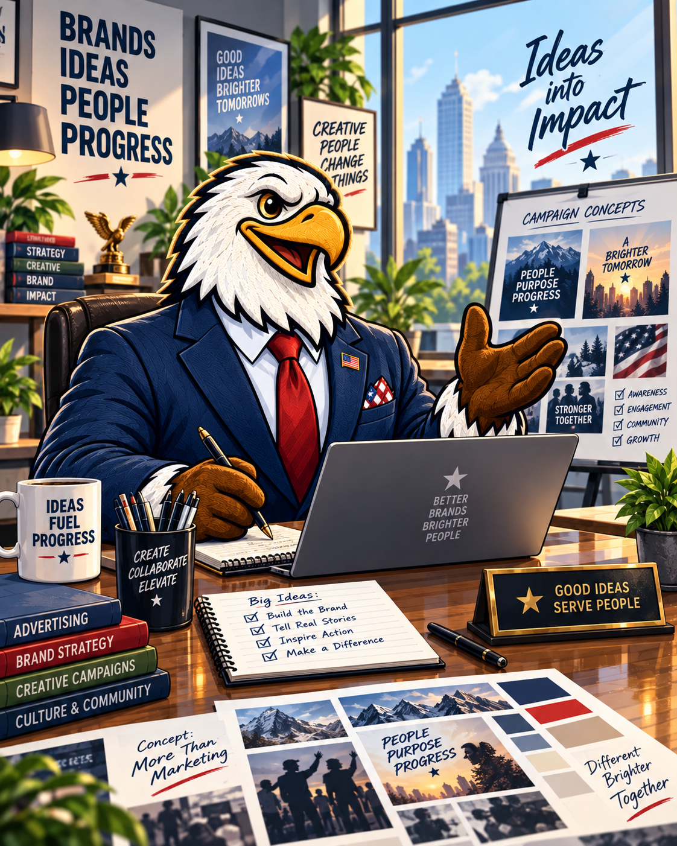
Advertisement
YOU HAVE TO ADVERTISE SO PEOPLE KNOW ABOUT YOU.

Slide 5

Advertisement
Idealist — Organizations and community groups can currently post volunteer opportunities for free
VolunteerMatch has also become part of Idealist, so this is now one of the major online places to list volunteer opportunities.
https://www.idealist.org/en/volunteer

Slide 6
Advertisement
Community bulletin boards — Libraries, community centers, colleges, grocery stores, coffee shops, recreation centers, churches, and municipal buildings may allow nonprofit or volunteer flyers at no charge.
Colleges and universities — Contact Veteran Services, social work, psychology, nursing, criminal justice, human services, and service-learning offices. Ask them to distribute the opportunity to students, faculty, alumni, and student veterans.

Slide 7
Advertisement
Email signatures — Staff can add a simple line such as “Interested in becoming a Veteran Mentor? Ask us how.” to their regular email signatures.
Local newspapers and community calendars — Submit volunteer opportunities as community announcements rather than paid advertisements when the publication offers that option.

Slide 8
Advertisement
Email signatures — Staff can add a simple line such as “Interested in becoming a Veteran Mentor? Ask us how.” to their regular email signatures.
QR codes — Put a QR code linking to the mentor application on every flyer, presentation, email, social-media graphic, business card, and event sign.
Former participants and graduates — When appropriate under program policies, invite successful graduates to learn about volunteering rather than automatically recruiting them directly into mentoring.
.

Slide 9
Advertisement
Radio and public-service announcements — Local radio stations sometimes provide nonprofit/community announcement opportunities. The coordinator can ask whether they accept free PSAs.

Slide 10
Advertisement
Email signatures — Staff can add a simple line such as “Interested in becoming a Veteran Mentor? Ask us how.” to their regular email signatures.
Radio and public-service announcements — Local radio stations sometimes provide nonprofit/community announcement opportunities. The coordinator can ask whether they accept free PSAs.

Slide 11
5-5-5 Strategy
“5–5–5 Recruitment Strategy”: identify 5 organizations to contact, 5 places to advertise for free, and 5 individuals to personally invite. That gives each coordinator 15 active recruitment opportunities without spending any money.

Slide 12
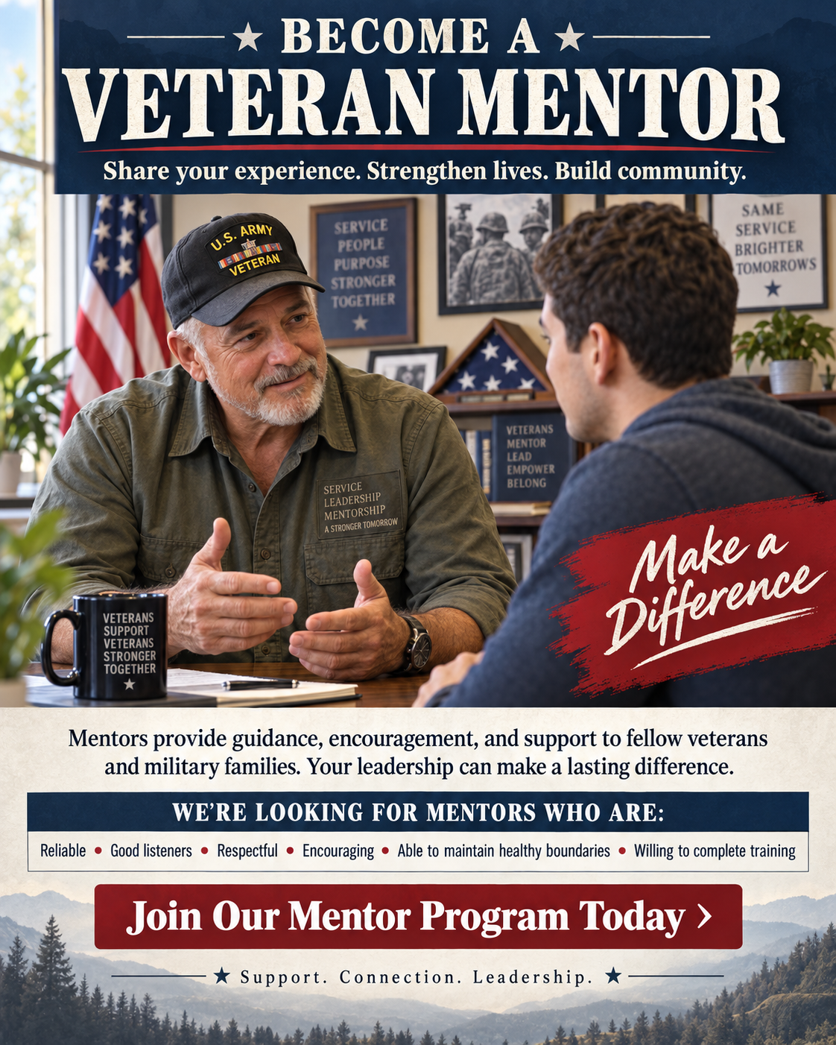

Recruit people through activities rather than recruitment meetings alone
Host veteran-centered activities where prospective mentors naturally interact with your organization
Recruitment becomes a relationship-building activity rather than a sales pitch.

Slide 13


Suggested Events
Veteran breakfasts.
Service projects
Fishing/hunting/outdoor events
Ruck walks
Community service days
Veteran resource fairs
Family events.
Recovery celebrations
Court graduation ceremonies.

Slide 14
Instead of “Do you want to be a Mentor?”
Ask “What could you teach another Veteran”
Employment • VA navigation • Recovery • Fishing • Fitness • Parenting • Financial responsibility • Education • Relationships • Community service • Transition from the military
Now you've started a conversation rather than handed them an application process.

Slide 15

Instead of “Do you want to be a Mentor?”
Ask “What could you teach another Veteran”

Slide 16
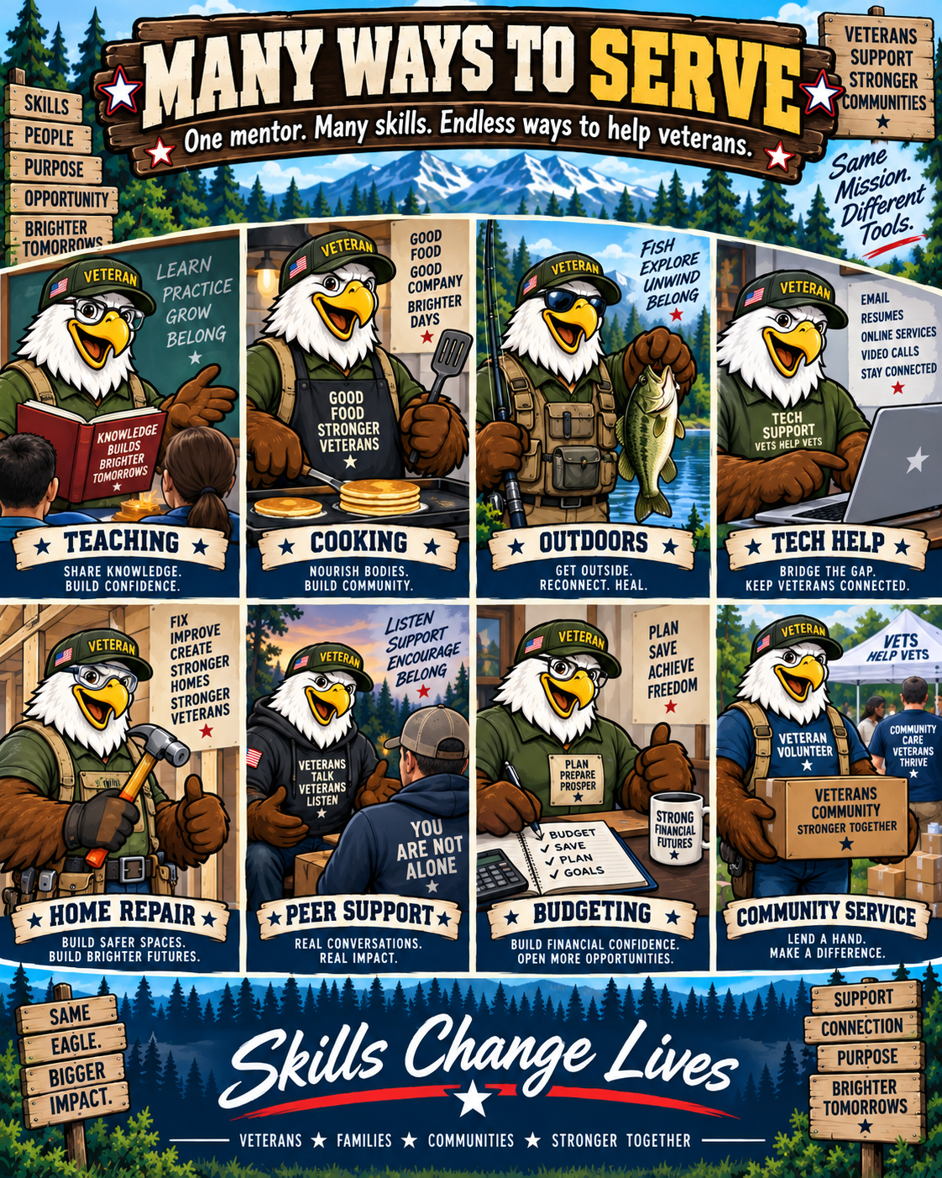
Don’t just recruit for Mentors

Slide 17

Don’t just recruit Veterans

Slide 18
Recruit From Multiple Sources
Former program participants who meet eligibility requirements.
Veterans and veteran organizations.
Recovery and peer-support communities.
Colleges and universities.
Social work, psychology, counseling, criminal justice, and human-service programs.
Community organizations.
Faith-based organizations when appropriate.
Civic organizations.
Professional associations.
Employers and corporate volunteer programs.
Community events and volunteer fairs.
Social media and organizational websites.
Current mentor referrals.

Slide 19

Identify the Ideal Mentor
Develop a clear mentor profile before recruiting. Strong candidates should demonstrate:

Slide 20
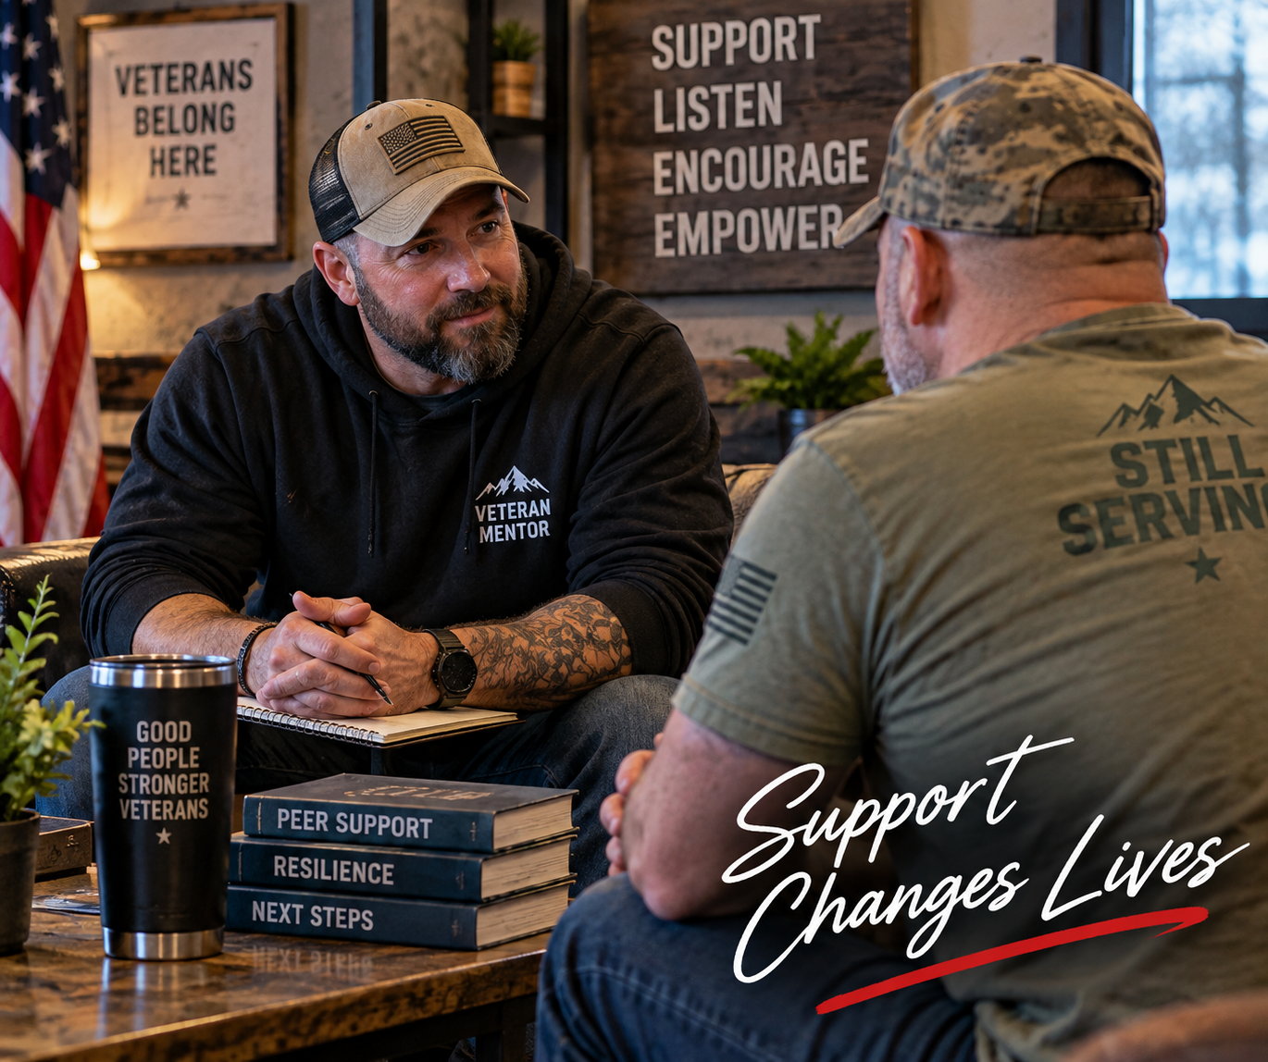
Plus, maybe they work towards Mentorship
Supporter → Event Volunteer → Mentor Candidate → Trained Mentor → Senior Mentor → Mentor Leader

Slide 21
FIND → ENGAGE → INVITE → SCREEN → TRAIN → CONNECT → RETAIN
FIND people who demonstrate the qualities you want.
ENGAGE them through events, relationships, and your mission.
INVITE them personally.
SCREEN for values, motivation, boundaries, and readiness.

Slide 22
FIND → ENGAGE → INVITE → SCREEN → TRAIN → CONNECT → RETAIN
TRAIN them before assigning a mentee or a task.
CONNECT them quickly to the mentor community.
RETAIN them through supervision, recognition, support, and opportunities for leadership.

Slide 23
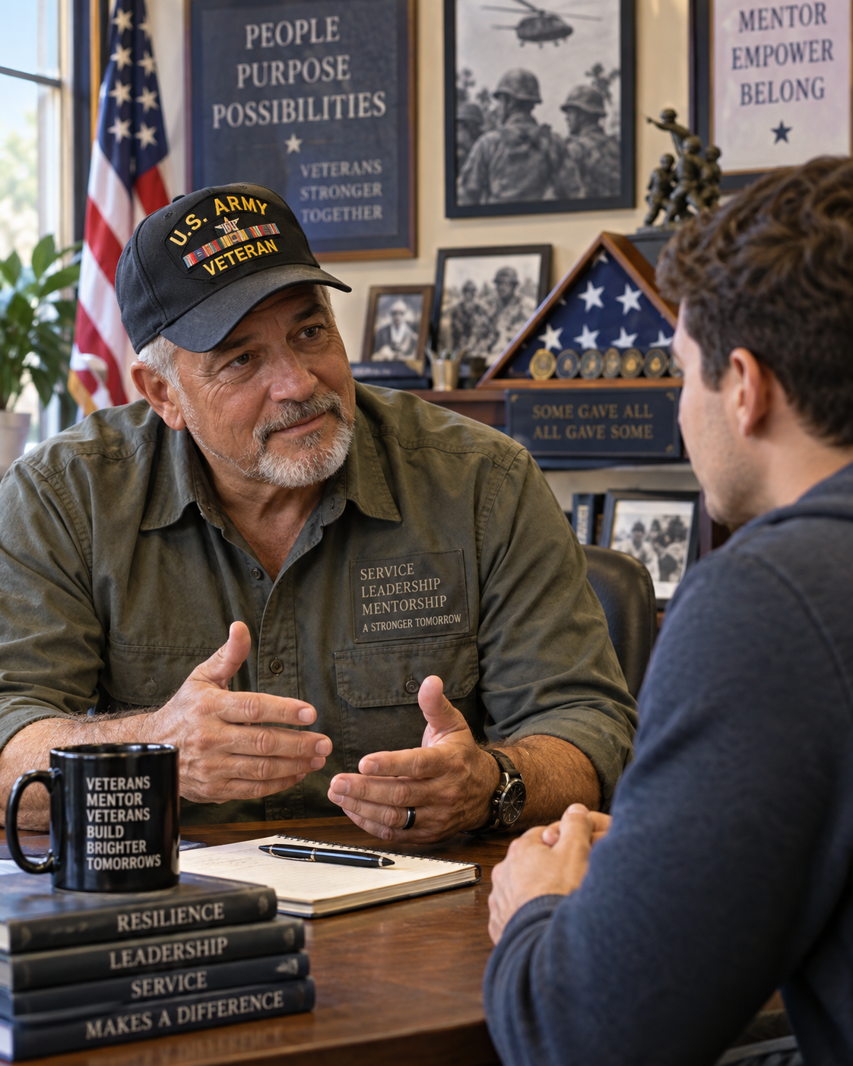
Ideal Mentor
Reliability and consistency.
Good communication and listening skills.
Empathy without over-identification.
Emotional maturity.
Respect for different backgrounds and experiences.
Ability to receive supervision and feedback.
Healthy personal boundaries.
Appropriate motivation for becoming a mentor.
Willingness to complete training and follow program policies.
Ability to maintain confidentiality.

Slide 24
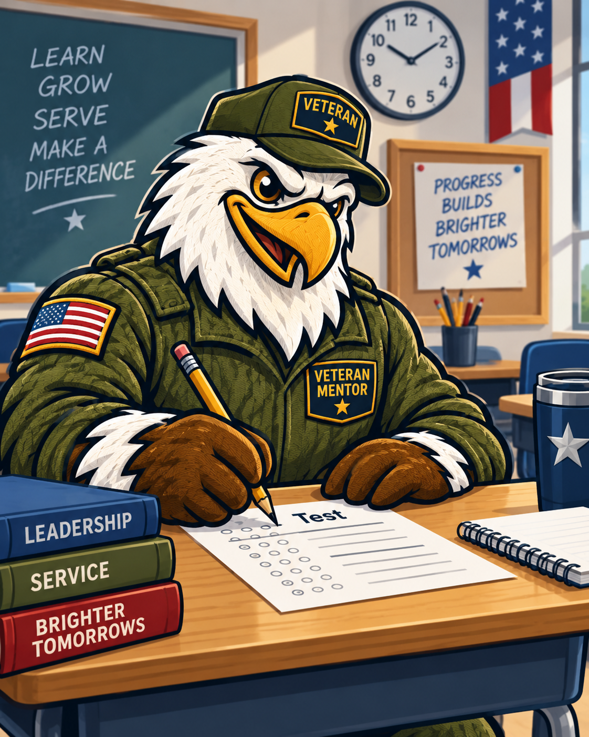
Mentor Questionnaire

Slide 25

Use a Clear Recruitment Message
Whom the program serves.
What mentors actually do.
Expected time commitment.
Training requirements.
Supervision requirements.
Appropriate boundaries.
Confidentiality expectations.
Whether the position is volunteer or paid.
Minimum length of commitment.
Benefits of mentoring without overselling the experience.

Slide 26

Recruit for the Right Reasons
Desire to give back.
Interest in supporting others.
Personal experience that has been adequately processed.
Commitment to community service.
Desire to help someone develop independence and stability.

Slide 27
Recruit Warning Signs
Wanting to “fix” or rescue people.
Seeking validation through mentoring.
Trying to work through unresolved personal trauma through mentees.
Wanting authority or control.
Expecting mentees to follow personal advice.
Difficulty respecting boundaries.
Becoming excessively emotionally invested in helping others.

Slide 28
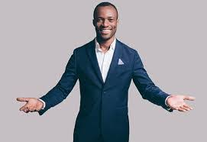

Provide Realistic Expectations
Missed appointments.
Resistance.
Relapse or setbacks.
Difficult conversations.
Limited gratitude.
Slow progress.
Emotional situations.
Maintaining boundaries even when they want to do more.
Candidates should know before accepting the position that mentoring can involve

Slide 29

Give people different ways to become involved
Maybe being a mentor is not a good fit. But we can still use them as volunteers
Volunteers may plan events, lead activities, serve locally, or take larger leadership roles.
It explicitly tells prospective volunteers that opportunities can fit different interests, skills, and amounts of available time

Slide 30
Sunchaser Solutions
Questions ???
Notes:
Summarize the core training message.

Slide 31
Sunchaser Solutions
Sunchaser Solutions 906-281-7554
markepana@gmail.com
We can handle all your training needs.
Notes:
Summarize the core training message.

