Slide 1
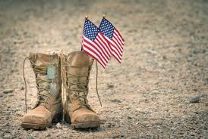
The Mentor Coordinator Readiness & Operational Training (MCROT)
Staying in the Fight: Recognizing and Responding to Crisis
  Presenter: Mark Panasiewicz,
  Sunchaser Solutions LLC
  Staying in the Fight: Recognizing and Responding to Crisis

Slide 2
Training Objectives
Mentors will be able to identify warning signs of suicide in Veterans.
Mentors will understand common suicide myths and the correct facts
.
Mentors will learn how to ask directly about suicidal thoughts.
Mentors will be able to recognize different levels of suicide risk.
Mentors will apply basic steps to keep a Veteran safe during a crisis.
Mentors will understand the role and boundaries of a mentor.
Mentors will know how to connect Veterans to appropriate resources and support

Slide 3
What is Trauma?
Veterans: 35.2 per 100,000
Non-Veterans: ~16.9 per 100,000
Veterans are roughly 2x more likely to die by suicide.

Slide 4
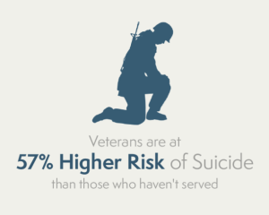
Statistics

Slide 5
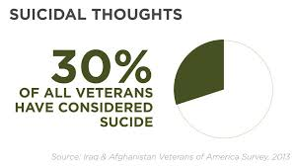
Statistics

Slide 6
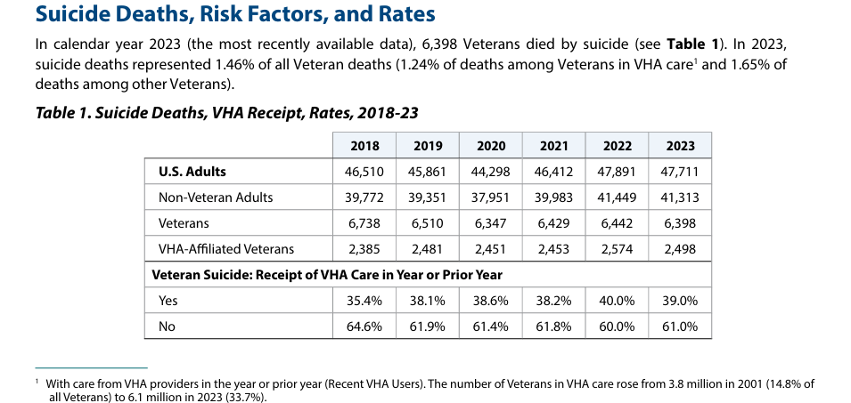
Statistics

Slide 7
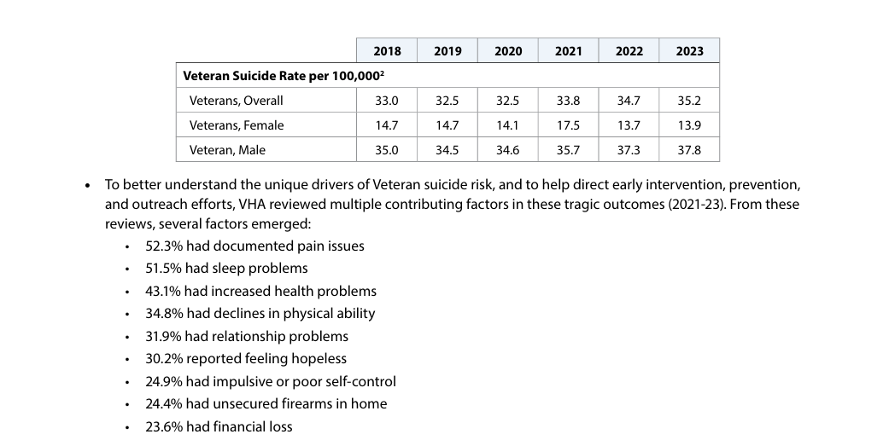
Veteran Suicide Rate per 100,000

Slide 8
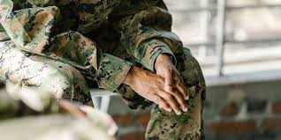
Some Facts
Rates increased for both men and women
Younger Veterans remain a high-risk group
Suicide remains a leading cause of death for Veterans under 45

Slide 9

S.U.D and M.H. connection
Mental Health, Substance Use, and Non-Mental Health Risks:
Among Veterans in VHA care who died from suicide in 2023,
60.9% had a VHA mental health or substance use disorder diagnosis,

Slide 10
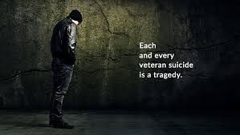
Is Suicidal Ideation a Mental Health Issue? Or Choice?
6,398 Veterans died by suicide in 2023
Average: ~17.5 Veterans per day

Slide 11
What is Trauma?
Veterans: 35.2 per 100,000
Non-Veterans: ~16.9 per 100,000
Veterans are roughly 2x more likely to die by suicide.

Slide 12

True or False
“If someone wants to die, they’ll find a way.

Slide 13

FALSE
❌ Myth
“If someone wants to die, they’ll find a way.
Many who survive an attempt never try again
Suicide is often an impulse action-Delaying it even by minutes can make a difference

Slide 14
FALSE
❌ Myth
“If someone wants to die, they’ll find a way.
Many who survive an attempt never try again
Suicide is often an impulse action-Delaying it even by minutes can make a difference

Slide 15
True or False
Only people with Mental Health Issues commit suicide

Slide 16
Sorta False Sorta True
Only people with Mental Health Issues commit suicide
Acute stress
Relationship conflict
Financial/legal crises
Substance use

Slide 17
True or False
“Talking about suicide will help prevent it.

Slide 18
True
Talking about suicide will help prevent it.
Asking about suicide REDUCES risk.
It creates relief, openness, and connection.
Ask directly: “Are you thinking about killing yourself?

Slide 19
True or False
Do “NO-Suicide Contracts” work?

Slide 20
True or False
❌ Myth
“NO-Suicide Contracts” work to help stop suicide
No-Suicide Contracts do now work. They do not reduce suicide risk and may increase liability.

Slide 21
True or False
People who talk about suicide just want attention.

Slide 22
True or False
❌ Myth
“People who talk about suicide just want attention.
They are communicating distress and need for help.
Many people who die by suicide gave warning signs beforehand.

Slide 23
Direct Verbal Warning Signs (Highest Risk)
These should always be taken seriously and immediately:
“I want to die”
“I wish I wasn’t here”
“Everyone would be better off without me”
“I can’t do this anymore”
Talking about wanting to kill themselves
Talking about feeling like a burden
Good Mentor rule: If they say it → assume risk is present

Slide 24
Behavioral Warning Signs (Often Missed)
Withdrawing from family, friends, activities
Giving away possessions
Writing goodbye messages or notes
Increased substance use (alcohol/drugs)
Searching for methods (online, buying items)
Sudden calmness after distress (major red flag)
Risky or reckless behavior
Good Mentor Tip- Sudden improvement = possible decision to act

Slide 25
Emotional & Cognitive Signs
Hopelessness (“Nothing will change”)
Feeling trapped or stuck
Intense anxiety or agitation
Rage or uncontrolled anger
Shame, guilt, or worthlessness
Loss of purpose or identity
Good Mentor Tip-Loss of mission + identity shift = major driver

Slide 26
Situational / Life Stress Warning Signs
Relationship conflict / divorce
Job loss or financial problems
Legal issues
Loss of housing
Major health diagnosis
Anniversary of trauma or loss
Good Mentor Tip- Suicide risk often spikes during acute life disruptions

Slide 27
IMMEDIATE REDS FLAGS-ACT NOW
Talking about wanting to die
Has a plan + means
Saying goodbye / giving things away
Sudden calm after severe distress
Intoxicated + suicidal
GOOD MENTOR ACTION-
Stay with them
Remove access to lethal means
Call 988 (Veterans press 1) or emergency services

Slide 28
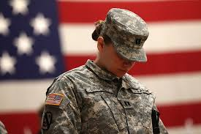
Ways to Prevent
Suicide attempts are often impulsive (minutes to hours)
If you delay access → survival dramatically increases

Slide 29
Ways to Prevent
Show up consistently (calls, texts, in-person)
Be reliable—don’t disappear
Use plain language, not therapy talk
Why it works:
Connection reduces isolation (one of the biggest risk factors)
Mentor mindset:
“I’m not here to fix you—I’m here to not leave you alone in it.”

Slide 30
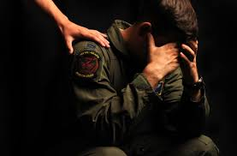
Ways to Prevent
VA Engagement & Risk
61% of Veterans who died by suicide were NOT in VA care
Engagement with VA care is associated with lower suicide risk

Slide 31
Ways to Prevent- Build Real Connection (Your #1 Job)
Show up consistently (calls, texts, in-person)
Be reliable—don’t disappear
Use plain language, not therapy talk
Why it works:
Connection reduces isolation (one of the biggest risk factors)
Mentor mindset:
“I’m not here to fix you—I’m here to not leave you alone in it.”

Slide 32
Ways to Prevent-Talk About Safety (Without Being a “Rat”)
What to do:
Ask about firearms when risk is present
Suggest temporary safety steps:
  Lock it up
  Let someone else hold onto it
  Separate ammo
Mentor can say (non-judgmental):
“Hey, while things are heavy, how can we make it harder to act on a bad moment?”

Slide 33
Ways to Prevent-Encourage Help (Without Forcing)
What to do:
Normalize getting help
Offer to go with them (or stay on the phone)
Encourage—not push
Many Veterans won’t go alone—but will go with someone
Mentors can say:
“You don’t have to do this alone.”
“Let’s make one call together.”

Slide 34
Ways to Prevent- Watch for Changes (Your Early Warning System)
Pay attention to:
Withdrawal
Increased drinking
Talking like they’re done
Giving things away
Sudden calm after distress
Mentor Tip- Mentors often see changes before clinicians do

Slide 35
What To Do If You THINK There Is Suicide Risk
STEP 1: Ask Directly (No Dancing Around It)
Say:
“Are you thinking about killing yourself?”
“Have you thought about how you would do it?”
“Do you have access to a gun or anything else?”

Slide 36
What To Do If You THINK There Is Suicide Risk
STEP 2: Stay Calm and Present
Don’t panic
Don’t lecture
Don’t argue
Say:
“I’m really glad you told me.”
“You’re not alone right now.”
“We’re going to slow this down together.”

Slide 37
What To Do If You THINK There Is Suicide Risk
STEP 3: Assess Immediate Danger
🔴 HIGH RISK (Act NOW)
Has a plan
Has access to means (especially firearms)
Intoxicated
Saying goodbye / giving things away
Sounds final or resolved
👉 Action:
Stay with them
Remove access to lethal means if safe
Call 988 (Press 1 for Veterans)
Or emergency services if immediate danger

Slide 38
What To Do If You THINK There Is Suicide Risk
🟡 MODERATE RISK
Thoughts but no plan
Feels overwhelmed / hopeless
👉 Action:
Stay connected
Help them call 988 or provider
Identify someone else they trust
Reduce isolation immediately

Slide 39
What To Do If You THINK There Is Suicide Risk
STEP 4: Reduce Immediate Danger
Ask about guns, meds, alcohol
Help create distance from them
Say:
“What can we move or lock up right now to keep you safe?

Slide 40
What To Do If You THINK There Is Suicide Risk
STEP 5: Get Backup (You Are NOT Alone)
Call 988 (Veterans press 1)
Loop in:
  Therapist
  Crisis line
  Trusted family member (if appropriate)
Important boundary:
You are NOT a therapist—but you are a bridge to safety

Slide 41
What Mentors should not do
⚠️ What Mentors SHOULD NOT Do
❌ Do not promise secrecy if they are at risk
❌ Do not minimize (“you’ll be fine”)
❌ Do not try to solve everything
❌ Do not act as law enforcement (“ratting”)
❌ Do not leave them alone during high risk

Slide 42

Sunchaser Solutions
Questions ???

Slide 43
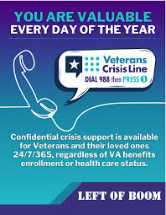
Sunchaser Solutions

Slide 44
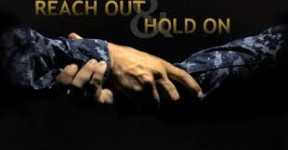
Sunchaser Solutions
Questions ???

Slide 45

Sunchaser Solutions
Questions ???

Slide 46

Sunchaser Solutions
Questions ???

Slide 47

Sunchaser Solutions
Questions ???

Slide 48
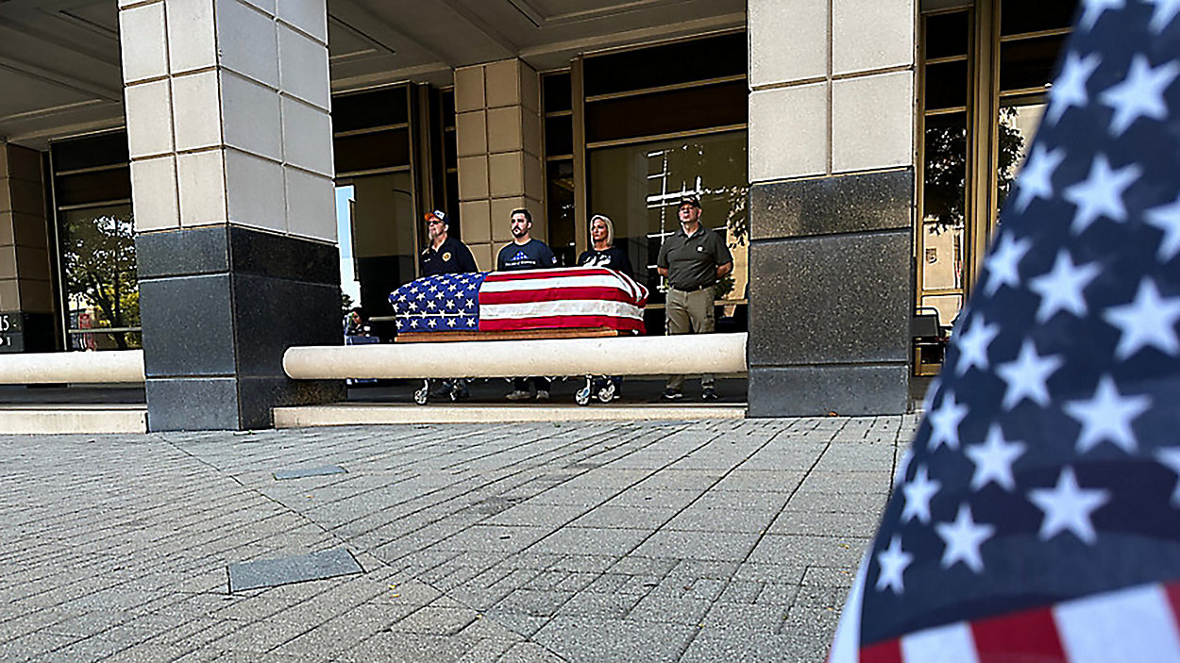
Sunchaser Solutions
Questions ???

Slide 49
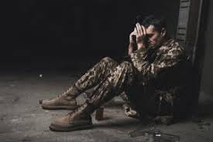
Sunchaser Solutions
Questions ???

Slide 50
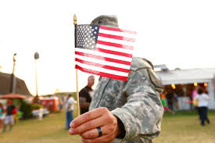
Sunchaser Solutions
Questions ???

Slide 51
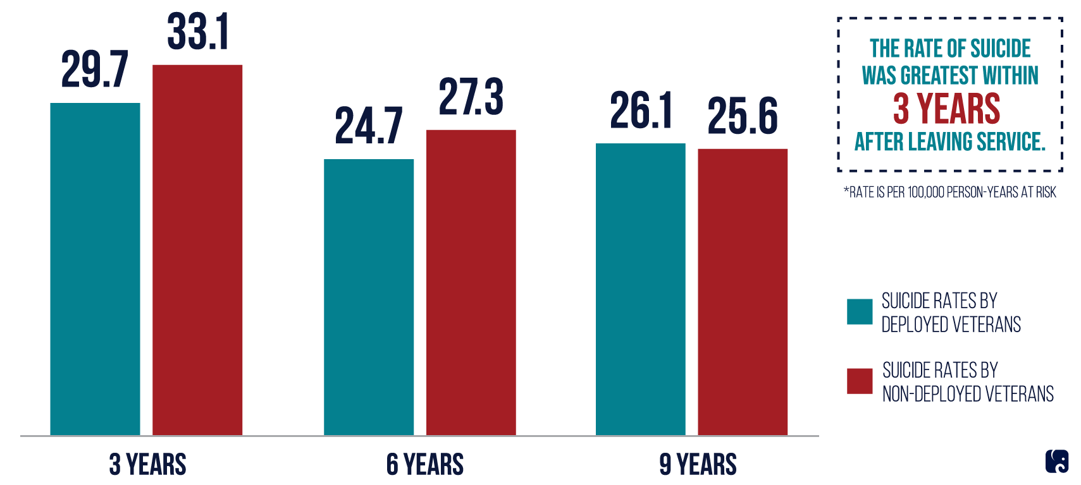
Sunchaser Solutions
Questions ???

Slide 52

Sunchaser Solutions
Questions ???

Slide 53
Key take away
Bottom Line
The most effective mentors:
Stay connected
Ask directly
Take it seriously
Reduce access to danger
Get help involved
You don’t need to be perfect—you just need to show up and not ignore it

Slide 54
Sunchaser Solutions
Questions ???
Notes:
Summarize the core training message.

Slide 55
Sunchaser Solutions
Sunchaser Solutions 906-281-7554
markepana@gmail.com
We can handle all your training needs.
Notes:
Summarize the core training message.

