Slide 1
The Mentor Coordinator Readiness & Operational Training (MCROT)
Teaching Your Treatment Court Team:
Understanding Veteran Culture and Military Language
  Presenter: Mark Panasiewicz,
  Sunchaser Solutions LLC
Recruitment, Recruitment, Recruitment

Slide 2
Training Objectives
Help non-veterans understand military culture, veteran identity, common language, traditions, expectations, and experiences that may continue after military service.
Participants will be able to describe important aspects of military and veteran culture, recognize common terminology and jargon, identify cultural differences between military and civilian environments, and communicate more effectively with veterans.

Slide 3

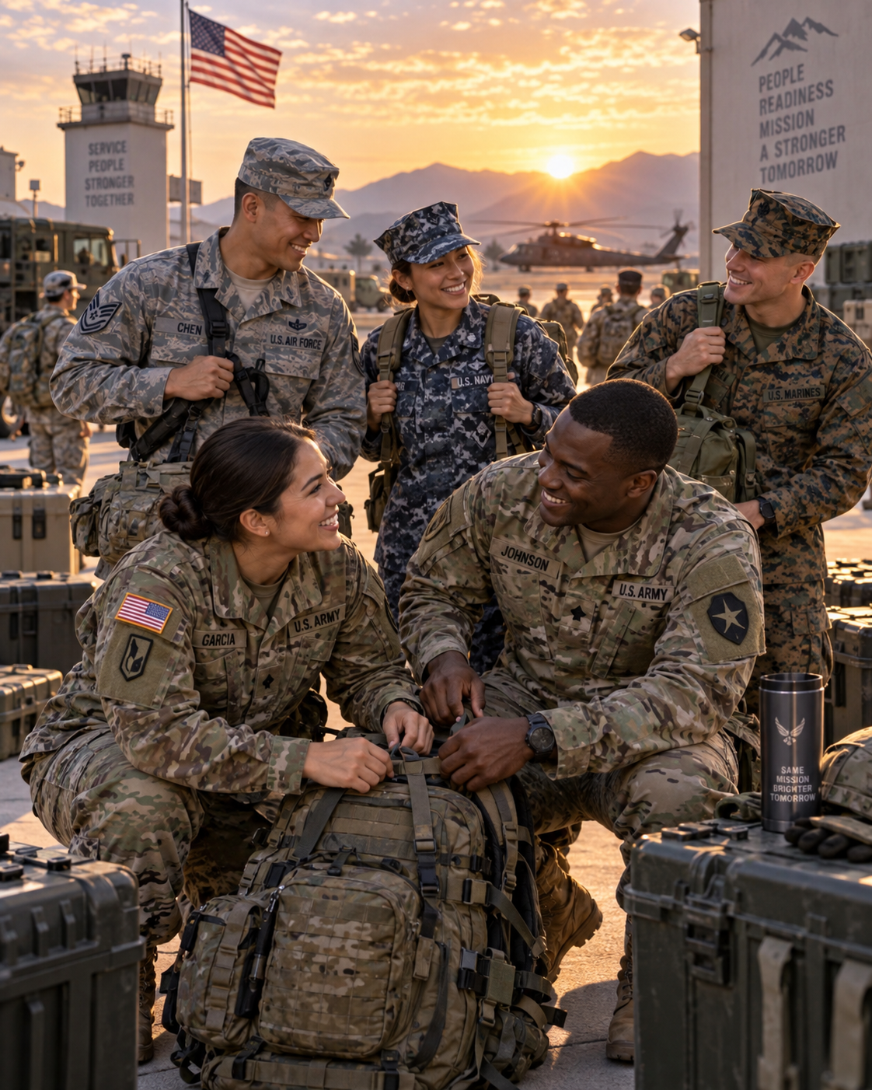
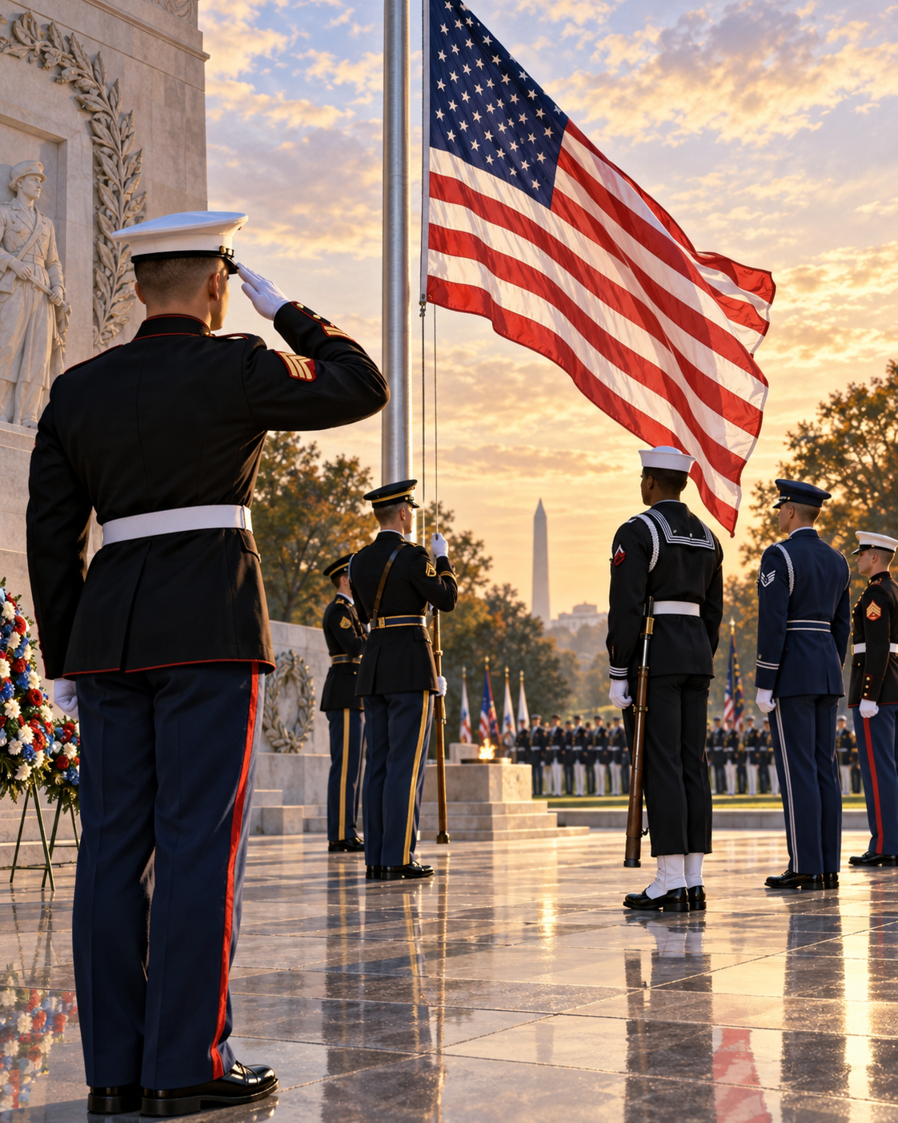
What Do We Mean by “Culture”?
Culture includes shared values, behaviors, traditions, language, symbols, expectations, rules, and ways of understanding the world.

Slide 4
Military Culture Is Its Own Culture
The military has its own language, hierarchy, customs, rituals, dress, expectations, and behavioral standards. Entering the military often requires learning a completely new culture.

Slide 5
Examples of Culture
An MOS is a Military Occupational Specialty—basically, a service member’s job in the military.
Military bearing is the professional appearance, conduct, discipline, and self-control expected of a service member.
“Watch your six” = stay alert and protect your back.
MRE
Charlie Foxtrot — Phonetic-alphabet way of saying “cluster…” meaning a chaotic mess.
MEPs/-------------oath of enlistment---------------- Basic Training

Slide 6
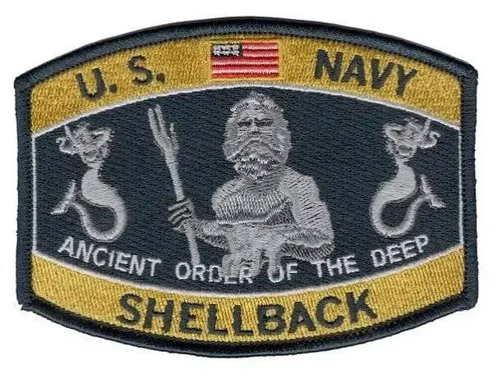
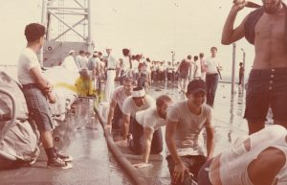
Understanding Veteran Identity
Military service may remain an important part of someone's identity long after leaving active service. Some people strongly identify as veterans while others do not.

Slide 7
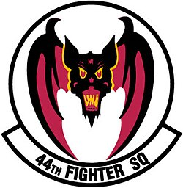
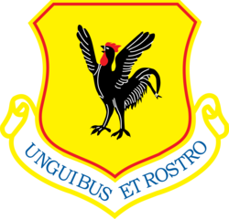
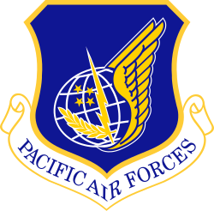
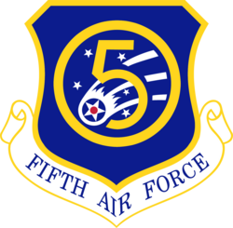
Veterans Are Not One Culture
Veteran experiences differ based on branch, military occupation, era served, rank, deployment history, combat experience, gender, age, Guard/Reserve status, and individual experiences.

Slide 8
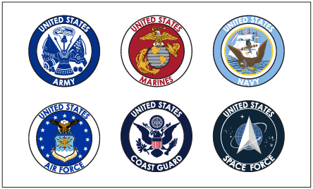
The Six Military Branches
Army, Navy, Air Force, Marine Corps, Coast Guard, and Space Force. Introduce each branch's basic mission and cultural identity.

Slide 9
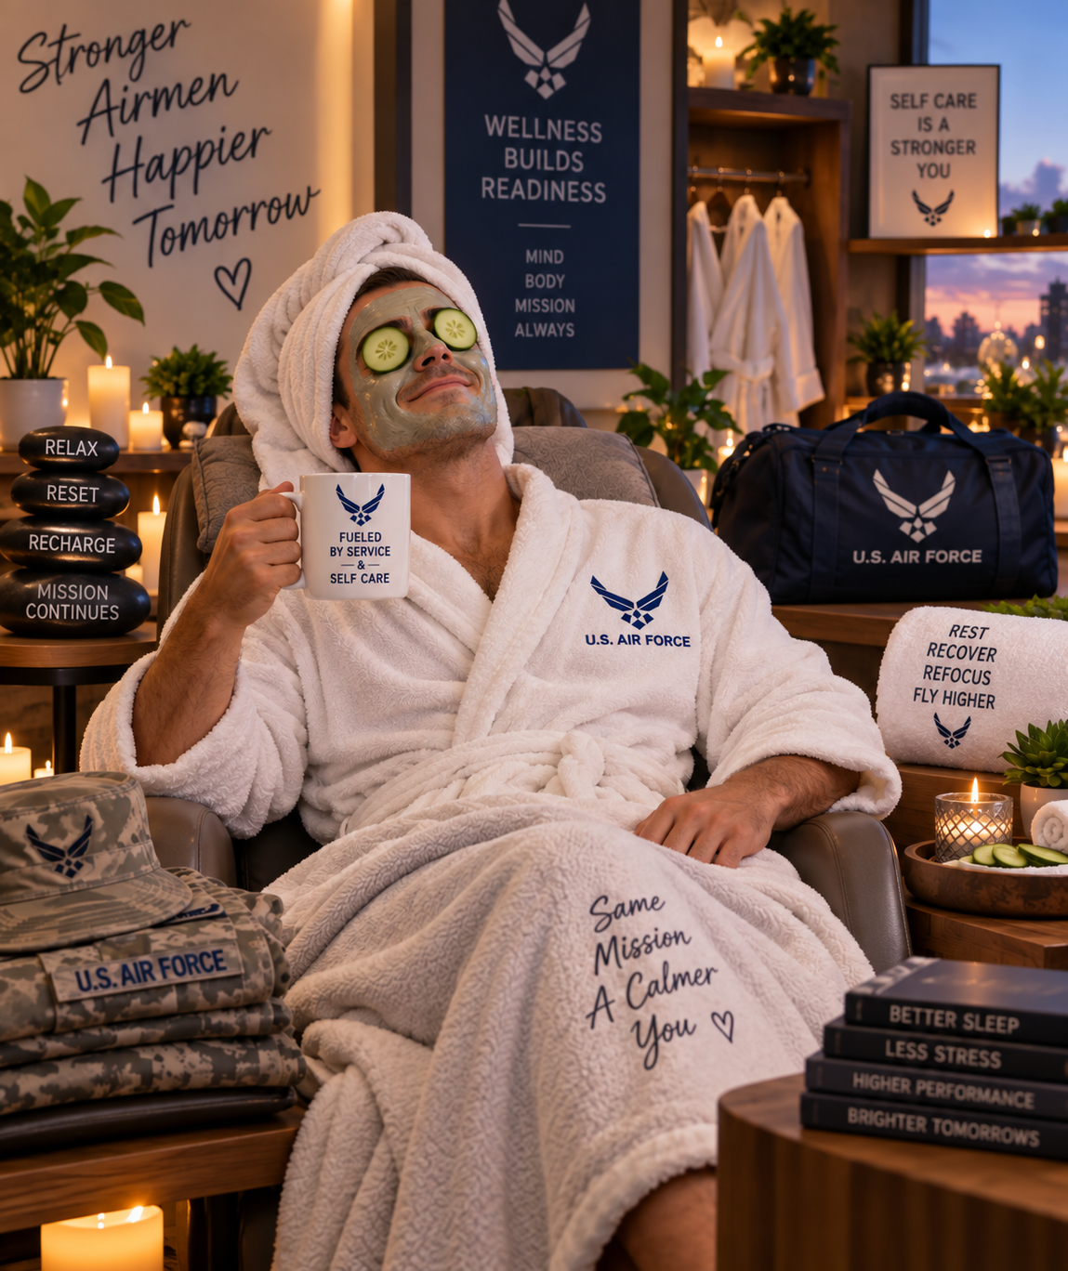
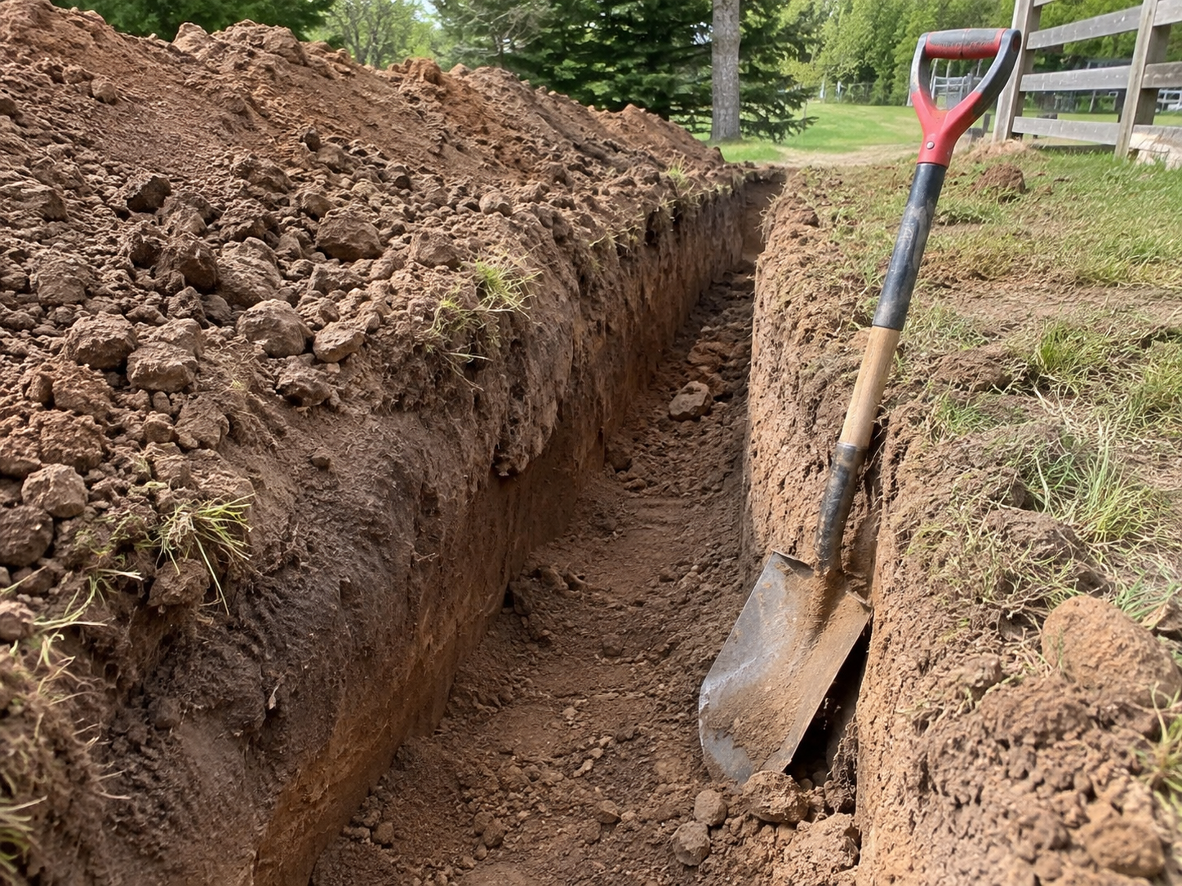
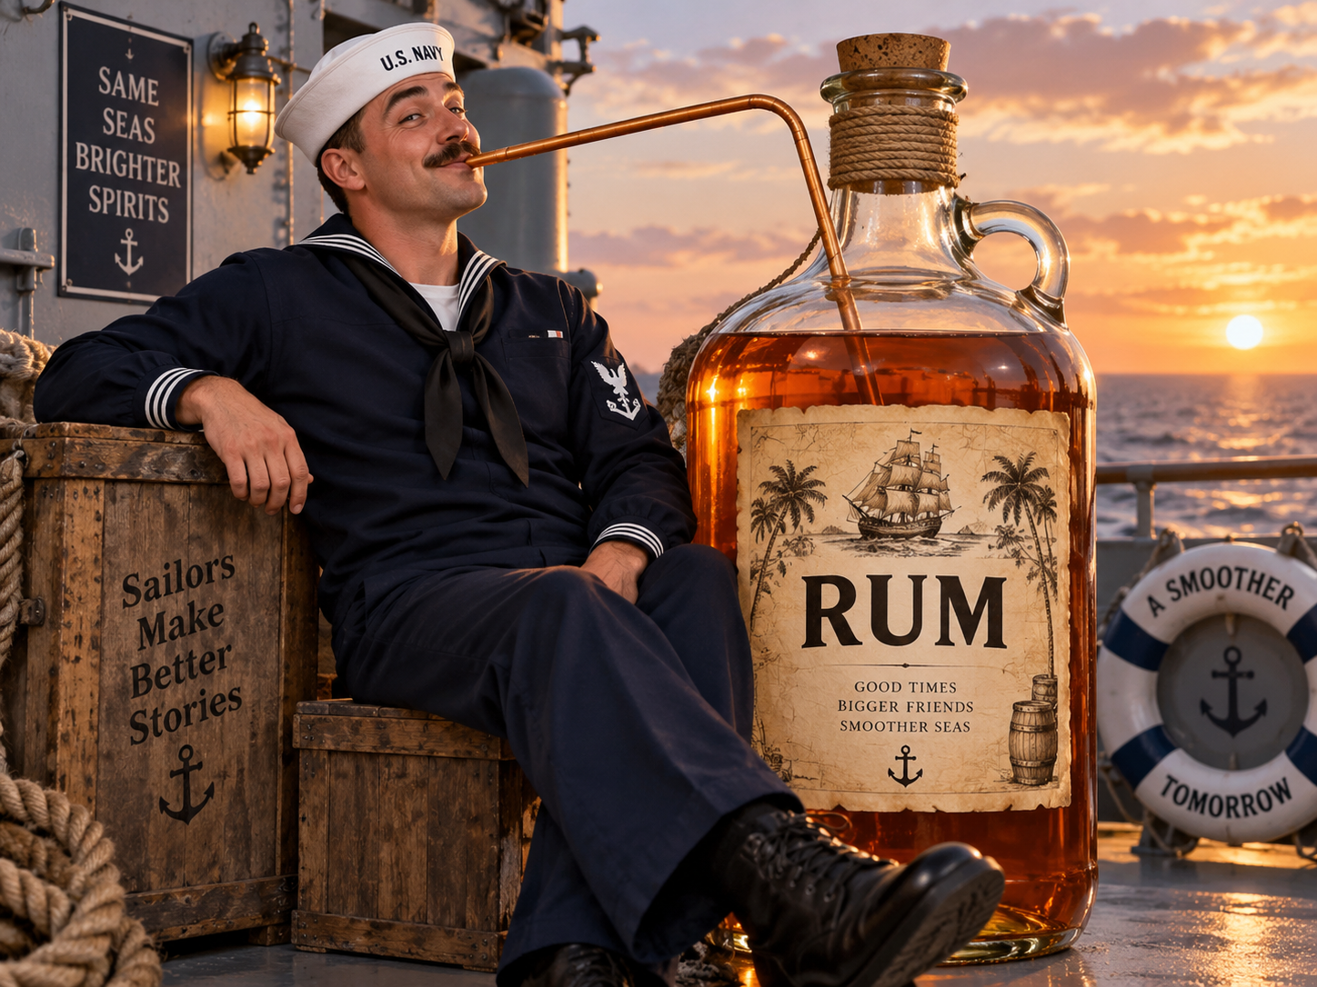
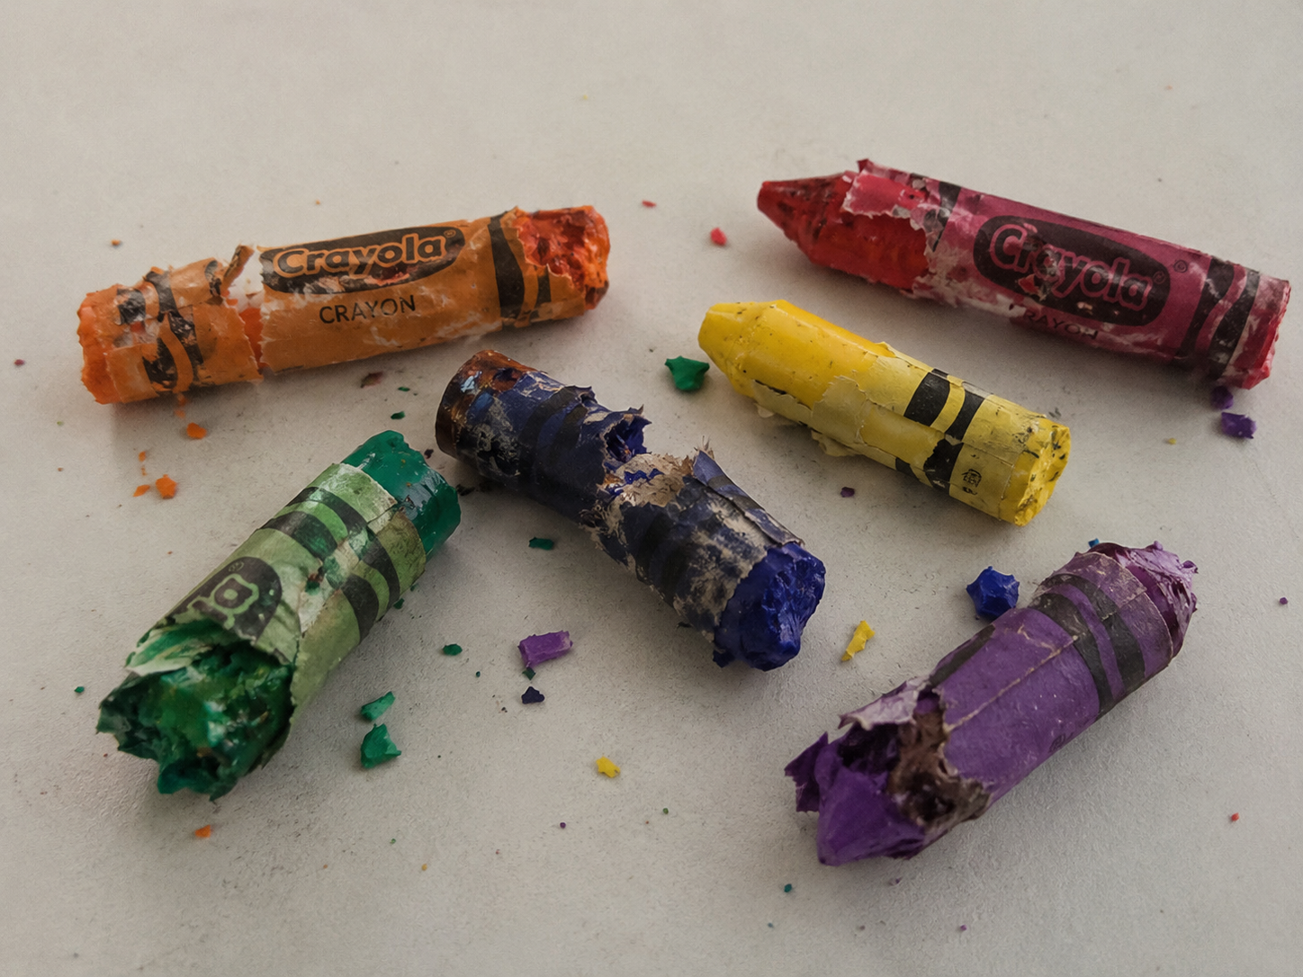
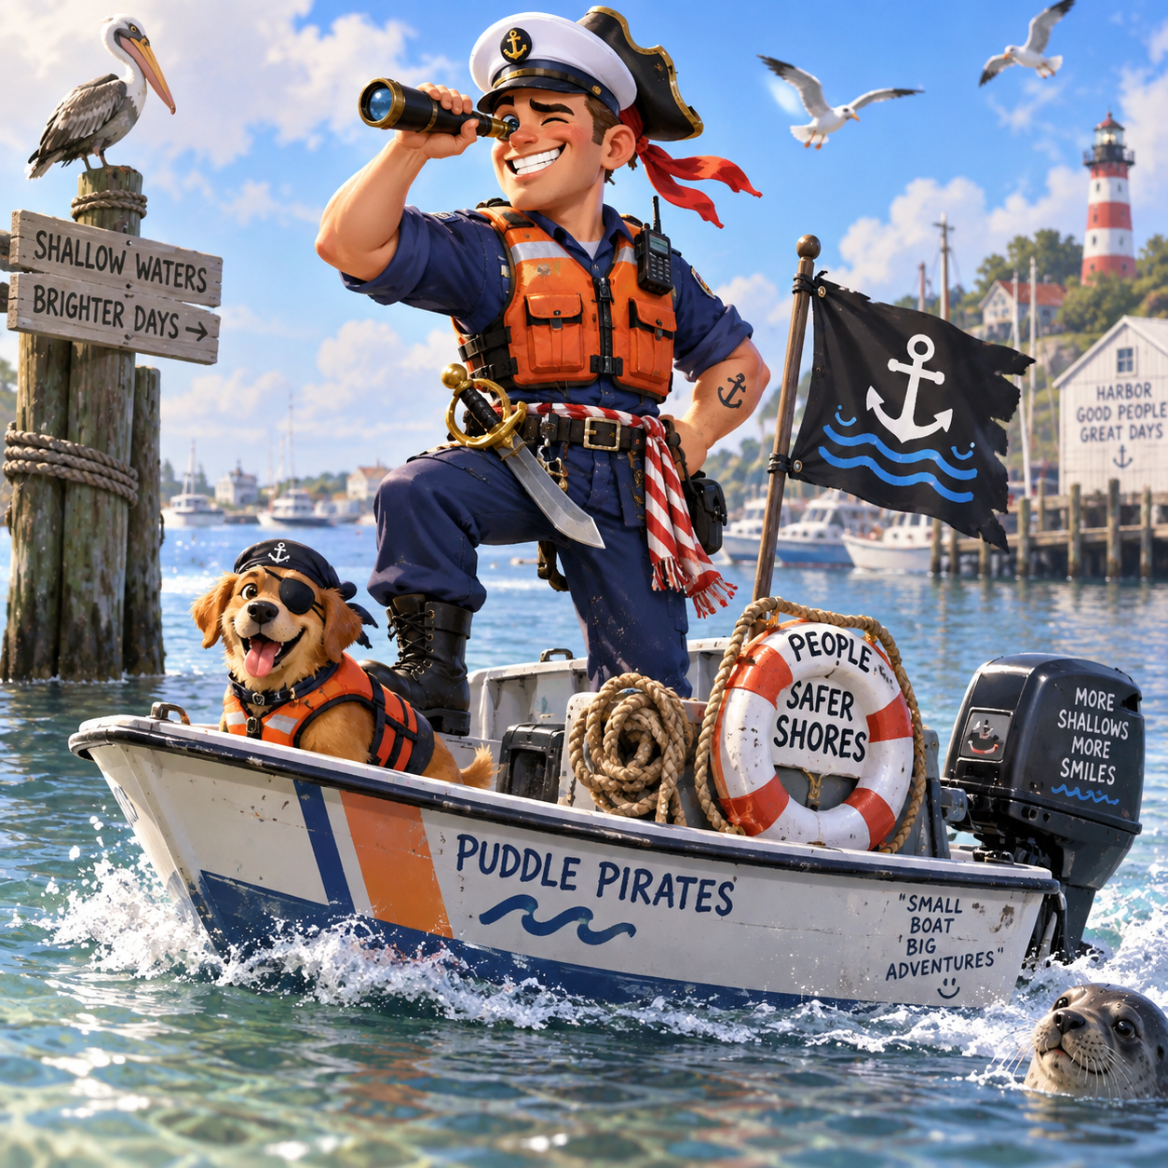
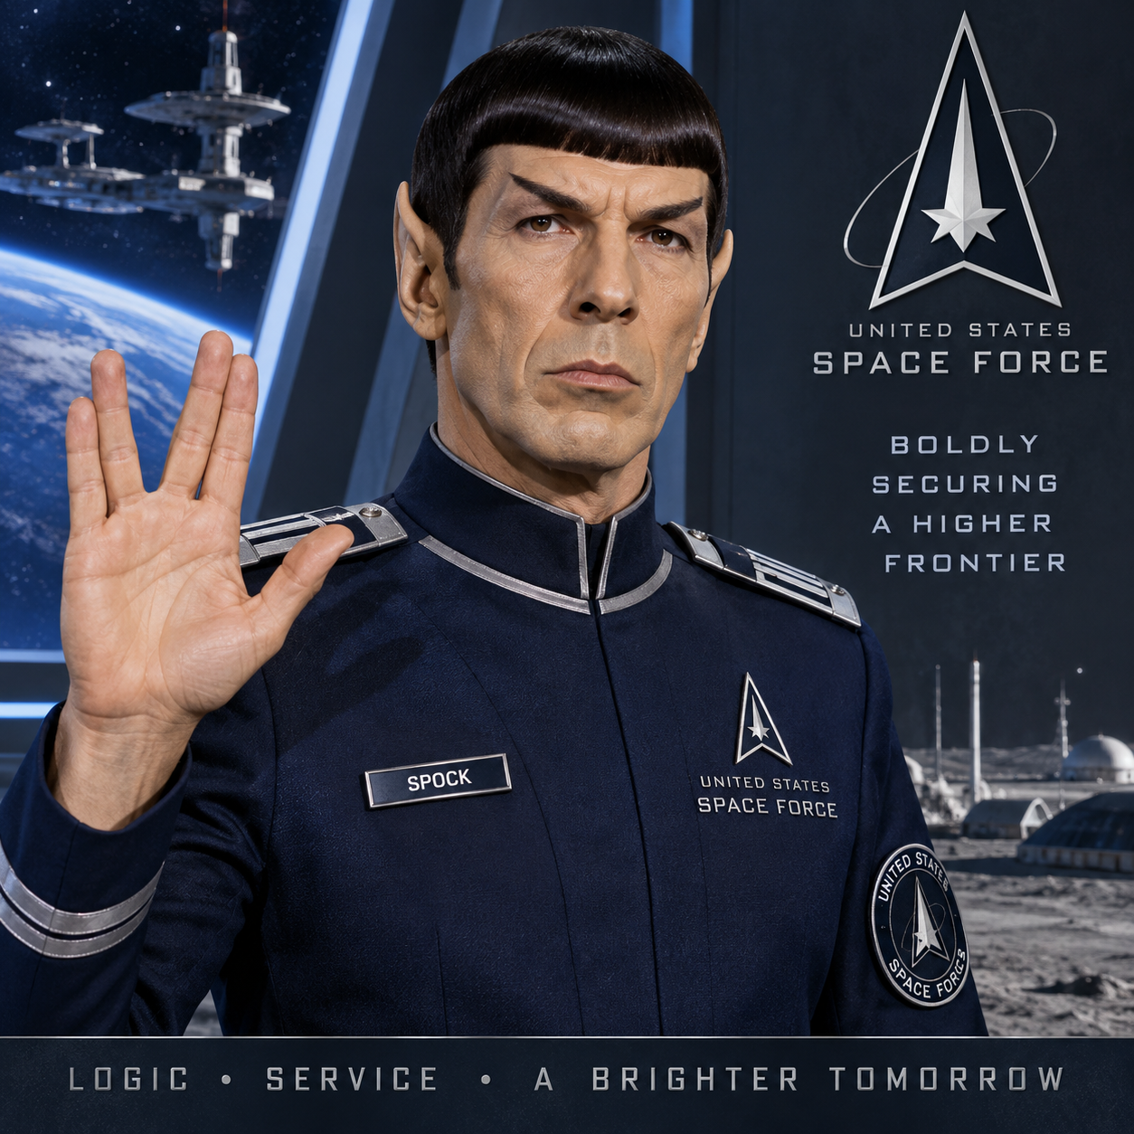
Branch Pride and Rivalry
Veterans often strongly identify with their branch. Friendly rivalry, teasing, traditions, mascots, slogans, and branch-specific language are common.

Slide 10
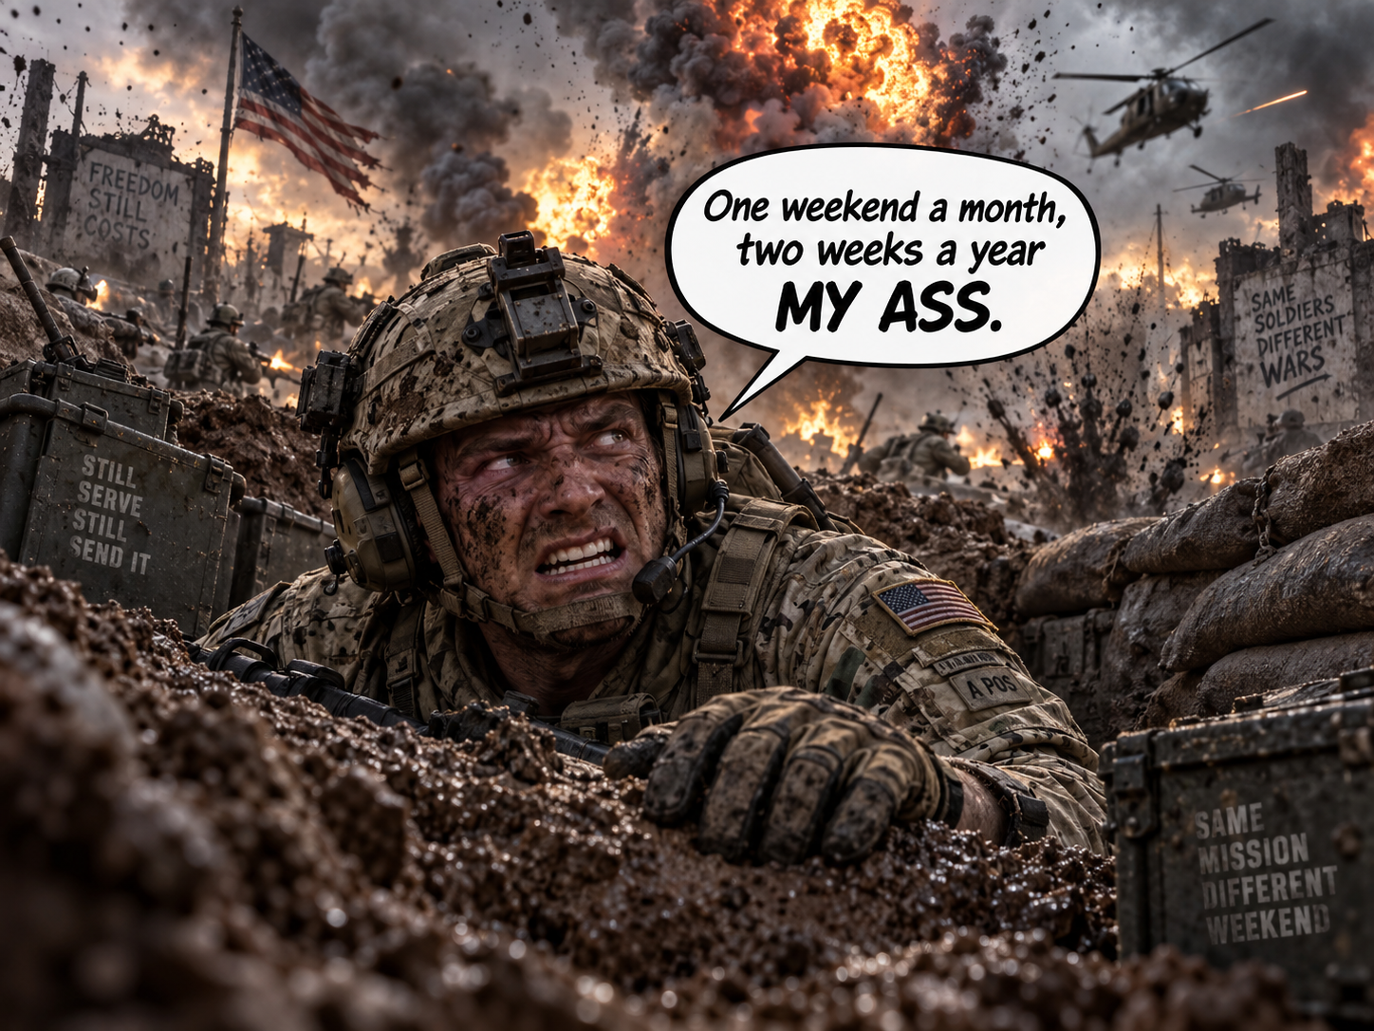
Active Duty, National Guard, and Reserve Culture
Explain the differences between full-time military service, Reserve service, and National Guard service and how experiences may differ.

Slide 11
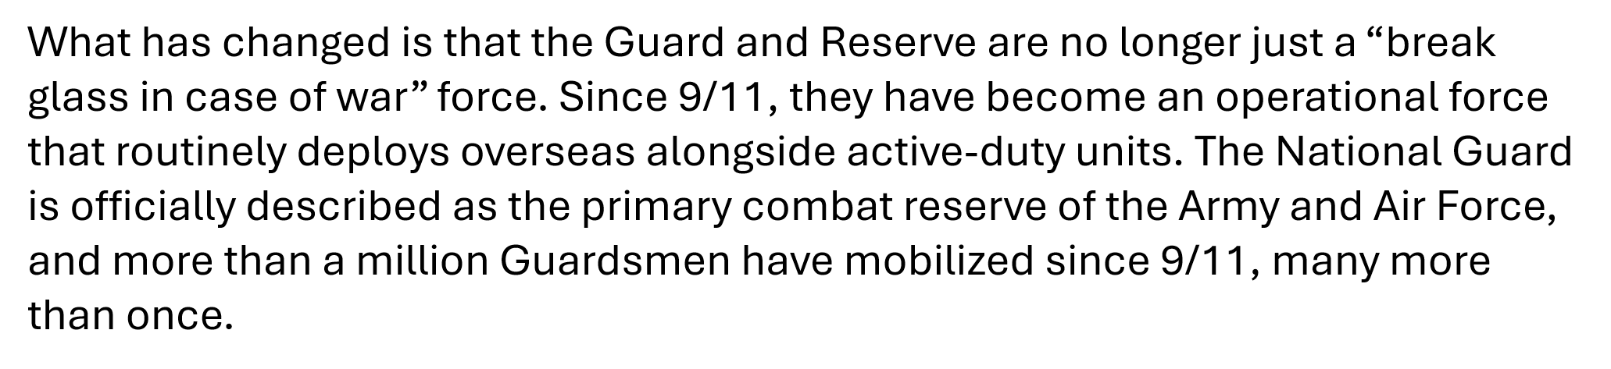
Nation Guard Reserve

Slide 12
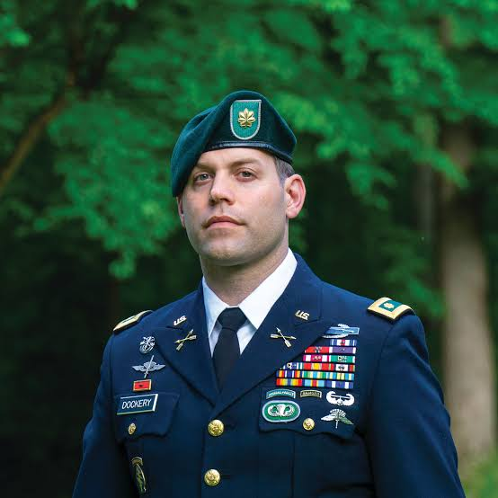
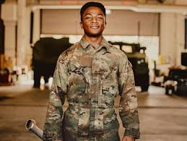
Rank and the Chain of Command
Rank affects responsibility, authority, communication, and expectations. Explain enlisted personnel, NCOs, officers, and the chain of command.

Slide 13
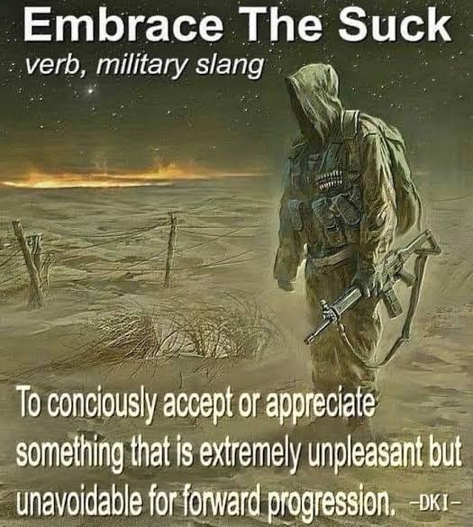
Mission First
Military culture often emphasizes completing the mission despite discomfort. Embrace the SUCK
What is a GIG Line

Slide 14
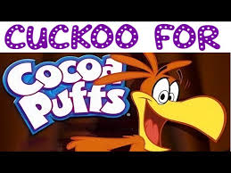
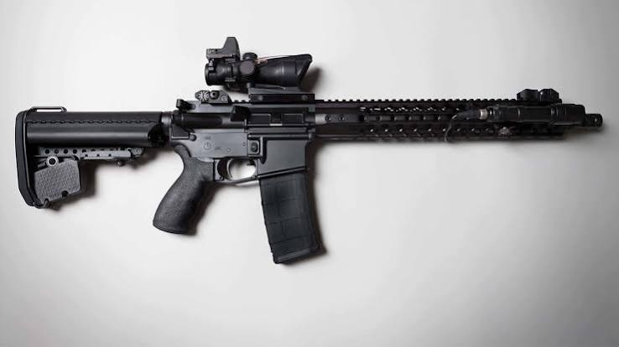
Mental Health Issues
Medical review: Severe or unmanageable conditions that prevent you from performing your job may trigger a medical evaluation board.
Discharge: If treatment does not restore fitness for duty, you may receive a medical separation or retirement.

Slide 15
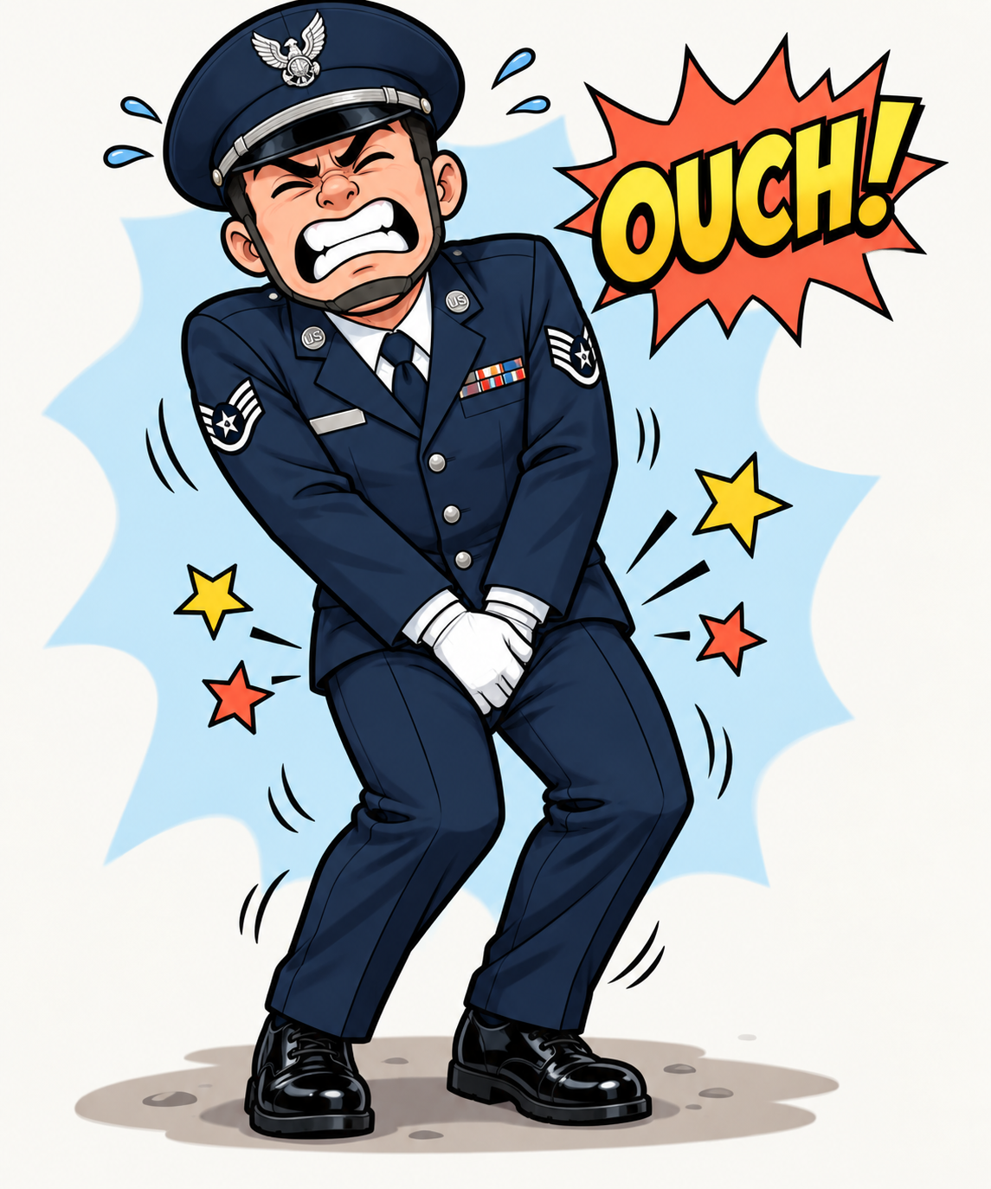
The More You Know
What is a shirt stay and why should you always wrap them around your leg

Slide 16
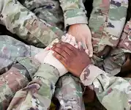
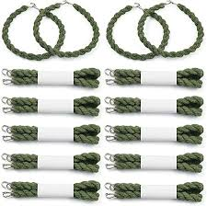
The Team Comes Before the Individual
Unit cohesion, teamwork, loyalty, interdependence, and protecting others are strongly reinforced.
What are blowsing straps

Slide 17
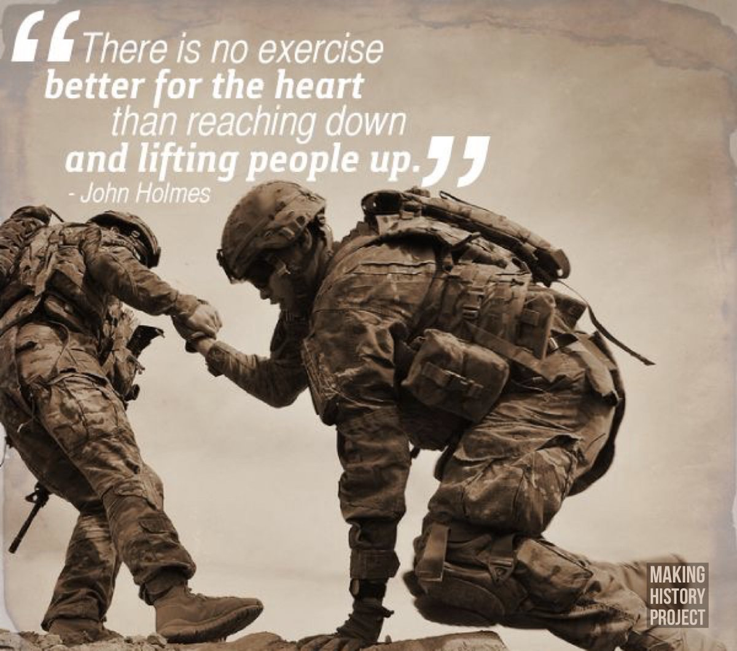
Never Leave Someone Behind

Slide 18
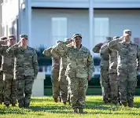
Military Concepts of Trust
Trust is often built through reliability, competence, loyalty, consistency, and follow-through. Saying one thing and doing another can damage trust quickly.
Reveille and Retreat

Slide 19
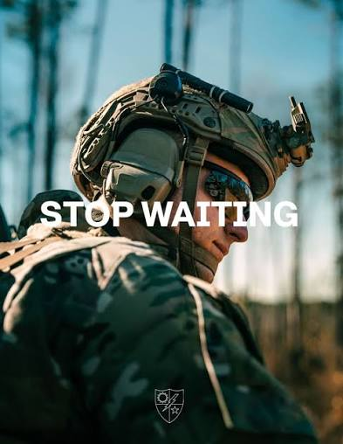
Time and Punctuality
Being early is often culturally reinforced. Introduce the familiar concept: “If you're on time, you're late.”

Slide 20
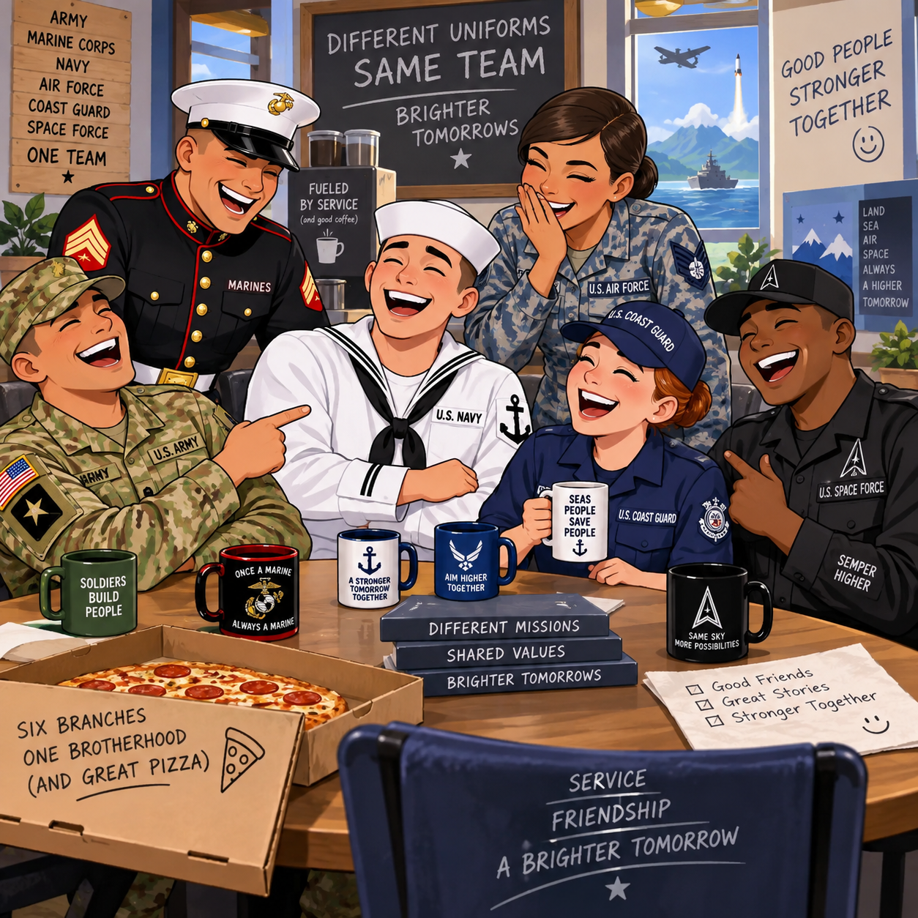
Military Humor

Slide 21
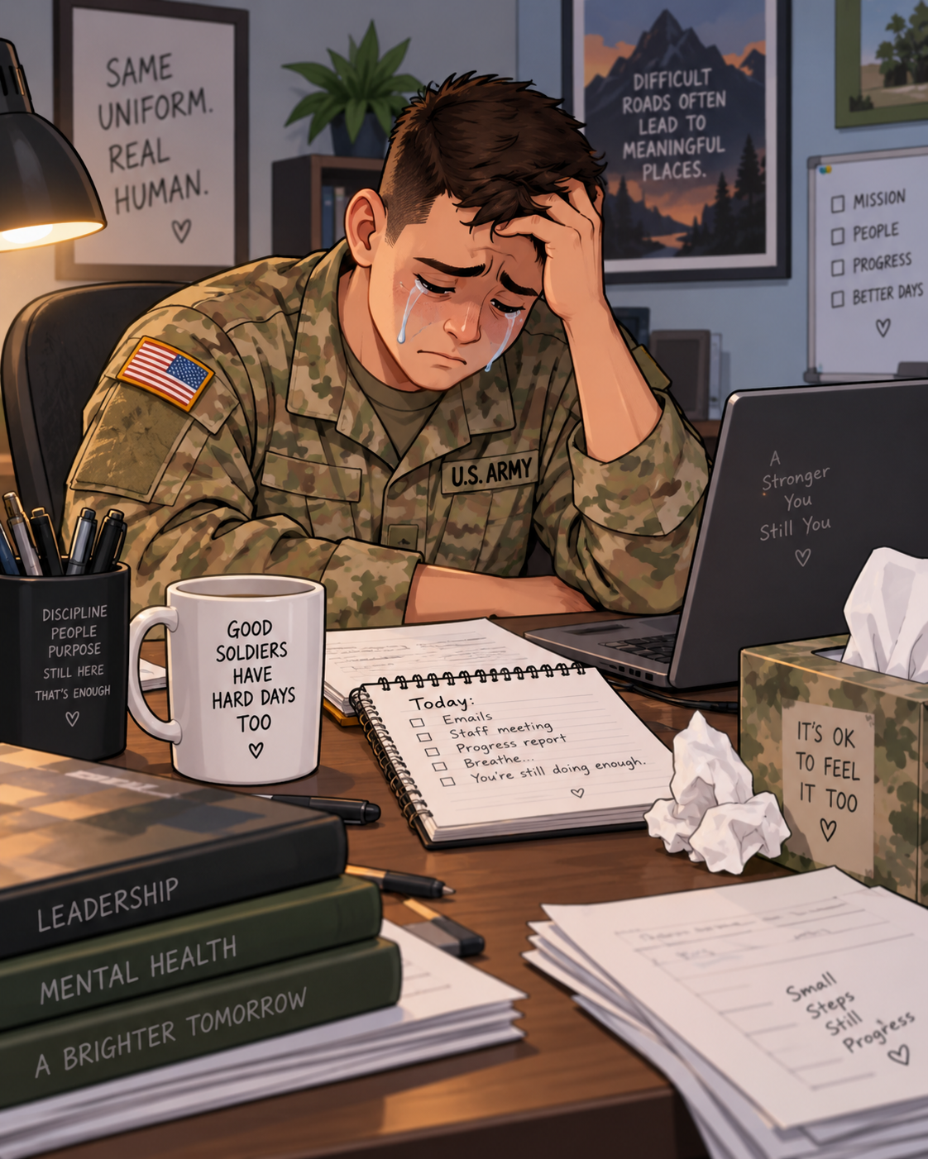
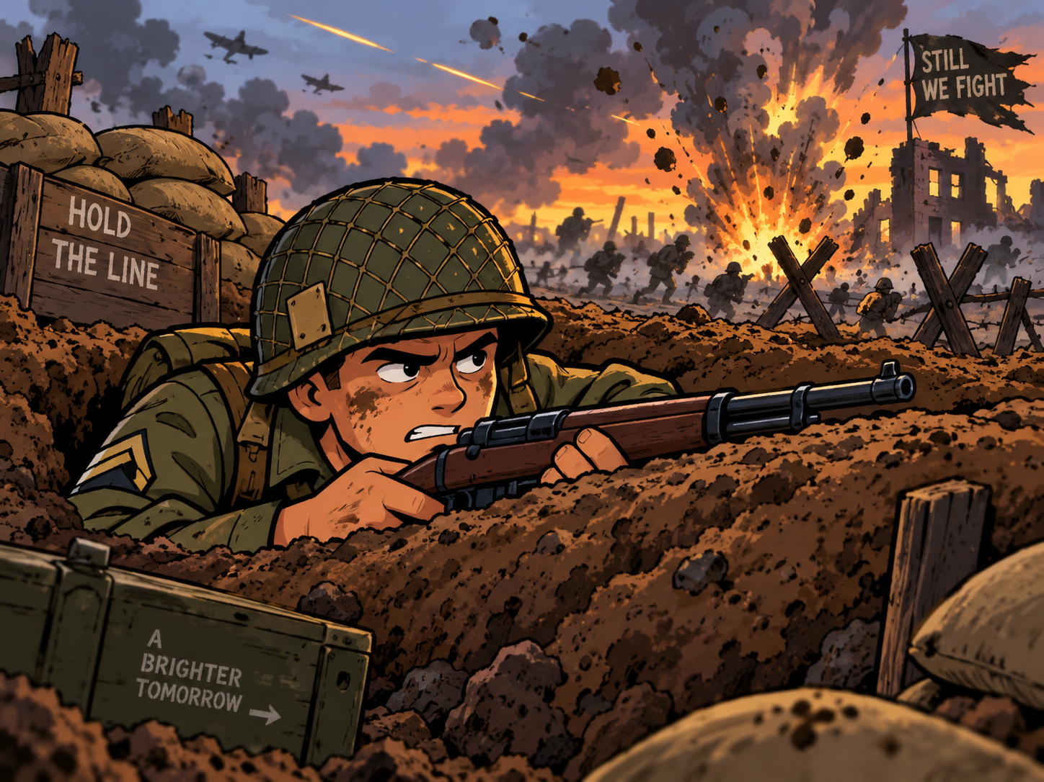
Combat Is Not the Definition of Veteran Service
Some veterans experienced combat while others did not. Avoid asking veterans to prove their service through combat experiences.
  Not all trauma is Combat related

Slide 22
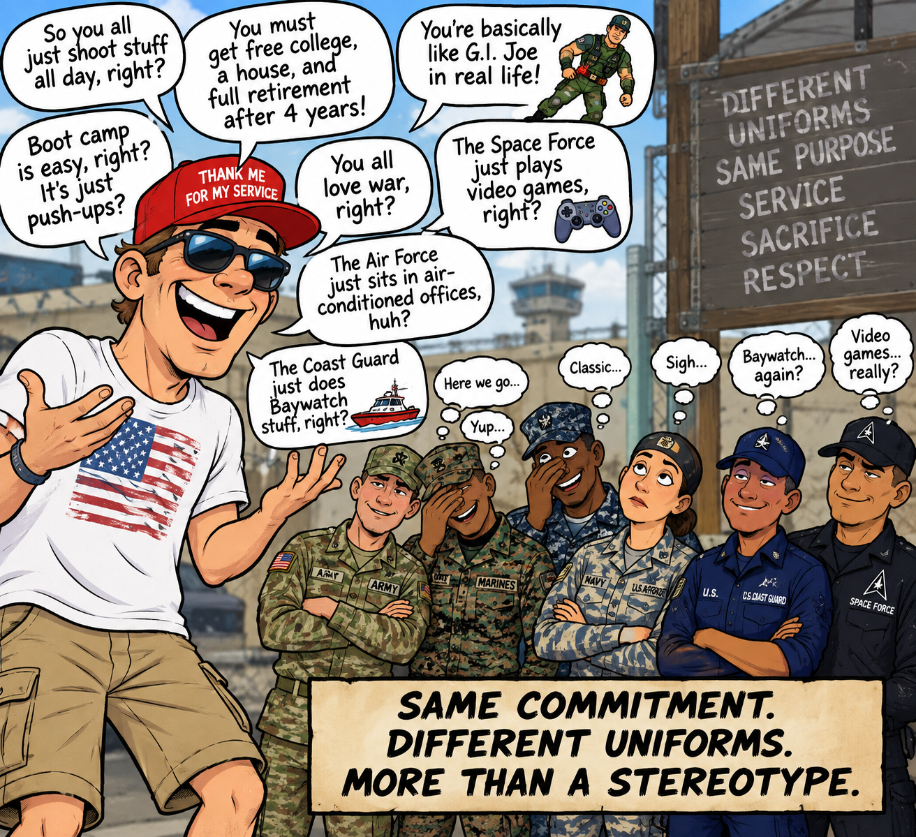
Avoiding Cultural Stereotypes
Do not assume every veteran is a combat veteran, has PTSD, owns weapons, is politically similar, is emotionally damaged, is heroic, or wants to discuss military experiences. Cultural competence means understanding patterns without assuming they describe every individual.

Slide 23
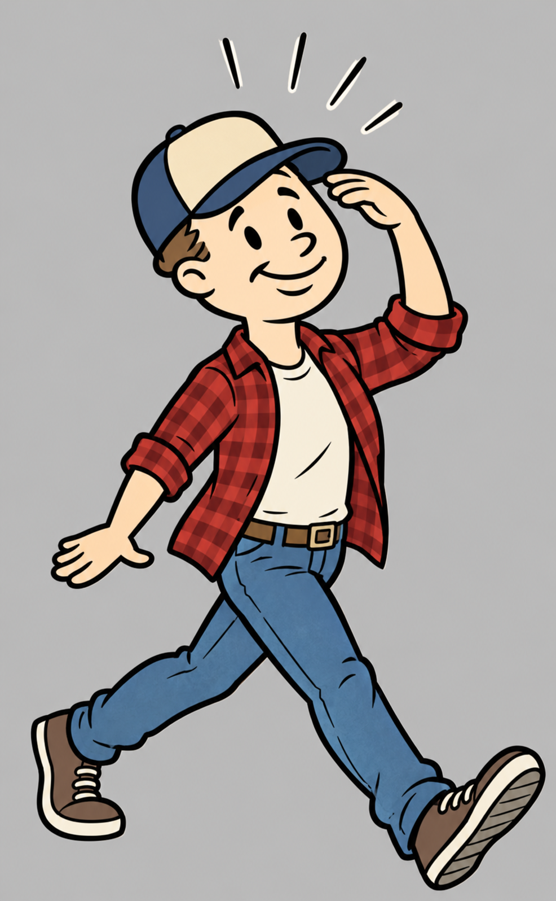
Transitioning Back Into Civilian Culture
Leaving the military can require learning another culture again. Veterans may experience loss of structure, mission, identity, belonging, and community.
Compare military and civilian expectations involving leadership, punctuality, teamwork, accountability, communication, clothing, decision-making, and workplace relationships

Slide 24
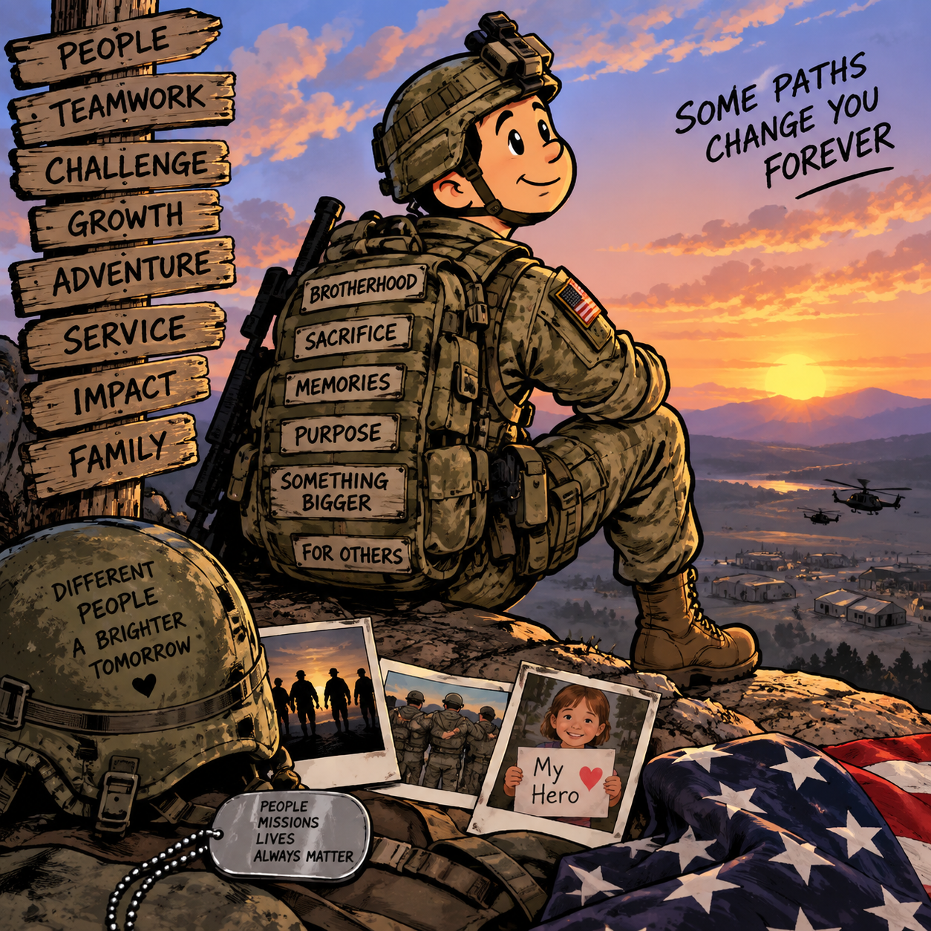
Not Just a JOB
Veterans do not simply leave a job when they leave the military. Many are transitioning from one culture into another

Slide 25
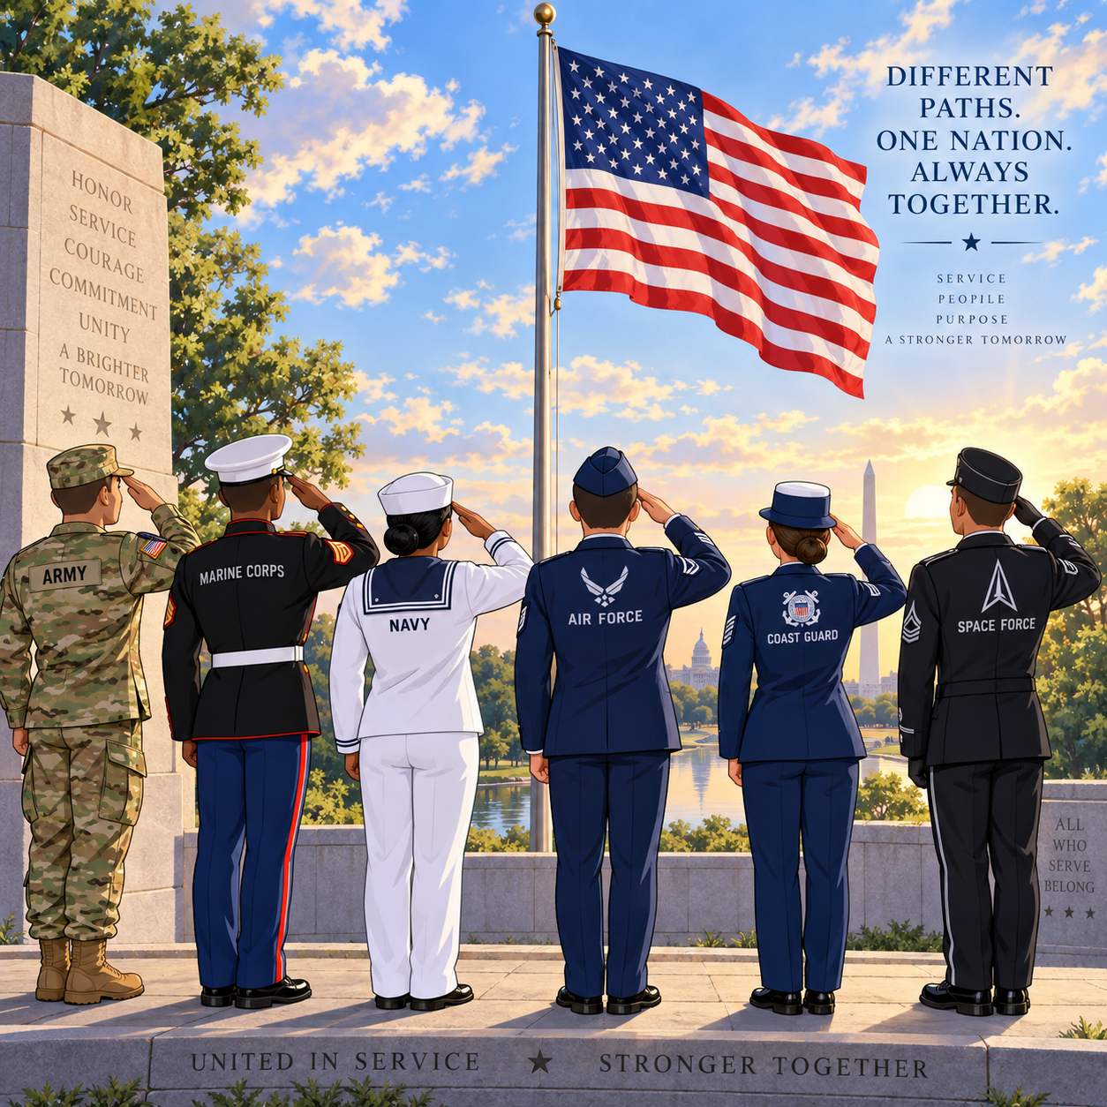
Working Effectively With Veterans — Cultural Humility
Listen before assuming. Ask respectful questions. Be dependable. Explain your role clearly. Learn the veteran's terminology when appropriate. Respect the importance—or lack of importance—that military service holds for that individual.

Slide 26
What Did You Learn
What is one thing you understand differently about veterans after today's training?”

Slide 27
Sunchaser Solutions
Questions ???
Notes:
Summarize the core training message.

Slide 28
Sunchaser Solutions
Sunchaser Solutions 906-281-7554
markepana@gmail.com
We can handle all your training needs.
Notes:
Summarize the core training message.

